Slide 1
3. Phylogenetic reconstruction

Slide 2
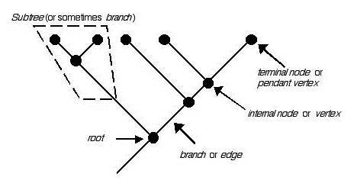
Background
What is phylogenetic reconstruction?
We seek to chart historical events
These cannot be observed
Thus, we infer them from observable, extant things
Taxa = leaf nodes. May represent species or gene family members

Slide 3
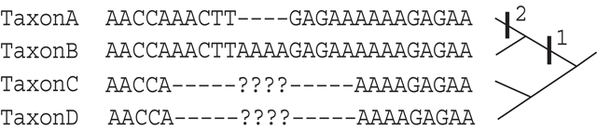
Background
Typically, all taxa are extant, present-day, available
Phylogenetic source data – sequence (protein, dna), or character data (phenotype properties)
Evolutionarily, only sequence data matters

Slide 4
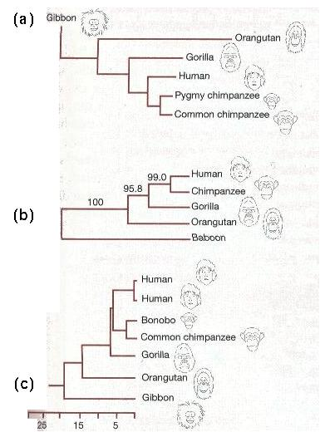
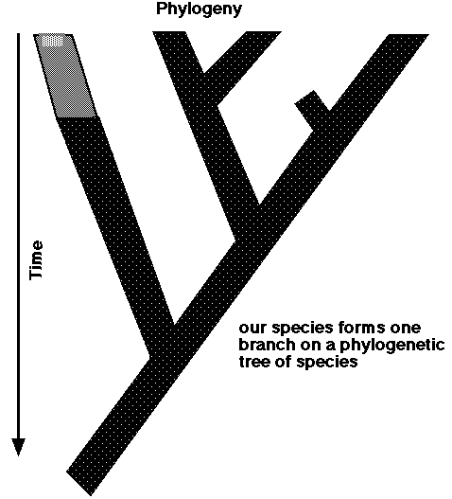
Background
Goal: history description, listing of historical events
Representable as a tree
Branches are stretches of “time”
Inner nodes are divisions (of species, genes etc.)

Slide 5
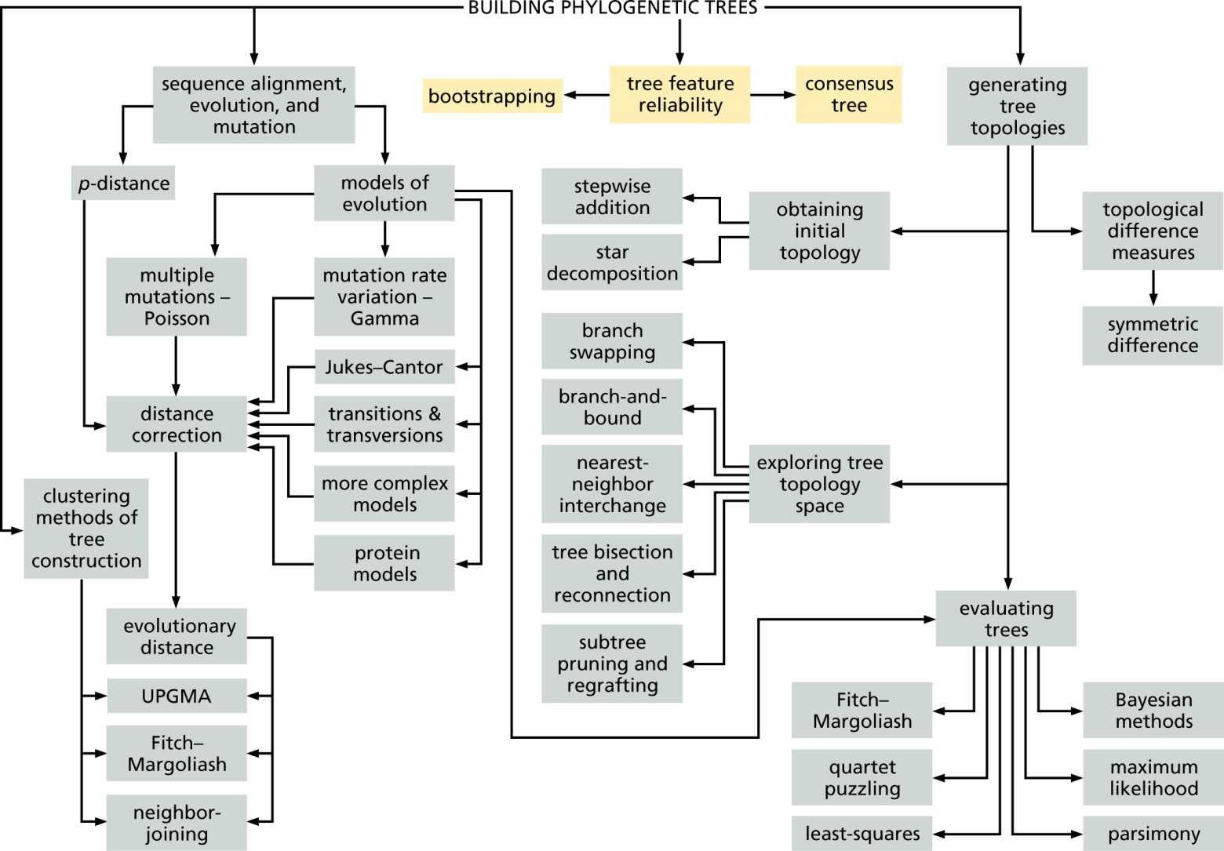
Flow diagram 8.5

Slide 6
Building trees computationally from sequences:
Approach 1: clustering based on pairwise distances
  Advantage: fast and deterministic
  Drawbacks: unlikely to find true tree. Different methods may yield different trees
Approach 2: search tree space for optimal tree
  Advantage: can find optimal tree
  Drawbacks: slow because tree space is gigantic. Different methods may yield different trees

Slide 7
Background
Each character must have a treelike history!
Assumes that everything is ultimately homologous – all life comes from one point
As soon as you have more than one character, consistent treelike evolutionary history cannot be guaranteed
Characters may evolve separately
Bases, amino acids etc. may evolve differently
  Different speed
  Different history – conflicting gene trees – recombinant parts of genes
Is the treelike assumption true enough for our purposes?
What shall we do if it is not?

Slide 8
Background
Hence, tools for testing treelikeness
Tools for assessing whether (parts of) trees are reliable (bootstrap)
Tools for finding areas where treelikeness breaks down
Tools for finding consensus among information sources (genes)
Tools for viewing disagreement between information sources (networks)

Slide 9
Background
Some repetition of basic phylogenetic techniques
First, you need an alignment
It is true that the alignment in itself is a tree hypothesis, but consider that a first guess, and anything generated from it as a refined guess
Garbage in, garbage out – sometimes a problem, sometimes not
Tree reconstruction?
Search through tree space and find the “best” tree

Slide 10
Background
Tree space is combinatorially large and cannot be exhaustively searched (the largest numbers are always combinatorial – far higher than eg. number of atoms in universe for even small trees)
Thus, heuristics – intelligent guesses
Often start from one tree and optimize until it seems as good as it gets
What does it mean that a tree is good?
Optimality criteria

Slide 11
Background
Optimality criteria from Occam – minimize assumptions
Smallest total distance
Smallest number of changes
Most probable set of events under a probability model
Generally easy to evaluate a tree
Moving through tree space (swapping branches and the like) and see if things improve
Different criteria and heuristics require different amounts of computation time and memory
Generally, always trade-off between accuracy and cost

Slide 12
Background
Parsimony – minimize number of state changes
Often mistakenly believed to make no assumptions
In truth, assumption that all changes between character states (like nucleotides in a sequence, or gain/loss of a morphological attribute) are equally important
Suffers from long branch attraction problem
  If two sequences are very unlike the rest of the dataset, they will be grouped together even if they also are very unlike each other!
  This is done even if the amount of data available is large!
  Hence, parsimony cannot be guaranteed to yield the right tree even with infinite data!

Slide 13
Distance-based methods
UPGMA – (Unweighted Pair Group Method with Arithmetic mean)
  Progressively cluster together the two closest taxa/taxa groups
  Assumes equal evolutionary rates (molecular clock)
Neighbour-joining - most used
  Like UPGMA but can handle unequal evolutionary rates
  Good compromise between speed and tree quality

Slide 14
Distance-based tree building
A1 MRFRKLPQLPDS
A2 MKYRKLPDLPDN
A3 MRFYTACENPRS
Distance matrix
A2
A3
1
A1
A2
A3
2
A1
4
8
3
A2
10
5

Slide 15
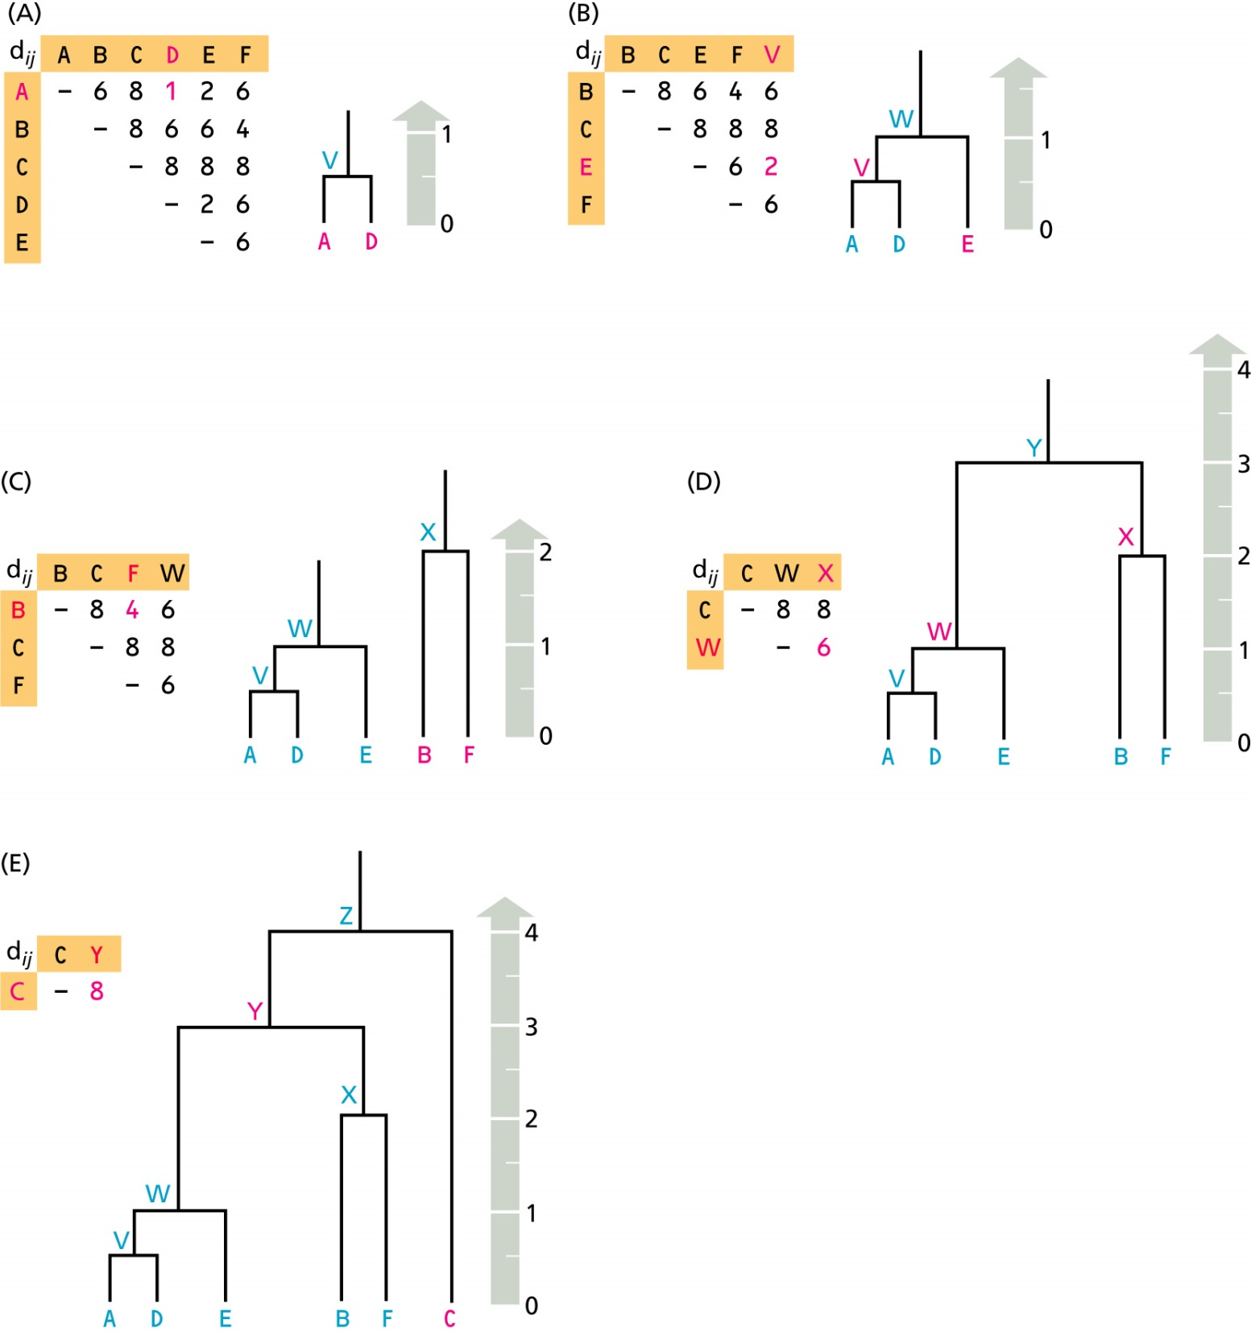
Fig 8.3 UPGMA

Slide 16
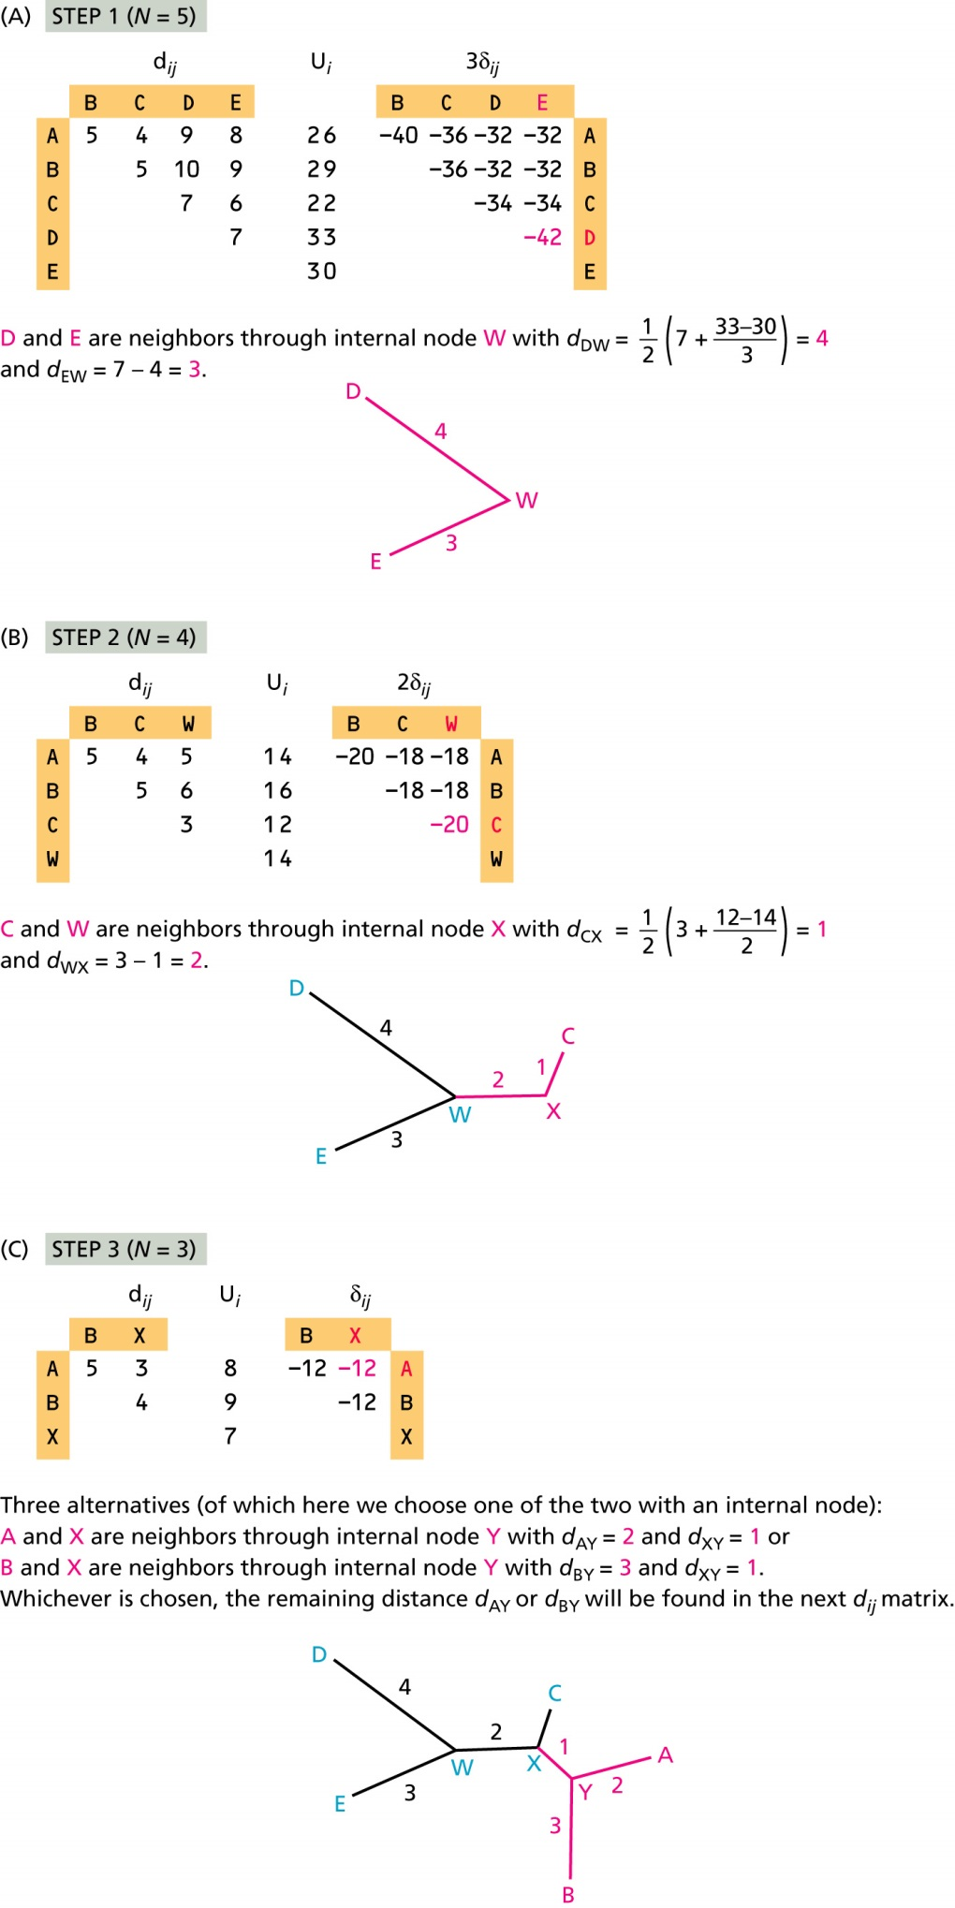

Fig 8.7 Neighbor-joining

Slide 17
UPGMA flaw
True tree:
UPGMA:
A1
A2
B1
B2
B1
A2
A1
B2

Slide 18
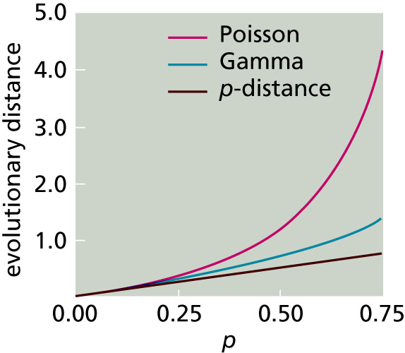
Esitmating distances
Fig 8.1

Slide 19
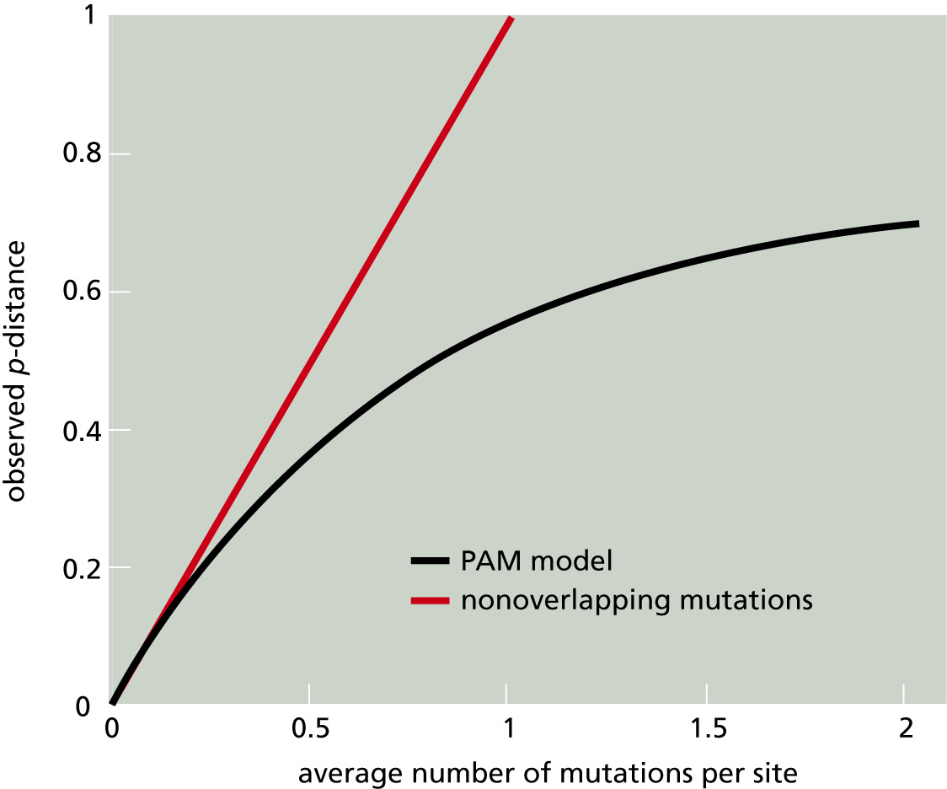
Esitmating distances
Fig 7.7

Slide 20
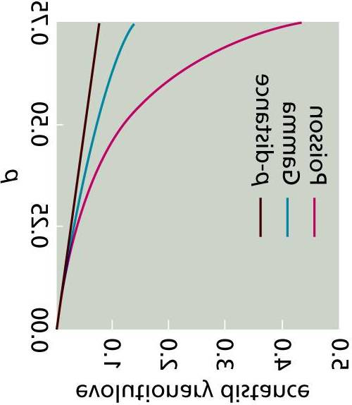
Esitmating distances

Slide 21
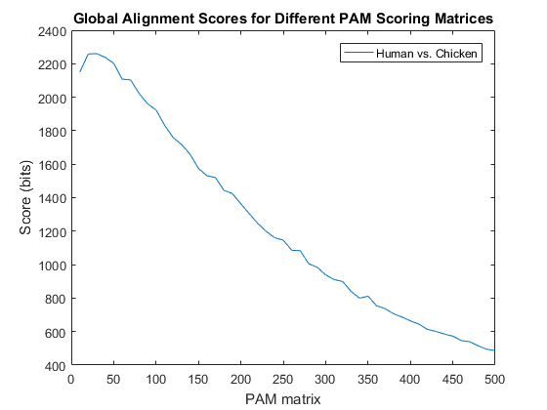
Some distance measures (proteins)
Uncorrected distances (p-distance in Z&B)
Corrected distances:
  Poisson
  Gamma
  Kimura
  Jukes-Cantor
  Scoredist (not in book but in Belvu)
Evolutionary distance of the optimal score matrix used for alignment
  Iterative search for the maximum likelihood matrix
  Integration to find the expected distance

Slide 22
Maximum likelihood methods
Under a probability model, determine how likely the data is given a certain tree - likelihood
If we knew prior probabilities for tree and data, we could compute the probability of a tree given the data
Typically, we do not really
Hence, maximum likelihood optimizes the likelihood score
Bayesian phylogeny typically uses Monte Carlo-type simulations to try to find suitable prior probabilities, and finds the tree that is actually most probable, not just most likely

Slide 23
The bootstrap
Allows us to test impact of sampling
If signal is weak or conflicting, small changes in sampling will change result
Nonparametric bootstrapping
  Generate pseudoreplicate datasets from the original
  This approximates resampling from the same distribution
  Analyze each pseudoreplicate individually
  Construct consensus result by the agreement of the pseudoreplicates

Slide 24
The bootstrap
What does this mean for trees?
Bootstrap alignment
  Generate new pseudoreplicate alignments (usually a hundred) by randomly picking (with replacement) the same number of columns as the original, from the original
  Reconstruct a tree from each pseudoreplicate alignment
  For each split present in the tree (branch separating two groups of species from each other), see how many pseudoreplicate trees contain it
  The fraction of pseudoreplicate trees supporting each split is its bootstrap support
  Use these to:
    1. Give support to branches in the tree constructed from the original alignment
    2. Construct a bootstrap consensus tree from either all splits present in a majority of trees, or in all trees

Slide 25
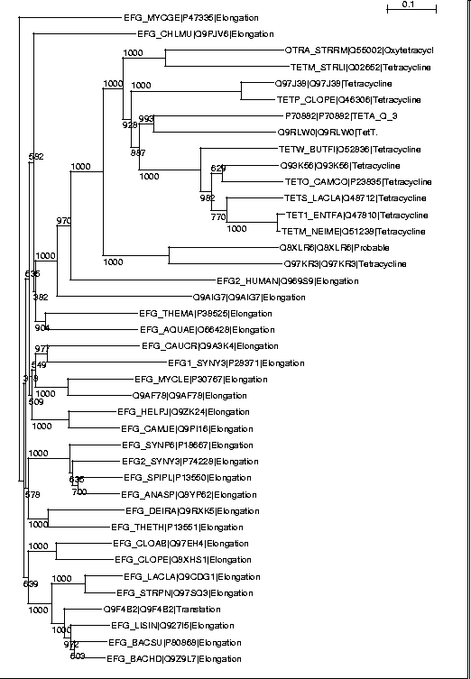
The bootstrap
Bootstrap values are not probabilities!
Poor bootstrap value for a branch indicates that it is uncertain.
High bootstrap values means high support, but not necessarily that it is correct.
Many programs compute them, such as Belvu and phylip.

Slide 26
Tree rooting
Most methods give unrooted trees.
If a root is defined, we know the “time” direction of each edge
If branch lengths are defined, we know “time” amount on each edge
“Time” is usually ‘evolutionary time’, i.e. number of substitutions or PAM units.
Evolutionary time can be converted to real time by calibrating with e.g. fossils

Slide 27
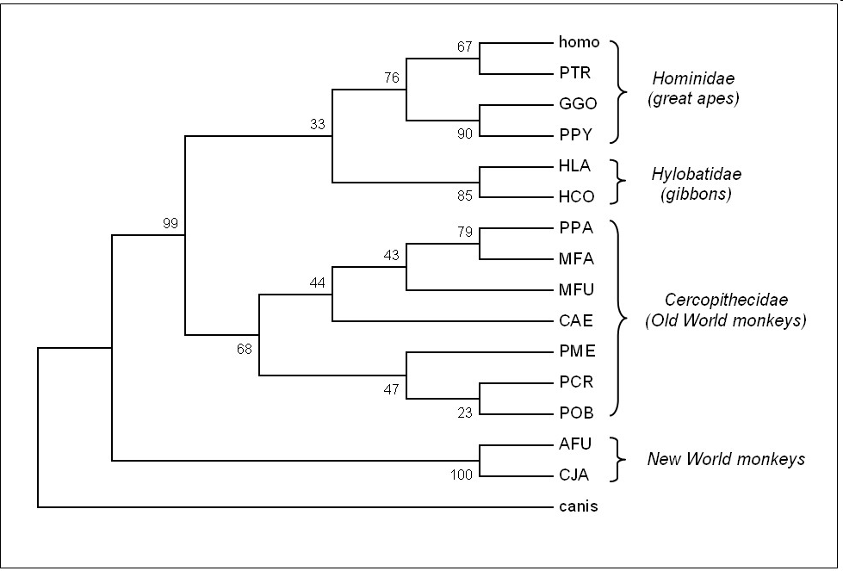
Tree rooting
Approach 1: Root at the most central branch (done by Belvu, Clustal, etc.). Search for the branch that splits the tree into 2 subtrees of equal total weight.
Approach 2: Include a distant species “outgroup” in the tree. The placement of this defines the root.

Slide 28
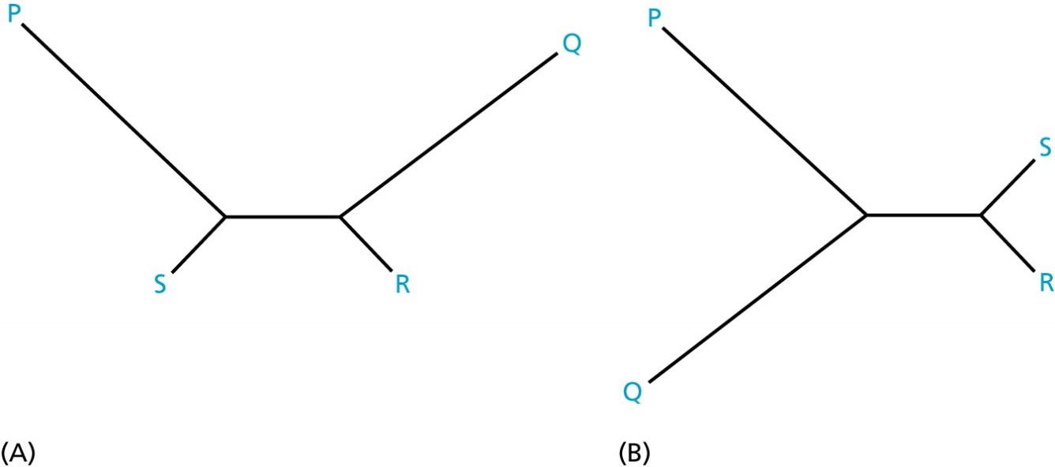
General tree building problems
Unresolved trees (unsupported internal nodes)
Inconsistencies across sequence regions (recombination)
Duplicated and lost genes in species tree
Horizontal gene transfer
Long branch attraction

Slide 29
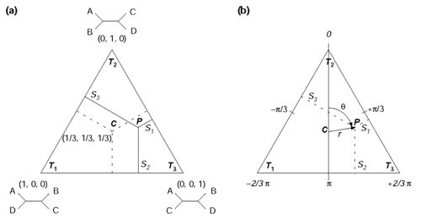
Quartet based quality check
Quartets are subsets of four taxa each
Quartet methods typically deal with all the quartets, but could also be used for a random sample if there are too many
Between four taxa, there are three possible trees
Each of those would get different support from the data
If these three mutually exclusive trees receive similar support, the data obviously is not treelike

Slide 30
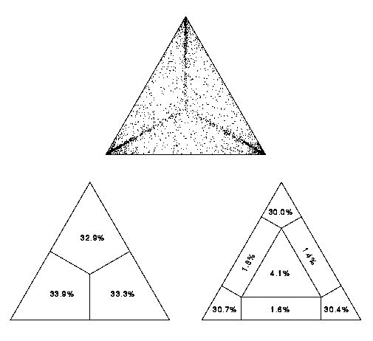
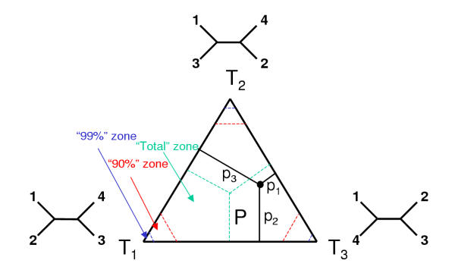
Quartet based quality check
Quartet mapping (usually likelihood mapping, using maximum likelihood quartet trees) involves inspection of a quartet diagram – if many quartets are unresolved, this implies nontreelikeness of data
Software - TREE-PUZZLE

Slide 31
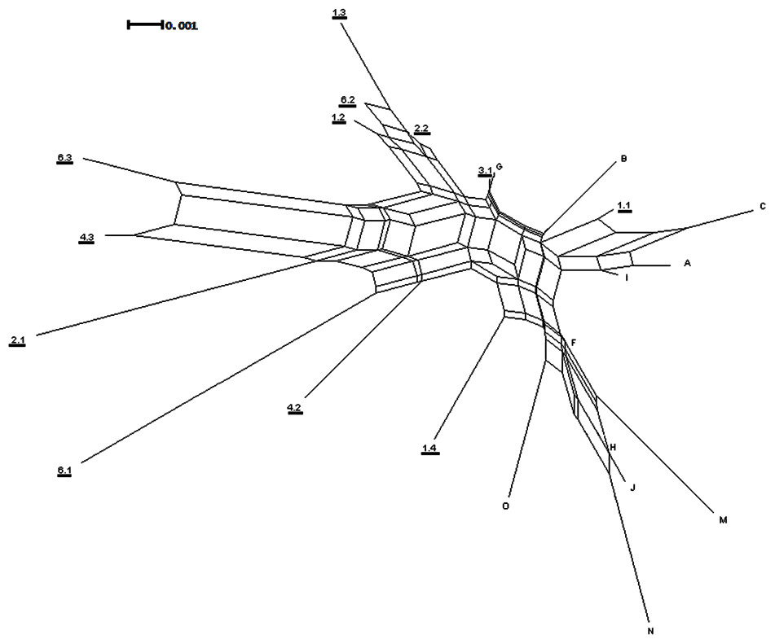
Phylogenetic networks
Assumes the data are not treelike but netlike.
Nodes can have 2 parents.
Make e.g. by generating splits of the data and merging individual trees.
A tree is a special case of the more general network system.

Slide 32
Phylogenetic networks
If applied to the data and producing what is more or less a tree, the data is indeed treelike
If not, then it is not
Network displays particularly which branches/splits that exhibits ambiguous signals
Software: Neighbour-Net, SplitsTree, Qnet...
Remember: Split graph/network is not a tree
Branches do not exactly represent historic events, but rather how different possible historical realities conflict
Effectively plots of information content in the data

Slide 33
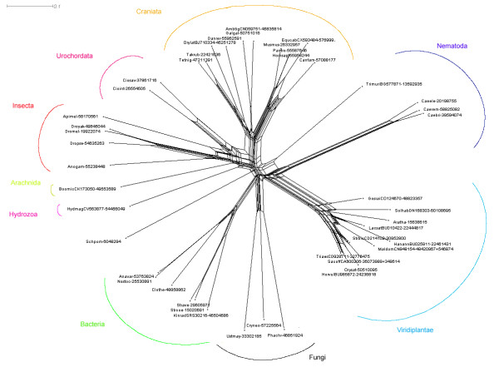
Phylogenetic networks
Beautiful but unintuitive?

Slide 34
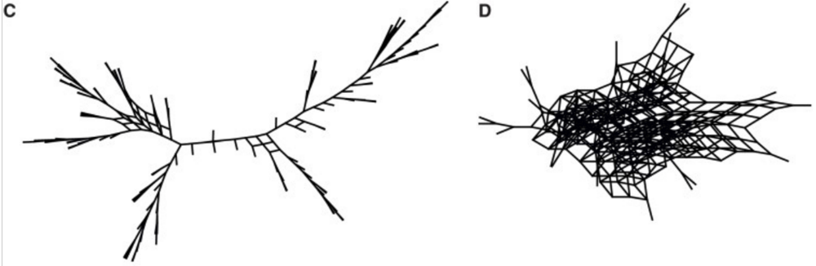
Phylogenetic supernetworks
In a phylogenetic supernetwork, identical topologies are merged into a tree structure and alternative topologies are combined into a network.
See Huson et al. 2004
From Boeckmann et al., 2015: eukaryotic (C) and bacterial (D) supernetworks from individual species trees.

Slide 35
Recombination breakpoint detection
If data is not treelike, and we assume this is because there are hybridized regions, and we want to find where they are.
To find which species, we determine which branches have poor bootstrap values, or which quartets are poorly resolved, and determine the species in question from there.
To find the sequence region in question, we use a sliding window approach.
The sliding window moves across the sequence, and when it passes the breakpoint, analysis performed over the next window will yield a different result
Software: PLATO, VisRD, SimPlot.

Slide 36
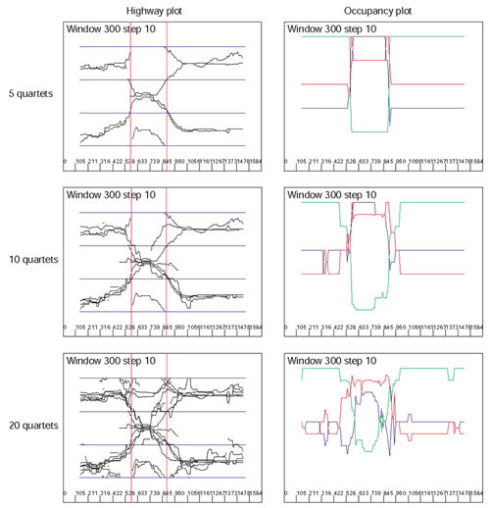
Recombination breakpoint detection
Visual approaches
Compute some quantity over a window of a sequence alignment
VisRD – looks for changes in many quartet phylogenies

Slide 37
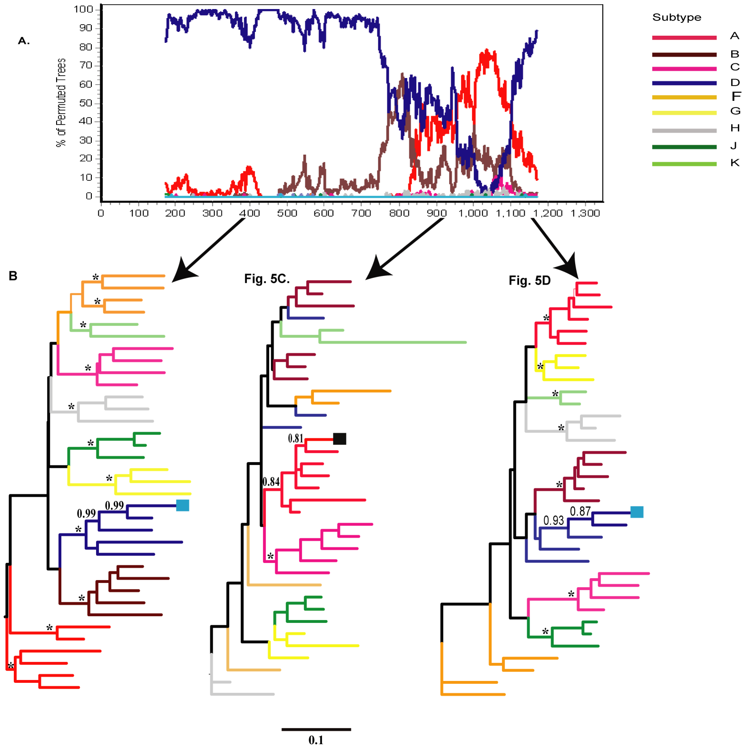
Recombination breakpoint detection
SimPlot and Bootscan.
Bootstrap-based.
Shows how bootstrap support to taxa changes throughout the sequence.

Slide 38
Take home messages
When it really matters and you can, use different methods and models to reconstruct your phylogeny – if they do not match, try to explain why
Whenever you make a tree for a serious purpose, you should use bootstrapping
If bootstrap values are too low, investigate which taxa and which regions are affected
Possibly investigate the gene sequences for recombination breakpoints
For messy data, consider visualizing it using a network method
Alternatively, quartet puzzle the data to see how treelike it is

