Slide 1
4. Phylogenomics & metaphylogenies

Slide 2
Introduction
Phylogenomics definition: use of phylogenetics approaches for functional characterization of genes.
Functional genomics work with phylogeny as a guide.
This lecture will also concern phylogenomics under another definition, namely the extension of phylogenetics to a genomic scale.

Slide 3
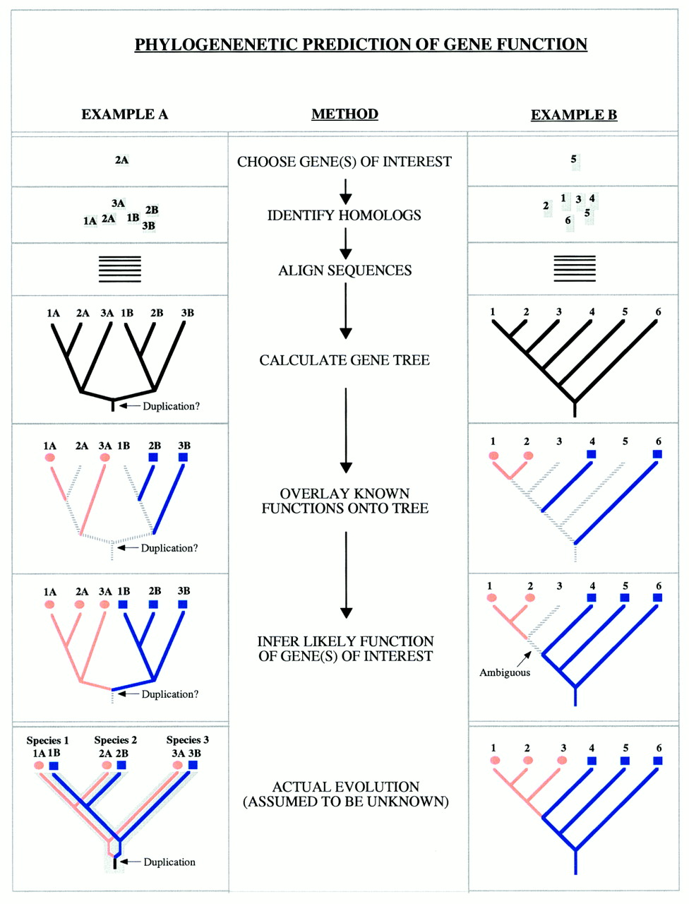
Introduction
Phylogenomic functional annotation workflow
Try to connect clades in a gene tree to specific functions
Use location of target gene in such a tree to determine function
Figs from Eisen, 1998 (PMID:9521918)

Slide 4
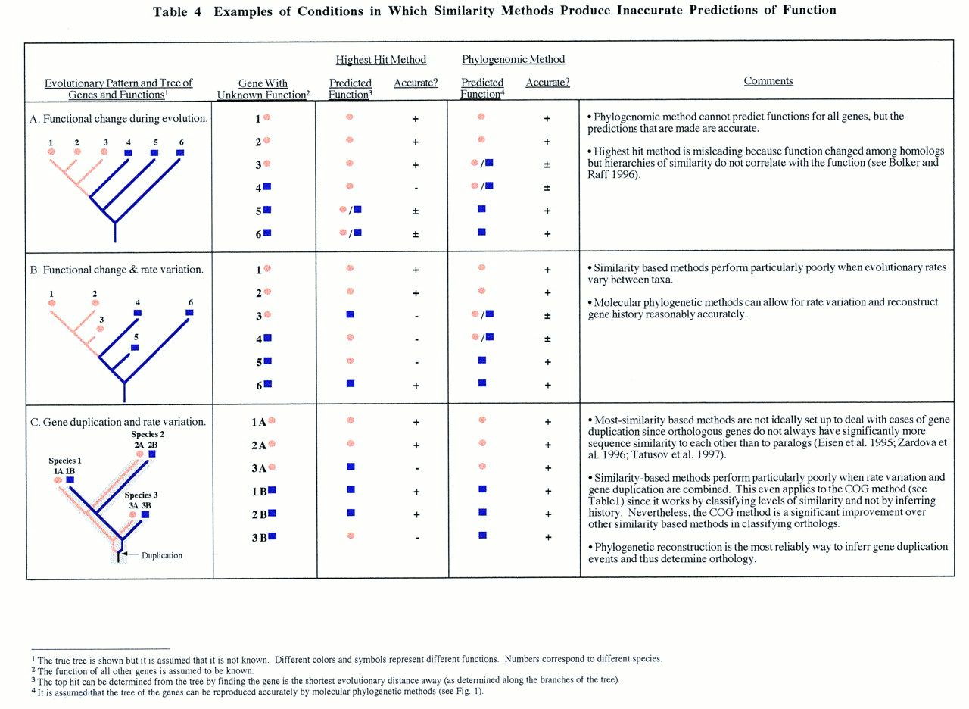
Introduction

Slide 5
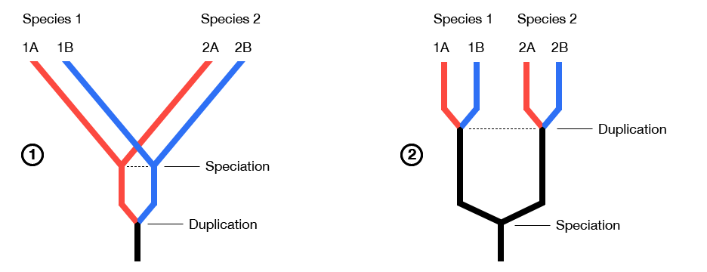
Phylogenomic gene study
Functional annotation by phylogeny:
Simplest: find a homolog.
Better: find an ortholog!
More on this in later lectures; briefly orthologs are genes in different species that were separated at their speciation.

Slide 6
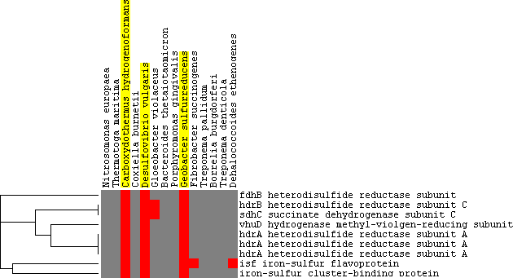
Phylogenomic gene study
“True” phylogenomics: use information across several genomes
Phylogenetic profiles
If a gene co-occurs with a group of other genes with respect to presence/absence across a class of genomes, this implies functional similarity

Slide 7
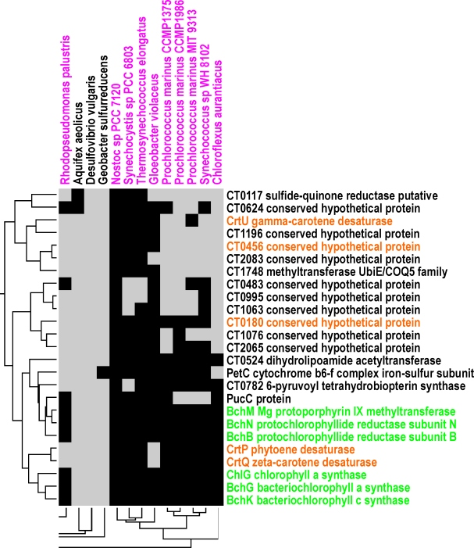
Phylogenetic profiles
Functional transfer via similar phylogenetic profile
Profile is defined for a set of gene (families) – for each genome, the element in the profile corresponding to each gene will be 0 if there is no homolog, 1 if there is.
The profiles can be compared – if they are similar, the genes should be similar in function.
Notes:
#Add equation?

Slide 8
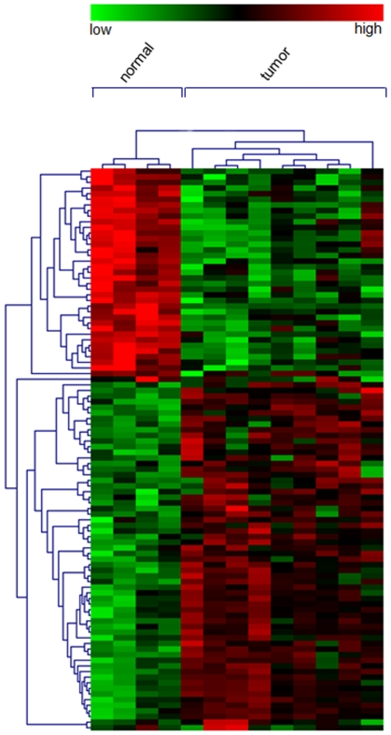
Expression profiles
If two genes are expressed in similar tissue types – that is, their profiles are similar – they are likely to be similar in function.

Slide 9
Metaphylogeny
Other meaning: phylogenomic evolution study
Beyond single genes
Supertrees, networks, reticulate networks
Gene trees, species trees
Recombination

Slide 10
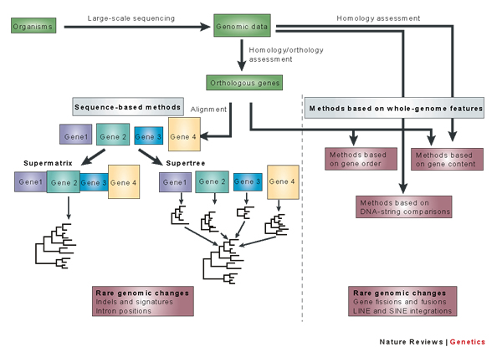
Metaphylogeny
Notes:
#which paper? Why so poor resolution?

Slide 11
Metagene/supermatrix trees
Concatenate alignments.
Perform phylogenetic reconstruction on the resulting “supermatrix” or metagene.
Important: there may be a lot of data, but conflicting signals may be present as well.
Some form of sliding window analysis may be advisable.

Slide 12
Supertrees
Join trees with overlapping but distinct leaf sets.
May be needed to construct very large trees – costly methods could be used on small source trees which could then be joined.
Consensus trees
Merge multiple trees.
Different genes may reveal conflicting evolution.
These must be reconciled, or else the disagreement noted.
One reconciliation approach: find the clades (most of) the trees agree on.
Consensus trees – strict or majority rule.

Slide 13
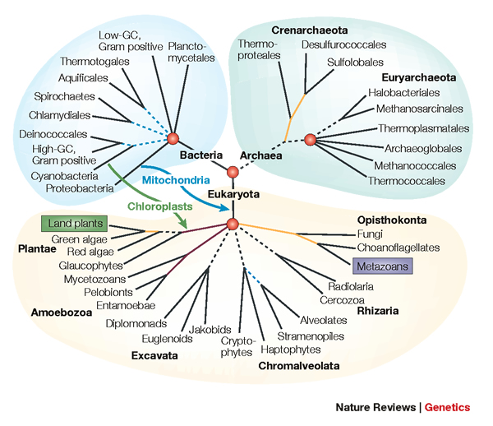

Tree of life

Slide 14
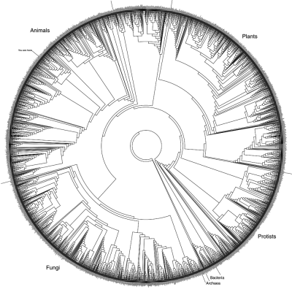
itol.embl.de - interactive tree of life

Slide 15
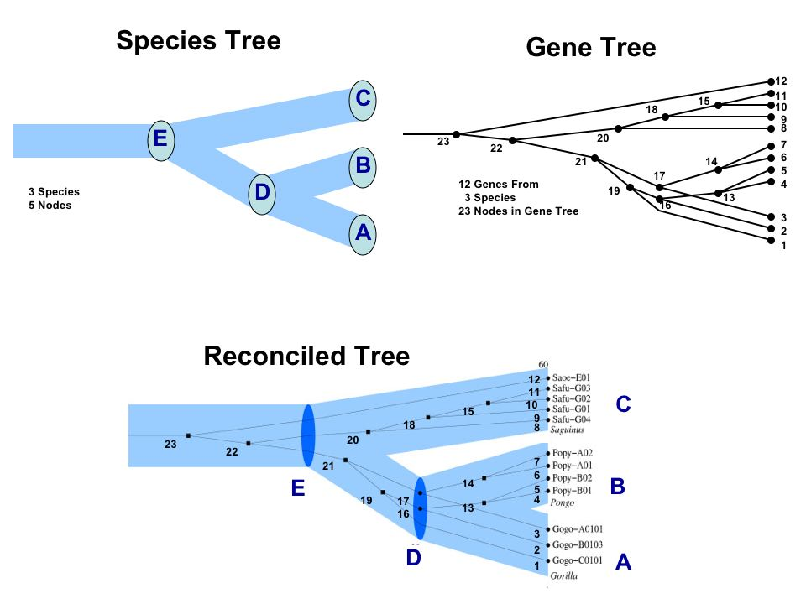
Gene tree vs species tree
Algorithms exist for reconciling a gene tree with a species tree
More in lecture 6.
Notes:
#poor example - the gene tree is already fit to species tree, and no duplications are added!

Slide 16
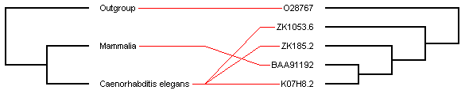
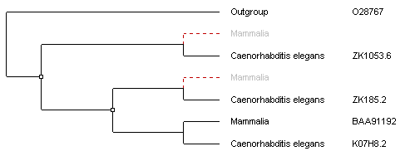
Orthology by tree reconciliation
Species tree
Gene tree
Infer 2 duplications and 2 losses

Slide 17
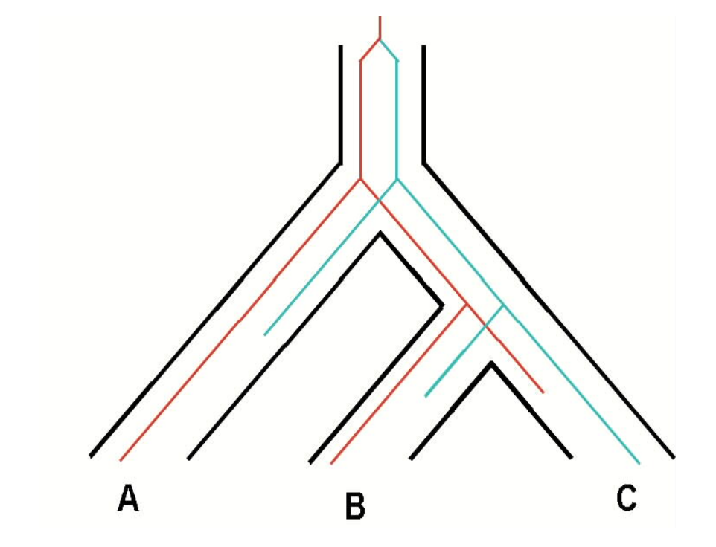
Causes for phylogenetic disagreement
Horizontal gene transfer - very common in prokaryotes, but rare in eukaryotes.
“Incomplete lineage sorting” - anything other than perfect segregation of all alleles into all lineages.
Gene loss in certain species.

Slide 18
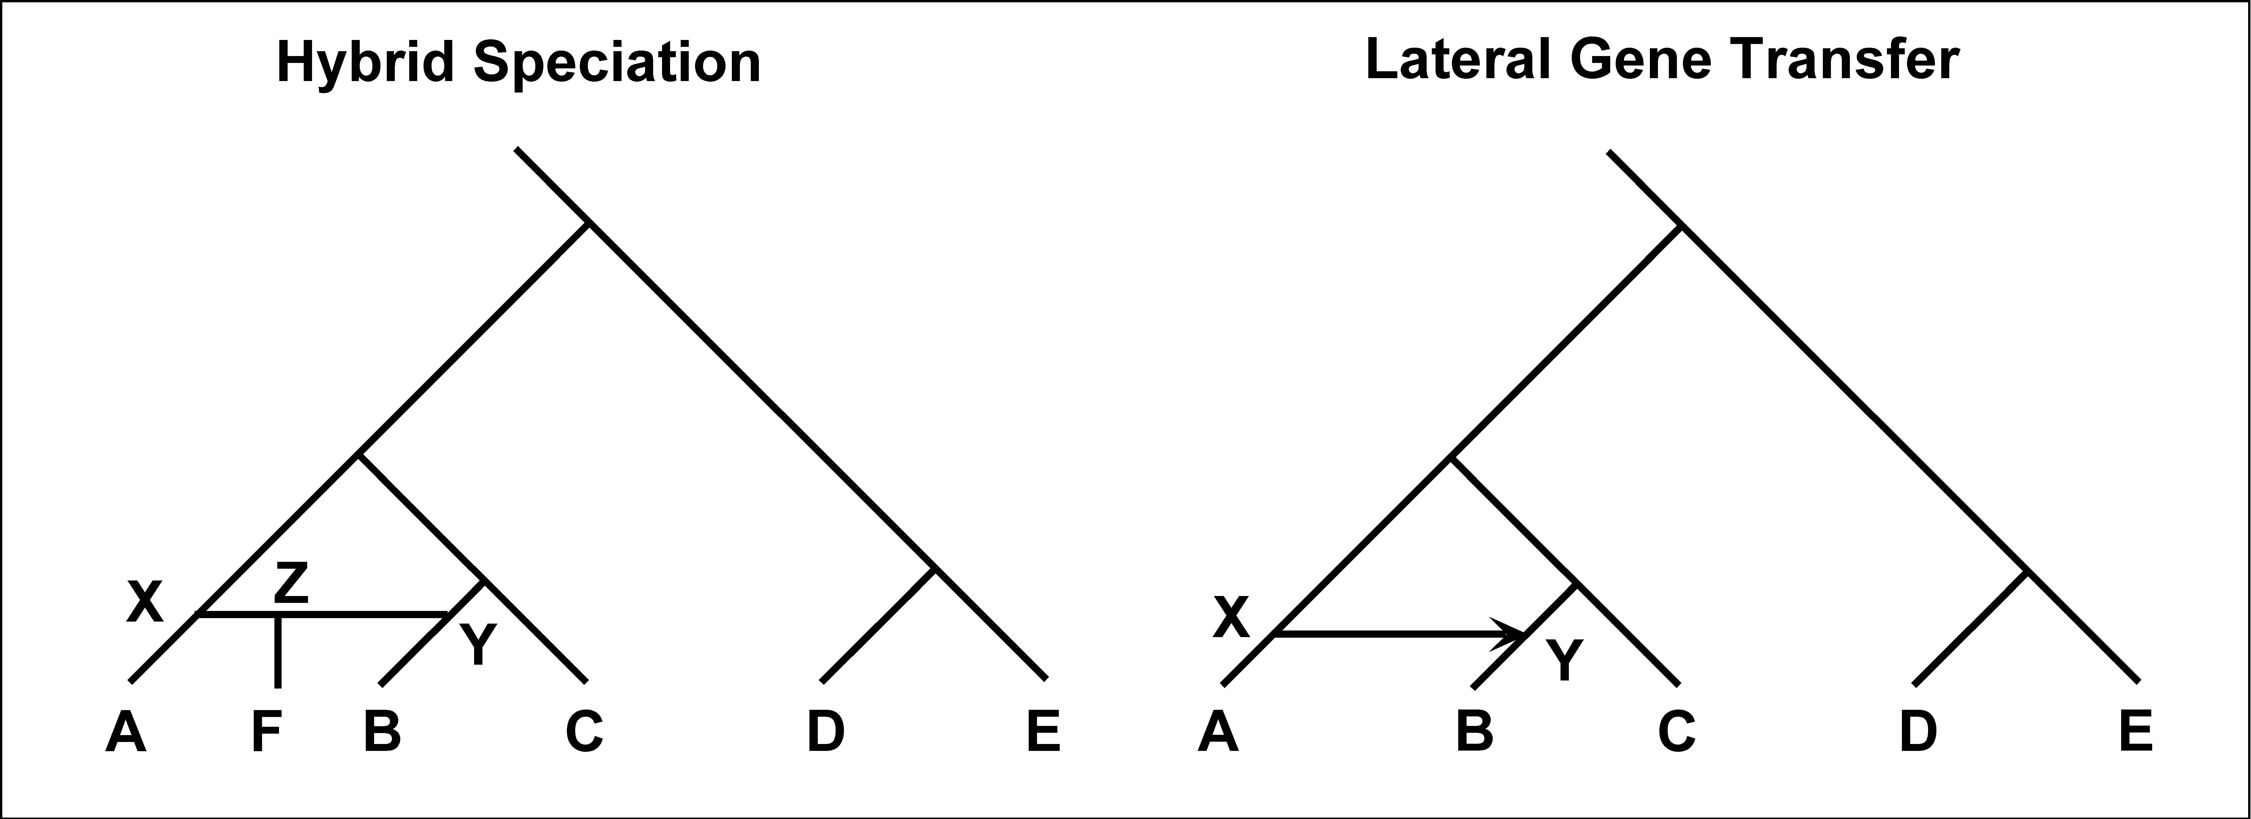
Causes for phylogenetic disagreement
Hybrid speciation – two organisms join to build a new species
Lateral Gene Transfer/Horizontal Gene Transfer - “jumping genes”
Often via some vector like a virus

Slide 19
Take-home messages
The larger scale an analysis can be made at, the better!
Single-gene phylogenies may be misleading
Supertree approaches may make larger datasets possible
Consensus phylogenies across genes may yield the best species phylogeny
Reticulation models that infer tree + lateral transfer events may yield easily interpretable conclusions
Tree of life/taxonomy projects may require supertree approaches, and will become more reliable the more genes are used

Slide 20
Take-home messages
Functional annotation is an important bioinformatics application, which can be aided using phylogeny between genes
Phylogenomics is an example of such a framework
Phylogenetic profiles is a tool for functional classification that will, just like phylogenomics, become more powerful the more organisms are studied

