Slide 1
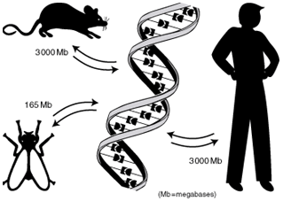
KB8019 Comparative Genomics
Teachers:
Erik Sonnhammer
Assistants
Daniel Morgan
Mateusz Kaduk

Slide 2
Roll Call
Registered students 2017:
Aranda Guillén Maria Isabel
Arroyo Gomez Javier
Challoori Mounika
Ester Manuel
Gupta Revant
He Tianlin
Kyriakidis Vasilieios-evripidis
Lanillos Javier
Lawson Ryno
Lee Ka Wai
Löverli Elinor
Normark Tanja
Rosa André
Savatier-dupré Bañares Carolina
Tomar Siddharth
Von Berlin Leonie
Wang Xueqing
Wirjowerdojo Dimitri Alvin
Özgün Ceren

Slide 3
Comparative Genomics
Prerequisites ~ Applied Bioinformatics
Course dates: 2/5-2/6
4x2 Lectures: Mondays or Tuesdays 13:15 at K205
8 Practicals
3 Project assignments.
Practicals and project assignments in groups of 2 persons
    Analyse 12 anonymous genomes

Slide 4
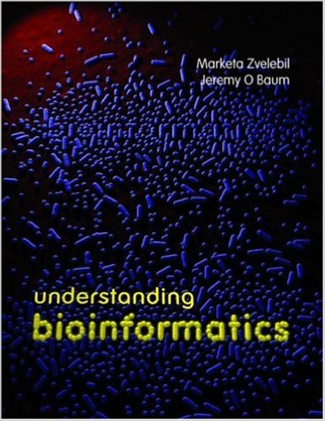
Course book: Zvelebil & Baum
Based on chapters:
  3 Dealing with Databases
  7 Recovering Evolutionary History
  8 Building Phylogenetic Trees
  9 Revealing Genome Features
  10 Gene Detection and Genome Annotation
  17 Systems Biology
Basic bioinformatics knowledge from chapters 4, 5, 6, 7, 8, 11, 12, 15, 16 covered in the introduction course KB7004 is assumed.
Read listed chapters before Monday lecture, email me questions you want to discuss one day before next lecture.
Compulsory attendance on lectures, but no exam.

Slide 5
Project assignments
Analyse 12 genomes by:
DNA genome statistics tool, protein statistics tool
  Compute GC content and nucleotide (dinucleotide) frequency in a genome
  Compute amino acid (diamino acid) frequencies in a proteome
ORF finder
  Compute Open Reading Frames (ORFs) in a genome.
Distance matrix tool
  Computes the distance between two genomes from a DNA statistic above. Use distance matrix to create a species tree.
Write report and give 10-15 minute presentation

Slide 6
Comparative Genomics
Week 1 The structure of genomes; Gene prediction
Week 2 Evolution of genes and genomes
Week 3 Orthology analysis
Week 4 Function and interaction prediction
Week 5 Project work, report writing, finishing labs
June 3, 13-15: Project presentations
Note: “Cheating might lead to disciplinary actions”

Slide 7
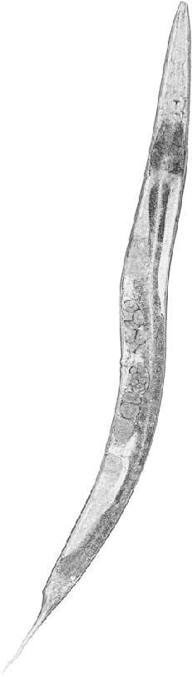
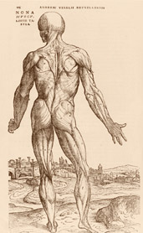
Why Comparative Genomics?

Slide 8
What is Comparative Genomics?
Google [define:Comparative Genomics]:
The study of human genetics by comparisons with the genetics of other organisms.
Study of the relationship of genome structure and function across different biological species.
Comparative studies of whole genomes help researchers understand what parts of the genome in one organism are similar to those in another, how the overall structures of genes and genomes have evolved, and what these findings tell us about gene expression, gene regulation, and how to interfere ...
The study of relationships between the genomes of different species or strains. Comparative genomics is an attempt to take advantage of the information provided by the signatures of selection to understand the function and evolutionary processes that act on genomes. ...

Slide 9
Course Goals
[from course description]
After this course, the student will:
Be able to describe the contents of different types of genomes
Be able to predict genes in a genome
Understand the principles of sequence analysis and be able to apply such methods on complete genomes and proteomes
Be able to describe the principles for phylogenetic analysis and to apply phylogenetic methods
Be able to describe the principles for orthology analysis and to apply orthology identification methods

Slide 10
Course Grades
A = excellent
B = very good
C = good
D = satisfactory
E = sufficient
Fx = insufficient
F = completely insufficient

Slide 11
Course Grades
Weighting scheme:
Weight of all practicals' reports = 0.5
(each report has 1/8 weight)
Weight of project report/presentation = 0.5

