Slide 1
Comparative Genomics
2. Gene Prediction
Zvelebil Chapters 9, 10

Slide 2
Outline
Introduction genes
Gene prediction
  ORFs
  Prokaryote prediction
  Eukaryote prediction
  Experimental support
  Database searches
Promoter prediction
  Prokaryotes
  Eukaryotes

Slide 3
Introduction why?
What can be said based solely upon raw sequence?
Why do we need special methods to do this?
ASLDITALSKDJMIGHTPOWEIURBELERNBLKJDHARDLASKDJJDETOASKDGETJWOVNBRGJINFORMATIONASNREFROMAJKRACNERAWALKEJFSEQUENCELKHFENLKNAMGIRASDF

Slide 4
Introduction why?
What can be said based solely upon raw sequence?
Why do we need special methods to do this?
ASLDITALSKDJMIGHTPOWEIURBELERNBLKJDHARDLASKDJJDETOASKDGETJWOVNBRGJINFORMATIONASNREFROMAJKRACNERAWALKEJFSEQUENCELKHFENLKNAMGIRASDF

Slide 5
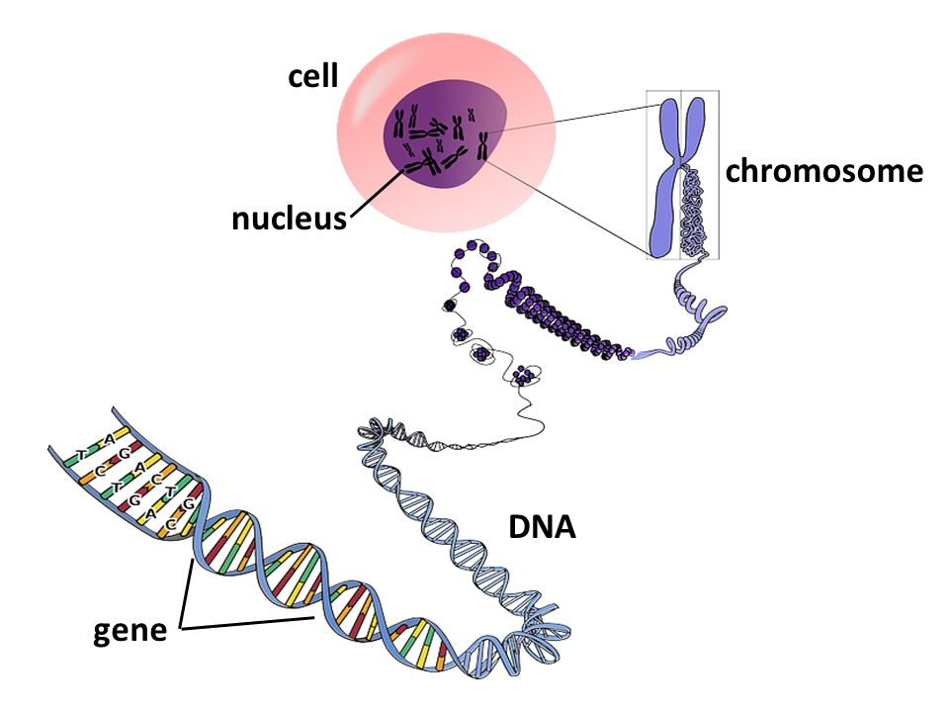
Introduction
Genes
What is a gene ?

Slide 6
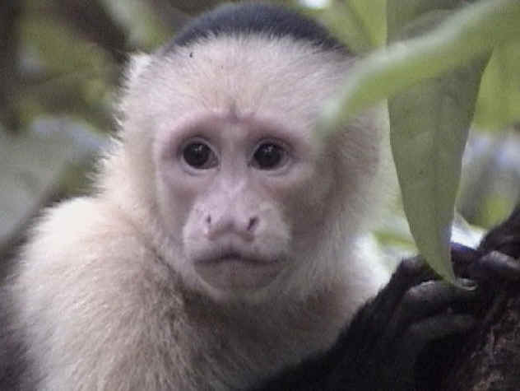
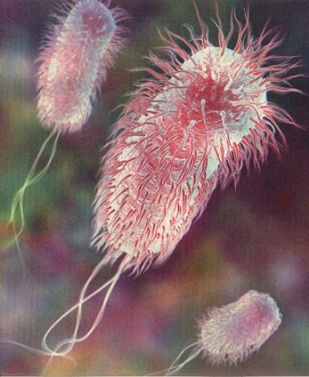
Introduction
Eukaryotic vs prokaryotic genes
What do they have in common?
What differences are there ?

Slide 7
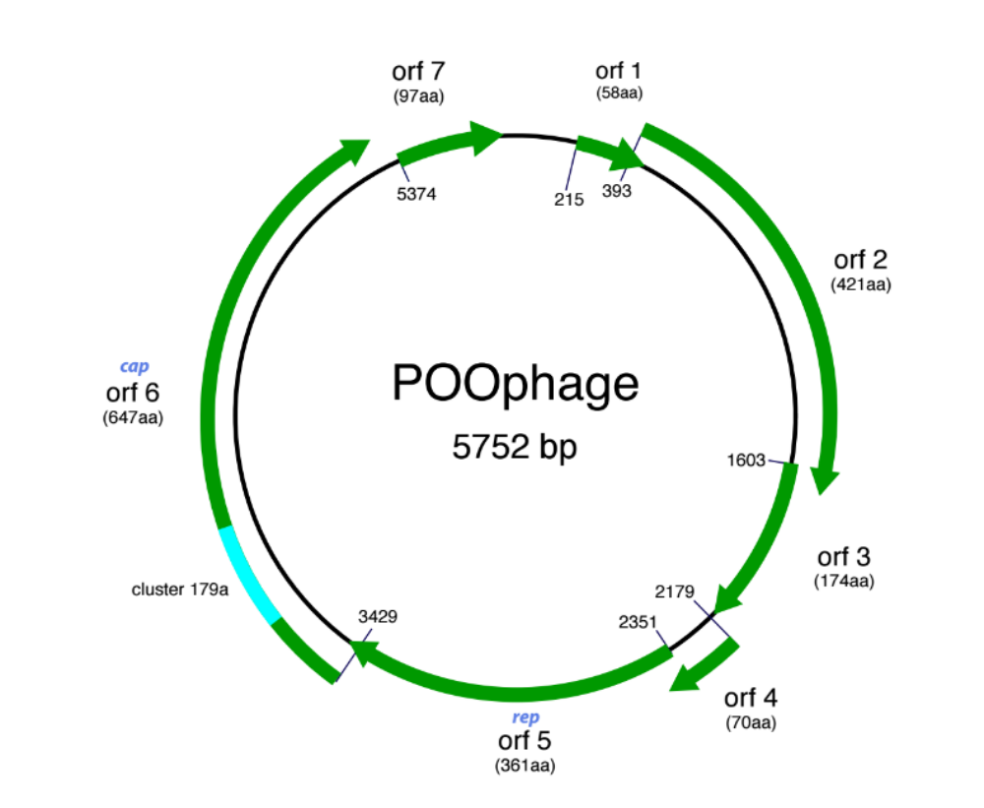
ORFs - open reading frames

Slide 8
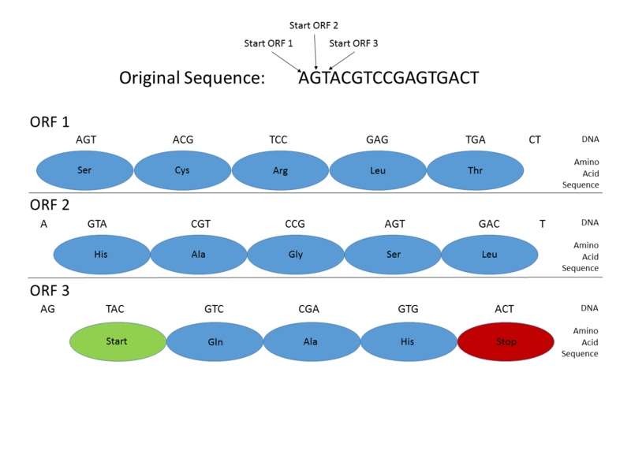
ORFs - open reading frames

Slide 9
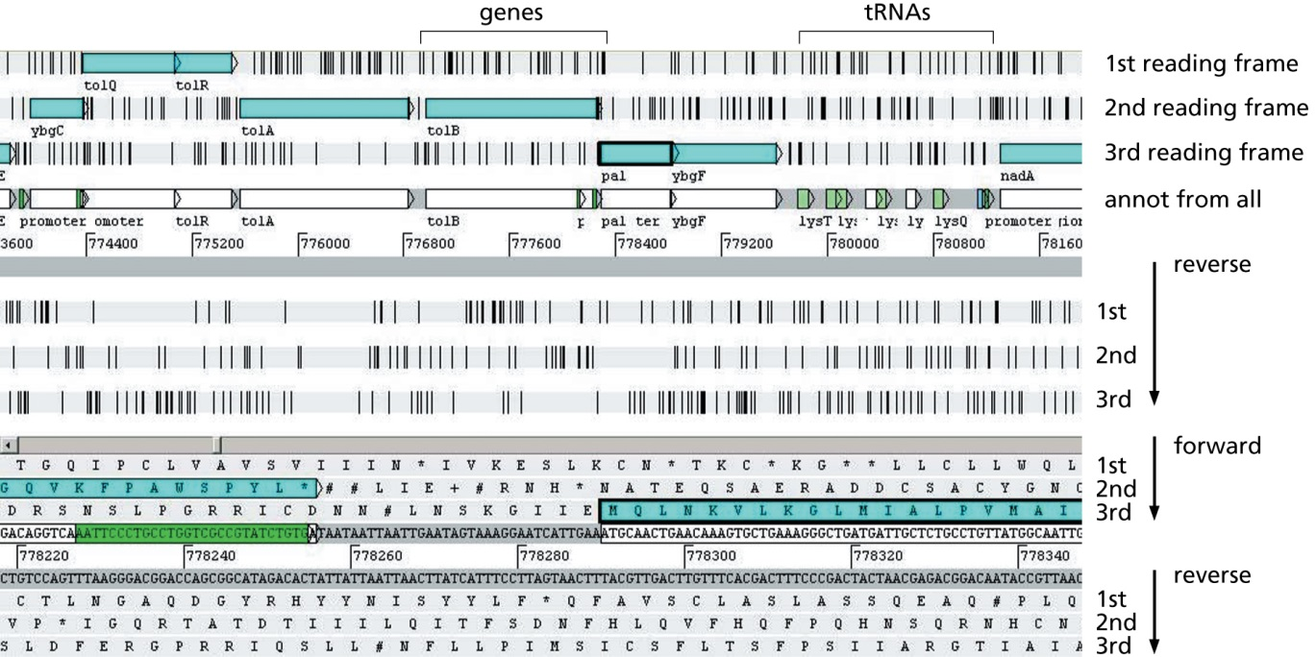
E. coli in Artemis
(Zvelebil Figure 9.3)

Slide 10
Start codon
Stop codon
Genomic DNA
Transcription
pre-mRNA
Cap-
-Poly(A)
Splicing
mRNA
Cap-
-Poly(A)
Translation
Protein
exon
intron
GT AG
Donor site
Acceptor site
Splice sites
(Brendel 2005)

Slide 11
Introns and alternative splicing
Complex eukaryotes have their genes split up into a series of exons (sometimes hundreds) separated by intron sequences.
After transcription, a special machinery (splicing) removes the introns.
This machinery may also remove exons selectively, so the same gene can give rise to different final proteins: alternative splicing.
Alternative splicing and more complex regulatory systems, enabling more fine-grained reaction patterns, may explain why complexity grows faster than gene number.

Slide 12
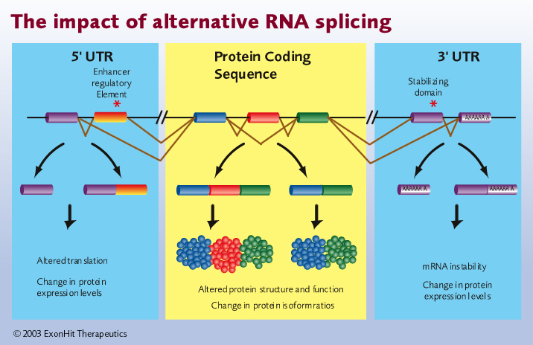
Alternative splicing

Slide 13
Gene Prediction
Protein coding considerations
Is the genetic code the same as the universal code?
If there is intron splicing, is it the same for all tissues?
Is the mRNA edited?
Is the mRNA chemically modified?

Slide 14
Gene Prediction
2 main approaches
Ab initio methods
  Searching by sequence motifs, e.g Open Reading Frames, Splice motifs, Breakpoints
  Searching by content, e.g. different composition coding/non-coding regions
Extrinsic evidence methods
  E.g. sequence match to known gene, EST, or protein
  E.g. similarity to aligned closely related genomes

Slide 15
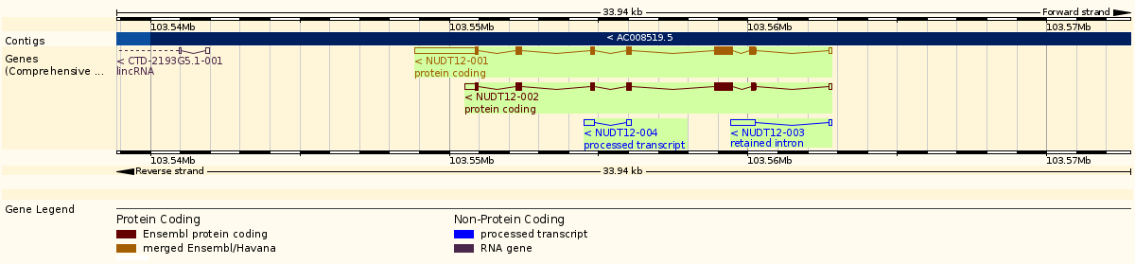
Prokaryote
Eukaryote

Slide 16
ORFs
Characteristics
A stretch without stop codons is an Open Reading Frame.
ORF sequence is not random but list of specific codons
Each species has characteristic pattern of use of synonymous codons
Different patterns of use of codons in strongly versus weakly expressed genes.
Organisms with high GC content have a bias towards G and C in the third codon position

Slide 17
Gene Prediction testing ORFs
Third base more commonly the same in ORF
  TESTCODE
Compare codon usage in gene with average codon usage for organism
  CODONFREQUENCY
ORF translated into aa seq and compared with database of known proteins.

Slide 18
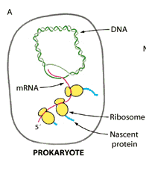
Gene Prediction
Prokaryotes
Often no modification from DNA -> mRNA -> Protein
Find the longest ORF from start- to stop codon

Slide 19
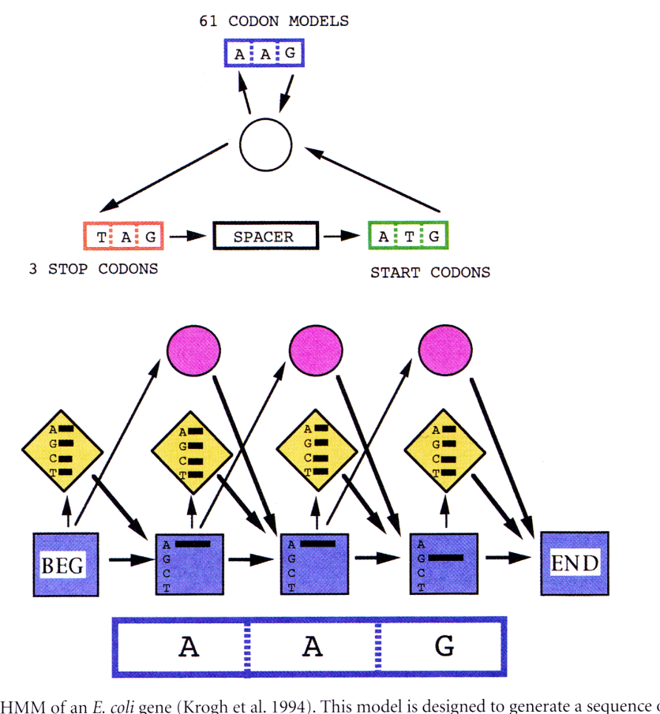
Gene Prediction
Prokaryote predictions
Highly conserved features of E.coli genes
Use HMM for gene prediction
  GeneMark.HMM, Glimmer (Interpolated Markov model)‏

Slide 20
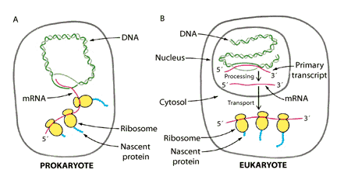
Gene Prediction
Eukaryotes
More complex gene structure
Not just a matter of finding longest ORF
Complex exon/intron structure

Slide 21
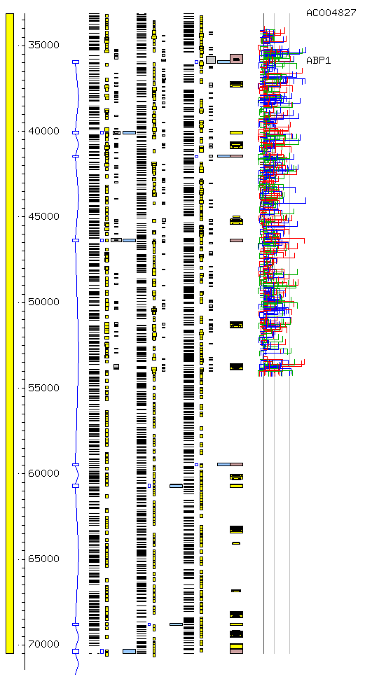
Gene frame1 frame2 frame3 homology Splice sites

Slide 22
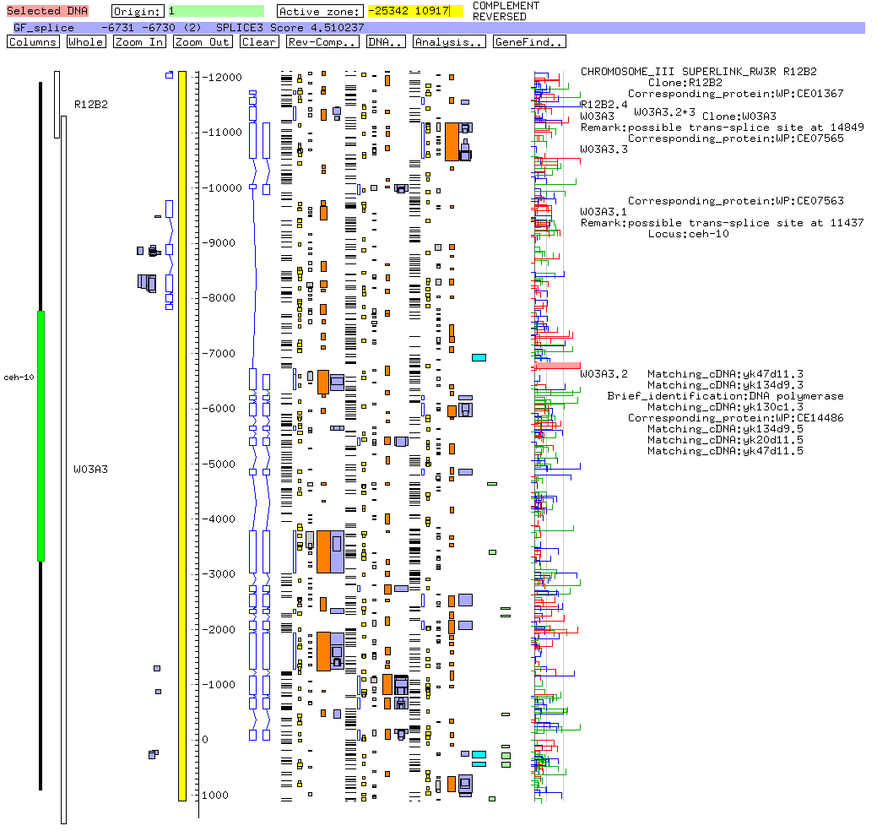
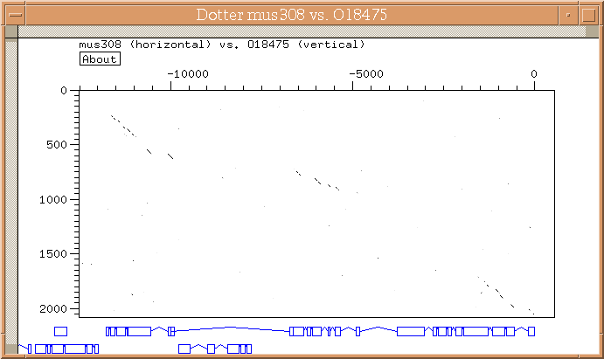
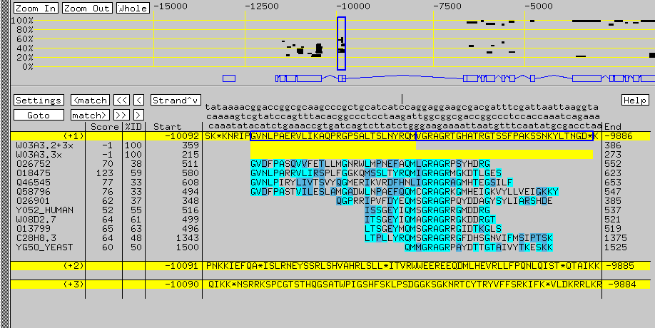
Analysis of gene structure in ACEDB

Slide 23
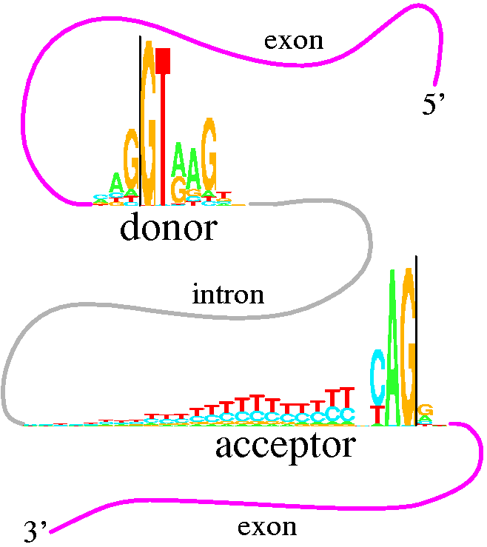
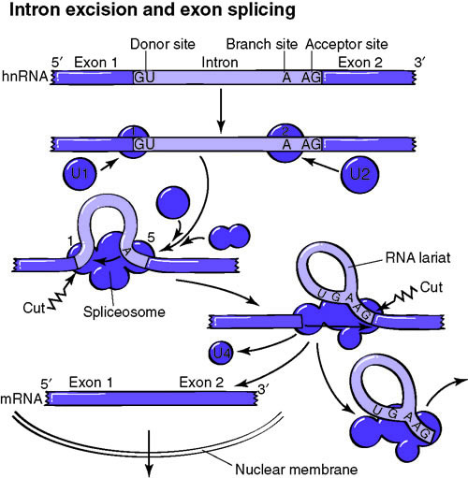
Gene Prediction
Eukaryote predictions
Intron signals
  Donor
  Acceptor

Slide 24
Gene Prediction
Eukaryote predictions
Find the difference between coding/noncoding regions
  Compositional bias
  Uneven use of synonymous/nonsynonymous codons
HMM
  E.g. Genscan
Neural networks
  E.g. GRAIL, GeneParser
Pattern discriminating methods
  E.g. HEXON, FGENEH, MZEF

Slide 25
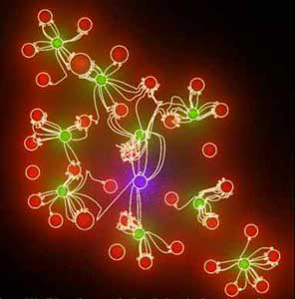
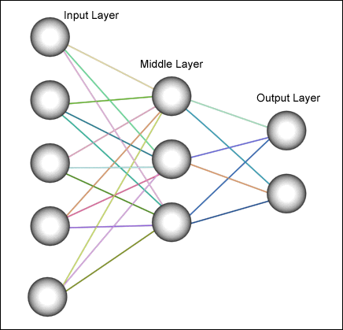
Gene Prediction
Neural networks
Nodes read the sequence, perform evaluation and pass on information to lower layers
Final node makes a prediction
Requires training on known genes

Slide 26

Gene Prediction
Sequence database searches
I: Find proteins/genes of a sequence
  Translate sequence in all reading frames
  Search protein db using BLASTX or FASTX
II: Scan sequence for a particular protein
  Search db with sequence translated in all reading frames
  TBLASTN or TFASTC/TFASTY

Slide 27
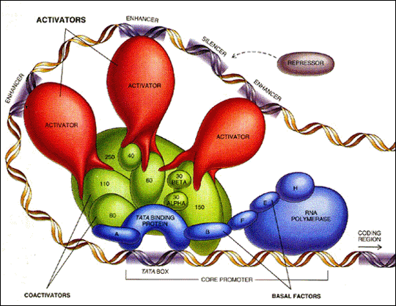
Promoter prediction

Slide 28
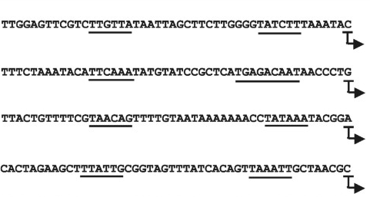
Promoter prediction
Prokaryotes
Characteristic promoters from E.coli
  consensus TATAAT at position -10
  consensus TTGACA at position -35
  AT rich region before the -35 region

Slide 29
Promoter prediction
Methods
Conserved patterns
  Align promotor regions
  Check for conserved patterns
  Check query sequence for these patterns
Scoring matrix
  Align promotor regions
  Count base frequencies for each column and convert to log odds scores in a matrix
  ”Slide” matrix over query sequence and calculate score
Neural Networks
Works well when the regions are well conserved

Slide 30
Promoter prediction
Statistical methods
Expectation maximization
  Initial scoring matrix from guessed alignment
  Scan sequences with matrix
  Update scoring matrix with sequence pattern found at each position weighted by probability of match to position
HMMs

Slide 31
Promoter prediction
Eukaryotes
Predicting promotors not as easy in eukaryotes
NN trained on TATA and Inr sites/NN-genetic alg. To identify conserved patterns and spacings in RNAPII promoters
Recognition of TATA with weight matrix and an analysis of the density of TF sites
Linear discriminant model using features of promoter sequences
Weight matrixes from different organism against query sequence
Evaluation of query sequence for presence of clustered groups or modules of TF-binding sites that are characteristic of a given pattern

Slide 32
Conclusions
Gene prediction in prokaryotes is relatively easy
  Simple methods are often sufficient with more advanced methods giving a slight improvement
Introns in eukaryotes make gene prediction more difficult
  For lower organism this is still doable with more advanced methods
  Higher organisms have more and longer introns making prediction even harder
The need for experimental support/validation increases with genome complexity.

Slide 34
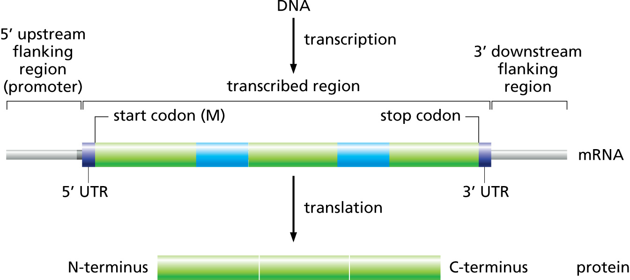
Zvelebil Figure 9.4

