Slide 1
SMU-X x Aramco
Web Crawler and Commodities Dashboard
Team: Petras Tan, Ek Wen Jie, Mayazhagu Guhan, Jason Chew, Rafe Ang

Slide 2
Client & Project Background
Client
Project
Aramco Trading: Middle East’s premier energy trading company and the largest shipper of refined oil products
Develop programming scripts that scrapes webpages for publicly available data
Store scraped data in a cloud database
Develop a front-end interface with charting tools to visualize the stored data

Slide 3









Client-Server Architecture
S3 Storage
Lambda
API Gateway
User
Commodities Website
MongoDB Database
Backend & Crawler
Frontend Dashboard

Slide 4

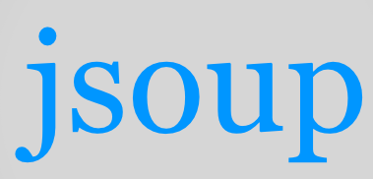




Libraries/Technology (Backend)
opencsv

Slide 5


Libraries/Technology (Frontend)

Slide 6
Application Design
Controllers
CrawlerController
ChinaController
s3Controller
/api/scrape/china
/api/china/all
/api/china/saveallexcel
/api/s3/china/{commodity}
Services
CrawlerService
ChinaService
s3Service
@Scheduled
scrapeChina()
saveAllExcelFiles()
Utils
ChinaExcel
ChinaLinkScraper
ChinaPageScraper
ChinaImportsPageScraper
ChinaExportsPageScraper
saves3()
retrieveS3LinksByCountryAndCommodity()
saveListChina()
retrieveAllChina()
Repositories
ChinaRepository
s3Repository
Models
China
s3

Slide 7
Application Design
Controllers
CrawlerController
ThailandController
s3Controller
/api/scrape/thailand
/api/thailand/all
/api/thailand/saveallexcel
/api/s3/thailand/{commodity}
Services
CrawlerService
ThailandService
s3Service
@Scheduled
scrapeThailand()
saveAllExcelFiles()
Utils
ThailandExcel
ThailandCrudeOilProductionScraper
ThailandCondensateProductionScraper
...
saves3()
retrieveThailandS3LinksByCountryAndCommodity()
saveListThailand()
getAllThailand()
Repositories
ThailandRepository
s3Repository
Models
Thailand
s3

Slide 8
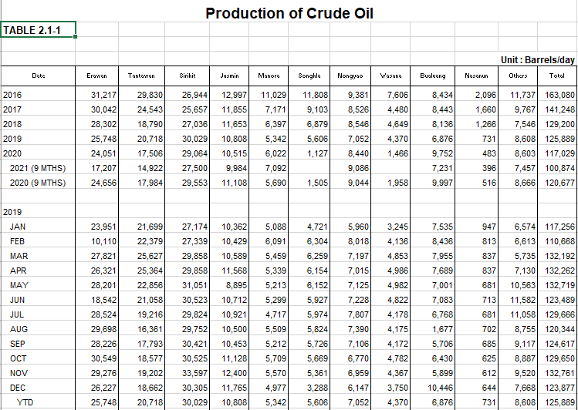
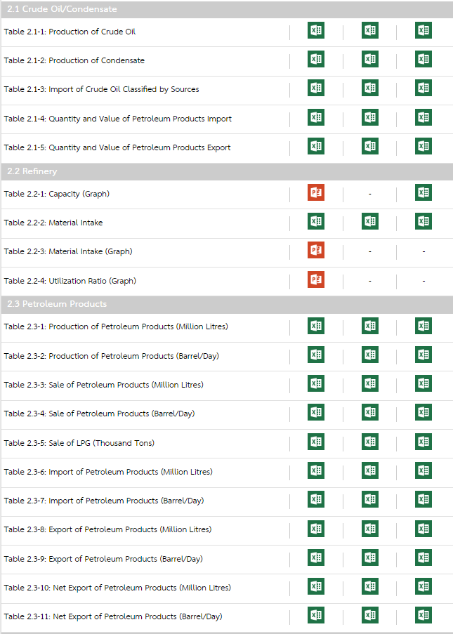
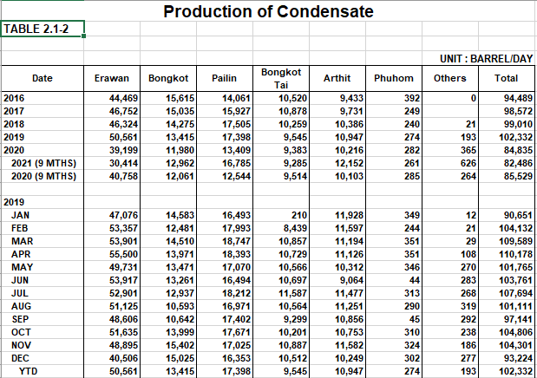
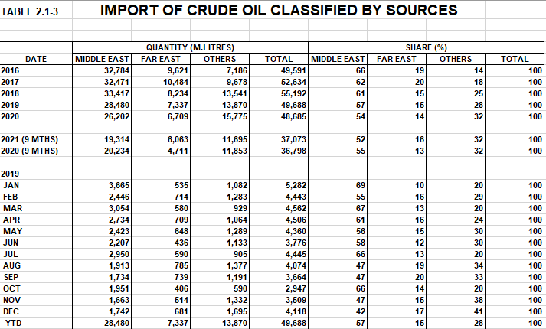
DRY (Don’t Repeat Yourself!)

Slide 9
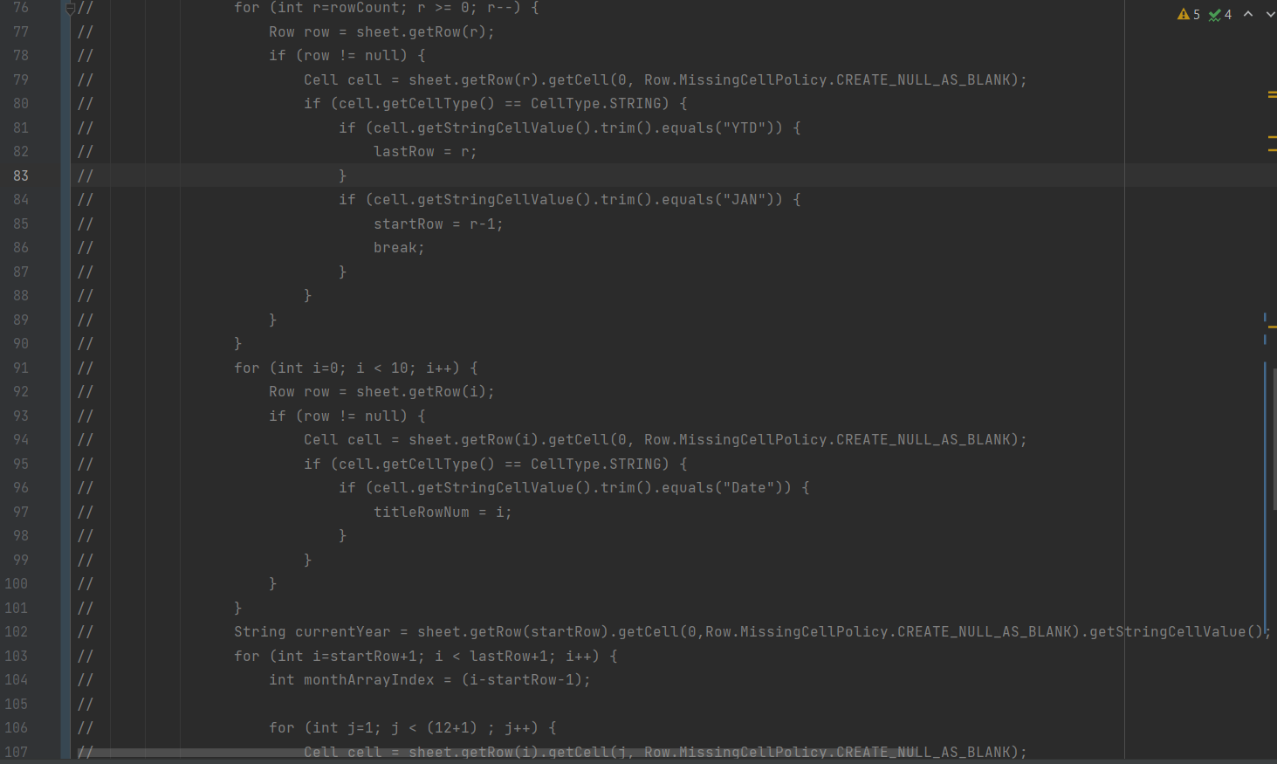
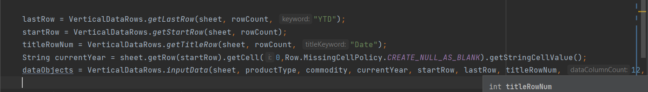
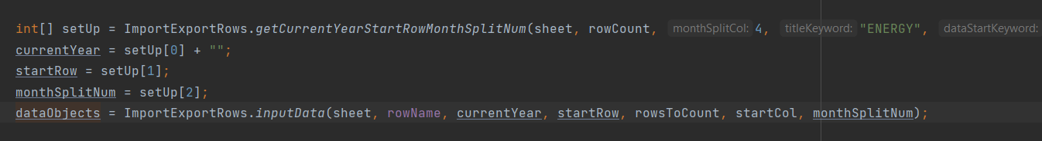
DRY (Don’t Repeat Yourself!)
Before
After

Slide 10
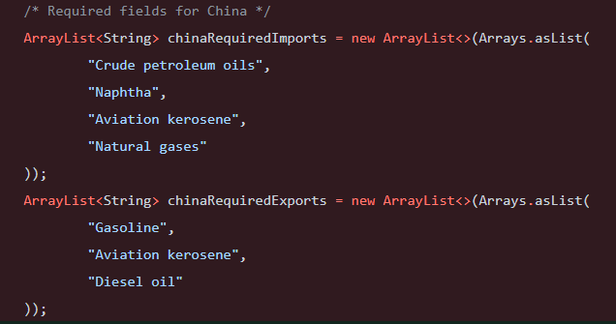
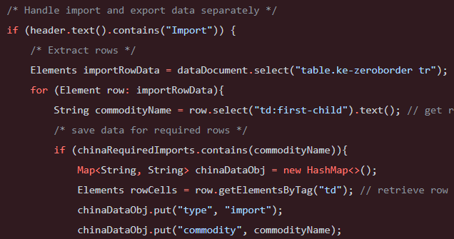
Open/Closed Principle
Objects or entities should be open for extension but closed for modification.
This means that a class should be extendable without modifying the class itself.
Before: CrawlerService.java

Slide 11
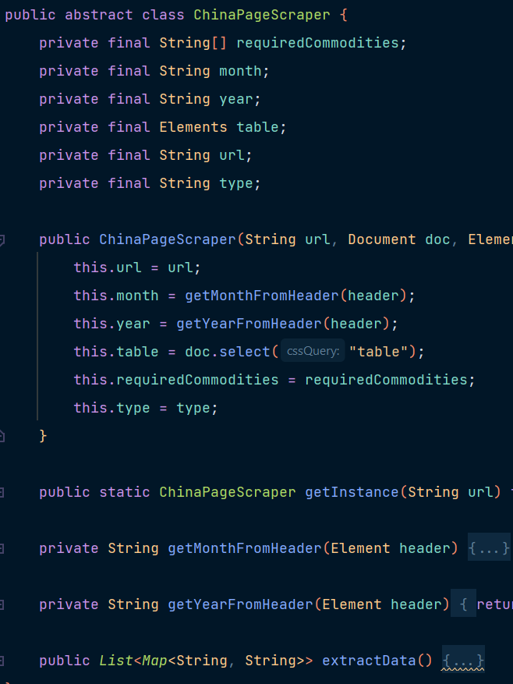
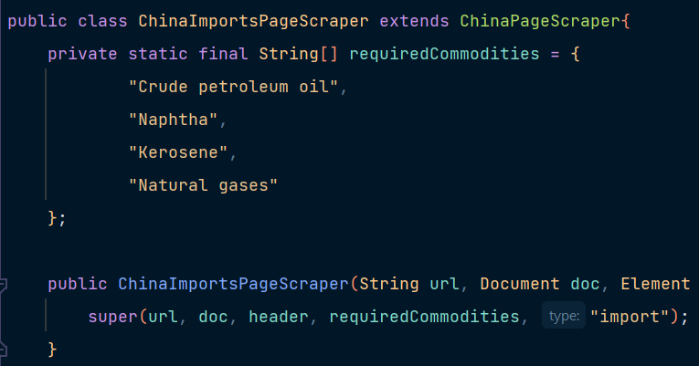
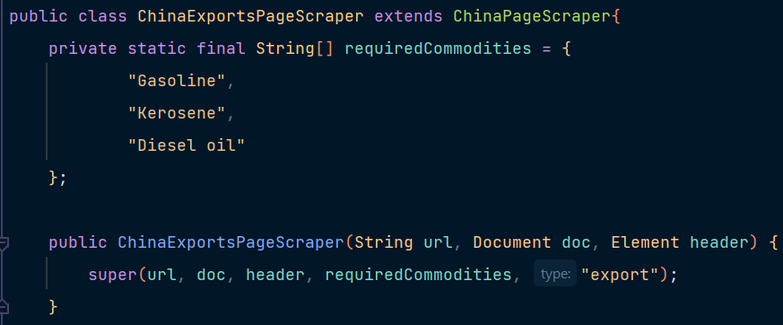
Open/Closed Principle
Objects or entities should be open for extension but closed for modification.
This means that a class should be extendable without modifying the class itself.
After: ChinaPageScraper.java, ChinaImportsPageScraper.java, ChinaExportsPageScraper.java

Slide 12
DEMONSTRATION

Slide 13
Thank You
Question & Answers Session

