Slide 1


Apex Institute of Management (AIM)
Program MBA -BA
Summer Internship (June- August, 2024)
Bipin Baby Mathew
23MBA20195
Internship Review: My Projects, Learning and Takeaways
DISCOVER . LEARN . EMPOWER

Slide 2

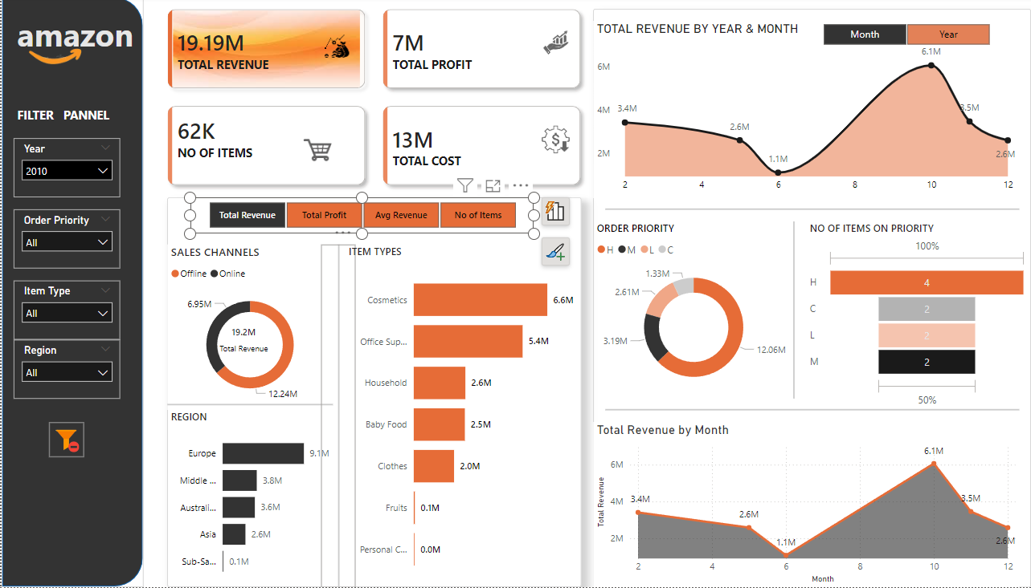
Amazon Sales Trend Analysis
Sales Trend Analysis focuses on identifying and understanding patterns in sales data over specific time periods. It helps businesses track performance, detect seasonal or cyclical patterns, and anticipate future sales. Key aspects of sales trend analysis include:
Time Period Analysis
Product and Regional Performance
Forecasting
Actionable Insights:

Slide 3

UNIFIED MENTOR
Unified Mentor’s journey started with a steadfast ambition to transform the face of online Mentor and equip people to succeed in the fast-paced world of technology. Established in 2022, Unified Mentor is a shining example of how lofty goals and real accomplishments can be reconciled. Unified Mentor has assumed the role of a transformational catalyst by concentrating on web development, data science, and digital marketing and encouraging growth, innovation, and excellence.
At Unified Mentor, it is deeply believed that personal growth drives our collective success.
Unified Mentor’s mission is simple yet powerful: to enhance employability through personalized skill development programs

Slide 4

Project Introduction
In the rapidly evolving global market, sales management has become a critical function for businesses to thrive. This project focuses on analysing sales trends for Amazon, a global leader in e-commerce, with the objective of identifying the follows
key sales patterns
developing actionable insights
Increase operational efficiency and profitability.

Slide 5
Review of Related Literature
Author Name & Year | Title | Key Findings
Brown & Martinez (2020) | "Real-Time Sales Data Analysis for E-commerce Optimization" | This paper proposes the implementation of real-time data analytics platforms to continuously monitor and analyse sales
Khan & Lee (2019) | Big Data Analytics in E-commerce: A Comprehensive Review" | This review suggests leveraging big data analytics to enhance sales forecasting.
Choi & Huang (2018) | "Time Series Forecasting in Retail: An Overview" | The authors recommend applying time series forecasting models such as ARIMA and its variants to retail sales data.
Li & Smith (2020) | "The Role of External Factors in Sales Forecasting: A Multi-Model Approach" | The paper recommends using a multi-model approach that integrates traditional forecasting models with external data sources, such as weather conditions, economic indicators, and social media trends.

Slide 6
Objectives of the Study
Objective 1 | Objective 2 | Objective 3 | Objective 4
To analyse monthly and yearly sales trends. | To identify top-selling products by region. | To evaluate profit by region | To forecast sales trends using a linear regression model.

Slide 7

Research Methodology
Need and Significance of the Study (GAP)
Its aims is to fill gaps in understanding how different factors such as region, product type, and time periods impact sales and profitability.
Research Design Exploratory Research Design
Sampling Design ( Sample unit, size and techniques)
Sampling Unit: Amazon sales data
Sample Size: 100 rows
Sampling Technique: Secondary data analysis from an existing dataset.
Data Collection Method : Secondary Data Collection
Tools Tools: Python (data analysis, modeling), Power BI (visualization).
Technique Descriptive analysis , Modeling

Slide 8
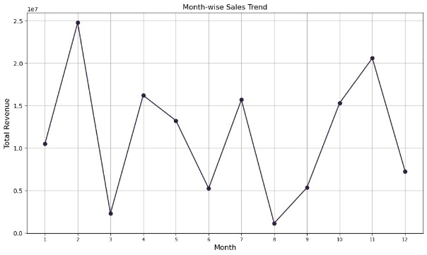
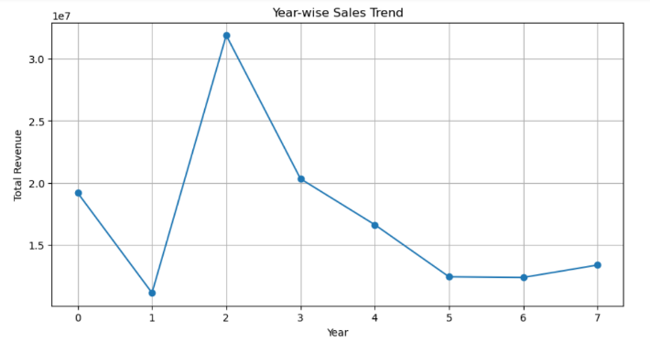
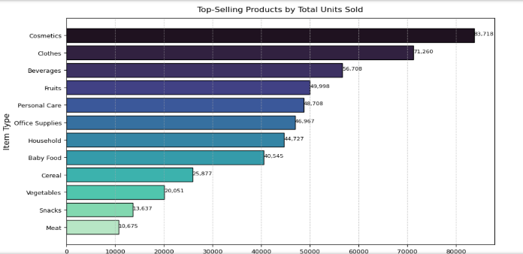
Data Analysis & Interpretations
Monthly Sales | Yearly Sales | Top Selling Product
1.February and March see the highest sales revenue, likely due to seasonal factors or promotions. | 2012 had the highest total revenue, marking a peak year in sales performance. 2011 and 2016 saw lower sales, indicating possible market challenges or reduced demand. | Cosmetics and Clothes lead in sales, showing high consumer demand and market popularity. 2.Meat and Snacks are the least sold, suggesting lower consumer interest or higher competition.

Slide 9
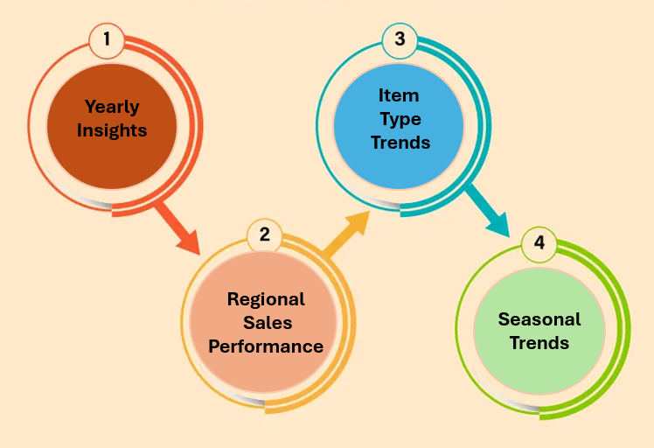
Findings and Suggestions

Slide 10
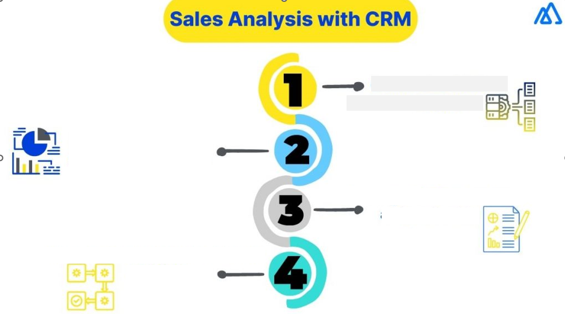
Future scope of the study
Product Categorization
Real-Time Analytics
Advanced Modeling
Cross-Industry Comparison

Slide 11

Conclusion
This study on Amazon sales trend analysis has provided crucial insights into the dynamics of sales and profitability across different regions, product categories, and time periods.
By identifying
Monthly and yearly sales trends,
Top-selling products by region
The analysis has highlighted the importance of tailored marketing and distribution strategies.
The effective use of a linear regression model for sales forecasting further emphasizes the potential for data-driven decision-making to optimize inventory management, reduce costs, and boost profits.

Slide 12
BIBLIOGRAPHY / REFERENCES
Brown, L., & Martinez, J. (2020). Real-Time Sales Data Analysis for E-commerce Optimization. Journal of Business Analytics, 12(3), 45-61.
Choi, S., & Huang, Y. (2018). Time Series Forecasting in Retail: An Overview. International Journal of Forecasting, 34(2), 150-165.
Green, P., & Davis, M. (2019). Advanced Forecasting Techniques for Improving Supply Chain Management in Retail. Supply Chain Management Review, 21(4), 98-112.
Johnson, R., & Wang, T. (2020). Data-Driven Approaches to Enhancing Sales Performance: A Review. Journal of Retailing and Consumer Services, 56, 1-14.
Khan, A., & Lee, K. (2019). Big Data Analytics in E-commerce: A Comprehensive Review. E-commerce Research Journal, 8(2), 67-82.
Kumar, R., & Rao, S. (2019). Predictive Analytics in Retail: Enhancing Sales Forecasting. Journal of Predictive Analytics, 14(1), 33-48.
Li, H., & Smith, B. (2020). The Role of External Factors in Sales Forecasting: A Multi-Model Approach. International Journal of Forecasting, 36(3), 315-330.

Slide 13
THANK YOU

