Slide 1
“3D Surface profile measurement using Fringe projection”

Slide 2
Outline
3D profile measurement
Different methods of 3D profile measurement
Optical set up in laboratory
Flow Chart of our followed method
Principle of Fourier transform method
Procedures
Results
Discussion

Slide 3
3D profile measurement
3D profile is the visualization of an object with respect to 3 dimension like height, width and depth.
The surface profile measurement of an object without any physical contact by optical method is very popular in different applications.

Slide 4
3-D Shape Measurement Techniques
Laser triangulation
Utilizes the triangle formed by the laser light source, the laser spot on the object surface, and the image of the spot on the receiving sensor to acquire range information.
Time of Flight
Detects the time of a laser pulse traveled to the object surface and reflected back to the receiving sensor
Stereo vision
Stereo vision technique reconstructs 3-D geometry of an object using a pair of 2-D images captured from two different points of view
Coded pattern projection
This techniques facilitate the building of pixel correspondences by projecting a single pattern or a set of light patterns onto the objects

Slide 5
3-D Shape Measurement Techniques
Interferometry
Beams are superposed on the object's surface to generate interference patterns, usually
fringe patterns.
Moire method
Moire method acquires the contour of the object surface by the interference of two grating patterns, a reference grating pattern and the deformed reference grating pattern
Digital fringe projection (DFP)
Digital fringe projection technique utilizes a liquid crystal display (LCD) projector or a digital light processing (DLP) projector to project single or multiple sinusoidal fringe patterns onto a diffuse object surface

Slide 6
DFP (Digital Fringe Projection)
Fringe Pattern Profilometry (FPP)
Phase Difference Estimation (PDE)
Fourier Transform Profilometry (FTP) (we have used this method)
Phase Shifting Profilometry (PSP)
Compared to FTP, PSP has higher measurement accuracy because of the multiple frames of the image used which can eliminate the influence of noise in the patterns

Slide 7
Principle of Fourier transform method
A sinusoidal fringe pattern can be represented by following expression-
here,
Φ(x,y)= Phase;
a(x,y) = It relates to the background illumination;
b(x,y) = It represents local amplitude of cosinefunction;
f₀ = Carrier frequency;
Applying Eulers formula we get this,

Slide 8
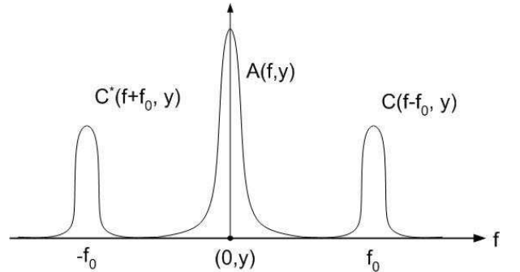
Principle of Fourier transform method
By taking 1-D Fourier transform with respect to x
Assuming Ø(x,y), a(x,y), and b(x, y) vary very slowly compared to the carrier frequency f₀, the three terms are separated in the spatial frequency domain. The Fourier spectra are shown below
A properly designed Filter is applied to isolate the C (f_{x} -f₀,y ) term.
Then the C (f_{x} - f₀,y ) is taken inverse Fourier transform.
The phase Ø(x,y) can be extracted by computing the logarithm of c(x, y)

Slide 9
Phase to height conversion formula
The height distribution of the object’s surface is given by –
h(x)=l₀Φ(x)/2πf₀d_{0 ;}
Φ(x)= It denotes the phase difference between two fringes(reference fringe and the deformed fringe),
f₀=Spatial frequency of the fundamental frequency component,
d₀= distance between camera and projector.

Slide 10
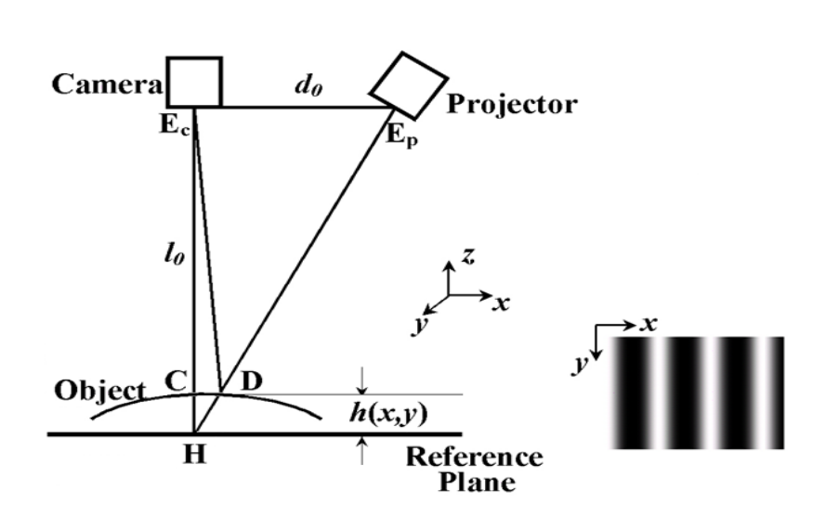
Optical set up in laboratory
In our work, we have used manikin as our object and sinusoidal fringe pattern that are projected on the manikin surface.
A digital camera.
A projector.
A white background (reference plane)
A laptop.
Figure : Optical set up of fringe projection in laboratory

Slide 11
Flow chart of our followed method
Image of reference plane
Image of object
FFT
FFT
Filter
Filter
IFFT
IFFT
Calculate Object Phase Map
Phase Unwrapping
Calculate height distribution

Slide 12
Procedures (Fourier Transform Profilometry)
Region of interest was selected
Fourier transform of both reference fringe and the distorted fringe on the object is calculated
First we get rid of the Low frequency components of the image by tasking a high pass window
Then, a properly designed Gaussian filter was used to keep only the first order component of the
Now, both images are transformed back to real space and phase is calculated
Phase is unwrapped and difference is calculated
At final stage height distribution from phase is calculated.

Slide 13
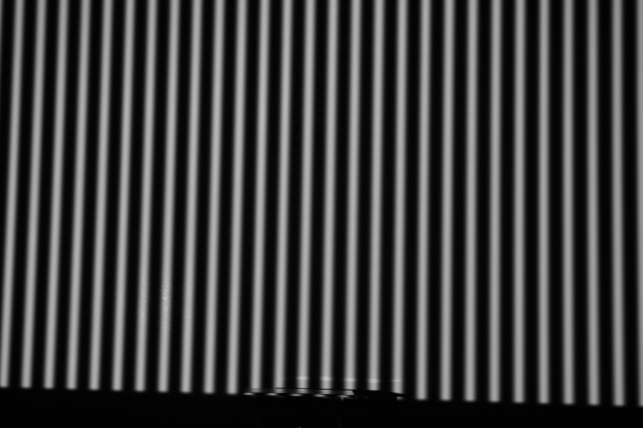
Fringe pattern

Slide 14
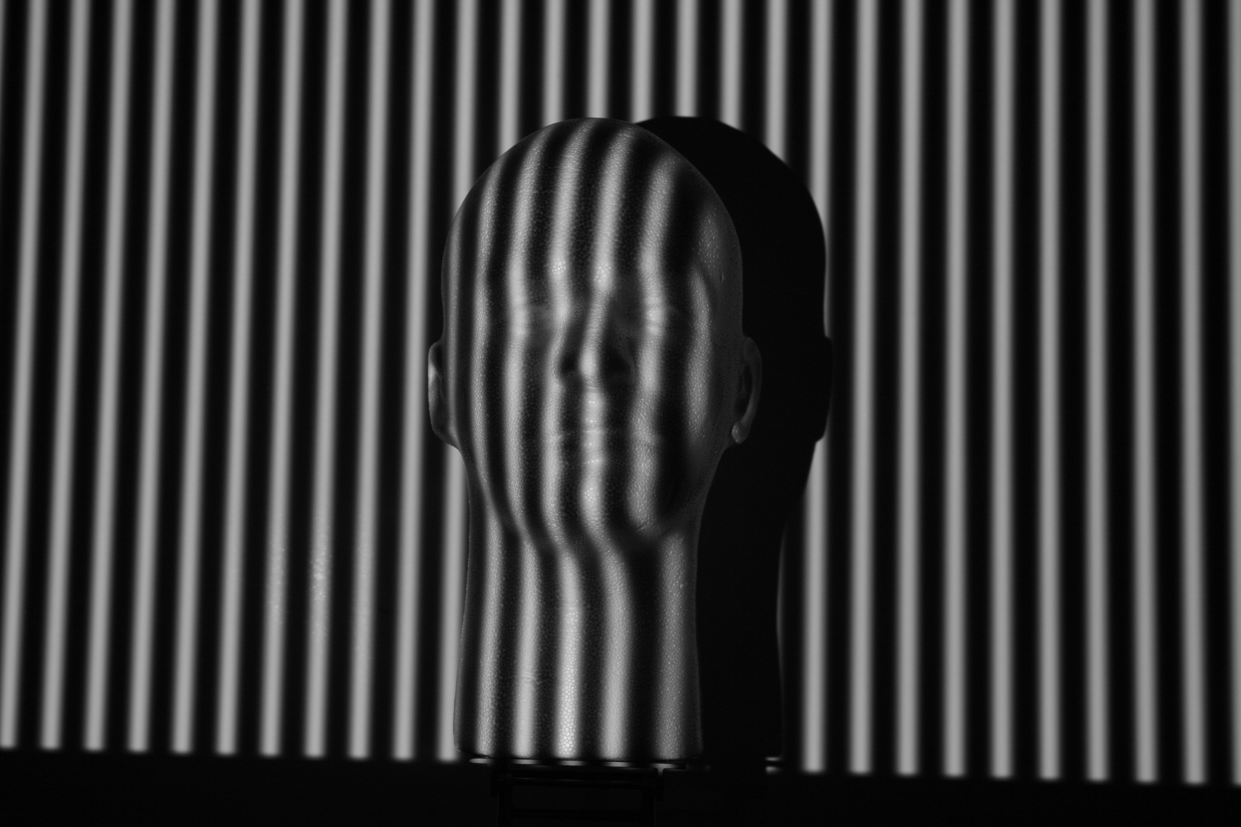
Fringe pattern projected on object

Slide 15
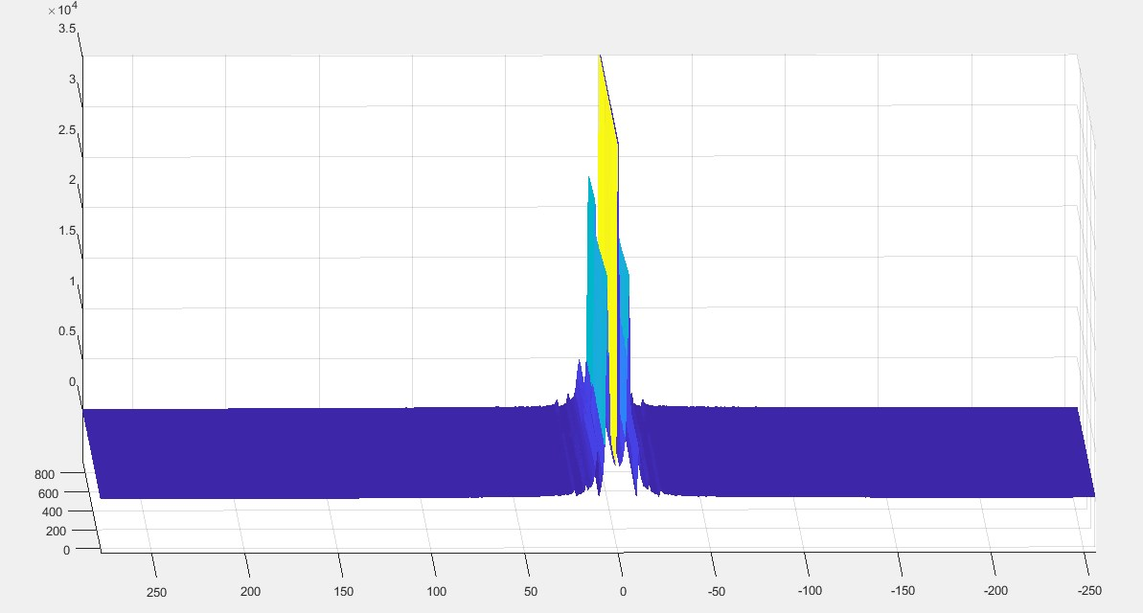
Columnwise Fourier spectrum (unfiltered)

Slide 16
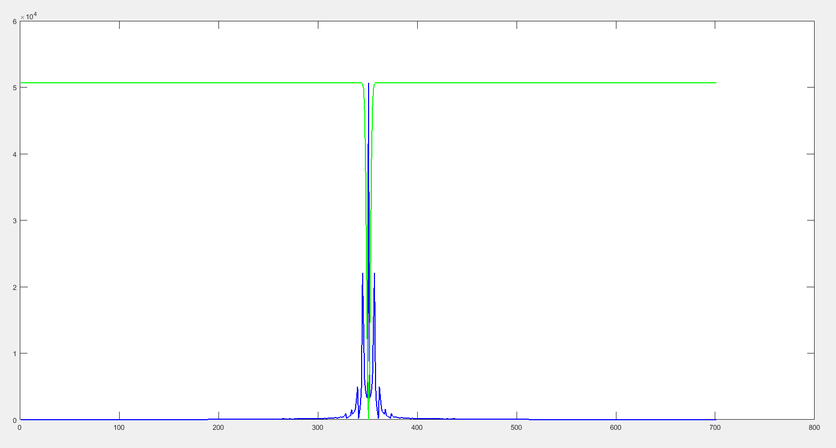
High-pass window (Remove low frequencies)

Slide 17
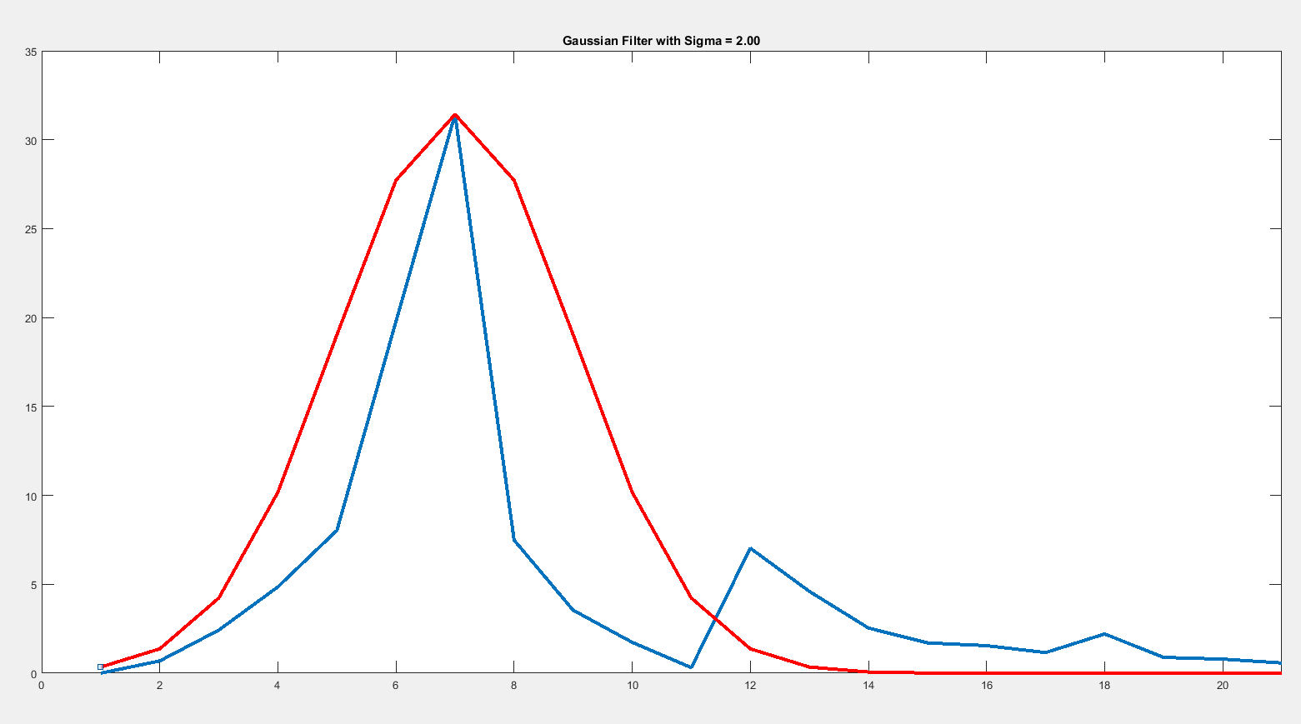
Gaussian window to remove higher order harmonics

Slide 18
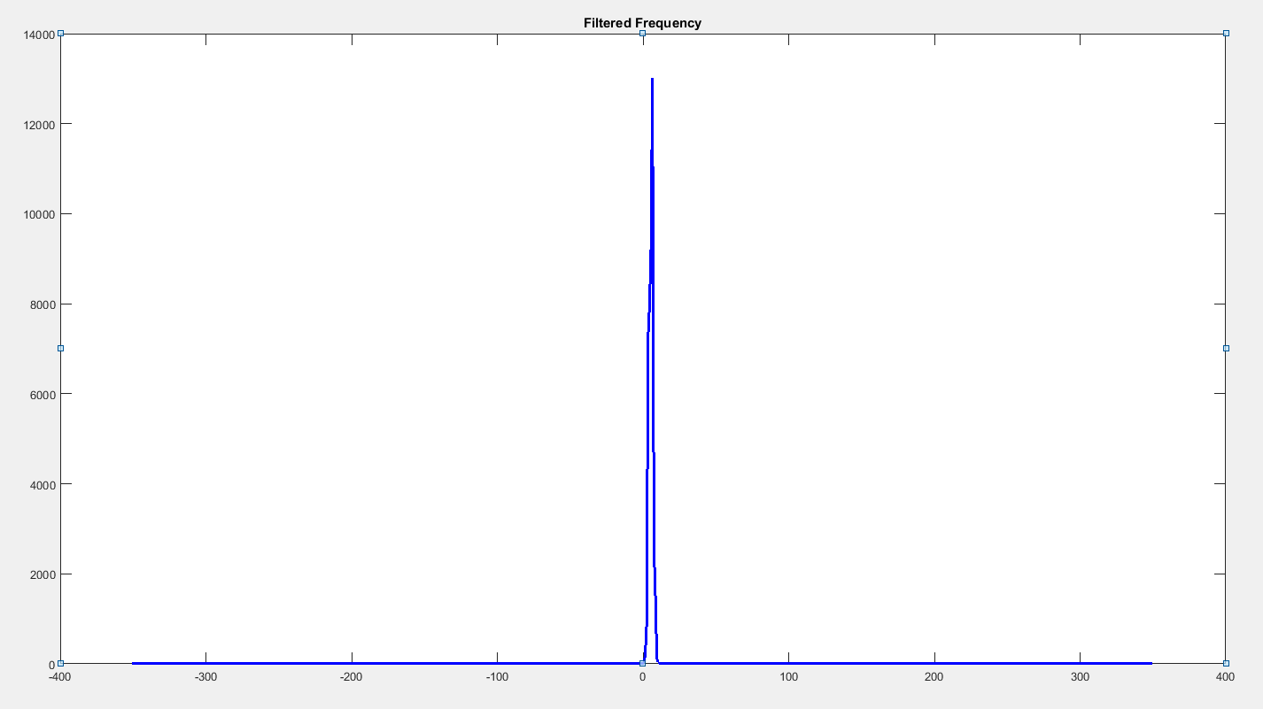
Frequency spectrum after filtering

Slide 19
RESULT

Slide 20
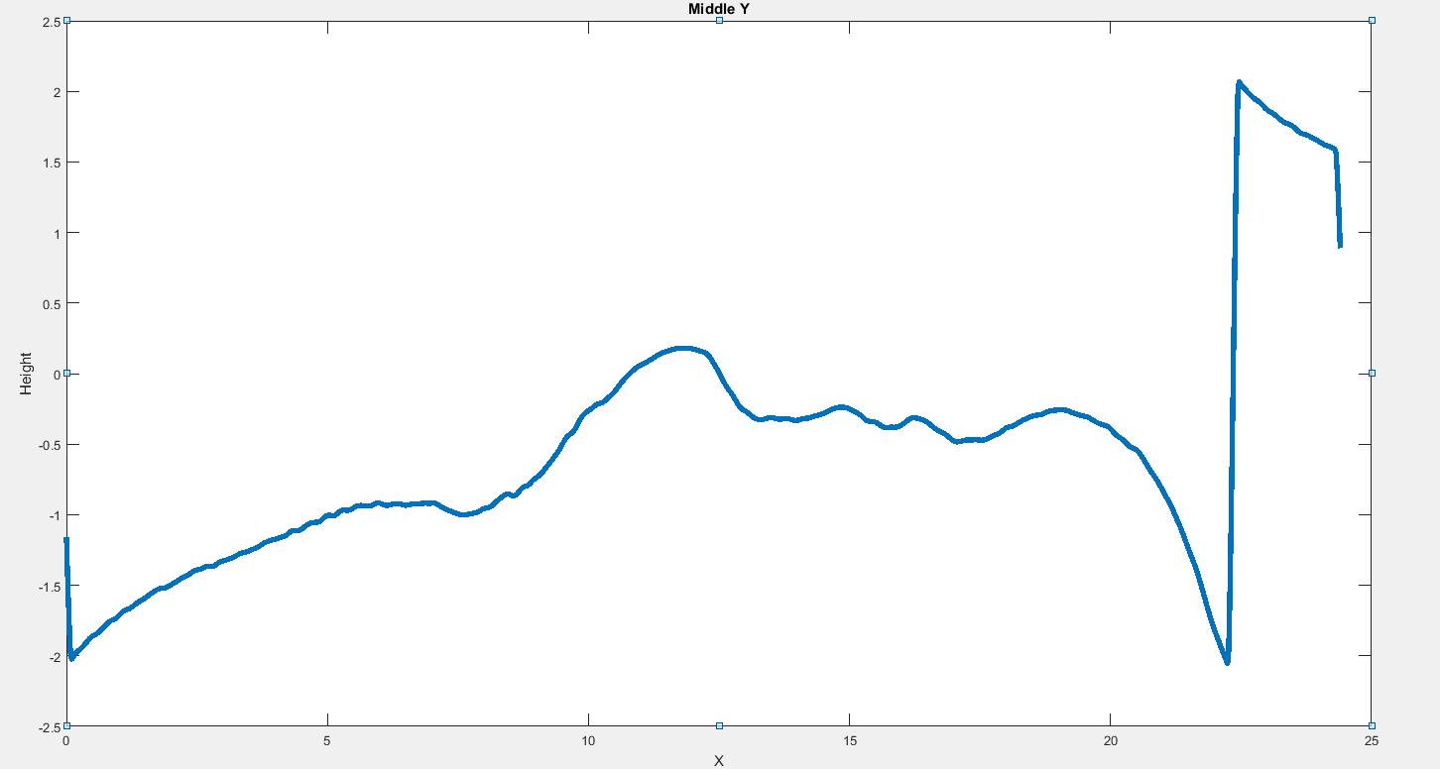
Depth map: Middle Y slice of the height profile

Slide 21
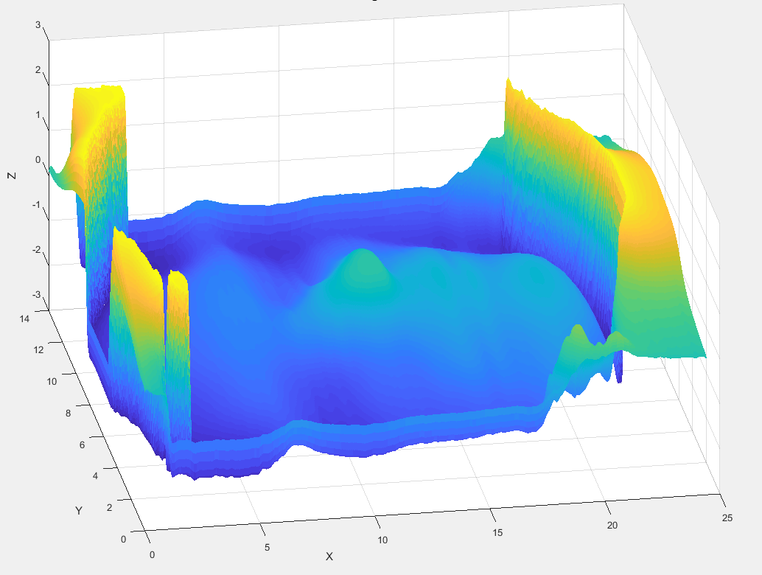
Final depth map 1

Slide 22
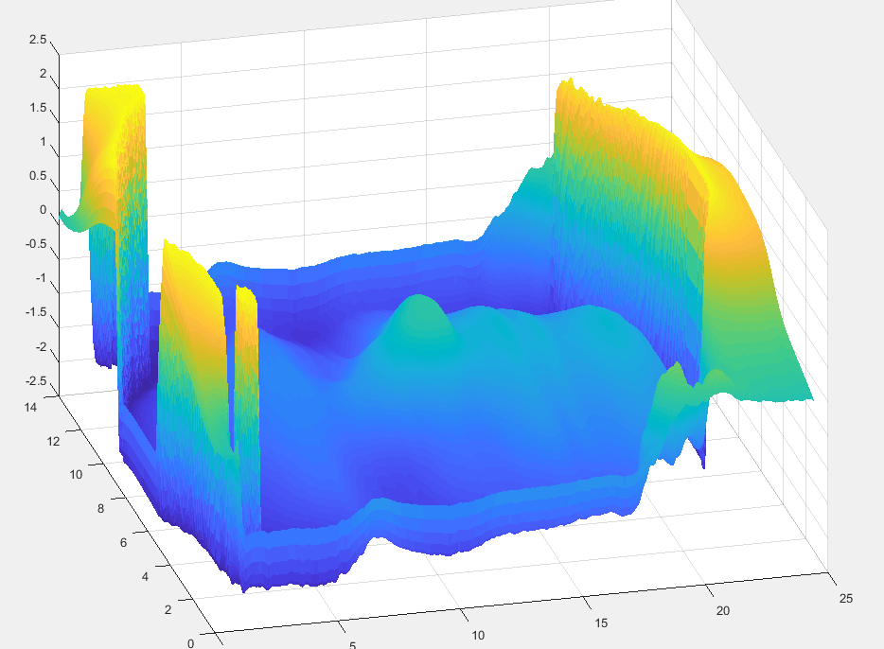
Final depth map 2

Slide 23
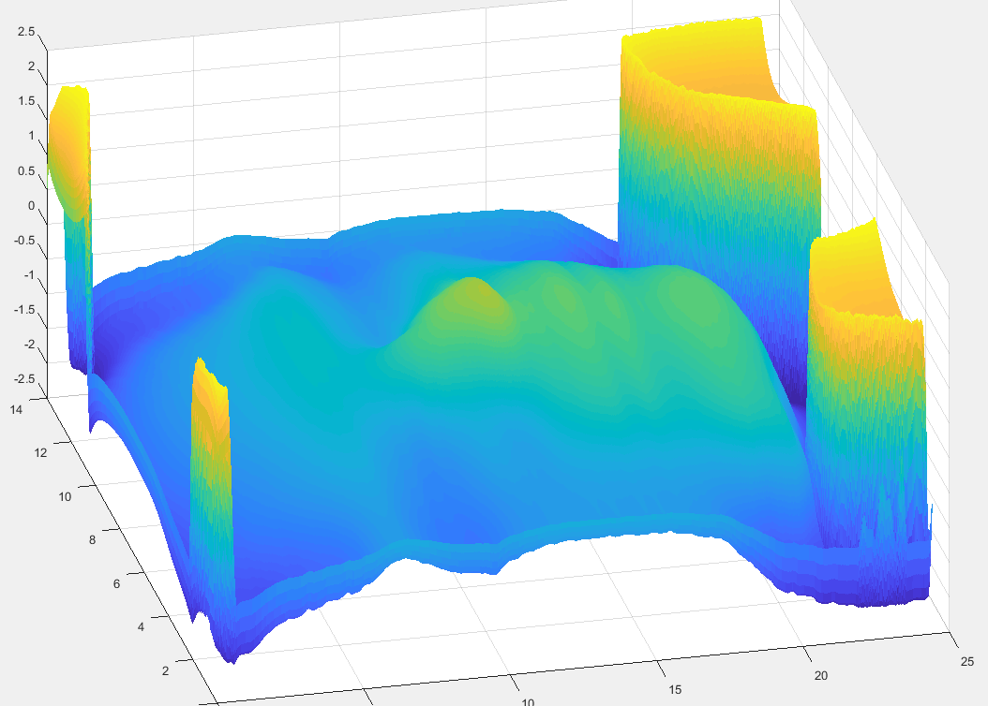
Final depth map 3

Slide 24
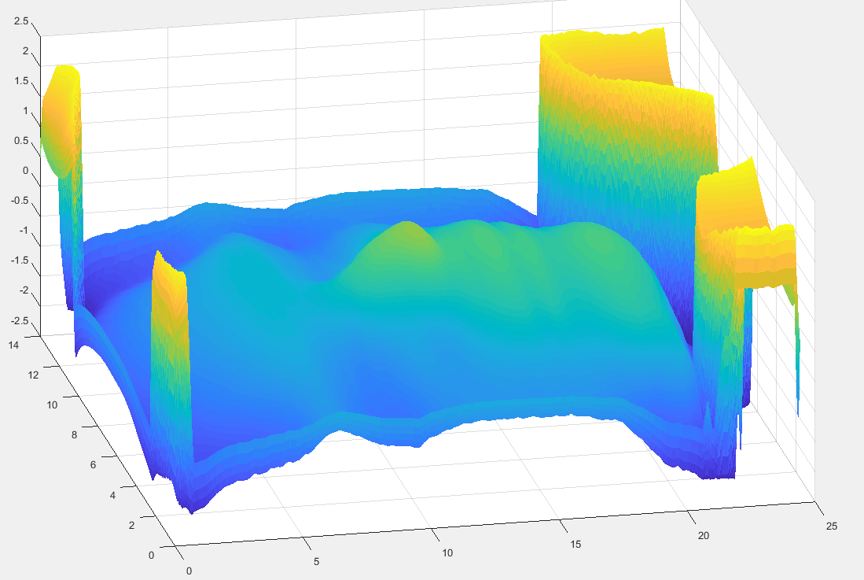
Final depth map 4

Slide 25
Discussion:
We were unable to reconstruct the object perfectly.
Sufficient data was not acquired, a higher frequency fringe could do a better job of estimation of height.
Heavy cropping was used to get rid of the spikes
Shadow due to projection angle was a major problem, It was not corrected.

