Slide 1
Sentiment Analysis of Text USING Long short term memory
Submitted By:
Alina Shrestha (15513/074)
Bipin Sunar (15524/074)
Ishan Maharjan (15527/074)
Under the supervision of
Mr. Ramesh chaudhary

Slide 2
Table of content
Introduction
Background study and literature review
System analysis
System design
Implementation and testing
Conclusion

Slide 3
Introduction
Sentiment Analysis is the study of people’s opinions, sentiments, attitudes, and emotions.
It specifies the polarity(positive, negative, and neutral) of the sentences.
Instead of spending time in reading and figuring out the positivity and negativity of text we can use automated techniques for sentiment analysis.
algorithm that can be used in classification of sentiment are: svm, random forest, knn and naïve bayes.

Slide 4
Problem statement
The main problem in sentiment analysis is classifying the polarity of a given text at the document.
Other challenges like:
difficult to classify irony and sarcasm.
Use of emoji needs a lot of preprocessing.
Hard to find the polarity with respect to contextual
In this project work , text sentiment is addressed by supervised lstm.
Example:
The movie was bad[ Negative ]
I am feeling happy[ Positive ]

Slide 5
Objectives
The main objective of the Sentiment Analysis System is:
1. To analyze the opinion of people on products and services.
2. To study the political views of people on current affairs.
3. To know the scope of the organization.

Slide 6
Development Methodology
AGILE methodology : Is a practice that promotes continuous iteration of development and testing throughout the software development lifecycle of the project.
Product is developed fast and frequently delivered (weeks rather than months.)
Even late changes in requirements are welcomed.
It continuously gave attention to technical excellence and good design.

Slide 7
Background study and literature review
The booming of mobile Internet and social media are growing fast in the technology industry worldwide With the availability of accessing the Internet, stories are shared, feelings are being expressed, everything in social media..
sentiment analysis has been a hot topic in this growing era of information.

Slide 8
Requirement analysis
Requirement analysis basically consists of two types:
Functional Requirement
Allow user to input the word/sentences.
Allow user to view the sentiment of entered word/sentences.
Non-Functional Requirement
Interface
Performance
Usability
Maintainability

Slide 9
Feasibility Analysis
Technical Feasibility
Operational Analysis
Economic Analysis
Schedule Analysis

Slide 10
System Analysis
System analysis is the process of observing the system for troubleshooting or development purpose.
It can be of types:
DFD (Data Flow Diagram)
Use Case Diagram

Slide 11
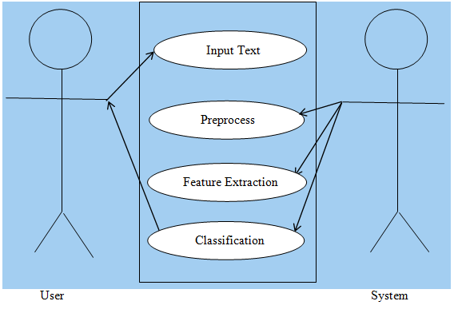
Use case diagram

Slide 12
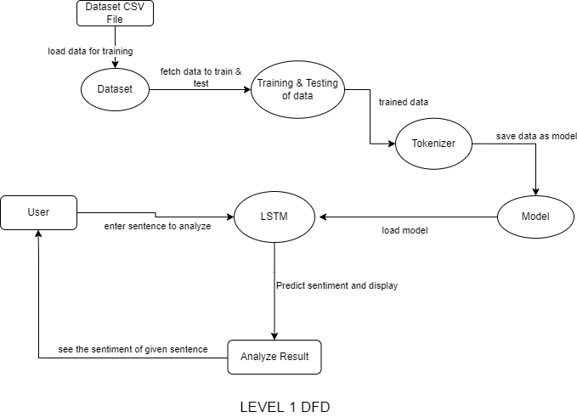
DFD LEVEL 1

Slide 13
System Design
Interface Design
Sequence Diagram
Input Output Design

Slide 14
FLOWCHART OF THE SYSTEM
Start
Input Data
Preprocessing
Feature Extraction
LSTM MODEL
Result Display
End

Slide 15
Algorithm Details
Long Short Term Memory algorithm:
LSTM networks are well-suited to classifying, processing and making predictions based on time series data, since there can be lags of unknown duration between important events in a time series.

Slide 16
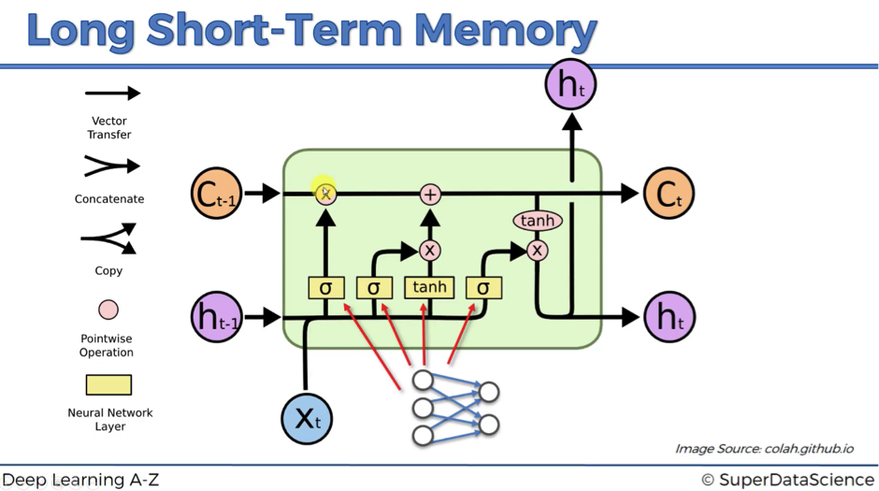
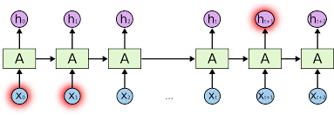

Slide 17
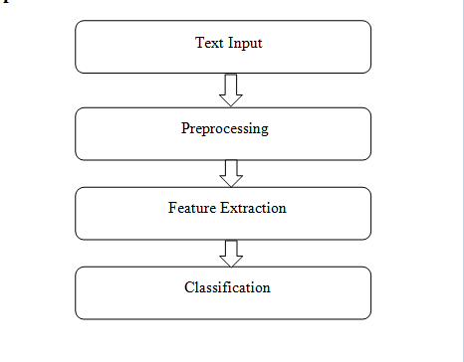
Implementation
Fig: Implementation model for Sentiment

Slide 18
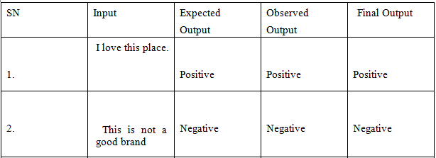
Testing
UNIT TESTING:

Slide 19



Result Analysis
There are 2 columns and 31973 rows in the dataset. The dataset is divided into 80% for training and 20% for testing
Precision:
Recall:
F-SCORE:

Slide 20
Conclusion
The system, Sentiment Analysis based on long short term memory (LSTM) Classification was able to provide 96.04%.
F- Score for 80/20 train-test split data set.
Using this sentiment analysis system, we can effectively evaluate people's opinion on products and political affairs and people's opinions can be extracted from this classification at some level.

Slide 21
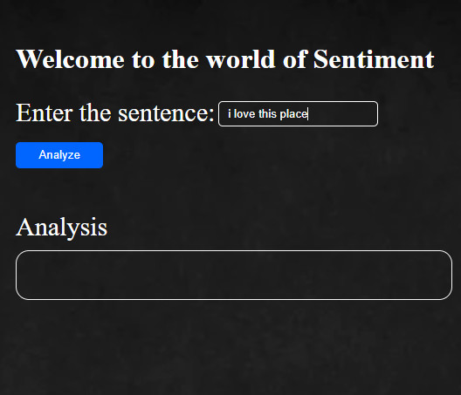
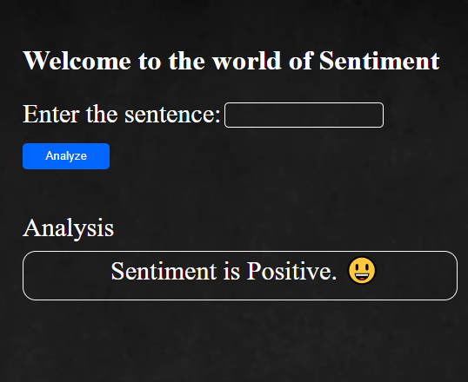
Outcome/ SYSTEM SNIPSHOTS

Slide 22
THANK YOU!

Slide 23
Any question??

