Slide 1

SMART VEhiCle service Maintenance crm
A Salesforce CRM implementation Project

Slide 2
Introduction
The Smart Vehicle Service & Maintenance CRM is a Salesforce-based CRM solution designed to optimize vehicle servicing operations. It connects Customers, Technicians, and Service Managers into one system to streamline service request handling, workload management, parts tracking, invoicing, and customer communication.
A Salesforce CRM implementation designed for the automobile service industry (B2C & B2B). This project digitizes service center operations by automating service requests, technician allocation, inventory tracking, preventive maintenance reminders, and customer communication.

Slide 3
USeCASES
Service Request Management:
->Customer books a service request (via form/portal).
->System auto-assigns a technician based on skills & workload. –
>Customer receives confirmation via email/SMS.
Vehicle History Tracking:
->Every service request is linked to the customer’s vehicle.
->System auto-updates Last Service Date.
->Service history visible to technicians & managers.
Technician & Workload Management:
->Service Manager assigns/auto-assigns jobs. -
>Technicians view assigned tasks on their LWC dashboard. ->Status updates: In Progress → Completed.

Slide 4
USECASES
Parts & Inventory Management: -
->Parts used during service are logged automatically.
->Inventory stock auto-reduces.
->Low stock alerts triggered if threshold is reached.
Preventive Maintenance Reminders:
->Monthly batch job sends preventive service reminders.
->Notifications via email/SMS.
Invoice & Payment Handling:
->Auto-generated invoice on service completion.
->Invoices > ₹10,000 require approval.
->Online payment supported via payment gateway integration.

Slide 5
USECASES
Customer Communication: -
->SMS/Email notifications at each stage: Booked, In Progress, Completed.
->Customers can track service status on portal (LWC).
Reporting & Dashboards:
->Service requests by type (regular, emergency, annual checkup).
->Technician productivity & workload distribution.
->Monthly revenue per service center. ->Inventory usage & trends.

Slide 6
Implementation
Custom Objects Created:
Vehicle__c → Stores customer vehicle details.
Service_Request__c → Tracks service bookings and status.
Technician__c → Holds technician details.
Parts_Inventory__c → Manages spare parts & stock.
Service_Parts_Used__c → Logs parts consumed during service.
Invoice__c → Handles billing and payments.
.Page Layouts & Fields Configured: Custom fields (Date, Lookup, Picklist, Currency, etc.) created for each object. Page layouts customized for Technician, Service Request, Vehicle, Parts Inventory, Invoice.

Slide 7
Implementation
Profiles Created:
Service Manager Profile → Read/Write on all service-related objects.
Technician Profile → Read/Write only on assigned requests, update status & parts used.
Customer Service Agent (CSA) Profile → Can create service requests, view status, and manage customer communication
Roles Created:
Service Manager
Technician (reports to Service Manager)
Customer Service Agent (reports to Service Manager)

Slide 8
IMPLEMENTATION
Users Configured:
Service Manager → Role: Service Manager Profile: Service Manager Profile
Technician → Role: Technician Profile: Technician Profile
Customer Service Agent (CSA) → Role: Customer Service Agent Profile: CSA Profile (cloned under Platform User license)
Sharing Rules & Security:
Org-Wide Defaults (OWD): Vehicle, Service Request,
Invoice → Private Parts Inventory → Public
Read Only Sharing Rule: Service Manager-owned
Service Requests → Shared with Technicians (Read/Write)

Slide 9
IMPLEMENTATION
Validation Rules:
->Vehicle Must Be Linked to Service Request Object
Service_Request__c :
Validation Rule: ISBLANK(Vehicle__c)
Error Message: Vehicle must be selected for a service request
->Invoice Amount Must Be Greater Than Zero Object:
Invoice__c Validation Rule: Amount__c <= 0
Error Message: Invoice amount must be greater than zero

Slide 10
IMPLEMENTATION
5.1 Record-Triggered Flows
1. Auto-Assign Technician
o Object: Service_Request__c
o Trigger: Record created, Technician__c is null
o Get Records: Technician__c where Availability__c = 'Available'
o Update Record: Assign the first available technician to the service request
o Optional: Email alert sent to customer
2. Service Request Status Change Notification
o Object: Service_Request__c
o Trigger: Record updated, Status__c changes
o Action: Send email alert to the customer
3. Service Request Confirmation
o Object: Service_Request__c
o Trigger: Record created
o Action: Send email confirmation to customer

Slide 11
implementation
5.2 Scheduled Flows
Preventive Maintenance Reminder
o Object: Service_Request__c
o Schedule: Monthly (using record filter conditions)
o Action: Send email to customers reminding them of preventive maintenance
Low Inventory Stock Alert
o Object: Parts_Inventory__c
o Trigger Condition: Stock < Reorder Level
o Action: Email alert to inventory manager

Slide 12
IMPLEMENTATION
Email Alerts
All email notifications are sent using Email Alerts linked to Flows or Approval Processes:
Service_Request_Confirmation – Confirmation email on new service request.
Service_Request_Status_Change – Customer notified of status change.
Invoice Approval Request – Service Manager notified of invoices > ₹10,000.
Preventive Maintenance Reminder Alert – Monthly preventive maintenance reminders.
Low Inventory Stock Alerts – Notify inventory manager if stock falls below reorder level.

Slide 13
IMPLEmentation
Approval Process (Invoices > ₹10,000):
Object: Invoice__c
Approval Process Name: Invoice_Approval_Process
Entry Criteria: Amount__c > 10000
Approver: Role → Service Manager
Approval Steps:
Initial Submission → Service Manager approval Approved → Status = Approved
Rejected → Status = Draft Process Activation: Activated

Slide 14
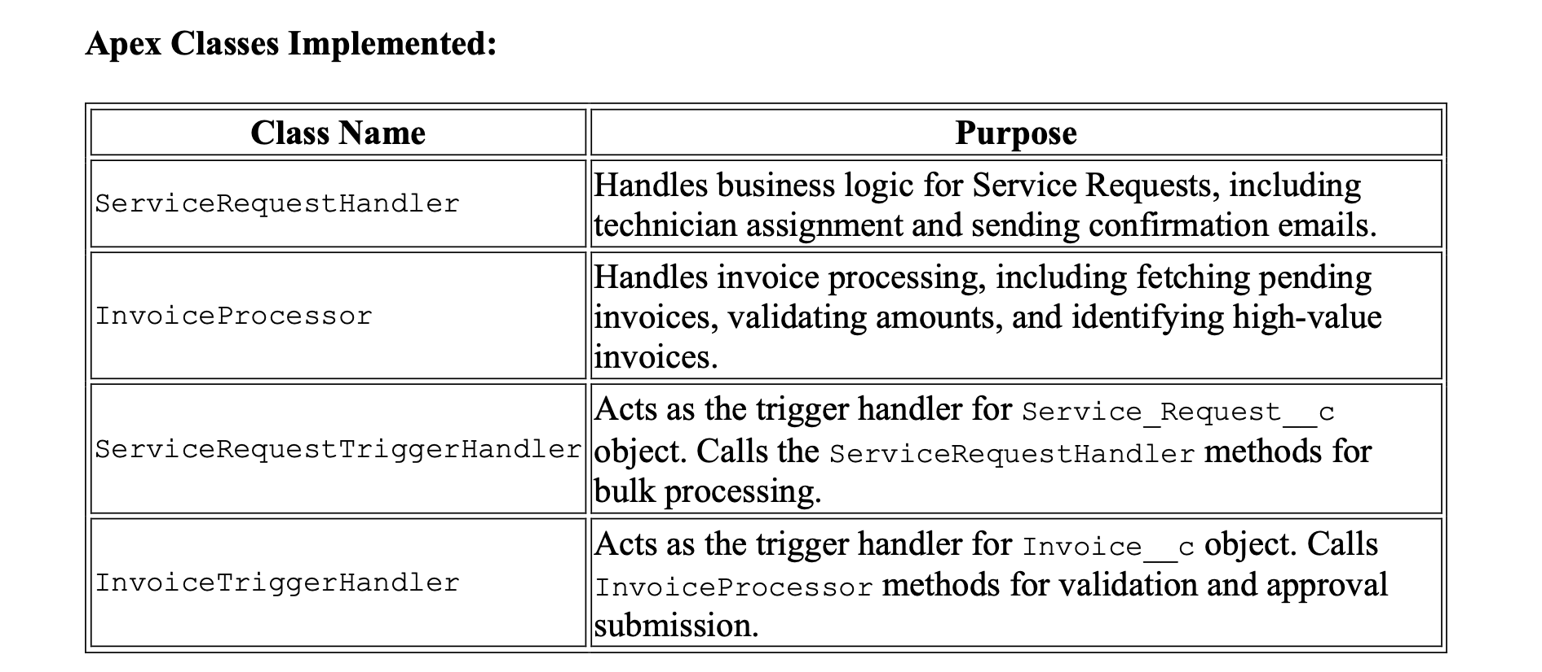
implementation

Slide 15
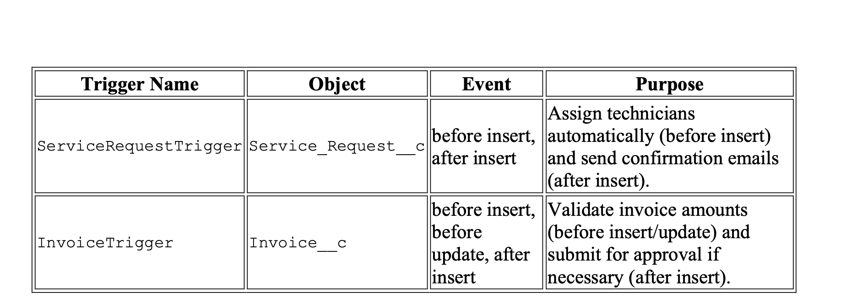
implementation

Slide 16
IMPLEMENTATION
.Metadata Retrieved & Source Control: Retrieved objects, profiles, layouts, and sharing rules into VS Code using Salesforce CLI. Cleaned metadata to keep only relevant project components. Integrated with GitHub for version control and submission.

