Slide 1
Primo
Project By:
Arjun Dahal (071/BEX/405)
Biplab Gautam(071/BEX/411)
Bishal Khanal (071/BEX/412)

Slide 2
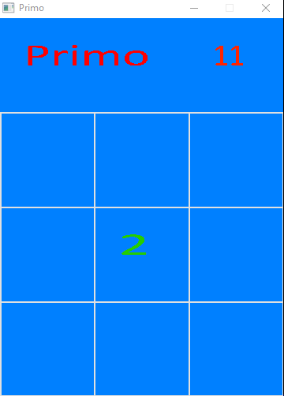
Introduction
Primo is a prime-version adaptation of the famous game 2048.
Objective of each level is to obtain a prime number corresponding to that level.
Game starts from Level 11 and proceeds to successive primes.

Slide 3
How the Game is played?
Cursor Keys are used to add the numbers in respective directions, as per the addition rule of the game.
Addition Rule:
Friendly numbers (1 and 2) add to any number.
Composites can add up among themselves.
Primes add only to form another prime.

Slide 4
How the Game is played?
III. Random Number Generation
Random number (from 1 to 5) pops out from random empty boxes in the board.
RandomGenerator() function is used for the purpose.

Slide 5
Features of Object Oriented Programming Used in the game: Classes
Class NumberObjects
Nine objects in 2-D array form are declared.
Each object consists of integer member data, which holds the value of number of each box.
Computation part is primarily done in this class.
Class MainTexture
This class is primarily for graphics related activities.
-Displays the number values of each boxes.
-Draws the game board in the SDL windows.
One object of this class is declared.

Slide 6
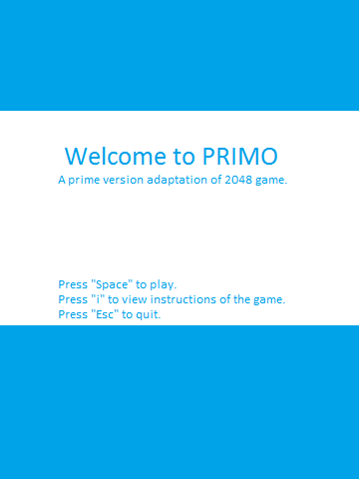
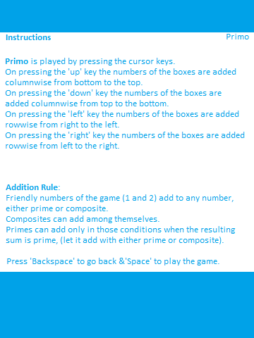
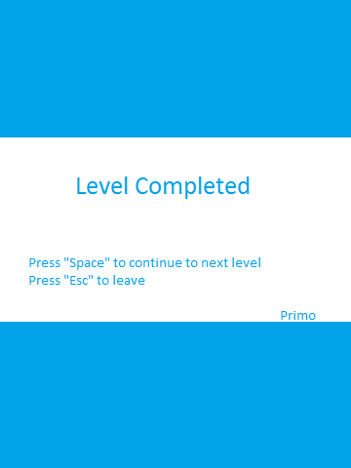
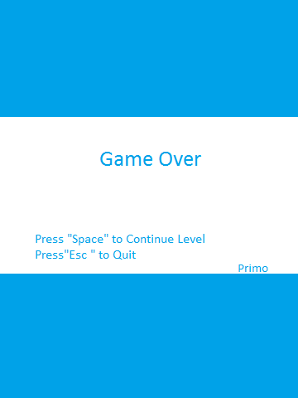
Features of Object Oriented Programming Used in the game: Classes
Class LoadingImages
Used to display the initial welcome window, instructions window, level completion window and game over window.
Four Objects of this class are declared for each type of window.

Slide 7
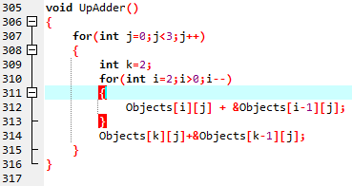
Features of Object Oriented Programming Used in the game: Operator Overloading
+ operator is overloaded in the programme as per the addition rule.
The game logic implementation has become easier with the use of this polymorphism feature.

Slide 8
Features of Object Oriented Programming Used in the game: Friend Function
Class NumberObjects declares following functions as friend:
i. NewLevel()
ii. CheckLevel()
iii. RandomGenerator()
This has allowed the functions to access the private data member of the class NumberObjects.

Slide 9
Global Functions used
Initialiser – It initialises the SDL subsystem, SDL window, TTF and IMG subsystems
Closer – Called at the end of the program to shut down subsystems.
CheckPrime – Checks whether the number is prime or not
CheckLevel – Checks whether the level is completed or not
NewLevel – Initialises all variable to zero at the start of new level
DownAdder, UpAdder, LeftAdder, RightAdder – Adds as per the game rule called by cursor key presses
RandomGenerator– Generates random number at random places

Slide 10
Graphics
SDL(Simple Directmedia Layer) library functions are used for displaying graphics part of the game.
Header Files used from SDL that we have used are:
SDL.h
SDL_image.h
SDL_ttf.h

Slide 11
Primo
Thanks for watching Primo Team

