Slide 1



Welcome to Presentation on
Dengue Disease Prediction using Random Forest Algorithm

Slide 2
Supervisor
Dr. Ahsan Habib
Associate Professor,
Institute of Information and Communication Technology
Shahjalal University of Science and Technology, Sylhet
Project Manager
Khaled Salah Uddin, Project Manager, DataSoft System Bangladesh Ltd.

Slide 3
Submitted By
Poritosh Modak (2022822023) -Team Leader
Roushni Rafa Majumder (2022822033) - BA (Business Analyst)
Bipro Bhowmik (2022822025) - Coder/Programmer
Mahbub Hussain (2022822029) - Coder/Programmer
Md. Nafiul Hasan Chowdhury (2022822007) - QA (Quality Assurance)
Afruja Akter Rumpa (2022822012) - BA (Business Analyst)

Slide 4
Table of Contents
Title: Page No.
Introduction………………………………………………………………............5-7
Industrial Attachment…………………………………………………………..8
Concept of ML using Random Forest……………………………………9
Methodology & Exploratory Data Analysis………………………….10-13
Feature Selection………………………………………………………………..14
Count of Dengue positive cases in the dataset…………………..15-16
Age variation of Dengue cases…………………………………………….17
Frequency of symptoms of Dengue patients……………………….18
Occurrence of symptom frequency per day…………………………19
Evaluation metrics………………………………………………………………..20
Decision Making…………………………………………………………….........21
Why Random Forest Classifier?....................................................22
Model implementation and UI interaction………………………......23-27
Limitations………………………………………………………………………..….28
Conclusion……………………………………………………………………………29-31

Slide 5
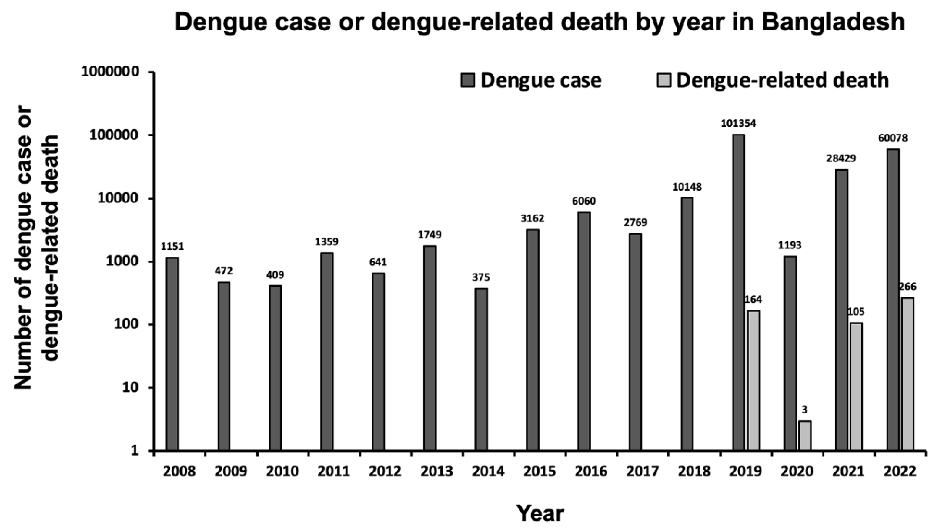
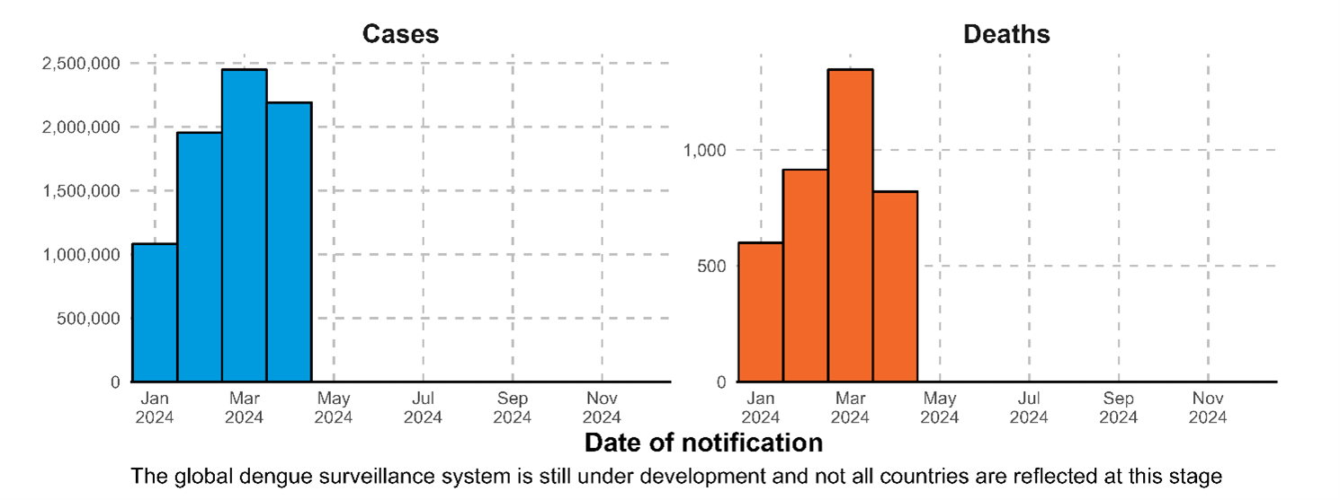
Introduction
Global and Local Impact:
Dengue fever is a growing health concern, especially in tropical regions. Recent data from Brazil and Bangladesh show alarming increases in cases and fatalities, particularly during rainy seasons when mosquito populations surge.

Slide 6
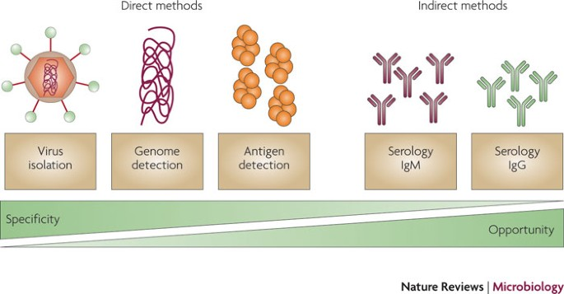
Introduction (Continue...)
Diagnostic Challenge:
Symptoms of dengue often overlap with other illnesses, leading to misdiagnoses. Standard lab tests like NS1 antigen can be inconclusive, especially in atypical cases. This delay in accurate diagnosis can worsen patient outcomes.

Slide 7
Introduction
Objective of Our Project:
We aim to address this diagnostic gap by developing a machine learning model that predicts dengue from symptoms, supporting early and accurate diagnosis even when lab results are unavailable.
Project Motivation and Scope:
Main Goal: To create an accessible, accurate dengue prediction model using the Random Forest algorithm. This tool is designed to be especially useful in low-resource areas where lab tests are limited.
Why This Matters: Early detection can improve patient care, reduce hospital burden, and help control outbreaks. An accurate model can help prioritize at-risk cases, allowing for proactive treatment.
Scope of Data: We used a dataset from Brazilian health reports, covering thousands of cases and various symptoms to build a robust model that can distinguish between dengue-positive and negative cases.

Slide 8
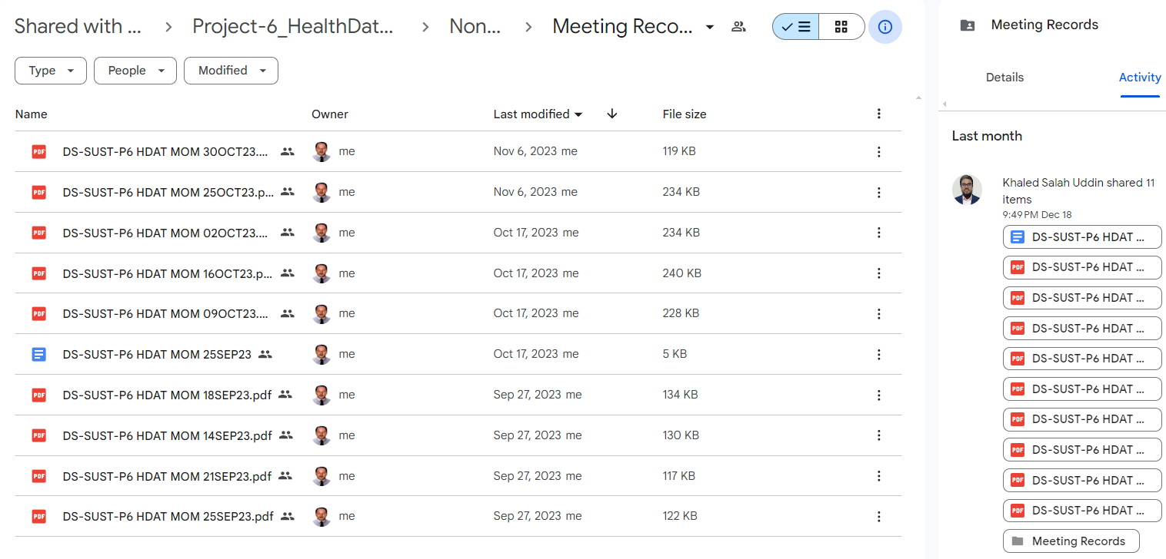
Industrial Attachment
SUST & Data Soft, work together as a joint venture to distribute the Project tasks.
We, the Team P-6 were assigned to Health data based Machine Learning project work.
Team P-6 step in and Decided to develop a generic machine learning tool for predicting diseases.
With the collaboration of Data Soft, finally the application developed and then back to supervisor.
There were Bi-weekly, Weekly Meeting with Data soft PM.
Conducting meeting, prepared meeting, distributed tasks among team members and so on.

Slide 9
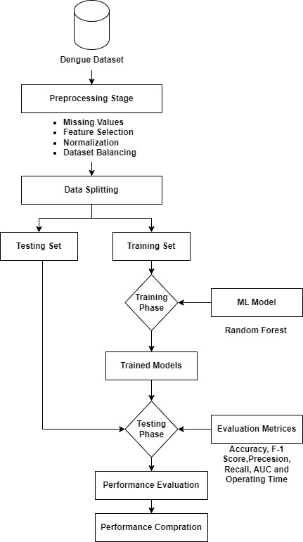
Concept of ML using Random Forest

Slide 10
Methodology & Exploratory Data Analysis (Continue...)
The project consists of 5 phases:
i) Data Preparation
ii) Exploratory Data Analysis
iii) Decision Making
iv) Evaluation metrics
v) Model implementation & UI interaction.

Slide 11
Methodology & Exploratory Data Analysis (Continue...)
Data Preparation
The dataset we have used consists of confirmed Dengue patients in the state of Amazonas and the city of Recife, Pernambuco from the year 2015 to 2020.
The data was retrieved from the SINAN.
SINAN is the official system for disease reporting in Brazil.
The dataset was prepared following all the ethical guidelines.

Slide 12
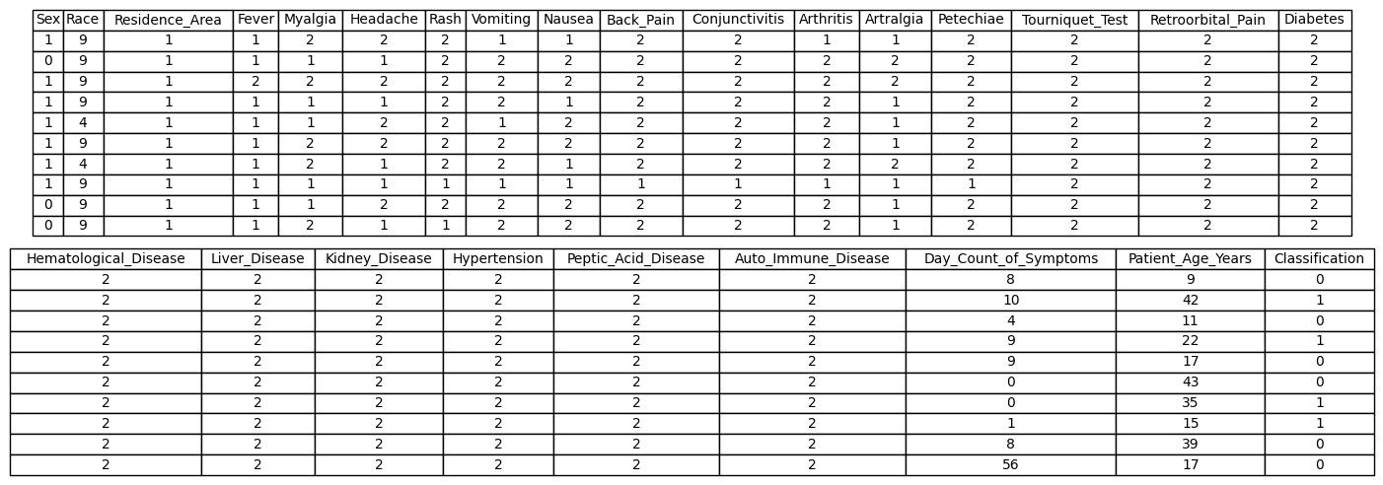
Methodology & Exploratory Data Analysis (Continue...)
Data Preparation
The dataset we have used consists of confirmed Dengue patients in the state of Amazonas and the city of Recife, Pernambuco from the year 2015 to 2020.
The data was retrieved from the SINAN.
SINAN is the official system for disease reporting in Brazil.
The dataset was prepared following all the ethical guidelines.

Slide 13
Methodology & Exploratory Data Analysis
Data processing steps
Removal of Irrelevant Features
Data Wrangling
Handling Missing Data
Label Encoding of the features
Feature Selection

Slide 14
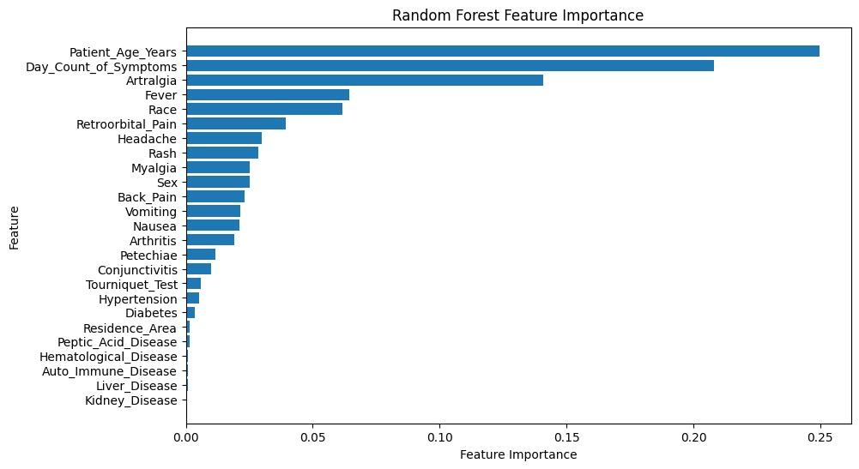
Feature Selection

Slide 15
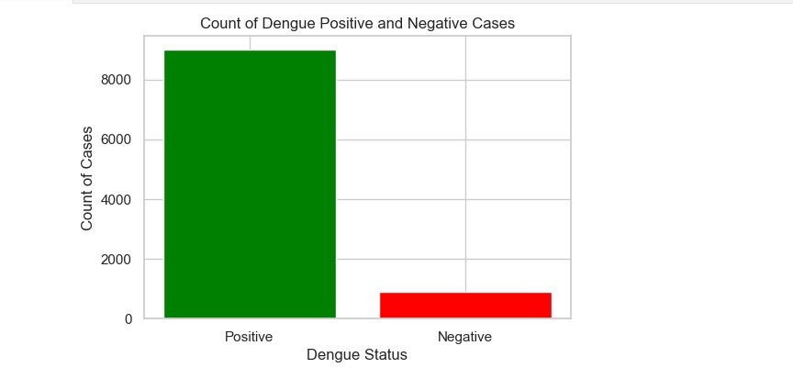
Count of Dengue Positive Cases in the Datase (Continue...)

Slide 16
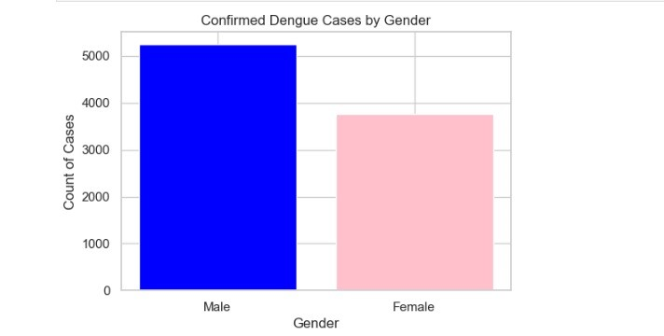
Count of Dengue Positive Cases in the Dataset

Slide 17
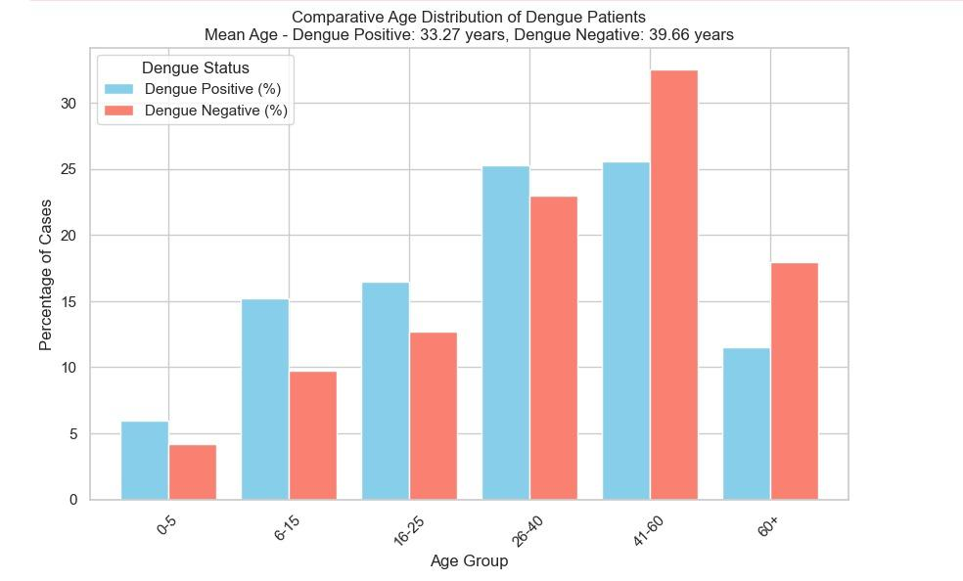
Age Variation of Dengue Cases

Slide 18
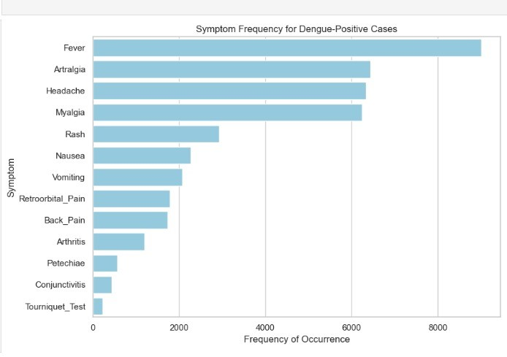
Frequency of Symptoms of Dengue Patients

Slide 19
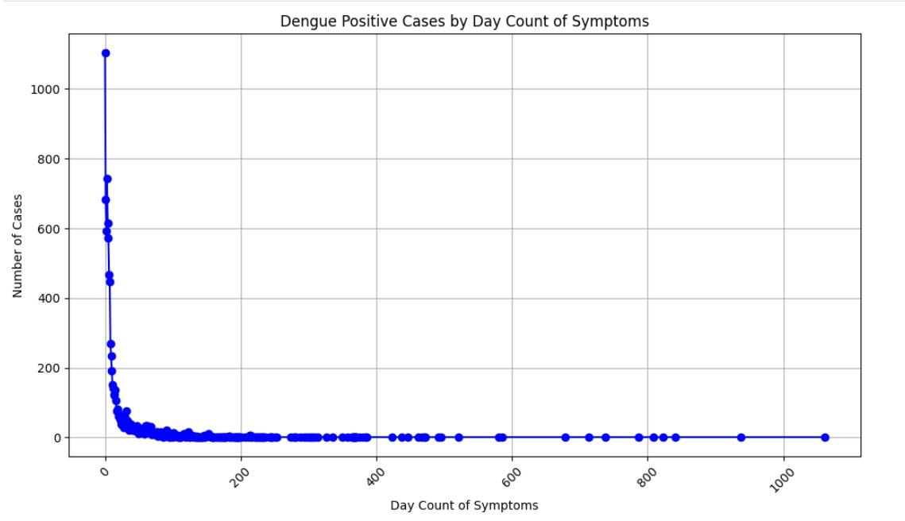
Occurrence of Symptom Frequency Per Day

Slide 20
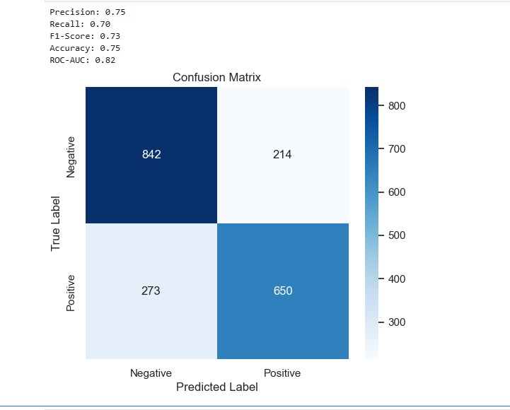
Evaluation Metrics
True Negative (TN): 842
False Positive (FP): 214
False Negative (FN): 273
True Positive (TP): 650

Slide 21
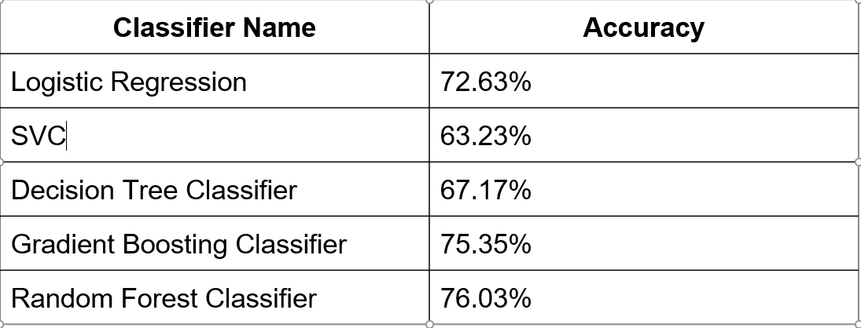
Decision Making

Slide 22
Why Random Forest Classifier?
High Accuracy: Random Forest lessens the variation associated with individual trees, resulting in predictions that are more accurate
Robustness to noise: As Random Forest combines the forecasts of several decision trees, it is resilient to noisy data.
Estimating Feature Importance: Features are considered more significant when they regularly result in a larger reduction of impurities or variance. This data can direct feature selection or dimensionality reduction efforts and aid in determining which characteristics are most relevant for prediction.
Missing Data and Outliers Handling: Random Forest does not require the use of data preprocessing methods like imputation or outlier removal in order to handle missing data and outliers. Every decision tree is trained using a random subset of the input, and the technique naturally handles missing values.
Handles Both Numerical and Categorical Data: Random Forest is capable of handling both types of data without bias since it automatically chooses random subsets of features for each decision tree during training.

Slide 23
Model Implementation and UI Interaction (Continue...)
Step 1: Model Training and Saving
Import the dataset
Preprocess the dataset:
Data cleaning
Label encoding
Feature selection
Missing Value Handling
Unnecessary value removing
Split dataset: 90% for training, 10% for testing
Fit the model to the Random Forest algorithm
Train and check accuracy
Export the trained model and save as a .pickle file

Slide 24
Model Implementation and UI Interaction (Continue...)
Step 2: API Backend Method Setup (Using Django)
Import libraries: json, joblib, JsonResponse, pandas etc.
Load pre-trained model
Receive data
Data convert to DataFrame
Predict
Return JSON response

Slide 25
Model Implementation and UI Interaction (Continue...)
Step 3: Frontend Prediction Interface Setup (Using VueJS)
Provide environment to get user input
Sends user input data
Receive response
Show Result

Slide 26
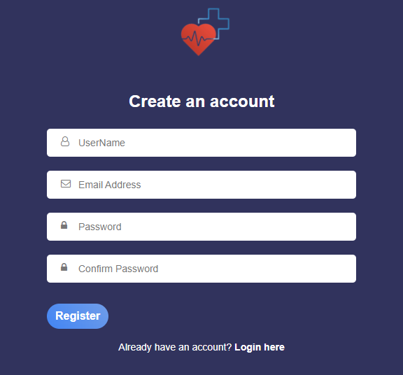

Model Implementation and UI Interaction (Continue...)
Interface Screenshots
Authentication

Slide 27
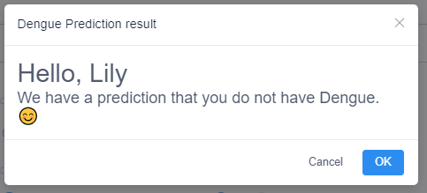
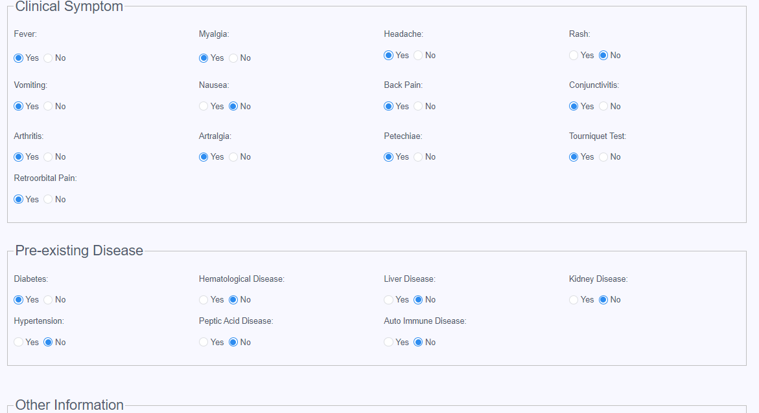
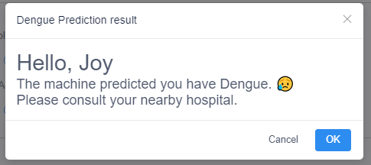
Model Implementation and UI Interaction
Interface Screenshots
2. Prediction

Slide 28
Limitations
While the model performed well, we noticed some areas that need improvement.
For example, it missed around 30% of actual cases (false negatives), which could be significant in a real-world health setting.
Also, it would be helpful to include more patient data and environmental factors, as dengue prediction might improve with factors like seasonality or climate data.

Slide 29
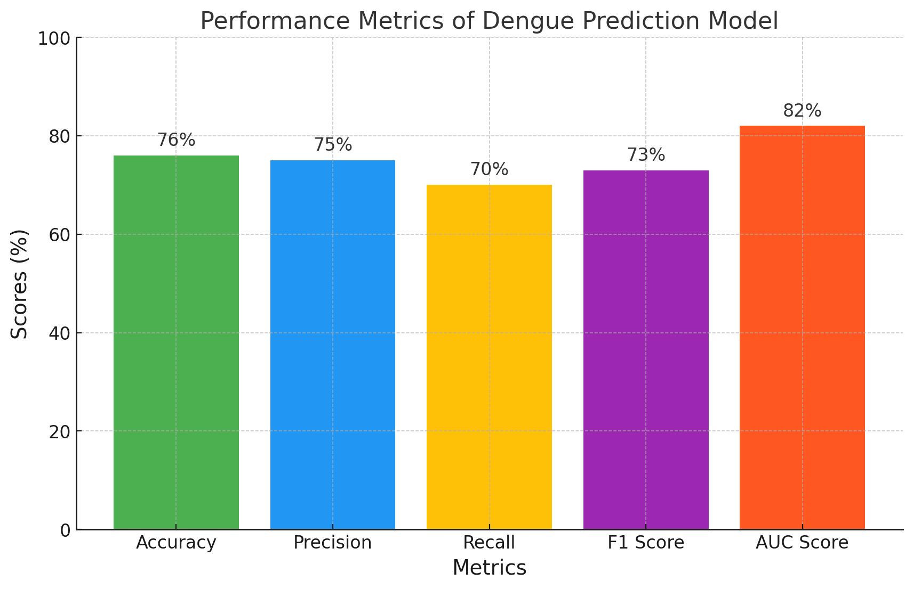
Conclusion (Continue...)
Overview:
The project utilized machine learning to address the challenge
of early dengue fever diagnosis.
Model Performance:
By implementing the Random Forest
algorithm, we achieved:
Accuracy: 76%
Precision: 75%
Recall: 70%
F1 Score: 73%
AUC Score: 82%

Slide 30
Conclusion (Continue...)
Reliability:
The model demonstrated strong reliability in distinguishing between dengue and non-dengue cases, even with complex datasets.
Data Processing:
Extensive data preprocessing and feature selection ensured robust predictions, resulting in a user-friendly tool for early diagnosis.
Practical Impact:
The software provides healthcare providers with a rapid way to assess symptoms, potentially enabling timely interventions and saving lives in high-risk regions.

Slide 31
Conclusion
Future Enhancements:
Incorporate additional laboratory data to boost accuracy.
Explore more advanced algorithms for better predictions.
Integrate IoT technology for real-time data collection and scalability.
Finally, This project underscores the impact of technology in healthcare by providing a scalable, efficient solution for proactive dengue management.

