Slide 1
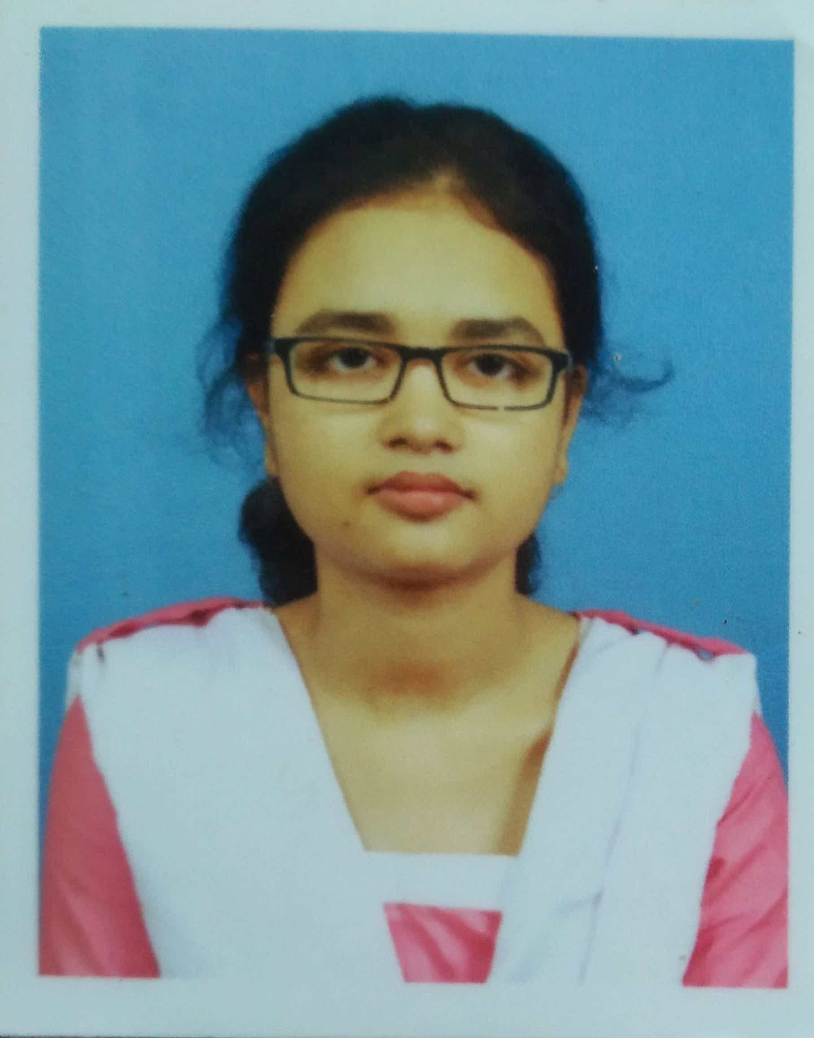




Bipsa Debnath
Analyst/Software Engineer
Bachelor of Technology
Computer Science : 2018 - 2022
Skills
Java 8 /J2EE | Java Basics, OOPS, Generics, Collections, Arrays, Loops, Lambda Exp,
Spring core | IOC & Dependency Injection, Autowire
Spring REST | REST controllers, Implementation of GET, POST, PUT & DELETE, Bean Validation & Exception Handling, Testing Services, Controller & Repository layer
Spring Data JPA And Micro Service | Implement DAO layer using spring Data repositories, Transaction Management Spring Boot Starters, annotations,
Machine Learning | Supervised, Unsupervised Learning , Kmeans, Decision tree, Knn, Random Forest
Database | PostgreSql, mySql, mongo db
UI Tech | HTML 5 & CSS 3, javascript Reusable templates, Optimized UI Designed
Add On skills | Communications, Team management. Peer learning
Mumbai
bipsa.debnath@capgemini.com
+91 8777329087
A4
Currently working in a shadow project under MarkComm team ( Marketing & Communication )interested in business challenges and communication
Amazon Web Services , Object oriented programing, . Core java , Data Science
AWS certified cloud practitioner ,CAF certified have knowledge in cloud model , EC2 instances, storage services
Practical understanding of oops concept ,java concept, some of data science part as in Machine Learning concepts, such like Supervised , unsupervised learning algorithms.
Java Microservice Development knowledge using Spring boot and spring cloud framework on beginner level.
Implemented Nodejs, postgresql in case study and upskilling his knowledge continuously.
Chemical Element Recognition By Hand Drawn Chemical image
model to recognize organic compound by checking hand drawn chemical reaction , SSD (Single Shot Multibox) with Mobilenet Model is used here , which is a Convolutional Neural Network which is trained to predict bounding box locations and classify
Online Shopping Cart System
Completed end to end case study of Online Shopping Cart Application along with JWT authentication with payment process
. Python for Data Science , AI & development at coursera by IBM (completed this course with 98.6%)
Linkedin www.linkedin.com/in/bipsa-d-1b9362170
GitHub https://github.com/Bipsa234/Online-Shopping-Cart

