Slide 1
DISPLAY DEVICES
Prepared BY
Dharti Raj Shah
Lecturer, IOE, T.U. Dharan
Dept. of Electronics & Computer Engineering

Slide 2
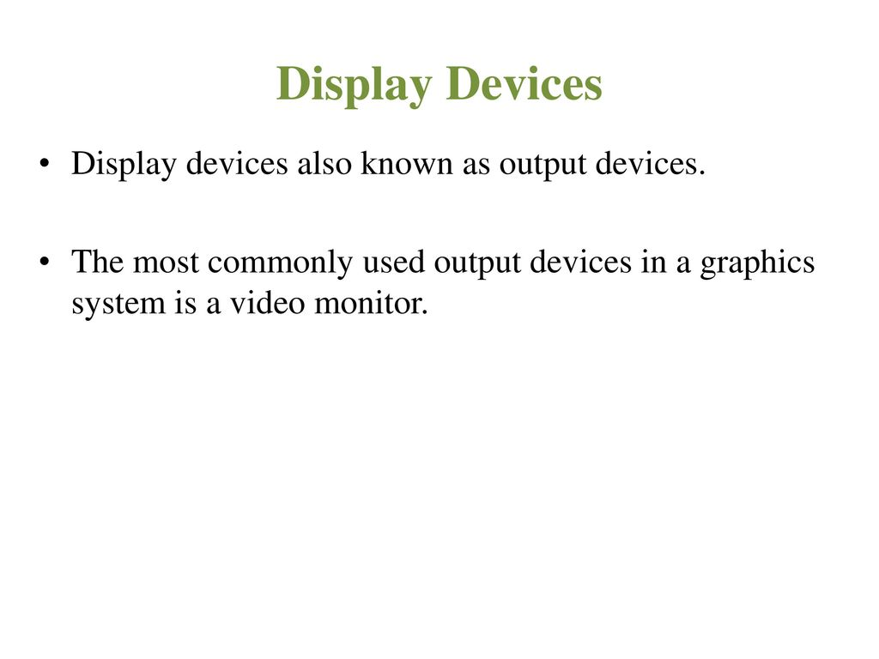

Slide 3
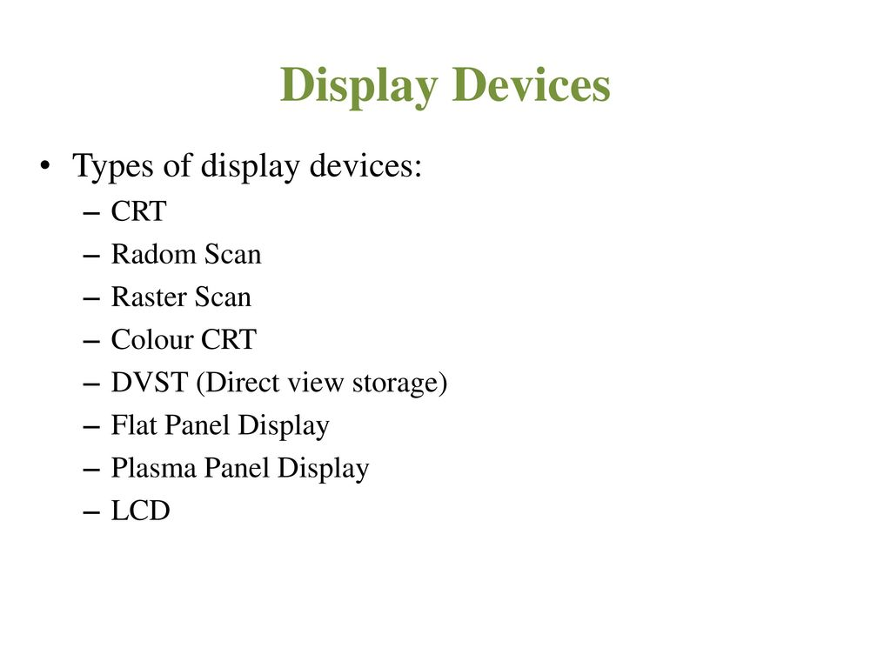

Slide 4
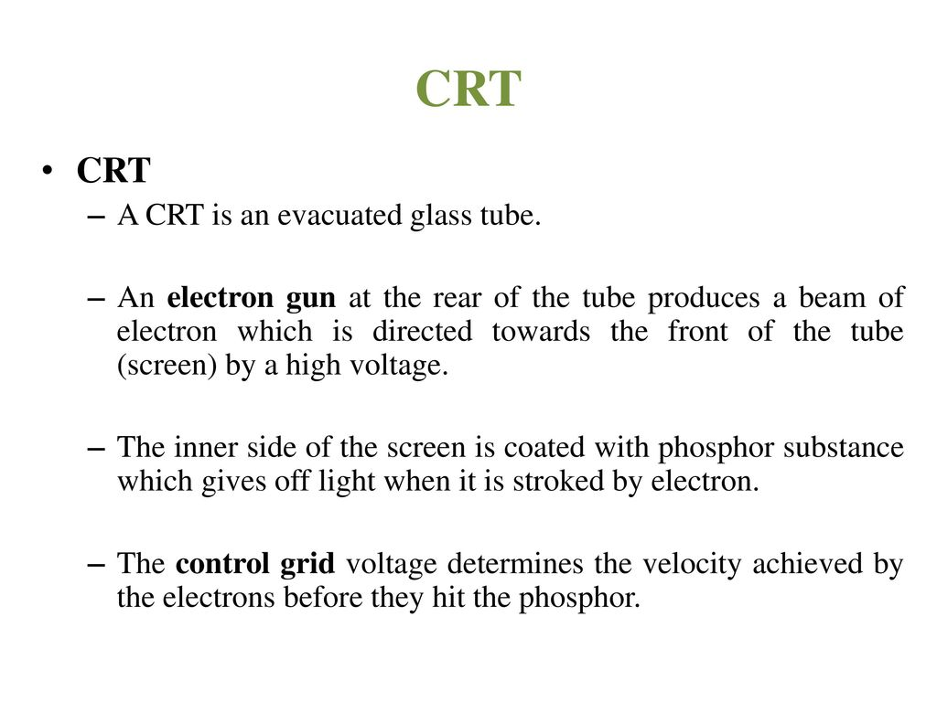

Slide 5
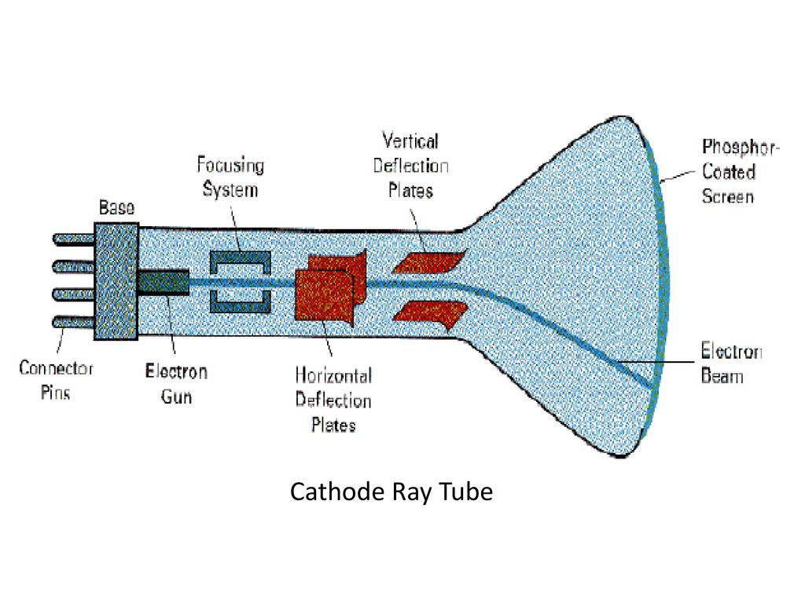

Slide 6
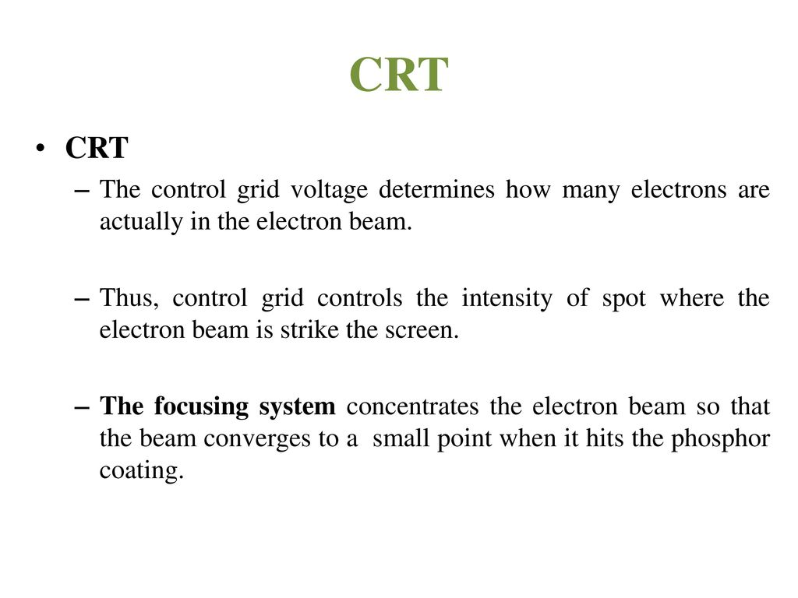

Slide 7
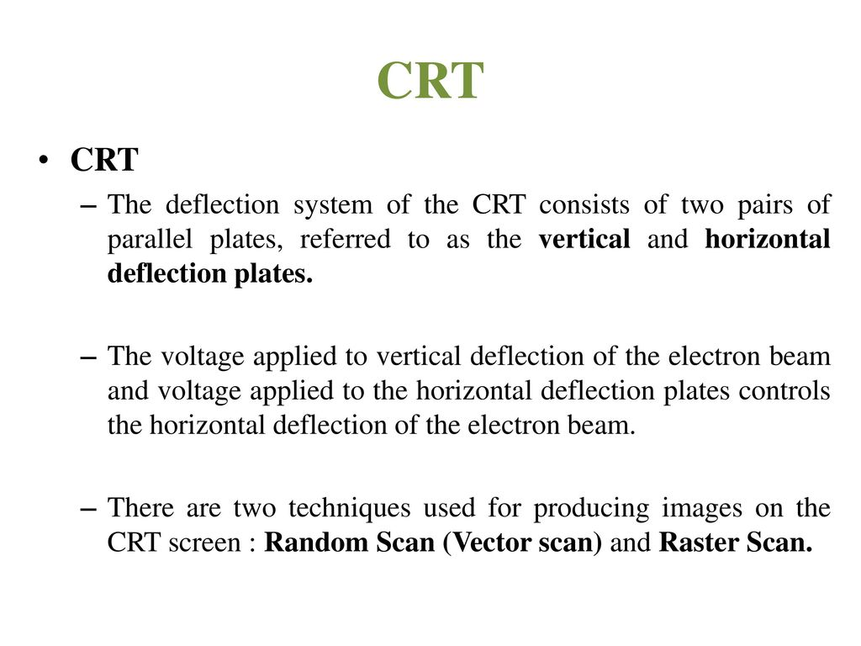

Slide 8
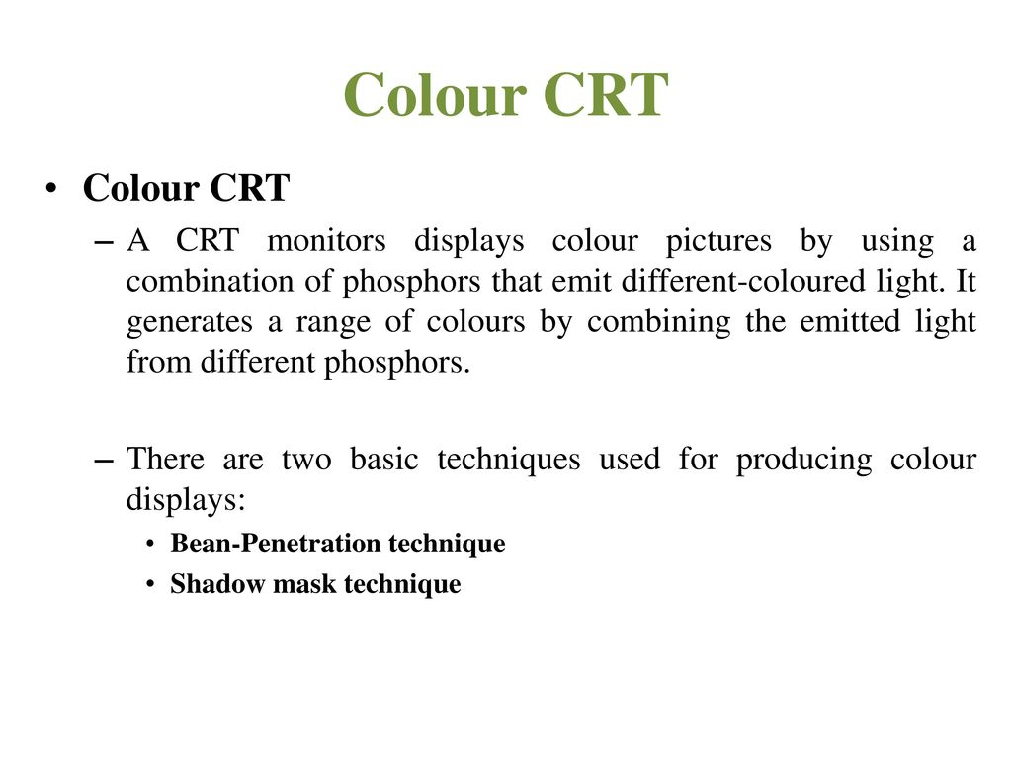

Slide 9
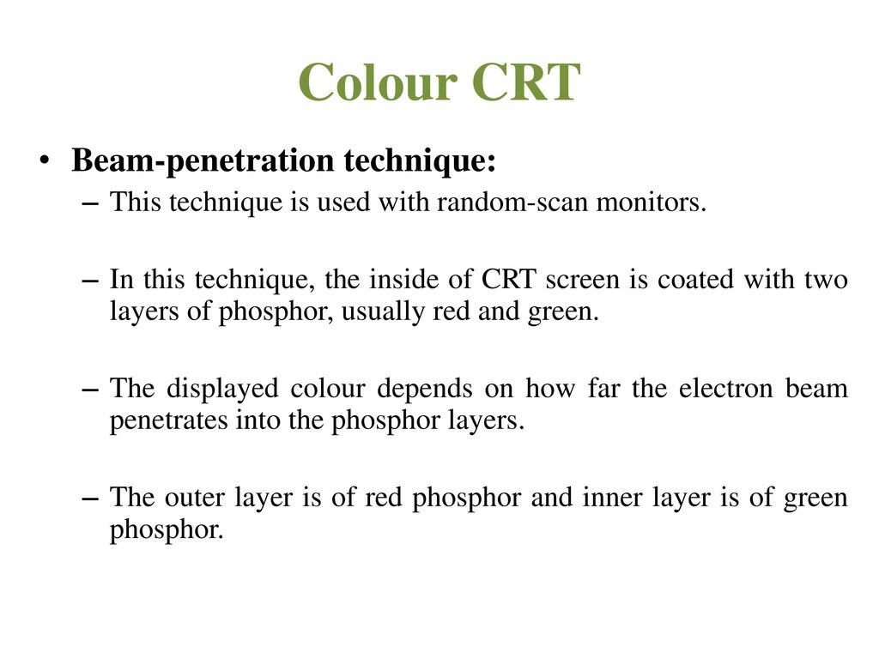

Slide 10
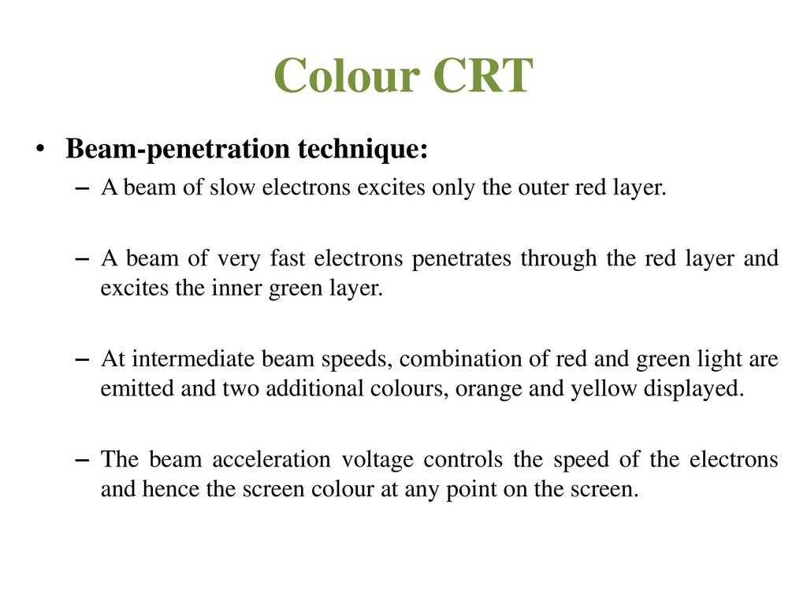

Slide 11
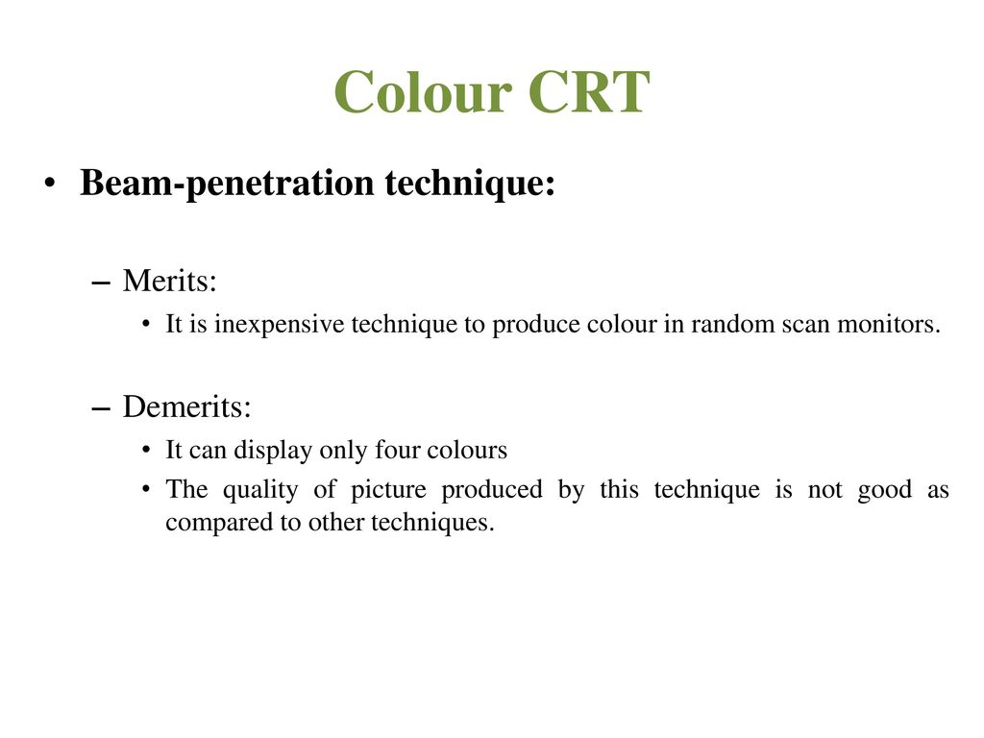

Slide 12
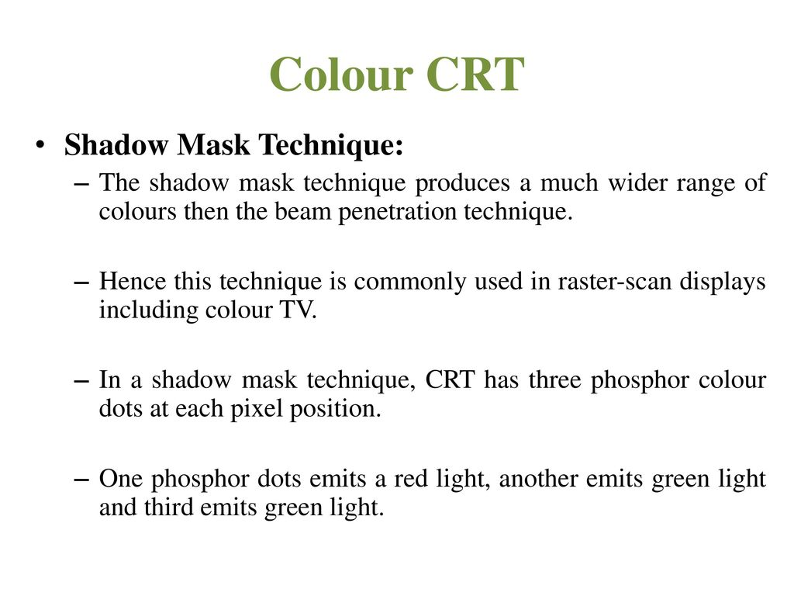

Slide 13
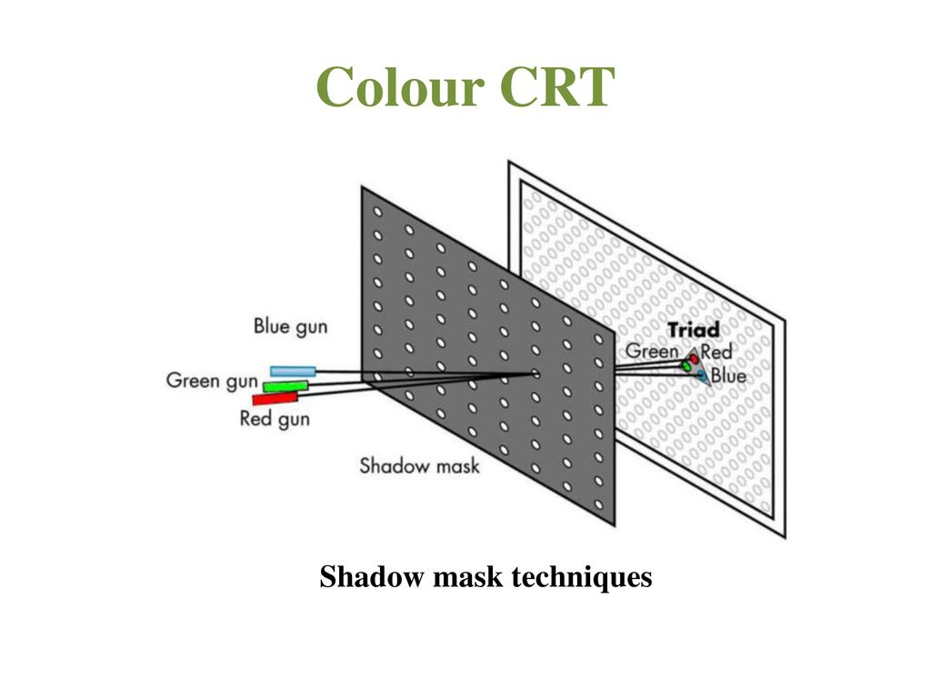

Slide 14
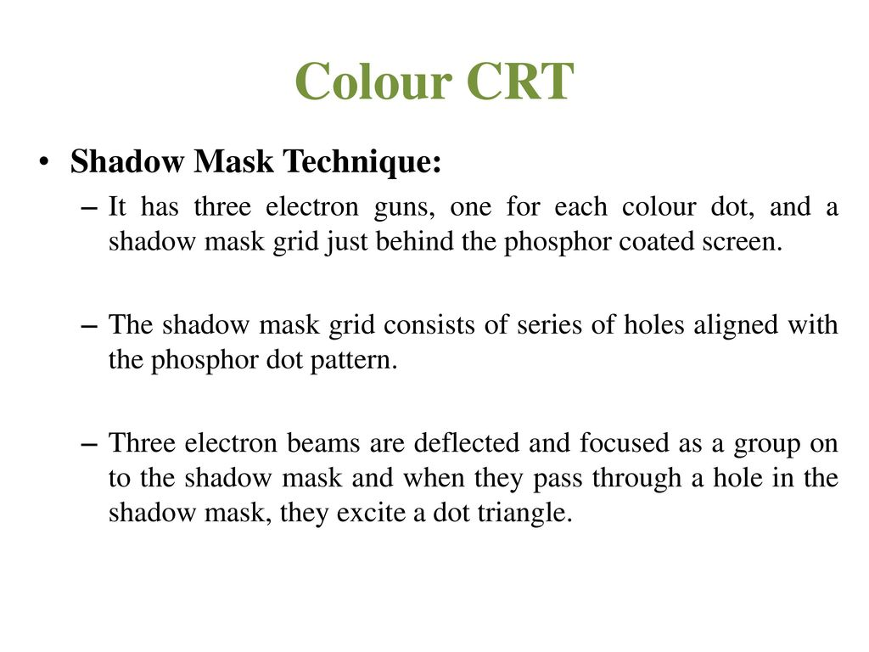

Slide 15
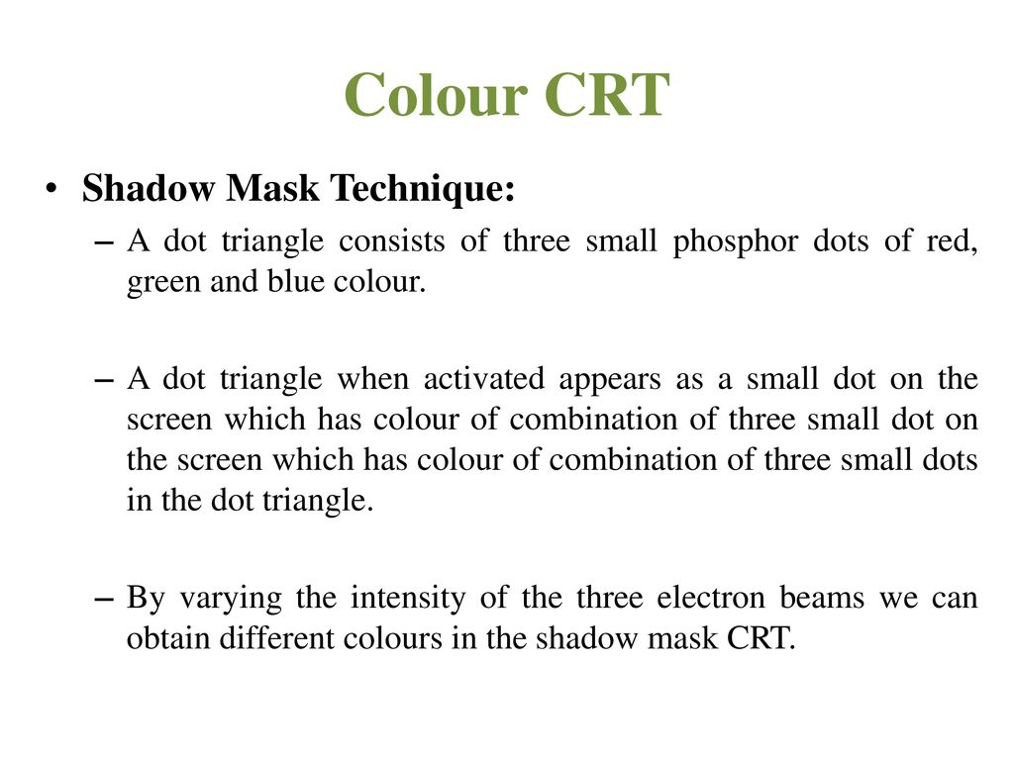

Slide 16
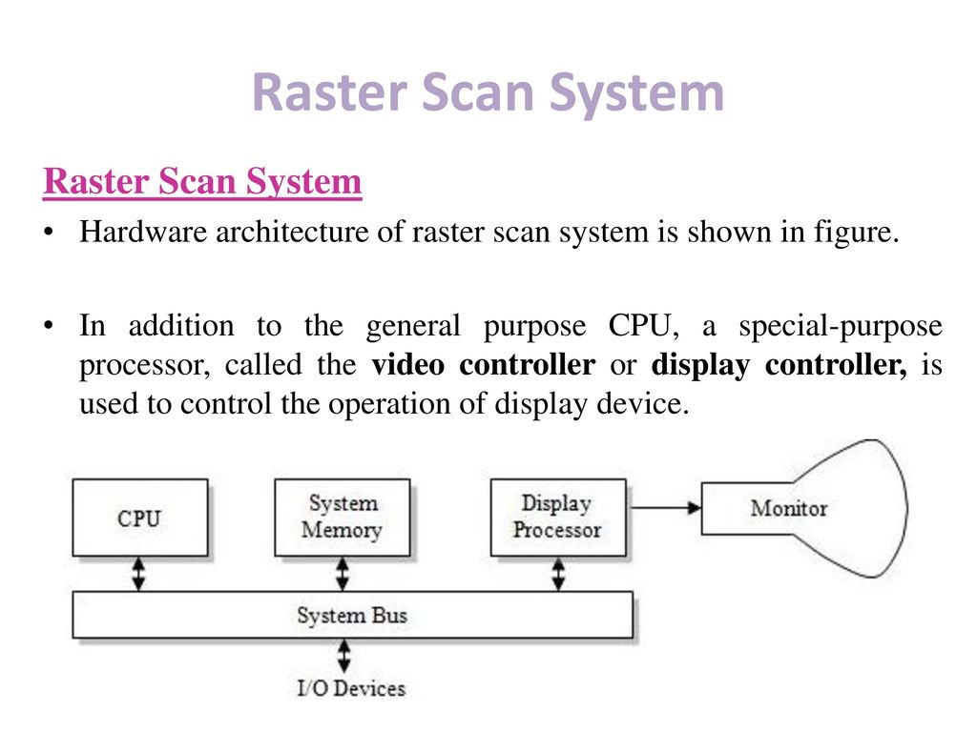

Slide 17
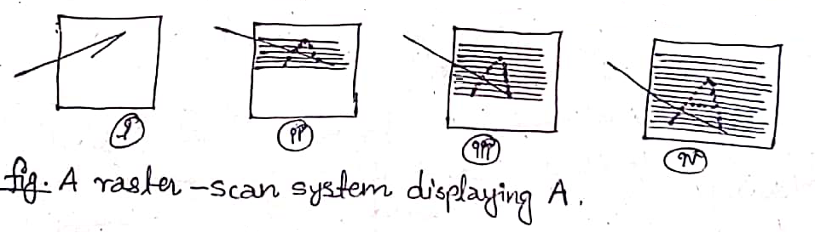
In Raster scan system, electron beam is swept across the screen, one row at a time from top to bottom
As the electron beam moves across each row, the beam intensity is turn on and off to create a pattern of image
Picture definition is store in memory called refresh buffer or frame buffer
Most of devices are based on this technology for e.g. CRT, LCD, LED etc.

Slide 18
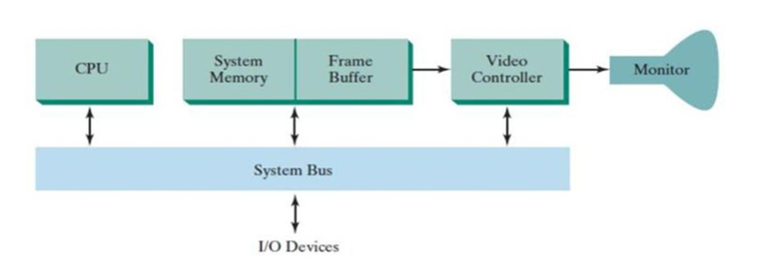
Architecture of Raster Scan System

Slide 19
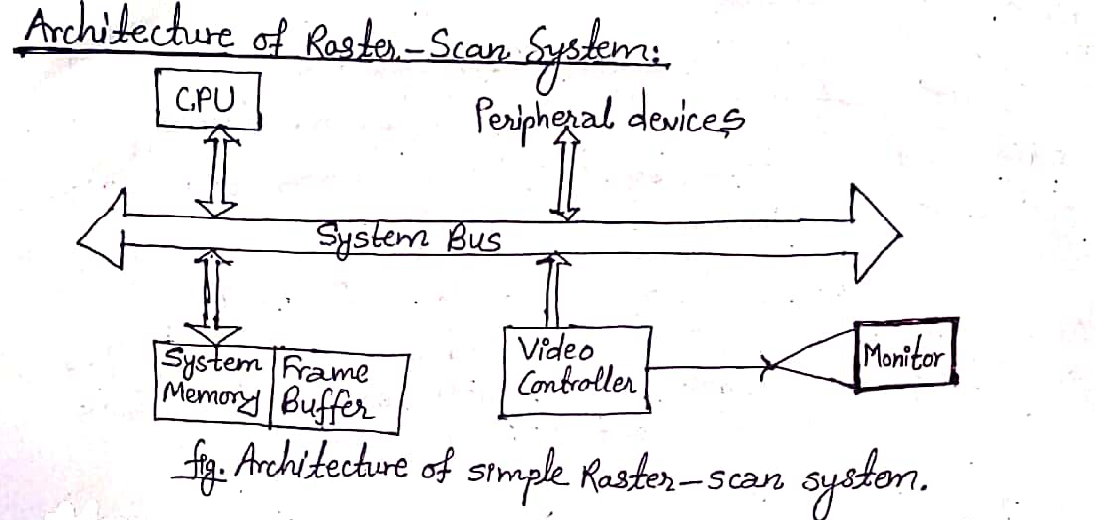

Slide 20
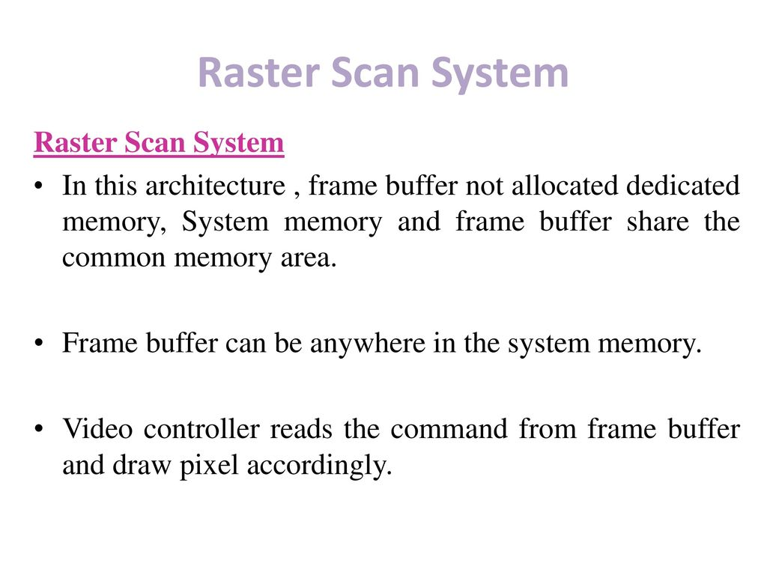

Slide 21
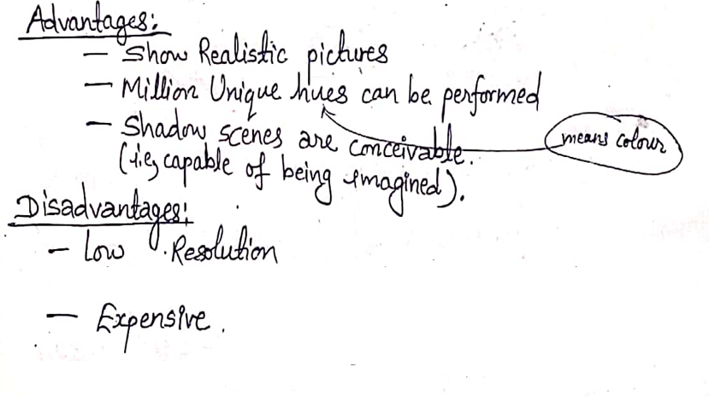

Slide 22
Random Scan (Vector) display system
In this technique, the electron beam is directed only to the part of screen where the picture is to be drawn rather than scanning from left to right and top to bottom as in raster scan system
Also called vector display or calligraphic display system
Picture definition is stored as a set of line drawing commands in a area of memory called refresh display file
E.g. plotter

Slide 23
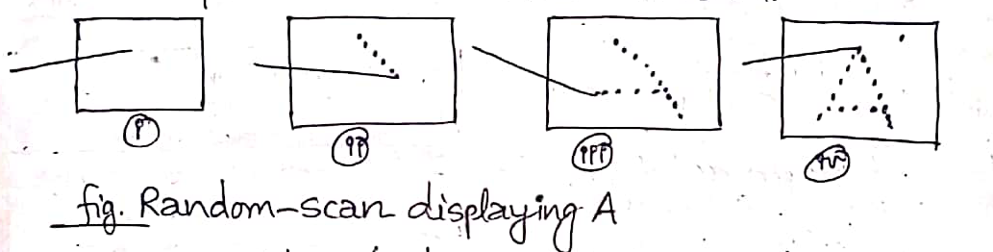

Slide 24
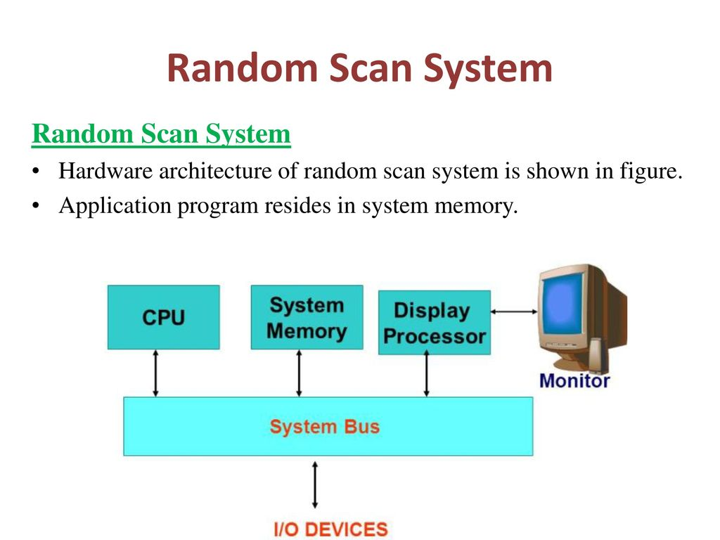

Slide 25
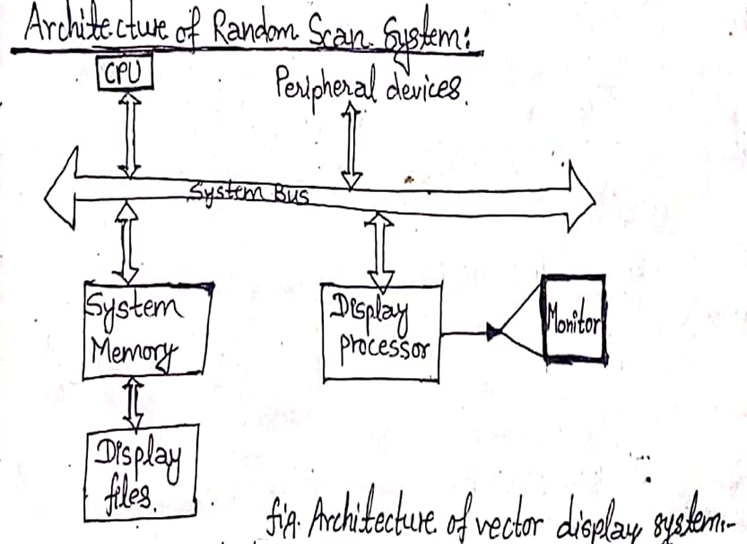

Slide 26
Random display system consists of additional processing unit along with CPU which is called display processor
Picture definition is stored as a set of line drawing commands in a area of memory called display list
This display list is then accessed by the display processor to create an image

Slide 27
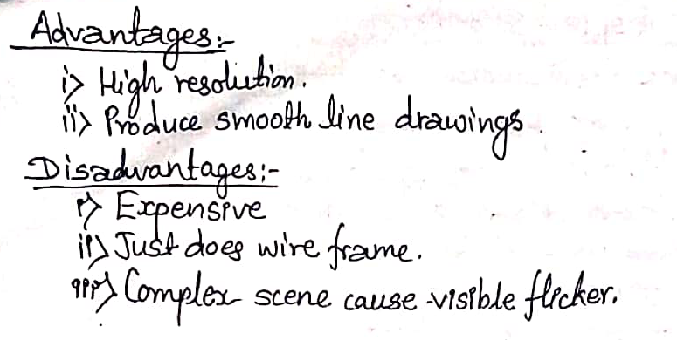

Slide 28
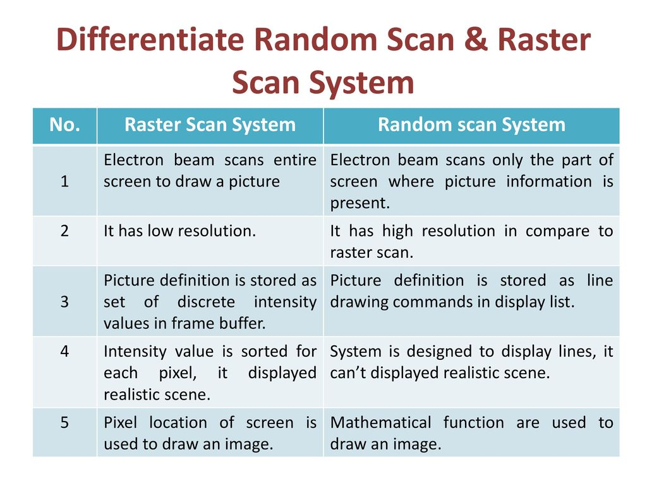

Slide 29
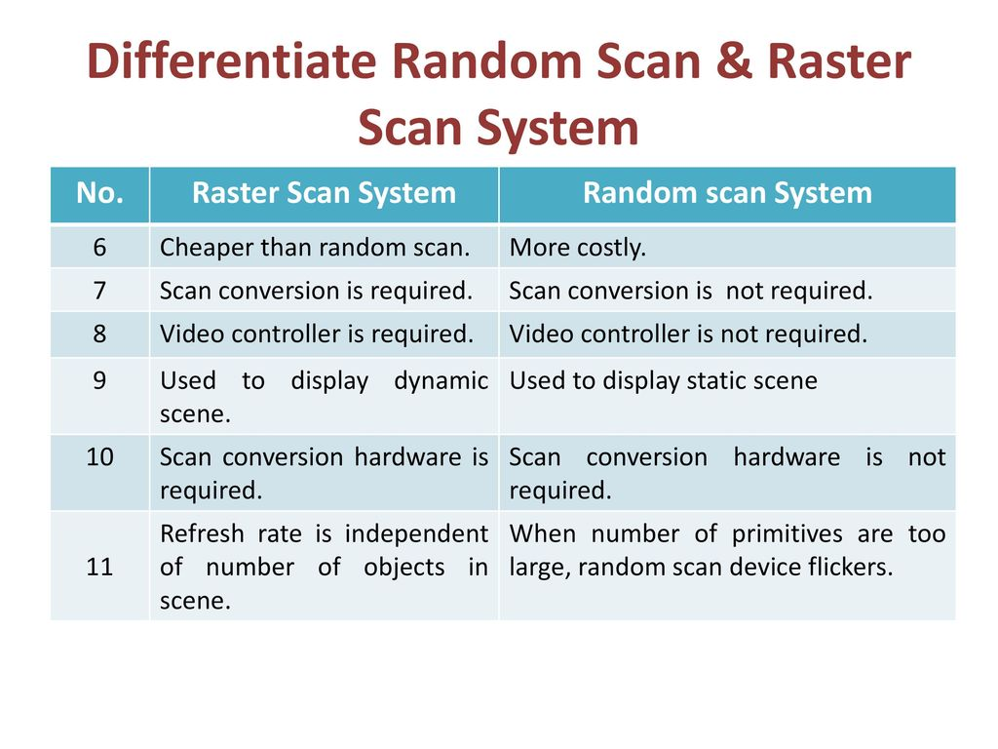

Slide 30
