Slide 1
GENAI • RAG
AI Research Paper RAG Assistant
📚 AI Research Paper Assistant
Ask a question
Ask questions. Retrieve the right evidence. Let Gemini generate a grounded answer.
What is multi-head attention?
ASK GEMINI
A simple, explainable portfolio project built for learning GenAI.
Answer
The system retrieves relevant paper sections first, then Gemini uses them to create the answer.
✓ Source: research paper • page 3

Slide 2
01 • HOW IT WORKS
From PDF → evidence → answer
The complete RAG pipeline in one simple story.
01
02
03
04
05
PDF PAPERS
CHUNK
EMBED
RETRIEVE
GENERATE
3 AI research papers
Break text into small pieces
Turn text into vectors
ChromaDB finds matches
Gemini writes the answer
GROUND VERSION
“Retrieve relevant document chunks first, then give them to Gemini as context so the answer is grounded.”
AI Research Paper RAG • Project Showcase
2 / 4

Slide 3

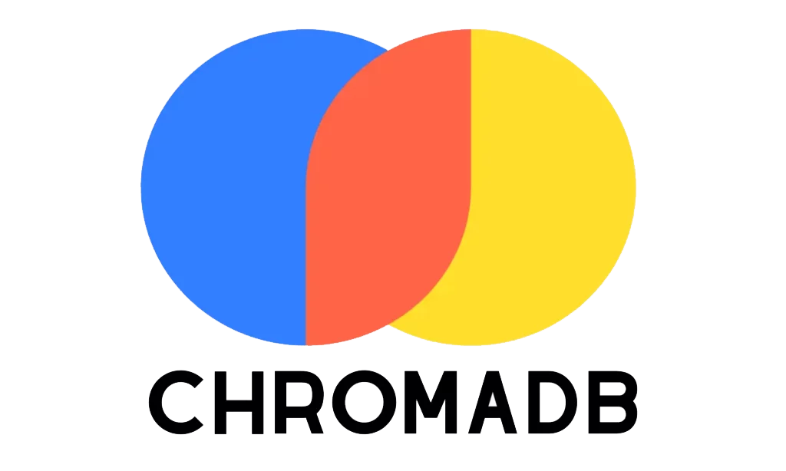

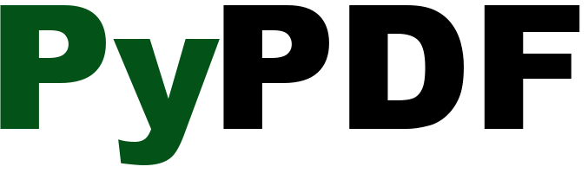
02 • THE STACK
Small stack. Clear responsibilities.
Every technology has one job — easy to explain and easy to demo.
GEMINI
Understands the question and generates the answer.
ChromaDB
Stores embeddings and finds similar text.
LLM + Embeddings
Vector Database
Extracts text from the research PDFs.
Streamlit
Turns Python code into a simple web app.
Document Reader
User Interface
Minimal project: app.py • ingest.py • requirements.txt • .env • papers/ • chroma_db/
AI Research Paper RAG • Project Showcase
3 / 4

Slide 4
03 • SHOWCASE
What the user experiences
A clean demo flow — and a clear story for an interviewer.
USER
WHY THIS PROJECT?
“What are the two sub-layers in each encoder layer of the Transformer?”
✓
Grounded answers
✓
Simple architecture
RAG
ChromaDB → retrieves relevant chunks Gemini → generates the grounded answer
✓
Easy to demonstrate
→
Next: evaluation + better citations
SOURCE ATTRIBUTION
Research paper • page reference
PORTFOLIO MESSAGE • “I understand the RAG workflow end-to-end, not just the API call.”
AI Research Paper RAG • Project Showcase
4 / 4

