Slide 1
YOCTO-PROJECT
By:
Surya Narayan Pradhan

Slide 2
Contents
What is build system
Types of build system
Intro and components of yocto
Tech terms
Directory structure
Environment setup
Build directory
Configuring the build system
Building an image
Package variants
Recipes
Layers
Machine configuration
Application
Conclusion

Slide 3
What is Build sytem ?
Build system is a tool that automate the process of building a target system, including the kernel, boot loader & toolchain.
It creates or build a customized embedded Linux system for different targets & provide a working image to the customer.
It automatically download, configure, compile and install all the components in the right order.

Slide 4
Types of Build system
Buildroot, developed by the community
http://www.buildroot.org
PTXdist, developed by Pengutronix
http://pengutronix.de/software/ptxdist
OpenWRT, originally a fork of Buildroot for wireless routers, now a more generic project
http://www.openwrt.org
Yocto
http://www.yoctoproject.org:

Slide 5
Yocto Project
It is an open source project initiated by the Linux Foundation in 2010 & then collaborated with Openembedded .

Slide 6
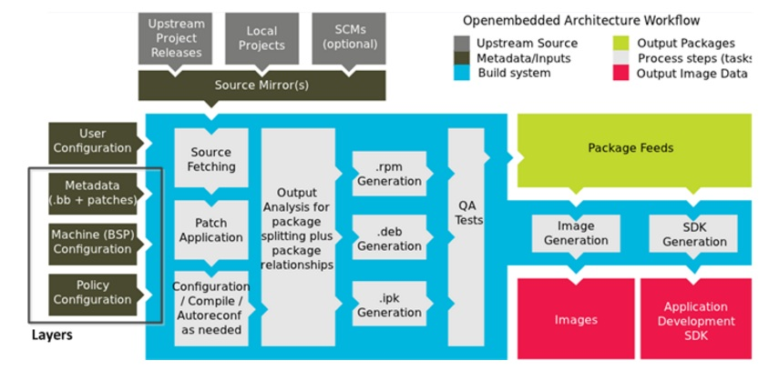
Architecture of Yocto:

Slide 7
Components of Yocto:
The core components of the Yocto Project are:
BitBake: the build engine. It is a task scheduler, like make.
OpenEmbedded-Core: a set of base layers. It is a set of recipes, layers and classes.
Poky : the reference system. It is a collection of projects and tools.

Slide 8
Tech terms:
Recipes: It describe how to fetch, configure, compile and package applications and images. They have a specific syntax.
Classes: Classes combine functionality used inside recipes into reusable block.
Layers: Collection of recipes, classes and configuration meta data.
Can be BSP layer,base layer etc.
Notes:
<number>

Slide 9
Directory structure:
Bitbake :Holds all scripts used by the BitBake command.
Documentation: All documentation sources for the Yocto Project documentation
meta:Contains the OpenEmbedded-Core metadata.
meta-skeleton: Contains template recipes for BSP and kernel development

Slide 10
Continues..
meta-yocto: Holds the configuration for the Poky reference distribution.
meta-yocto-bsp: Configuration for the Yocto Project reference hardware board support package.

Slide 11
Environment setup :
A script, oe-init-build-env, is provided to set up the build directory and the environment variables (needed to be able to use the bitbake command for example).
source oe-init-build-env
Sets up a basic build directory .The default is set to build.
We can rename it or set it according to our preferences .
source oe-init-build-env <dir_name>

Slide 12
Build directory structure:
Conf:Configuration files. Image specific and layer configuration.
Downloads: Downloaded upstream tarballs of the packages used in the builds.
sstate-cache: Shared state cache. Used by all builds.
Tmp:Holds all the build system outputs.
tmp/buildstats: Build statistics for all packages built (CPU usage,elapsed time, host, timestamps…).

Slide 13
tmp/deploy: Final output of the build.
tmp/deploy/images:Contains the complete images built by the OpenEmbedded build system. These images are used to flash the target.
tmp/work: Set of specific work directories, split by architecture.They are used to unpack, configure and build thepackages. Contains the patched sources, generated objects and logs.
tmp/sysroots:Shared libraries and headers used to compile packages for the target but also for the host.

Slide 14
Configuring the build system:
The conf directory in the build one holds build specific configuration.
bblayers.conf :Explicitly list the available layers.
local.conf :Set up the configuration variables relative to the current user for the build.

Slide 15
The conf/local.conf configuration file holds local user configuration variables:
BB_NUMBER_THREADS :How many tasks BitBake should perform in parallel.
PARALLEL_MAKE:How many processes should be used when compiling.
MACHINE :The machine the target is built for, e.g. beaglebone,phyWEGA,RANA-AM335X
PACKAGE_CLASSES :Packages format (deb, ipk or rpm).

Slide 16
Building an Image:
There are two ways to build an yocto-image.
1.GUI based
2.Command line based
GUI based: Hob provides an user friendly interface to build yocto-image relatively easy.
Set the environment
hob &

Slide 17
Command line based by using bitbake commands.
bitbake [options] [recipename/target ...]
bitbake [target]
bitbake core-image-minimal
Common targets are:
core-image-minimal
core-image-sato
..

Slide 18
Packages variants:
Some packages have the same purpose, and only one can be used at a time.
The build system uses virtual packages to reflect this. A virtual package describes functionalities and several packages may provide it.
Only one of the packages that provide the functionality will be compiled and integrated into the resulting image.

Slide 19
The virtual packages are often in the form virtual/<name>
Example of available virtual packages with some of their variants:
virtual/bootloader: u-boot, u-boot-ti-staging…
virtual/kernel: linux-yocto, linux-yocto-tiny, linux-yocto-rt, linux-ti-staging…
bitbake –c clean virtual/kernel
bitbake -b virtual/kernel

Slide 20
bitbake -c listtasks virtual/kernel
Gives a list of the available tasks for the package virtual/kernel. Tasks are prefixed with do_.
bitbake -c menuconfig virtual/kernel
Execute the task menuconfig on the kernel package.
bitbake -f dropbear
Force the dropbear package to be rebuilt from scratch.
bitbake -c fetchall world
Download all package sources and their dependencies.

Slide 21
Recipes:
A recipe is a set of instructions to describe how to retrieve, patch, compile, install and generate binary packages for a given application.
It also defines what build or runtime dependencies are required.
The recipes are parsed by the BitBake build engine.
The format of a recipe file name is
<package-name>_<version>.bb

Slide 22
To make it easier to write a recipe, some variables are automatically available:
PN package name, as specified in the recipe file name.
PV package version, as specified in the recipe file name.
PR package release, defaults to r0
PE package epoch: used to reorder package versions.
When using the recipe bash_4.2.bb:
${PN} = "bash"
${PV} = "4.2"

Slide 23
We can divide a recipe into three main parts:
▶ The header: what/who
▶ The sources: where
▶ The tasks: how
Header:
DESCRIPTION describes what the software is about.
HOMEPAGE URL to the project's homepage
PRIORITY defaults to optional
SECTION package category (e.g. console/utils)
LICENSE the package's license

Slide 24
Source:
SRC_URI defines where and how to retrieve the needed elements. It is a set of URI schemes pointing to the resource locations (local or remote).
BitBake expects to find the extracted sources in a directory called <package-name>-<version>. This is controlled by the S variable. If the directory has another name, you must explicitly define S.
By default, sources are fetched in $BUILDDIR/downloads.

Slide 25
Tasks:
Default tasks already exists, they are defined in classes:
▶ do_fetch
▶ do_unpack
▶ do_patch
▶ do_configure
▶ do_compile
▶ do_install
▶ do_package
▶ do_rootfs

Slide 26
Layers:
The Yocto build system manipulates metadata.
A layer is a collection of packages and build tasks.
The Poky reference system is a set of basic common layers:
▶ meta
▶ meta-skeleton
▶ meta-yocto
▶ meta-yocto-bsp

Slide 27
When making modifications to the existing recipes or when adding new packages, it is a good practice not to modify Poky. Instead we can create your own layers.
The list of layers BitBake uses is defined in
build/conf/bblayers.conf
To include a new layer, add its absolute path to the BBLAYERS variable.
BSP layers are device specific layers. They hold metadata with the purpose of supporting specific hardware devices.
A good practice is to name it meta-<bsp_name>.

Slide 28
yocto-bsp create <name> <arch>
yocto-bsp create phytec arm
conf/layer.conf :The BSP layer's configuration.
conf/machine :Holds the machine configuration files. One is created by default: <bsp_name>.conf

Slide 29
Machine Configuration:
TARGET_ARCH The architecture of the device being built.
PREFERRED_PROVIDER_virtual/kernel The default kernel.
SERIAL_CONSOLE : Passed to the kernel as the console parameter, e.g. 115200 ttyS0
KERNEL_IMAGETYPE The type of kernel image to build, e.g zImage
IMAGE_FSTYPES Format of the root filesystem images to be created, e.g. tar.bz2 squashfs

Slide 30
Add a application.
Lets add hello world application to meta-yocto.
bbexample folder
Compile it using
bitbake bbexample.

Slide 31
Thank You…

