Slide 1


Slide 2


Slide 3


Slide 4


Slide 5


Slide 6


Slide 7
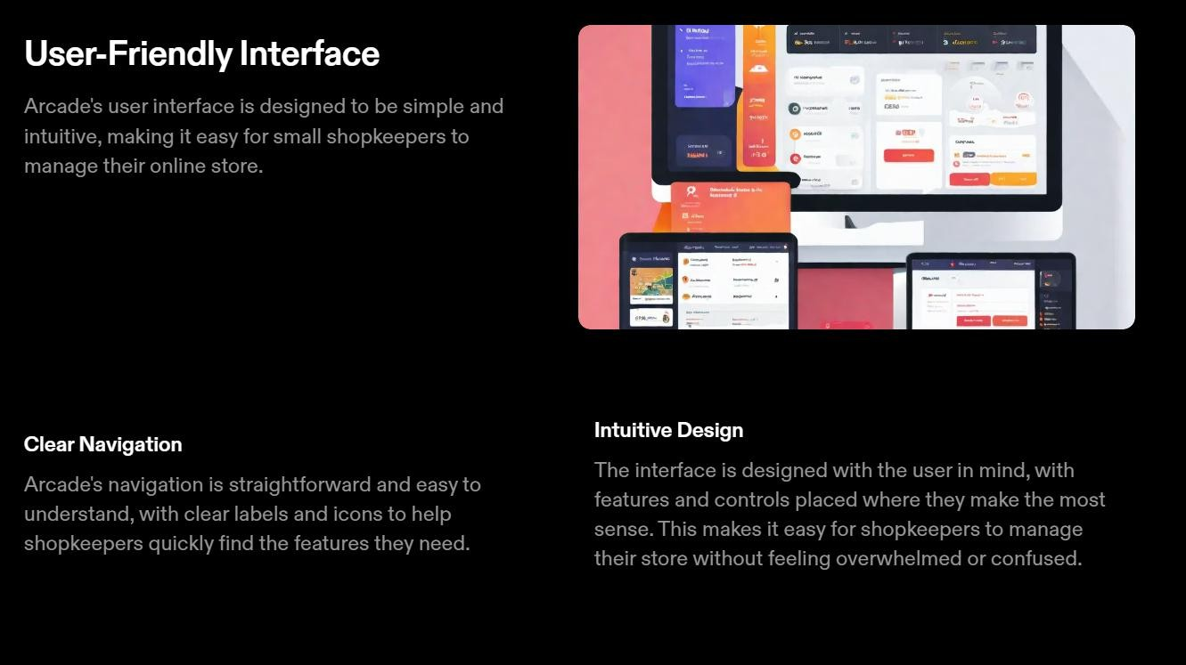

Slide 8


Slide 9
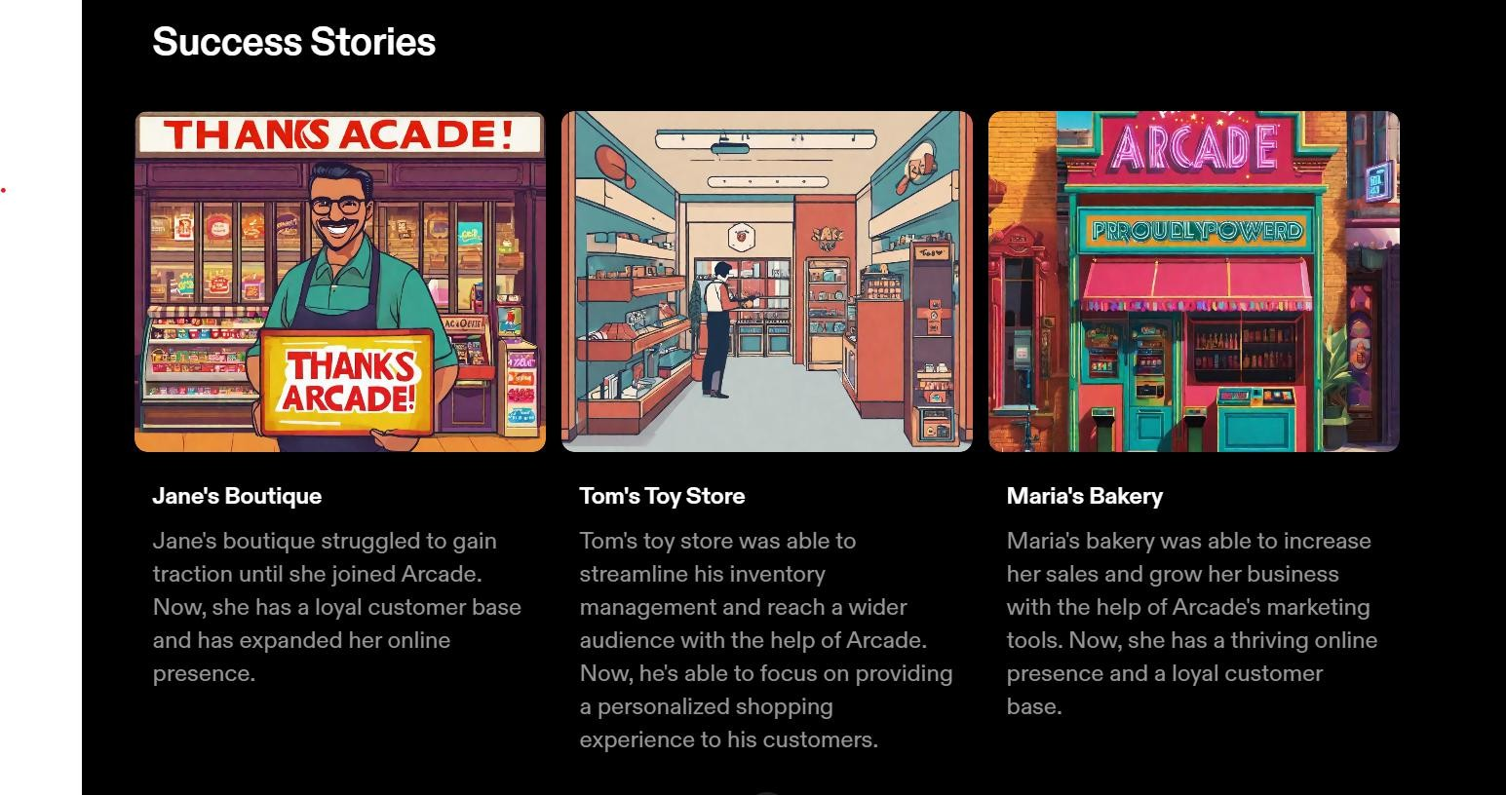

Slide 10
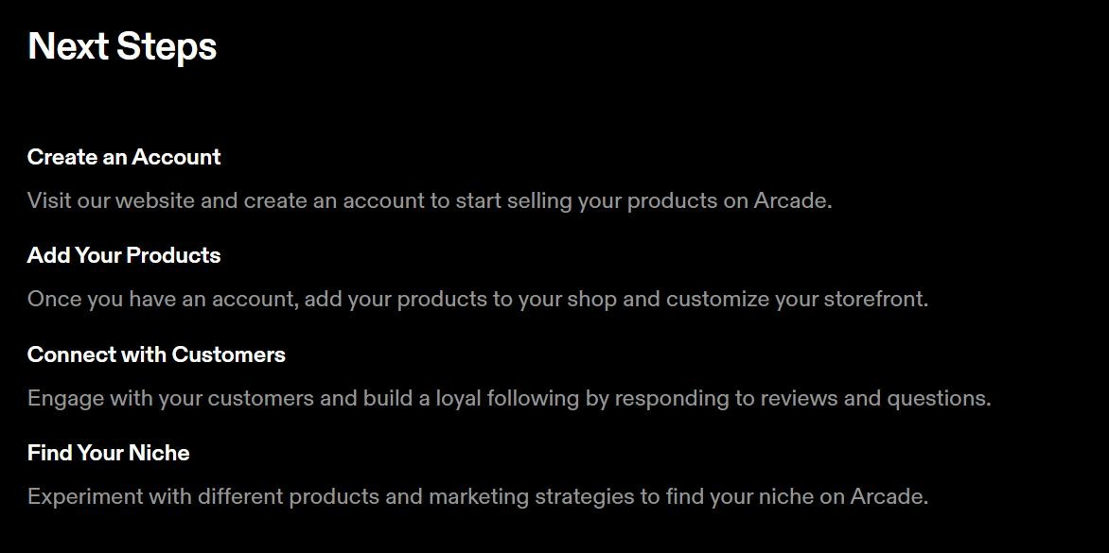

Slide 11
Data Flow Diagram (DFD)

Slide 12
Control Flow Diagram

Slide 13
Use Case Diagrams

Slide 14
Class Diagram

Slide 15
Sequence Diagram

Slide 16
E-R Diagram

Slide 17
Data Flow Diagram (DFD)

Slide 18
Activity Diagram

Slide 19
State Transition Diagram

Slide 20
State Transition Diagram

Slide 21
Architecture diagram

