Slide 1

Cars24 website to analyse used cars in the market

Slide 2
About me
Biradar Shashikanth (MBA-Finance)
Vivek Vardhani School of Business Management
I want to improve my knowledge and learn the Data Science
I have an experience of 3.5yr in Mortigage process.
Tejash(B-Tech)
Keshav Memorial Institute of Technology

Slide 3
Business Problem
To find the best used car within the budget of Rs. 7 lakhs and to make
the best use of the given budget

Slide 4
Objective
To Help the client make a decision based on his requirement
Client requirement is to buy a best used car within a budget of 7 lakhs and make the best use of his money
There are 2 cases to help meet the client requirement
Case 1:
In order to the buy a best used car the car needs to meet the following criteria namely:
1. Age of the car should be less as it ensures the latest engine and increasing the life of the car
2. The car should be in the range 0 to 7 lakhs in terms of one time payment
3. The no. of kilometers travelled shall be less
4. less no. of ownership (less than 4)
Case 2 :
After analysing the data the client can buy 2 cars with in the budget taking the EMI option .
Where one car can be used for personal use and the other can be used for providing cabs services.
Within the area and generate revenue out of it.

Slide 5
Project Flow
Step 4:
DATA VISUALIZATION AND DATA ANALYSIS
Step 5:
ANALYSIS AS PER CLIENT REQUIREMENT
Step 1: WEB SCRAPING
Step 2: DATA CLEANING
Step 3: DATA MANIPULATION

Slide 6
Step 1
WEBSCRAPING

Slide 7
WEBSCRAPING ON CARS24 WEBSITE
Loading the page using the Requests library.
Check the page status code to be 200.
Using BeautifulSoup to extract the content from the page.
Creating an empty list which are (paramenters/columns) for the content to be extracted.
Each parameter in the web page has an ID and Class, Using those ID and Class the content is extracted and appended to their respective list.

Slide 8
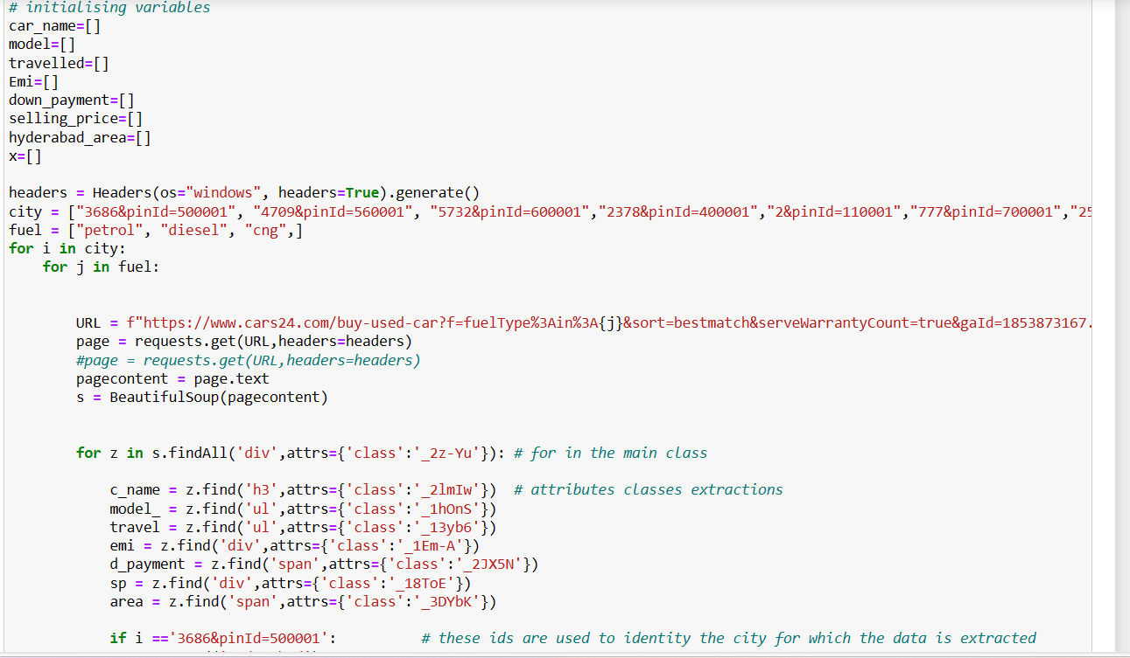

Slide 9
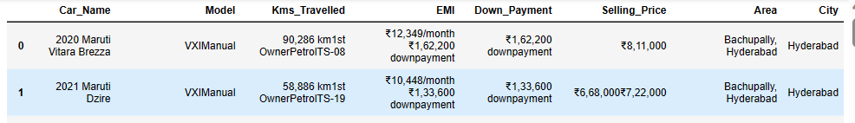
DATA CLEANING
Create a dataframe using a pandas library.
Further information can be extracted from the columns above like Year, Company, Car Name, Model, EMI, Kms, Downpayment etc.,
Those extractions were done using the regex library by using the find and sub methods for further extractions and the cleaning of data

Slide 10
Step 2
DATA MANIPULATION

Slide 11
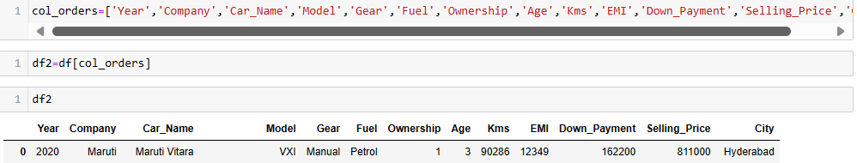
DATA MANIPULATION
The columns names are renamed
The columns not used for analysis are dropped like the image below
Changing the data types from string to integers

Slide 12
Step 3
Data visualization and Analysis

Slide 13
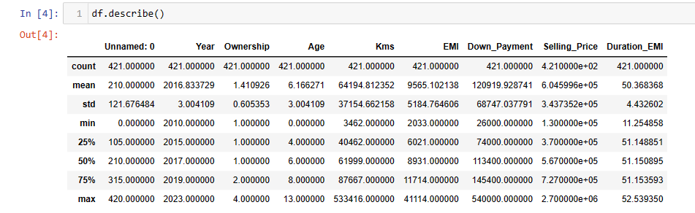
Data visualization and Analysis
Applying statistical methods on the data frame
The mean ,count and standard deviation of the entire data set is calculated and the values of these are depicted in the image left

Slide 14
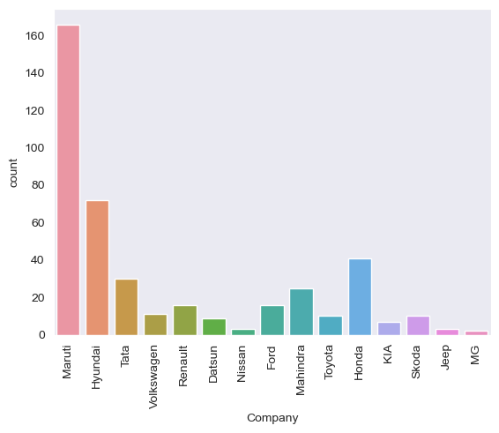
Univariate analysis
A bar graph is plotted on the company
Maruti and Hyundai are the leading Car Companies where the used car are for sales
Nissan, Jeep and MG are the bottom 3 in terms of no. of used cars for sale in the market

Slide 15
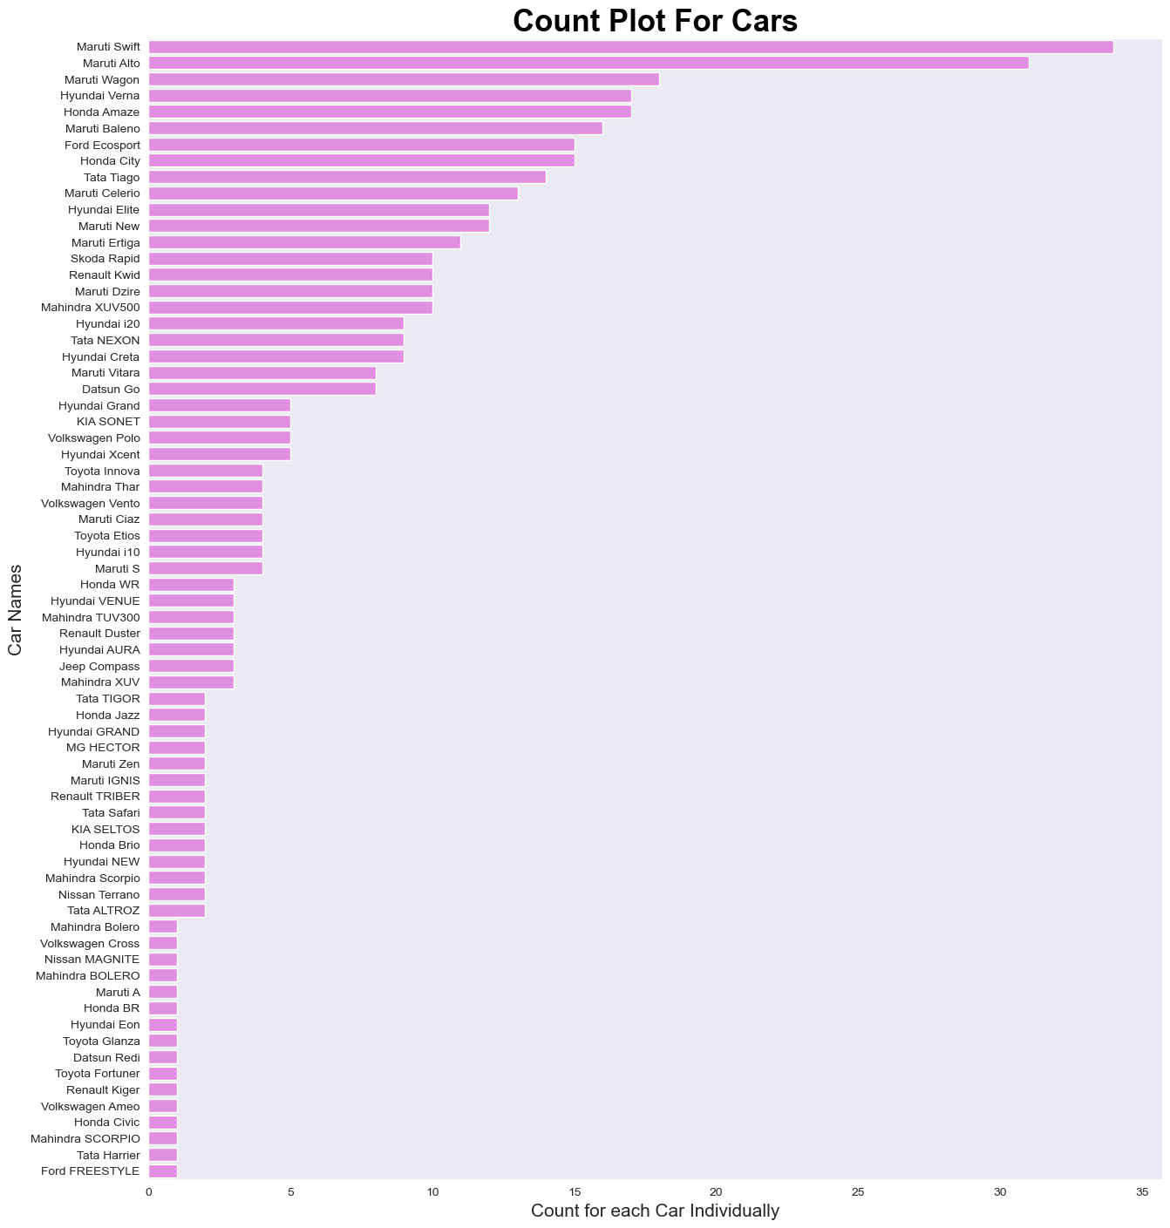
Maruti Swift, Maruti Alto , Maruti Wagon and Hyundai Verna are the most number of used cars available for sale.
we also observe that, there are about many cars which are for sale in equal magnitude i.e. from Mahindra Bolero to Ford Freestyle

Slide 16
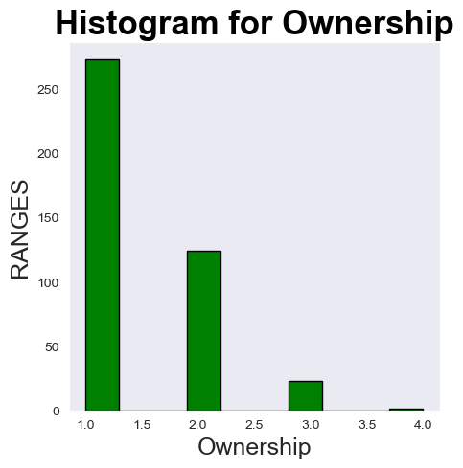
Histogram on Ownership
Insights
Most no. of cars for sale are 1st hand owner i.e. above 200+ cars and least are 4th owners around 5.

Slide 17
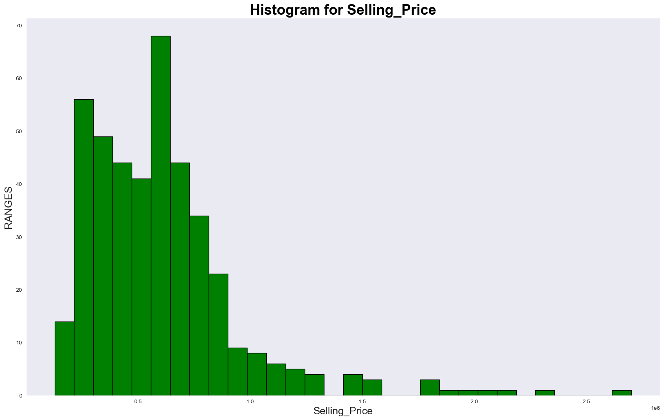
Histogram of Selling Price
Insights
From the graph it is observed that most of the cars falls under the range of 2 lakhs-3 lakh
From 3-5 lakh there are less no. of cars available
Maximum number of cars are in the range 5-6.5 lakhs
Very few are in the range 12-16 lakhs

Slide 18
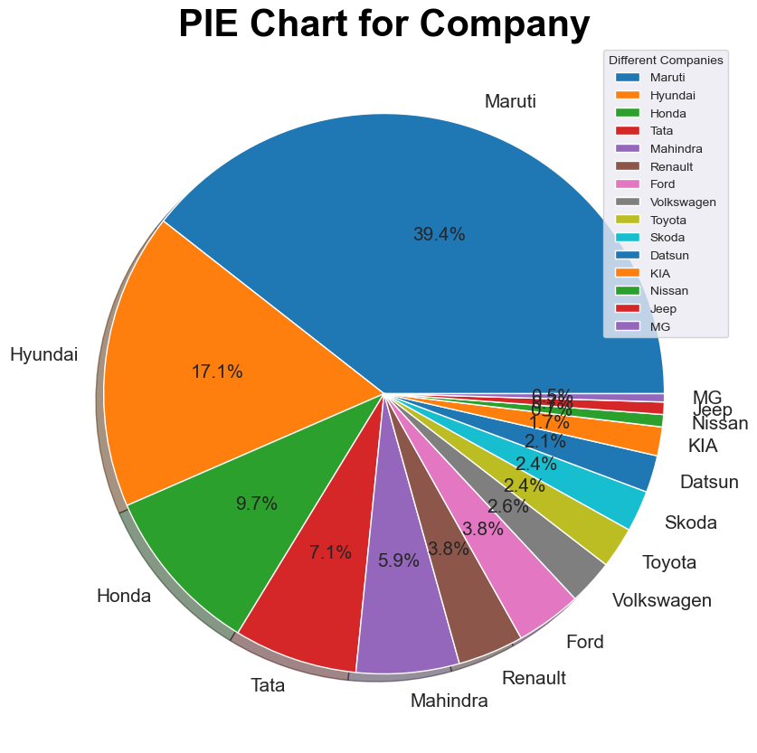

Slide 19
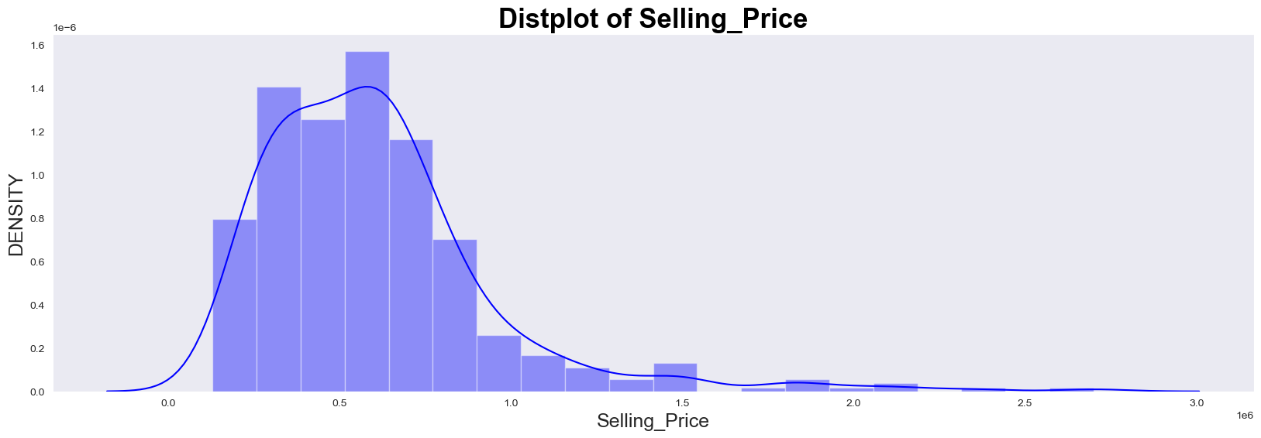
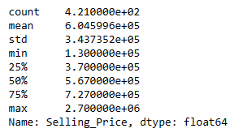
Insights
- Maximum number of cars are having a selling price of 3-9 lakhs
- As the selling price increases the density of cars also decreases
- Average selling price of a car is 6 lakhs

Slide 20
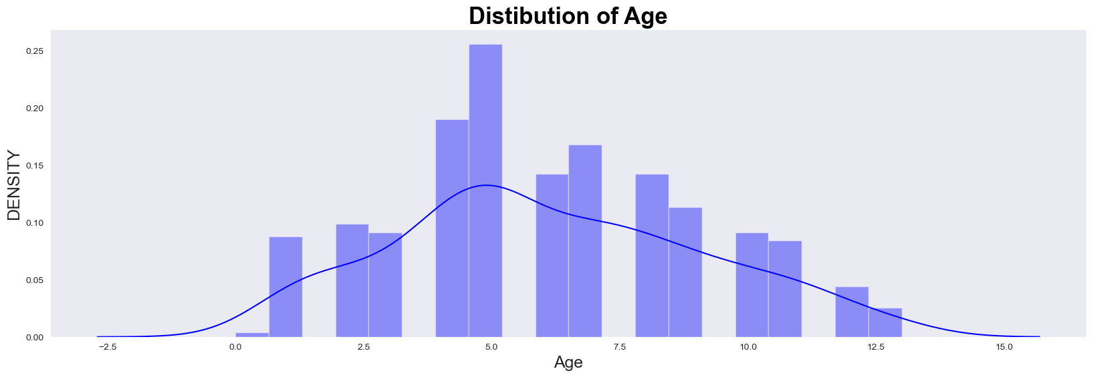
INSIGHTS
mixer of Hist plot and KDE plots.
Most of the cars are lying between the age of 4 to 5 years.
after 5 years as age increases the number of cars available also decreases.
The spread is increasing and then decreasing

Slide 21
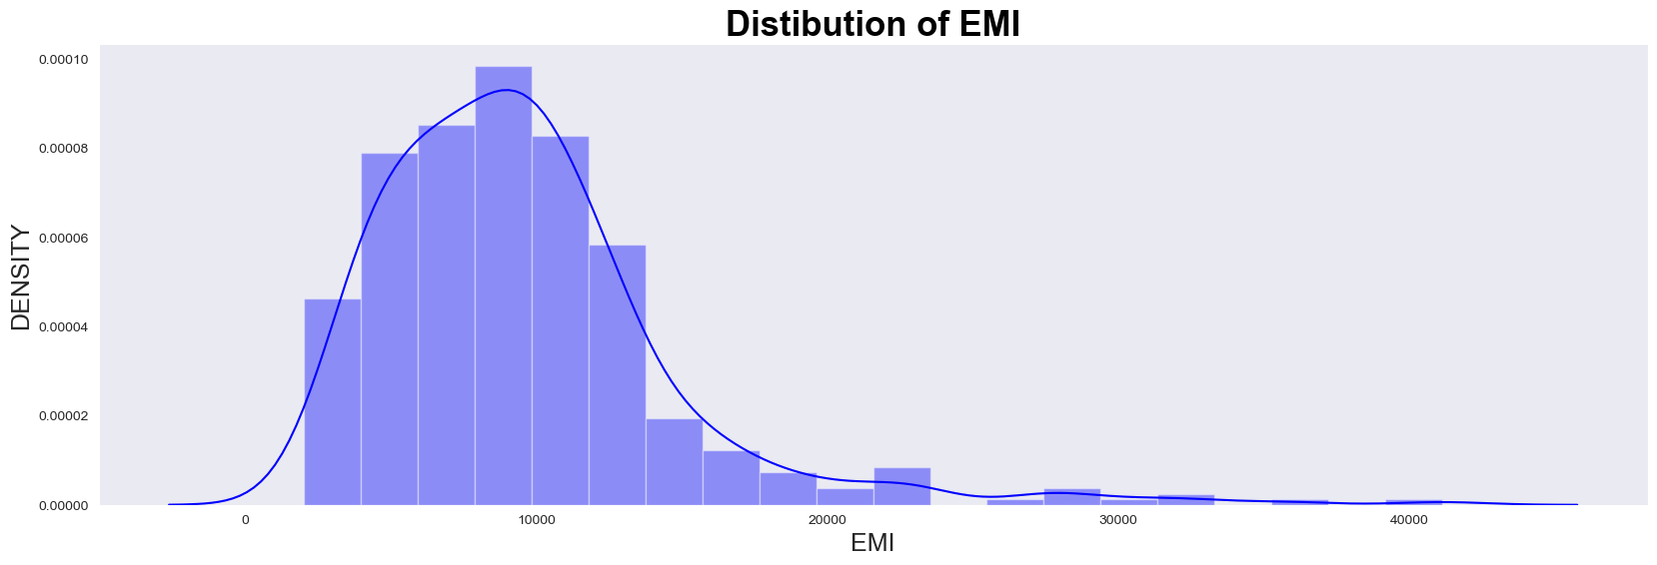
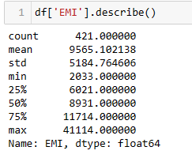
INSIGHTS
mixer of Hist plot and KDE plots.
Most of the cars are having an EMI lying between the age of 4k to just above 12.
Very less spread within the remaining ranges of EMI.
As the EMI increased the density of the car decreases
Mean EMI is around RS.9,565 with a standard deviation of Rs5,000

Slide 22
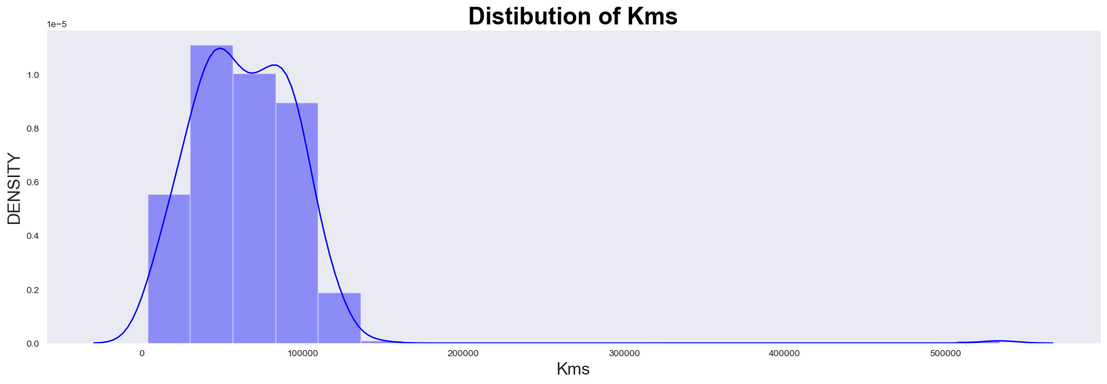
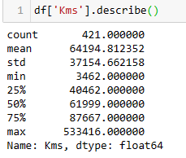
INSIGHTS
mixer of Hist plot and KDE plots.
Most of the cars have a Kms reading from 5,000 to 8,000kms.
Very less spread after 88000kms.
The mean distance reading is 64,000
The maximum is 5,33,416

Slide 23
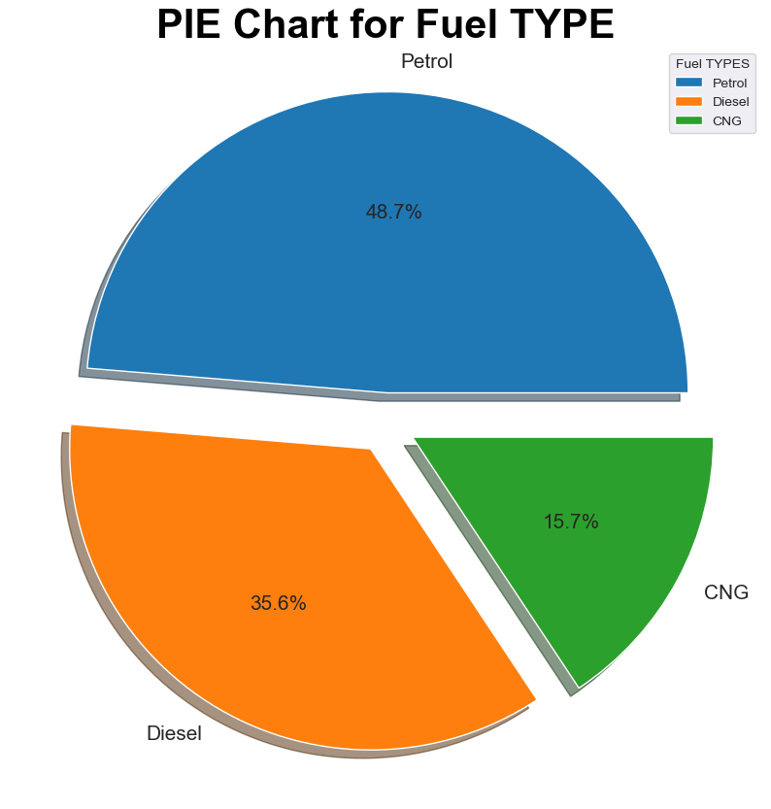
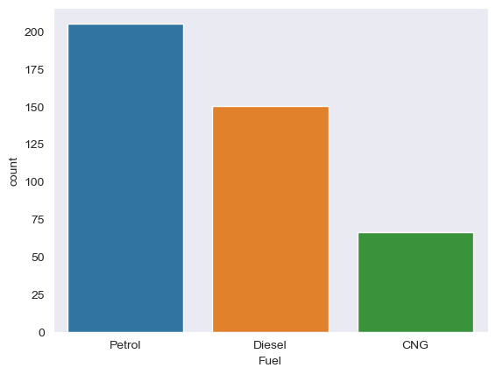
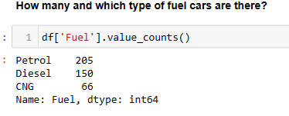

Slide 24
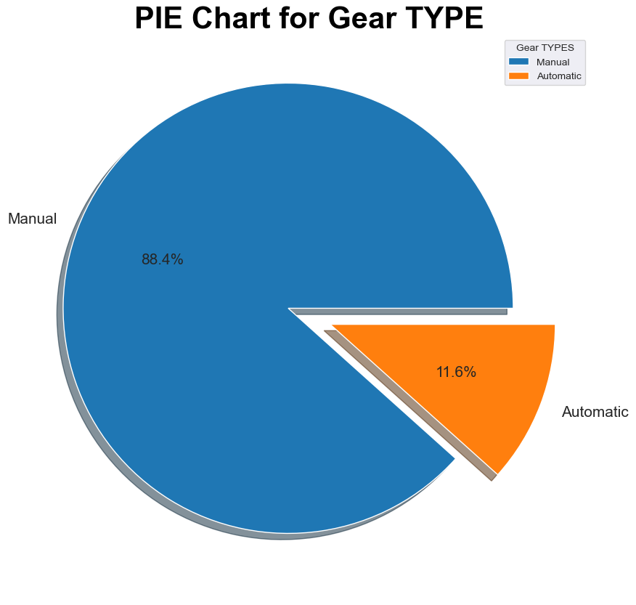
Insights
Around 88% of the used cars are having manual gears
and 11% of Automatic gear

Slide 25
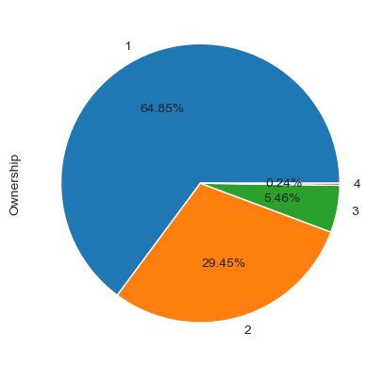
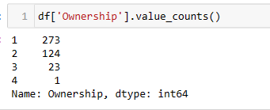
Pie plot on which time owners
Insights
Most number of cars are 1st owners selling their cars
Around 30% of the cars being sold are from 2 time owners
There is only one 4th time owner selling car

Slide 26
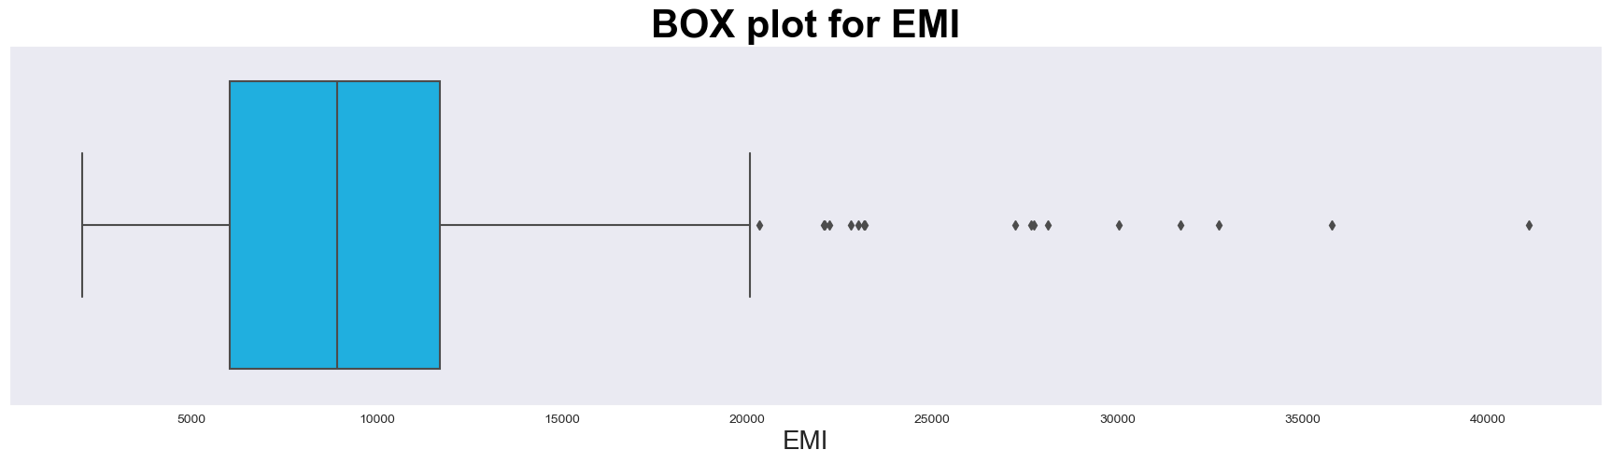
Insights
From the above boxplot there are outliers present
Outliers are from EMI Rs.20,000

Slide 27
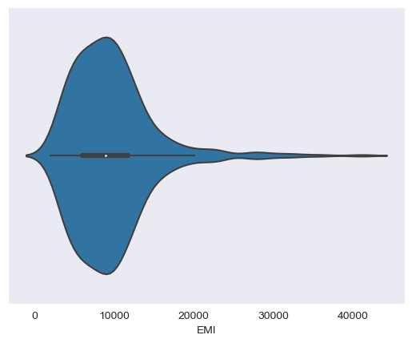
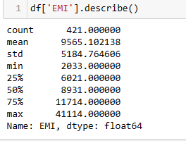
Violin plot on EMI
Insights
Most of the cars are having an EMI lying between the inter quartile range. Very less spread after Rs.20,000/- As the EMI increased the density of the car decreases Mean EMI is around RS.9,565 with a standard deviation of Rs5,000

Slide 28
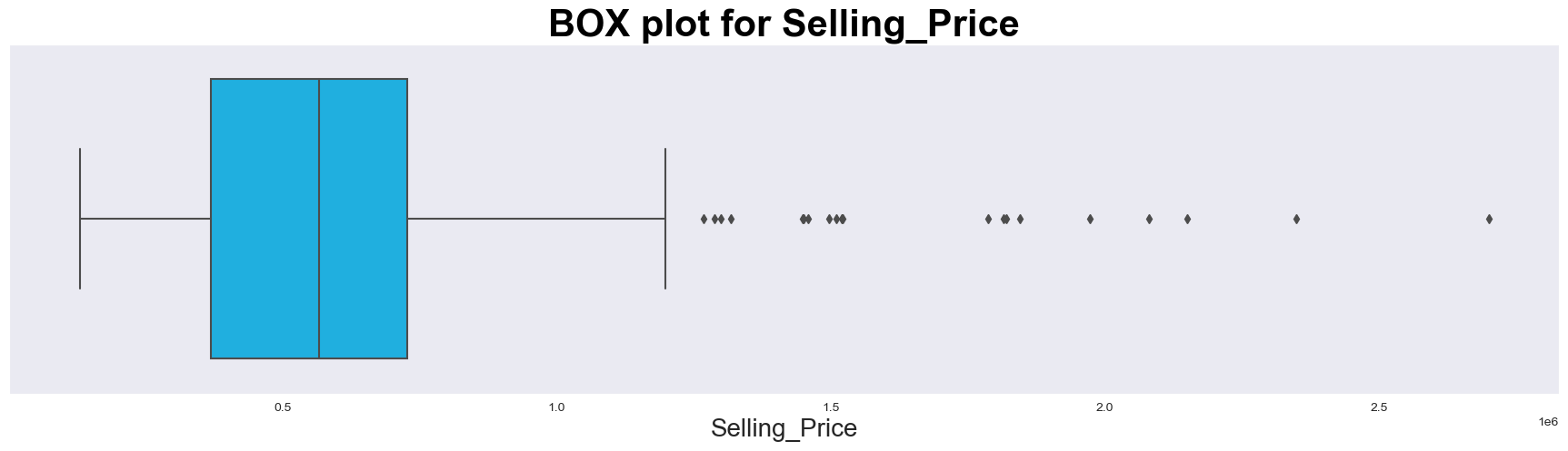
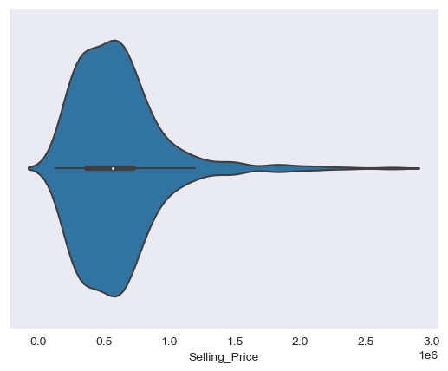
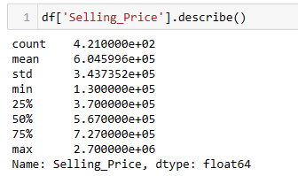

Slide 29
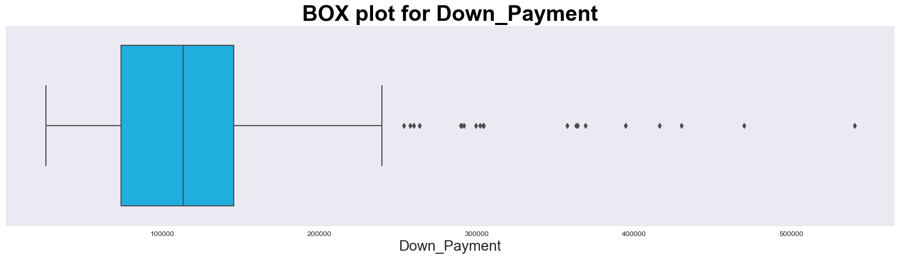
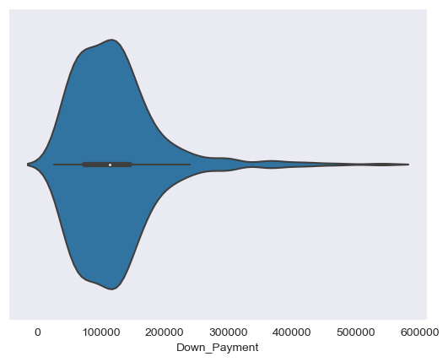
INSIGHTS
There are many outliers in the box plots and the spread of the outiiers are shown from the violin plot and we observe that the spread is less

Slide 30
Step 4
Bi- Variate & Multi-Variate Analysis

Slide 31
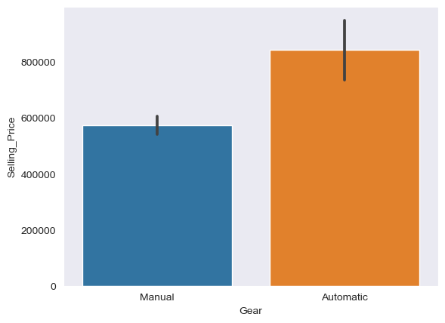
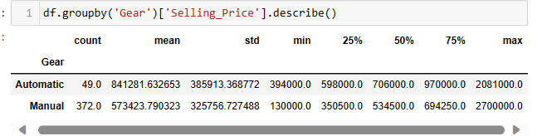
Gear V/S Selling Price Plot
Insights
From the above graph it is observed that the maximum selling price of manual cars is 27 lakhs which is an outlier and automatic is 20 lakhs
The mean of selling price for automatic is 8 lakhs and for manual cars is 5.7 lakhs
Automatic price range (4-20 lakhs)
Manual price range (1.3-27 lakhs)

Slide 32
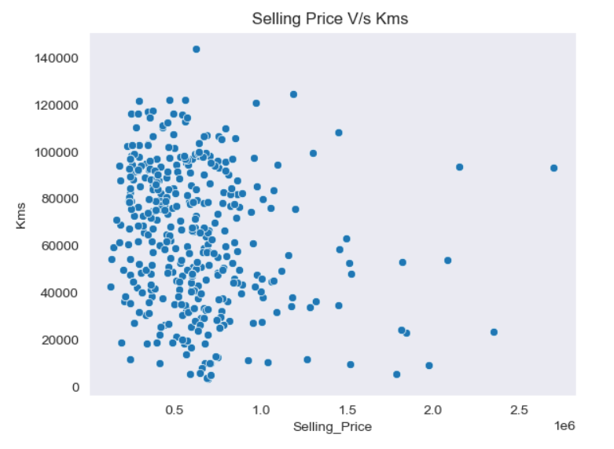
As it is observed from the graph, as kms increases the selling Price of the car is decreases.

Slide 33
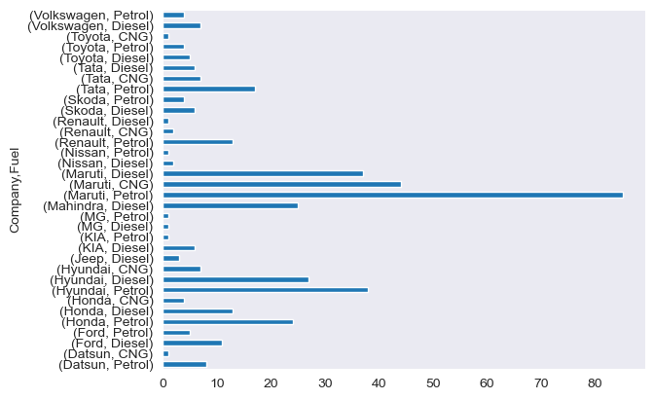
Company V/S Fuel Plot
Insights
It is observed that only Datson, Hyundai, Honda, Maruti, Renault, Tata, Toyota are offering cars using CNG as fuel

Slide 34
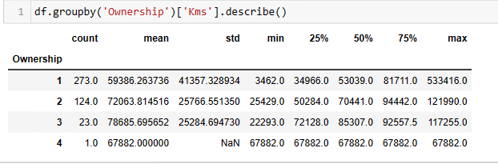
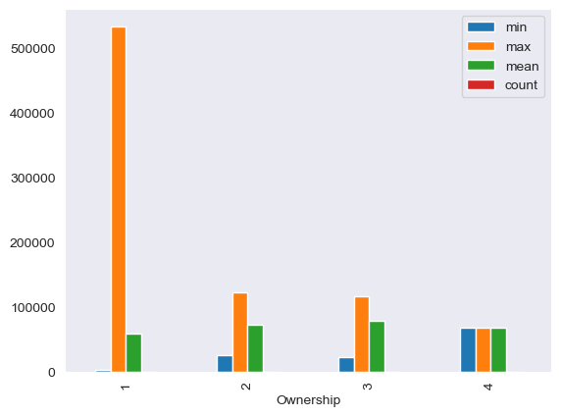
Ownership vs Kms plot

Slide 35
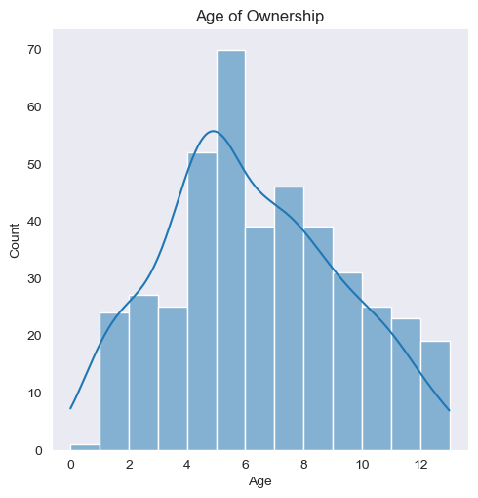
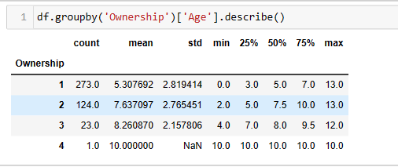
Insights
1st time owners are more and the mean age of the cars is 5 years
2nd and 3rd time owners the mean age of the cars are 7 and 8 years
As the Age increases the number of cars for sale decrease
Maximum number of cars lie between the age group 4 to 6 Years

Slide 36
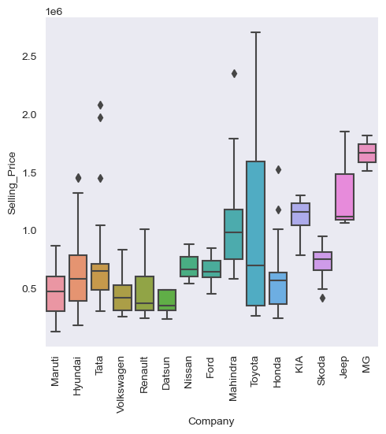
Catplot between company and selling price
Insights
Hyundai , Tata, Mahindra, Honda have outliers meaning their selling price of cars is too high and Skoda has negative outlier meaning its selling price of its car is low comparatively

Slide 37
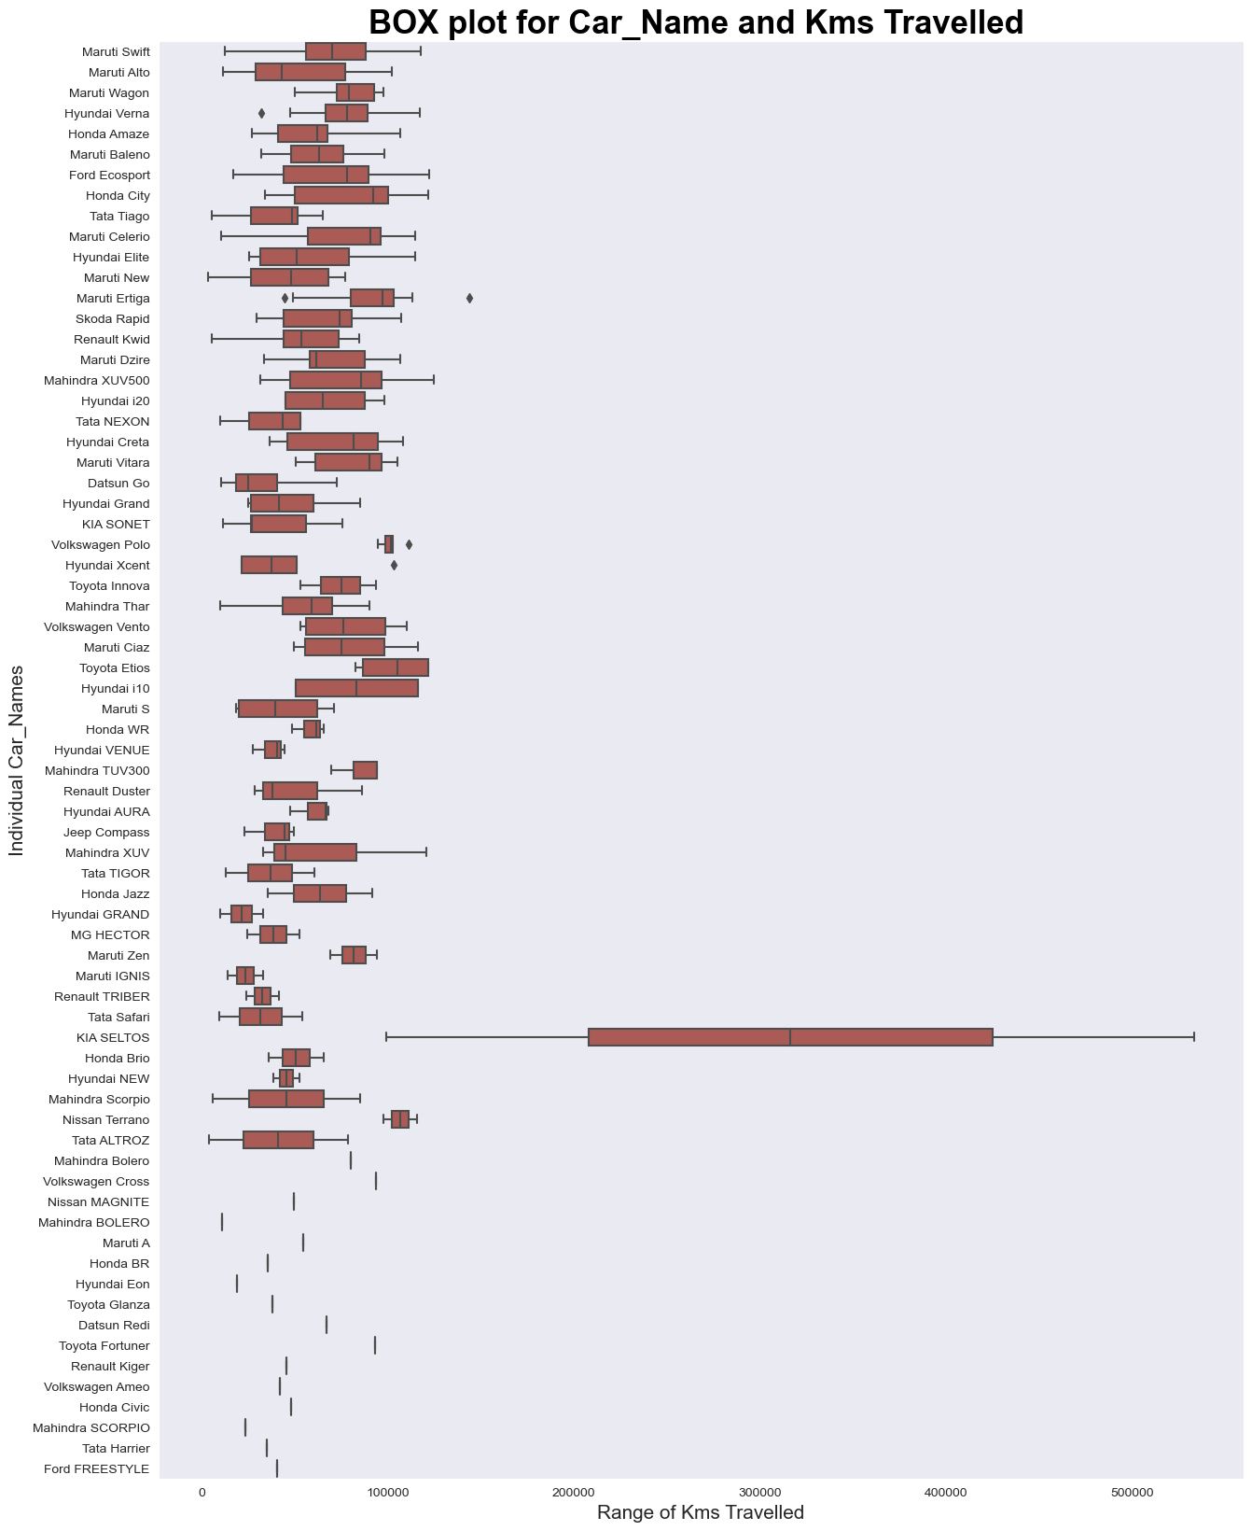
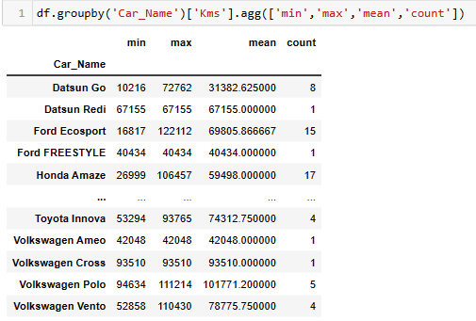
Box plot between car name and kms travelled
Hyundai verna
Maruti Ertiga
Volkswagon Polo
Hyundai Xcent
This are the cars that have outliers
Red- -ve ,Yellow- +ve and –ve
Blue- +ve kia Seltos have the max range of kms reading

Slide 38
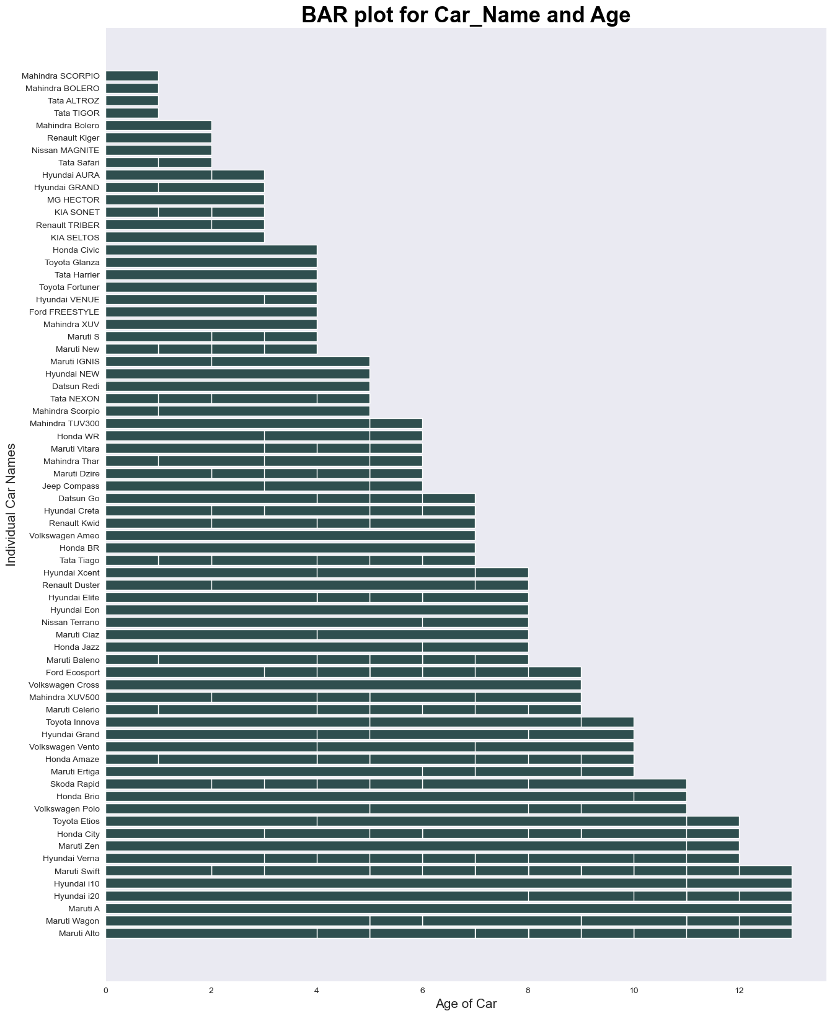
INSIGHTS
As the age of the car is increasing the distance travelled is also increasing but there are exceptions as to Kia Selto as its age is between 2 to 4 years but its is the car with maximum distance covered

Slide 39
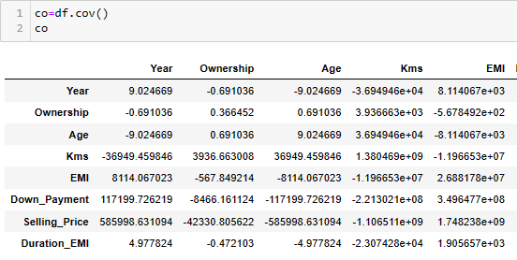
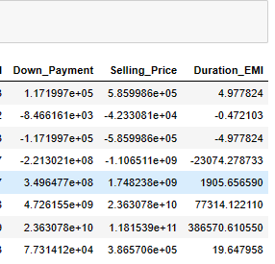
Relationship
The covariance tells us about the relations between the parameters weather its positive or negative meaning how does one affect the other
But it does not answer the question how much is the affect?
To answer the strength of the relationship correlation is calculate to get the measure and it is graphically show in the form of heatmap

Slide 40
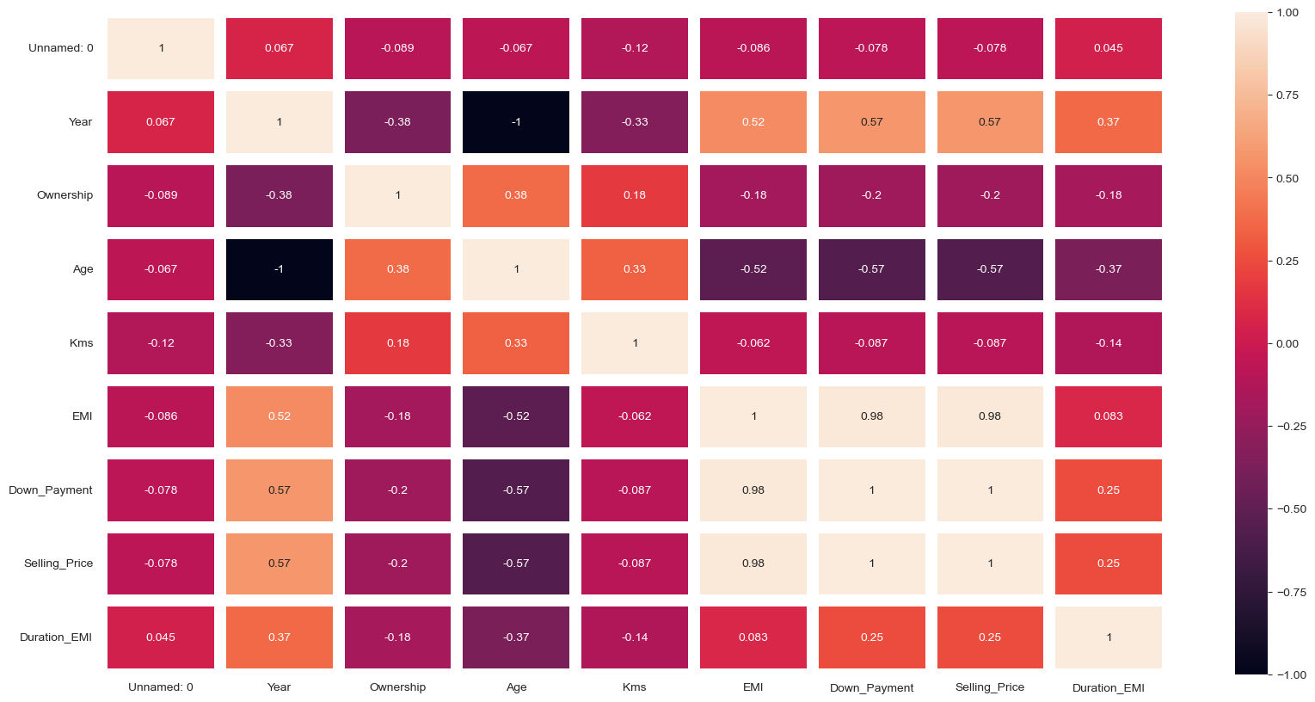
Heat Map

Slide 41
Step 5
ANALYSIS AS PER CLIENT REQUIREMENT

Slide 42
ANALYSIS AS PER CLIENT REQUIREMENT
To Help the client make a decision based on his requirement Client requirement is to buy a best used car within a budget of 7 lakhs and make the best use of his money
There are 2 cases to help meet the client requirement
case 1: In order the buy a best used car the car needs to meet the following criteria namely:
1.Age of the car should be less than 6 as it ensures the latest engine and increasing the life of the car
2.The car should be in the range 0 to 7 lakhs in terms of one time settlement
3.The no. of kilometers travelled shall be less
4.less no. of ownership (less than 4)

Slide 43
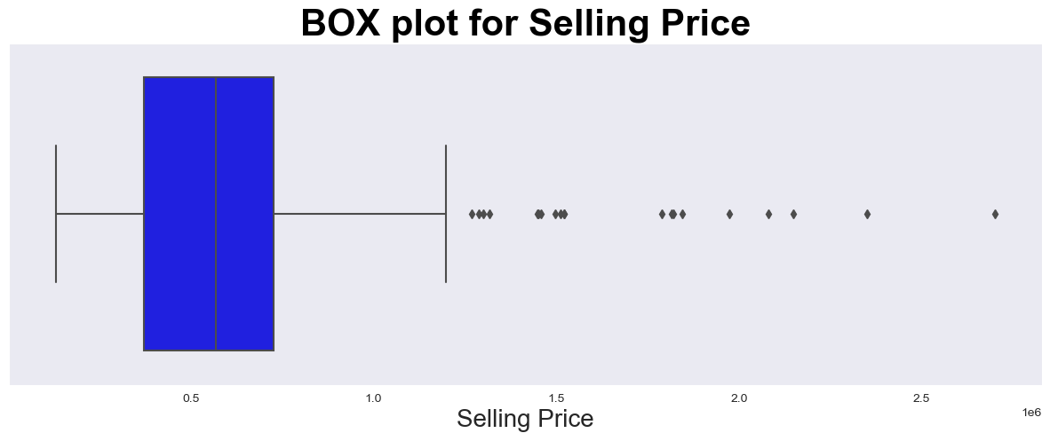
As it is evident from the above graph that there are more than one outliers present there for to make the data set uniform removing the outliers

Slide 44
Removing outliers
1st Quantile is 25 percentile
3rd Quantile 75 percentile
Calculate the interquartile range using the formula
Interquartile range=Q3-Q1
Upper limit=Q3+1.5*IQR
Lower limit=Q1-1.5*IQR
Using this condition extract the new data set and store it in a new data frame

Slide 45
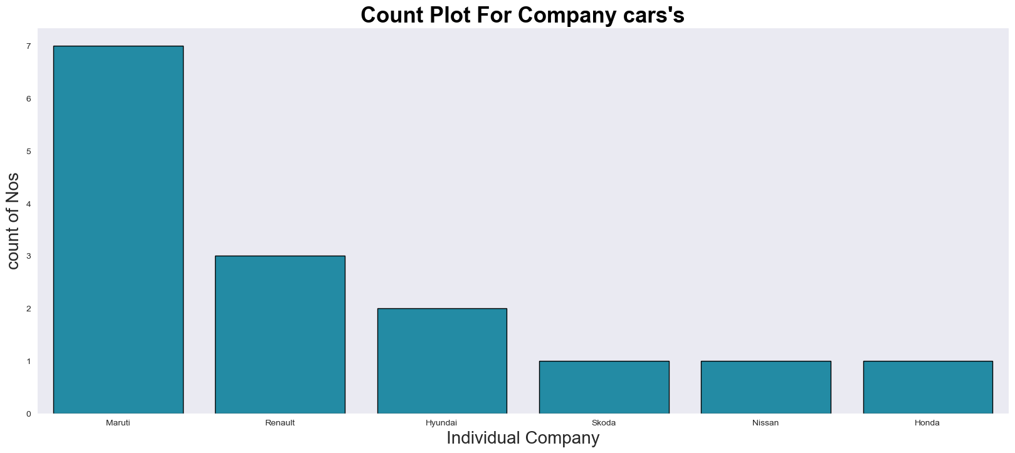
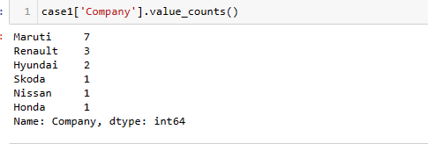

Slide 46
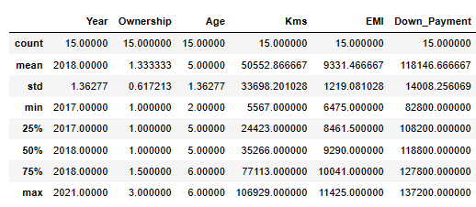
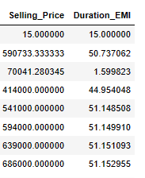
Statistics of the New Data Set

Slide 47



Plots between Selling Price ,Kms and Age
In a single time payment Renault kwid from Bangaluru =Rs.591000 and Maruti S from Nashik =Rs.543000 are the best budget cars to buy

Slide 48

INSIGHTS
The youngest car is Renault Triber and the second youngest car is Maruti S

Slide 49
Case 2
where the client utilizes a portion of his budget to buy a personal car and the rest uses to invest in a car for starting a cab services The only possibility here is to buy the car in terms of EMI due to budget constraints therefor find the maximum Down payment value
keeping in mind to have a long lasting business and good returns its best to invest in a good car than taking less EMI as a factor to choose a car for higher returns. we will take case1 as the criteria and use its data set to buy cars

Slide 50

List of car options to buy

Slide 51
Conclusion
Car Name | Down payment | EMI | Driver salary | Maintenace | Total cost | Average estimate form cab | Net monthly income estimate | Yearly income estimate
Hyundai Grand | 1,27,200 | 9,947 | 20,000 | 5,000 | 34,947 | 45,000 | 10,053 | 1,20,636/-
Renault Kwid | 1,18,200 | 9,243 | null | null | null | null | null | null
The best cars are Renault Kwid and Hyundai Grand within the budget of 7,00,000/- is best to buy were in which one can be used for the personal use and 2nd can be used for the business purpose. Income from one car can be used to pay for both the cars as the evident from the above calculation after 4 years both the cars
will be owned by the client, and generating the revenue of 1,20,636/- per annum.

Slide 52
Experience/Challenges working on Web Scraping – Data Analysis Project.
Loading the url as certain webpages do not give access to read from python programs to stop the reading of data
Learned about the concept of user-agents that acts like a requests from a browser
Writing the right regex code for data extraction
Used regex 101 to write the right regex
Helped a lot to work as a team and know individual strengths and weakness and become a team player and made me appreciate my team member

Slide 53

THANK YOU

