Slide 1

QUADRUPED ROBOT DEVELOPMENT
━━━━━━━━━━━━━━━━━━━━━━━━━━━━━━━━━━━━━━━━━━━━━
Certification-Based Industrial Training
WTL & MeitY Project | Group-E
Department of Electronics & Communication Engineering
Cooch Behar Government Engineering College | 2026
Guided by: Dr. Palash Das (ECE) | Mrs. Susmita Banik Barik (Project Eng., WTL) | Mr. Arijit Bhunia | Mr. Bhaskar Mondal

Slide 2
Team Members — Group E
Department of ECE, CGEC | WTL & MeitY Project | 2026
#
Name
Roll No.
Reg. ID
GUIDED BY
1
Sarupya Guha
34900323046
FS08A0198
Dr. Palash Das
ECE
2
Sohan Ghosh
34900323050
FS08A0202
3
Sayan Sarkar
34900323048
FS08A0157
Mrs. Susmita
4
Debanjan Chakraborty
34900323015
FS08A0154
Banik Barik
Proj. Eng., WTL
5
Joydip Das
34900323020
FS08A0220
6
Aushi Sarkar
34900323011
FS08A0288
Mr. Arijit Bhunia
7
Anupam Dutta
34900323003
FS08A0206
Proj. Co-ord.
8
Bikkram Das
34900323012
FS08A0528
Mr. Bhaskar
9
Biraj Sarkar
34900323013
FS08A0239
Mondal
Faculty, WTL
10
Soumyajit Pandit
34900323052
FS08A0189
Quadruped Robot Development | Group-E | ECE Dept., CGEC | WTL & MeitY | 2026
2/21

Slide 3
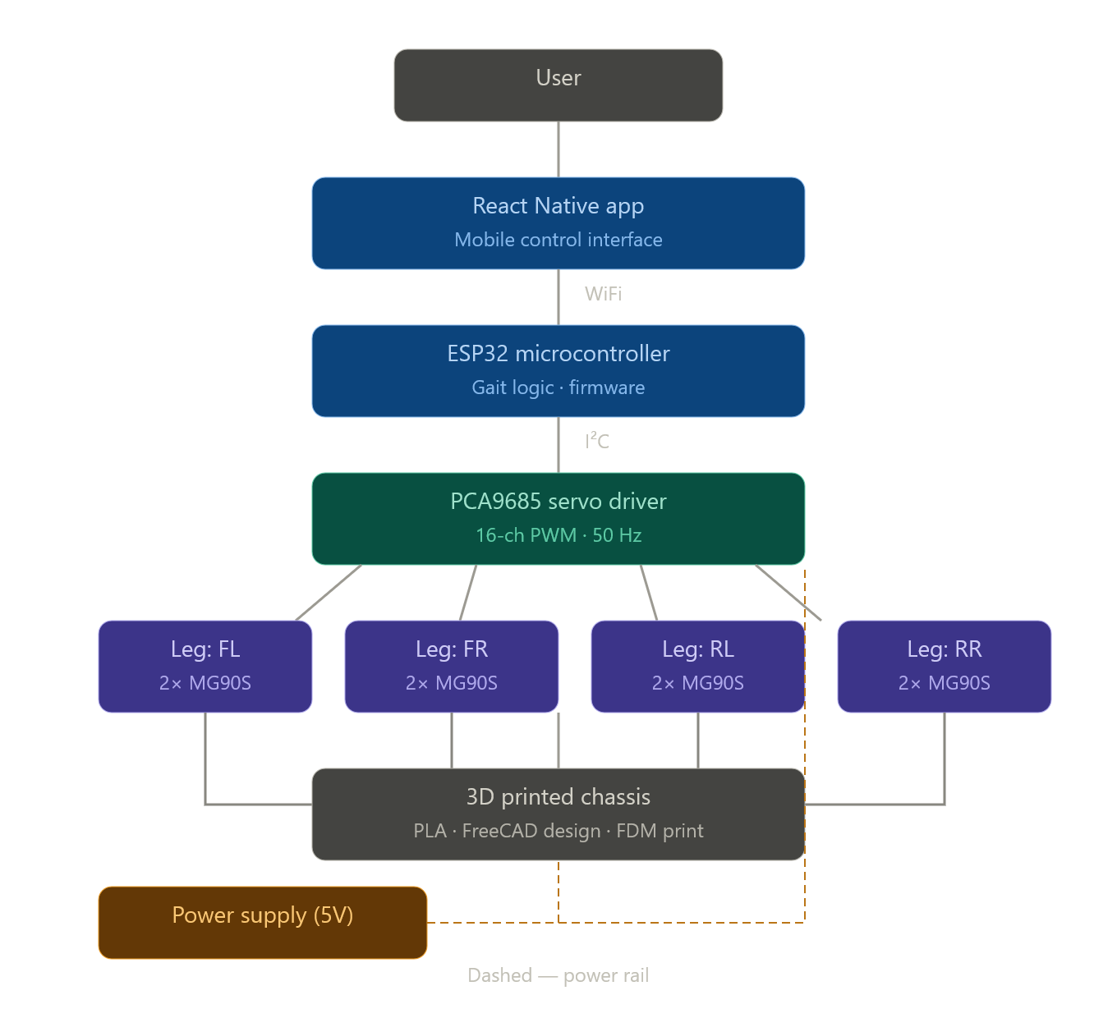
Project Objective
What are we building and why?
▶
Design, fabricate & program a fully functional 8-DOF Quadruped Robot
▶
Use affordable, open-source components and tools (ESP32 + FreeCAD + FDM printing)
▶
Core hardware: ESP32 microcontroller | PCA9685 16-ch servo driver | 8 × SG90S servos
▶
Chassis designed in FreeCAD — fabricated with FDM 3D printing (PLA+ & ABS)
▶
Hands-on experience across: Electronics • Mechanical Design • Additive Manufacturing
▶
End goal: Robot capable of standing stably and executing a walking gait
▶
Future roadmap: Sensor integration → Autonomous navigation
▶
Aligned with GoI skills development initiative under WTL & MeitY programme
Quadruped Robot Development | Group-E | ECE Dept., CGEC | WTL & MeitY | 2026
3/21

Slide 4
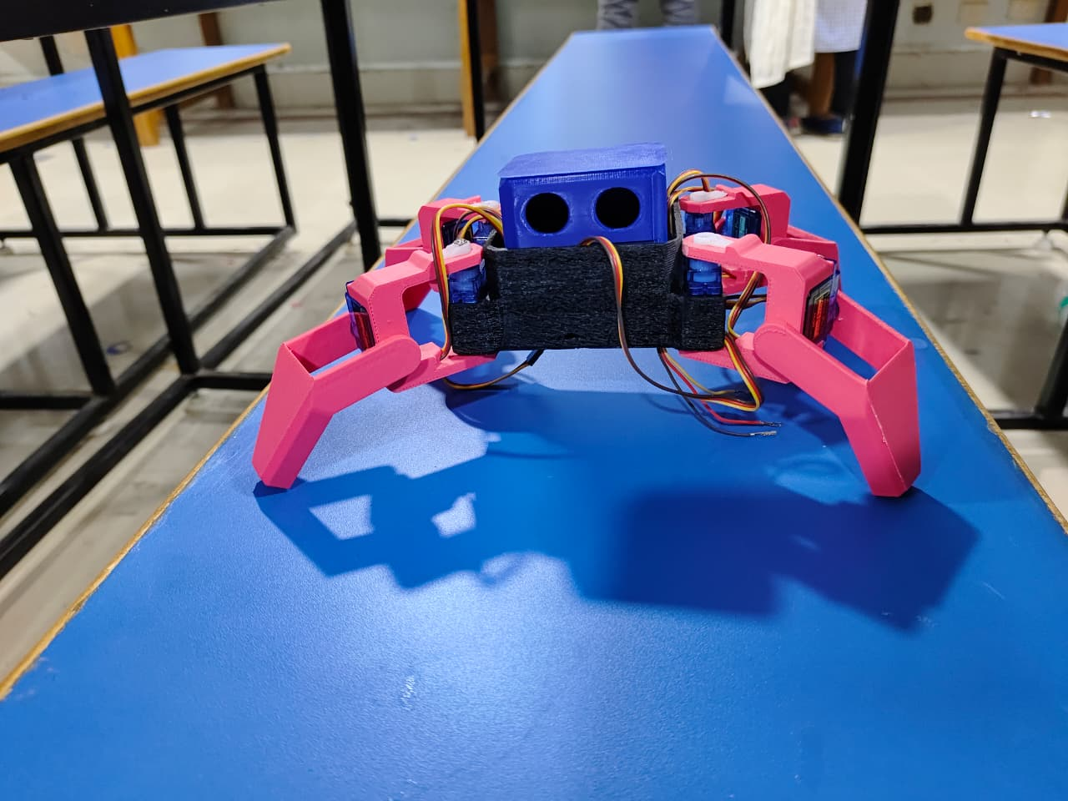
Introduction — What is a Quadruped Robot?
▶
A legged mobile robot that moves on four limbs — mimicking dogs, horses, insects
▶
Unlike wheeled robots, quadrupeds navigate uneven terrain, climb stairs, step over obstacles
▶
Each leg has 2+ joints providing degrees of freedom for stable gait generation
▶
This robot: Hip joint + Knee joint per leg → 8 DOF for locomotion
▶
Notable examples: Boston Dynamics Spot • Unitree Go1 • University research platforms
8 DOF
Static Head
8 Total
3 Domains
Locomotion (4 hips + 4 knees)
Head is stationary
SG90S Servos
Electronics Mechanical 3D Printing
Quadruped Robot Development | Group-E | ECE Dept., CGEC | WTL & MeitY | 2026
4/21

Slide 5
Real-World Applications of Quadruped Robots
🔍 Search & Rescue
🏥 Medical / Rehab
Navigates rubble, collapsed structures and disaster zones where wheels cannot go
Companion and assistive robots for elderly care and rehabilitation
⚙ Rough Terrain
🔬 Research Platform
Pipeline inspection, mining surveys, and remote area monitoring
Studying locomotion algorithms, control theory, and AI-based navigation
🎖 Military / Defence
🏭 Industrial
Cargo carrying, reconnaissance missions, and hazardous environment scouting
Automated factory floor inspection and infrastructure monitoring
Quadruped Robot Development | Group-E | ECE Dept., CGEC | WTL & MeitY | 2026
5/21

Slide 6
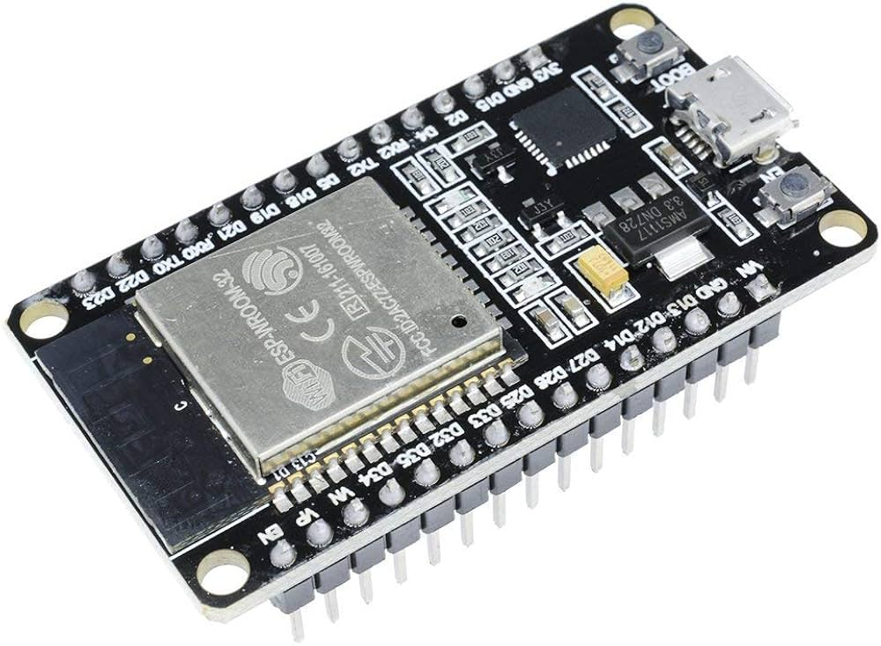
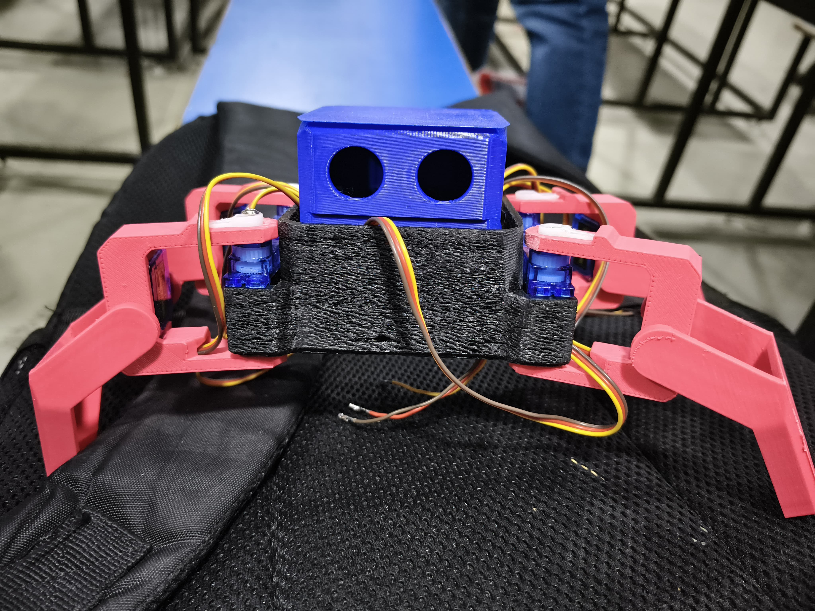
Why ESP32? & Why 3D Printing?
ESP32 — Central Controller
3D Printing — Chassis Fabrication
▶
Dual-core 240 MHz processor — powerful yet low-cost
▶
Rapid iteration on part dimensions without tooling cost
▶
Built-in Wi-Fi & Bluetooth for wireless control
▶
Customised mounting positions for every component
▶
Supports I2C and SPI for peripheral communication
▶
Fabricate geometrically complex parts cheaply
▶
Well-supported Arduino IDE ecosystem
▶
PLA+ → structural rigidity for Core Body & Head Box
▶
ESP32Servo library — direct servo control via PWM
▶
ABS → flexibility & impact resistance for leg links
▶
Wireless capability → OTA updates, remote teleoperation
▶
Entire robot chassis printed in the CGEC 3D Printing Lab
Quadruped Robot Development | Group-E | ECE Dept., CGEC | WTL & MeitY | 2026
6/21

Slide 7
Development Roadmap — 9-Phase Journey
From component verification to autonomous navigation
Phase 1
Phase 2
Phase 3
Phase 4
Phase 5
Phase 6
Phase 7
Phase 8
Phase 9
Servo & MCU Test
›
CAD Design
›
3D Printing
›
Assembly
›
Standing Pose
›
Walking Gait
›
Turning Gait
›
Sensor Integration
›
Autonomous Nav.
Complete
Complete
Complete
Complete
Complete
In Progress
Planned
Future
Future
Complete
In Progress / Planned
Future Roadmap
📌 This report covers Phases 1–5 in detail. Phases 6–9 form the future roadmap.
Quadruped Robot Development | Group-E | ECE Dept., CGEC | WTL & MeitY | 2026
7/21

Slide 8
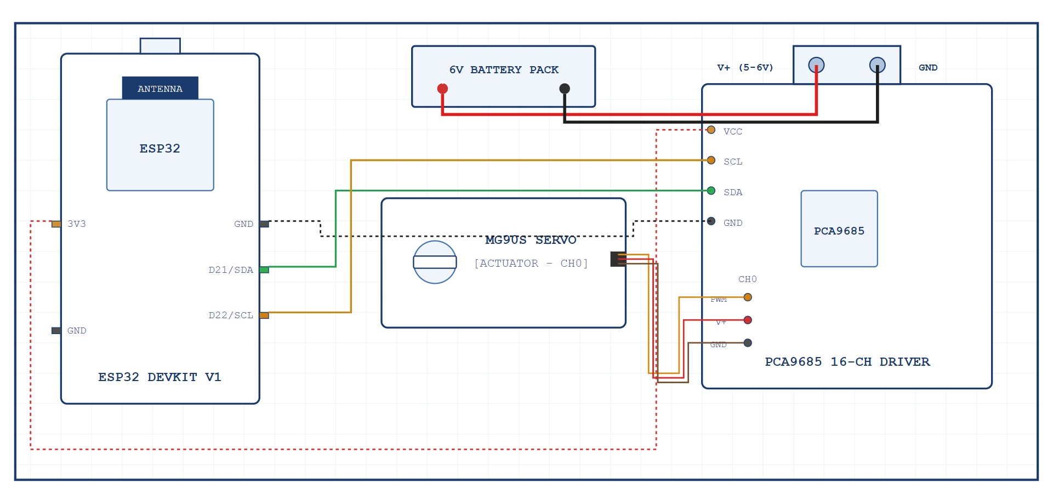
Electronics Architecture
4-Layer electronics stack
Layer 1 — Central Controller
ESP32 → PCA9685 Wiring
ESP32 Dev Board (I2C Master, Dual-core 240 MHz)
ESP32 Pin
PCA9685 Pin
▼
3.3V
VCC
Layer 2 — Servo Driver
GND
GND
PCA9685 16-Channel PWM Driver (I2C Slave @ 0x40)
GPIO21
SDA
▼
GPIO22
SCL
Layer 3 — Actuators
8× SG90S Metal Gear Micro Servos (4 Hip + 4 Knee)
▼
Layer 4 — Power Supply
External 5V Supply → PCA9685 V+ Servo Rail
⚠ PCA9685 V+ rail MUST have an external 5V supply (separate from VCC)
Quadruped Robot Development | Group-E | ECE Dept., CGEC | WTL & MeitY | 2026
8/21

Slide 9
Servo Channel Mapping
PCA9685 CH0–CH7 → 8 SG90S servos
CH0
Front Left Hip
CH5
Rear Left Knee
Type: Hip
Type: Knee
CH1
Front Left Knee
CH6
Rear Right Hip
Type: Knee
Type: Hip
CH2
Front Right Hip
CH7
Rear Right Knee
Type: Hip
Type: Knee
CH3
Front Right Knee
Type: Knee
CH4
Rear Left Hip
Type: Hip
Hip Servo
Knee Servo
Head Servo
Quadruped Robot Development | Group-E | ECE Dept., CGEC | WTL & MeitY | 2026
9/21

Slide 10
Critical Discovery — Servo Power Rail Issue
Real-world debugging experience during Phase 1
⚠ SYMPTOM
All 8 servos were completely unresponsive when controlled via PCA9685
🔍 I2C DIAGNOSIS
I2C scanner confirmed PCA9685 at address 0x40 — ESP32, I2C bus, and chip all functioning correctly
🔎 ROOT CAUSE
V+ rail measured only 0.10 V (expected 4.8–5.2 V) — servo power rail NOT connected to external 5V supply
✅ RESOLUTION
Connected 5V directly to PCA9685 V+ terminal → Servos responded immediately. V+ measured 4.92–5.05 V
📖 LESSON
Always verify servo rail voltage FIRST before suspecting firmware or I2C communication issues
Quadruped Robot Development | Group-E | ECE Dept., CGEC | WTL & MeitY | 2026
10/21

Slide 11
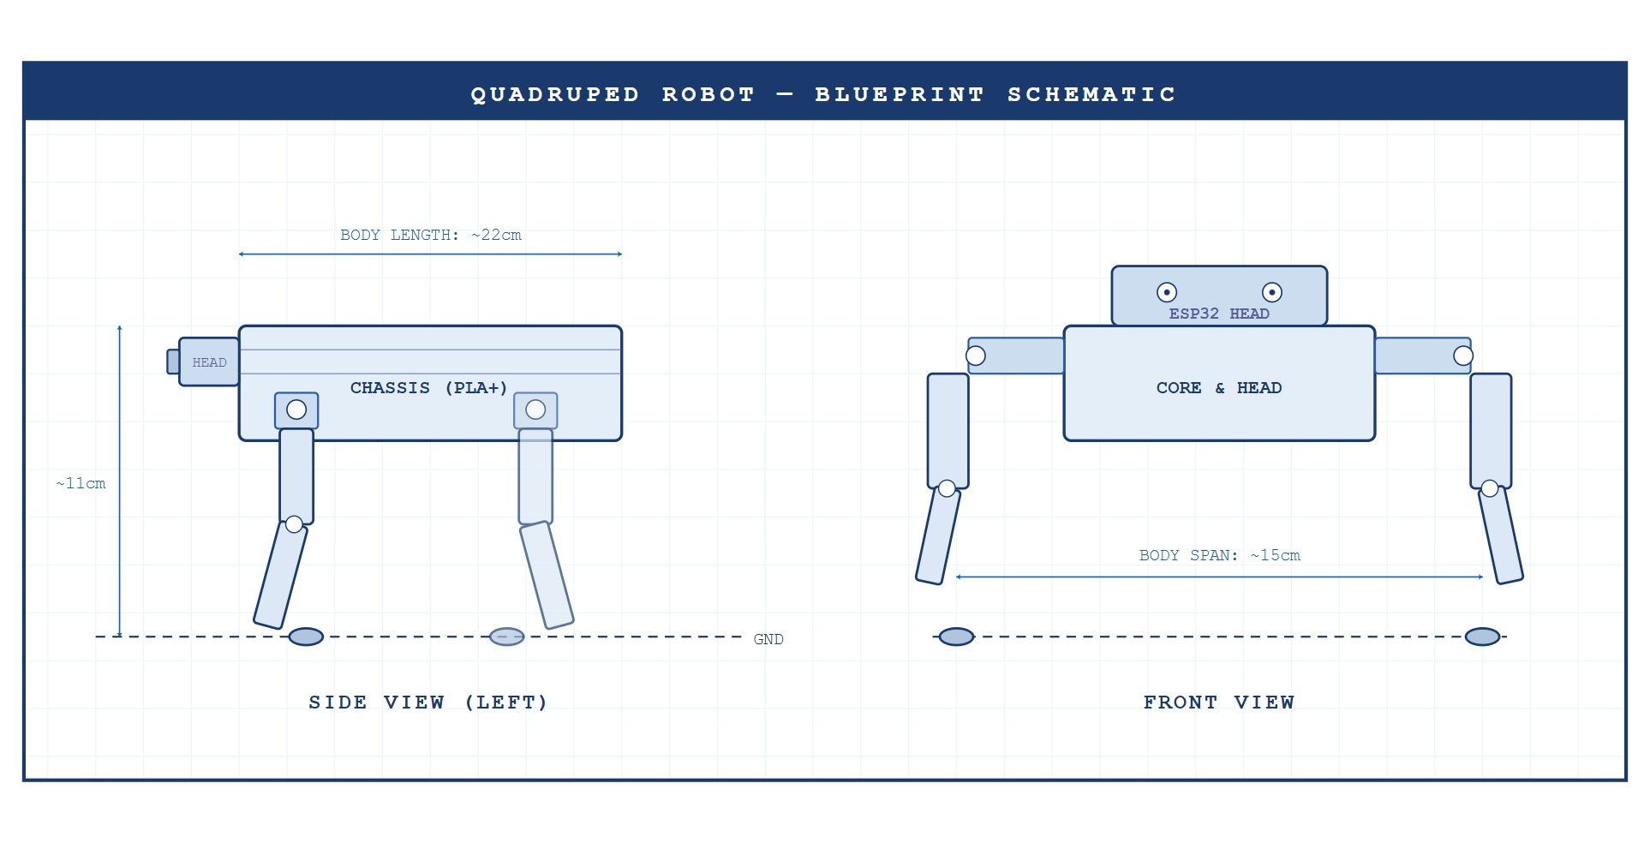
Mechanical Architecture & Component Dimensions
FreeCAD-designed chassis — all parts 3D printed
Structural Overview
Component Dimensions
▶
Two main assemblies: Head Box (electronics enclosure) + Core Body (central chassis)
Component
Dimensions (mm)
Notes
▶
Head Box — houses ESP32, PCA9685, power switch + future sensor mount provision
Core Body
110 × 85 × 4
4 hip mounts
▶
Core Body — mounts all 4 hip servos (4 total on chassis)
Head Box
85 × 65 × 45
Wall 2.5 mm — ESP32, PCA9685
▶
Each leg: Upper Leg (hip-driven) + Lower Leg (knee-driven) → 2 links per leg
Upper Leg ×4
45 × 10 × 5
PLA+ — hip servo driven
Lower Leg ×4
55 × 10 × 5
PLA+ — knee servo driven
Quadruped Robot Development | Group-E | ECE Dept., CGEC | WTL & MeitY | 2026
11/21

Slide 12
FreeCAD Design Workflow
Part Design workbench — parametric modelling
Core Body
Upper Leg
1
4
Base 110×85×4 mm plate with 4 symmetric hip servo pockets and central head servo mount
45 mm PLA link with servo horn connection hole at proximal end
Head Box
Hip
Lower Leg
2
5
Enclosure designed around ESP32 and PCA9685 PCB footprints (85×65×45 mm)
Four symmetric press-fit pockets at FL, FR, RL, RR corners
55 mm PLA link with foot pad boss at distal (terminal) end
Hip Servo Mounts
Assembly
3
6
Four symmetric press-fit pockets at FL, FR, RL, RR corners
All bodies assembled in FreeCAD Assembly with correct spacing and constraints
4
Quadruped Robot Development | Group-E | ECE Dept., CGEC | WTL & MeitY | 2026
12/21

Slide 13
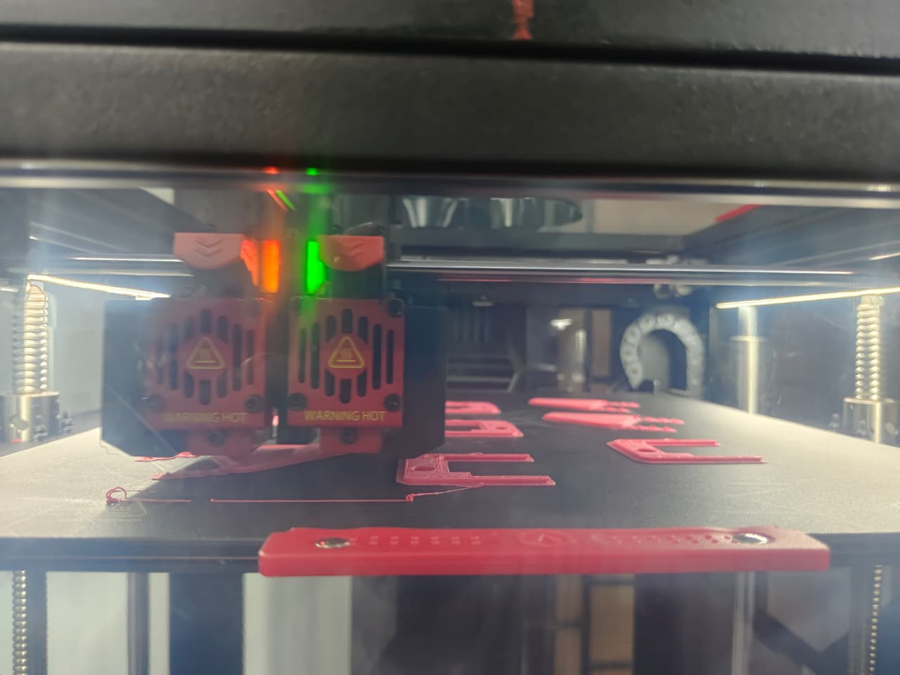
3D Printing Process — FDM Technology
CAD → STL → G-code → Print
Fused Deposition Modelling (FDM): thermoplastic filament melted & deposited layer-by-layer | Workflow: CAD Model → STL Export → Slicer (G-code) → 3D Printer
Material Selection
Slicer Settings
Core Body, Head Box
Parameter
Value
ABS
High stiffness, low warping, easy to print
Layer Height
0.2 mm
Infill Density
40%
Upper Leg, Lower Leg (×4 each)
PLA
Perimeter Walls
4
Toughness & flexibility for repeated bending/impact loads
Nozzle Diameter
0.4 mm
Print Speed
50 mm/s
Support
As required
Quadruped Robot Development | Group-E | ECE Dept., CGEC | WTL & MeitY | 2026
13/21

Slide 14
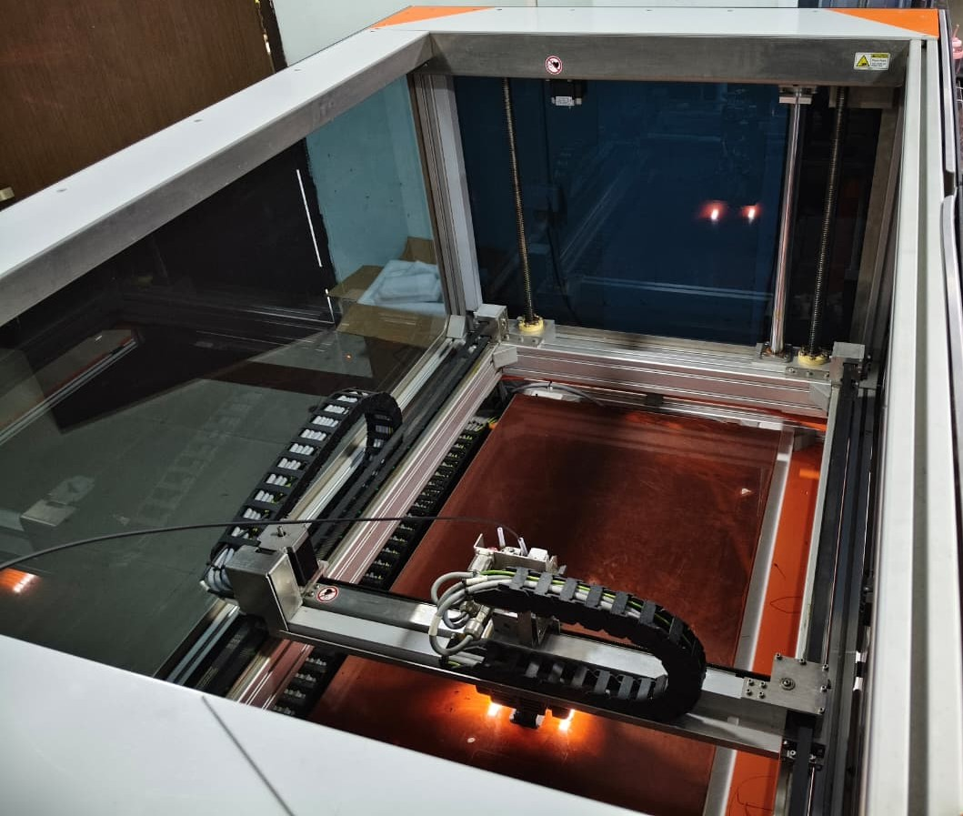
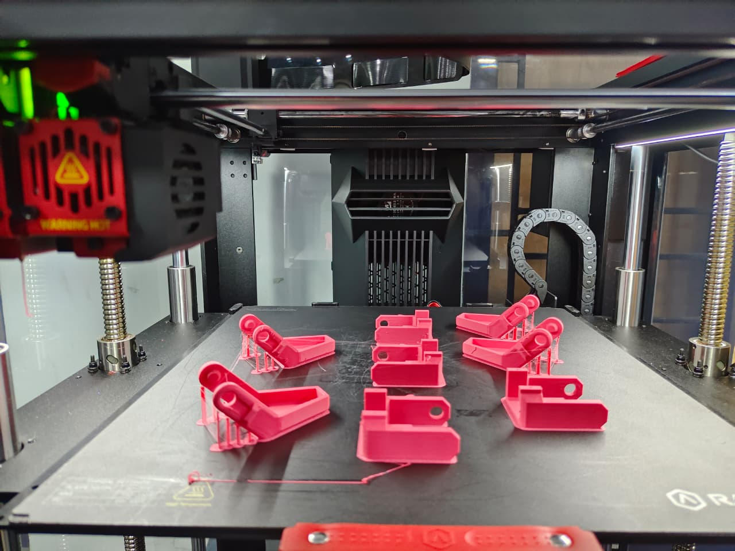
3D Printing in the Lab
Fabrication of quadruped robot components at CGEC 3D Printing Lab
3D Printer (FDM) in the CGEC Lab during fabrication of the Core Body and Head Box using ABS.
Fabricated leg components (Upper and Lower leg segments) printed in magenta PLA for high layer adhesion and impact strength.
Quadruped Robot Development | Group-E | ECE Dept., CGEC | WTL & MeitY | 2026
14/21

Slide 15
Products Made — 3D Printed Parts
19 total printed components
Part
Material
Dimensions
Qty
Description
Core Body
ABS
110×85×4 mm
1
Central chassis; 4 hip mounts; 4mm thickness for bending rigidity
Head Box
ABS
85×65×45 mm
1
Electronics enclosure for ESP32, PCA9685 & power switch; 2.5mm walls; future sensor provision
Upper Leg
PLA
45×10×5 mm
4
Hip-servo driven link; servo horn attachment hole at proximal end
Lower Leg
PLA
55×10×5 mm
4
Knee-servo driven link; foot pad boss at distal terminal end
Quadruped Robot Development | Group-E | ECE Dept., CGEC | WTL & MeitY | 2026
15/21

Slide 16
Arduino Programming
Arduino IDE + ESP32 board support package
Development Environment & Libraries
// Servo Test Code — ESP32 direct GPIO18
ESP32Servo
Direct servo control via GPIO PWM
#include <ESP32Servo.h>
Wire
I2C communication for PCA9685
Servo myServo;
void setup() {
Adafruit_PWMServoDriver
High-level PCA9685 servo control
myServo.attach(18); // GPIO18
}
Code Listings
void loop() {
Listing 1
Servo Test Code: Direct GPIO18 sweep — 0° → 90° → 180° per servo
myServo.write(0); delay(1000);
Listing 2
PCA9685 I2C Scanner: Scans I2C bus, confirms address 0x40
myServo.write(90); delay(1000);
myServo.write(180); delay(1000);
Listing 3
I2C Scan Output: Expected serial monitor: 'I2C device found at 0x40'
}
Listing 4
PCA9685 Servo Control: All-channel sweep through Adafruit PWM library
Quadruped Robot Development | Group-E | ECE Dept., CGEC | WTL & MeitY | 2026
16/21

Slide 17
Results & Testing
I2C verification · Power rail · All-servo sweep
I2C Communication Verification
Individual Servo Test Results (All 8 Passed)
PCA9685 confirmed at address 0x40 via I2C scanner
#
Function
0°
180°
Full chain validated: ESP32 → GPIO21/22 → SDA/SCL → PCA9685
1
Front Left Hip (CH0)
✓ Pass
✓ Pass
Power Rail Diagnosis & Resolution
2
Front Left Knee (CH1)
✓ Pass
✓ Pass
Before fix: V+ = 0.10 V (expected 4.8–5.2 V)
3
Front Right Hip (CH2)
✓ Pass
✓ Pass
After fix: V+ = 4.92–5.05 V → All servos responded immediately
4
Front Right Knee (CH3)
✓ Pass
✓ Pass
5
Rear Left Hip (CH4)
✓ Pass
✓ Pass
6
Rear Left Knee (CH5)
✓ Pass
✓ Pass
7
Rear Right Hip (CH6)
✓ Pass
✓ Pass
8
Rear Right Knee (CH7)
✓ Pass
✓ Pass
Quadruped Robot Development | Group-E | ECE Dept., CGEC | WTL & MeitY | 2026
17/21

Slide 18
Development Phase Status
Current progress across all 9 phases
1
Component Verification
Complete
6
Walking Gait
In Progress
2
CAD Design in FreeCAD
Complete
7
Turning Gait
Planned
3
3D Printing All Parts
Complete
8
Sensor Integration
Planned
4
Servo Calibration
Complete
9
Autonomous Navigation
Future
5
Standing Pose
Complete
55% Complete (5 of 9 Phases)
Quadruped Robot Development | Group-E | ECE Dept., CGEC | WTL & MeitY | 2026
18/21

Slide 19
Conclusion
Key achievements and future roadmap
Electronics
Systematic debugging validated: I2C chain, servo power rail fix, all 8 servos operational across full 0°–180° range
Mechanical Design
Parametric FreeCAD CAD workflow mastered: , press-fit tolerances, STL export → design-for-manufacture skills
3D Printing
Hands-on material selection (PLA & ABS), slicer optimization, and print quality assessment in CGEC Lab
Overall Platform
Fully functional 8-DOF quadruped hardware + software stack built — validated foundation for walking gait development
Roadmap: Phase 6 Walking Gait (IK) → Phase 7 Turning → Phase 8 Sensors → Phase 9 Autonomous Navigation via ESP32 Wi-Fi
Quadruped Robot Development | Group-E | ECE Dept., CGEC | WTL & MeitY | 2026
19/21

Slide 20
References
[1]
Previous Batch Project Report — 3D Printing and Embedded Systems, CGEC Dept. of ECE, WTL & MeitY Project, Cooch Behar, West Bengal, 2024
[2]
Espressif Systems, ESP32 Technical Reference Manual, v5.3, Espressif Systems, 2024
[3]
NXP Semiconductors, PCA9685 16-channel 12-bit PWM I2C-bus LED controller, Product datasheet Rev. 4, NXP, 2015
[4]
Tower Pro, SG90S Metal Gear Micro Servo Datasheet, Tower Pro Co. Ltd., 2020
[5]
FreeCAD Community, FreeCAD: Your Own 3D Parametric Modeler, https://www.freecad.org
Quadruped Robot Development | Group-E | ECE Dept., CGEC | WTL & MeitY | 2026
20/21

Slide 21
THANK YOU
━━━━━━━━━━━━━━━━━━━━━━━━━━━━━━━━━━━━━━━━━━━━━
Quadruped Robot Development | Group-E | CGEC 2026
WTL & MeitY Industrial Training Programme
Guided by: Dr. Palash Das · Mrs. Susmita Banik Barik · Mr. Arijit Bhunia · Mr. Bhaskar Mondal

