Slide 1
Contents
01. INTRODUCTION
Project motivations, HMI background, and previous works review.
02. SYSTEM DESIGN
Overall system block diagram and hardware-software signal flow.
03. TRANSMITTER HARDWARE
ESP32 transmitter board, wearable glove assembly, and MPU6050 sensor.
04. RECEIVER HARDWARE
ESP32 receiver board, dual L298N drivers, and four 200 RPM BO motors.
05. CIRCUIT INTEGRATION
Direct GPIO schematic connections and common grounding system.
06. WIRELESS PROTOCOL
ESP-NOW protocol, connectionless peer-to-peer latency, and MAC pairing.
07. WHEEL KINEMATICS
Mecanum wheel force vectors and the holonomic movement control matrix.
08. CONTROL ALGORITHMS
Trigonometric Pitch and Roll calculation, filters, and code listings.
09. CALIBRATION & ASSEMBLY
Sensor threshold configuration and wearable glove prototype build.
10. TESTING & FUTURE SCOPE
Performance metrics (8 ms latency, 45 m range) and next steps.
GESTURE CONTROLLED WIRELESS 4WD ROBOTIC CAR | MINI-PROJECT REPORT
Slide 1 of 12

Slide 2
1. Introduction & Project Overview
Intuitive Human-Machine Interfaces (HMI)
Standard controllers (joysticks, remote control pads) require physical contact, manual dexterity, and training. Gesture-based steering offers an intuitive, hands-free interface.
Gesture-Based Motion Mapping
Translates natural hand tilts into system command vectors. Tilting the hand forward, backward, left, or right coordinates physical direction changes in real-time.
ESP32/ESP-NOW Architecture
Using Espressif's connectionless protocol reduces transmission latency to a minimum, bypassing the handshaking delays and router pairing required in traditional Wi-Fi setups.
Real-World Application Scope
Highly applicable to heavy warehouse logistics, search-and-rescue assistance in hazardous areas, and assistive mobility interfaces for disabled individuals.
GESTURE CONTROLLED WIRELESS 4WD ROBOTIC CAR | MINI-PROJECT REPORT
Slide 2 of 12

Slide 3
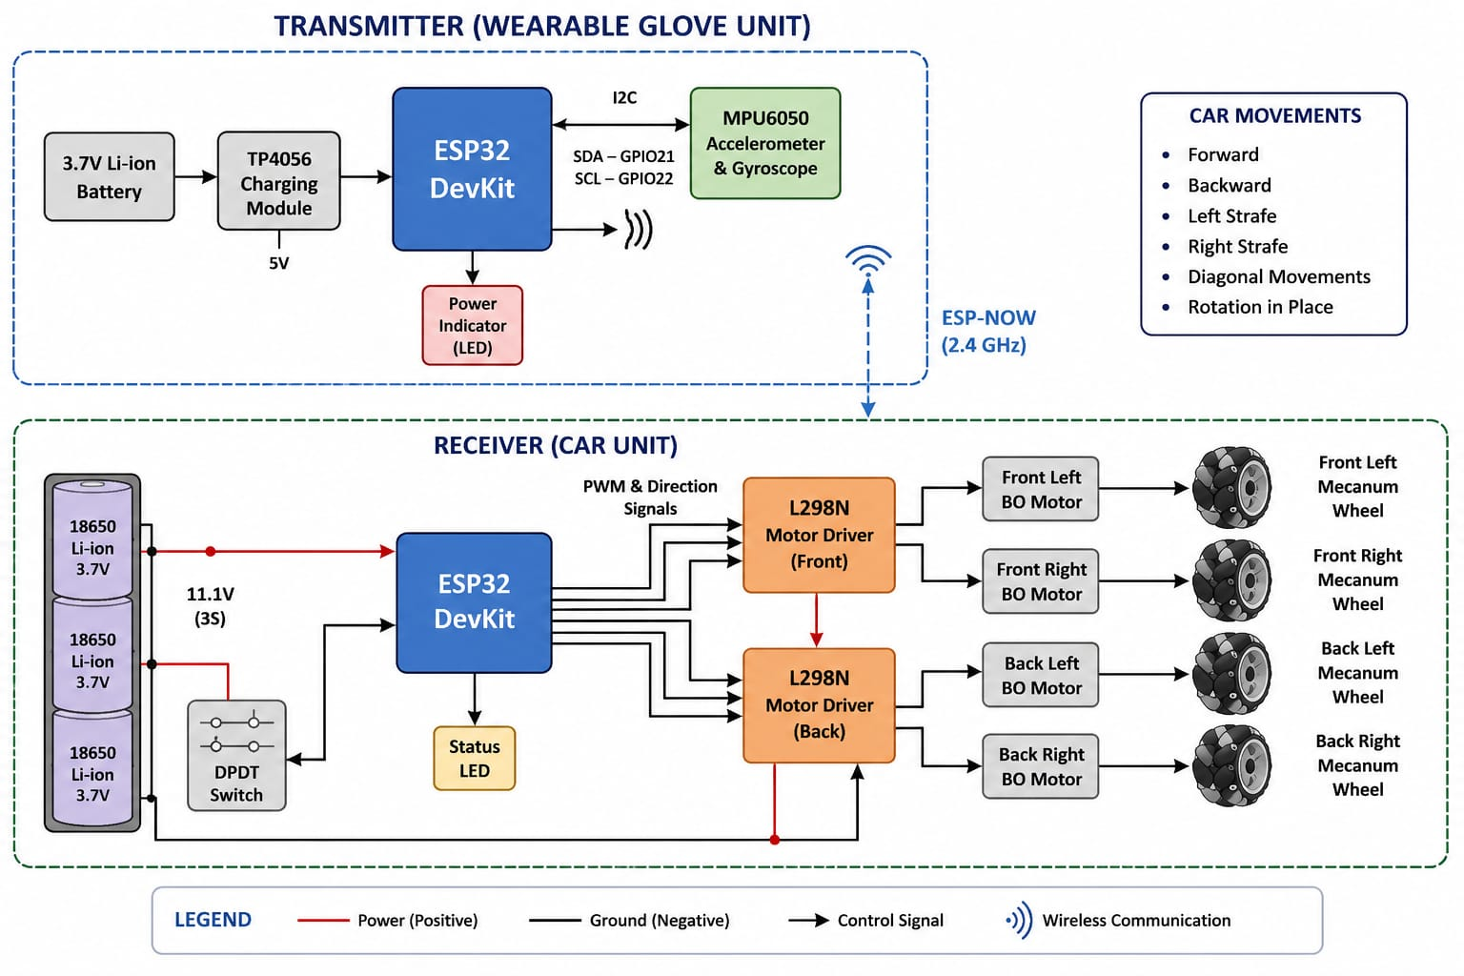
2. System Architecture Design
Transmitter Wearable Glove
Interfaced with the MPU6050 motion sensor. Tracks static gravity vectors to compute wrist orientation (Pitch and Roll).
ESP-NOW Direct Communication Link
Broadcasts structured packets over the 2.4 GHz band directly to the receiver's physical MAC address, minimizing delay.
Receiver Mobile Chassis
Decodes structural packets and drives dual L298N H-Bridge motor drivers to regulate the speed and direction of all four wheels.
GESTURE CONTROLLED WIRELESS 4WD ROBOTIC CAR | MINI-PROJECT REPORT
Slide 3 of 12

Slide 4
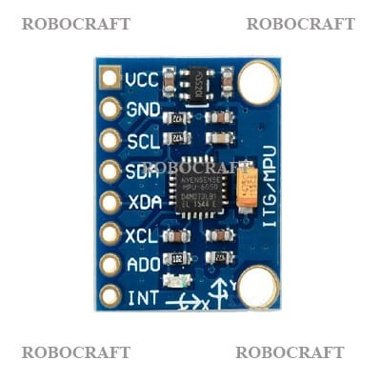
3. Transmitter Hardware Components
ESP32 Development Board
Features a 32-bit dual-core processor running at 240 MHz. Handles sensor initialization, complementary filtering, and ESP-NOW broadcasts.
MPU6050 6-Axis Motion Sensor
Combines a 3-axis accelerometer and a 3-axis gyroscope on a single silicon die. Transmits orientation vectors over the hardware I2C bus.
Physical Interface Connections
Operates at 3.3V. SCL is mapped to GPIO 22 and SDA is mapped to GPIO 21 on the transmitter board.
GESTURE CONTROLLED WIRELESS 4WD ROBOTIC CAR | MINI-PROJECT REPORT
Slide 4 of 12

Slide 5
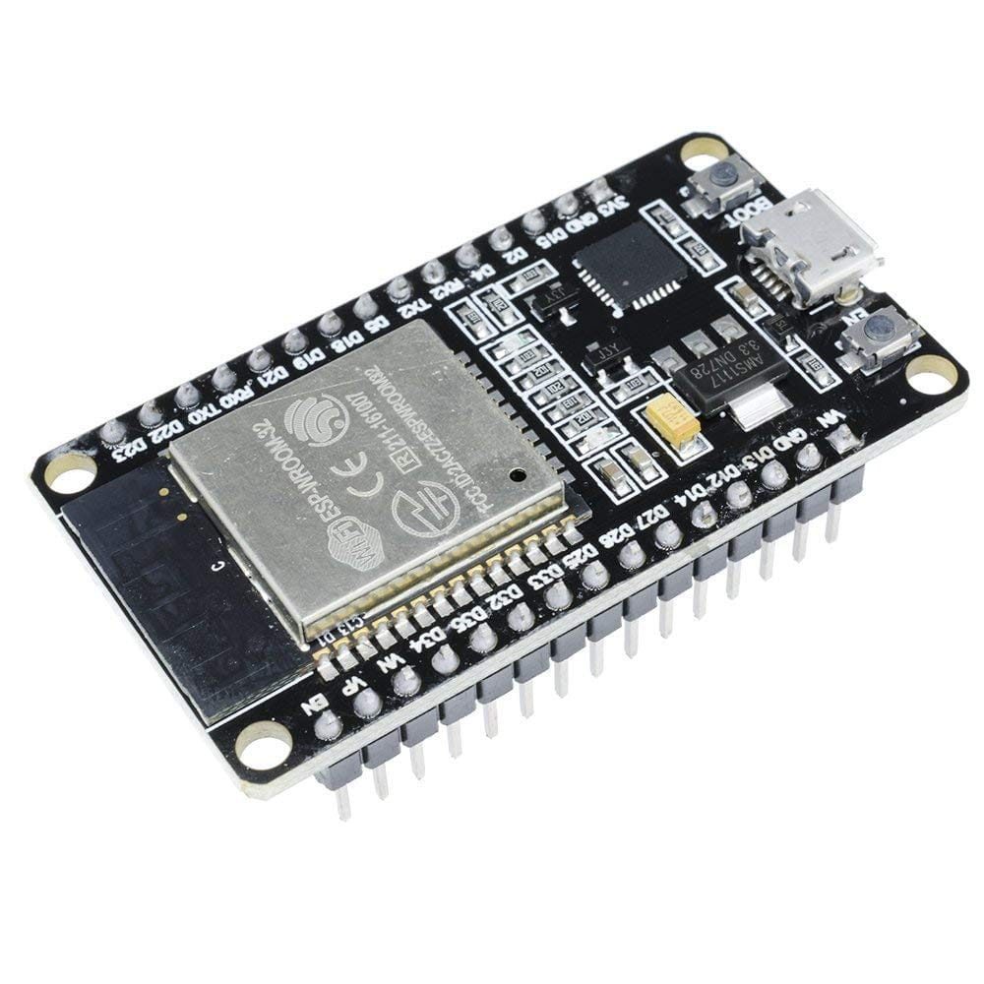
4. Receiver Hardware Components
ESP32 Receiver Board
Runs a dedicated ESP-NOW receiver callback routine. Decodes incoming packets and outputs logic commands and PWM values.
Dual L298N H-Bridge Drivers
Split into Front and Back configurations. Handles up to 2A per channel to power the motors without overloading the microcontrollers.
Actuators & 7.4V Power Supply
Four 200 RPM dual shaft BO geared motors provide optimal torque, driven by two series-wired 18650 Lithium-Ion batteries.
GESTURE CONTROLLED WIRELESS 4WD ROBOTIC CAR | MINI-PROJECT REPORT
Slide 5 of 12

Slide 6
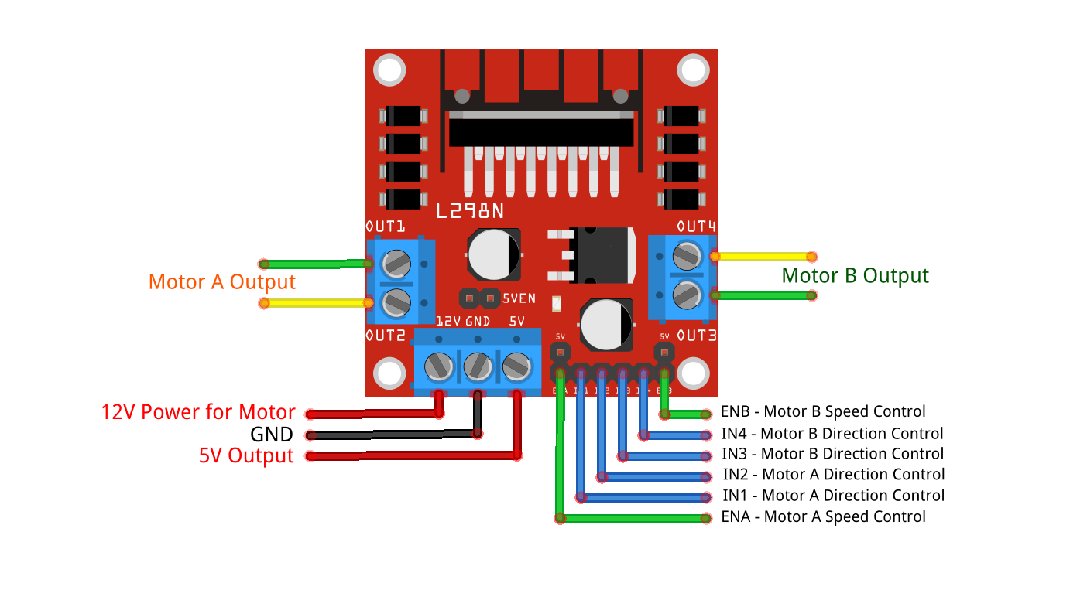
5. Circuit Integration & Wiring
Direct GPIO Connection Mapping
Maintains dedicated pins (ENA, IN1-IN4, ENB) for both the Front and Back motor drivers to support independent wheel speed.
PWM Signal Modulation
ESP32 outputs analog-mapped PWM speed controls (range 0-255) to L298N enable pins to smooth acceleration and cornering.
Isolated Power & Common Ground
Tying all GND pins together establishes a common reference voltage, preventing motor back-EMF spikes from causing microcontroller resets.
GESTURE CONTROLLED WIRELESS 4WD ROBOTIC CAR | MINI-PROJECT REPORT
Slide 6 of 12

Slide 7
6. Wireless Protocol: ESP-NOW
Connectionless Packet Transfer
Operates at 2.4 GHz, broadcasting command payloads directly without routing through a local wireless router.
Ultra-Low Latency Performance
Command transmission time is restricted to under 10 ms, ensuring instant reaction compared to standard Bluetooth or Wi-Fi pairings.
Unicast MAC Address Registration
Secure peer-to-peer connection is established by programming the receiver ESP32's unique physical 48-bit MAC address into the transmitter.
Signal Reliability and Range
Built-in CRC check and direct pairing deliver high noise immunity and a stable control range of up to 45 meters under line-of-sight conditions.
GESTURE CONTROLLED WIRELESS 4WD ROBOTIC CAR | MINI-PROJECT REPORT
Slide 7 of 12

Slide 8
7. Mecanum Wheel Kinematics
Holonomic Mobility Control
Rollers mounted at 45-degree angles on the wheel perimeter create diagonal force vectors, allowing 360-degree translation.
Movement Control Matrix
Varying the rotational speed and direction of individual wheels enables lateral sliding, diagonal steering, and spot rotation.
Action | FL Wheel | FR Wheel | BL Wheel | BR Wheel
Forward | Forward | Forward | Forward | Forward
Backward | Reverse | Reverse | Reverse | Reverse
Lateral Left | Reverse | Forward | Forward | Reverse
Lateral Right | Forward | Reverse | Reverse | Forward
Stop | Stop | Stop | Stop | Stop
GESTURE CONTROLLED WIRELESS 4WD ROBOTIC CAR | MINI-PROJECT REPORT
Slide 8 of 12

Slide 9
8. Software Control Firmware
Trigonometric Angle Calculations
Transmitter reads MPU6050 raw accelerations over the I2C bus and calculates hand Pitch and Roll angles using trigonometric atan2 functions.
Vibration Complementary Filtering
Applies complementary filtering to raw angles, blending accelerometer and gyroscope vectors to remove high-frequency motor vibrations.
Structured Payload Broadcasting
Maps Pitch/Roll values to 0-254 integers, packages them in a structured payload, and broadcasts via ESP-NOW to the receiver.
Callback Direction Decoding
Receiver decodes packets instantly inside an ESP-NOW callback, driving the H-bridges based on calibrated tilt thresholds.
GESTURE CONTROLLED WIRELESS 4WD ROBOTIC CAR | MINI-PROJECT REPORT
Slide 9 of 12

Slide 10
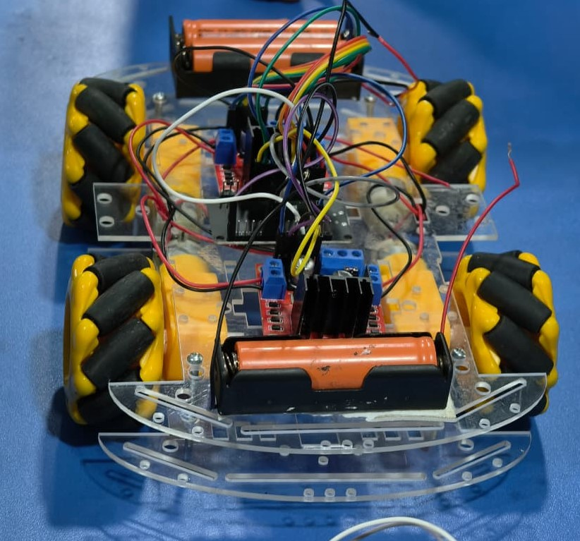
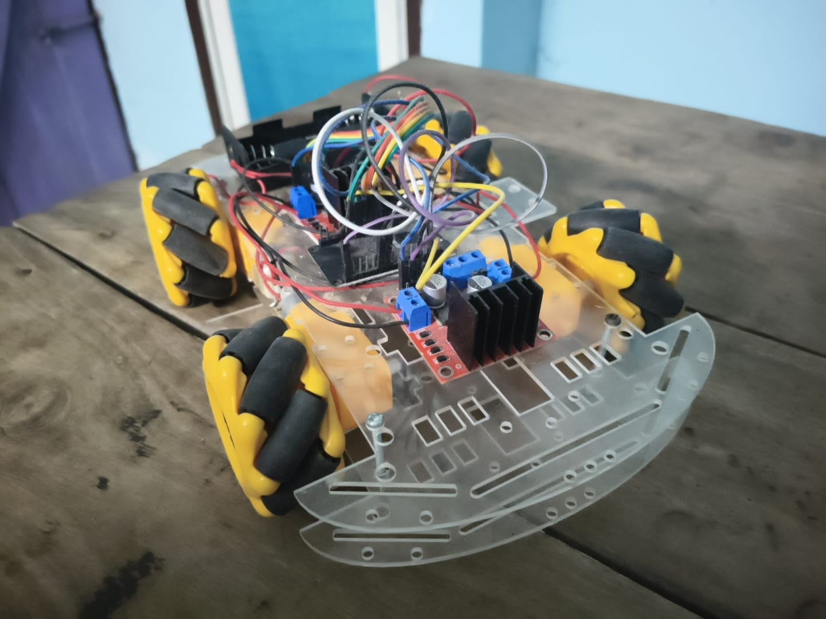
9. Calibration & Physical Assembly
Sensor Threshold Calibration
Neutral flat state mapped to 310-350. Directional tilt triggers are set at boundaries (< 290 and > 370) to prevent accidental movements.
Wearable Control Glove
MPU6050 sensor, ESP32 transmitter, and a slide power switch integrated onto a wearable glove for comfortable, intuitive hand gestures.
Assembled 4WD Vehicle
Dual shaft BO motors, L298N drivers, 18650 battery pack, and ESP32 receiver consolidated onto a stable dual-deck acrylic robot chassis.
GESTURE CONTROLLED WIRELESS 4WD ROBOTIC CAR | MINI-PROJECT REPORT
Slide 10 of 12

Slide 11
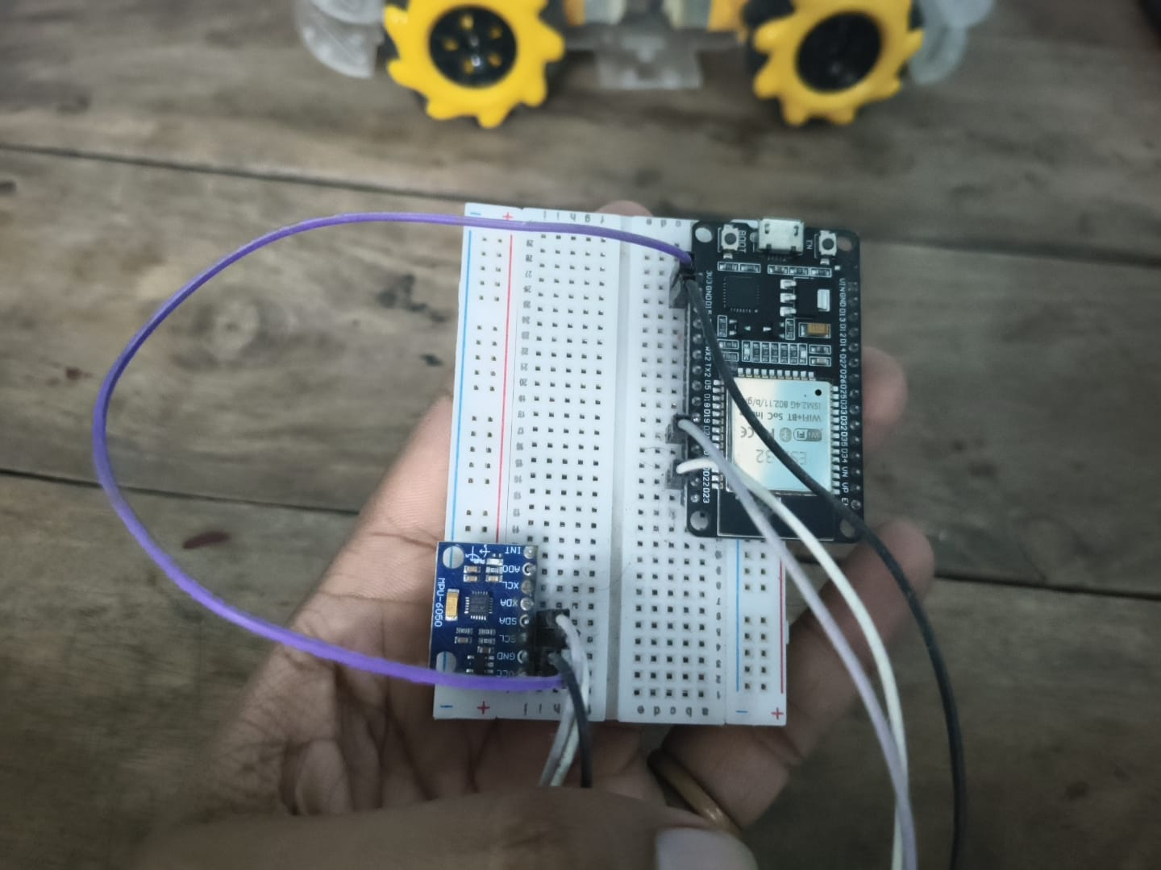
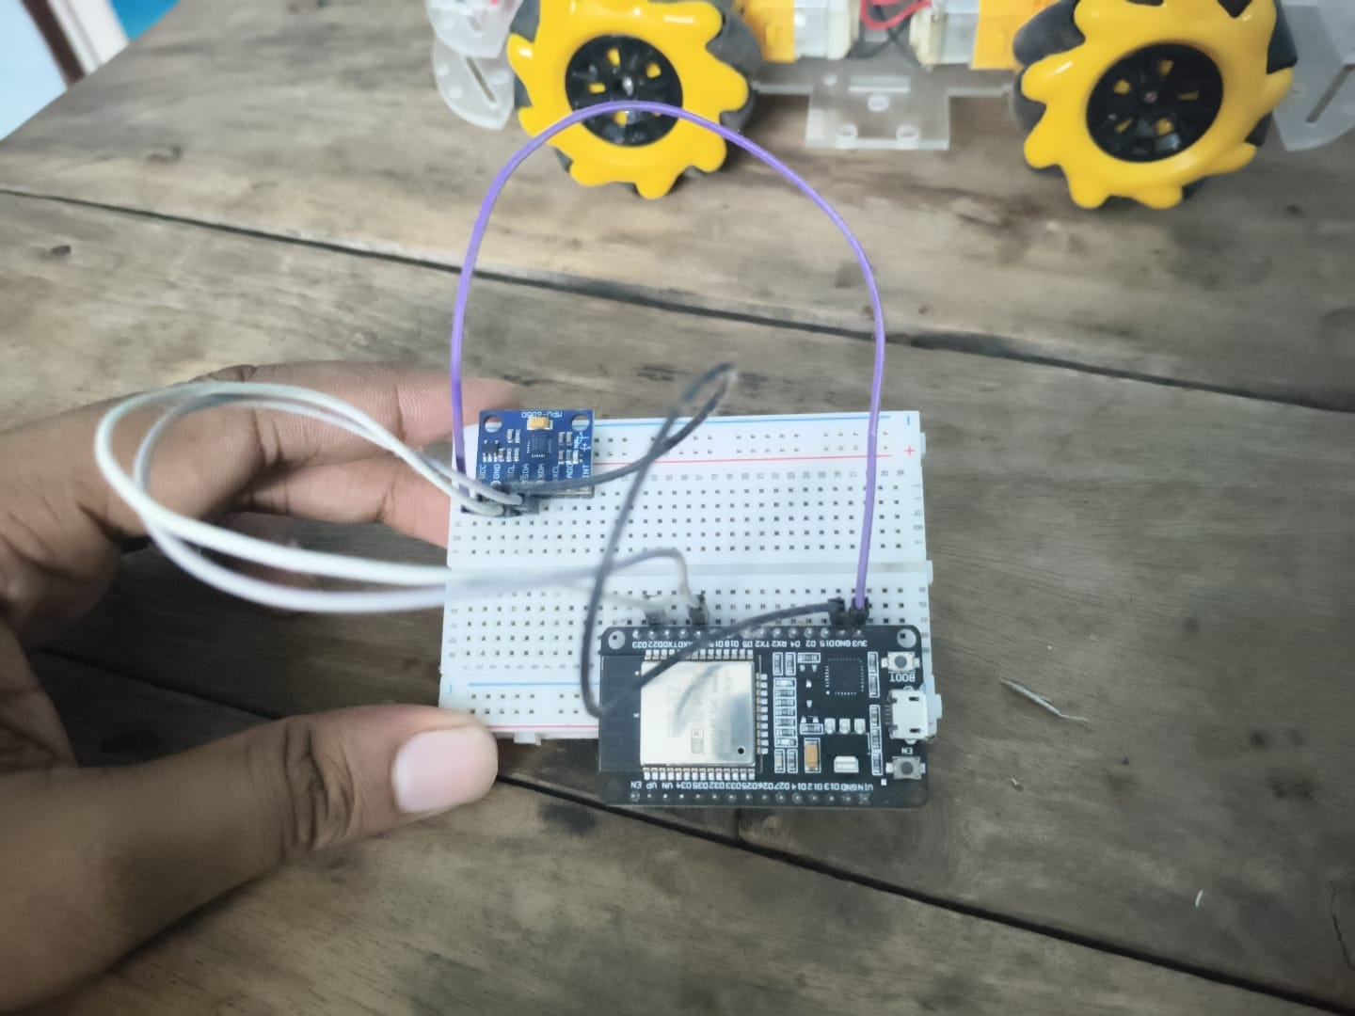
10. Performance Testing & Evaluation
Signal Latency Metrics
Achieves a highly responsive latency of 8 ms from hand tilt to motor reaction.
Wireless Range Testing
Maintains a stable, error-free line-of-sight wireless control range of up to 45 meters.
Operational Battery Runtime
Two series 18650 Li-Ion cells supply 45 minutes of continuous run time under full load.
GESTURE CONTROLLED WIRELESS 4WD ROBOTIC CAR | MINI-PROJECT REPORT
Slide 11 of 12

Slide 12
11. Conclusions & Future Scope
Successful System Realization
Realized a low-latency connectionless ESP-NOW mobile robotic vehicle driven by wearable MPU6050 accelerometer wrist tilt gestures, providing a highly intuitive and responsive HMI interface.
Stable Physical Verification
System calibration and trials verified instant directional response (Forward, Reverse, Lateral Left/Right, Diagonal Drift) with high noise immunity and battery efficiency.
Future Research and Enhancements
Planned expansions include replacing L298N drivers with high-efficiency TB6612FNG drivers, integrating ultrasonic and LiDAR sensors for autonomous obstacle avoidance, implementing Kalman filters for sensor fusion, and integrating with the Robot Operating System (ROS) for warehouse routing.
GESTURE CONTROLLED WIRELESS 4WD ROBOTIC CAR | MINI-PROJECT REPORT
Slide 12 of 12

