Slide 1

OBJECT FOLLOWING ROBOT USING ARDUINO UNO
MINI-PROJECT PRESENTATION
Department of Electronics and Communication Engineering Cooch Behar Government Engineering College Maulana Abul Kalam Azad University of Technology (MAKAUT)
PROJECT MEMBERS:
Anupam Dutta (34900323003) | Biraj Sarkar (34900323013) | Debanjan Chakraborty (34900323015) Sayan Sarkar (34900323048) | Soumyajit Pandit (34900323052)
PROJECT SUPERVISOR: Dr. Gautam Das

Slide 2
Contents
01. INTRODUCTION & PROJECT OVERVIEW
Project motivations, HMI background, and active sensor envelope.
02. SYSTEM ARCHITECTURE DESIGN
Overall system block diagram and hardware pin connection mapping.
03. HARDWARE COMPONENTS & SENSORS
Arduino UNO board, HC-SR04, and IR proximity sensor modules.
04. ACTUATORS & MOTOR DRIVERS
Brushed DC BO geared motors and L298N H-Bridge driver module.
05. POWER SCHEME & SYSTEM STABILITY
Unified 7.4V battery pack delivery and power isolation details.
06. SOFTWARE CONTROL ALGORITHMS
State machine movements: forward, lateral turns, and search modes.
07. CONTROL SOFTWARE SOURCE CODE
Arduino C++ code implementation utilizing the NewPing library.
08. CALIBRATION & INTEGRATION
Sensor threshold calibrations and action-command state mappings.
09. PERFORMANCE TESTING & EVALUATION
Experimental ranging trials, system latency, and battery runtimes.
10. CONCLUSIONS
Summary of completed physical prototype and design achievements.
11. FUTURE SCOPE
Solutions to voltage drops and proposed ESP32-CAM and PID upgrades.
OBJECT FOLLOWING ROBOT USING ARDUINO UNO | MINI-PROJECT PRESENTATION
Slide 1 of 12

Slide 3
1. Introduction & Project Overview
Autonomous Target Following
Following capabilities represent an essential domain of Human-Machine Interaction (HMI). It enables hands-free operation and natural cooperation between humans and mobile platforms.
Active Sensory Envelopes
Traditional vision-based human tracking requires high processing power (like Raspberry Pi boards), increasing weight, cost, and power consumption. Acoustic and IR sensors offer a low-cost, power-efficient alternative.
Multi-Sensor System Configuration
By combining a front-mounted HC-SR04 ultrasonic distance sensor with side-mounted infrared proximity sensors, the robot establishes a clean spatial envelope to follow targets in real-time.
Real-World Applications
Highly applicable in industrial automation, smart hospital carts that follow medical staff, hands-free warehouse transport luggage, and automated shopping guides.
OBJECT FOLLOWING ROBOT USING ARDUINO UNO | MINI-PROJECT PRESENTATION
Slide 2 of 12

Slide 4
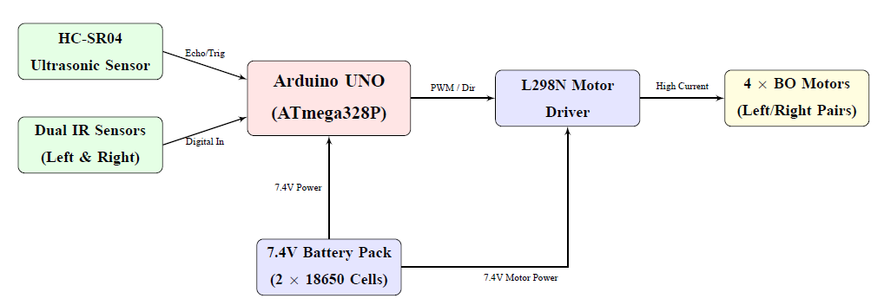
2. System Architecture Design
Multi-Sensor Input Interface
An HC-SR04 ultrasonic sensor provides front distance metrics. Side-mounted left and right IR proximity sensors detect lateral offsets when the target moves sideways.
Central Processing Core
The Arduino UNO reads inputs, determines distance and target boundaries, and executes a state machine to compute direction and PWM motor speeds.
Differential Steering Actuation
The L298N H-Bridge motor driver regulates battery current to four BO geared motors. Steering is achieved by varying the rotation of left and right wheels.
OBJECT FOLLOWING ROBOT USING ARDUINO UNO | MINI-PROJECT PRESENTATION
Slide 3 of 12

Slide 5
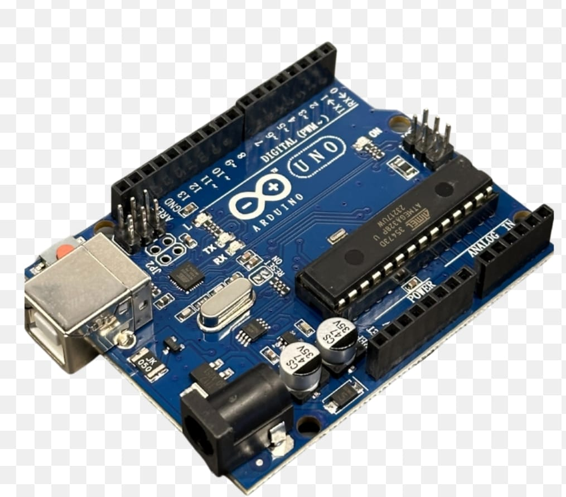
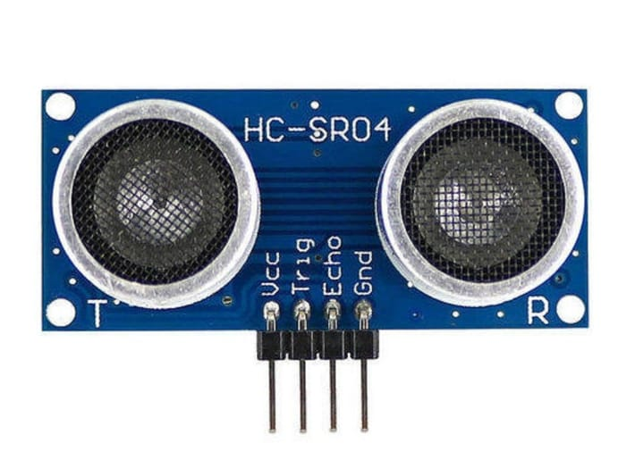
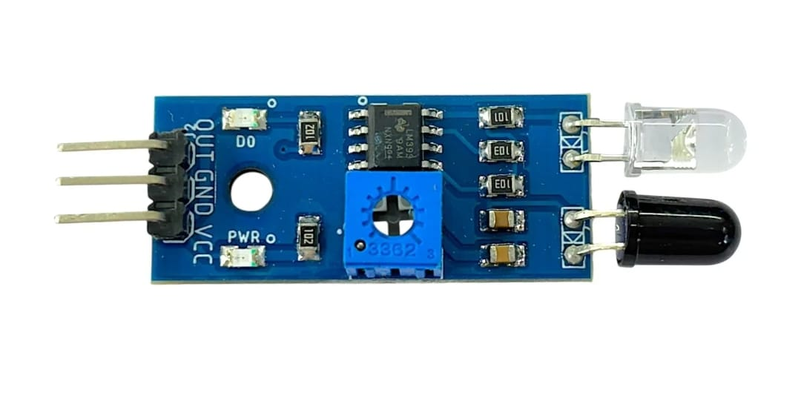
3. Arduino UNO & Sensors
Arduino UNO Development Board
Based on the ATmega328P microcontroller running at 16 MHz. Features 14 digital I/O pins (6 PWM) and 6 analog inputs. Runs the control loop that processes inputs and regulates actuators.
HC-SR04 Ultrasonic Distance Sensor
Measures target distance by transmitting 40 kHz acoustic waves. Ranging duration determines distance: d = (t * 0.034) / 2. Operates from 2 cm to 400 cm with a 3 mm accuracy.
Infrared Proximity Sensors
Dual side-mounted sensors detect lateral offset. Emits IR light; reflections decrease receiver photodiode resistance, outputting LOW when target is detected within 8 cm.
OBJECT FOLLOWING ROBOT USING ARDUINO UNO | MINI-PROJECT PRESENTATION
Slide 4 of 12

Slide 6
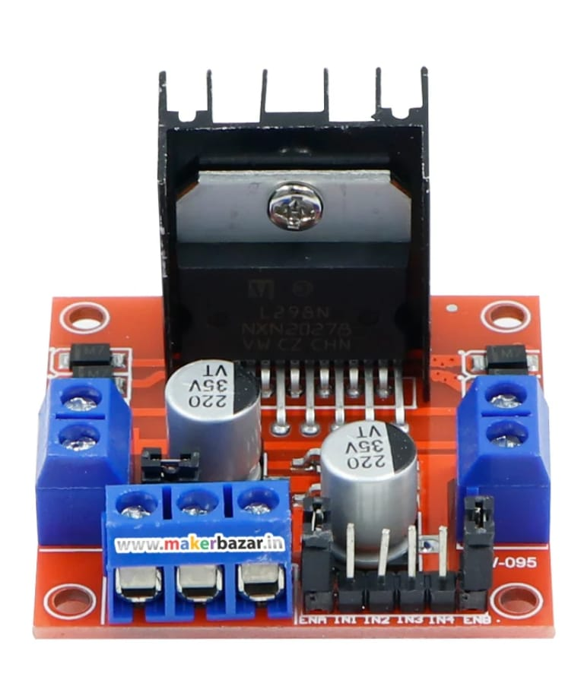
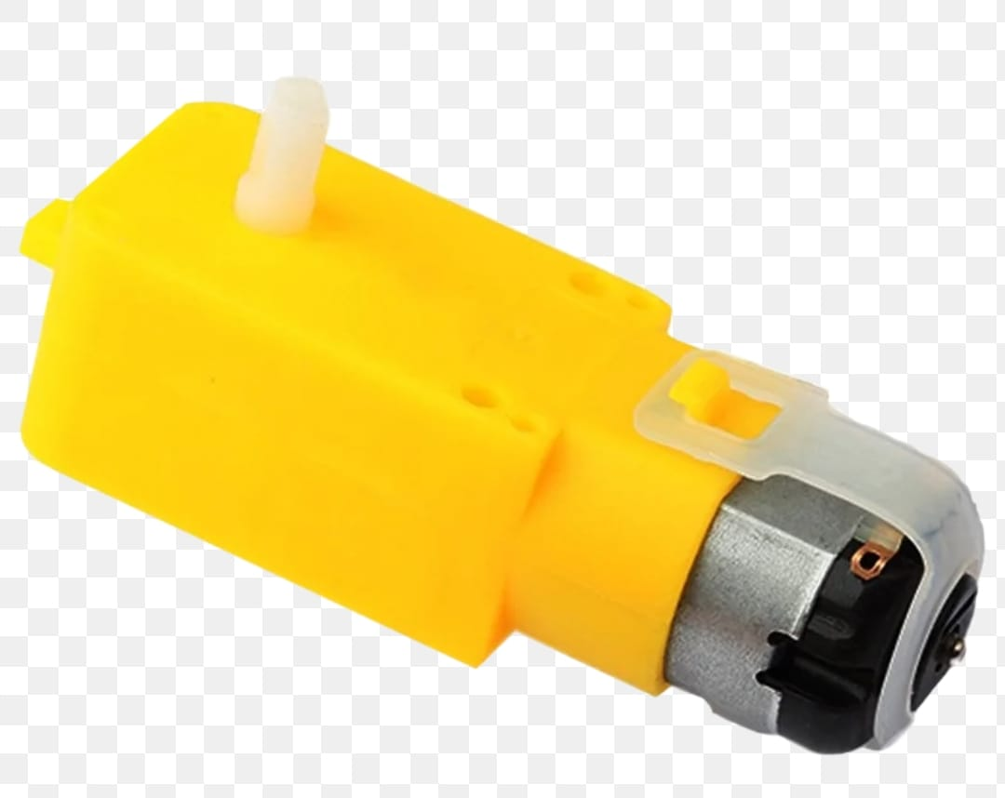
4. Actuators & Motor Driver
L298N H-Bridge Motor Driver Module
Controls DC motor speed and direction using high-power transistors. Handles up to 2A per channel. Modulates average motor voltage via PWM signals on Enable pins (ENA, ENB).
Brushed DC BO Geared Motors
Four battery-operated (BO) geared motors operating between 3V and 9V. Features a 1:48 gear reduction ratio, providing 150 RPM at 6V with high torque.
4WD Kinematics & Steering Control
The motors are wired in parallel left and right pairs. Steering is achieved by differential speed: forward drive, reverse drive, and pivoting turns.
OBJECT FOLLOWING ROBOT USING ARDUINO UNO | MINI-PROJECT PRESENTATION
Slide 5 of 12

Slide 7
5. Power Scheme & System Stability
Power Isolation & Split Rail Scheme
DC motors draw high starting currents, which drop the battery voltage and cause microcontroller resets. To prevent this, the power rails are separated. The 7.4V battery pack connects directly to the L298N driver, while the driver's onboard 5V regulator steps down the voltage to power the Arduino UNO.
Unified Battery Supply Reference
Tying the grounds of the battery, Arduino, and L298N driver together is essential to establish a common electrical reference voltage for the PWM control signals.
Microcontroller Resets and Brownouts
Initial prototype builds integrated a servo motor and OLED display. During active scans, the servo's high current load caused significant voltage drops (brownouts) on the 5V line, resetting the microcontroller and introducing sensor noise.
Stability Resolution
To ensure stable and continuous operation, the servo motor and OLED display were excluded from the final deployed prototype. This power split ensures that motor current spikes do not affect microcontroller logic rails.
OBJECT FOLLOWING ROBOT USING ARDUINO UNO | MINI-PROJECT PRESENTATION
Slide 6 of 12

Slide 8
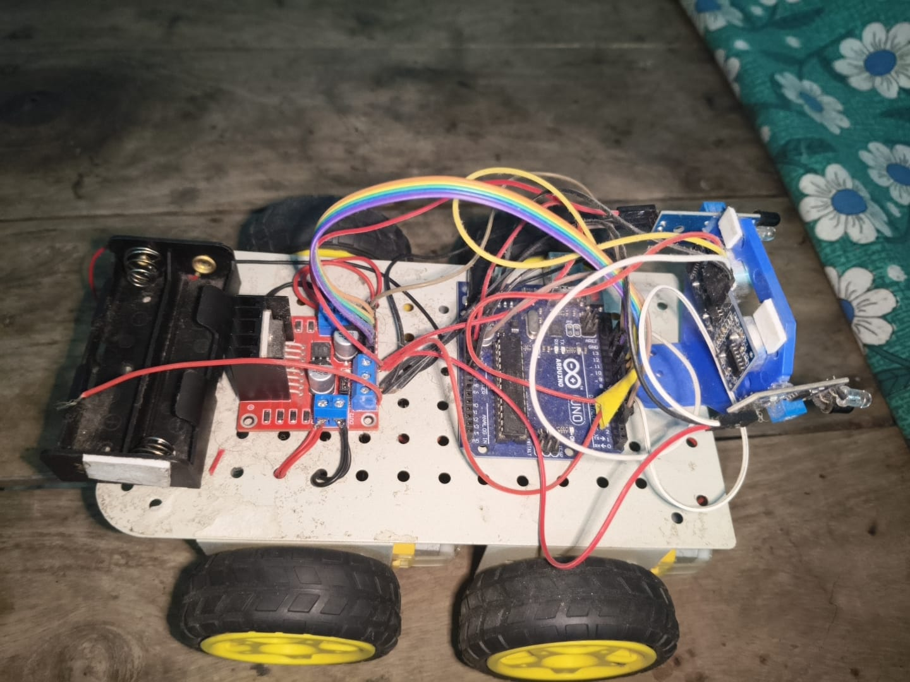
6. Software Control Algorithms
Arduino Control Framework
Written in C++ using the Arduino IDE 2.x. Standard input/output pins are polled to drive state machine transitions. Incorporates the NewPing library for non-blocking acoustic ranging.
Closed-Loop State Transitions
Continually processes distance and lateral IR states. Triggers direction codes: Forward, Steer Left, Steer Right, Safe Recovery, and Search.
Calibration Limits & Speed Control
Maintains a safe follow envelope between 10 cm and 35 cm. Modulates motor PWM (170/220) dynamically based on distance to adjust speed.
OBJECT FOLLOWING ROBOT USING ARDUINO UNO | MINI-PROJECT PRESENTATION
Slide 7 of 12

Slide 9
7. Control Firmware Source Code
Core loop() Structure
The main loop reads ultrasonic distance and flank IR sensors to determine motor actions in real-time.
Safety Backup and Turn
If target is detected closer than 10 cm, the loop halts, reverses, turns right, and halts again to safely recover distance.
Rotating Search State
If target is lost or exceeds 35 cm, the robot pivots right to scan the surrounding area.
void loop() { int distance = sonar.ping_cm(); if (distance == 0) distance = 200; int rightIR = digitalRead(RIGHT_IR); int leftIR = digitalRead(LEFT_IR); analogWrite(ENA, (distance > 25) ? 220 : 170); analogWrite(ENB, (distance > 25) ? 220 : 170); if (distance < MIN_DISTANCE) { // Safety Stop & Backup setMotors('S'); delay(300); setMotors('B'); delay(400); setMotors('S'); delay(200); setMotors('R'); delay(300); setMotors('S'); return; } if (rightIR == LOW && leftIR == HIGH) setMotors('R'); else if (rightIR == HIGH && leftIR == LOW) setMotors('L'); else if (distance <= FOLLOW_DISTANCE) setMotors('F'); else setMotors('R'); // Search Mode }
OBJECT FOLLOWING ROBOT USING ARDUINO UNO | MINI-PROJECT PRESENTATION
Slide 8 of 12

Slide 10
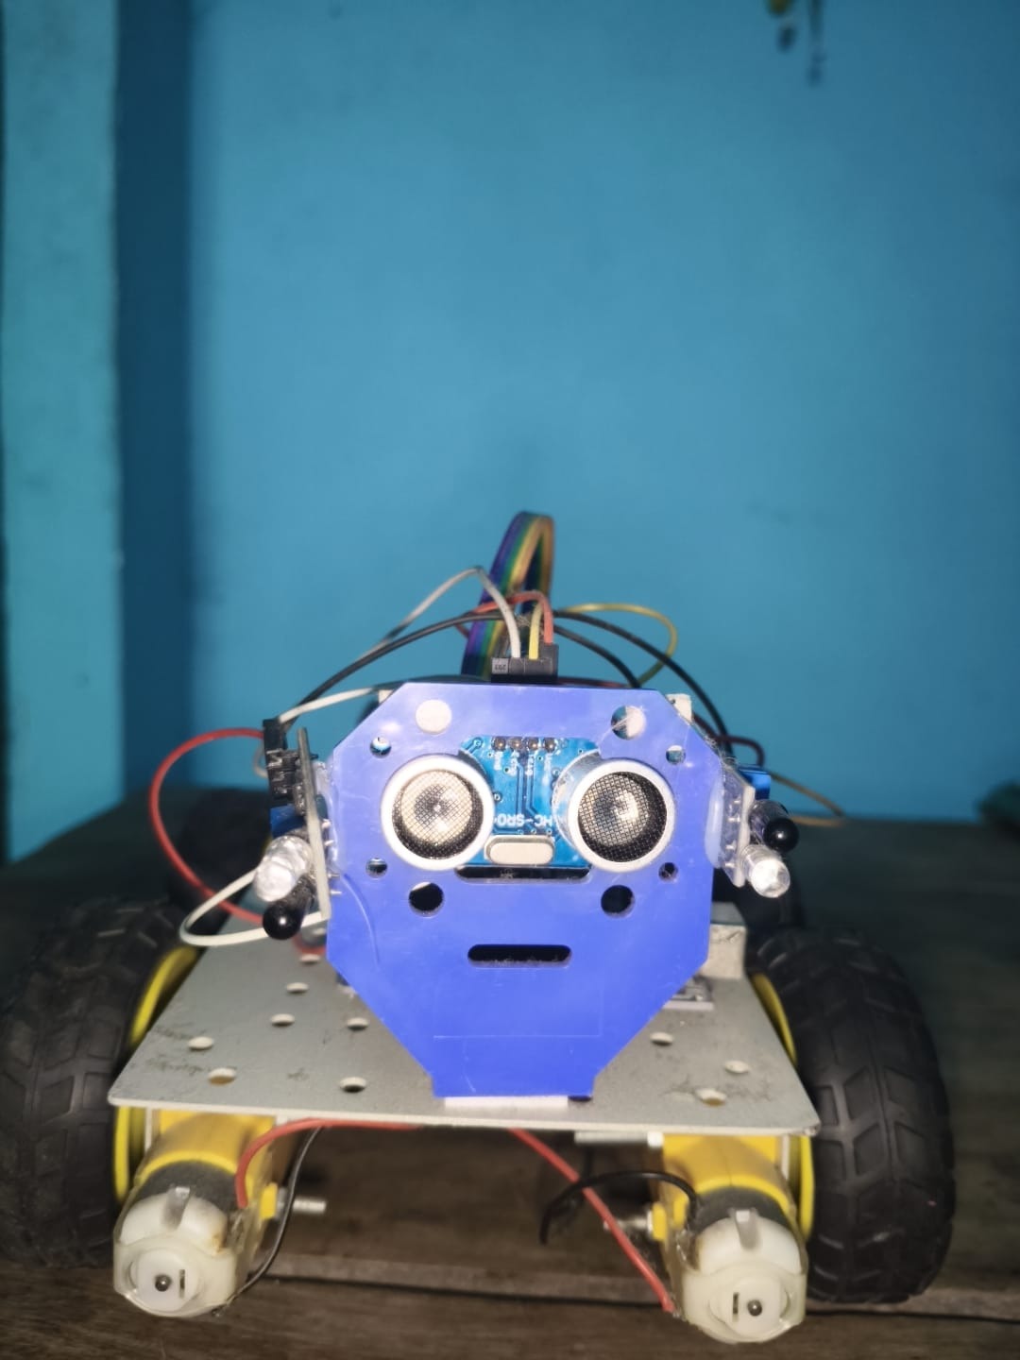
8. Calibration & Integration
Sensor Threshold Configurations
IR sensors are adjusted using onboard potentiometers to ignore ambient lighting and trigger reliably at a maximum distance of 8 cm.
Command State Calibration Mapping
Calibration trials established solid tracking zones: - Under 10 cm: Safety Backup & Turn - 10 cm to 35 cm: Drive Forward - Left IR detection: Pivot Left - Right IR detection: Pivot Right - Over 35 cm: Target lost, enter Search pivot
Physical Platform Integration
All modules are integrated onto a 4-wheel acrylic chassis. Common grounding resolves electrical noise and signal fluctuations.
OBJECT FOLLOWING ROBOT USING ARDUINO UNO | MINI-PROJECT PRESENTATION
Slide 9 of 12

Slide 11
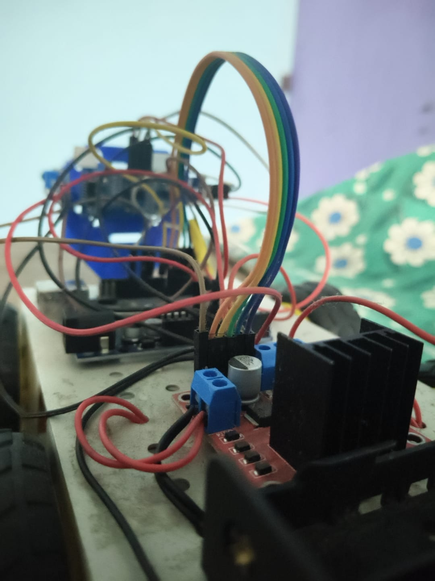
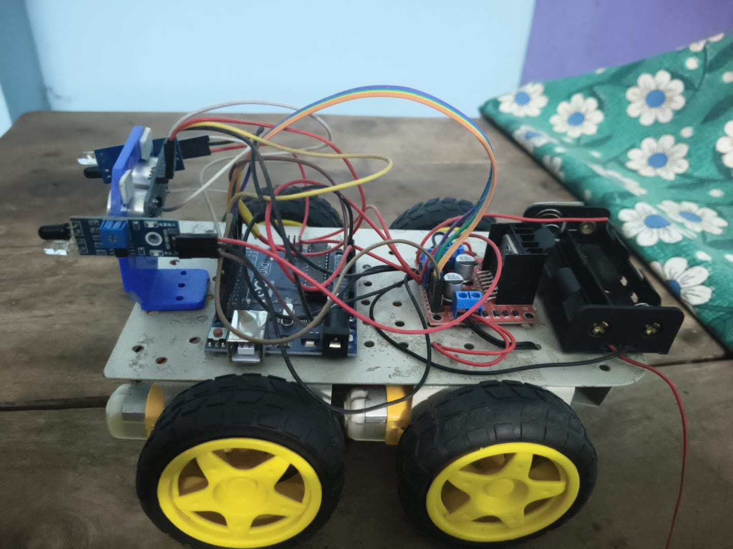
9. Performance Testing & Evaluation
Target Tracking Reliability
Maintains a safe tracking boundary. Follows leading targets reliably between 10 cm and 35 cm without manual input.
Ranging & Latency Metrics
Ultrasonic sensor achieves accurate ranging with a variance of $\pm$0.5 cm. Low control loop latency (10 ms) enables real-time response to target speed shifts.
Power Runtime Capacity
Dual 18650 cells in series supply stable current for 50 minutes of continuous run time under full motor loads.
OBJECT FOLLOWING ROBOT USING ARDUINO UNO | MINI-PROJECT PRESENTATION
Slide 10 of 12

Slide 12
10. Conclusions
Successful Prototype Construction
Designed and built a low-cost, low-power autonomous robot that tracks and follows targets in real-time, validating the core design concepts.
Coordinated Sensor Control
Showed that simple acoustic ranging and infrared proximity sensors provide a reliable tracking envelope, avoiding the need for expensive computer vision hardware.
Verified Differential Steering
Validates that differential drive steering coupled with state-command sensor feedback handles lateral and forward movements cleanly.
Practical Educational Experience
Provided valuable practical experience in hardware-software co-design, electrical power isolation, sensor calibration, and closed-loop control algorithms.
OBJECT FOLLOWING ROBOT USING ARDUINO UNO | MINI-PROJECT PRESENTATION
Slide 11 of 12

Slide 13
11. Future Scope
Active Scanning Servos
Re-integrating the SG90 micro servo motor to rotate the ultrasonic sensor, allowing it to scan the environment up to 180 degrees.
Onboard OLED Displays
Re-introducing the 0.96-inch SSD1306 OLED screen to display target distance and operational status.
LM2596 Power Isolation
Adding a step-down buck converter to isolate the servo's high current draw from the logic rails, preventing resets.
ESP32-CAM Recognition
Upgrading the core microcontroller to an ESP32 with an onboard camera (ESP32-CAM) to support face detection and human recognition.
PID Control Steering
Implementing a Proportional-Integral-Derivative (PID) control loop to adjust motor speed dynamically, creating smoother acceleration and turning curves.
OBJECT FOLLOWING ROBOT USING ARDUINO UNO | MINI-PROJECT PRESENTATION
Slide 12 of 12

