Slide 1

Object Following Robot using Arduino Uno
MINI-PROJECT PRESENTATION
Department of Electronics and Communication Engineering Cooch Behar Government Engineering College
Maulana Abul Kalam Azad University of Technology (MAKAUT)
PROJECT MEMBERS
Bikkram Das (34900323012) | Biraj Sarkar (34900323013) | Debanjan Chakraborty (34900323015)
| Sayan Sarkar (34900323048) | Soumyajit Pandit (34900323052)
PROJECT SUPERVISOR Dr. Gautam Das

Slide 2
Contents
Introduction & Overview
Motivation, HMI background, sensor envelope
System Architecture
Block diagram & signal flow
Hardware & Sensors
Arduino Uno, HC-SR04, IR modules
Actuators & Motor Drivers
BO geared motors, L298N H-Bridge
Power Scheme & Stability
Split-rail power, brownout fix
Software Control Algorithm
State machine & decision logic
Firmware Source Code
Arduino C++ with NewPing library
Calibration & Integration
Thresholds, chassis assembly
Performance Testing
Accuracy, latency, runtime
Conclusions
Outcomes & design validation
Future Scope
ESP32-CAM, PID, active scanning

Slide 3
Introduction & Project Overview
Autonomous target following
Following is a core capability of Human–Machine Interaction (HMI) — enabling hands-free operation and natural cooperation between people and mobile platforms.
Why not a camera?
Vision-based tracking (e.g. Raspberry Pi + camera) needs heavy processing, more weight, cost and power. Acoustic and IR sensors are a low-cost, low-power alternative.
Multi-sensor configuration
A front HC-SR04 ultrasonic sensor plus two
side-mounted IR sensors together define a clean spatial envelope for real-time following.
Real-world applications
Industrial automation carts
Hospital carts following staff
Hands-free warehouse transport
Automated shopping-guide robots
Design goal:
low-cost | low-power | real-time

Slide 4




System Architecture
Sensor input
HC-SR04 gives front distance; left/right IR modules flag lateral offset.
Central processing
Arduino Uno runs a state machine that turns sensor readings into direction and PWM speed commands.
Actuation
L298N H-bridge drives four BO geared motors; steering is by differential wheel speed.
HC-SR04
Ultrasonic
Dual IR Sensors (Left & Right)
Echo/Trig
Digital In
Arduino Uno ATmega328P
PWM / Dir
5V (reg.)
L298N
Motor Driver
7.4V power
7.4V Battery (2×18650)
High Current
4× BO Motors
(L/R pairs)

Slide 5
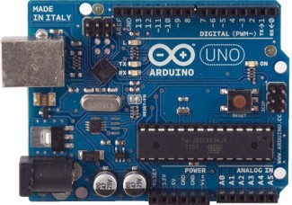
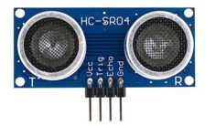

Hardware: Arduino Uno & Sensors
Arduino Uno board
Runs the control loop that reads every sensor and regulates the actuators each cycle.
HC-SR04 ultrasonic sensor
Emits 40 kHz pulses; distance from echo time:
Arduino Uno — ATmega328P, 16 MHz, 14 digital I/O (6 PWM), 6 analog in
_{d =} t × 0.034 _{cm}
2
Range 2–400 cm, accuracy ±3 mm.
IR proximity sensors
Dual side-mounted units emit IR light; a reflection lowers photodiode resistance, driving the output LOW when a target is within 8 cm.
HC-SR04 ultrasonic sensor (left) and IR proximity module (right)

Slide 6
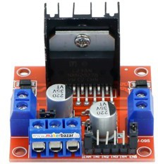
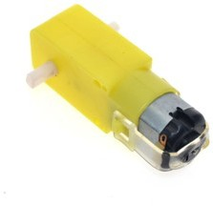
Actuators & Motor Driver
L298N H-bridge driver
Switches high-power transistors to control DC-motor speed and direction; up to 2 A per channel. Average motor voltage is set by PWM on the Enable pins (ENA, ENB).
Brushed DC BO geared motors
Four motors, 3–9 V operating range, 1:48 gear reduction → 150 RPM at 6 V with high torque.
4WD kinematics
Motors wired as parallel left/right pairs. Differential speed between the pairs gives forward drive, reverse, and pivot turns.
L298N H-bridge module
BO geared DC motor

Slide 7
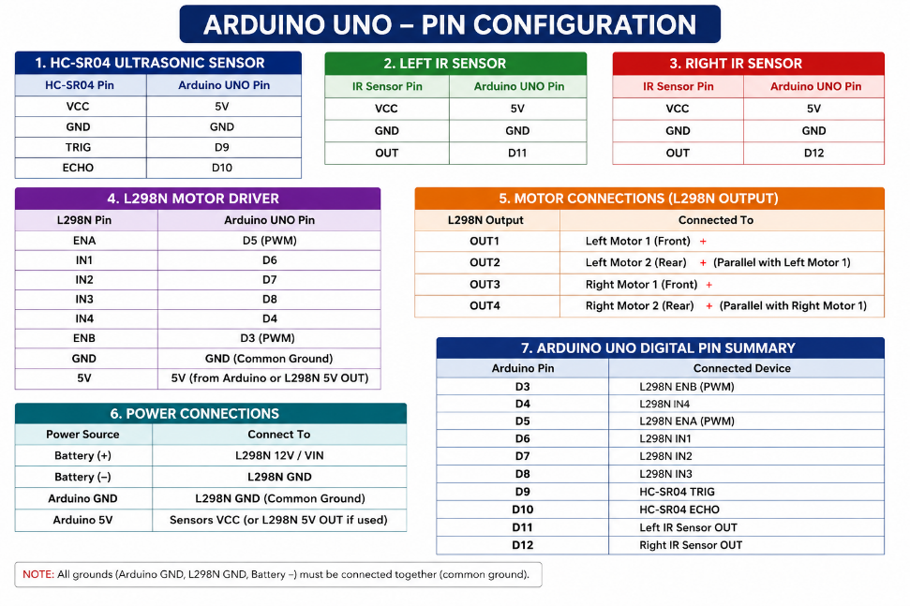
Pin Configuration

Slide 8
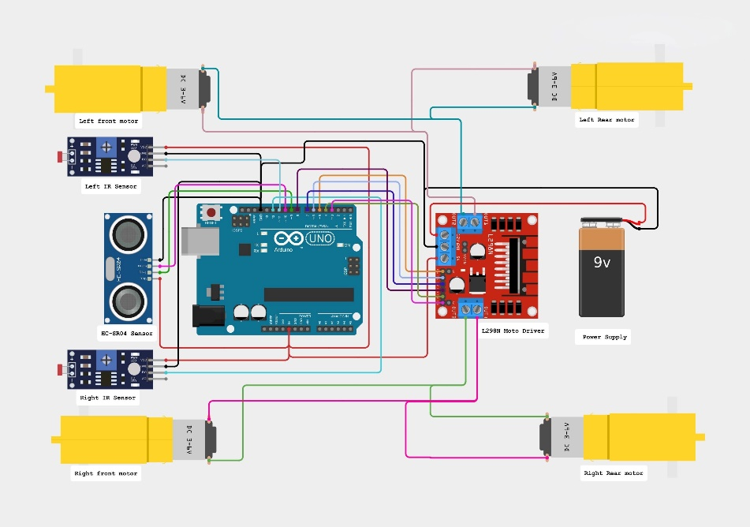
Circuit Diagram

Slide 9
Power Scheme & System Stability
The problem
High DC-motor starting current pulls battery voltage down, resetting the microcontroller. An earlier prototype (with a servo + OLED) browned out during active scans.
The fix: split power rails
The 7.4V pack feeds the L298N directly; the driver’s onboard 5V regulator powers the Arduino separately, so motor current spikes never touch the logic rail. All grounds are tied together for a common reference.
Outcome
Servo and OLED were dropped from the final build; the rail split alone gave stable, continuous operation.
common ground reference
7.4V Battery Pack
7.4V (direct)
onboard 5V reg.
Arduino Uno (logic)
L298N Driver
high current
clean logic
Drive Motors
5V regulated
Isolation prevents motor-current spikes from resetting
the MCU.

Slide 10
Software Control Algorithm
Control framework
Written in C++ (Arduino IDE 2.x). The NewPing library gives non-blocking acoustic ranging while digital pins are polled for IR state.
Closed-loop transitions
Distance and lateral IR states are continually re-evaluated, triggering one of five direction codes each cycle.
Speed control
Follow envelope: 10–35 cm. PWM is modulated (170/220) based on distance to slow down as the target gets close.
Search (pivot)
target found
Forward 10–35cm
target lost / >35cm
too close
left IR
right IR
Safety Stop & Backup
<10cm
Steer Left
Steer Right

Slide 11
Control Firmware — Source Code
Core loop() structure
Reads ultrasonic distance and both IR flanks each cycle to pick a motor action.
Safety backup & turn
Target closer than 10 cm →
halt, reverse, turn right, halt
— then re-evaluate.
Rotating search
Target lost or beyond 35 cm
→ robot pivots right to re-acquire.
1 void loop() {
2
3
4
5
6
7
8
9
10
11
12
13
14
15
16
17
18
19
20 }
int distance = sonar.ping_cm(); if (distance == 0) distance = 200;
int rightIR = digitalRead(RIGHT_IR); int leftIR = digitalRead(LEFT_IR);
analogWrite(ENA, (distance > 25) ? 220 : 170);
analogWrite(ENB, (distance > 25) ? 220 : 170);
if (distance < MIN_DISTANCE) {
setMotors('S'); delay(300);
setMotors('B'); delay(400);
setMotors('S'); delay(200);
setMotors('R'); delay(300); setMotors('S'); return;
}
// Safety Stop & Backup
if (rightIR == LOW && leftIR == HIGH) setMotors('R'); else if (rightIR == HIGH && leftIR == LOW) setMotors('L'); else if (distance <= FOLLOW_DISTANCE) setMotors('F');
else setMotors('R'); // Search Mode

Slide 12
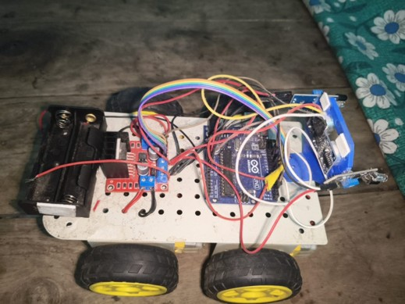
Calibration & Integration
Sensor threshold configuration
IR sensors are trimmed via onboard potentiometers to ignore ambient light and trigger reliably at a maximum range of 8 cm.
Physical integration
All modules mount on a 4-wheel acrylic chassis; a common ground plane removes electrical noise and signal fluctuation.
Command–state calibration map
Condition Action
Distance < 10 cm 10 cm – 35 cm Left IR triggered Right IR triggered Distance > 35 cm
Safety backup & turn Drive forward
Pivot left Pivot right
Target lost → search

Slide 13
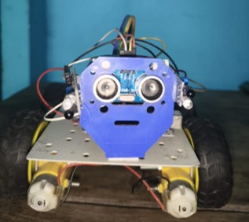
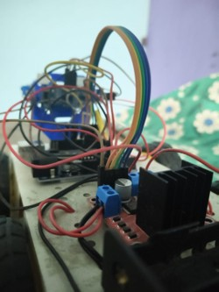
Performance Testing & Evaluation
±0.5 cm
ranging variance
10 ms
control loop latency
50 min
continuous runtime
Target tracking
Maintains the 10–35 cm follow boundary reliably, no manual input.
Ranging & latency
10 ms loop latency enables real-time reaction to target speed changes.
Power runtime
Dual 18650 cells sustain full motor load for 50 continuous minutes.

Slide 14
Conclusions
Successful prototype
Built a low-cost, low-power autonomous robot that tracks and follows a target in real time, validating the core design.
Verified differential steering
Coordinated sensor control
Simple acoustic ranging plus IR proximity gives a reliable tracking envelope — no expensive vision hardware required.
Practical experience
Differential drive combined with state-command Hands-on exposure to hardware–software sensor feedback handles lateral and forward co-design, power isolation, sensor calibration, movement cleanly. and closed-loop control.
A complete, working object-following platform built entirely on low-cost, readily available components.

Slide 15
Future Scope
Active scanning servo
Re-integrate an SG90 micro servo to sweep the ultrasonic sensor across a 180° field of view.
Onboard OLED display
ESP32-CAM recognition
Upgrade the controller to an ESP32 with onboard camera for face detection and human recognition.
PID control steering
Re-introduce a 0.96” SSD1306 screen to show live Add a Proportional–Integral–Derivative loop for
distance and operating status.
LM2596 power isolation
Add a step-down buck converter to isolate servo current spikes from the logic rail, removing the earlier reset issue for good.
smoother acceleration and turning, replacing today’s fixed-speed steps.

Slide 16
Thank You
Questions & Discussion

