Slide 1
Imaging of the Craniovertebral Junction
Dr. Prasanna Sayami
Second Year Resident, Department of Radiology
Nepal Mediciti Hospital
Neuro-Radiology Meet · 5 November 2026
Notes:
CUE — Greet; one sentence on why the CVJ matters.
SCRIPT: Good morning. Today’s topic is imaging of the craniovertebral junction. This small region carries the brainstem, the upper cord, the lower cranial nerves and the vertebral arteries, and it lets the head move on the spine. That is why a few millimeters here decide whether a patient is observed, fixed in a collar, or taken to theater. I will go through the anatomy and technique, then craniometry in some detail, then the main groups of pathology, and finish with what changes surgical management and what needs an urgent phone call.
SOURCE: Chen & Liu 2009 (introduction).

Slide 2
Learning Objectives
Apply craniometric lines, angles and intervals with their modality and normal values
Separate basilar invagination, basilar impression and platybasia
Recognize anomalies that predispose to atlantoaxial instability
Grade CVJ injuries by the features that decide stability
Characterize inflammatory, infective and neoplastic lesions
Report reducibility and direction of compression
2
Notes:
CUE — Read briefly; do not elaborate.
SCRIPT: These are the six practical points I want to cover. The thread running through them is that the report should answer the surgeon’s questions: where the dens is relative to the skull base, whether the junction is stable, whether a deformity is reducible, and from which direction the neural structures are compressed.
SOURCE: Structure from Chen & Liu 2009; management factors from Youmans & Winn 8e Ch 260.

Slide 3
Outline
Anatomy, ligaments and imaging technique
Craniometry
Congenital and developmental anomalies
Trauma
Inflammatory, degenerative and infective disease
Neoplasms
Instability and management
Urgent findings and checklist
3
Notes:
CUE — Ten seconds; move on.
SCRIPT: This is the order we will follow.
SOURCE: Classification order follows Chen & Liu Box 1.

Slide 4
1
Anatomy, Ligaments and Technique
4
Notes:
CUE — Section change.
SCRIPT: Let us start with the anatomy that the measurements depend on.

Slide 5
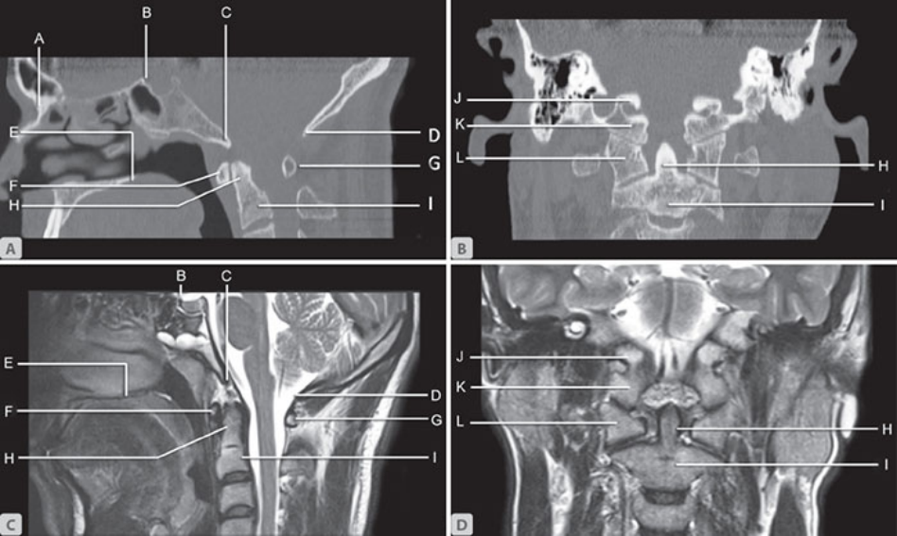
Normal CVJ Landmarks
Normal landmarks of CVJ: midsagittal (A) CT; (B) T2W MR; coronal (C) CT; (D) T2W MR. A, nasion; B, tuberculum sella; C, basion (anterior margin of foramen magnum); D, opisthion (posterior margin of foramen magnum); E, posterior margin of hard palate; F, anterior arch of atlas; G, posterior arch of atlas; H, odontoid process; I, body of axis; J, jugular tubercles; K, occipital condyles; L, lateral atlas masses.
Lines are built on basion, opisthion, hard palate
5
Notes:
CUE — Point to basion, opisthion, hard palate: these build every line.
SCRIPT: The craniovertebral junction consists of the occipital bone, foramen magnum, clivus, atlas, axis, and the ligaments of the atlanto-occipital and atlantoaxial articulations. The landmarks lettered here are the ones every craniometric line uses: the posterior margin of the hard palate, the basion at the anterior margin of the foramen magnum, the opisthion at its posterior margin, the tuberculum sellae and the nasion. The atlantoaxial joints enable head rotation about the dens axis, whereas the atlanto-occipital joints primarily allow flexion, extension, and lateral bending.
IF TIME: Biomechanics (AIIMS): nodding or yes-yes movements occur at the atlanto-occipital joints; rotatory or no-no movements at the atlantoaxial joints. Average flexion-extension at the occipitoatlantal joint is 13–15°, with an additional 10° at the atlantoaxial articulation. Atlantoaxial rotation varies from 37° to 42°.
FIGURE: AIIMS-MAMC-PGI 3e, CVJ chapter, Figs. 1A–D, p.6 (PDF). Letter labels A–L only, no arrows. 700 × 418 px composite: small but legible at full width.
CLINICAL: The basion and opisthion define McRae’s line and the foramen magnum diameter; the hard palate anchors Chamberlain and McGregor lines.
SOURCE: Chen & Liu p.483 (definition, joint function); AIIMS p.6–9 (landmarks, biomechanics).

Slide 6
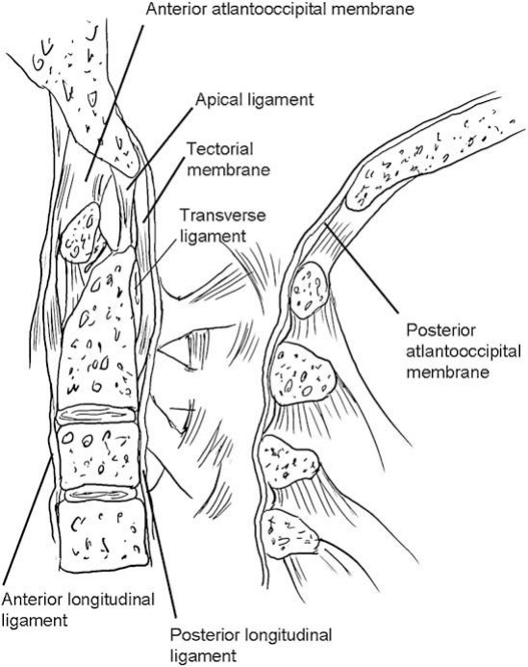
Ligaments: Four Layers
Anterior atlanto-occipital membrane
​Alar and apical ligaments
​Cruciate ligament (transverse part)
​Tectorial membrane
  Transverse ligament keeps dens pressed forward against C1 arch
Midsagittal view of CVJ and its ligaments.
6
Notes:
CUE — Front to back: membrane, alar/apical, cruciate, tectorial.
SCRIPT: The occipito-atlantoaxial ligaments are arranged in four layers. The most anterior layer is the anterior atlanto-occipital membrane, the superior extension of the anterior longitudinal ligament. The second layer is formed by the alar and apical ligaments: the paired alar ligaments connect the odontoid with the lateral masses and the occipital condyles, and the small apical ligament extends from the tip of the odontoid to the foramen magnum.
IF TIME: The cruciate ligament forms the third layer, immediately dorsal to the odontoid; its transverse portion connects both lateral masses of the atlas and keeps the dens pressed forward against the anterior arch. The most posterior layer is the tectorial membrane, the superior continuation of the posterior longitudinal ligament. There is no vascular communication between the base of dens and body of axis. This is important in understanding the etiology of os odontoideum and formation of a sequestrum with type II odontoid fracture (AIIMS p.7).
FIGURE: Chen & Liu Fig. 5, p.485 (journal). Line drawing, leader-line labels only (anterior atlanto-occipital membrane, apical ligament, tectorial membrane, transverse ligament, anterior and posterior longitudinal ligaments, posterior atlanto-occipital membrane). No pointer symbols.
CLINICAL: Transverse ligament is the key restraint to anterior C1 translation; alar ligaments are the secondary restraint.
SOURCE: AIIMS p.7 (four layers, verbatim condensed).

Slide 7
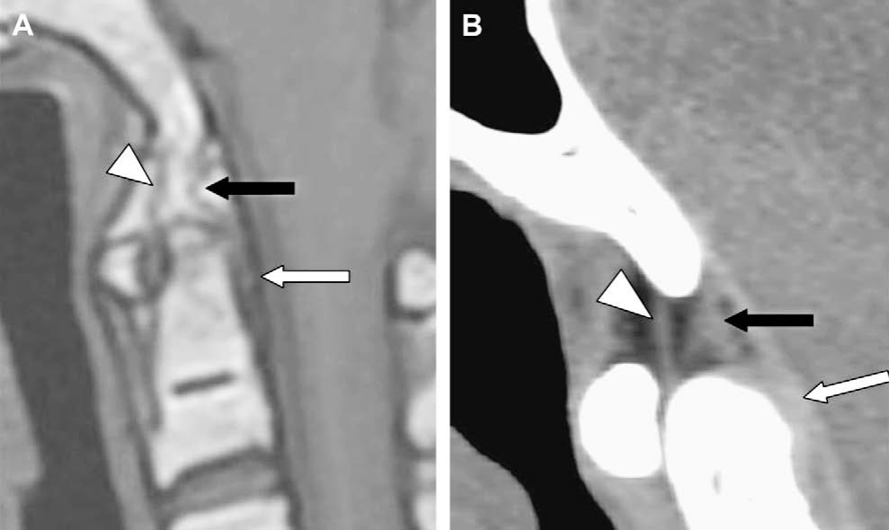
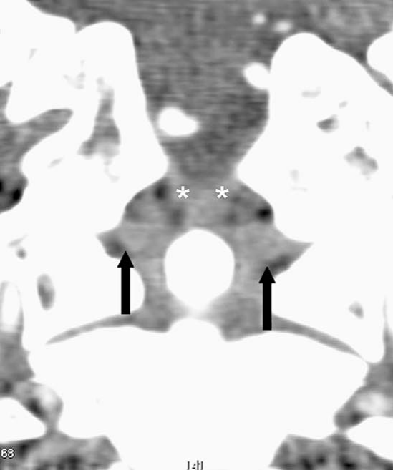
Ligaments on MRI and CT
Paramedian sagittal T1-weighted (A) and high-resolution CT (B): transverse ligament →, alar ligament →, apical ligament ▶. Right: coronal high-resolution CT shows bilateral alar ligaments → from the dens to the occipital; apical ligament surrounded by fat *.
Transverse ligament: oval signal void behind the upper dens
7
Notes:
CUE — Show the transverse ligament void; then alar ligaments on coronal CT.
SCRIPT: On sagittal MR imaging the transverse ligament appears as an oval area of signal void posterior to the upper dens, and it can be visualized on axial T1-weighted MR imaging and axial CT. Posterior to the dens, the dura, tectorial membrane and vertical part of the cruciform ligament are imaged as a single vertical band of low signal.
IF TIME: A transverse line of low signal with brighter signal above and below is usually evident at the junction of the odontoid process and body of C2 in individuals younger than 50 years; this is the normal synchondrosis remnant, not a fracture. On coronal CT the alar ligaments run from the superior and lateral aspects of the dens to the occipital condyles. The supraodontoid space lies between the alar ligaments and foramen magnum and between the tectorial and atlanto-occipital membranes, divided into symmetric halves by the apical ligament and a thin fatty membrane (Chen p.485).
FIGURE: Chen & Liu Fig. 6 (p.486) and Fig. 7 (p.486). Fig. 6: transverse ligament = white arrow (→ gray); alar ligament = black arrow (→ black); apical ligament = white arrowhead (▶ gray). Fig. 7: alar ligaments = black arrows (→ black); fat around apical ligament = white asterisks (* gray).
CLINICAL: Do not call the subdental low-signal line a fracture in patients under 50 years.
Q&A: Q: Best sequence for the transverse ligament? A: Chen: axial T1-weighted MR and axial CT for bony avulsion; AIIMS: axial gradient-echo MRI may be prominently useful in assessing the integrity of the transverse atlantal ligament.
SOURCE: Chen & Liu p.483–486; AIIMS p.27 (gradient echo).

Slide 8
Imaging Technique
Radiographs: lateral in neutral, flexion, extension; open-mouth view
NCCT with sagittal/coronal reformats and 3D: bone
MRI: brainstem, cord, tonsils, syrinx, ligaments
​Dynamic flexion–extension studies are essential
  stability, reducibility, position of fixation
MRA / CTA when vessels may be deformed with motion
8
Notes:
CUE — Stress: every modality, also dynamic.
SCRIPT: A combination of MRI and either standard radiography or CT is ideal in evaluating most CVJ anomalies. Radiographs are the translateral view of the skull including the upper cervical spine in neutral, flexion and extension, plus the open-mouth view for dens anomalies and lateral displacement. Non-contrast CT shows the arches, lateral masses, atlanto-odontoid distance and canal diameters, and helps make a definitive diagnosis of atlantoaxial rotatory fixation. MRI is especially helpful for the brainstem, spinal cord, cerebellar tonsils, syringohydromyelia, cervicomedullary kink and hydrocephalus.
IF TIME: Most importantly, in all techniques, dynamic flexion and extension studies are essential to assess stability and to provide information related to reducibility and position of fixation. AIIMS institutional dynamic MRI study, 25 patients: in neutral position 81% had some canal narrowing; 16% showed increased narrowing on flexion, half of them with direct cord compression not detected in neutral position. Youmans: thin-section CT identifies epiphyseal growth plates in children, which predicts further osseous development.
CLINICAL: If the report says “no instability”, state whether flexion–extension images were obtained.
Q&A: Q: Is dynamic MRI safe in a myelopathic patient? A: The sources do not address safety; Youmans describes flexion and extension dynamic MRI in parasagittal views in both T1 and T2, and documents the effect of traction with MRI. Positioning is done within the patient’s comfortable range.
SOURCE: AIIMS p.14–16 (investigations; verbatim condensed); Youmans p.7 ("The diagnostic procedure of choice is MRI, but cervical spine radiographs, with dynamic views, help elucidate craniocervical biomechanics"; MRA/CTA).

Slide 9
2
Craniometry
Lines, angles and intervals
9
Notes:
CUE — Section change.
SCRIPT: Now the measurements. For each one I will give the landmarks, the modality and the normal value as the source gives it.

Slide 10
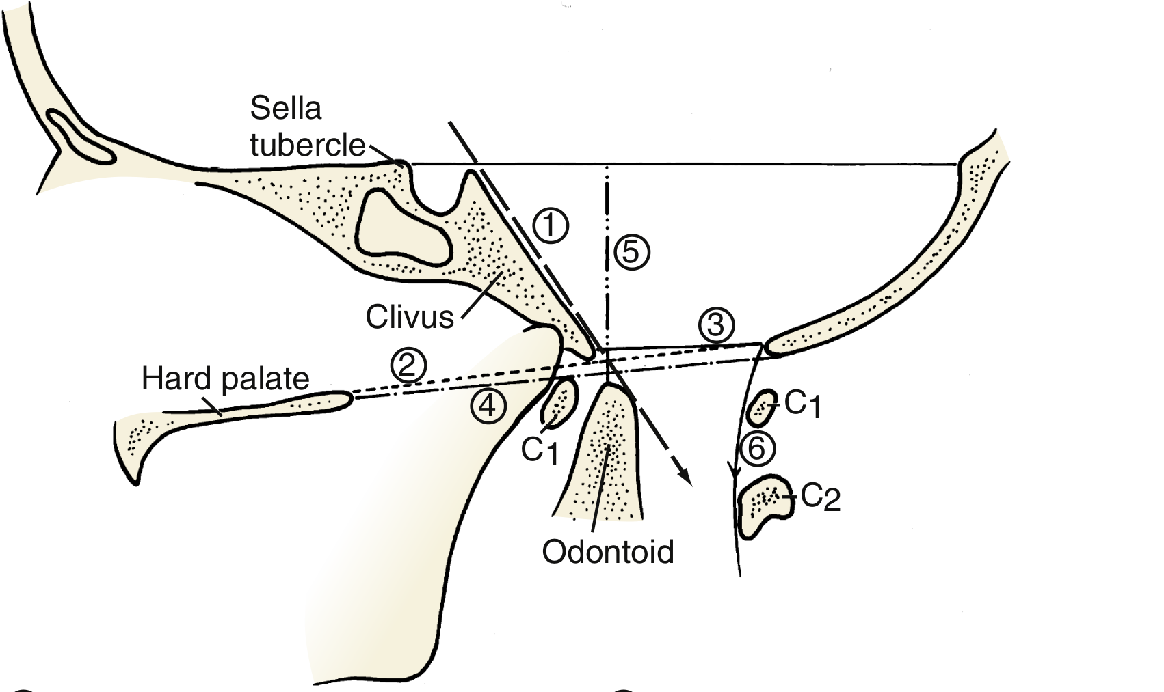
Lines on the Lateral View
Lateral craniometry with points of reference. (1) Wackenheim’s clivus canal line; (2) Chamberlain line; (3) McRae line; (4) McGregor line; (5) Height index of Klaus; (6) Spinous interlaminar line.
Defined on X-rays; now applied to sagittal CT
10
Notes:
CUE — One map for the next five slides.
SCRIPT: Craniometry uses a series of lines, planes and angles to define the normal anatomic relationships of the junction. These measurements were initially defined on plain X-rays but are now extrapolated to non-contrast CT sagittal and coronal images. The Smoker review, which illustrates each line on a diagram, a lateral radiograph and a midsagittal T1-weighted MR image, notes that the junction is visible in most MR studies of the brain.
IF TIME: Youmans makes the point that numerous craniometric reference lines were described before CT and MRI, and that of these the Wackenheim clivus canal line is of greatest significance.
FIGURE: Youmans & Winn 8e Fig. 260.3, p.1962. Circled numbers 1–6 on a line drawing (black lines); legend reproduced from the figure legend.
Q&A: Q: Which line do neurosurgeons trust most? A: Youmans: “The Wackenheim clivus canal line … is of greatest significance.” AIIMS notes McGregor’s position varies with flexion and extension, “hence not important”.
SOURCE: AIIMS p.10 (craniometry statement); Youmans p.7–8; Smoker RadioGraphics 1994 abstract.

Slide 11
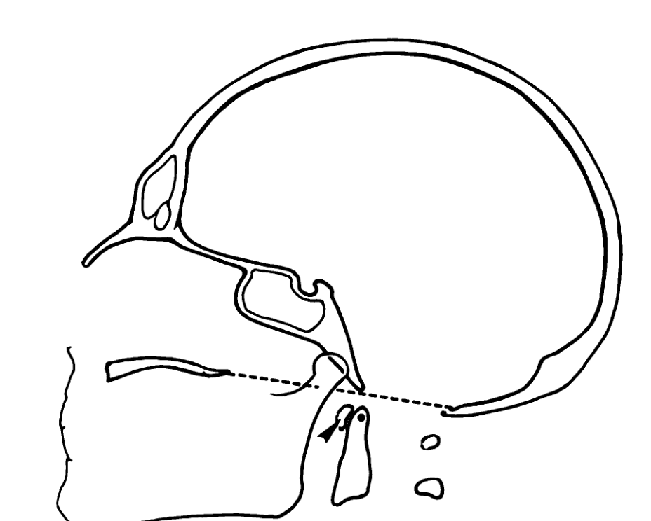
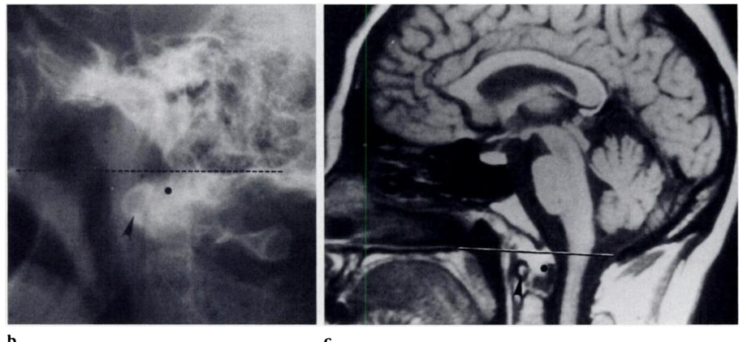
Chamberlain Line
Chamberlain line. Diagram (a), lateral radiograph (b), and midsagittal T1-weighted MR image (c) demonstrate the Chamberlain line (dashed and solid line) drawn between the posterior pole of the hard palate and the opisthion. The anterior arch of the atlas ▶ and the odontoid process (dot) lie below this line.
Basilar invagination: odontoid process bisects the line
11
Notes:
CUE — Hard palate to opisthion; dens below.
SCRIPT: Chamberlain’s line, the palato-occipital line, joins the posterior pole of the hard palate to the opisthion. Normally the tip of the dens lies below this line, and the anterior arch of the atlas typically lies below it as well. In basilar invagination the odontoid process bisects the line. The weakness of this line is the opisthion: the posterior rim of the foramen magnum shows great anatomic variability and may be difficult to pinpoint radiologically, which is why McGregor modified it.
IF TIME: Smoker shows the same line on a diagram, a lateral radiograph and a T1-weighted MR image, which is a reminder that the line transfers directly to sagittal MR and CT.
FIGURE: Smoker, RadioGraphics 1994;14:255–277, Fig. 4 (p.259). Chamberlain line = dashed and solid line (named on slide); anterior arch of atlas = black arrowhead (▶ black); odontoid process = dot (no glyph, word kept). Panels a–c shown whole; scanned 1994 print, panel b/c 915 × 421 px.
Q&A: Q: How many millimeters above Chamberlain is abnormal? A: Sources disagree. AIIMS table prints “Tip of dens 1 + 3.6 mm below this line” (likely ±). Smoker: may normally project above it, “ranging from 1 mm ± 3.6 to 6.6 mm”. Youmans: “below this line or at most 3 to 5 mm above it”. Chong (Liu & Chen): “Dens apex < 5 mm above this line”. Chen 2009: “The dens is 3.6 to 6.6 mm below the line.” The qualitative rule (dens bisecting the line) is common to all.
SOURCE: AIIMS Table 1 p.12; Smoker p.259; Youmans p.7; Chong Table 14.1 p.292; Chen p.488.

Slide 12
McGregor and McRae Lines
Line | Definition | Normal | Implication
McGregor (basal line) | Hard palate to lowest point of occipital bone | Tip of dens should not exceed 5 mm above | Position varies with flexion + extension
McRae (foramen magnum line) | Anterior and posterior edges of foramen magnum (basion to opisthion) | Tip of dens does not exceed this line | Sagittal diameter <20 mm: neurological symptoms
Lateral view; defined on radiographs, applied to sagittal CT
12
Notes:
CUE — McGregor = Chamberlain variant; McRae = foramen magnum.
SCRIPT: McGregor developed a modification of the Chamberlain line when the opisthion could not be identified on plain radiographs; it extends from the hard palate to the lowest point of the occipital squamosal surface. The tip of the dens should not exceed 5 millimeters above it. Its position varies with flexion and extension, so AIIMS considers it less important. McRae’s line joins the basion to the opisthion, the anterior and posterior edges of the foramen magnum. The tip of the dens does not exceed this line.
IF TIME: When the effective sagittal diameter of the foramen magnum is less than 20 millimeters, neurological symptoms occur, which is foramen magnum stenosis.
FIGURE: Lines are shown on the previous slide (Youmans Fig. 260.3, numbers 3 and 4) and in Backup (Chong Fig. 14.1).
Q&A: Q: Normal McGregor value? A: AIIMS: “should not exceed 5 mm above”; Chong Table 14.1: “Dens apex < 7 mm above this line”. Q: Sagittal foramen magnum cut-off? A: AIIMS: <20 mm causes symptoms; Youmans: “Sagittal constriction at the cervicomedullary junction to less than 20 mm in a child older than 8 years is typically associated with a neurological deficit.”
SOURCE: AIIMS Table 1 p.12 (verbatim); Smoker p.259; Youmans p.7; Chong p.292.

Slide 13
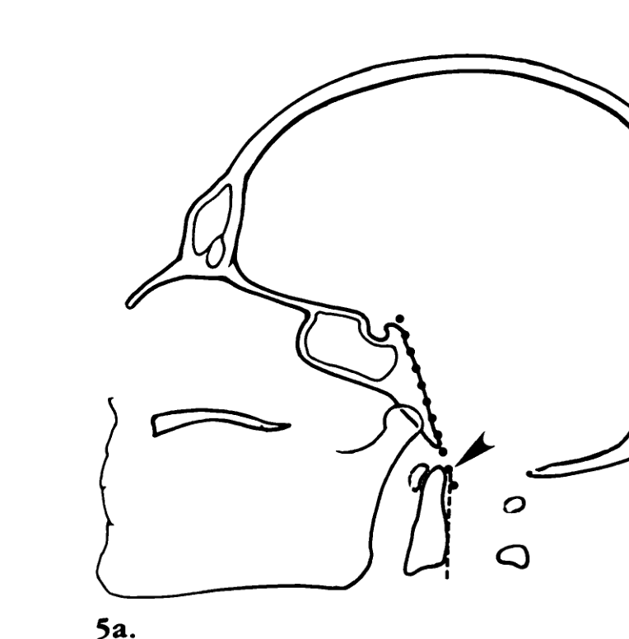
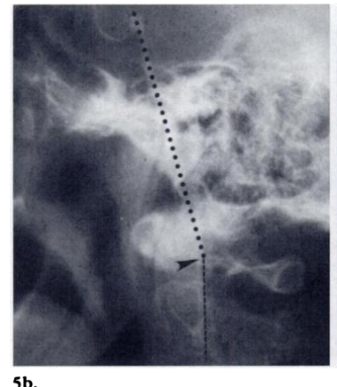
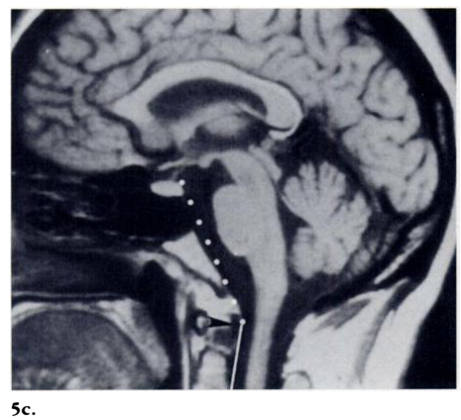
Wackenheim Clivus Baseline
Wackenheim clivus baseline. Diagram (a), lateral radiograph (b), and midsagittal T1-weighted MR image (c) demonstrate the Wackenheim line (dotted line), drawn along the clivus and extrapolated inferiorly (dashed and solid lines). The line falls tangent to the posterior aspect of the odontoid process. The clivus-canal angle ▶ should range between 150° and 180°.
Odontoid transects the line in basilar invagination
13
Notes:
CUE — Line along the clivus; dens tangent or ventral.
SCRIPT: The Wackenheim clivus baseline is drawn along the clivus and extrapolated inferiorly into the upper cervical canal. It should fall tangent to the posterior aspect of the tip of the odontoid process. The odontoid tip is ventral and tangential to the line normally; it transects the line in basilar invagination or in forward position of the skull. Because it is drawn along the clivus, it does not depend on the hard palate or the opisthion, which is why Youmans calls it the line of greatest significance.
FIGURE: Smoker Fig. 5, p.260. Wackenheim line = dotted line, extrapolation = dashed and solid lines (named); clivus-canal angle = black arrowhead (▶ black) in a–c.
Q&A: Q: Wackenheim in trauma? A: Chong Table 14.1 lists it for “Assessment of CVJ traumatic injuries”: line falls tangent to, or intersects, the posterior one-third of the odontoid.
SOURCE: Smoker p.260–261; AIIMS Table 1 p.12; Youmans p.7; Chong Table 14.1.

Slide 14
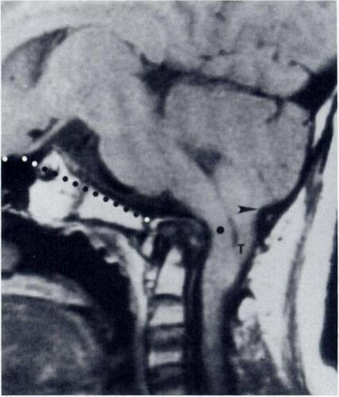
Clivus–Canal Angle
Platybasia. Midsagittal T1-weighted MR image. Welcher basal angle (dotted line) measures 155°. Chamberlain line and Wackenheim clivus baseline are not violated, but the clivus-canal angle measures 110°, producing marked bow-string deformity and compression of the cervicomedullary junction (dot). Cerebellar tonsils (T) extend far below the opisthion ▶.
Wackenheim line + posterior axis line
Normal 150° (flexion) to 180° (extension)
​<150°: ventral cord compression may occur
14
Notes:
CUE — Angle captures kyphotic bow-string even when lines are normal.
SCRIPT: The angle formed at the intersection of the Wackenheim clivus baseline with a line along the posterior surface of the axis body and odontoid process is the craniovertebral or clivus-canal angle. It normally ranges from 150 degrees in flexion to 180 degrees in extension, and ventral spinal cord compression may occur when the angle is less than 150 degrees. This case is instructive: the Chamberlain and Wackenheim lines are not violated, yet the clivus-canal angle is 110 degrees, with a bow-string deformity and compression of the cervicomedullary junction. So the lines alone can miss a compressive deformity; measure the angle as well.
FIGURE: Smoker Fig. 8, p.262. Welcher angle = dotted line; cervicomedullary junction = dot (word kept); cerebellar tonsils = letter T; opisthion = black arrowhead (▶ black).
CLINICAL: An acute clivus-canal angle with cord distortion is a compressive lesion even without basilar invagination.
SOURCE: Smoker p.261–262; Chen p.488 (150–180°); AIIMS Figs. 8–9 (<150° in BI with basiocciput hypoplasia and platybasia).

Slide 15
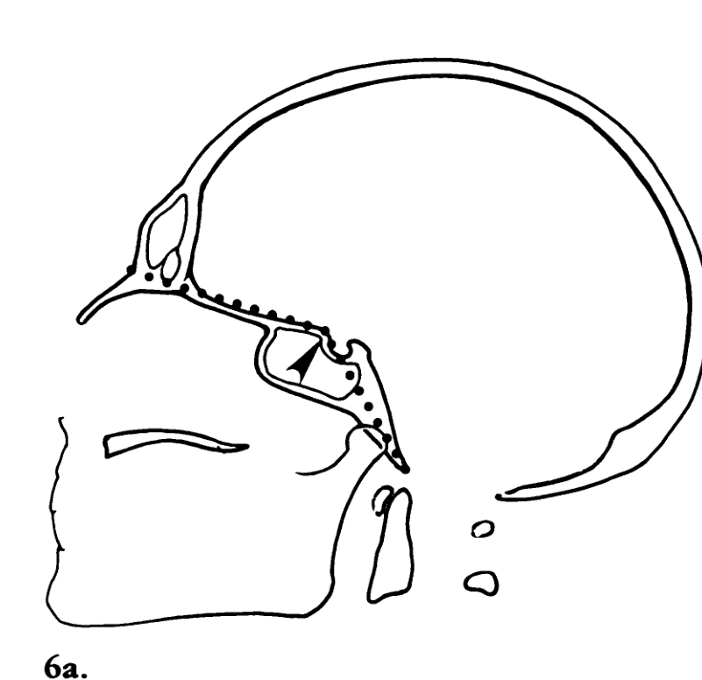
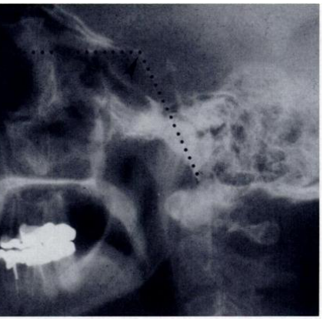
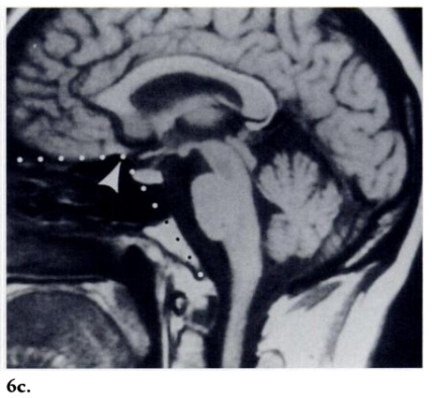
Welcher Basal Angle
Welcher basal angle. Diagram (a), lateral radiograph (b), and midsagittal T1-weighted MR image (c) demonstrate the Welcher angle ▶▶ formed between the nasion-tuberculum and tuberculum-basion lines (dotted lines). The angle should be 140° or less.
Normal 124–142°; widening = platybasia
15
Notes:
CUE — Nasion–tuberculum–basion; obtuse = platybasia.
SCRIPT: The basal angle is the angle between the lines drawn from the nasion to the tuberculum sellae and from the tuberculum sellae to the basion. AIIMS gives the normal as 124 to 142 degrees, and widening is called platybasia. Platybasia refers only to an abnormally obtuse basal angle. It is not a measure of basilar invagination, although it may be associated with it, and there are no symptoms or signs associated with platybasia alone.
FIGURE: Smoker Fig. 6, p.260. Welcher angle = arrowhead: black in diagram a (▶ black), white in MR c (▶ gray); lines = dotted lines (named).
Q&A: Q: Which cut-off for platybasia? A: Sources differ. AIIMS: normal 124–142° (slide). Smoker: “averages 132° and should always be less than 140°”. Chen: “should always be less than 140°”. Chong text: platybasia when the Welcher basal angle is “>143–145 degrees”, while its Table 14.1 gives “<140 degrees”. AIIMS Fig. 9 caption uses “Welcher basal angle >140°”. EPOS C-2392: “Must be between 123 º and 143 º … greater than 143 º is called platybasia”; C-0882 and C-2555: >140°. In practice, >140° on CT or MR is abnormal in all sources except the Chong text and C-2392.
SOURCE: AIIMS Table 1 p.13, p.17; Smoker p.260–261; Chen p.486–488; Chong p.291–292.

Slide 16
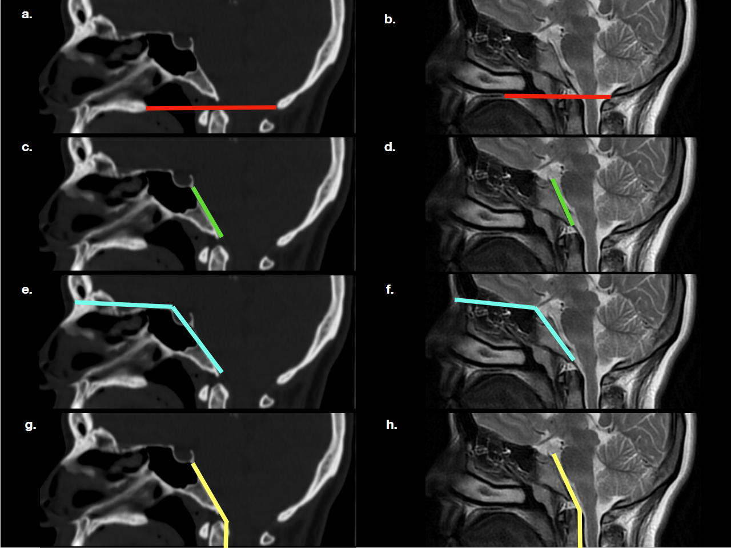
The Same Lines on CT and MRI
Normal lines and angles: (a, c, e, g) mid-sagittal reformatted CT; (b, d, f, h) sagittal T2W. (a, b) Chamberlain line (red line); (c, d) Wackenheim’s clivus baseline (green line); (e, f) Welcher basal angle (blue lines); (g, h) clivus canal angle (yellow lines).
Use a true midline slice
16
Notes:
CUE — Bridge from radiograph diagrams to modern studies.
SCRIPT: The 1994 diagrams were drawn on radiographs and T1-weighted images. This poster shows the same four measurements on a midline sagittal CT reformat and a sagittal T2-weighted image of the same patient: the Chamberlain line, the Wackenheim clivus baseline, the Welcher basal angle and the clivus-canal angle. As one exhibit puts it, two lines have remained particularly useful with virtually any imaging modality, the Chamberlain line and the Wackenheim clivus baseline, and two angles, the Welcher basal angle and the atlanto-occipital joint axis angle.
IF TIME: The practical point is to use a true midline sagittal slice through the dens tip, basion and opisthion.
FIGURE: EPOS C-2555 (ECR 2018), Fig. 2, “Findings” section. Pointers are drawn lines named in the caption: Chamberlain = red line; Wackenheim = green line; Welcher = blue lines (render cyan/turquoise); clivus-canal angle = yellow lines. 1280 × 961 px.
Q&A: Q: Is MRI as accurate as CT for these lines? A: The sources do not compare accuracy; AIIMS states the measurements were defined on plain X-rays and are now extrapolated to NCCT sagittal and coronal images.
SOURCE: Eser MB, Baysal B, Atalay B, Önal C, Erdemli S. ECR 2018, C-2555, doi:10.1594/ecr2018/C-2555 (figure). Quotation: Arcalis N et al. ECR 2010, C-2392, Craniometry section.

Slide 17
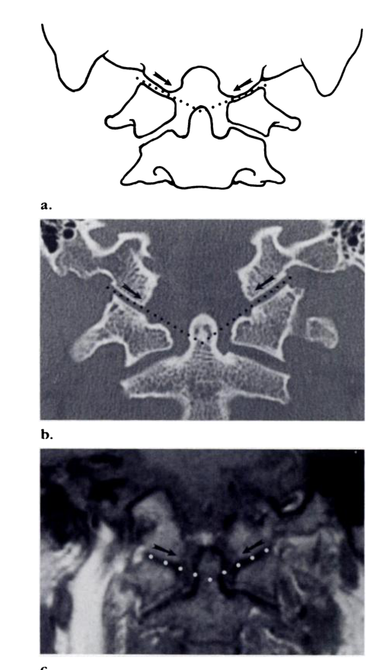
Coronal Plane: Joint Axis Angle
Atlantooccipital joint axis angle. Diagram (a), coronal CT (b), and coronal T1-weighted MR image (c): angle formed by lines drawn through the atlantooccipital joints (dotted lines). The angle should range between 124° and 127°. If the mastoid tips were connected (bimastoid line), the entirety of the odontoid process would lie below this line. The skull base should descend as it approaches midline →.
Normal 124–127°
Wider in condylar hypoplasia
Dens tip not above digastric line
17
Notes:
CUE — Coronal: joint axis angle widens in condylar hypoplasia.
SCRIPT: In the coronal plane, the atlanto-occipital joint axis angle, also called the Schmidt-Fischer angle, is formed by lines drawn parallel to the atlanto-occipital joints. They typically intersect at the center of the odontoid process when the condyles are symmetric. The average angle is 125 degrees, with a range between 124 and 127 degrees. It becomes more obtuse in occipital condyle hypoplasia. On the same view, the Fishgold digastric line joins the digastric fossae; the dens tip should not project above it, and its central axis should be perpendicular to it.
IF TIME: The bimastoid line runs across the atlanto-occipital joints, about 10 millimeters below the digastric line.
FIGURE: Smoker Fig. 7, p.261. Lines = dotted lines (named); skull-base descent = black arrows (→ black) in diagram a. Panels a–c stacked as printed; 490 × 893 px.
CLINICAL: An oblique odontoid on the coronal view suggests a paramedian (condylar) abnormality (AIIMS Table 2).
SOURCE: Smoker p.261; AIIMS Table 2 p.14 (Fishgold lines, Schmidt-Fischer 124–127°).

Slide 18
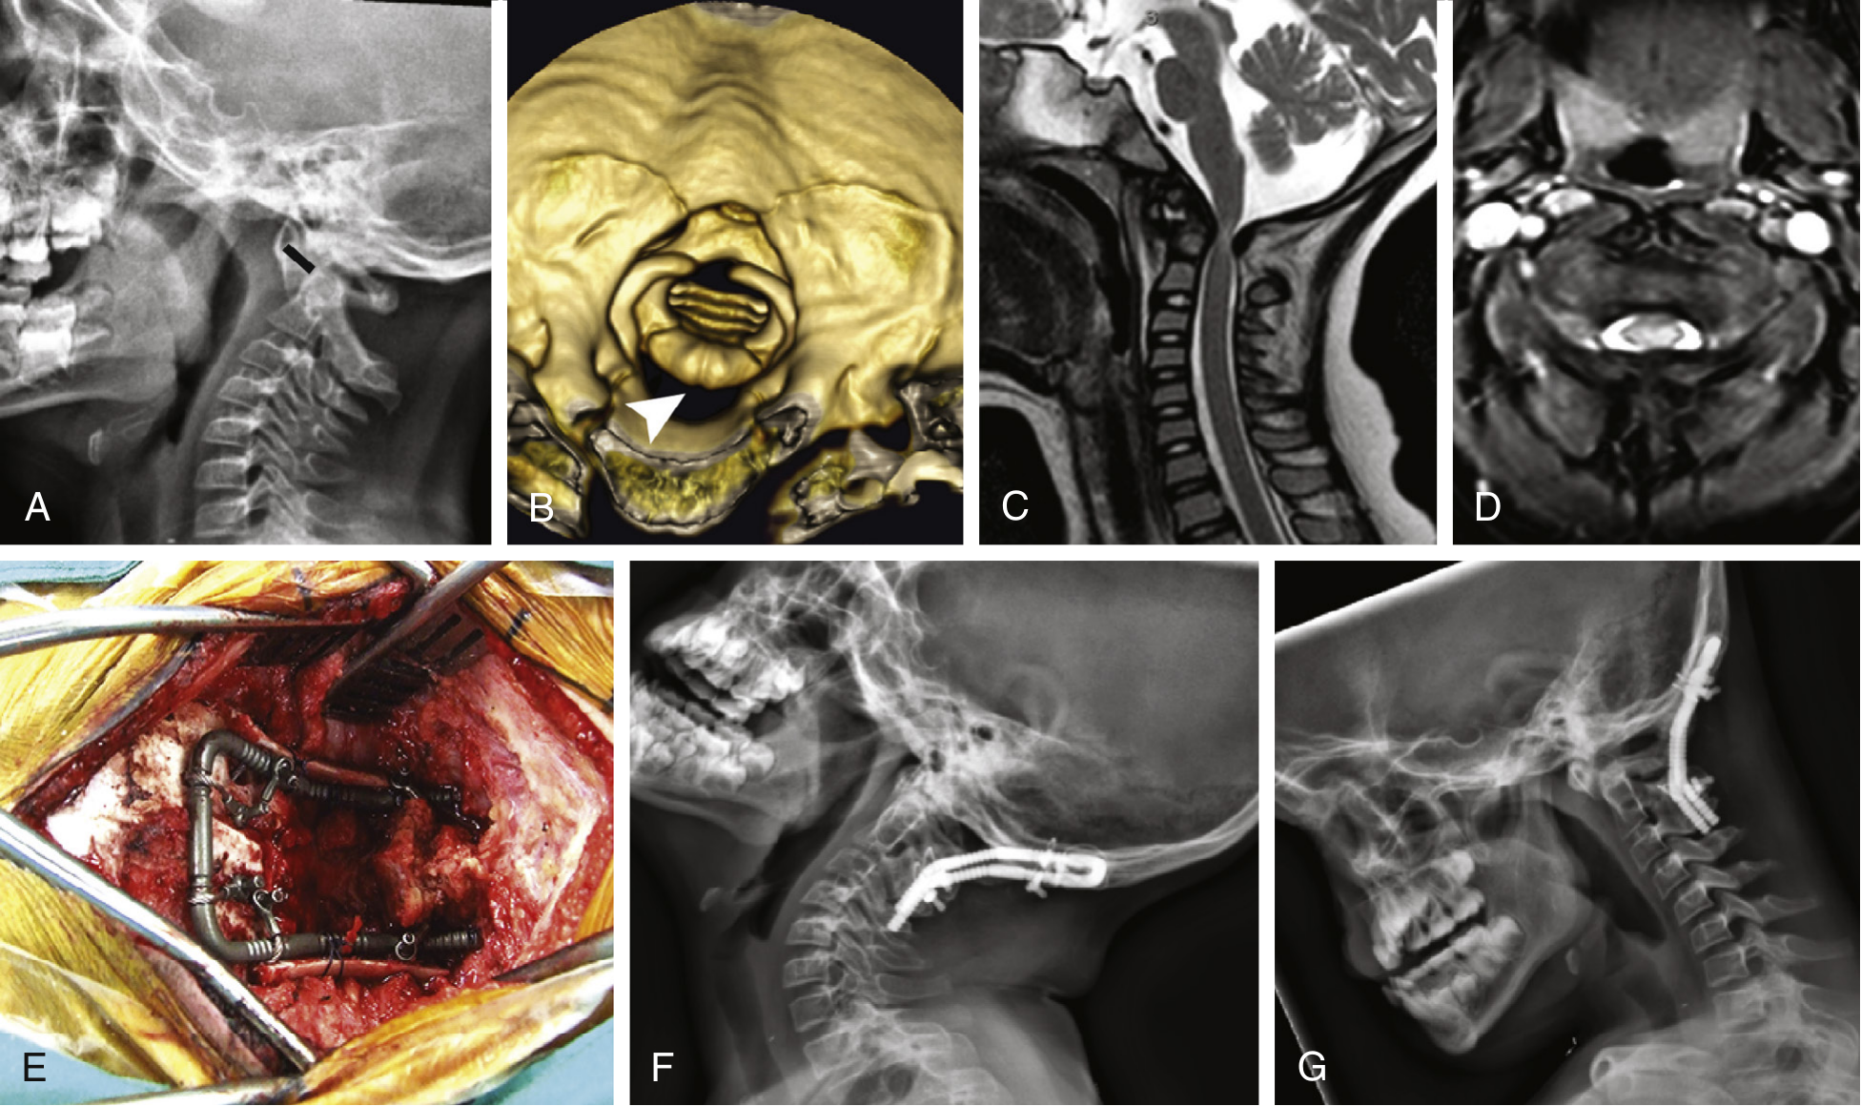
Atlantodental Interval
Lateral radiographs in flexion and extension
Adults: >3 mm
Children: >4 mm
​>5 mm motion: instability conclusive
Craniocervical instability in a 5-year-old with Down syndrome. (A) Lateral cervical radiograph: pathologic atlantodental interval (10 mm, black line). (B) 3D CT: anterior displacement of C1 with canal stenosis ▶. (C, D) MR: severe stenosis and cord signal change. (E) Operative view, occiput–C2 fusion. (F, G) Follow-up images.
18
Notes:
CUE — Simplest, most important interval.
SCRIPT: The atlantodental, or predental, interval is measured on lateral radiographs in flexion and extension, or on sagittal CT. AIIMS states that the diagnosis of transverse ligament rupture and atlantoaxial dislocation is purely radiological: an atlas–dens interval of more than 4 millimeters in children and more than 3 millimeters in adults is diagnostic, and if more than 5 millimeters of motion is present, conclusive evidence of instability exists.
IF TIME: Youmans adds the ligament logic: with the transverse component disrupted, intact alar ligaments limit displacement to between 5 and 6 millimeters; if both are incompetent, translation exceeds 6 millimeters. Youmans: in a child, up to 5 mm of translation is considered normal; beyond the age of 8 years the predental space excursion must be limited to 3 mm. In Down syndrome “An atlantodental interval greater than 4.5 mm mandates further neurosurgical evaluation.”
FIGURE: Youmans & Winn Fig. 260.6, p.1964. ADI = short black line in A (named); canal stenosis = white arrowhead in B (▶ gray). Verifier note: panels F and G look like lateral radiographs although the legend says MR images; caption here says “follow-up images”.
Q&A: Q: Pediatric cut-off — 4 or 5 mm, and up to what age? A: AIIMS is internally inconsistent: p.9 “up to 5 mm in children younger than 8 years”, p.25 “more than 4 mm in children”, p.27 “less than 4 mm in children under 9 years”. Youmans: up to 5 mm normal in a child; beyond 8 years limited to 3 mm. Dähnert SAE: abnormal predental space >2.5 mm in adults and >4.5 mm in children. EPOS posters: C-2392 “<3mm adult, <5 mm child” and “Predental space > 5 mm in children <8 y./ >3 mm above”; C-2555 “AADI greater than 3 mm in adults”. Slide uses AIIMS p.25 (higher-ranked source).
SOURCE: AIIMS p.9, p.25, p.27; Youmans p.6, p.10.

Slide 19
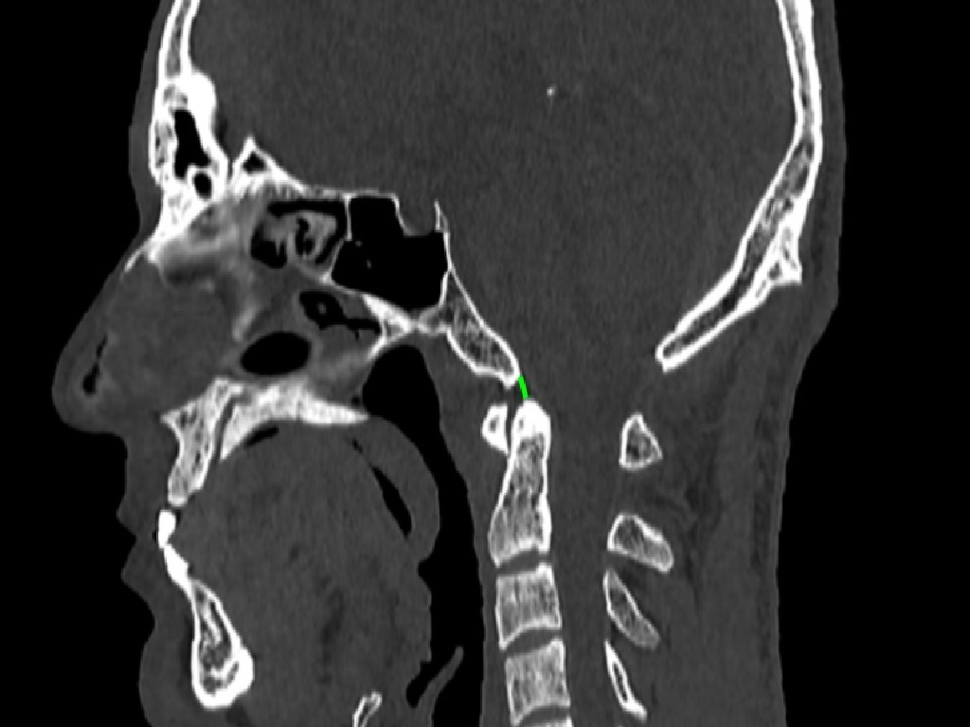
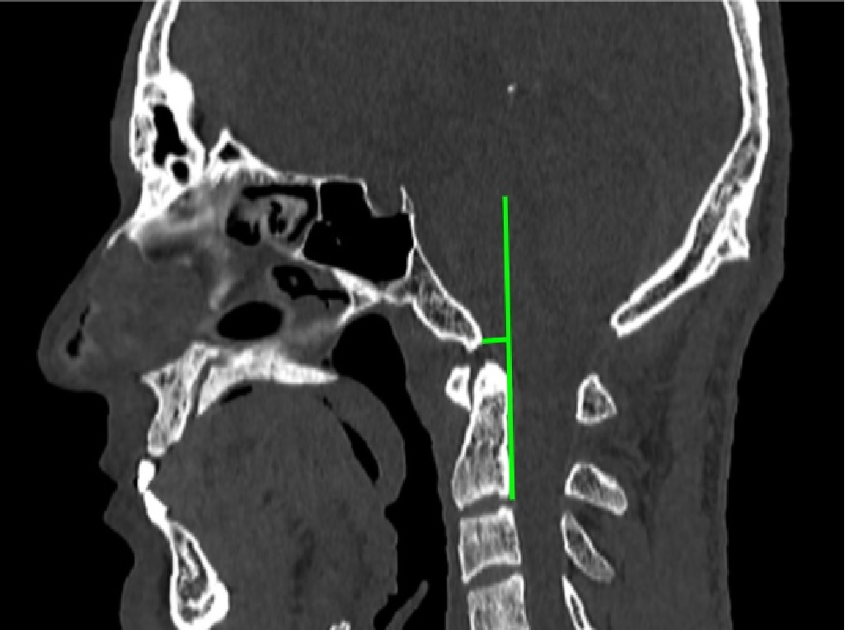
Basion–Dens and Basion–Axial Intervals
Left: the basion–dens interval on mid-sagittal CT (green line). Right: the basion–axial interval on mid-sagittal CT (green lines: posterior axial line, and distance from the basion).
Harris rule of 12: >12 mm indicates instability
19
Notes:
CUE — The intervals for atlanto-occipital injury.
SCRIPT: Two intervals look at the occiput–C1–C2 relationship directly. The basion–dental interval is the distance from the most inferior portion of the basion to the tip of the dens. The basion–axial interval is the distance between the basion and the posterior axial line, a line drawn along and tangential to the posterior cortex of the body of the axis and extended cranially. In the Harris rule of twelves, a distance of more than 12 millimeters indicates instability.
IF TIME: One exhibit states that in atlanto-occipital dislocation the basion–dens interval is more than 12 millimeters, without traction, on the lateral radiograph. C-2392 also lists vertical translation between the clivus and odontoid process greater than 2 mm as atlanto-occipital instability, and a gap between the occipital condyles and the atlas lateral facets visible on a lateral radiograph.
FIGURE: EPOS C-2397 (ECR 2019) Figs. 9 (BDI) and 8 (BAI), “Findings” section. Pointers are drawn green lines (named). 1024 × 767 and 1025 × 765 px. The BDI line is short; point to it on the slide.
CLINICAL: An increased BDI or BAI after trauma suggests alar and tectorial membrane failure (AIIMS): urgent call and MRI.
Q&A: Q: Modality of the 12 mm rule? A: The value is given for the lateral radiograph (C-0882: “The basion-dens interval is > 12 mm. (without traction) on the lateral radiograph”; C-2392: Harris rule of 12). C-2397 gives CT definitions but no CT cut-offs, so the 12 mm value is a radiographic threshold applied to CT. Q: Powers ratio? A: C-2397 defines it on CT but gives no value; image in Backup. No source in this talk gives a numeric Powers ratio cut-off.
SOURCE: Pandit RV, Bommineni B, Kumar A. ECR 2019, C-2397, doi:10.26044/ecr2019/C-2397 (definitions, figures). Arcalis N et al. ECR 2010, C-2392, doi:10.1594/ecr2010/C-2392 (Harris rule). Bermejo AMM et al. ECR 2005, C-0882, doi:10.1594/ECR05/C-0882 (BDI in AOD). AIIMS p.27.

Slide 20
3
Congenital and Developmental Anomalies
20
Notes:
CUE — Section change.
SCRIPT: With the measurements in hand, the congenital and developmental anomalies.

Slide 21
Why CVJ Anomalies Matter Here
CVJ anomalies are common in our country
​Single major cause of cervical cord compression: nearly half
Most patients 11–40 years; male preponderance
Trivial trauma: fall or heavy loads on the head
Congenital atlantoaxial dislocation most common (56%)
​Multiple anomalies frequent (48.8%)
21
Notes:
CUE — Local relevance: South-Asian series.
SCRIPT: This slide is from the AIIMS chapter and is directly relevant to our practice. Craniovertebral junction anomalies are seen all over the world, but are common in our country. 03 percent of admissions to neurology wards, and they were the single major cause of cervical cord compression, accounting for nearly half the cases. Therefore, in every patient presenting with high cervical cord compression, CVJ anomalies must be excluded. Most patients are between 11 and 40 years, with a male preponderance, and onset is usually gradual.
IF TIME: The most common precipitating factor is trivial trauma, either a fall or carrying heavy loads at the back of the head. In a series of 82 patients, congenital atlantoaxial dislocation was the most common anomaly at 56 percent, followed by multiple anomalies, most commonly AAD with occipitalization of C1, basilar invagination with Chiari malformation, and basilar invagination with occipitalization of C1. In 70 patients from the same institute, the most common symptom was cervical pain and stiffness (77%), mostly in the second decade; pyramidal tract involvement was the commonest sign (70%). Recurrent throat infection and fever may lead to hyperemia and laxity of ligament causing dislocations.
CLINICAL: High cervical myelopathy in a young adult who carries loads on the head: look for a CVJ anomaly first.
SOURCE: AIIMS p.13–14 (Incidence; verbatim condensed). Studies cited there: Chopra et al., Br J Neurosurg 1988 (82 cases).

Slide 22
Classification of Congenital Malformations
​Occipital bone
  Platybasia, basioccipital hypoplasia, condylar hypoplasia, condylar dysplasia
​Atlas
  Assimilation, aplasia/hypoplasia, arch anomaly
​Axis and odontoid process
  Dens aplasia/hypoplasia, ossiculum terminale, os odontoideum, Klippel–Feil
22
Notes:
CUE — Three bones; walk through in this order.
SCRIPT: Chen and Liu classify the congenital malformations by the bone involved: the occipital bone, the atlas, and the axis with the odontoid process. Developmental and acquired disorders are then grouped as traumatic, inflammatory and degenerative, infectious, neoplastic, and metabolic or genetic. I will follow this order. One point from Smoker is worth stating early: basilar invagination is best thought of as a radiographic finding and not a diagnosis in itself; if at all possible, one should define the underlying abnormality responsible for it.
Q&A: Q: Other classifications? A: AIIMS uses a sclerotome-based classification (malformations of occipital sclerotomes including proatlas; atlas; axis) followed by developmental and acquired abnormalities; Youmans Box 260.1 (Menezes) is similar and notes “significant overlap”.
SOURCE: Chen & Liu Box 1 p.487; AIIMS p.10; Smoker p.262; Youmans Box 260.1.

Slide 23
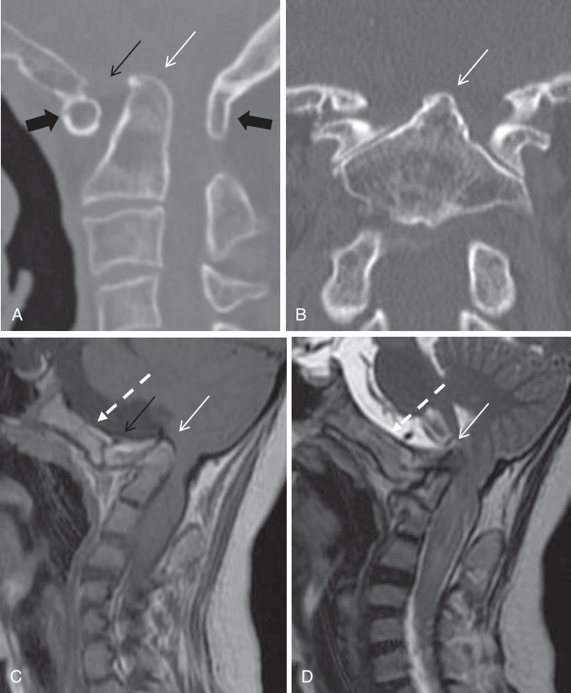
Basilar Invagination
Classic imaging findings in basilar invagination. (A) Sagittal and (B) coronal CT reconstruction. (C) Sagittal T1- and (D) T2-weighted images. Odontoid process protruding into the foramen magnum → and C1-2 or dens-clivus dislocation → directly compressing the pontomedullary junction. Upper row: atlas assimilation → and agenesis of occipital condyle. Lower row: dysplasia of clivus (dotted white arrow) and partial agenesis of atlas.
23
Notes:
CUE — Dens up into the foramen magnum, compressing the medulla.
SCRIPT: Basilar invagination refers to upward herniation of the margins of the foramen magnum into the posterior fossa; AIIMS describes it as a developmental defect implying prolapse of the vertebral column into the skull base. The tip of the odontoid is more cephalad and protrudes into the foramen magnum, compressing the brainstem. Most patients with basilar invagination actually have a normal basal angle and so do not have platybasia.
IF TIME: It is associated with Chiari malformations, syringobulbia and syringomyelia in about 25 to 30 percent of cases, and the most common associations are Chiari malformation, occipitalization of C1, and fused upper vertebrae. Chen: primary basilar invagination is associated with other congenital CVJ anomalies such as atlanto-occipital fusion, hypoplasia of C1, spina bifida of the posterior arch of C1, Klippel–Feil syndrome, Chiari malformation and skeletal dysplasias.
FIGURE: Chong (ed.) Skull Base Imaging 2018, Ch 14 (Liu & Chen), Fig. 14.2, p.294. Dens tip = small white arrow (→ gray); C1-2 or dens-clivus dislocation = small black arrow (→ black); atlas assimilation = large black arrow (→ black); clivus dysplasia = white dotted arrow (no glyph, words kept).
SOURCE: Chen p.486–488; AIIMS p.16; Chong p.291–293.

Slide 24
Invagination, Impression, Platybasia
Term | Meaning
Basilar invagination | Primary developmental anomaly: vertebral column abnormally high, prolapsed into skull base
Basilar impression | Secondary or acquired form: softening of the skull base (Paget, osteomalacia, OI, rickets, hyperparathyroidism, infection)
Platybasia | Flattening of the skull base: increased Welcher basal angle; no symptoms alone
Cranial settling | CVJ changes of rheumatoid arthritis
24
Notes:
CUE — Terms are not synonymous.
SCRIPT: The literature fuels confusion by using these terms interchangeably, but they are not synonymous. Basilar invagination refers to a primary developmental anomaly in which the vertebral column is abnormally high and prolapsed into the skull base. Basilar impression should be reserved for the secondary or acquired form, which results from softening of the skull base, mainly in Paget disease and osteomalacia, and also hyperparathyroidism, osteogenesis imperfecta, Hurler syndrome, rickets and skull base infection. Platybasia is an anthropometric term for flattening of the skull base, manifested by an increased Welcher basal angle.
IF TIME: Cranial settling is the term applied to the CVJ changes of rheumatoid arthritis.
Q&A: Q: Chen uses “basilar invagination (basilar impression)” as one term — conflict? A: Yes. Chen treats them as synonyms and divides into primary and secondary; Smoker, AIIMS and Youmans reserve “impression” for the acquired form. Youmans notes Chamberlain in 1939 used basilar invagination as a synonym for platybasia.
SOURCE: Smoker p.262 (Terminology; verbatim condensed); AIIMS p.17; Youmans p.13; Chen p.486.

Slide 25
Two Developmental Patterns
Feature | Group 1: dislocation | Group 2: clivus
Mechanism | Odontoid protrudes; C1-2 or dens-clivus dislocation | Horizontal clivus; odontoid–clivus alignment kept
Lines violated | Chamberlain, McRae and Wackenheim | Chamberlain only
C1-2 facets | Listhesis of oblique facets | Normal or fused horizontal facets
AIIMS term | Paramedian (exoccipital hypoplasia) | Anterior (basi-occiput hypoplasia)
Pattern decides whether the problem is instability or skull-base shape
25
Notes:
CUE — Clinically the most useful split for surgeons.
SCRIPT: Liu and Chen describe two different types of developmental basilar invagination on imaging. The first group has classical findings: odontoid protrusion into the foramen magnum, C1-2 dislocation or dens-clivus dislocation directly compressing the pontomedullary junction, violation of the Chamberlain, McRae and Wackenheim lines, and listhesis of oblique C1 and C2 facets; this type is considered related to atlantoaxial dislocation. The second group has a horizontal clivus with anatomic alignment of the odontoid and clivus, violation of the Chamberlain line but not the McRae and Wackenheim lines, and normal or fused horizontal facets. AIIMS similarly recognizes an anterior variety, with a short horizontal clivus from basi-occiput hypoplasia, and a paramedian variety, with exoccipital hypoplasia and a dorsally displaced clivus of normal length.
Q&A: Q: Is this Goel’s type A and B? A: Neurosurgeons will recognize the parallel, but Goel’s classification itself is not described in these sources; I have kept to the source descriptions. Q: Is the last row an exact mapping? A: No. The AIIMS anterior/paramedian varieties are an anatomical (bone-deficiency) split, placed in the table for comparison only; the sources do not equate them with the two imaging groups.
SOURCE: Chong Ch 14 p.292–293 (two types, verbatim condensed); AIIMS p.16.

Slide 26
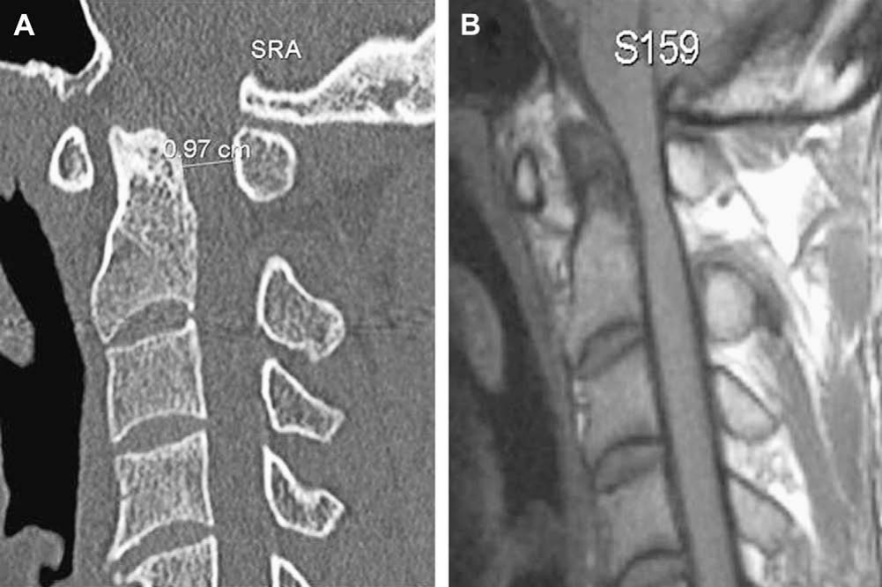
Basioccipital Hypoplasia
Basioccipital hypoplasia. Midsagittal CT (A) and T1-weighted MR imaging (B) show severe hypoplasia of the basiocciput and shortening of the clivus. The ligaments inside the supraodontoid space are poorly seen.
Short clivus; clivus–canal angle <150°
26
Notes:
CUE — Short clivus on midline sagittal.
SCRIPT: The basiocciput forms the lowermost part of the clivus, and its hypoplasia may be mild or severe depending on the number of occipital vertebrae affected. Plain radiographs show basilar invagination with the odontoid tip above Chamberlain’s line, while the position of the Wackenheim clivus baseline is usually normal. Sagittal midline MR imaging demonstrates the shortening of the clivus and the degree of cervicomedullary compression. The clivus-canal angle is typically less than 150 degrees.
FIGURE: Chen & Liu Fig. 10 (p.489): no pointers; in-image measurement label (0.97 cm) from the source. AIIMS Fig. 8 (short clivus, clivus-canal angle <150°) moved to Backup: 479 × 353 px, low resolution.
SOURCE: Chen p.486; AIIMS p.16, Fig. 8.

Slide 27
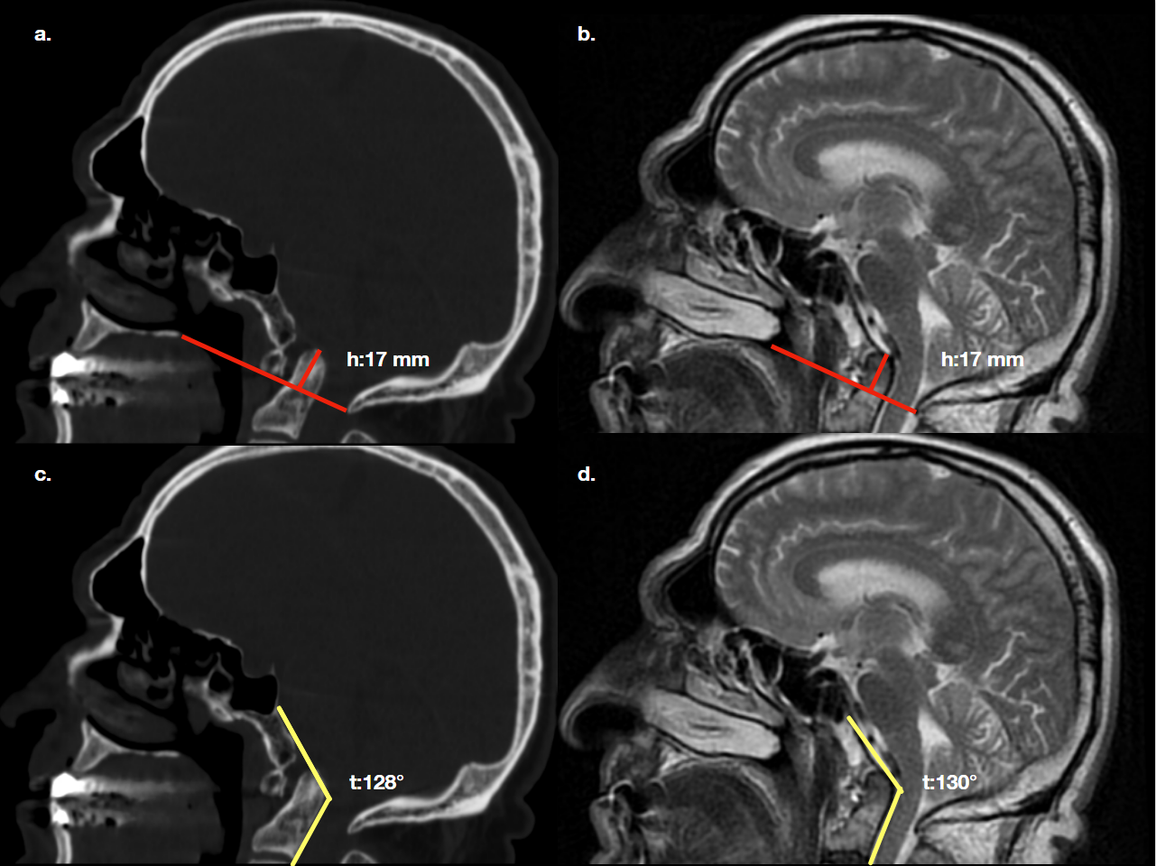
Measuring Basilar Invagination
Basioccipital hypoplasia. (a) Mid-sagittal CT, (b) mid-sagittal T2W: odontoid process above 17 mm on the Chamberlain line (red line, h:17 mm): basilar invagination. (c) Mid-sagittal CT, (d) mid-sagittal T2W: clivus canal angle narrowed (yellow lines, 128° and 130°) and spinal canal stenosis.
Dens 17 mm above Chamberlain
Clivus–canal 128–130°
27
Notes:
CUE — How to put numbers in the report.
SCRIPT: This is how the measurements look in a real report. The dens tip lies 17 millimeters above the Chamberlain line on both CT and T2 MRI, which is basilar invagination, and the clivus-canal angle is narrowed to about 128 to 130 degrees, well below 150, with canal stenosis. Giving both numbers lets the surgeon follow progression and compare after reduction.
FIGURE: EPOS C-2555 (ECR 2018) Fig. 7, “Findings” section. Drawn lines named in caption: Chamberlain line = red line with perpendicular labelled h:17 mm; clivus canal angle = yellow lines labelled t:128° (CT) and t:130° (MR). 1281 × 960 px.
SOURCE: Eser MB et al. ECR 2018, C-2555, doi:10.1594/ecr2018/C-2555. Thresholds: AIIMS Table 1, Smoker p.261.

Slide 28
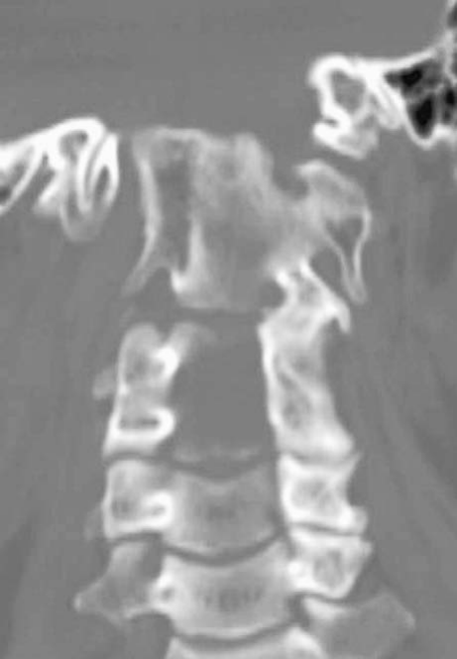
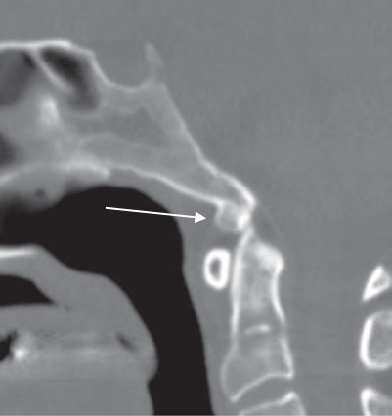
Condylar Hypoplasia and Condylus Tertius
Left: occipital condylar hypoplasia; the lateral mass of the atlas fuses with the hypoplastic condyle; the skull base ascends medially, more on the right, causing basilar invagination. Right: condylar dysplasia (condylus tertius); the ossified remnant → is at the distal end of the clivus and fuses to it.
28
Notes:
CUE — Coronal: skull base should descend medially.
SCRIPT: When the occipital condyles are normally developed, the skull base descends medially. In condylar hypoplasia the condyles are underdeveloped and flat, so the skull base is flattened or even ascends medially, causing basilar invagination and widening of the atlanto-occipital joint axis angle. Clinically, it limits movement at the atlanto-occipital joint and may compress the vertebral artery from excessive posterior gliding of the occiput.
IF TIME: The condylus tertius, or third occipital condyle, is an ossified remnant of the proatlas at the distal end of the clivus, usually directly above and anterior to the arch of C1. It is mostly asymptomatic, may form a joint or pseudojoint, and is associated with an increased prevalence of os odontoideum.
FIGURE: Chen & Liu Fig. 12 (p.489): no pointers. Chong Fig. 14.4 (p.296): ossified remnant = white arrow (→ gray).
Q&A: Q: Condylus tertius vs ossiculum terminale (Bergmann’s ossicle)? A: Chen Fig. 13 notes the differential diagnosis can be difficult; condylus tertius is fused to or articulates with the lower clivus, the ossiculum sits at the dens tip.
SOURCE: Chen p.488–489; Chong p.293–296.

Slide 29
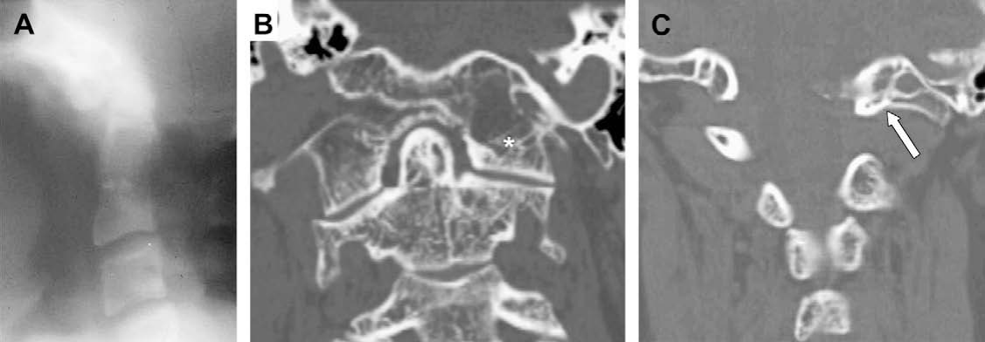
Assimilation of Atlas
Occipital assimilation of the atlas. (A) Polytomography: assimilation of the anterior arch of the atlas to the lowest clivus; basilar invagination is also shown. (B) Reconstruction CT: assimilation of the atlas to the occipital condyle on the left half * but not on the right. (C) Reconstruction CT: assimilation of the left posterior arch of the atlas → to the occipital base.
Failure of segmentation of C1 and skull: 0.14–0.25%
29
Notes:
CUE — Complete or partial; commonest at anterior arch.
SCRIPT: Assimilation of the atlas, or occipitalization, is congenital fusion of C1 with the occiput, from failure of segmentation between the fourth occipital and first spinal sclerotomes. It is found in 0.14 to 0.25 percent of the population. It may be complete or partial, bilateral, unilateral, segmental or focal; the most common type is assimilation of the anterior arch of C1 to the anterior rim of the foramen magnum. On lateral radiographs the C1 arches appear too high when incompletely assimilated and are not visible at all when completely assimilated. It invariably results in basilar invagination.
IF TIME: Wackenheim classification (Chen Table 2): type I partial assimilation; type II type I plus Klippel–Feil anomaly of C2 and C3; type III complete assimilation, basilar invagination and maldevelopment of the transverse ligament causing atlantoaxial dislocation; type IV complete assimilation with multiple malformations including C2–C3 fusion, hemivertebrae, dens aplasia, tertiary condyle and C2–C3 spondylolisthesis.
FIGURE: Chen & Liu Fig. 14, p.490. (A) no pointer (polytomogram, blurry); (B) left assimilation = white asterisk (* gray); (C) left posterior arch = white arrow (→ gray).
CLINICAL: AIIMS: with C2–C3 segmentation failure, atlantoaxial luxation develops in childhood in about 50%; granulation tissue from instability leads to irreducible compression. Chen: occipital assimilation of C1 may be associated with sudden death.
SOURCE: Chen p.490–491, Table 2; AIIMS p.17.

Slide 30
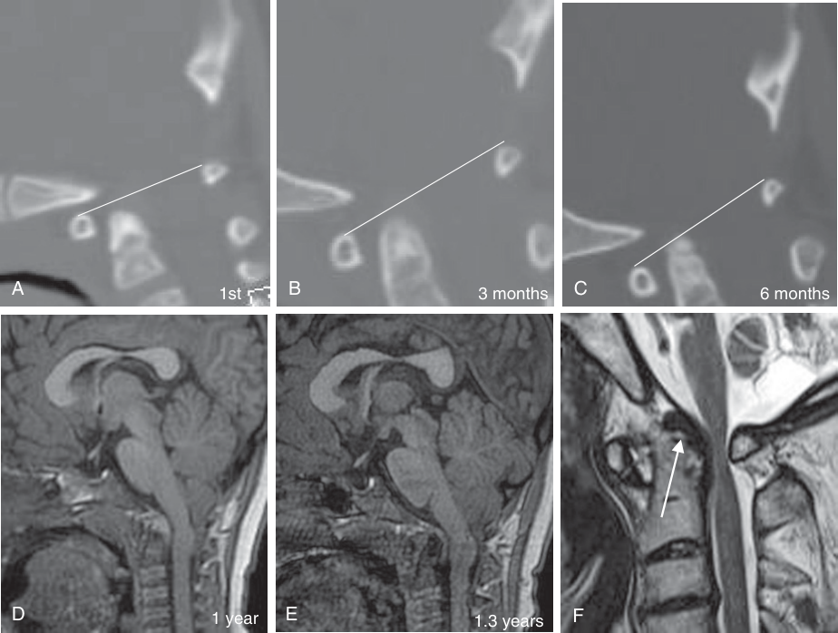
Reducible Becomes Irreducible
Atlantoaxial dislocation progressing from reducible instability to irreducible basilar invagination. (A–C) Serial sagittal CT: the dens moves posteriorly (A→B), then ascends into the foramen magnum (B→C); note the distance to the line between the upper margins of the C1 arches. (D, E) Sagittal T1: increasing indentation of the pontomedullary junction. (F) Another patient: granulation tissue at the top of the dens →.
Report the trend
30
Notes:
CUE — Time course: instability first, invagination later.
SCRIPT: This series shows why time matters. Atlantoaxial dislocation is a slow, developmental and acquired change that may evolve into basilar invagination. In the initial stage the instability is reducible. Pannus, a prolific granulation tissue mass, surrounds the odontoid and prevents its upward motion into irreducible basilar invagination until about 14 to 15 years of age. In the irreducible stage the junction emerges from an abnormal groove behind the occipital condyles and pushes up into the cranial base, giving platybasia, a short horizontal clivus, and an acquired hindbrain herniation.
IF TIME: The authors stress that the treatment of reducible, irreducible and acquired hindbrain herniation states is completely different.
FIGURE: Chong Fig. 14.7, p.298. (A–C) white drawn reference line between the upper margins of the C1 arches (named); time stamps; (F) granulation tissue = white arrow (→ gray).
CLINICAL: In children, compare with previous studies: progressive ascent of the dens is an argument for early fixation.
SOURCE: Chong p.294–296 (verbatim condensed).

Slide 31
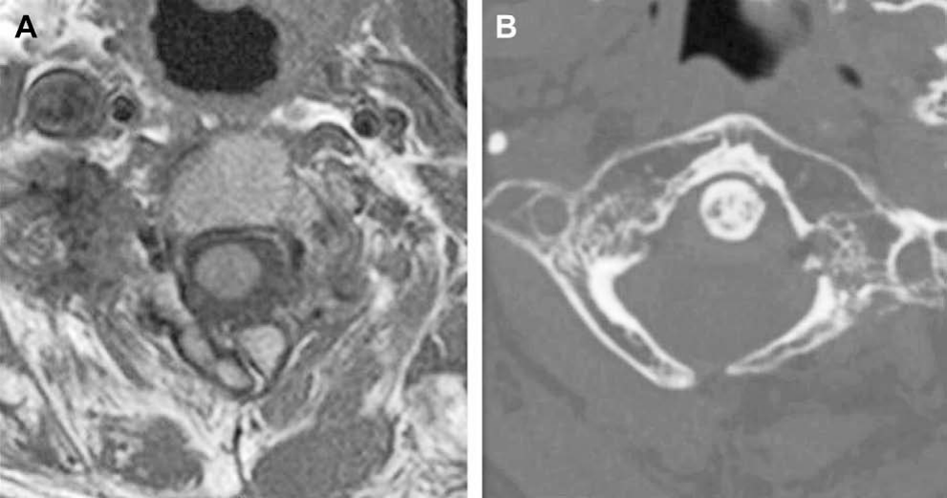
Atlas Arch Anomalies
Posterior arch rachischisis. Axial T1-weighted MR imaging (A) and CT (B) show a midline defect in the posterior arch of the atlas.
Cleft: smooth, corticated; fracture: jagged, soft-tissue swelling
31
Notes:
CUE — Do not call a cleft a Jefferson fracture.
SCRIPT: The most common atlas arch anomaly is posterior arch rachischisis, present in 4 percent of adult autopsy specimens; 97 percent are midline. It has been reported in 70 percent of children with myelomeningoceles. 1 percent, and almost always occurs with posterior rachischisis, in which case the term split atlas is applied. These anomalies may be confused with a Jefferson fracture.
IF TIME: CT helps: margins of a developmental cleft are smooth with an intact cortical edge and no abnormal soft tissue, whereas fractures have jagged edges or are comminuted and generally associated with soft tissue swelling. Ponticulus posticus (Chong Fig. 14.8, in Backup): the vertebral artery may run through it, relevant before C1 lateral mass screw placement.
FIGURE: Chen & Liu Fig. 16 (p.492): no pointers. Split atlas (AIIMS Figs. 11A–B, 700 × 256 px, low resolution) and Smoker Fig. 23 (anterior arch configurations) are in Backup.
SOURCE: AIIMS p.17–19; Chen p.490; Chong p.296–297.

Slide 32
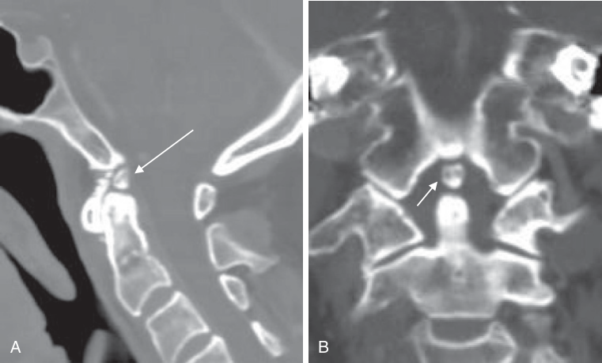
Ossiculum Terminale and Dens Hypoplasia
Persistent ossiculum terminale → (A, coronal; B, coronal reconstruction) located above the alignment of upper C1 and the dens, between the dens and the lowest end of the clivus.
Hypoplastic dens: no alar or apical attachment
32
Notes:
CUE — Ossiculum: stable when isolated; hypoplasia: unstable.
SCRIPT: Persistent ossiculum terminale, Bergmann’s ossicle, results from failure of the terminal ossicle to fuse with the rest of the odontoid. It may be confused with a type I odontoid fracture, and absolute differentiation may be difficult. Whether traumatic or congenital, it is stable when isolated and of little clinical significance; the odontoid is usually of normal height. In contrast, in aplasia and hypoplasia of the odontoid, the attachments for the apical and alar ligaments are absent, predisposing to atlantoaxial dislocation.
IF TIME: The odontoid tip normally lies approximately at the level of the superior margin of the anterior arch of atlas.
FIGURE: Chong Fig. 14.9 (p.300): ossiculum terminale = white arrow (→ gray); verifier notes panel A looks sagittal although the legend says coronal. Odontoid hypoplasia (AIIMS Figs. 12A–C, 700 × 217 px, low resolution) is in Backup.
Q&A: Q: Ossiculum terminale vs type I fracture? A: Chen: absolute differentiation may be difficult; both are stable when isolated. AIIMS: the os terminale is usually about 12 mm long; if atlantoaxial dislocation occurs, the remaining odontoid may compress the cervicomedullary region.
SOURCE: Chen p.491; AIIMS p.19, p.22; Youmans p.4 (tip ossification center seen by 3 years, fuses by 12 years).

Slide 33
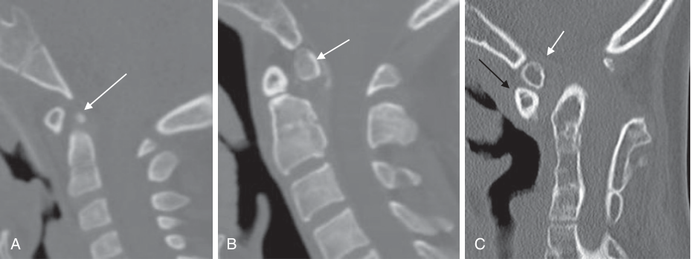
Os Odontoideum
Os odontoideum: (A) orthotopic and (B) dystopic type on sagittal CT. The os → moves in different relationship to the clivus and the rest of C2. Note the round or triangular anterior arch of C1 →. With associated Klippel–Feil anomaly, basilar invagination resulted (C).
Orthotopic moves with C1–C2; dystopic moves with clivus
33
Notes:
CUE — Independent ossicle + hypertrophic C1 arch.
SCRIPT: Os odontoideum is an independent osseous structure cephalad to the C2 body in the area of the odontoid process, with a small hypoplastic dens. The anterior arch of C1 may appear rounded and hypertrophic. In the orthotopic type, the os lies at the site of the dens and moves with C1 and C2. In the dystopic type, it lies near the skull base and moves with the clivus, to which it may be fused.
IF TIME: Because the gap usually extends above the level of the superior articular facets of C2, cruciform ligament incompetence and atlantoaxial instability are common. The degree of instability must be assessed by flexion and extension studies. The weight of current evidence points to a traumatic etiology in the majority.
FIGURE: Chong Fig. 14.10, p.300. Os = white arrow (→ gray); anterior arch of C1 = black arrow (→ black) (verifier: black arrow on panel C only). Composite 929 × 349 px.
CLINICAL: Youmans: in the dystopic type, dorsal compression may arise from anterior displacement of the posterior atlas during flexion, and ventral compromise by the axis body in extension: report both positions.
Q&A: Q: Incidence associations? A: AIIMS: increased in Down syndrome, spondyloepiphyseal dysplasia and Morquio syndrome.
SOURCE: Chen p.491–492; AIIMS p.22–23; Youmans p.14.

Slide 34
Os Odontoideum vs Type II Fracture
Feature | Os odontoideum | Type II fracture
History of trauma | Often present | Always
Line of separation | Below superior articular facet | Above superior articular facet
Margins | Smooth, convex superiorly, well corticated | Acute, irregular, not corticated
Anterior arch of atlas | Hypertrophic and round | Half-moon shaped
Associated anomaly | Often present | Absent
CT is the best modality to distinguish them
34
Notes:
CUE — The table neurosurgeons ask for.
SCRIPT: Differentiating an os odontoideum from a type II odontoid fracture can be difficult on a lateral radiograph, and CT is the best modality to distinguish them. In os odontoideum the upper margin of the axis body is convex, and the anterior arch of the atlas is hypertrophic with a convex posterior border and increased cortical thickness. In an odontoid fracture, the upper margin of the axis is flattened with a sharp uncorticated margin and a normal-appearing, half-moon shaped anterior arch.
FIGURE: Comparison image (AIIMS Fig. 14, 700 × 205 px) is in Backup: too small to project here.
Q&A: Q: Does it change management? A: The sources do not give a separate algorithm; both are judged by stability on flexion–extension imaging (Chen) and by reducibility (Youmans algorithm, later).
SOURCE: Chen Table 4 p.498 (verbatim); AIIMS p.23–24.

Slide 35
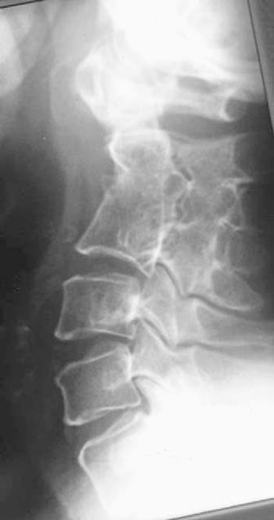
Klippel–Feil Anomaly
Congenital fusion of cervical spine
Classic triad in <50%
With C1 assimilation: early instability
Klippel–Feil anomaly. Severe malsegmentation of multiple vertebral bodies with the axis is shown. The posterior elements are also involved.
35
Notes:
CUE — Fusion above or below increases C1–C2 load.
SCRIPT: Klippel–Feil anomaly is congenital fusion of the cervical spine from failure of segmentation between the third and eighth weeks of gestation. It may be localized, multisegmental or diffuse, and fusion may not be obvious in infancy because of incomplete ossification. The classic triad of short neck, low posterior hairline and limited neck movement is present in less than 50 percent. Associations include scoliosis, Sprengel’s deformity, renal anomalies, congenital heart disease and hearing loss.
IF TIME: At the junction, patients with occipitalization of the atlas plus atlantoaxial fusion and odontoid hypermobility, or with multisegment fusion, are at high risk of early instability or degenerative disease.
FIGURE: Chen & Liu Fig. 19 (p.493): no pointers; 351 × 665 px (low resolution, flagged). AIIMS Figs. 20A–C (3D CT, Sprengel shoulder, short neck; 700 × 210 px) are in Backup.
SOURCE: Chen p.492–493; AIIMS p.30.

Slide 36
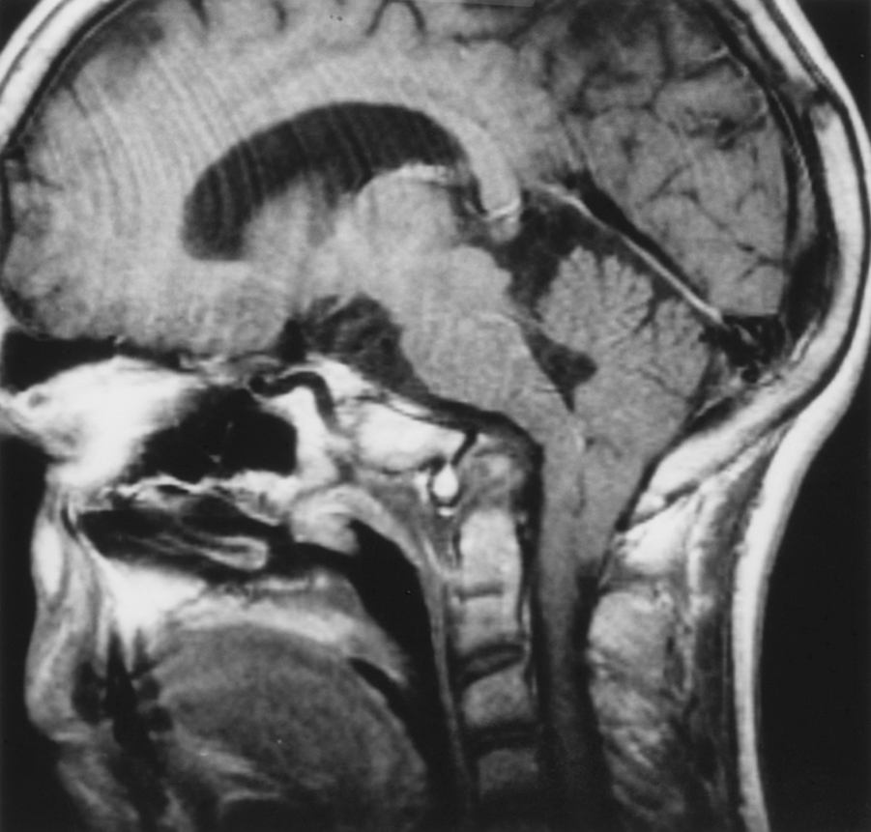
Chiari I and the Bony CVJ
Peg-like tonsils below foramen magnum
Syrinx 20–40%; 60–90% if symptomatic
Osseous anomalies 25%
​Look for BI before planning decompression
Midsagittal T1-weighted MR image, 14-year-old with headaches, ataxic gait, spastic quadriparesis and downbeat nystagmus: atlas assimilation with basilar invagination, a short clivus, and an abnormal clivus–C1–C2 articulation.
36
Notes:
CUE — Chiari + BI: the bone is the problem.
SCRIPT: In Chiari I malformation, elongated pointed peg-like cerebellar tonsils are displaced inferiorly through the foramen magnum into the upper cervical canal. A syrinx is present in 20 to 40 percent of all patients, increasing to 60 to 90 percent in symptomatic patients. Osseous anomalies are seen in 25 percent, in the form of basilar invagination, Klippel–Feil anomaly and atlanto-occipital assimilation. Phase-contrast cine MRI can study CSF flow across the foramen magnum, which is abnormal in the majority of these patients.
FIGURE: Youmans & Winn Fig. 260.11, p.1967: no labels or pointers.
CLINICAL: Youmans (Chiari with BI): ventral decompression should be performed before any posterior surgical procedure; posterior procedures attempted before relieving ventral compression are associated with unfavorable results in up to 30%. “An operative procedure that relies on posterior decompression for hindbrain herniation without addressing the potential for instability can have unfortunate results.”
Q&A: Q: Value of cine flow MRI? A: AIIMS describes phase-contrast cine MRI showing downward systolic and upward diastolic flow; abnormal flow observed in the majority; research continues (AIIMS Fig. 21 in Backup).
SOURCE: AIIMS p.30–31 (Chiari I; verbatim condensed); Youmans p.7, Fig. 260.11.

Slide 37
Syndromic and Metabolic CVJ
​Down: AO instability 61%; AAI 9–30%
​Achondroplasia: tear-drop foramen magnum
​MPS: dysplastic dens, soft tissue
​OI: basilar impression
37
Notes:
CUE — Four syndromes, four mechanisms.
SCRIPT: Down syndrome is frequently complicated by atlanto-occipital instability, 61 percent, as well as atlantoaxial instability, 9 to 30 percent, with persistent synchondroses, posterior C1 rachischisis and os odontoideum. In achondroplasia the foramen magnum is constricted with a distinct tear-drop configuration, together with odontoid dysplasia, basiocciput hypoplasia and thickening of the posterior rim of the foramen magnum.
IF TIME: In the mucopolysaccharidoses, especially Morquio and Hurler, there is a hypoplastic or dysplastic odontoid, ligamentous instability, soft tissue thickening around the dens, and cord compression by the posterior atlas arch; the soft tissue is hypointense on T2 and may represent non-ossified fibrocartilage. In osteogenesis imperfecta, repetitive microfractures cause infolding of the occipital condyles and basilar impression.
Q&A: Q: Down syndrome screening value? A: Youmans: an ADI greater than 4.5 mm mandates further neurosurgical evaluation; symptomatic instability is believed to be <1%. AIIMS: 10–20% of children with Down syndrome have radiological AAI, only 18% of them symptomatic. Sources differ on prevalence.
SOURCE: AIIMS p.30–31; Youmans p.10, p.17; Chong p.294 (Down 14–20% AAS).

Slide 38
4
Trauma
38
Notes:
CUE — Section change.
SCRIPT: Trauma. Fractures of the junction account for approximately 25 percent of cervical spine fractures.

Slide 39
Trauma: What to Check
​NCCT with sagittal and coronal reformats; MRI for soft tissue
Dens or posterior axial line to basion: alar and tectorial injury
ADI: <3 mm adults, <4 mm children under 9
Open mouth: C1 lateral masses align with C2
AO and AA joints congruent on reformats
MRI: STIR/fat-suppressed GRE for ligaments and cord
39
Notes:
CUE — A six-point trauma checklist.
SCRIPT: NCCT is now the mainstay for bone and high-resolution MRI for soft tissue. An abnormal distance between the dens or the posterior axial line and the basion suggests failure of the alar ligaments, the tectorial membrane, or both. An increased atlantoaxial distance, which should be less than 4 millimeters in children under 9 years and less than 3 millimeters in adults, points to transverse ligament injury. On the open-mouth view, the lateral masses of C1 should align exactly with the lateral margins of C2.
IF TIME: On CT reformats, the atlanto-occipital and atlantoaxial articulations should be congruent. MRI with fat-suppressed gradient-echo T2 or STIR shows increased signal in the joints, ligaments, prevertebral soft tissues and cord, and axial gradient-echo images help assess the transverse ligament. EPOS C-2392 instability signs: predental space >5 mm in children <8 years, >3 mm above; lateral mass separation >6 mm; vertical clivus–odontoid translation >2 mm; Harris rule of 12. Subarachnoid hemorrhage and epidural hematoma may accompany craniocervical junction injuries. Fractures of the dens tip or occipital condyles may be associated with alar ligament insufficiency.
Q&A: Q: Basion–dens interval number? A: AIIMS describes the principle without a value; EPOS C-2392 and C-0882 give the Harris rule of 12 (>12 mm abnormal on the lateral radiograph), shown on the craniometry slide.
SOURCE: AIIMS p.27 (Trauma; verbatim condensed); Chen p.493.

Slide 40
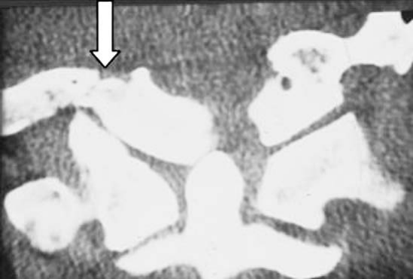
Occipital Condyle Fracture
Comminuted: stable
With basioccipital fracture: stable
​Avulsion: alar ligament disrupted, unstable
  Needs high-resolution CT
Occipital condylar fracture. Coronal CT: fracture of the right occipital condyle ⇨ with medial displacement of the fragment.
40
Notes:
CUE — Type III avulsion = unstable.
SCRIPT: Occipital condylar fracture results from high-energy blunt trauma with axial compression, lateral bending, or rotational injury to the alar ligament, and is usually associated with severe head and cervical injuries. It may be missed without proper tomographic imaging, so diagnosis requires a high index of suspicion and high-resolution CT. Three types are described. Type I is comminuted, from axial compression. Type II is a condyle fracture with extensive basioccipital fracture, from a direct blow. In both, the alar ligament and tectorial membrane are preserved and the injury is stable.
IF TIME: Type III is an avulsion, from forced rotation and lateral bending; the alar ligament and tectorial membrane are disrupted, and it is unstable. Paralysis of the ninth to twelfth cranial nerves, Collet-Sicard syndrome, may occur. An alternative classification divides these fractures into displaced and stable, with and without ligamentous injury.
FIGURE: Chen & Liu Fig. 20, p.494. Fracture = white block arrow (⇨ gray).
Q&A: Q: Whose classification? A: Anderson and Montesano. Chen presents it as Table 3 citing refs 27–28 without naming it; EPOS C-0882 names it: “Type I: comminuted impaction fracture due to axial loading; Type II: skull base fracture that extends through the occipital condyle; Type III (most common): avulsion fracture mediated through tension in the alar ligament.”
SOURCE: Chen p.493–494, Table 3 (verbatim).

Slide 41
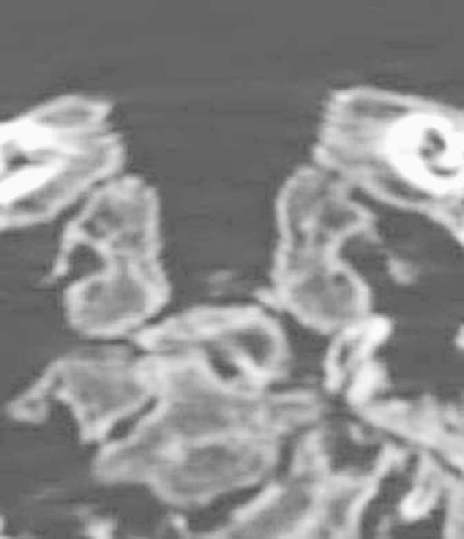
Atlanto-occipital Dislocation
​Anterior displacement of occiput
​Longitudinal distraction
​Posterior displacement
  Commoner in children; mortality from brainstem injury
Atlanto-occipital dislocation. Coronal CT reconstruction: dislocation of the atlanto-occipital joint with fracture of the left lateral mass of the atlas (6-year-old mummy).
41
Notes:
CUE — Rare survivors; do not miss it.
SCRIPT: Atlanto-occipital dislocation follows complete or near-complete disruption of the ligaments between the occiput and upper cervical spine, typically after hyperextension. With incompetence of the alar ligaments and tectorial membrane, the cranium dislocates anteriorly, and type I odontoid fractures are usually found. It is more frequent in children because their atlanto-occipital joints are more horizontal and their ligaments weaker. It is commonly complicated by head injury, and mortality is highly related to brainstem injury. High-resolution CT is necessary for accurate diagnosis, and MRI demonstrates the ligament and soft tissue injury.
IF TIME: The three types are anterior displacement of the occiput, longitudinal distraction, and posterior displacement of the occiput with respect to C1.
FIGURE: Chen & Liu Fig. 21, p.495: no pointers; image of a mummy specimen, soft, but the only AOD image in the sources.
CLINICAL: Any widening or incongruence of the atlanto-occipital joints on coronal reformats is an urgent call. EPOS C-2392: “Cervical traction is absolutely contraindicated, since further stretching of the brainstem can occur.” C-0882: the basion–dens interval is >12 mm (without traction) on the lateral radiograph; on CT, incongruity between the occipital condyles and lateral masses of the atlas. Lateral radiograph example in Backup (C-0882 Fig. 17).
Q&A: Q: Traynelis classification? A: These three types are Chen’s description citing ref 31 (Traynelis et al.); AIIMS lists Down syndrome atlanto-occipital instability at 61%.
SOURCE: Chen p.494 (verbatim condensed).

Slide 42
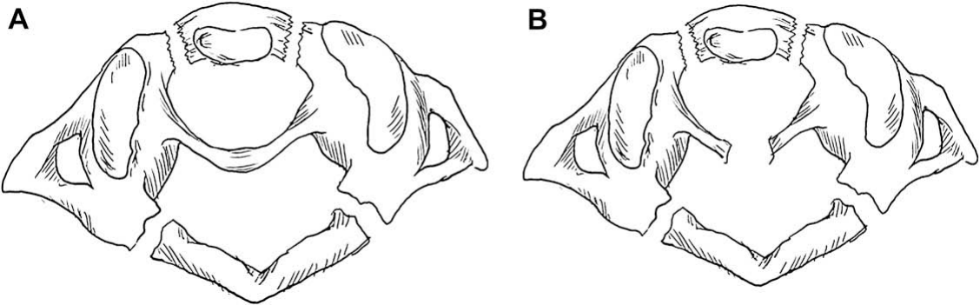
Jefferson Fracture
Jefferson’s fracture. A Jefferson’s fracture with an intact transverse ligament is stable (A), whereas one with a ruptured transverse ligament is unstable (B).
Transverse ligament decides; lateral masses >6 mm apart
42
Notes:
CUE — Axial load; arches break; ligament decides.
SCRIPT: Jefferson’s fracture results from axial loading and is the simultaneous disruption of the anterior and posterior arches of C1, with or without disruption of the supporting ligaments. The commonest causes are a fall from a height and a diving injury. The transverse ligament is of critical importance: it is frequently avulsed at its bony insertion on C1. If it remains intact, the fracture is stable; if it is disrupted, stability depends on the integrity of the alar ligament.
IF TIME: Neurologic deficits are extremely rare in isolated C1 fractures; clinical features are neck and suboccipital pain, dysphagia from retropharyngeal hematoma, and posterior fossa stroke or TIA from vascular damage. CT may show the bony avulsion, and MRI is more helpful for the ligament and cord. Chong Fig. 14.11 also shows a transverse foramen fracture, where vertebral artery injury is suspected: mention CTA.
FIGURE: Chen & Liu Fig. 22 (p.495): line drawings, no pointers. Caption keeps the printed wording minus the duplicated “with a with”.
CLINICAL: Lateral mass separation >6 mm on the open-mouth view or coronal CT: the cruciate (transverse) ligament is felt to be disrupted (EPOS C-2392); obtain MRI of the transverse ligament.
Q&A: Q: Rule of Spence / lateral mass overhang? A: Not named in the sources. EPOS C-2392: “Separation of the atlas lateral masses more than 6 mm. Cruciate ligament is felt to be disrupted. RX: open-mouth view, coronal CT.” C-0882: “disruption of ligament must be suspected with a distance of 6 mm. or more between the odontoid process and the lateral masses on an open-view projection.” The posters word the 6 mm threshold differently (lateral mass separation vs odontoid–lateral mass distance); the slide uses C-2392. The textbooks give no value.
SOURCE: Chen p.494–495; Chong p.299. Arcalis N et al. ECR 2010, C-2392 (Imaging findings, instability signs); Bermejo AMM et al. ECR 2005, C-0882 (Imaging findings, Atlas).

Slide 43
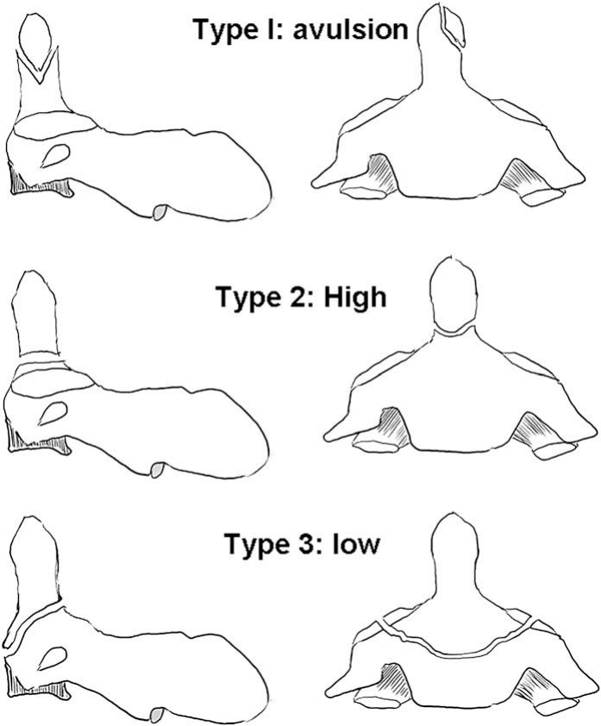
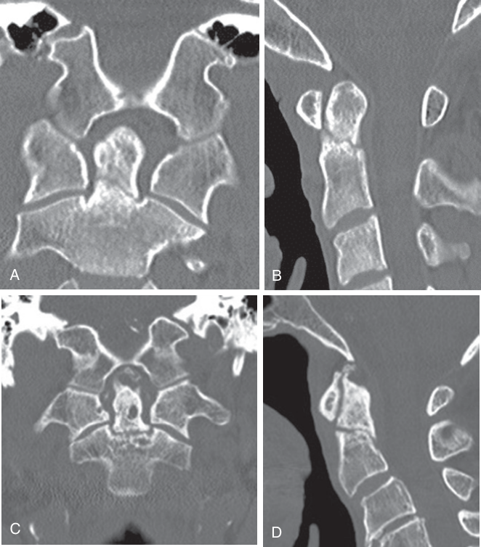
Odontoid Fractures
Left: types of odontoid fracture. Type I: avulsion of the tip of the dens at the insertion of the alar ligament. Type 2: at or above the junction of the dens and the central body. Type 3: in the superior body and superior articular facets of C2. Right: type 2 on coronal (A) and sagittal (B) CT; type 3 on coronal (C) and sagittal (D) CT; on the sagittal view alone it is sometimes difficult to differentiate the types.
43
Notes:
CUE — Use the coronal reformat to type it.
SCRIPT: Odontoid fracture represents approximately 15 percent of all cervical fractures, and hyperflexion is believed to play a major role. The three types are the familiar ones. Type I is an avulsion of the tip at the insertion of the alar ligament. Type II is a fracture at or above the junction of the dens and the body. Type III extends into the superior body and superior articular facets of C2.
IF TIME: As the Chong figure shows, on the sagittal view alone it can be difficult to separate types II and III, so always look at the coronal reformat. MRI shows the relation of C1 to C2, ligament disruption and cord injury, and a fracture line with marrow edema; high-resolution CT may be better for a subtle type I fracture. EPOS C-2392 (Anderson & D’Alonzo): type II most common (59%), always unstable, high prevalence of nonunion (64%) from limited vascular supply; type III 33%, better prognosis. C-0882: for type II, axial CT alone misses more than 50% (use reformats). AIIMS: the odontoid process is the most commonly fractured bone in this region. There is no vascular communication between the base of the dens and the body of the axis, relevant to sequestrum formation with type II fracture.
FIGURE: Chen & Liu Fig. 23 (p.496): text labels “Type I: avulsion”, “Type 2: High”, “Type 3: low” in the drawing (numeral style inconsistent in source). Chong Fig. 14.13 (p.303): no pointers.
CLINICAL: State the type, displacement and angulation of the fragment, and any ligament or cord injury. Type II is the one surgeons worry about.
Q&A: Q: Classification name? A: Chen presents the three types citing ref 21 (Anderson & D’Alonzo); AIIMS uses the same three types.
SOURCE: Chen p.495–496; AIIMS p.27; Chong p.300.

Slide 44
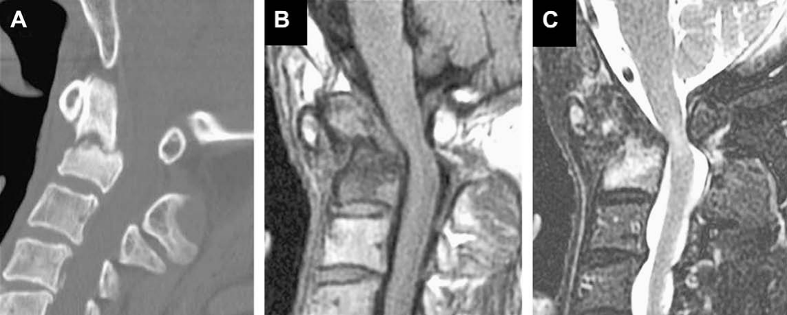
Type 3 Odontoid Fracture on MRI
Type 3 odontoid fracture. Midsagittal CT (A), T1-weighted (B), and T2-weighted MR imaging (C) show fracture at the low dens, resulting in rupture of the transverse ligament and causing C1-2 dislocation and compression to the cord. (B) Apical and alar ligaments are intact but displaced along with the upper fragment. (C) Dens body and spinal cord show edema.
MRI: ligaments, cord, marrow edema
44
Notes:
CUE — MRI: cord, marrow edema, ligament.
SCRIPT: This case shows what MRI adds. A type 3 fracture at the low dens has ruptured the transverse ligament, with C1-2 dislocation and cord compression. The apical and alar ligaments are intact but displaced with the upper fragment, and there is edema in the dens body and the cord. These are the details that move a patient from a collar to fixation. AIIMS adds that MRI with fat-suppressed gradient-echo T2 or STIR shows marrow edema and cord contusion.
FIGURE: Chen & Liu Fig. 25 (p.497): no pointers. AIIMS type II example (Figs. 18A–E, flexion–extension radiographs and MRI; low quality, tonal reversal in source print) is in Backup.
CLINICAL: Cord signal change or dislocation with a dens fracture = urgent spinal surgery referral.
SOURCE: AIIMS p.33; Chen p.497.

Slide 45
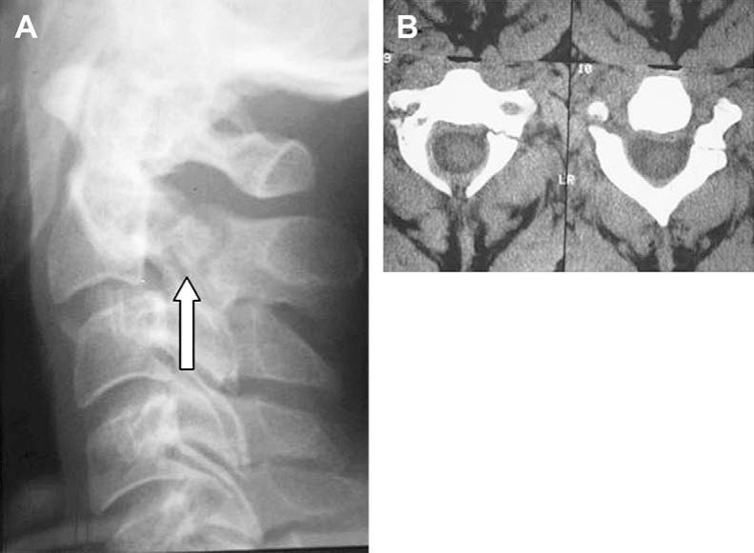
Hangman’s Fracture
Minimally displaced ring fracture
Pars fracture + anterior displacement of C2 body
Plus bilateral facet dislocation
  Type 2: >3 mm, angulation C2–3
Hangman’s fracture. Plain radiography (A) and axial CT (B): fracture at the pars interarticularis ⇨. Type 1: no displacement of the anterior or posterior arch; cord not compromised.
45
Notes:
CUE — Effendi 1–3; type 2 is the unstable one.
SCRIPT: Hangman’s fracture, or axial traumatic spondylolisthesis, is a hyperextension fracture involving the pars interarticularis. Effendi and colleagues categorized three types. Type 1 is an isolated minimally displaced fracture of the ring without displacement of the body or facets. Type 2 is a fracture of the pars with anterior displacement of the axial body. Type 3 adds anterior displacement in flexion with dislocation of the bilateral facets. A type 2 lesion is more unstable and is usually considered a hyperextension-flexion injury; on imaging the displacement can be more than 3 millimeters with angulation at the C2–C3 disk space, and the longitudinal ligaments and disk may be disrupted. MRI defines cord injury, ligament injury and any acute disk herniation.
FIGURE: Chen & Liu Fig. 27, p.498. Pars fracture = white open block arrow in A (⇨ gray); B two axial CT slices without pointers.
Q&A: Q: Levine–Edwards? A: Not described in these sources; Chen uses Effendi.
SOURCE: Chen p.495 (verbatim condensed).

Slide 46
5
Inflammatory, Degenerative and Infective
46
Notes:
CUE — Section change.
SCRIPT: Next, inflammatory, degenerative and infective disease.

Slide 47
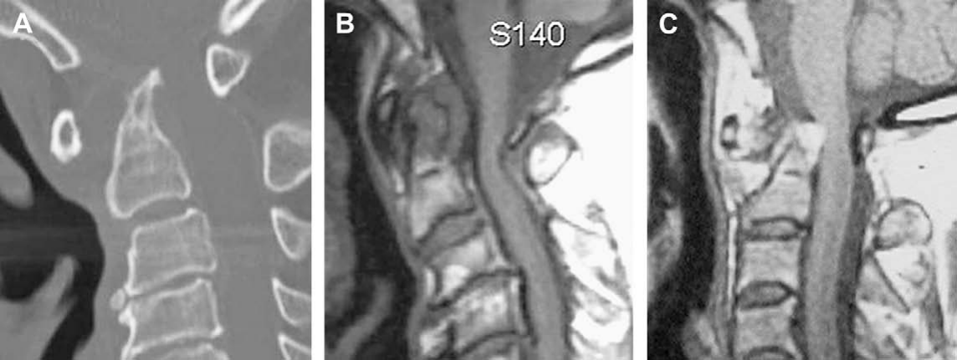
Rheumatoid Arthritis
RA. (A) Midsagittal CT: erosion of the dens with a “pencil-tip” appearance. (B) Midsagittal T1-weighted MR imaging in another patient: retrodental mass, deformity of the dens, and involvement of the bone marrow. (C) Postcontrast T1-weighted MR imaging: enhancing lesion in the location of the transverse ligament surrounding the eroded dens tip.
AAI 25% · cranial settling 8–16% · pannus 10–30%
47
Notes:
CUE — Three RA abnormalities.
SCRIPT: Rheumatoid arthritis is the most common inflammatory disorder at the junction; the cervical spine is clinically affected in 44 to 88 percent of patients. Three types of abnormality are seen: atlantoaxial instability in 25 percent, upward migration of the odontoid or cranial settling in 8 to 16 percent, and rheumatoid granulation tissue or pannus around the odontoid in 10 to 30 percent. Hyperemia weakens the transverse and alar ligaments and erodes the bones, giving the dens a pencil-tip appearance.
IF TIME: In cranial settling, erosion and compression of the C1 lateral masses lets the anterior arch descend and the dens migrate upward, reducing the canal diameter. MRI shows the dens erosion, widening of the atlantodental space, degree of subluxation and the configuration of the junction.
FIGURE: Chen & Liu Fig. 28, p.499: no pointers; composite 1144 × 431 px.
Q&A: Q: Ranawat or Redlund-Johnell values for settling? A: Not given numerically in these sources; Youmans lists rheumatoid cranial settling under secondary basilar invagination. Q: Prevalence differs (Chen 60–70% cervical spine)? A: Chen: cervical spine involved in 60–70%, atlantoaxial joint in 20–25%; AIIMS: clinically affected in 44–88%, AAI 25%.
SOURCE: AIIMS p.26 (verbatim condensed); Chen p.495–496; Smoker p.262 (cranial settling).

Slide 48
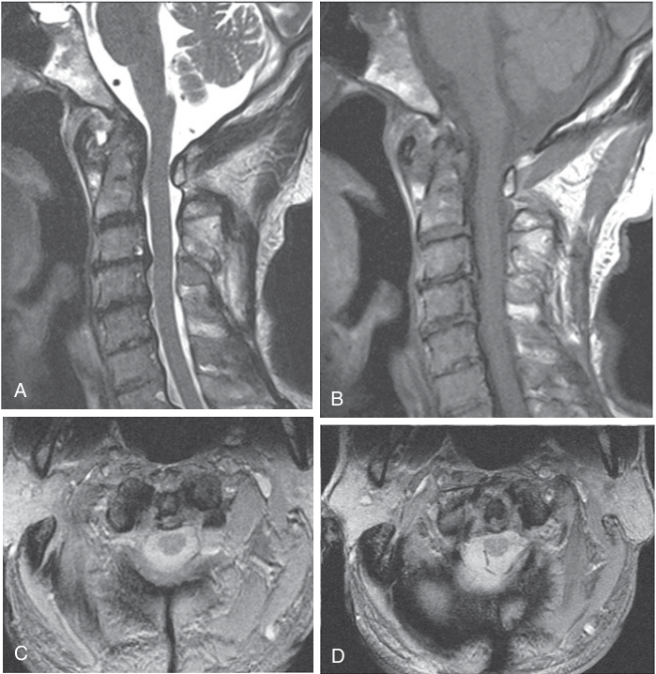
Pannus Types on MRI
​Hypervascular: T2 bright, early intense enhancement
​Hypovascular: intermediate T2, delayed enhancement
​Fibrous: T2 dark, no enhancement
RA with C1-2 involvement, 76-year-old. (A) Sagittal T2WI, (B) T1WI, (C, D) axial gradient echo: C1-2 subluxation with soft tissue between C1 anterior arch and dens and retroodontoid; heterogeneous hypo- to hyperintensity on T2WI, isointense on T1WI, with dens erosions.
48
Notes:
CUE — Dynamic contrast separates pannus from effusion.
SCRIPT: MRI is the modality of choice for rheumatoid pannus, which can be hypervascular, hypovascular or fibrous. On T2-weighted images the hypervascular pannus is hyperintense, while hypovascular and fibrous pannus show intermediate and low signal respectively. Hypervascular pannus and joint effusion are both bright on T2, but hypervascular pannus shows early intense enhancement on dynamic postcontrast studies. Hypovascular pannus shows delayed enhancement, and fibrous pannus shows no enhancement.
FIGURE: Chong Fig. 14.19, p.309: no pointers.
CLINICAL: Chong: Goel first suggested that retroodontoid tissue is a manifestation of atlantoaxial instability and proposed atlantoaxial fixation; several authors have shown resolution of the retroodontoid mass after fixation.
SOURCE: AIIMS p.26 (pannus types; verbatim condensed); Chong p.305–307.

Slide 49
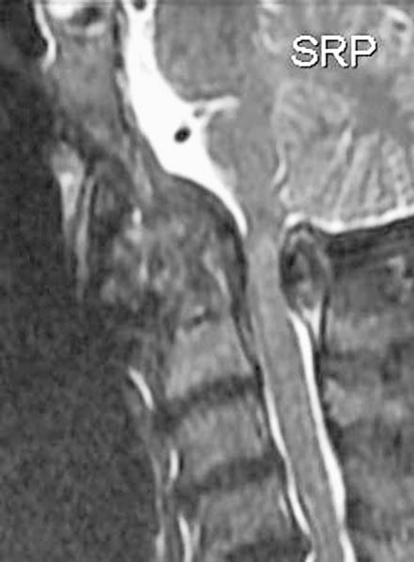
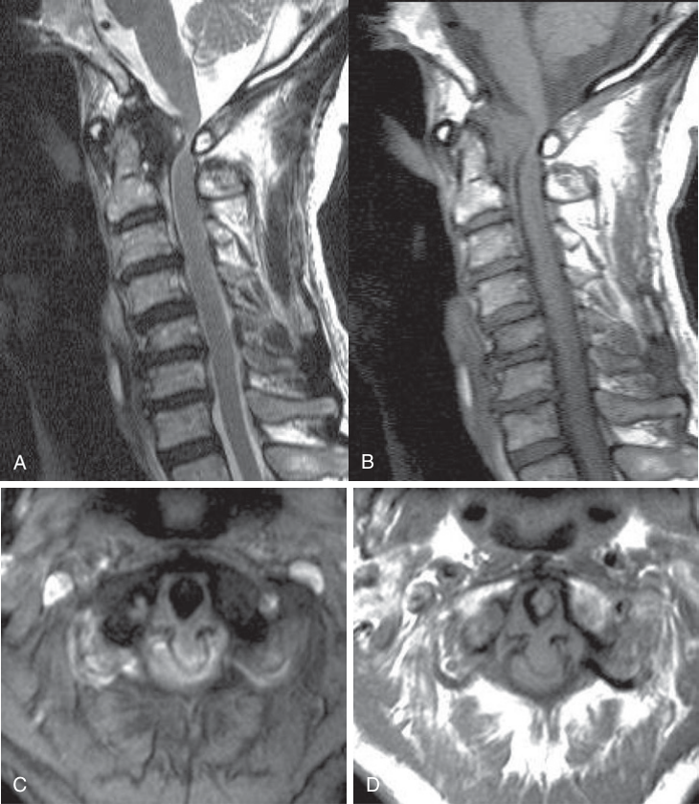
Retro-odontoid Masses: Other Causes
Left: CPPD; midsagittal T2-weighted MR: large hypointense mass involving the odontoid process, moderately compressing the cervicomedullary junction. Right: retroodontoid pseudotumor, 76-year-old with myelopathy; sagittal T2WI (A), T1WI (B), axial gradient echo (C), axial T1WI (D): retroodontoid mass, dark on T2WI and isointense on T1WI.
CPPD: retro-odontoid calcification on NCCT
49
Notes:
CUE — Dark retro-odontoid mass: CPPD, pseudotumor, RA.
SCRIPT: A retrodental mass should be differentiated from calcium pyrophosphate deposition disease, psoriasis, amyloid arthropathy, and pseudotumors from chronic mechanical instability. CPPD has a predilection for the anterior atlantoaxial joint, involving the transverse ligament. Radiographic findings are subtle; NCCT shows retro-odontoid calcifications, and MRI shows retro-odontoid soft tissue hypointense on both T1 and T2, sometimes with disruption of the transverse ligament. Retro-odontoid pseudotumor is a non-neoplastic mass, more common in the elderly and possibly caused by atlantoaxial instability; it is hypointense on T1 and T2 with peripheral enhancement.
IF TIME: Dialysis-related retro-odontoid pseudotumor (Chong Fig. 14.18) is in Backup.
FIGURE: Chen & Liu Fig. 29 (p.499): no pointers; 441 × 599 px (low resolution, flagged). Chong Fig. 14.17 (p.307): no pointers.
Q&A: Q: Crowned dens? A: The term is not used in these sources; CPPD is described by its retro-odontoid calcification and soft tissue.
SOURCE: Chen p.496; AIIMS p.26; Chong p.304–305.

Slide 50
Tuberculosis of the CVJ
Feature | Tuberculosis | Rheumatoid arthritis
Source | Retropharyngeal TB | Chronic inflammation, vasculitis
Mechanism | Destruction of ligaments | Loss of tensile strength of transverse ligament
Process | Infiltration | Breakage
Additional | Bone destruction; cold abscess, granulation tissue | Erosions; synovial granulation tissue
Stages: I abscess + AAD, normal bone · II mild · III gross destruction
50
Notes:
CUE — Rare but ours; staging guides management.
SCRIPT: 3 to 1 percent. It begins in the retropharyngeal space with secondary involvement of bone, or rarely in the bone itself. Local neck pain, tenderness and restricted neck movement are the cardinal features. AIIMS divides it into three stages: stage I, retropharyngeal abscess with atlantoaxial dislocation or instability and normal bony architecture; stage II, retropharyngeal abscess with or without AAD and mild bony destruction; stage III, retropharyngeal abscess with or without AAD and gross bony destruction. CT myelography or MR shows bony destruction of C1–C2 with increased prevertebral soft tissue.
IF TIME: The table compares the mechanism with rheumatoid arthritis. Chen: CVJ infection may follow inadequately treated contiguous infection (otitis externa, sinusitis, dental caries); lymphatic channels from the nasopharynx and retropharynx drain to the synovial lining. Previous head and neck radiotherapy predisposes. Grisel syndrome is the inflammatory, spontaneous form after parapharyngeal infection (Youmans; next slide).
FIGURE: No tuberculosis image is available in any source (logged gap). A pyogenic CVJ infection after radiotherapy (Chen Fig. 42) is in Backup.
CLINICAL: In our setting, a retropharyngeal collection with C1–C2 erosion and AAD is TB until proven otherwise.
Q&A: Q: Does TB AAD reduce with traction? A: The sources do not give TB-specific data; Youmans: reducible lesions from inflammatory states respond to external immobilization once reduction is achieved.
SOURCE: AIIMS p.26–27 (TB stages; verbatim); Chen Table 5 p.508 (verbatim), p.508; Youmans p.9.

Slide 51
6
Neoplasms
51
Notes:
CUE — Section change.
SCRIPT: Neoplasms. The role of imaging is to determine the nature and resectability of the tumor.

Slide 52
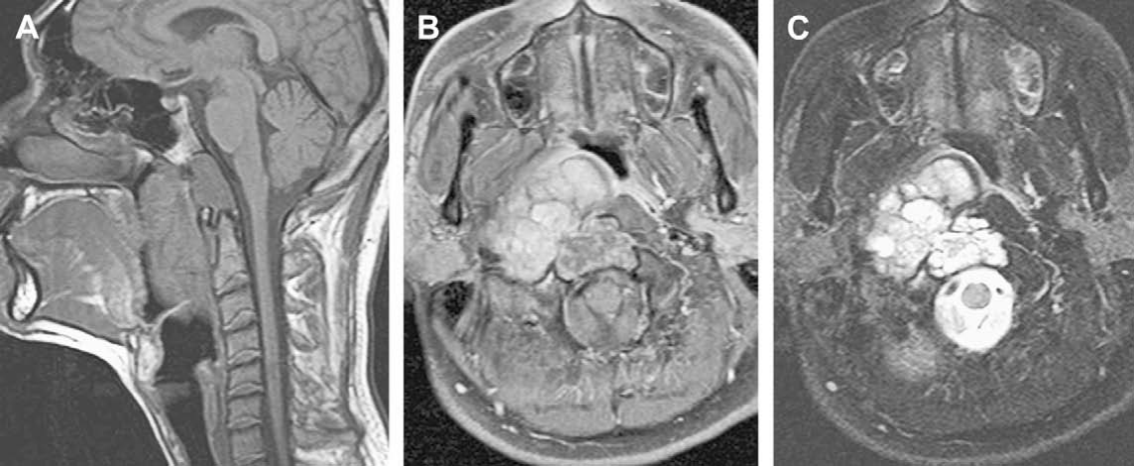
Chordoma
Large chordoma with retropharyngeal extension. (A) Sagittal T1: destruction of the lower clivus with a large soft tissue mass extending into the nasopharyngeal and oropharyngeal retropharyngeal spaces. (B) Hypointense on T1 with heterogeneous enhancement. (C) Characteristic bright T2 signal.
Midline clivus; T2 bright; honeycomb enhancement
52
Notes:
CUE — Midline, destructive, T2 bright.
SCRIPT: Neoplasms of the junction mainly arise from extradural structures, and the most common primary tumors are meningiomas and chordomas. Chordomas are locally aggressive tumors from notochordal remnants. At CT, chordoma is a well-defined expansile soft tissue mass arising from the clivus with lytic bone change, and intratumoral calcifications are common. On T1 it is intermediate to low signal, easily seen against the bright fatty marrow of the clivus. Classic chordoma is bright on T2, reflecting vacuolated cells, and most show moderate to marked enhancement, typically in a honeycomb pattern.
IF TIME: It can spread to the jugular fossa and foramen magnum and erode C1. Chondrosarcoma is the main differential: typically paramedian at the petroclival synchondrosis, curvilinear chondroid calcification on CT, T2 bright, ring-and-arc enhancement; final diagnosis may depend on immunohistochemistry.
FIGURE: Chen & Liu Fig. 36, p.503: no pointers.
CLINICAL: Report: tumor extent, direction of encroachment, vascular or intramedullary component, and craniovertebral stability.
SOURCE: Chen p.502–503 (verbatim condensed).

Slide 53
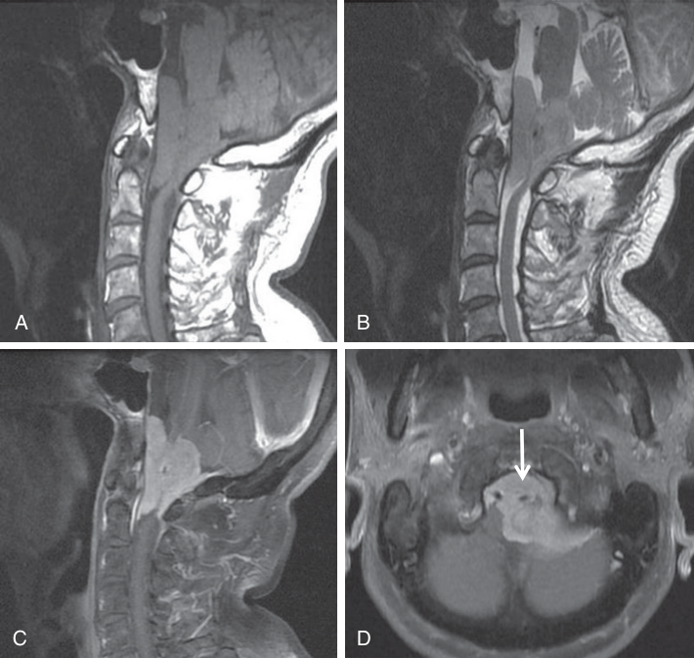
Foramen Magnum Meningioma
Foramen magnum meningioma, 66-year-old with left hemiparesis and numbness. (A) Sagittal T1WI, (B) sagittal T2WI, (C, D) postcontrast T1WI: large dura-based mass at the anterior and left lateral foramen magnum, isointense on T1WI and T2WI, strongly enhancing. Tumor encases the left vertebral artery →.
Most common tumor at foramen magnum: anterior rim
53
Notes:
CUE — Intradural, anterior, vertebral artery.
SCRIPT: About 3 percent of all meningiomas occur at the foramen magnum, yet meningiomas are the most common tumors there, 70 percent of all benign tumors. Two thirds occur in women, usually symptomatic between 35 and 60 years. Most are strictly intradural, and 10 percent have extradural extension. They typically attach to the anterior rim of the foramen magnum and may invade the region of the vertebral artery entry and the cranial and cervical nerve root exits, which explains the higher rate of incomplete removal of extradural tumors.
IF TIME: They are homogeneous, intermediate on T1 and T2, and enhance strongly; postcontrast images delineate the dural attachment and the relation to neural and vascular structures.
FIGURE: Chong Fig. 14.26, p.318. Vertebral artery encasement = white arrow (→ gray) in D.
CLINICAL: Name the vertebral artery relationship and any extradural extension: both change the surgical approach. Preoperative angiography if highly vascular and embolization is contemplated (Chen).
SOURCE: Chen p.505 (verbatim condensed); Chong p.311.

Slide 54
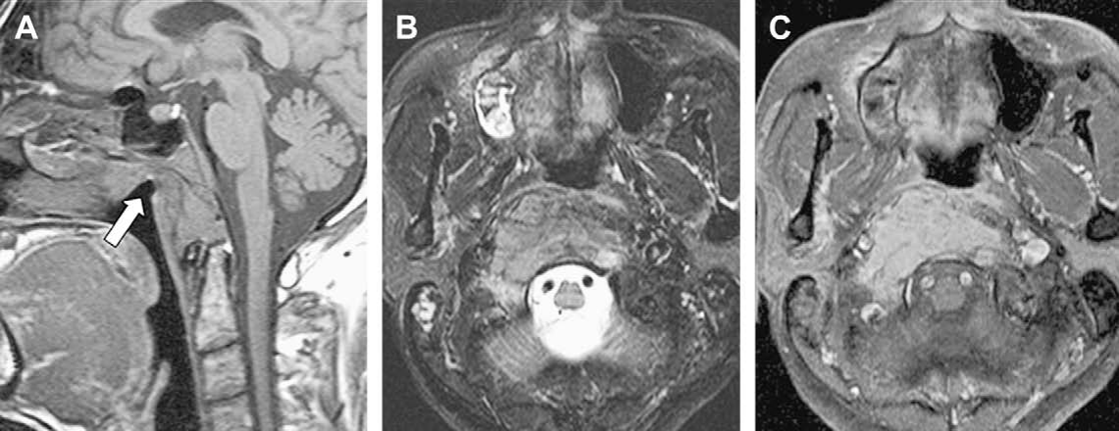
Nasopharyngeal Carcinoma Invading CVJ
NPC with CVJ invasion. (A) T1: mass lesion in the CVJ with abnormal signal of the whole clivus; slightly prominent soft tissue swelling in the nasopharyngeal roof ⇨, not well shown on axial images (B, C) and missed on initial clinical examination. Iso- to mild hyperintensity on T2 (B); homogeneous enhancement (C).
CVJ bone lesion: always check the nasopharynx
54
Notes:
CUE — Check the nasopharyngeal mucosa.
SCRIPT: Nasopharyngeal carcinoma, common in southern China and Southeast Asia, invades the skull base often without mucosal symptoms. Its signal mimics plasmacytoma or metastasis. NPC is suggested by focal or diffuse thickening of the nasopharyngeal mucosa contiguous with the bony lesion, so in any CVJ bony lesion the nasopharyngeal mucosa should always be checked, because a small mucosal tumor can be overlooked.
IF TIME: Plasmacytoma: homogeneous, often lower T2 signal from densely packed cells; differential includes lymphoma and metastasis; pathology always necessary.
FIGURE: Chen & Liu Fig. 38 (p.505): nasopharyngeal roof thickening = white block arrow in A (⇨ gray). Nerve sheath tumor image (Fig. 40) on the next slide.
SOURCE: Chen p.504–506 (verbatim condensed).

Slide 55
7
Instability and Management
What changes the surgical decision
55
Notes:
CUE — Section change: neurosurgeons’ section.
SCRIPT: This section is about what the surgeon needs from us.

Slide 56
Atlantoaxial Instability: Classification
Group | Description
I | AAI with occipitalization of atlas, fusion of C2 and C3; odontoid displaced posteriorly
II | AAI from incompetent odontoid: os odontoideum; ossiculum terminale; agenesis of base, apical segment, or whole odontoid
III | Odontoid dislocated posteriorly; no abnormality of C1 or odontoid
Dynamic studies decide fixed or mobile instability
56
Notes:
CUE — The classification used in South-Asian neurosurgical practice.
SCRIPT: AIIMS classifies atlantoaxial instability into three groups. Group I is instability combined with occipitalization of the atlas and fusion of C2 and C3, with the odontoid displaced posteriorly. Group II is instability due to incompetence of the odontoid process: type I os odontoideum, type II ossiculum terminale, type III agenesis of the odontoid base, type IV agenesis of the apical segment, and type V agenesis of the odontoid. Group III is posterior dislocation of the odontoid with no abnormality of C1 or the odontoid. Dynamic flexion and extension studies are important not only for the diagnosis but also for management, that is, whether the instability is fixed or mobile.
Q&A: Q: Where does this classification come from? A: AIIMS presents it citing Gupta SK, Khosla VK, Sharma BS et al., PGI Chandigarh experience, in “Cranio-vertebral junction anomalies: the Indian experience” (1998).
SOURCE: AIIMS p.26 (verbatim condensed).

Slide 57
Factors That Decide Treatment
​Reducibility: can alignment be restored?
​Direction of encroachment: ventral or dorsal
Cause; hindbrain herniation, syrinx, vascular anomaly
Abnormal ossification centers, growth plates
57
Notes:
CUE — Four questions the report should answer.
SCRIPT: Youmans lists four factors that influence the specific treatment of craniovertebral abnormalities. First, reducibility of the bony lesion, that is, the ability to restore anatomic alignment and so relieve compression on neural structures. Second, the mechanics of compression and the direction of encroachment. Third, the cause of the pathologic process, and the presence of hindbrain herniation, syrinx and vascular abnormalities. Fourth, the presence of abnormal ossification centers and epiphyseal growth plates, which is why thin-section CT in children should comment on them.
IF TIME: Each of these is an imaging question, so each should appear in our report.
CLINICAL: Report template line: “Reducible on extension / traction: yes or no. Compression: ventral (dens, pannus, clivus) or dorsal (C1 arch, opisthion). Chiari/syrinx: yes or no. Vertebral artery course.”
SOURCE: Youmans & Winn Ch 260, Treatment, p.1961 (verbatim condensed).

Slide 58
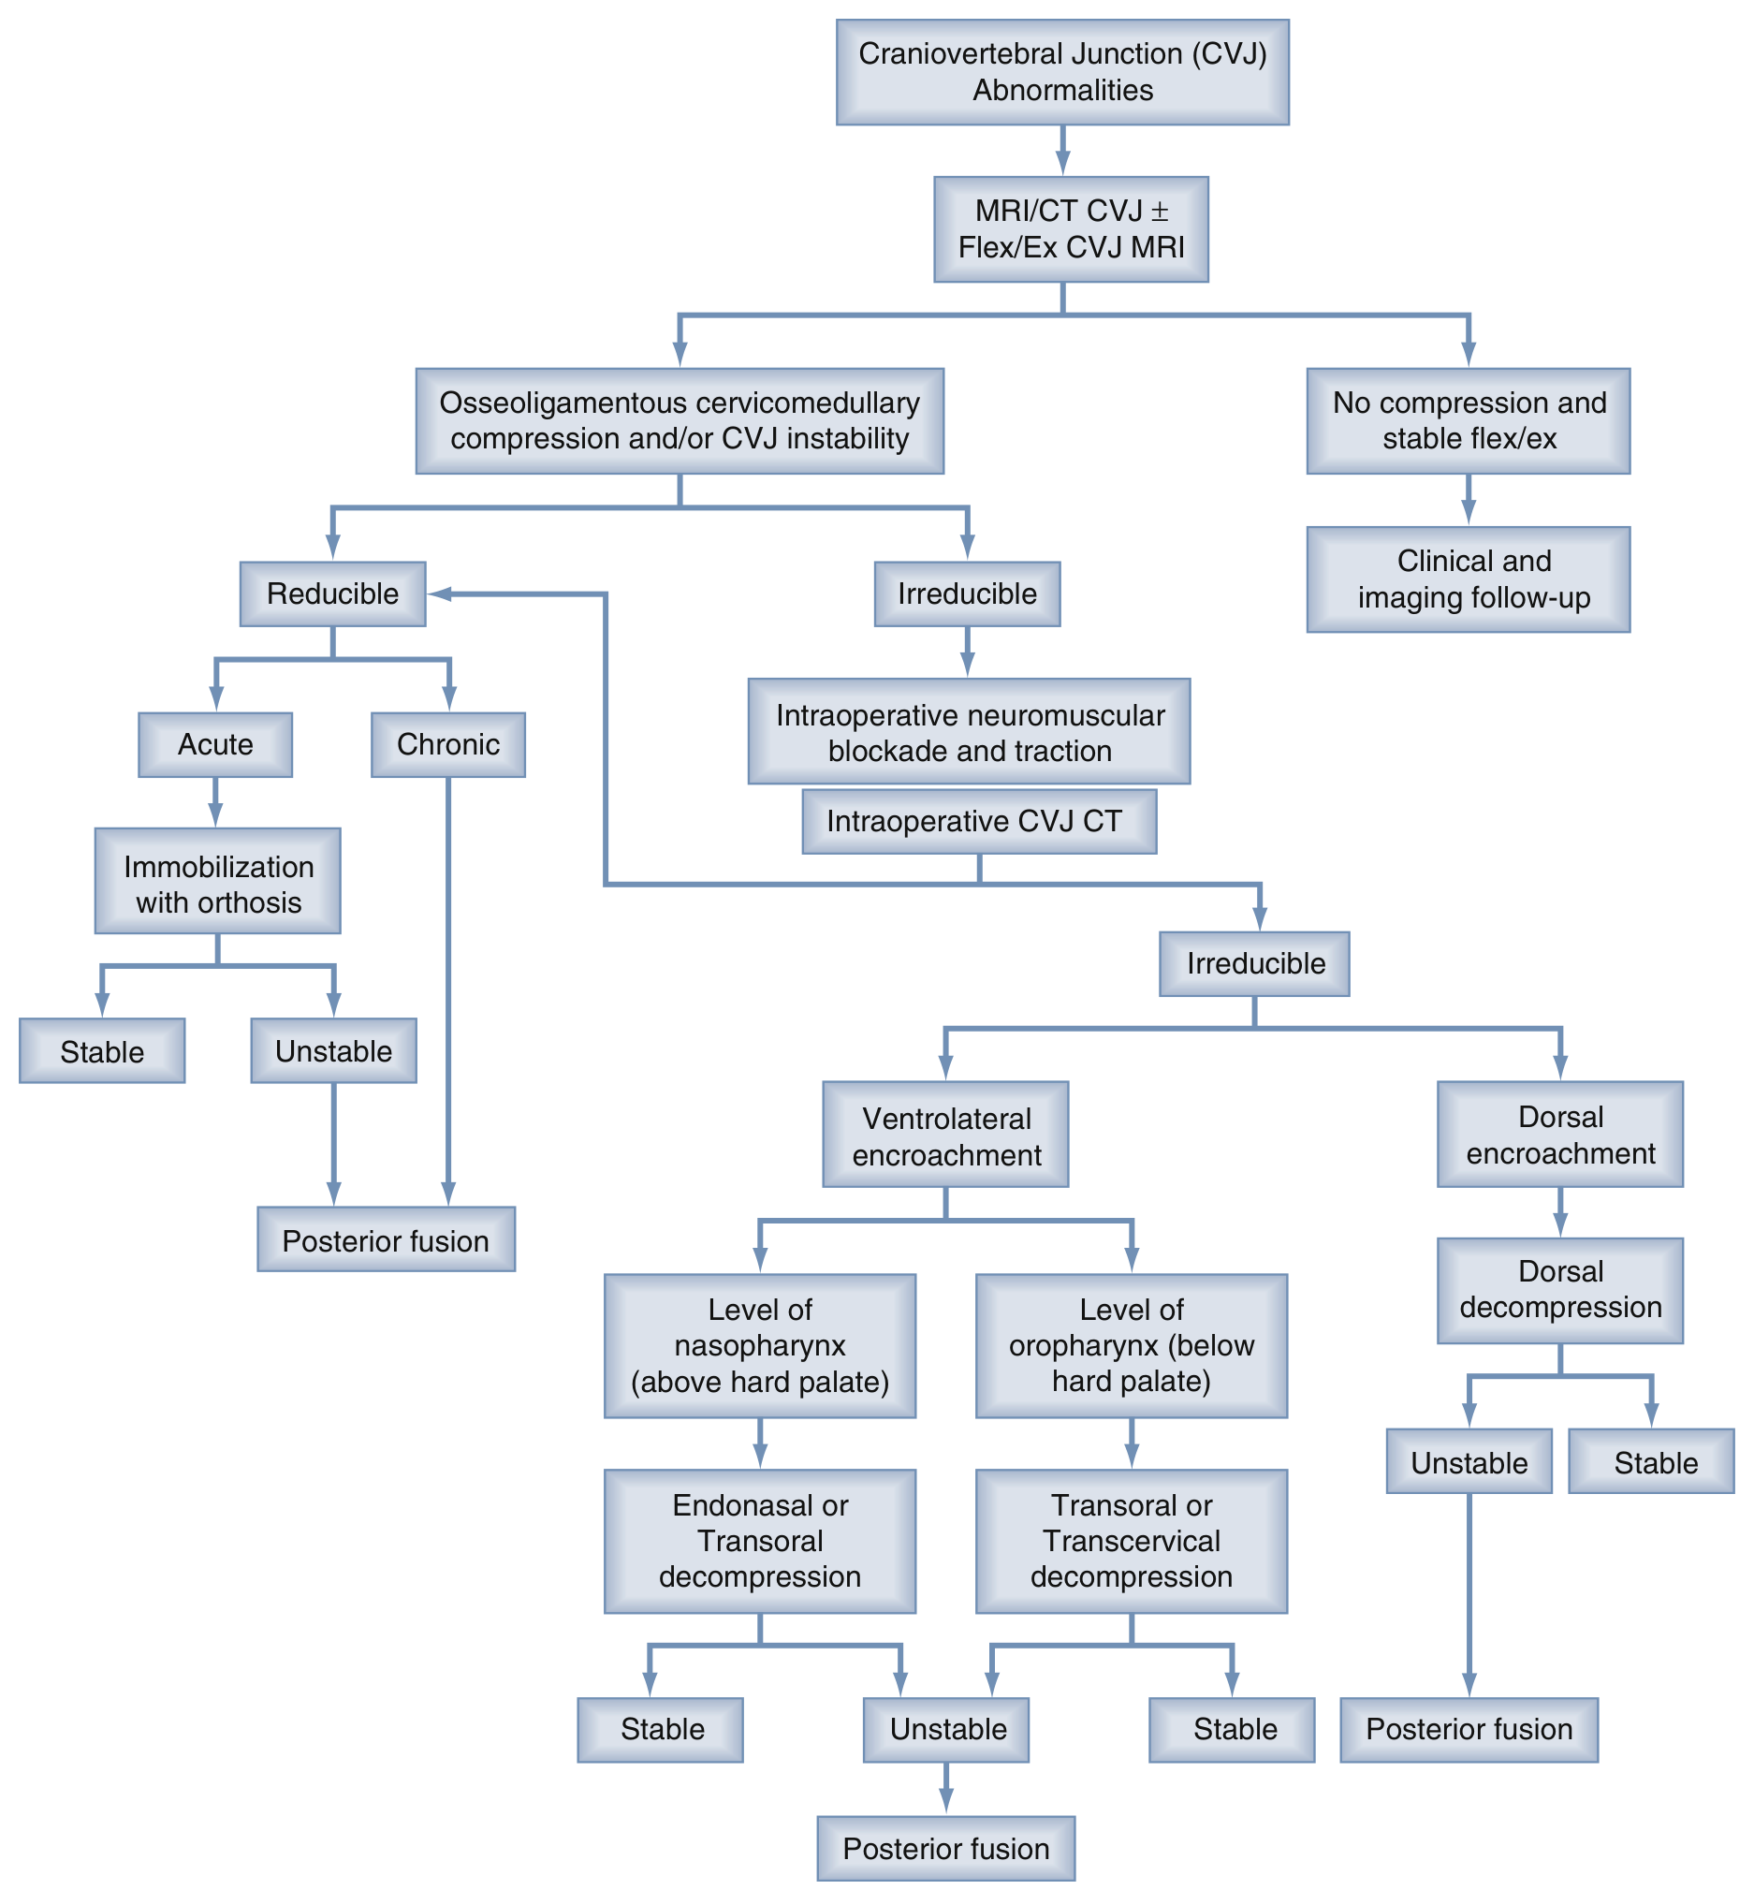
Treatment Algorithm
Evolution of craniovertebral abnormalities treatment algorithm. CT, computed tomography; flex/ex, flexion–extension; MRI, magnetic resonance imaging.
​Reducible → stabilize
​Irreducible → decompress by direction
58
Notes:
CUE — Walk the two main branches only.
SCRIPT: This is the Youmans treatment algorithm. Imaging, MRI and CT with flexion–extension MRI, separates patients with osseoligamentous compression or instability from those with no compression and a stable flexion–extension study, who are followed clinically and with imaging. Reducible lesions are stabilized: acute lesions with an orthosis, and chronic or unstable ones with posterior fusion. Irreducible lesions undergo intraoperative neuromuscular blockade and traction with intraoperative CT; if still irreducible, the direction of encroachment decides the approach. Ventrolateral compression at the level of the nasopharynx, above the hard palate, is approached endonasally or transorally; at the oropharynx, below the hard palate, transorally or transcervically. Dorsal encroachment gets dorsal decompression. Any instability after decompression is followed by posterior fusion.
FIGURE: Youmans & Winn 8e Fig. 260.4, p.1963. Flowchart; rendered from vector graphics at high resolution; chapter tab removed.
CLINICAL: The hard-palate level of the compression decides endonasal vs transoral: state where the dens tip lies relative to the hard palate line.
Q&A: Q: Traction weights? A: Youmans: under 2 years, 8- to 10-point skull fixation with 1–2 pounds pin pressure; 2–5 years, maximal pin pressure 4 pounds; over 5 years, traction starts at 3–4 pounds, not exceeding 7; adults start at 7–8 pounds, not exceeding 15 pounds.
SOURCE: Youmans p.1961–1963, Fig. 260.4.

Slide 59
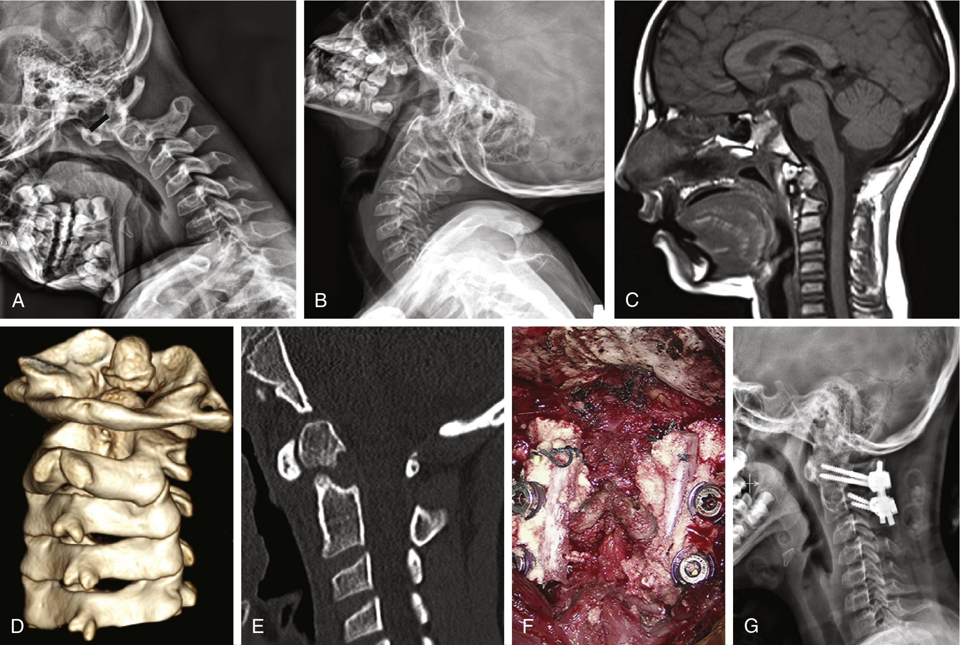
Reducible vs Irreducible
Reducible: stabilize
Irreducible: decompress, then fix
  Ventral: transoral, endonasal, transcervical
  Dorsal: posterolateral
8-year-old, prior motor vehicle accident. Dynamic radiographs: increased atlantodental interval in flexion (A, black line), reduced in extension (B). (C) Sagittal MRI. (D) 3D and (E) sagittal CT: dystopic os odontoideum. (F) C1–C2 screw fixation with rib. (G) Stable alignment.
59
Notes:
CUE — A reducible case: fixation alone.
SCRIPT: The primary aim of treatment is to relieve compression at the cervicomedullary junction. Stabilization is paramount in reducible lesions to maintain neural decompression. Irreducible lesions require decompression and are subdivided into ventral and dorsal compression states. Ventral decompression uses a transpalatopharyngeal route, a Le Fort drop-down maxillotomy, or a lateral extrapharyngeal route; dorsal compression needs posterolateral decompression. If instability is present after decompression, posterior fixation is mandated. This child’s atlantodental interval widened in flexion and reduced in extension, so the lesion was reducible and was treated with C1–C2 fixation alone.
IF TIME: Youmans: reducible lesions from inflammatory states or recent trauma respond to external immobilization once reduction is achieved. Rates of fusion failure reach 50% when immobilization is inadequate; instrumented fusion is undertaken above 6 years of age.
FIGURE: Youmans & Winn Fig. 260.13, p.1969. Atlantodental interval = short black line in A (named); no other pointers.
Q&A: Q: In Chiari with basilar invagination, can we just do a posterior decompression? A: Youmans: ventral decompression should be performed before any posterior procedure in irreducible ventral compression; posterior procedures first are associated with unfavorable results in up to 30%.
SOURCE: Youmans p.1961–1963, 1967 (verbatim condensed).

Slide 60
8
Urgent Findings and Checklist
60
Notes:
CUE — Section change.
SCRIPT: Finally, what needs a phone call, and a checklist for reading these studies.

Slide 61
Findings Needing Urgent Communication
Atlanto-occipital dislocation or joint widening
C1 fracture with transverse ligament disruption
​Unstable dens, hangman’s or condyle avulsion fracture
​Cord compression or edema at the CVJ
Retropharyngeal or epidural abscess
Transverse foramen fracture: vertebral artery
61
Notes:
CUE — Six things that cannot wait.
SCRIPT: These are the findings I would call about rather than just report. Atlanto-occipital dislocation, because mortality is highly related to brainstem injury. A C1 fracture with transverse ligament disruption, or an increased atlantodental interval after trauma, because stability then depends on the alar ligaments. Unstable fractures: type II hangman’s fractures with displacement, type III occipital condyle avulsions, and displaced odontoid fractures. Any cord compression or edema at the junction, including os odontoideum after minor trauma, since severe neurological deficit after minor trauma is well described. A retropharyngeal or epidural abscess compressing the cord. And a fracture through the transverse foramen, where vertebral artery injury is suspected.
CLINICAL: Youmans: clinical presentation may be insidious, or infrequently a rapid neurological progression followed by sudden death.
SOURCE: Chen p.494–497, p.507 (Fig. 42: progression with gas and cord compression); AIIMS p.25–27; Chong Fig. 14.11 (transverse foramen); Youmans p.7, p.14. Selection of urgent items is the presenter’s, based on these source statements.

Slide 62
Key Takeaways: Reading Checklist
Dens vs Chamberlain, McRae, Wackenheim
​Clivus–canal angle and basal angle
​ADI in neutral, flexion, extension
C1 assimilation, arch clefts, os vs fracture
Ligaments, pannus, retro-odontoid tissue
​Reducible? Ventral or dorsal? Chiari, syrinx?
62
Notes:
CUE — End on the checklist; then thank and invite questions.
SCRIPT: To finish, a checklist for every CVJ study. One: where is the dens tip relative to the Chamberlain, McRae and Wackenheim lines. Two: measure the clivus-canal angle and the basal angle, remembering that platybasia alone is asymptomatic but an acute clivus-canal angle compresses the cord. Three: the atlantodental interval, ideally in neutral, flexion and extension. Four: look for assimilation of the atlas, arch clefts, and separate an os odontoideum from a fracture. Five: assess the ligaments, pannus and retro-odontoid tissue. Six: answer the surgeon’s questions — is it reducible, is the compression ventral or dorsal, and is there a Chiari malformation or syrinx. Thank you; I am happy to take questions.
SOURCE: Synthesis of the preceding slides.

Slide 63
References
Chen YF, Liu HM. Imaging of craniovertebral junction. Neuroimaging Clin N Am. 2009;19(3):483–510. doi:10.1016/j.nic.2009.06.002
Khandelwal N, Gupta V. Craniovertebral junction anomalies. In: Gupta AK, Garg A, Sandhu MS, eds. AIIMS-MAMC-PGI’s Comprehensive Textbook of Diagnostic Radiology. 3rd ed. New Delhi: Jaypee Brothers Medical Publishers; 2021. Chapter 208.
Developmental anomalies of the craniovertebral junction and surgical management. In: Winn HR, ed. Youmans & Winn Neurological Surgery. 8th ed. Philadelphia: Elsevier; 2023. Chapter 260, pp. 1959–1972.
Smoker WRK. Craniovertebral junction: normal anatomy, craniometry, and congenital anomalies. RadioGraphics. 1994;14(2):255–277.
Liu HM, Chen YF. Imaging of the craniovertebral junction. In: Chong V, ed. Skull Base Imaging. St. Louis: Elsevier; 2018. Chapter 14 (from p. 291).
Sutton D, Reznek R, Murfitt J; Aggarwal B, adaptation ed. Textbook of Radiology and Imaging. 8th ed. Vol 2. New Delhi: Elsevier (RELX India); 2024.
Dähnert W; Kale H, SAE ed. Radiology Review Manual. 8th ed. South Asian Edition. Wolters Kluwer Health (India); 2021.
Arcalis N, Medrano S, Cuadrado M, et al. Craniovertebral junction: pictorial review of the anatomy and pathologic conditions. ECR 2010, C-2392. doi:10.1594/ecr2010/C-2392
Bermejo AMM, Herraiz LH, Martin MAA, et al. The craniovertebral junction (CVJ): anatomy, bony variants and acquired pathology. ECR 2005, C-0882. doi:10.1594/ECR05/C-0882
Pandit RV, Bommineni B, Kumar A. Computed tomography evaluation of the craniovertebral junction: what to look for and how? ECR 2019, C-2397. doi:10.26044/ecr2019/C-2397
Eser MB, Baysal B, Atalay B, Önal C, Erdemli S. Congenital craniocervical junction anomalies incidentally detected in routine CT and MR evaluation: a pictoral essay. ECR 2018, C-2555. doi:10.1594/ecr2018/C-2555
63
Notes:
CUE — Do not read out.
SCRIPT: These are the sources; the AIIMS, Chen and Smoker chapters are the main ones for the radiology content, and Youmans for management.
SOURCE: Citation details taken from the source files; details not verifiable in the files (chapter authors of AIIMS and Youmans chapters, page ranges, years where not printed) are omitted. EPOS posters 8–11 were extracted in a separate local session (site blocked here); author names and title spelling as shown on the poster pages (capitalization of “eser”, “erdemli”, “garcia” normalized; “pictoral” kept as printed).

Slide 64
Backup Images
64
Notes:
CUE — Backup section; use for questions.
SCRIPT: Additional images for questions.

Slide 65
Further Lateral-View Indices
Measurement | Definition | Normal | Abnormal
Basion odontoid index | Basion to tip of odontoid | 5 mm adults; up to 10 mm children | Altered in flexion and extension
Height index of Klaus | Tip of dens to tuberculum–torcula line | 40–41 mm | <30 mm in BI
Bull’s angle | Hard palate line vs atlas arch midpoints | <10° | >13° in BI
Boogard’s angle | McRae’s line vs dorsum sellae–basion | 122° | >135° in BI
Spinolamellar line | Occipital ridge down C2–C3 spinous processes | Intersects C1 posterior arch | Fused arch anterior: cord compression
BI = basilar invagination. All from lateral view (AIIMS Table 1).
65
Notes:
CUE — Backup: Reference table; read two values only.
SCRIPT: For completeness, AIIMS lists further indices on the lateral view. The two I find most useful are the basion odontoid index, 5 millimeters in adults and up to 10 millimeters in children in neutral position, and the height index of Klaus, normally 40 to 41 millimeters, with less than 30 millimeters seen in basilar invagination. Bull’s angle and Boogard’s angle are older radiographic measures that you may still meet in surgical papers.
IF TIME: Atlanto-temporo-mandibular index: superior edge of the anterior arch of atlas to the highest point of the temporomandibular interspace, 30 ± 9 mm, <10 mm in basilar invagination (AIIMS, printed “30 + 9 mm”). Boogard’s line joins nasion to opisthion; the basion lies below it, altered in basilar impression.
Q&A: Q: Where are the basion–dens interval “rule of 12”, the basion–axial interval and the Powers ratio? A: None of the sources in this talk give them; the nearest is the AIIMS basion odontoid index (Whooley). Logged as a gap; values not quoted to avoid unsourced numbers.
SOURCE: AIIMS Table 1 p.12–13 (verbatim condensed).

Slide 66
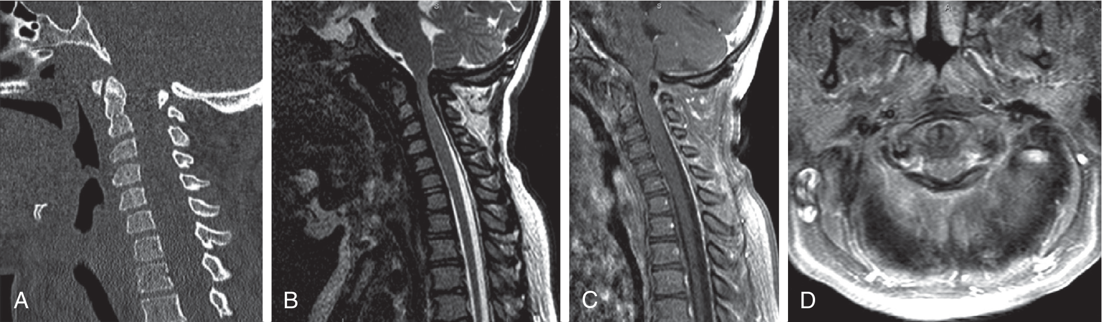
Mucopolysaccharidosis
A 15-year-old with type 1 mucopolysaccharidoses presented with myelopathic symptoms. (A) Sagittal two-dimensional CT scan shows dorsal compression from the C1 posterior arch. (B–D) MR sequences.
Compression may be dorsal: C1 posterior arch
66
Notes:
CUE — Backup: Example: dorsal compression in MPS.
SCRIPT: An example from Youmans: in this teenager with type 1 mucopolysaccharidosis, the compression is dorsal, from the posterior arch of C1, which by the algorithm we will see later points to a dorsal decompression rather than a ventral approach.
FIGURE: Youmans & Winn Fig. 260.16, p.1971. Panel letters only; no pointers. Caption condensed from the legend (B–D sequences summarized). Verifier note: the body text also cites this figure for achondroplasia, a text–figure mismatch in the source; caption follows the figure legend.
SOURCE: Youmans p.1971.

Slide 67
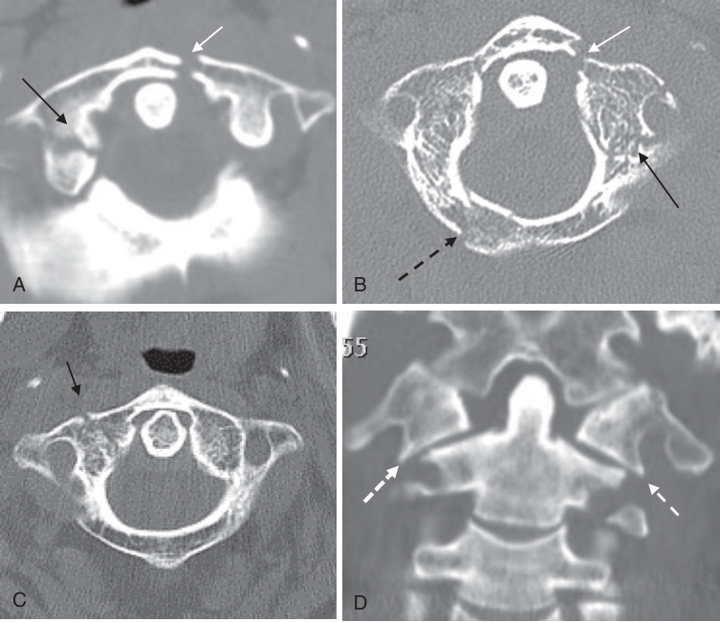
Atlas Fracture on CT
Atlas fracture (A–C, axial; D, coronal reconstruction). Anterior ring fracture → on (A) and (B). Lateral mass fracture → on (A), (B), and (D). Posterior arch fracture (dashed black arrow) on (B). Transverse foramen fracture on (B): vertebral artery injury suspected. (D) Lateral displacement of both lateral masses, outer borders (dashed white arrows) sliding laterally on C2.
67
Notes:
CUE — Backup: Read the CT: ring, lateral masses, transverse foramen.
SCRIPT: On CT, look at every part of the ring: the anterior arch, the lateral masses and the posterior arch, and at the transverse foramina, because a fracture through the transverse foramen raises the possibility of vertebral artery injury. On the coronal reformat, the outer borders of the lateral masses sliding laterally over C2 make fracture of both arches highly likely. Bilateral posterior arch clefts may resemble a Jefferson fracture, so check for smooth corticated margins before calling it.
FIGURE: Chong Fig. 14.11 (p.301): anterior ring = white arrows (→ gray); lateral mass = black arrows (→ black); posterior arch = dashed black arrow (words kept); lateral mass borders = dashed white arrows (words kept). Verifier: panel C has a black arrow not described in the legend; legend mentions a black arrow on D that is not drawn.
CLINICAL: Transverse foramen fracture: suggest CT angiography of the vertebral arteries.
Q&A: Q: Rule of Spence / lateral mass overhang? A: Not given in these sources; Chong shows lateral displacement qualitatively (panel D). I did not quote an outside value.
SOURCE: Chong p.297, p.301 (verbatim condensed).

Slide 68
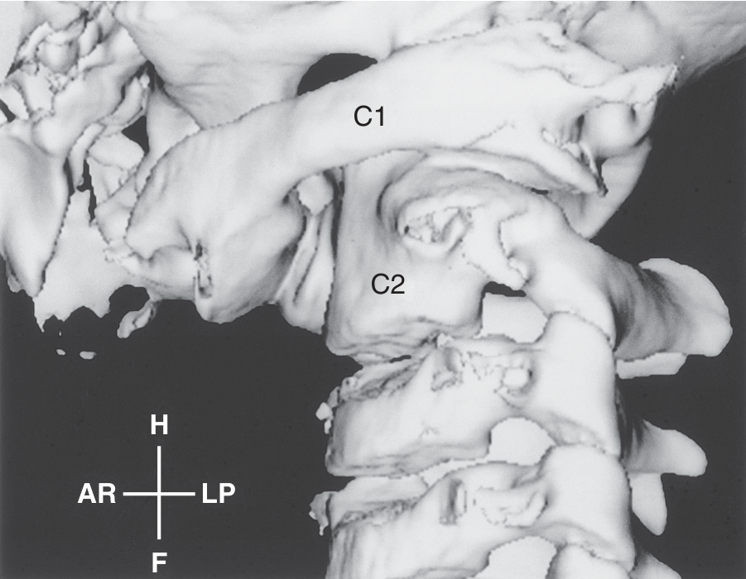
Grisel Syndrome
After parapharyngeal infection or ENT surgery
Mostly children <12 years
Retrograde lymphatic spread
CT: rotatory fixation; MRI: abscess, erosion
Three-dimensional CT, 7-year-old: significant rotational abnormality of the occipitoatlantoaxial joints, with perching of the occiput on the right lateral atlantal mass.
68
Notes:
CUE — Backup: Child with torticollis after throat infection.
SCRIPT: Grisel syndrome is defined as an inflammatory, spontaneous subluxation that affects the atlantoaxial joint following parapharyngeal infection, such as tonsillitis, mastoiditis, retropharyngeal abscess and otitis media, and also after tonsil and adenoid surgery. It mostly affects children below the age of 12 years. Lymphatic drainage of the junction is primarily into the retropharyngeal nodes, so retrograde infection may cause effusion and instability. MRI identifies parapharyngeal soft tissue masses, dislocation, osteomyelitis or bone erosion. AIIMS lists atlantoaxial instability after upper respiratory infection, mastoiditis, parotitis, tuberculosis, and after tonsillectomy, adenoidectomy and mastoidectomy. CT helps make a definitive diagnosis of atlantoaxial rotatory fixation.
FIGURE: Youmans & Winn Fig. 260.5, p.1964. Text labels C1, C2 and orientation cross only; no pointers.
CLINICAL: Youmans: manual reduction with cervical traction is reserved only for gross dislocations; otherwise a sternal-occipital-mandibular immobilizer is sufficient. Occipitocervical dislocation requires halo immobilization, and disruption of the craniocervical ligaments, especially the transverse ligament, would require a fusion.
SOURCE: Youmans p.9 (Grisel); AIIMS p.15, p.25; Chen p.508.

Slide 69

Nerve Sheath Tumor
Neurinoma of the upper cervical root. (A) Well-defined intradural extramedullary nodule in the posterior C1-2 canal: heterogeneous T2 hyperintensity with dark spots suggestive of hemorrhage. Hypointense on T1 (B); heterogeneous enhancement (C).
Second most common nonosseous CVJ tumor
69
Notes:
CUE — Backup: Brief: intradural extramedullary, T2 bright.
SCRIPT: Nerve sheath tumors are the second most common non-osseous tumors of the junction. They may be intradural extramedullary, entirely extradural, or have both components through an enlarged neural foramen, and multiple upper cervical neurinomas occur in neurofibromatosis. They are markedly bright on T2 with frequent central hypointensity, and enhance intensely except in areas of cystic degeneration or hemorrhage.
FIGURE: Chen & Liu Fig. 40 (p.506): no pointers.
SOURCE: Chen p.505–506 (verbatim condensed).

Slide 70

Craniometry on CT
(A, B) Measurements on lateral projection. A, posterior margin of hard palate; B, opisthion; C, inferior margin of posterior rim of foramen magnum; D, basion; E, dorsum sella; F, anterior clinoid process; G, floor of anterior cranial fossa. A–B Chamberlain; A–C McGregor; B–D McRae; D–E Wackenheim; D–F–G Welcher basal angle.
70
Notes:
CUE — Backup: show only if asked.
SCRIPT: The same lines on sagittal CT; useful if asked how to draw them on a modern study.
FIGURE: Chong Ch 14 Fig. 14.1 (p.292) with line names from Table 14.1. Drawn lines black on diagram, white on CT, labelled with letters (named in caption). Table 14.1 normal values: Chamberlain dens apex < 5 mm above; McGregor < 7 mm above; McRae tip of dens below; Wackenheim tangent to or intersecting the posterior one-third of the odontoid; Welcher < 140°.
SOURCE: Chong p.292.

Slide 71

Os Odontoideum or Fracture?
(a) Os odontoideum (O): well-corticated convex upper margin of the axis body ▶ and rounded hypertrophic anterior atlas arch (dot). (b) Type 2 odontoid fracture: normal half-moon anterior arch (dot) and flattened, straight upper margin of the axis ▶; odontoid and atlas posteriorly displaced.
71
Notes:
CUE — Backup: show only if asked.
SCRIPT: The radiographic version of the comparison table: convex corticated margin and round arch for the os; flat margin and half-moon arch for the fracture.
FIGURE: Smoker Fig. 32 (p.276). Axis upper margin = black arrowheads (▶ black); anterior arch = dot (white in a, black in b; word kept); os = letter O.
SOURCE: Smoker p.276.

Slide 72

Os Odontoideum: CT, MRI
Os odontoideum. Sagittal CT (A), coronal CT (B), and T2-weighted MR imaging (C) show the rounded and hypertrophic anterior arch of the atlas. (B) Lateral dislocation is also shown on the coronal study. (C) Severe cord compression and edema can be found inside the cord after minor trauma.
72
Notes:
CUE — Backup: show only if asked.
SCRIPT: Cord edema after minor trauma in an os odontoideum: the reason these patients are fixed even when symptoms are mild.
FIGURE: Chen & Liu Fig. 17 (p.492–493). No pointers. Note: in the printed article the image blocks of Figs. 17 and 18 appear swapped; image matched to caption content (CT, CT, T2) by the verifier.
SOURCE: Chen p.491–493.

Slide 73

Atlas Assimilation with Syrinx
29-year-old with lower cranial nerve palsy and hemianesthesia. Complete atlas assimilation and abnormal odontoid–clivus angulation on sagittal (A), coronal (B) and 3D CT (C). Sagittal MR: tonsillar ectopia with ventral medullary indentation (D) and holocord syringohydromyelia (E). (F) After transoral odontoidectomy and dorsal occiput–C2 fusion.
73
Notes:
CUE — Backup: show only if asked.
SCRIPT: An irreducible ventral compression treated ventrally first, then fused posteriorly, as the algorithm predicts.
FIGURE: Youmans & Winn Fig. 260.8 (p.1966). Panel letters only. Verifier: panel F is a lateral radiograph although the legend describes syrinx resolution.
SOURCE: Youmans p.1966.

Slide 74

Basilar Impression: Bone Softening
10-year-old with an unidentified bone-softening disorder. (A) Sagittal MR: severe cervicomedullary compression and syrinx. (B, C) CT: abnormal skull base, shallow posterior fossa, left C1–occiput assimilation. (D) Axial CT: compression from the C1 articular pillar →. (E, F) 3D CT: pathologic occiput–C1 articulation →. (G) Lateral radiograph.
74
Notes:
CUE — Backup: show only if asked.
SCRIPT: Secondary basilar impression from bone softening.
FIGURE: Youmans & Winn Fig. 260.14 (p.1970). C1 articular pillar = white arrow (→ gray) in D; occiput–C1 articulation = black arrows (→ black) in E, F.
SOURCE: Youmans p.1968.

Slide 75

Ponticulus Posticus
Ponticulus posticus. (A) Complete type; (B) calcified type; (C) bilateral involvement →; (D) the vertebral artery goes through the ponticulus posticus →.
75
Notes:
CUE — Backup: show only if asked.
SCRIPT: Relevant before C1 lateral mass screws: the vertebral artery may run through the bony bridge.
FIGURE: Chong Fig. 14.8 (p.299). Bilateral ponticulus = black arrows (→ black) in C; vertebral artery = white arrow (→ gray) in D.
SOURCE: Chong p.296–297.

Slide 76

Hangman’s Fracture on CT
Hangman fracture →→ involving the pars interarticularis. (A) Axial and (B) sagittal reconstruction CT.
76
Notes:
CUE — Backup: show only if asked.
SCRIPT: Bilateral pars fractures on CT.
FIGURE: Chong Fig. 14.14 (p.303). Pars fractures = white arrows in A (→ gray), black arrow in B (→ black).
SOURCE: Chong p.300.

Slide 77

Teardrop Fracture of the Odontoid
Teardrop fracture of odontoid process. Midsagittal CT (B) and T2-weighted MR imaging (C) show fracture at the posteroinferior odontoid process better than the plain radiography (A).
77
Notes:
CUE — Backup: show only if asked.
SCRIPT: CT and MRI show what the radiograph misses.
FIGURE: Chen & Liu Fig. 26 (p.497). No pointers.
SOURCE: Chen p.497.

Slide 78

Ankylosing Spondylitis and OPLL
Ankylosing spondylitis. (A) Radiograph: vertebral body squaring, disk calcification, apophyseal joint sclerosis; OPLL from C2 to C4. (B) T2: hyperintensity in disk space, vertebral body margins, bone marrow of dens body and erosion of the odontoid. (C) Abnormal enhancement in the same locations on postcontrast T1.
78
Notes:
CUE — Backup: show only if asked.
SCRIPT: Seronegative arthropathy can erode the dens like RA.
FIGURE: Chen & Liu Fig. 30 (p.500). No pointers.
SOURCE: Chen p.497–500.

Slide 79

OPLL at the CVJ
OPLL. (A) Radiograph: continuous type OPLL from the skull base to C4. Midsagittal T1 (B) and T2 (C): segmental (B) and continuous (C) lesions with cord compression. (D) Axial T2 at C1-2: OPLL with extensive calcification, or calcification of the synovial membranes of the atlantoaxial joint.
79
Notes:
CUE — Backup: show only if asked.
SCRIPT: Continuous OPLL is thicker and most often causes severe cord compression.
FIGURE: Chen & Liu Fig. 34 (p.502). No pointers.
SOURCE: Chen p.498–501.

Slide 80

Pseudotumor in Hemodialysis
Retroodontoid pseudotumor, asymptomatic 61-year-old on hemodialysis for 20 years. (A) Sagittal T2WI and (B) T1WI: soft tissue posterior to the dens, dark on T2WI and isointense on T1WI. (C, D) CT: hyperdense soft tissue posterior to the dens with dens erosions.
80
Notes:
CUE — Backup: show only if asked.
SCRIPT: Another dark retro-odontoid mass: think dialysis and amyloid.
FIGURE: Chong Fig. 14.18 (p.308). No pointers; panel letters C, D not visible in the render.
SOURCE: Chong p.305–306.

Slide 81

Chronic Fibrous Pannus
Chronic RA with hypointense soft tissue at the CVJ without any enhancement.
81
Notes:
CUE — Backup: show only if asked.
SCRIPT: Fibrous pannus: dark on T2, no enhancement.
FIGURE: AIIMS Figs. 16A–C (p.29). No pointers; 700 × 305 px (low resolution).
SOURCE: AIIMS p.26, p.29.

Slide 82

CVJ Infection after Radiotherapy
NPC after radiation therapy with infection of the CVJ; fatty marrow change from radiotherapy. (A) T2: prominent prespinal and epidural soft tissue. (B) Postcontrast T1: rim enhancement suggesting liquefaction; little bony change. (C) CT several days later: progression with a nonenhancing collection and gas; the cord is compressed.
82
Notes:
CUE — Backup: show only if asked.
SCRIPT: Rapid progression with gas and cord compression: an urgent finding.
FIGURE: Chen & Liu Fig. 42 (p.507). No pointers.
SOURCE: Chen p.508–509.

Slide 83

Osteoradionecrosis at the CVJ
Osteoradionecrosis, 66-year-old after palatal cancer irradiation, with diabetes. (A–C) T1 pre- and postcontrast: marrow signal change and enhancement of occipitoatlas and right atlantoaxial joints. (D) T2 and (E) postcontrast T1: soft tissue edema, heterogeneous enhancement, focal necrosis →. (F) After 1 year: partial resolution, mild C1-2 subluxation.
83
Notes:
CUE — Backup: show only if asked.
SCRIPT: Differential for a post-radiotherapy CVJ lesion: recurrence, infection, osteoradionecrosis.
FIGURE: Chong Fig. 14.21 (p.312). Focal soft tissue necrosis = white arrows (→ gray) in D, E.
SOURCE: Chong p.307–308.

Slide 84

Meningioma with Extradural Extension
Meningioma in the right foramen magnum with extradural extension through the hypoglossal canal to the right carotid space. Iso- to mildly hyperintense on T2 (A), homogeneous strong enhancement (B, C).
84
Notes:
CUE — Backup: show only if asked.
SCRIPT: Extradural extension explains incomplete removal.
FIGURE: Chen & Liu Fig. 39 (p.506). No pointers.
SOURCE: Chen p.505–506.

Slide 85


Neurenteric Cyst and Fibrous Dysplasia
Left: neurenteric cyst; large lobulated intradural extramedullary cystic mass ventral to brainstem and cord; T1 hyperintense (A), mixed T2 signal (B). Right: fibrous dysplasia of the clivus; expansile lesion, hypointense on T1 (A) and T2 (B), homogeneous enhancement (C), no soft tissue component; ground-glass on CT (D).
85
Notes:
CUE — Backup: show only if asked.
SCRIPT: Two benign lesions that can mimic tumor.
FIGURE: Chen & Liu Figs. 41 (p.507) and 37 (p.504). No pointers.
SOURCE: Chen p.503–507.

Slide 86

Bow Hunter Syndrome
28-year-old with episodic posterior circulation strokes. (A) FLAIR: cerebellar, thalamic infarcts. (B) Sagittal T2: atlas assimilation, Klippel–Feil C2-3, basilar invagination. (C, D) Vertebral angiography: abnormal course with mild right C1-2 stenosis →. (E, F) During left head turn: right C1-2 → and foramen magnum (dashed black arrow) stenoses; left C1-2 →.
86
Notes:
CUE — Backup: show only if asked.
SCRIPT: Dynamic vertebral artery compression with head rotation in a bony CVJ anomaly.
FIGURE: Chong Fig. 14.28 (p.321). Stenoses = black arrows (→ black), dashed black arrow (words kept), white arrow (→ gray).
SOURCE: Chong p.312–313.

Slide 87

Chiari I: CSF Flow
Arnold–Chiari type I with syrinx: phase-contrast cine MRI showing downward → and upward → flow of the CSF.
87
Notes:
CUE — Backup: show only if asked.
SCRIPT: CSF flow study across the foramen magnum.
FIGURE: AIIMS Fig. 21 (p.36). Downward flow = black arrow (→ black); upward flow = white arrow (→ gray). 700 × 261 px (low resolution).
SOURCE: AIIMS p.31, p.36.

Slide 88

Basi-occiput Hypoplasia
Basilar invagination (BI) with basi-occiput hypoplasia: clivus is short and clivus-canal angle is typically less than 150°.
88
Notes:
CUE — Backup: show only if asked.
SCRIPT: Short clivus with acute clivus–canal angle.
FIGURE: AIIMS Fig. 8 (p.19). No pointers; 479 × 353 px (low resolution).
SOURCE: AIIMS p.16, p.19.

Slide 89


Split Atlas
Left: split atlas. (A) Lateral radiograph: rounded, hypertrophic anterior arch without typical cortication (thin arrows) and two posterior arches without a spinolaminar line (thick arrow); (B) NCCT: clefts in anterior and posterior arch. Right: (a) normal half-moon anterior arch (dot) with a 1–2-mm predental space ▶; (b) split atlas: rounded anterior arch with duplicated anterior margins ▶ overlapping the odontoid tip (dotted line), so no predental space can be identified.
89
Notes:
CUE — Backup: show only if asked.
SCRIPT: A rounded anterior arch hides the predental space: do not mistake it for a fracture.
FIGURE: AIIMS Figs. 11A–B (p.22): thin and thick arrows (small; words kept); 700 × 256 px, low resolution. Smoker Fig. 23 (p.270): anterior arch = dot (word kept); predental space and duplicated margins = black arrowheads (▶ black); odontoid tip = dotted line.
SOURCE: AIIMS p.19, p.22; Smoker p.270.

Slide 90

Odontoid Hypoplasia
Odontoid hypoplasia: the odontoid process is barely seen and the attachments for the apical and alar ligaments are absent.
90
Notes:
CUE — Backup: show only if asked.
SCRIPT: Hypoplastic dens predisposes to atlantoaxial instability.
FIGURE: AIIMS Figs. 12A–C (p.22). No pointers; 700 × 217 px (low resolution).
SOURCE: AIIMS p.19, p.22.

Slide 91

Klippel–Feil Syndrome
Klippel–Feil syndrome: young patient showing multiple vertebral anomalies (A), Sprengel’s shoulder (B), and short neck (C).
91
Notes:
CUE — Backup: show only if asked.
SCRIPT: The clinical phenotype with the 3D CT.
FIGURE: AIIMS Figs. 20A–C (p.35). No pointers; 700 × 210 px (low resolution).
SOURCE: AIIMS p.30, p.35.

Slide 92

Type II Fracture: Dynamic Study
Type-II odontoid fracture. Lateral radiographs in (A) flexion and (B) extension: cortical breach at the base of dens, more marked in flexion →; (C) NCCT MIP: type-II fracture with irregular margins of contiguous fragments; (D, E) sagittal T1W and T2W in flexion and extension: cord compression and cord signal changes.
92
Notes:
CUE — Backup: show only if asked.
SCRIPT: Flexion shows the instability of a type II fracture.
FIGURE: AIIMS Figs. 18A–E (p.33). Cortical breach = black arrows (→ black) in A, B. Radiographs show tonal reversal in the source print (verifier: present on the source page, not an extraction error).
SOURCE: AIIMS p.27, p.33.

Slide 93


Powers Ratio and Modified Ranawat on CT
Left: the determination of distances for the purpose of calculation of Power’s ratio, mid-sagittal CT (green lines). Right: the modified Ranawat index on mid-sagittal CT (green lines).
93
Notes:
CUE — Backup: definitions only; no values in sources.
SCRIPT: Powers ratio is calculated by dividing the distance between the tip of the basion and the spinolaminar line of the atlas by the distance from the tip of the opisthion to the midpoint of the posterior aspect of the anterior arch of C1. The modified Ranawat index is the distance between the midpoint of the base of the C2 end-plate and a line from the center of the anterior arch of C1 to the center of the posterior arch. None of the sources in this talk gives a normal value for either, so I do not quote one.
FIGURE: EPOS C-2397 (ECR 2019) Figs. 4 and 5, “Findings”. Drawn green lines (named). 1024 × 769 px each. A tiny blue square at the top edge of Fig. 5 is in the original file (viewer artifact), left uncropped.
SOURCE: Pandit RV et al. ECR 2019, C-2397, doi:10.26044/ecr2019/C-2397 (definitions verbatim condensed).

Slide 94

Atlanto-occipital Dislocation: Radiograph
Atlantoaxial dislocation as a result of severe trauma. The basion-dens interval * is dramatically increased.
BDI >12 mm without traction
​Traction contraindicated
94
Notes:
CUE — Backup: AOD on a lateral radiograph.
SCRIPT: The basion–dens interval is dramatically increased. In atlanto-occipital dislocation the basion–dens interval is more than 12 millimeters without traction on the lateral radiograph, and cervical traction is absolutely contraindicated because further stretching of the brainstem can occur.
FIGURE: EPOS C-0882 (ECR 2005) printed Fig. 17 (site gallery “Fig. 16”), Imaging findings. Basion–dens interval = black asterisk (* black); a faint black double-headed arrow is not named in the caption. Caption says “Atlantoaxial” although the text places it under atlanto-occipital dislocation. 242 × 312 px: very low resolution, upscaled.
SOURCE: Bermejo AMM et al. ECR 2005, C-0882, doi:10.1594/ECR05/C-0882; Arcalis N et al. ECR 2010, C-2392 (traction).

Slide 95

Condylus Tertius on CT
Condylus tertius: (a) axial CT, (b) mid-sagittal CT, (c) coronal CT, (d) 3D volume rendering, posterior view. C1 (atlas) →; odontoid process →; condylus tertius →. Proatlas persists or fails to integrate with the clivus: an ossified, well-corticated remnant at the distal end of the clivus.
95
Notes:
CUE — Backup: condylus tertius in three planes.
SCRIPT: The third condyle in three planes and on 3D: a well-corticated ossicle at the distal clivus, above and anterior to the dens.
FIGURE: EPOS C-2555 (ECR 2018) Fig. 10. C1 = green arrows (→ green); odontoid = purple arrows (→ purple); condylus tertius = red arrows (→ red). 1279 × 959 px.
SOURCE: Eser MB et al. ECR 2018, C-2555, doi:10.1594/ecr2018/C-2555.

Slide 96

Platybasia with Basilar Invagination
Platybasia: (a) mid-sagittal CT with Welcher basal angle (meaningful for platybasia above 140°; t:172°); (b) sagittal T2W: flattened skull base, enlarged Welcher basal angle (t:167°); (c) 3D VR: nasion–tuberculum sellae and tuberculum sellae–basion lines; (d) mid-sagittal CT: basilar invagination (Chamberlain line, red, h:13 mm).
96
Notes:
CUE — Backup: platybasia measured.
SCRIPT: A Welcher basal angle of about 170 degrees on CT and MRI, with the dens 13 millimeters above the Chamberlain line in the same patient.
FIGURE: EPOS C-2555 (ECR 2018) Fig. 5. Welcher lines = blue drawn lines labelled t:172°/t:167°; Chamberlain line = red line with h:13 mm. 1282 × 959 px.
SOURCE: Eser MB et al. ECR 2018, C-2555, doi:10.1594/ecr2018/C-2555.

