Slide 1
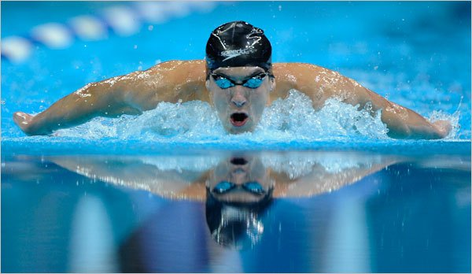
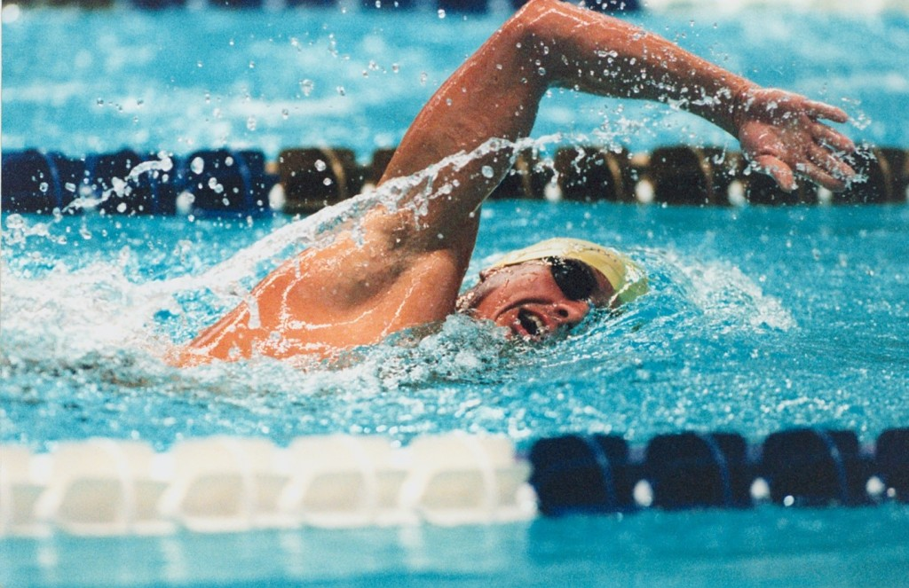
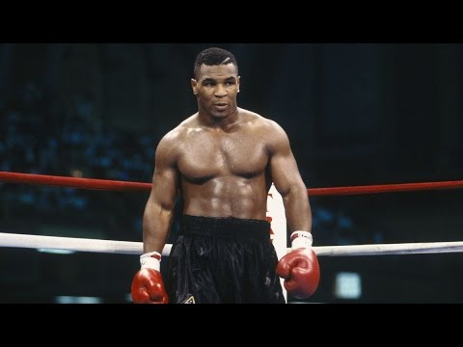
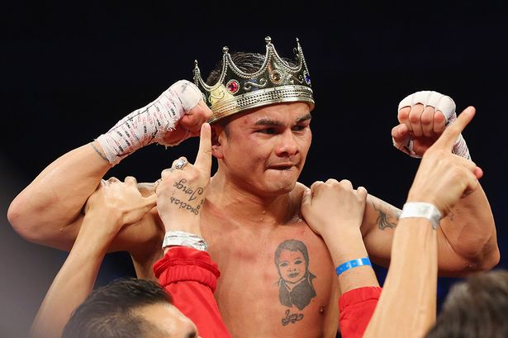
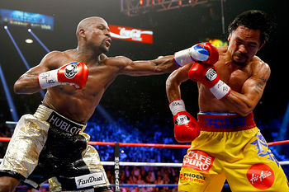
ATHLETE MANAGEMENT SYSTEM

Slide 4
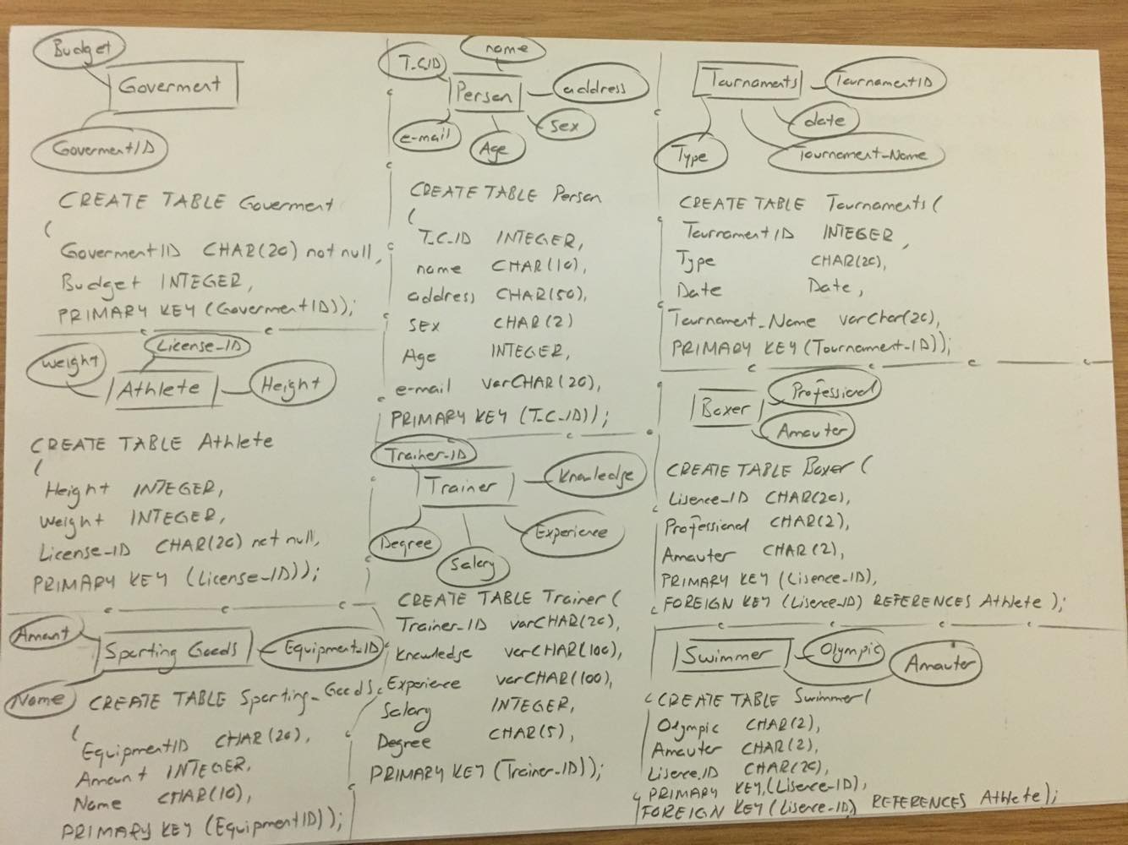

Slide 5
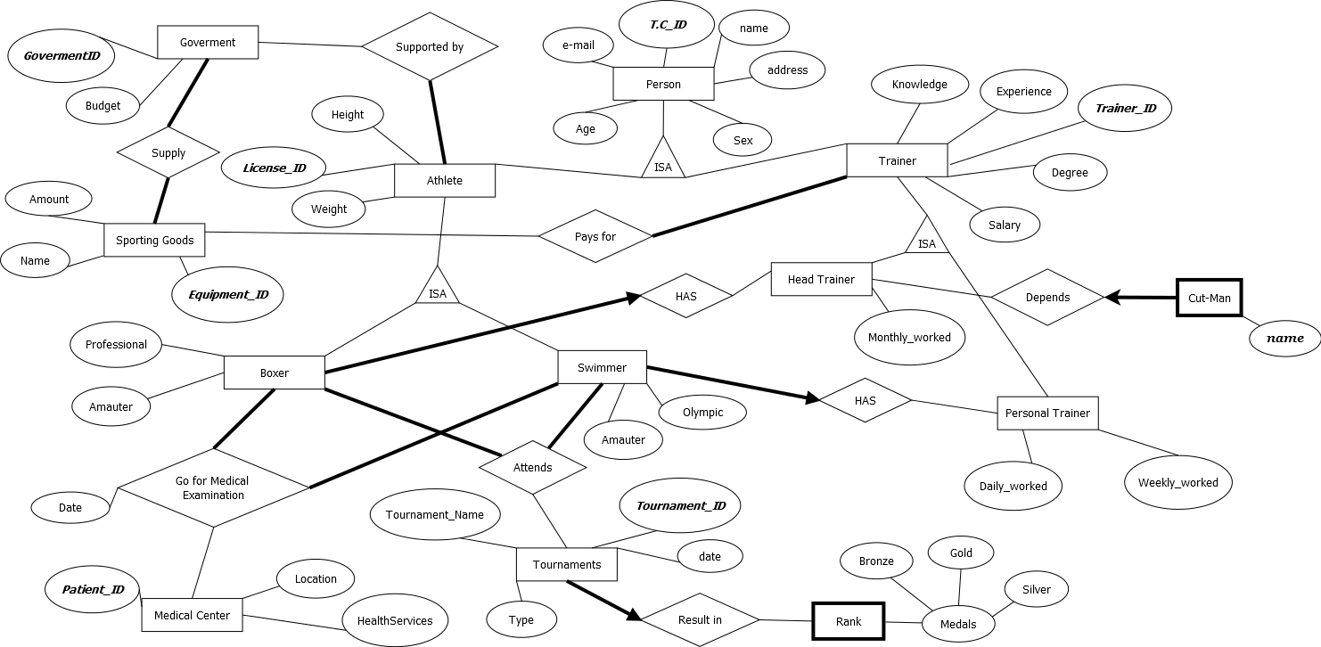
E-R DIAGRAM

Slide 6
REFERENCES
Photos are taken from,
https://www.google.com.tr/search?tbm=isch&sa=1&ei=YyU4WqGmJIb0UPb-m5gB&q=swimmer&oq=swimmer&gs_l=psy-ab.3..0l10.55021.55848.0.55937.7.7.0.0.0.0.153.712.1j5.6.0....0...1c.1.64.psy-ab..1.6.709....0.6Q8raSLfpTg#imgrc=IoyCve1EIQZtcM:
https://www.google.com.tr/search?tbm=isch&sa=1&ei=GSU4Wq-tGcSvUbmpkJgD&q=maidana&oq=maidana&gs_l=psy-ab.3..0l7j0i30k1l3.72513.73081.0.73210.7.7.0.0.0.0.193.613.0j4.4.0....0...1c.1.64.psy-ab..3.4.612...0i10i67k1.0.UPm1IX4k7V8#imgrc=edBTuBJ-JxIeBM:
https://www.google.com.tr/search?tbm=isch&sa=1&ei=2iQ4WtN6wbxRr661uA0&q=mike+tyson&oq=mike&gs_l=psy-ab.3.0.0i67k1l3j0l4j0i67k1j0l2.60255.60681.0.62538.4.4.0.0.0.0.140.466.1j3.4.0....0...1c.1.64.psy-ab..0.4.464....0.jnOXmRnOEP4#imgrc=U-ebt7rdlGbn6M:
https://www.google.com.tr/search?q=floyd+manny+pacquiao&tbm=isch&source=iu&ictx=1&fir=z_SUc-IbZhLejM%253A%252Chef1cmzABvwbqM%252C_&usg=__cUIs-9bPyNLFOjaliSYVwtE-fRI%3D&sa=X&ved=0ahUKEwi-hdr_spTYAhWL7xQKHaNBArMQ_h0IkAEwCw#imgrc=z_SUc-IbZhLejM:

