Slide 1
Beyond Wirelength and Regularity: Timing-, Congestion-Aware and Multi-Objective Reinforcement Learning for Macro Regulation
Deep Reinforcement Learning | Mid-Semester Project Presentation
Presented by:
Pratyush Mohata
Aditya Birari
2023A3PS0690P
2023A3PS0700P
Based on a review of these papers
Lee et al., 2025: Chip Placement with Diffusion Models (ICML)
Xue et al., 2024: RL Policy as Macro Regulator Rather than Macro Placer (NeurIPS)
Notes:
Introduce the team and the two papers our project builds on.

Slide 2
The Macro Placement Problem
Netlist: the chip as a graph of components and the wires (nets) between them.
Macros: a few hundred large blocks (e.g. memories), placed first.
Standard cells: millions of small gates, placed around the macros.
Why it matters: macro positions largely decide power, performance and area (PPA).
How a placement is judged
Wirelength
Regularity
Congestion
Timing
total length of all nets
macros close to the edges
wires needed vs. available
do signals arrive in time?
Notes:
Placement gives every component a location. Macros go first because they are large and highly connected. Wirelength and congestion are quick estimates; timing is checked with a static timing analysis tool.

Slide 3
Why RL Placers Struggle
Slow: a new agent is trained for every chip, which takes hours.
Poor generalisation: chip designs are confidential, so there is little data to learn from.
Irreversible early moves: macros are placed one by one on an empty canvas, so the first macro is placed before the agent knows where its neighbours will go.
Sequential placement
step 1
step 2
step 3
Each macro is fixed once placed, before later macros are known.
Two responses
Paper A replaces RL with a generative model. Paper B keeps RL but gives it a different job.
Notes:
These limitations of RL placers such as Google's GraphPlace and MaskPlace motivate both papers.

Slide 4
Paper A: Chip Placement with Diffusion Models
Goal: train once, then place any new chip in minutes.
Idea: like an image generator: start from randomly scattered macros and nudge them all, step by step, into a clean layout.
Free training data: scatter blocks first, then add wires between nearby blocks, so the layout is already good.
Random start
Step by step
Final layout
Reported results
Shortcomings
Minutes per chip instead of hours
Shorter wires and less congestion than earlier placers
Timing is never checked
Cannot easily trade extra compute for quality
Notes:
Paper A in simple words. A diffusion model gradually turns random positions into a good layout, moving all macros together, so no early decision is locked in. While generating, it is steered towards shorter wires and no overlaps. Results are on academic benchmarks (IBM, ISPD 2005). The authors suggest RL fine-tuning as future work.

Slide 5
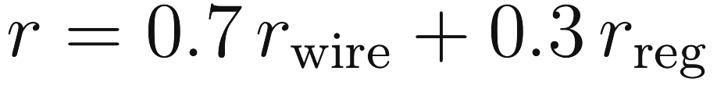
Paper B: MaskRegulate, RL as a Regulator
Key idea: instead of building a layout from scratch, RL refines an existing DREAMPlace layout one macro at a time. Every move's effect is known exactly, so the reward is accurate. It also pushes macros towards the edges (regularity).
PositionMask
WireMask
RegularMask
which cells are free
wirelength change per cell
regularity change per cell
Reward per move:
trained with PPO
17%
73%
38%
better routed wirelength
less horizontal overflow
better total negative slack
vs. MaskPlace on ICCAD 2015, evaluated with Cadence Innovus (as reported in the paper)
Notes:
The agent looks at mask images, picks a grid cell for the current macro and is rewarded for reducing wirelength and improving regularity. Like editing a full draft rather than writing from a blank page. Numbers are the paper's own results.

Slide 6
Comparing the Two Papers
 | Paper A: Diffusion | Paper B: MaskRegulate
View of RL | Replace it | Keep it, as a refiner
Starts from | Random positions | A DREAMPlace placement
How it decides | All macros together, step by step | One macro at a time
Objectives | Wirelength + no overlap | Wirelength + regularity
Evaluation | Quick estimates only | Estimates + routing and timing
Strength | Fast, works on new chips | Best real PPA, exact rewards
Main gap | Not PPA-aware | No timing/congestion; one fixed trade-off
Notes:
Paper A is a fast drafter; Paper B is an accurate editor. They are complementary.

Slide 7
Research Gaps We Target
Timing and congestion are not in Paper B's reward (timing is its weakest metric)
Direction 1: add them to what the regulator sees and is rewarded for
G1
Paper B uses one hand-picked trade-off (0.7 / 0.3)
Direction 2: return a set of trade-off placements from one policy
G2
The regulator is limited by its starting draft
Start the regulator from a diffusion-generated placement
G3
Notes:
These gaps come from the papers' own results and limitations sections. G1 and G2 become our two directions; G3 links the two papers.

Slide 8
Proposed Flow and How the Regulator Works
Netlist
Initial placement
(DREAMPlace / diffusion)
RL regulator
Standard-cell
placement
Routing +
timing check
Input masks
Blue = new in this project
Position
Wire
Regular
Timing
Congestion
Preference
Sees: masks for the current macro
Does: moves it to a free grid cell (each macro once, largest first)
Gets: the weighted improvement the move produced
MaskRegulate uses only the first two terms; the network (CNN) and training (PPO) stay the same.
Notes:
We keep MaskRegulate's framework; all changes are inside the regulator. The per-move rewards add up to the total improvement of the final layout, so any objective we can predict per move can be added. Setting the new weights to zero gives back MaskRegulate exactly.

Slide 9
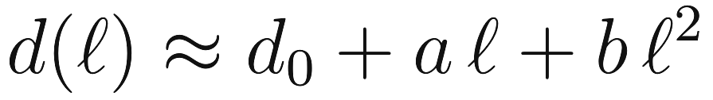
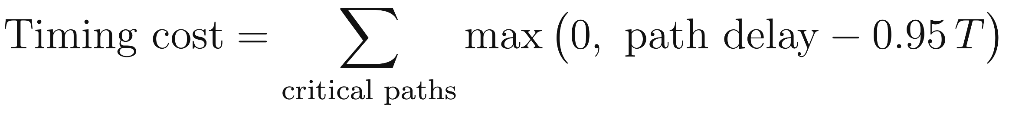
Direction 1: TimingMask
Pushing macros to the edge can stretch wires on timing-critical paths.
Delay grows faster than length: a long wire is disproportionately slow.
Critical paths: a timing tool (OpenSTA / OpenTimer) lists the slowest paths; re-run every few episodes.
Mask: for every grid cell, how the timing cost would change if the macro moved there.
Cheaper option: give more weight to critical nets in the existing WireMask.
Wire delay
Timing cost
0.95 T: also counts paths that are nearly late
Notes:
The delay model has a constant, a linear and a squared term in wire length, so long wires are very slow. Moving a macro only changes the two wires connecting it to its neighbours on each path, so the change in timing cost can be computed exactly for every grid cell, like the WireMask.

Slide 10
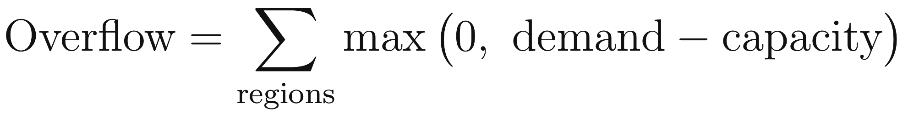
Direction 1: CongestionMask
Routing demand (RUDY): spread each net's wire evenly over its bounding box to estimate how many wires cross each region.
Capacity: each region can carry a fixed number of wires; a macro blocks part of it.
Mask: for every grid cell, the extra overflow if the macro blocked a busy region there.
Regularity
Indirect rule: "keep macros near the edge"
CongestionMask
Direct measure: "don't block busy routing"
Notes:
Total routing demand equals total wirelength, so wirelength controls how much demand there is but not where it concentrates. The CongestionMask targets where it concentrates, and only where it causes overflow.

Slide 11
Direction 2: A Menu of Good Placements
Why: different chips need different trade-offs (e.g. mobile: short wires; high-performance: timing). Paper B fixes one.
Goal: give the designer a set of Pareto-optimal placements, where no objective can improve without another getting worse.
Pareto front (illustration)
wirelength
BASELINE
PROPOSED
REFINEMENT
One regulator per trade-off
One preference-conditioned regulator
Reach balanced trade-offs
Separate regulators for several weight settings; cost grows with the number of settings.
Preference weights are an extra input; random during training, chosen by the designer at test time.
Chebyshev rule: score a layout by its worst-weighted objective.
Judging a set: hypervolume (higher = better and more varied placements), over 35 preference settings.
Notes:
The preference-conditioned policy follows preference-driven multi-objective RL (PD-MORL); the preference enters the network through a simple conditioning layer (FiLM). The sketch is only an illustration of a Pareto front.

Slide 12
Linking the Papers and Conclusion
Diffusion model
RL regulator
Final layout
draft layout (Paper A)
timing/congestion-aware,
multi-objective
better PPA
The regulator only edits, so a better draft should give a better final layout. Stretch goal: fine-tune the diffusion model with RL.
In summary
Literature: Paper A drafts fast; Paper B edits accurately. Neither optimises timing or congestion.
Direction 1: TimingMask and CongestionMask as new inputs and reward terms.
Direction 2: one preference-conditioned regulator returning a set of trade-off placements.
Notes:
This connects the drafter (Paper A) to the editor (Paper B), then summarises the project.

Slide 13
Evaluation Plan
Benchmarks
ID | Question
E1 | Can we reproduce MaskRegulate's published numbers?
E2 | Does the TimingMask improve timing, and at what cost?
E3 | Does the CongestionMask reduce overflow beyond regularity?
E4 | Do timing and congestion pull in different directions?
E5 | Can one conditioned policy replace many regulators?
E6 | Does a diffusion start improve the final layout?
E7 | Does it work on chips it has not seen?
ICCAD 2015 superblue (with timing); ISPD 2005
Baselines
DREAMPlace, AutoDMP, MaskPlace, MaskRegulate, diffusion placer
Metrics
Wirelength, overflow, WNS, TNS; hypervolume for sets
Tools
Cadence Innovus, or the open-source OpenROAD flow
Notes:
Each experiment tests one question. Expected challenges: compute (start from released checkpoints and smaller chips), tool access (OpenROAD fallback), and timing-analysis cost (cheaper critical-net weighting).

Slide 14
Questions?
Thank you for your attention.
Notes:
Invite questions.

