Slide 1
Default probability prediction: Credit data

Slide 2
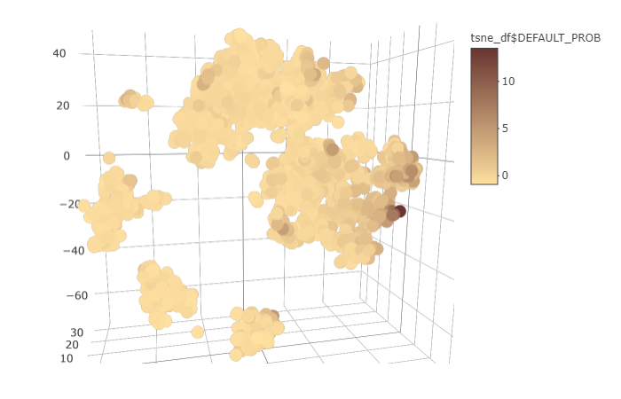
Overview
Predict default probability
Good model
Insights

Slide 3
Good model
Missing data
Outlying observations → Great prediction power
Nonlinear relationships

Slide 4
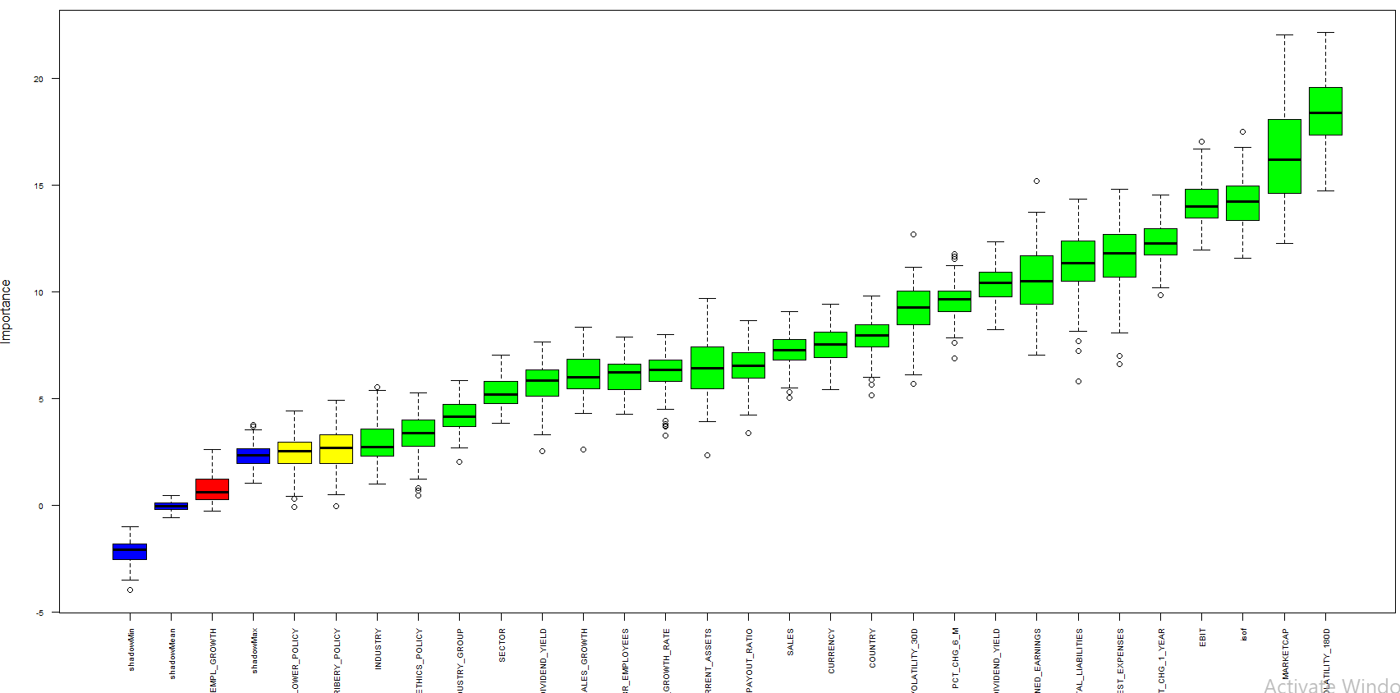
Insights: important features

Slide 5
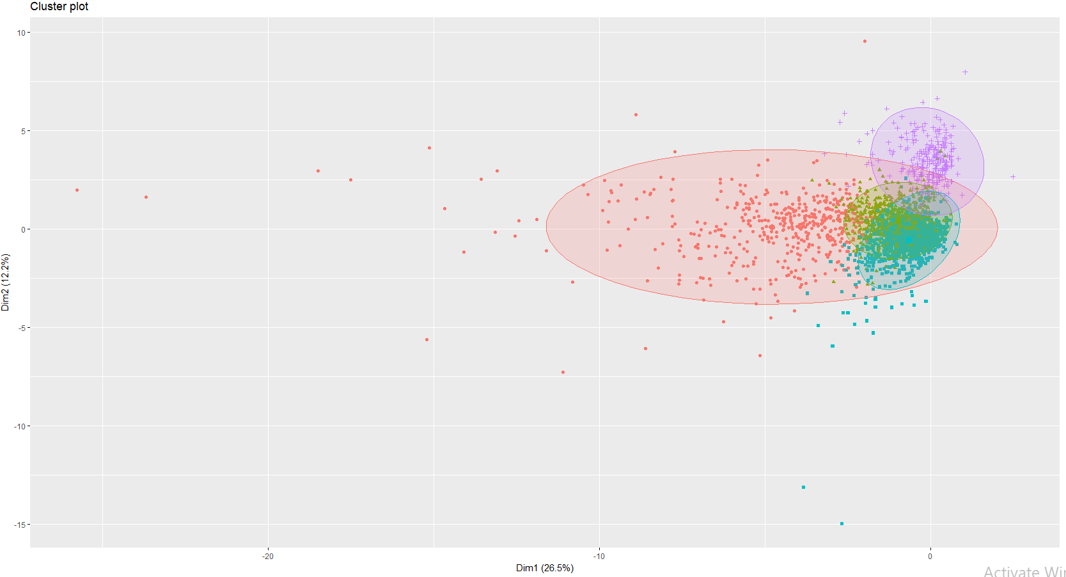
Insights: Clustering

Slide 6
Wrap up
We build a model with strong predictive performance
We found the most relevant financial and non-financial features

Slide 7
Appendix – more details:

Slide 8
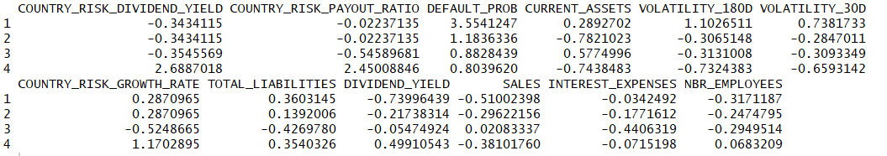
Keep quiet boys!
Standardized weight
Standardized weight

Slide 9
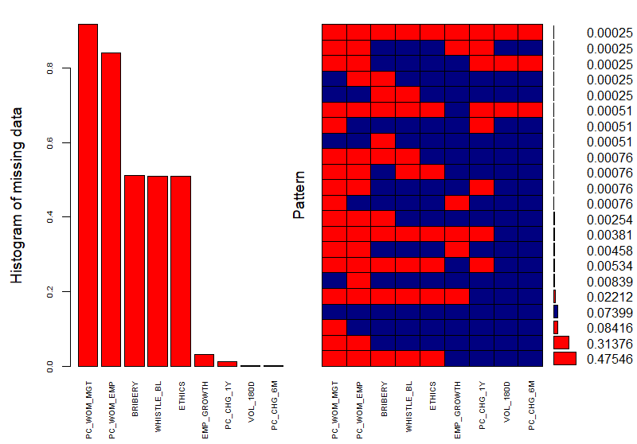
Overview
Missing Data
2 variables : 90% (woman employment rate)
All policies (some missing)
3 var-→ 50% missing-→ missing together
Missingness pattern
Difference in currency

Slide 10
Feature selection & Logistic model
Volatility is the most
relevant to Default probability
Coefficients of Logistic model
Odds ration

Slide 11
Best prediction of Default probability
directly model default_probability
Neural network model: 50% better than logistic regression on test data
EM: jointly estimate missing data and nn

Slide 12
missingness and preprocessing
#variables: 31 variables, #observations: 3933
8 Categorical variables, 23 Continuous variables,
Missing Data
2 variables : 90% (woman employment rate)
All policies (some missing)
3 var-→ 50% missing-→ missing together
Missingness pattern
Only 7% are complete
Some are simultaneously missing
Removing a column
Change the imputation method
Difference in currency
Adjusted by dividing by asset--standarding

