Slide 1
Film Lair
Justin Nichols

Slide 2
What is Film Lair?
The Film Lair is a movie database that is quick to access and can give you quick information on any movie! Actors, ratings, and even cool posters are easy to access and discover! This program was made thanks to the many guides Microsoft has on movie databases. I also needed a pretty easy to set up API for this program for it’s simplicity, and that’s why I went with OMDb, as it’s easy to set up and it didn’t cause me to rip my hair out nearly as much as some other APIs. With the help of its documentation and some guides by Microsoft, I was able to create a nice and easy to use program, which is now known as Film Lair.

Slide 3
Data Sources
The main source of this project is the OMDb API. I chose this API because not only was it easy to work with, I had some struggle using other ones. Although it does the job well, it can only do so much. The API is very limited on what can be done with it, and although I tried to make some fancy features, not many really made the cut. The closest I got to getting a unique feature to work was searching films by actors, but even then it only works for some specific actors. Getting extra information on movies was pretty simple, but there’s only so much that can be done with the API, and only so much my little brain of mine knows, so I put focus on the more simple and convenient features. I also used Json.NET originally for some configurations, but I just left it to add the API key.

Slide 4
What can it do?
Film Lair is able to search films by title. There is an actor option available, but it currently support specific actors, and sometimes can have interesting results. You are able to view any movie and see details, such as the summary, genre, and even the IMDb rating. For people who hate bright screens, a dark theme is available, as well as the normal light theme, making it easier or harder on the eyes, whichever you choose. Not only that, but you can see posters of any film. You can even enlarge them and get a better look.

Slide 5
How was testing done?
I tested this program by running it after any changes, mostly trying out the search function and viewing different posters. I also tested the error handling for lacking the API Key or if no results are found. Thankfully, with the simplicity of this program, testing it isn’t too frustrating and doesn’t take up too much time.

Slide 6
GITHUB
https://github.com/BirdUp27/Film-Lair.git
The code and presentation are stored right here.

Slide 7
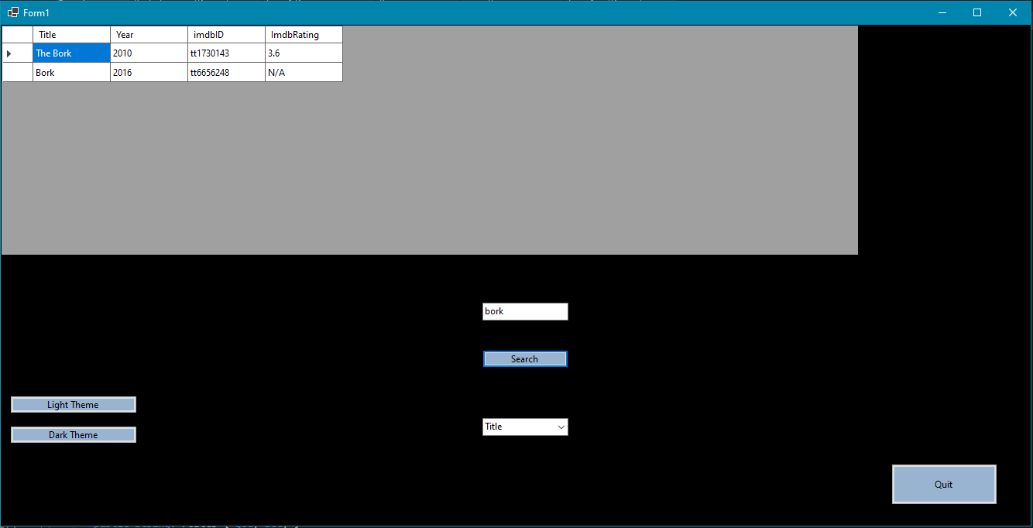
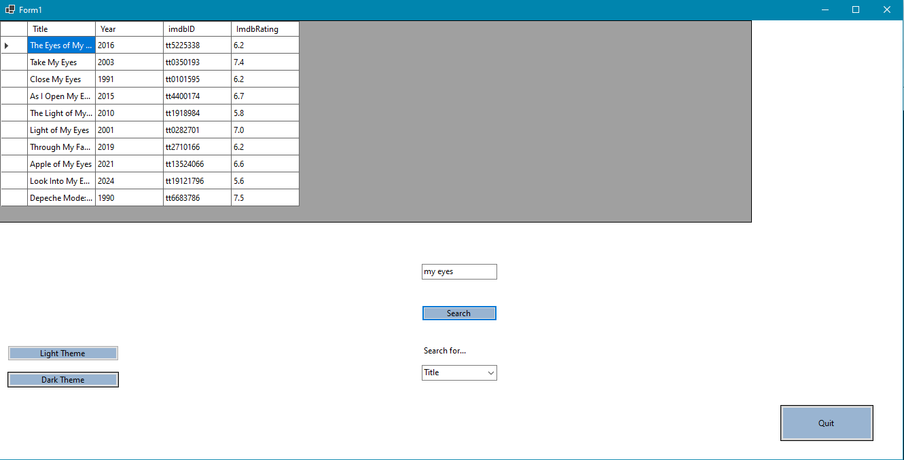
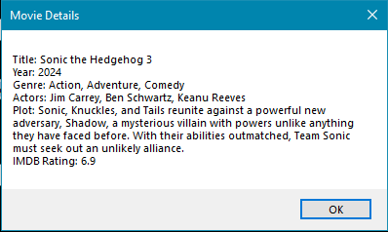
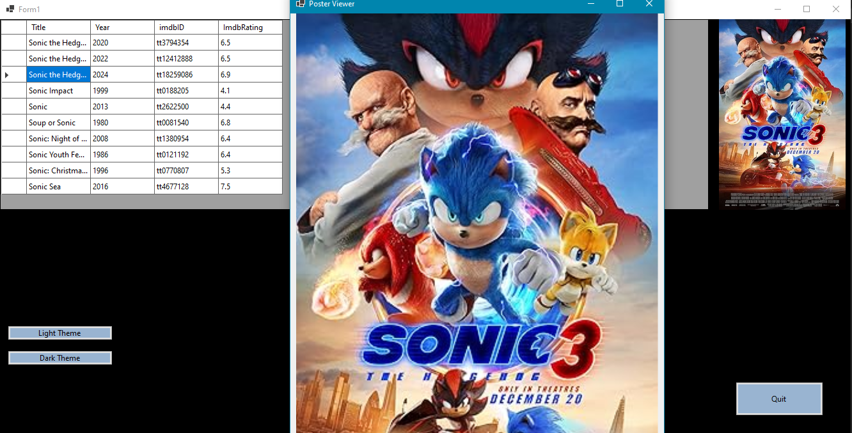
Screenshots

Slide 8


Conclusion
Overall, this program was quite a hassle. Throughout development, Visual Studio had many problems that I was not able to fix easily, and I did have to rewrite the program a few times. Getting some technical things to work in the beginning were not easy as well. Despite that, this is a great tool for getting information on movies. Of course, I eventually plan to add…
Otherwise, I hope to make the program actually look pretty and not the abomination it becomes when you maximize the window…I also plan to make a real configuration menu so the singular window isn’t flooded with settings.

Slide 9
Works Cited
https://www.omdbapi.com/
https://www.newtonsoft.com/json
Create a Movie Database Application in 15 Minutes with ASP.NET MVC (C#) | Microsoft Learn
Guards In .NET

