Slide 1



Classifying Personality Types with Neural Networks Based on Social Media (Twitter) Posts
Author: Stephan Schuller Advised by: Dr. Razvan Andonie
(CWU) CS457
Computational Intelligence and Machine Learning

Slide 2

Project Overview and Goals
Make a Machine Learning model that uses a Neural Network
Train the model using a Dataset of Status (tweets) that are paired with O.C.E.A.N. data
Test the model on unpaired tweets to evaluate personality and credibility

Slide 3

Initial idea
A bot, that can take a username
Analyze with model
Output some generalization
The personality type display here: INTP
Related to emotional volatility and patterns of dealing with stress poorly.
Highly neurotic people are more likely to experience negative emotions.

Slide 4


Inspiration
Andrew Dunn
Sentiment Analysis of Tweets
Central Washington University - Ellensburg, Washington, United States
CS 557
Hima Vijay & Neenu Sebastian
Personality Prediction using Machine Learning
SCMS School of Engineering & Technology - Vidya Nagar, Karukutty, Ernakulam
2022 International Conference on Computing, Communication, Security and Intelligent Systems (IC3SIS)

Slide 5
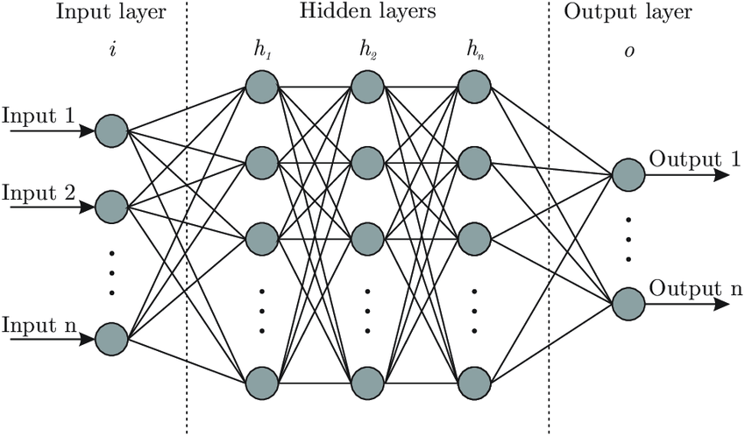
Neural Networks
Not Natural Language Processing
Notes:
86 billion neurons in human brain

Slide 6


TOOLS
Python 3.11
SciKitLearn
Pickle
NLTK
Tweepy
+

Slide 7
Classifying Personality Types O.C.E.A.N.

Slide 8
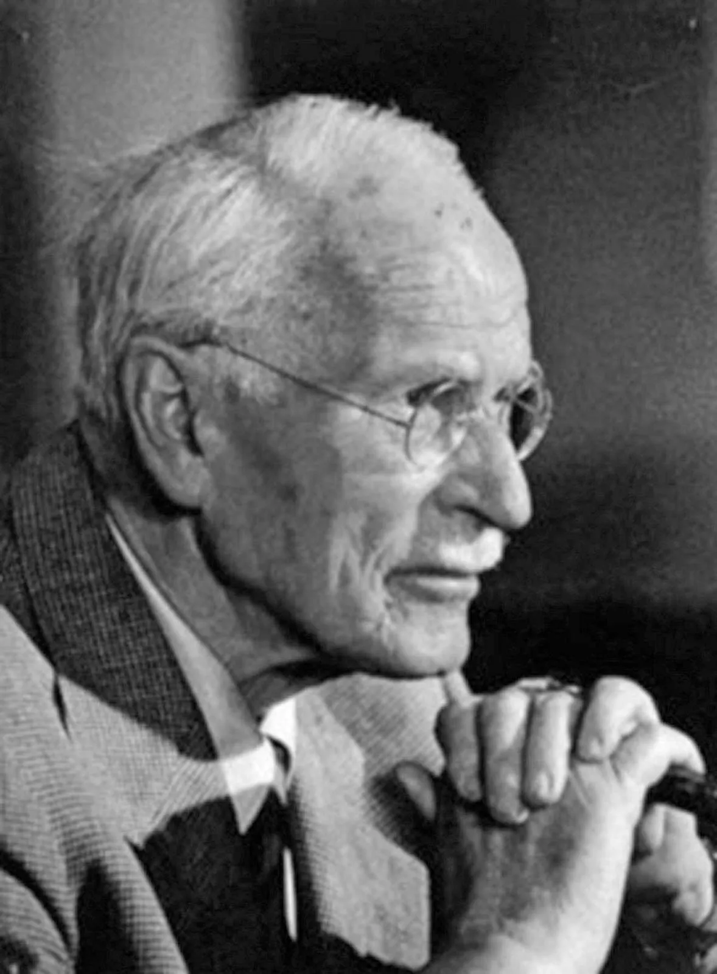
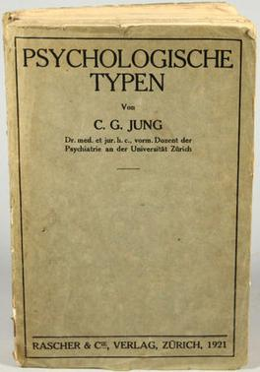
History of Personality Traits
OBJECTIVE
Carl Jung
Personality Types
1920’s - 4000 measures of personality
1950’s – 171 characteristics
1960’s – 5 O.C.E.A.N.
1987’s – 16 (based on 4) Myer’s Briggs
SUBJECTIVE
1921
1875-1961

Slide 9
Different versions of the same thing
Ocean
IPIP
HEXACO
Openness
Conscientiousness
Extroversion
Agreeableness
Neuroticism
>
>
>
>
>
Intellect
Conscientiousness
Extroversion
Agreeableness
Emotionality
Big 5, + H (H for Honesty / Humility)
Extraversion
Neuroticism
X
emotionality
Myers - Briggs
If Neuroticism is dropped
4 measures 2 polar
2^4 = 16
ESTJ, ENTJ, ESFJ, ENFJ,
ISTJ, ISFJ, INTJ, INFJ,
ESTP, ESFP, ENTP, ENFP,
ISTP, ISFP, INTP & INFP

Slide 10
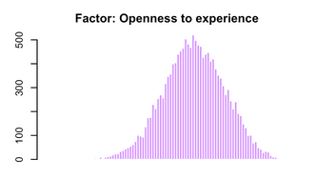
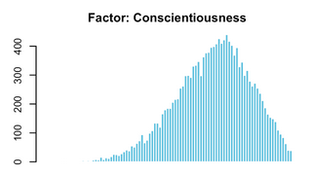
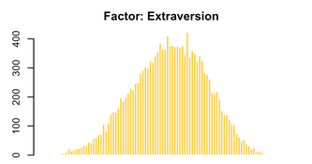
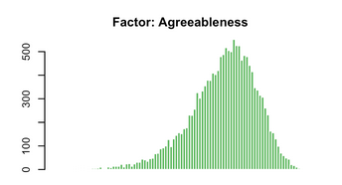
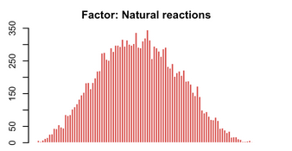
The Datasets
Open Psychometrics
IPIP FFM Dataset
1,015,342
My Personality Project
Stanford University
50,605
Personality in 100,000 Words
Tal Yarkoni
694

Slide 11
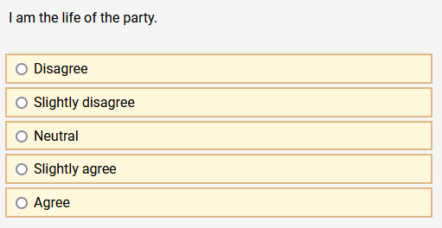

The Datasets (more details)
All “I” Statements
[ ‘I’, ‘am’ , ‘the’ , ‘life’ , ‘of’ , ‘the’, ‘party’]
[ ‘life’ , ‘party’]
Words are sufficient to categorize

Slide 12
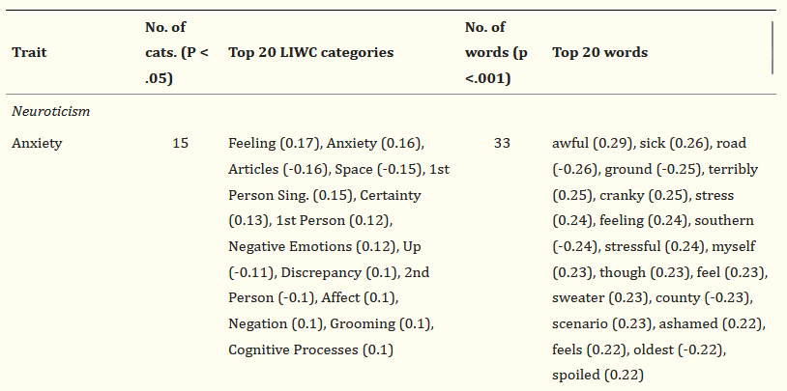
How can we be so sure?
Tal Yarkoni, Personality in 100,000 Words: A large-scale analysis of personality and word use among bloggers

Slide 13
Data Preprocessing
Things that lowers accuracy of the model
Misspelled words
Hashtags
URLs
Uppercase / Lowercase
Stopwords
Unknown Characters
Numbers
Unique “words”
NLTK
REDUCE NOISE to INCREASE ACCURACY

Slide 14
“Bag-of-Words” Tactic
Simplistic model that counts the occurrence of known words in a text
My model uses a dictionary of 3,500 words
A binary vector is constructed for each input text
Same Size as dictionary (each index is a word)
A value of 1 means the word exists

Slide 15
THE Neural Network Model
Model is a standard Multi-Layer Perceptron
Mutli-Linear Output
3500 input neurons
Two hidden layers, with 250 and 10 neurons
Uses relu function
Output layer is 5 neurons, and quantifies O.C.E.A.N.

Slide 16
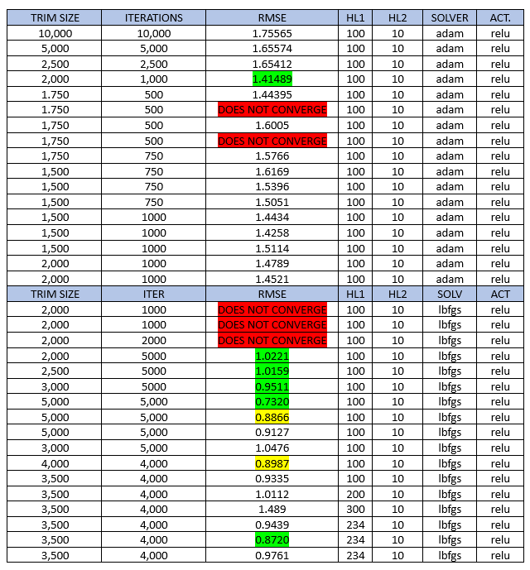
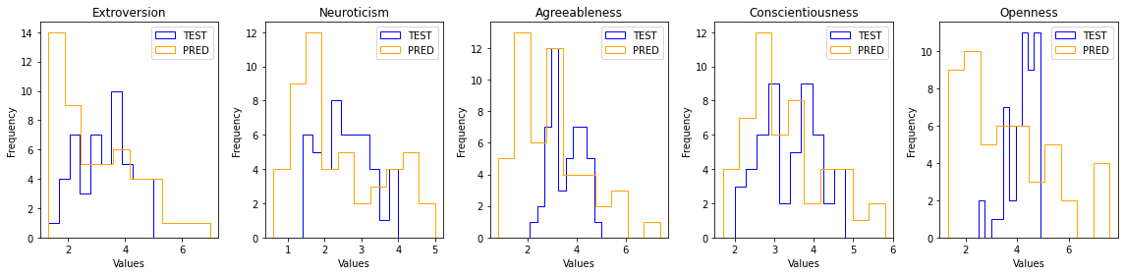
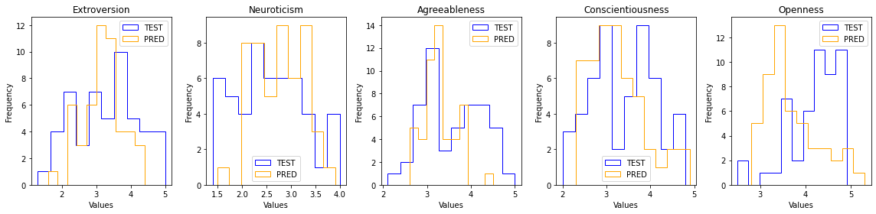
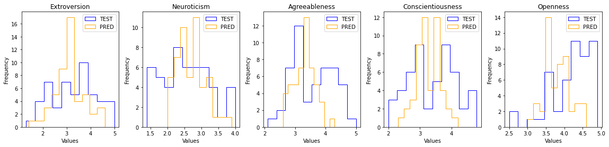
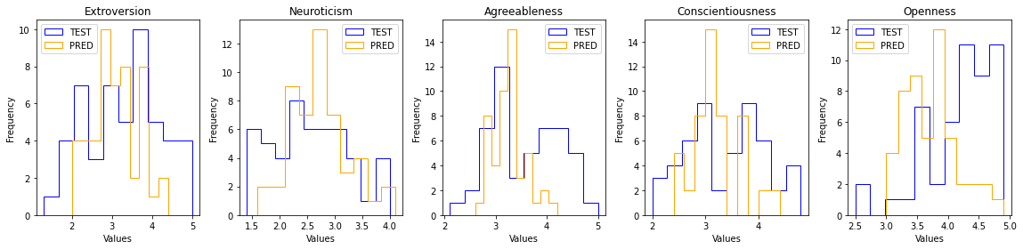
Some Results

Slide 17
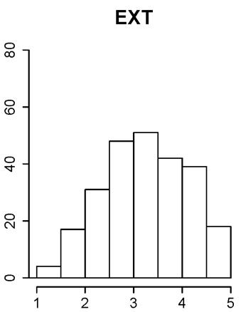
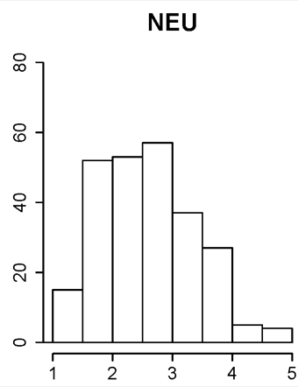
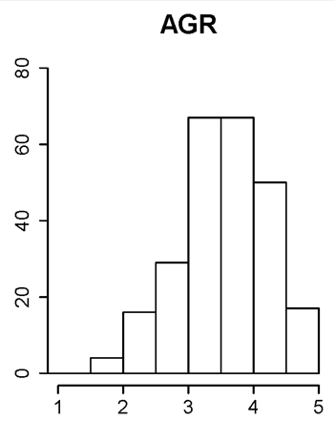
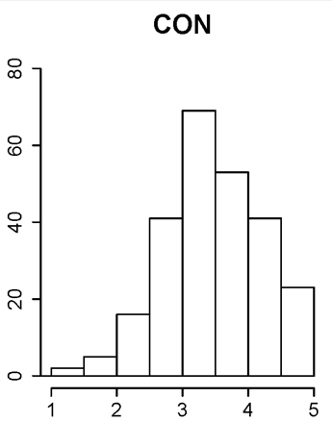
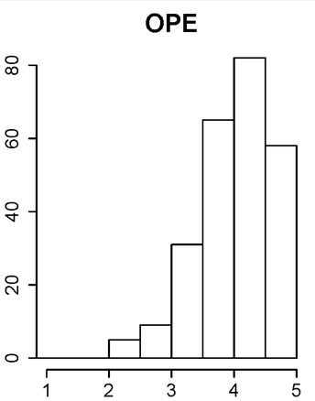
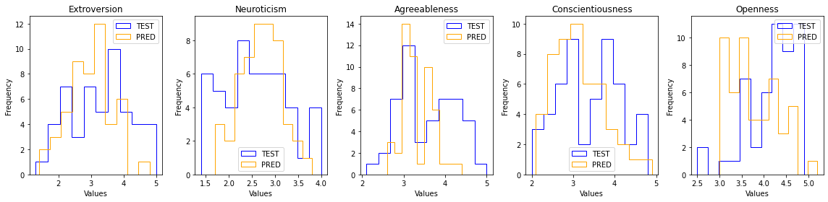
How close are we?
IPIP
My
Personality
Project
Model

Slide 18
Discussion
Overall testing accuracy: 69%
Bag-of-words tactic without NLP is has limiting results
Perhaps wrong tools for the job
NLP models have much higher accuracy (as high as 90%)
Tweepy API is expensive (now)
Need a fairly large sample
Accurate evaluation needs 300 to 500 words per Author for accuracy above 70%

Slide 19
References
Goldberg, L. R. (1992). The development of markers for the Big-Five factor structure. Psychological Assessment, 4(1), 26–42. https://doi.org/10.1037/1040-3590.4.1.26
Hima Vijay & Neenu Sebastian (2022) Personality Prediction using Machine Learning - 2022 International Conference on Computing, Communication, Security and Intelligent Systems https://searchlib.cwu.edu/permalink/01ALLIANCE_CWU/1c5n89p/cdi_globaltitleindex_catalog_367322427.
Andrew Dunn 2020, Sentiment Analysis of Tweets – Central Washington University
Tal Yarkoni, 2010, Personality in 100,000 Words: A large-scale analysis of personality and word use among bloggers, https://www.ncbi.nlm.nih.gov/pmc/articles/PMC2885844/

