Slide 1
Human Computer Interaction
Review

Slide 2
Outline
Introduction
Design principles and usability principles
Conceptualizing Interaction
Identifying needs and establishing requirements
Prototyping
Interaction design models

Slide 3
Outline
Introduction
Design principles and usability principles
Conceptualizing Interaction
Identifying needs and establishing requirements
Prototyping
Interaction design models

Slide 4
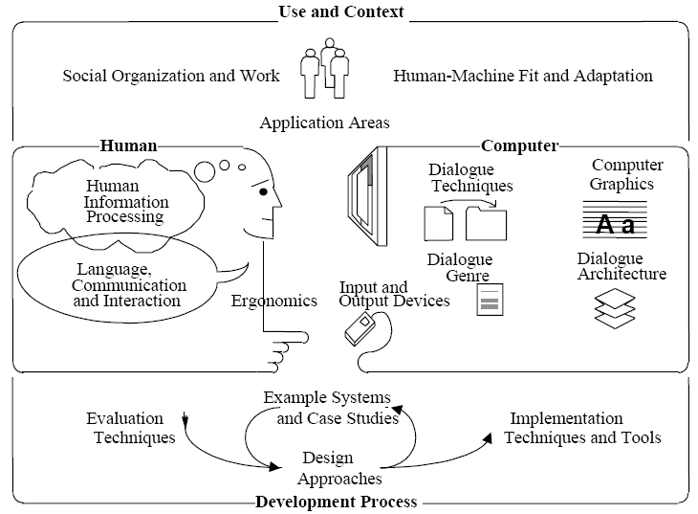
Why Study HCI?
HCI is worth studying because it aligns both human interests and economic interests.
The HCI discipline includes the study of:
- the use and context of computers
- human characteristics
- computer system and interface
architecture
- the development process

Slide 5
Central topic
Interaction design
  Not just a software interface on a desktop monitor!
Designing interactive products to support people in their everyday and working lives.
-- Jennifer Preece, Yvonne Rogers, Helen Sharp

Slide 6
Goals of Interaction Design
Allow users to carry out tasks
  Safely
  Effectively
  Efficiently
  Enjoyably

Slide 7
Two Crucial Errors
Assume all users are alike
Assume all users are like the designer

Slide 8
History of HCI
Key people, events and ideas

Slide 9
History of HCI
Input/output devices
The lesson
  keyboards & terminals are just artifacts of today’s technologies
  new input/output devices will change the way we interact with computers

Slide 10
The Development
- Multi-modal Interaction
- VR & 3D interaction
- Ubiquitous computing
- Smart space & Intelligent UI
- Standards

Slide 11
Up-and-Coming Areas
Gesture Recognition
Multi-Media
3-D
Virtual Reality and "Augmented Reality"
Computer Supported Cooperative Work
Natural language and speech

Slide 12
Outline
Introduction
Design principles and usability principles
Conceptualizing Interaction
Identifying needs and establishing requirements
Prototyping
Interaction design models

Slide 13
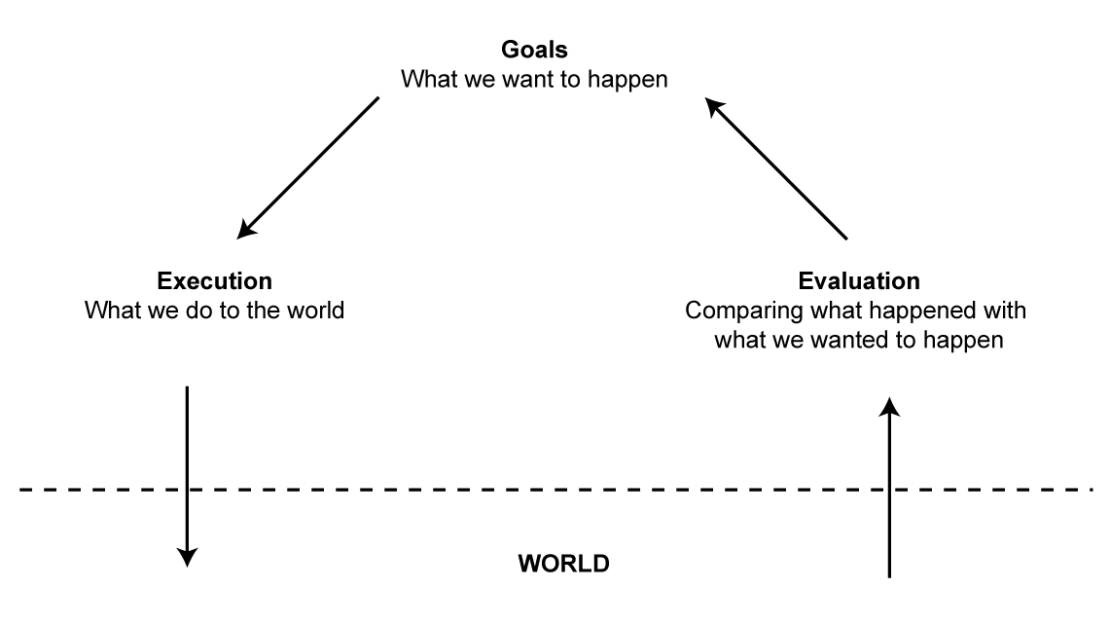
Execution/Evaluation Action Cycle (EEAC)
Goal > Intention > Actions > Execution
Perceive > Interpret > Evaluate
1-<number>

Slide 14
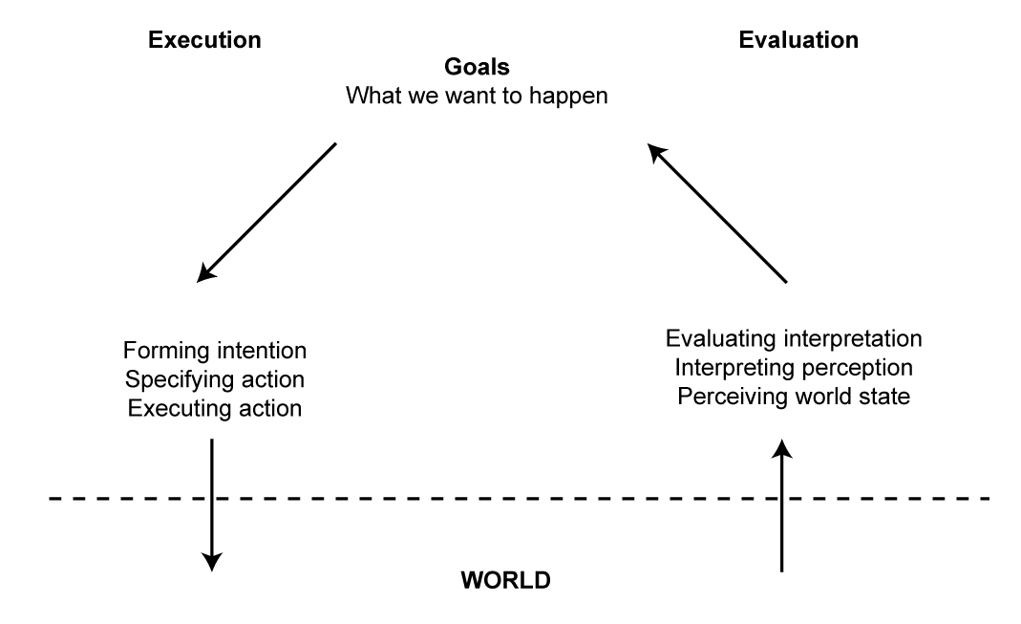
Execution/Evaluation Action Cycle (EEAC)
Seven Stages of Action
1-<number>

Slide 15
Interaction Framework
Abowd and Beale expanded on the EEC to include the system
System (S)—Uses its core language (computational attributes related to system state)
User (U)—Uses its task language (psychological attributes related to user state)
Input (I)—Uses its input language
Output (O)—Uses its output language
1-<number>

Slide 16
General Idea of a User Interface
Human transfer function
Percepts→ User goals
User
User goals->Action
Display->Perception Infomation
Input Device
Output Device
Action->Signals
System
System goals->Display
System transfer function
Signals→ system goals

Slide 17
User Interface Design Requires:
Knowledge of People
Knowledge about the Task
Knowledge about Computers

Slide 18
Goal in HCI: Universal Usability
Address the needs of ALL users
The computer is incidental to the design
Achieve usability by considering humans and human needs as the driving force behind a design.
Occurring or likely to occur as an unpredictable or minor accompaniment
Of a minor, casual, or subordinate nature

Slide 19
Usability
Usability is a quality measure for a system
It is a dynamic, unpredictable process which requires understanding of
  Who the users are
  Their knowledge, goals and tasks
It is measured by different types of evaluation

Slide 20
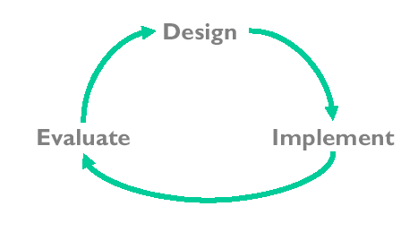
Usability Engineering Is a Process

Slide 21
Analyzing Interaction Paradigms
Interaction paradigm: A model or pattern of human-computer interaction that encompasses all aspects of interaction, including physical, virtual ,perceptual, and cognitive
An interaction paradigm defines the “who, what, where, when, why, and how” (5W+H) of computer system use.

Slide 22
What is involved in the process of interaction design?
Identify needs and establish requirements
Develop alternative designs
Build interactive prototypes that can be communicated and assessed
Evaluate what is being built throughout the process

Slide 23
Core characteristics of interaction design
Users should be involved through the whole development of the product
Specific usability and user experience goals need to be identified, clearly documented and agreed at the beginning of the project
Iteration is needed throughout the core activities

Slide 24
Usability Goals
Effective to use (effectiveness)
Efficient to use (efficiency)
Safe to use (safety)
Have a good utility (utility)
Easy to learn (learnability)
Easy to remember how to use (memorability)

Slide 25
User Experience Goals
Satisfying
Enjoyable
Fun
Entertaining
Helpful
Motivating
Rewarding
Compelling—which may mean it is not necessarily easy to learn. Instead, the user can gain satisfaction from learning e.g. medical image analysis workstation for use by radiologists.

Slide 26
Usability Goals vs User Experience Goals
Usability goals are central to interaction design and are operationalized through specific criteria.
User experience goals are more subjective and less clearly defined.

Slide 27
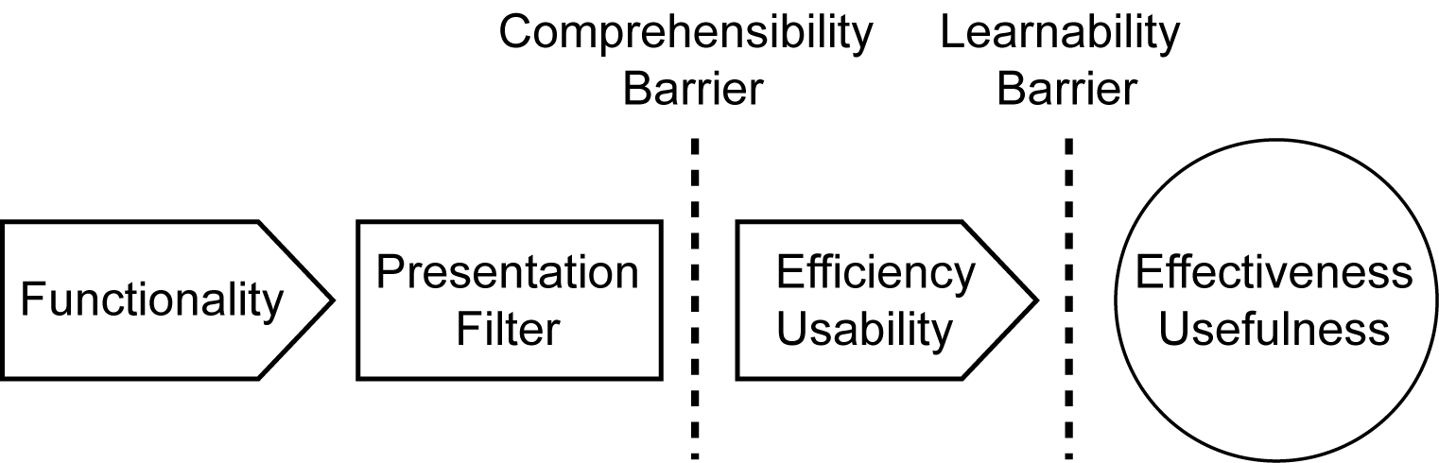
Framework for Design Principles
Comprehensibility Barrier - If the presentation is comprehensible, the comprehensibility barrier will be superseded. This depends on the degree of efficiency/usability in the interface design.
Learnability Barrier – If the interface is comprehensible it will be learnable, there is a direct relationship.
Effectiveness/Usefulness - If the user can learn the interface he can take advantage of the functionality and the interface will, therefore, be useful.
1-<number>

Slide 28
Principles of Interaction Design
Effectiveness/Usefulness
  Utility
  Safety
  Flexibility
  Stability
Efficiency/Usability
  Simplicity
  Memorability
  Predictability
  Visibility
1-<number>

Slide 29
Interaction Design Principles
Don Norman (1988) – the Design of Everyday Things
Visibility—don’t hide buttons e.g. bank web site
Feedback– so you don’t re-hit buttons
Constraints– grey-out options in different modes
Mapping—between controls and effects
Consistency—right mouse click always behaves same
Affordances—give a clue as to the use eg pushing a button
Similar to Nielson’s 10 usability principles (2001).

Slide 30
10 Usability Principles (Nielsen 2001)
  Visibility of system status
  Match between system and real
  User control and freedom
  Consistency and standards
  Help users recognize, diagnose and recover from errors
  Error prevention
  Recognition rather than recall
  Flexibility and efficiency
  Aesthetic and minimalist design
  Help and documentation

Slide 31
Outline
Introduction
Design principles and usability principles
Conceptualizing Interaction
Identifying needs and establishing requirements
Prototyping
Interaction design models

Slide 32
A framework for analysing the problem space
Are there problems with an existing product?
  What are they? List them explicitly!
Why do you think there are problems?
  You had them? Everybody has them?
Why do you think your proposed ideas might be useful?
  Faster? Easier? More comofortable?
How would you see people using it with their current way of doing things?
How will it support people in their activities?
Will it really help them?

Slide 33
Conceptual model
A conceptual model is a high level description of:
  “the proposed system in terms of a set of integrated ideas and concepts about what it should do, behave and look like, that will be understandable by the users in the manner intended”

Slide 34
Conceptual models
Many kinds and ways of classifying them
Here we describe them in terms of core activities and objects
Also in terms of interface metaphors

Slide 35
Conceptual models based on activities
Giving instructions
  issuing commands using keyboard and function keys and selecting options via menus
Conversing
  interacting with the system as if having a conversation
Manipulating and navigating
  acting on objects and interacting with virtual objects
Exploring and browsing
  finding out and learning things

Slide 36
Interface metaphors
Interface designed to be similar to a physical entity but also has own properties
  e.g. desktop metaphor, web portals
Can be based on activity, object or a combination of both
Exploit user’s familiar knowledge, helping them to understand ‘the unfamiliar’
Conjures up the essence of the unfamiliar activity, enabling users to leverage of this to understand more aspects of the unfamiliar functionality

Slide 37
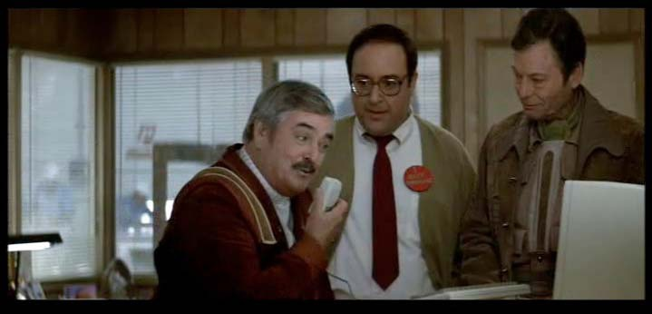
Conceptual models: from interaction mode to style
Interaction mode:
  what the user is doing when interacting with a system, e.g. instructing, talking, browsing or other
Interaction style:
  the kind of interface used to support the mode, e.g. speech, menu-based, gesture

Slide 38

Many kinds of interaction styles available…
Command Line
Menu-Based Interface
Form Fill-In
Question and Answer
Direct Manipulation
Metaphors
Web Navigation
Three-Dimensional Environments
Zoomable Interface
Natural Language
1-<number>

Slide 39
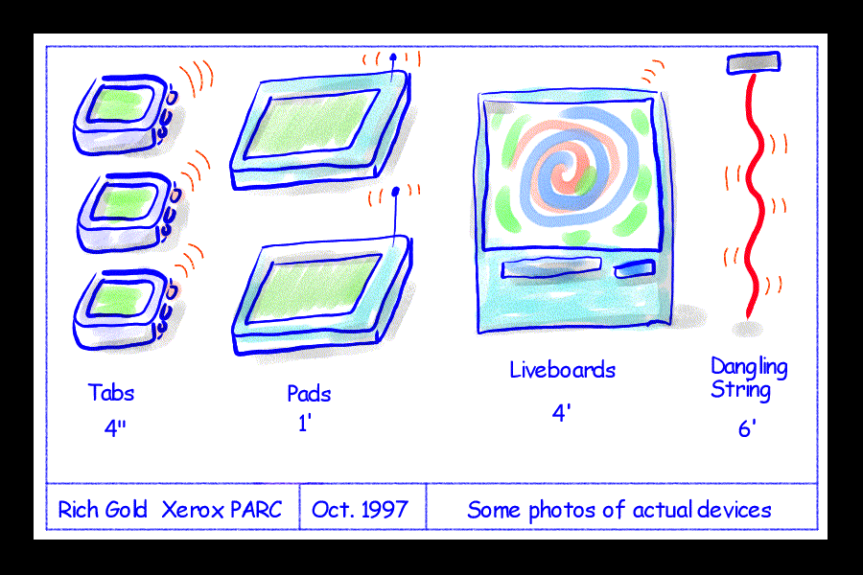
Interaction paradigms
Another form of inspiration for conceptual models
From the desktop to ubiquitous computing
(embedded in the
environment)

Slide 40
Outline
Introduction
Design principles and usability principles
Conceptualizing Interaction
Identifying needs and establishing requirements
Prototyping
Interaction design models

Slide 41

Overview
The importance of requirements
Different types of requirements
Data gathering, interpretation
and analysis
Task descriptions: Scenarios
Use Cases
Essential use cases
Task analysis: HTA

Slide 42
What, how and why?
Identifying needs
  -- Understand as much as possible about the users, their work, and the context of that work, so that the system under development can support them in achieving their goals.

Slide 43
What, how and why?
Establishing requirements
  -- Produce a stable set of requirements that form a sound basis to move forward into thinking about design.
  -- Not necessarily a major document nor a set of rigid prescriptions, but you need to be sure that it will not change radically in the time it takes to do some design and get feedback on the ideas.

Slide 44
What, how and why?
How can we achieve this?
Beginning: we know that we have a lot to find out and to clarify.
Middle?
End: have a set of stable requirements.
  Data gathering activities
  Data analysis activities
  Expression as ‘requirements’
  - capturing the finding in a form that can be expressed as requirement

Slide 45
What are requirements
A requirement is a statement about an intended product that specifies what it should do or how it should perform.
Should be specific, unambiguous, and clear.
    E.g. time to download any complete page is less than 5 seconds.
    Teenage girls should find the site appealing.

Slide 46
Different Kinds of Requirements
Functional requirements
Data requirements
Environmental requirements
  Physical requirements
  Social requirements
  Organizational requirements
  Technical requirements
User requirements
Usability requirements

Slide 47
Data gathering techniques
Essentially a small number of basic techniques for data gathering
  questionnaires
  interviews
  focus groups and workshops
  naturalistic observation
  studying documentation
Data gathering techniques are flexible and can be combined and extended in many ways.

Slide 48
Data interpretation and analysis
Different approaches emphasize different elements
- class diagrams for object-oriented systems,
- entity-relationship diagrams for data intensive systems
The requirements activity iterates a number of times before a set of stable requirements evolves.
- As more interpretation and analysis techniques are applied, a
deeper understanding of requirements will emerge and the
requirements descriptions will expand and clarify.

Slide 49
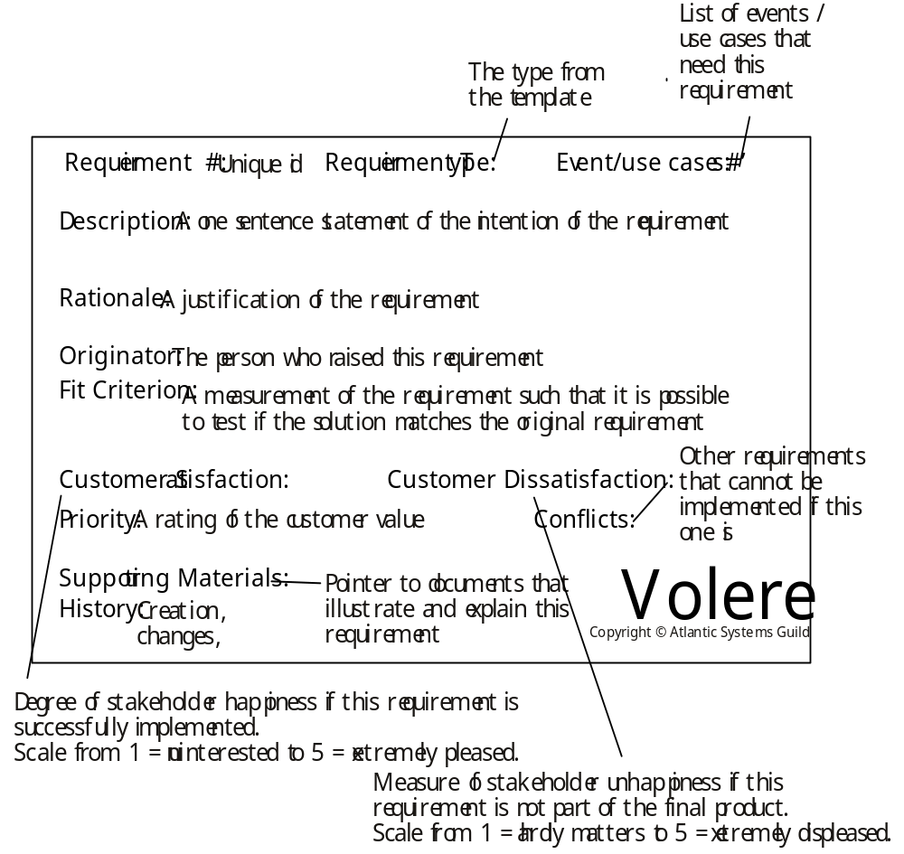

Slide 50
Task descriptions
Business Scenarios
- commonly used as the basis for acceptance testing
Task descriptions are used throughout development, from early requirements activities through prototyping, evaluation, and testing due to the emphasis on involving users earlier in the development lifecycle
Different flavors of task descriptions
  Scenarios
  Use cases
  Essential use cases
  may be used to describe either existing tasks or envisioned tasks with a new device.
  not mutually exclusive

Slide 51
Task analysis
Task descriptions are often used to envision new systems or devices
Task analysis is used mainly to investigate an existing situation
It is important not to focus on superficial activities, but to analyze the underlying rational and purpose of what people are doing:
What are people trying to achieve?
Why are they trying to achieve it?
How are they going about it?

Slide 52
Task analysis
Task analysis is an umbrella term that covers techniques for investigating cognitive processes and physical actions, at a high level of abstraction and in minute detail.
Many techniques, the most popular is Hierarchical Task Analysis (HTA)
Another well-known task analysis technique called GOMS (goals, operations, methods, and selection rules) models procedural knowledge.

Slide 53
Outline
Introduction
Design principles and usability principles
Conceptualizing Interaction
Identifying needs and establishing requirements
Prototyping
Interaction design models

Slide 54
Summary
Different kinds of prototyping are used for different purposes and at different stages
Prototypes answer questions, so prototype appropriately
Construction: the final product must be engineered appropriately
Conceptual design (the first step of design)
Physical design: e.g. menus, icons, screen design, information display
Prototypes and scenarios are used throughout design

Slide 55
Compromises in prototyping
All prototypes involve compromises
For software-based prototyping maybe there is a slow response? sketchy icons? limited functionality?
Two common types of compromise
    ‘horizontal’: provide a wide range of functions, but with little detail
    ‘vertical’: provide a lot of detail for only a few functions
Compromises in prototypes mustn’t be ignored. Product needs engineering

Slide 56
Prototyping cultures
The culture of an organization has a strong influence on the quality of the innovations that the organization can products.
Primarily two kinds of organizational culture for innovation: specification culture and prototyping culture.
Organizations wanting to be innovative need to move to a prototyping-driven culture.

Slide 57
Three perspectives for a conceptual model
Which interaction mode?
Which interaction paradigm?
Is there a suitable metaphor?

Slide 58
Outline
Introduction
Design principles and usability principles
Conceptualizing Interaction
Identifying needs and establishing requirements
Prototyping
Interaction design models

Slide 59
Interaction design models
Model Human Processor (MHP)
GOMS
Physical Models

Slide 60
Evaluation

Slide 61
Grading
Projects (60%)
Final Exam (25%)
Participation (10%+5%)

Slide 62
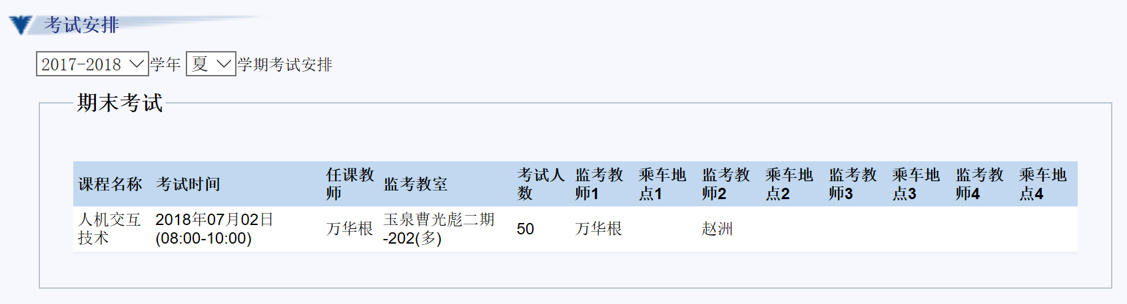

Slide 63
Thank you.

