Slide 1
Telco Customer
7,043
26.5%
Churn Analysis
Total customers
Overall churn rate
End-to-End Data Analytics
Portfolio Project
Domain
Telecommunications
1,869
$1.45M
Tool
Python · Pandas · Matplotlib · Seaborn
Dataset
7,043 customers × 21 features
Churned customers
Annual revenue at risk
Target
Churn (Yes / No)
IBM Telco Customer Churn Dataset | Class balance: 73.5% No / 26.5% Yes

Slide 2
Contents
Business Problem Statement
Dataset Overview & Data Cleaning
01
02
Why churn matters and what we set out to answer
7,043 records, 21 features, 4 cleaning steps
Exploratory Data Analysis
Key Findings & Insights
03
04
6 charts: distributions, patterns, correlations
Top risk segments, numeric comparisons
Business Case — Retention ROI
Recommendations
05
06
Unit economics & 5 retention scenarios
4 targeted, data-backed interventions

Slide 3
01 Business Problem Statement
The Problem
Analytical Objectives
A telecom company loses customers every month. Each churned customer means:
Identify WHO is most likely to churn (high-risk segments)
Understand WHY they churn — key behavioural drivers
Quantify the revenue at risk in exact dollar terms
Build a financial business case for a retention programme
Recommend targeted, data-backed intervention strategies
Lost monthly recurring revenue (avg $64.80/mo)
High replacement cost to acquire a new customer (~$324)
Forfeited lifetime value of the relationship
Potential negative word-of-mouth to other customers
Permanent market share loss to competitors

Slide 4
02 Dataset Overview & Data Cleaning
7,043
21
1,869
26.5%
11
Total Customers
Features
Churned
Churn Rate
Rows Dropped
Key Feature Categories
Data Cleaning Steps
Category | Columns
Demographics | gender, SeniorCitizen, Partner, Dependents
Account | tenure, Contract, PaymentMethod, PaperlessBilling
Services | PhoneService, InternetService, Security, TechSupport, Streaming
Financials | MonthlyCharges, TotalCharges
Target | Churn (Yes / No)
TotalCharges type fix
1
Stored as string due to blank values for new customers. Fixed with pd.to_numeric(errors='coerce').
2
Missing value removal
11 rows (tenure=0) dropped via dropna(). Data loss = 0.16% — negligible.
3
Outlier check (IQR)
1.5×IQR fence applied to MonthlyCharges. Result: 0 outliers. No capping needed.
4
Feature engineering
ChurnBin (0/1) and TenureBand cohort column created for analysis.

Slide 5
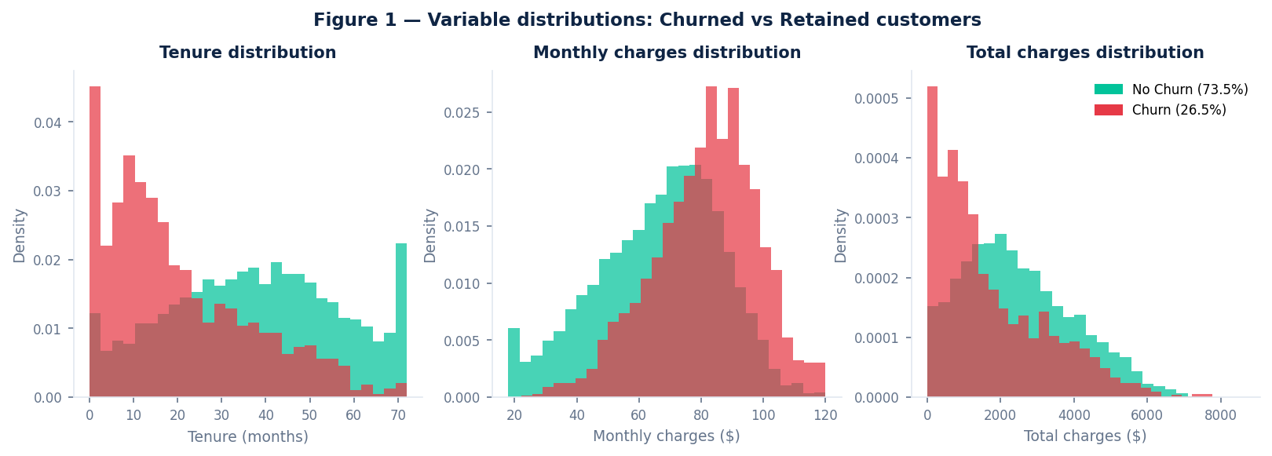
03 EDA — Variable Distributions
Density histograms compare churned vs retained. density=True normalises both groups to the same y-scale despite unequal sizes (1,869 churned vs 5,174 retained).
Tenure (left)
Monthly Charges (middle)
Total Charges (right)
Red bars pile up at 0-20 months — churners are new customers. Green bars spread across all tenure. Long-tenure customers almost never leave.
Red bars lean toward higher $. Churned avg: $74.4/mo vs $61.3/mo retained. Higher bills = value perception pressure.
Retained customers have higher totals — mainly because they stayed longer. TotalCharges is largely a proxy for tenure.

Slide 6
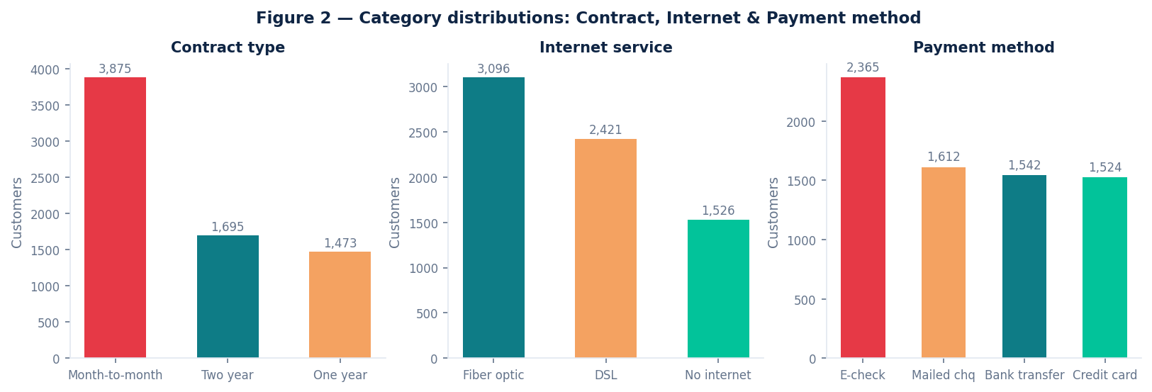
03 EDA — Category Distributions
Before measuring churn rates, we need sample composition. These charts count customers per category — essential context for interpreting any segment-level rates.
Contract type
Internet service
Payment method
Month-to-month dominates: 3,875 customers (55%). Most of the base has zero switching cost — they can leave any month.
Fiber optic is largest: 3,096 customers (44%). Critical because fiber optic has one of the highest churn rates (41.9%).
Electronic check is most popular: 2,365 (34%). This is also the highest-churn payment method — a large, dangerous overlap.

Slide 7
03 EDA — Churn Patterns by Segment
Key Takeaway #1 15× gap between month-to-month (42.7%) and two-year (2.8%) contracts. Contract type is the single biggest lever. Key Takeaway #2 Churn drops from 47.7% (0-12 mo) → 6.6% (49-72 mo). If a customer survives year one, they are almost certainly yours forever.

Slide 8
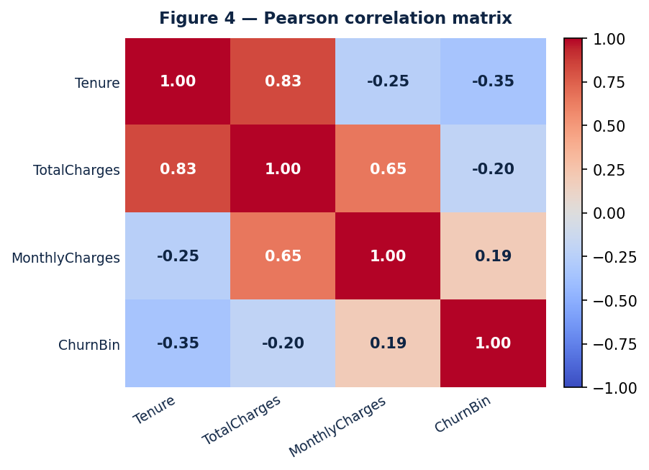
03 EDA — Correlation Matrix
Pearson correlation: values from -1 to +1. Near -1 = inverse relationship. Near +1 = direct relationship. ChurnBin included to directly show which features predict churn.
Interpretation
Feature pair | r value | What it means
Tenure → Churn | -0.354 | Strongest signal. More months = much lower churn.
TotalCharges → Churn | -0.199 | Negative because high spend = stayed long (proxy for tenure).
MonthlyCharges → Churn | +0.193 | Higher bill = slight churn signal. Value perception gap.
Tenure → TotalCharges | +0.825 | Very strong — total charges is mostly tenure × rate.
Tenure (r = -0.354)
Strongest predictor. Higher tenure = much lower churn. Tenure is the most protective factor the company can nurture.
MonthlyCharges (+0.193)
Paying more per month = slightly more likely to churn. Customers feel the cost but may not perceive matching value.
TotalCharges (-0.199)
Negative — but it's mainly a proxy for tenure. Longer-stay = more cumulative spend. Not an independent signal.

Slide 9
04 Key Findings — Churn Risk Factors
47.7%
Tenure < 12 months
45.3%
Electronic check
42.7%
Month-to-month
Segment | Churn Rate | vs Baseline | Risk
Tenure < 12 months | 47.7% | +21.2pp | CRITICAL
Electronic check | 45.3% | +18.8pp | CRITICAL
Month-to-month | 42.7% | +16.2pp | HIGH
Fiber optic internet | 41.9% | +15.4pp | HIGH
Two-year contract | 2.8% | -23.7pp | VERY LOW

Slide 10
04 Key Findings — Churned vs Retained
⏱
💳
📊
Average Tenure
Monthly Charges
Total Charges
CHURNED
CHURNED
CHURNED
18.0 months
$74.4 / mo
$1,532
RETAINED
RETAINED
RETAINED
37.7 months
$61.3 / mo
$2,556
Diff: -19.7 months
Diff: +$13.1 / month
Diff: -$1,024 lifetime
Churned customers pay MORE per month but stay LESS — the classic value perception gap. They never reached the total charges level of loyal customers.

Slide 11
05 Business Case — Unit Economics
$64.80
1,869
$324
$32
Avg monthly revenue / customer
Total churned customers
Cost to ACQUIRE 1 customer
Cost to RETAIN 1 customer
THE 10× RULE
Acquiring a new customer costs $324 (5× avg monthly). Retaining an existing one costs only $32 (0.5× monthly). That is a 10× cost difference — every retained customer generates revenue recovery at 10× the efficiency of finding a replacement.
$1,454,124
Annual revenue at risk
(1,869 churners × $64.80 × 12 months)

Slide 12
05 Business Case — Retention ROI Scenarios
Scenario breakdown
% | Saved | Net Value
5% | 93 | $101K
10% | 187 | $202K
15% | 280 | $304K
20% | 374 | $405K
25% | 467 | $506K
ROI Formula
revenue_saved = retained × $64.80 × 12
cost_to_retain = retained × $64.80 × 0.5
net = revenue_saved − cost_to_retain
Bottom Line Annual revenue at risk: $1.45M. Retaining just 15% of churners saves $303K net/year at a 10:1 cost ratio vs acquisition. The case for a retention programme is unambiguous.

Slide 13
06 Recommendations
Four targeted interventions — each grounded in a specific finding from the EDA, prioritised by estimated impact.
Convert Month-to-Month to Annual
Onboarding Loyalty Programme
Target: month-to-month customers, tenure 12-24 months
Target: all customers in first 12 months (47.7% churn)
01
02
Action: 10-15% discount to upgrade to annual plans
Action: check-ins at month 3 & 6, loyalty credits or add-ons
Why: 15x churn rate gap vs two-year contracts — highest ROI lever
Why: surviving year one halves churn risk from 47.7% to 24.9%
Fiber Optic Value Communication
Electronic Check Auto-Pay Migration
Target: 3,096 fiber optic customers (41.9% churn rate)
Target: 2,365 electronic check users (45.3% churn)
03
04
Action: dedicated support channel, transparent billing
Action: $5/mo discount to switch to auto-pay
Why: premium price + high churn = perceived value gap
Why: lowest cost intervention, removes disengagement signal

Slide 14
Summary
Key takeaways from the analysis
Tech Stack
26.5% of customers churn — 1 in 4 leaves every period, putting $1.45M at risk annually
Month-to-month (42.7%) vs two-year (2.8%) contracts = 15× gap — contract conversion is the #1 lever
First 12 months = critical window — 47.7% churn drops to 6.6% by year four
Tenure (r = -0.354) is the strongest predictor — protecting new customers is the most impactful strategy
Retention is 10× cheaper than acquisition ($32 vs $324) — ROI case is unambiguous
4 interventions address all 5 risk segments: contract upgrade, onboarding, fiber comms, auto-pay
Python 3.11
Pandas
NumPy
Matplotlib
Seaborn
Jupyter Notebook
Data Analytics Portfolio Project | IBM Telco Churn Dataset | 7,043 customers

