Slide 1



Maven
View in Power BI
Last data refresh:
7/30/2021 7:35:55 PM UTC
Downloaded at:
7/30/2021 7:37:43 PM UTC

Slide 2
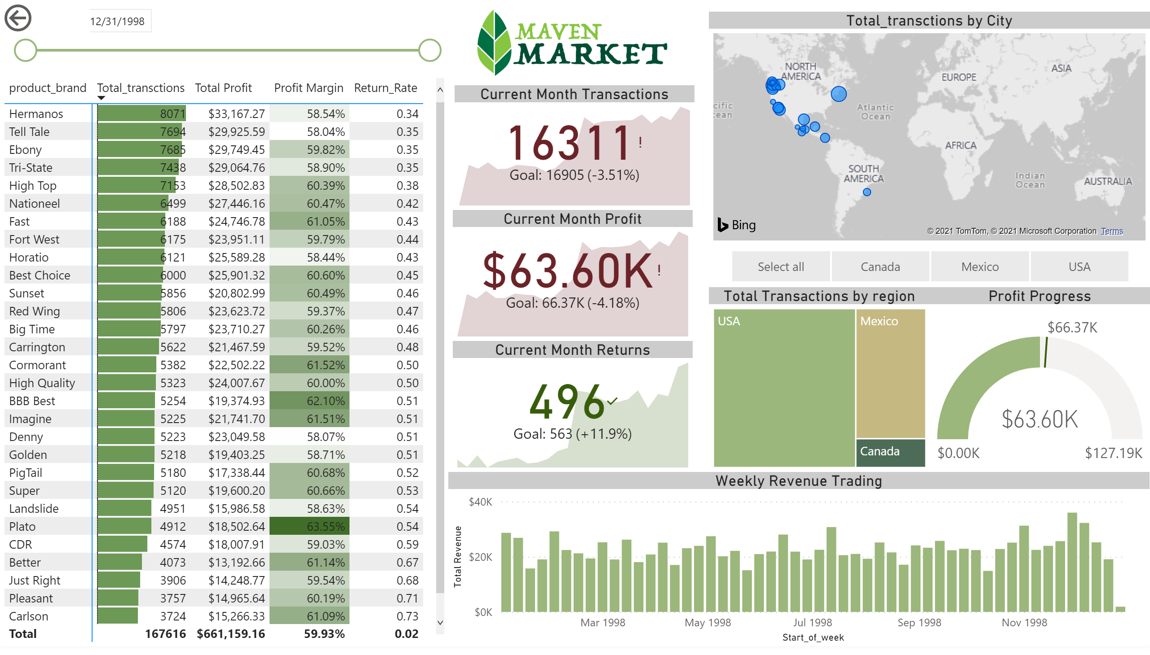
topline performance
Notes:
image
No alt text provided.
pivotTable
No alt text provided.
Current Month Transactions
No alt text provided.
Current Month Returns
No alt text provided.
Current Month Profit
No alt text provided.
map
No alt text provided.
slicer
No alt text provided.
Total Transactions by region
No alt text provided.
Weekly Revenue Trading
No alt text provided.
Profit Progress
No alt text provided.
slicer
No alt text provided.
actionButton
No alt text provided.

