Slide 1
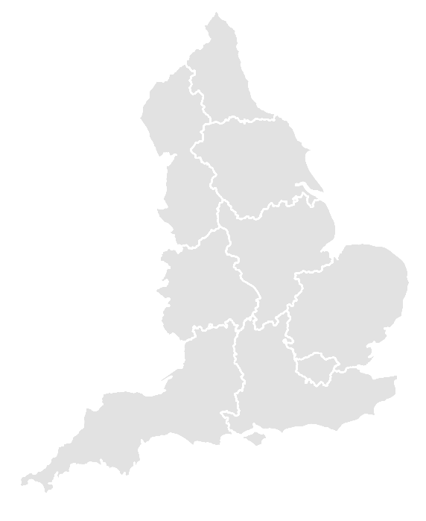
North
East
Yorkshire
and H.
North
West
East
Midlands
West
Midlands
East of
England
London
South West
South East
Notes:
North East
North West
Yorkshire and H.
East Midlands
West Midlands
East of England
London
South East
South West

