Slide 1
TRNLTK
Turkish Natural Language Toolkit

Slide 2
Overview
Natural language processing
From Wikipedia: “... a field of computer science (…) concerned with the interactions between computers and human (natural) languages.”
Natural language toolkit : nltk.org
“Suite of libraries and programs (...) for NLP”
Functionality to make use of speech/text data by investigating semantics, morphology, etc.

Slide 3
NLP Possibilities
Easy
Spell checker
...
Hard
Grammar checker
Synonym & antonym detection
Very hard
Machine translation
Named entity recognition
Plagiarism detection
...
Part of speech tagging
...

Slide 4
Some properties of Turkish
Need to parse words morphologically
Agglutination
ev : (the) house
eviniz : your house
evinizde : at your house
evinizdeyim : I am at your house
Vowel harmony : front/back and rounding harmonies
masa-da : on the table (masa+Singular+Locative)
pencere-de : on the window (pencere+Singular+Locative)
batı-nın : west’s (batı+Singular+Genitive)
doğu-nun : east’s (doğu+Singular+Genitive)
Voicing, devoicing:
talep : the request
talep+im → talebim : my request
kitap : (the) book
kitap+da → kitapta : in the book
Lack of grammatical gender
Pronoun “o” = “he/she/it”
Word order
Ben okula gittim : I went to school
Okula ben gittim : It is me who went to school
Less common, but following are also possible and used in literature and daily life
Gittim ben okula
Ben gittim okula
...
Makes morphological parsing harder
This makes things a little bit easier!
Part-of-speech tagging is very hard!

Slide 5
Possibilities Revisited - Turkish
Spell checker: A dictionary based solution doesn’t work. Cannot store all possible Turkish words in advance
Grammar checker : Wordering makes it harder
Machine translation : A direct-statistical approach doesn’t work (unless you’re Google and have the text of billions of books)
Too many unique tokens
Corpus size | Vocabulary size
 | English | Turkish
1 Million words | 34K | 110K
10 Million words | 100K | 420K
Much larger vocabulary.
It grows faster too!
Turkish NLP needs a different approach! → TRNLTK

Slide 6
Most Basic Operation in NLP for Turkish: Morphological Parsing
Why needed?
Phrases represented in multiple words in other languages might be only one word in Turkish → Machine translation is not possible w/o it
Too many unique “tokens” → Can’t implement even a simple spell checker w/o it
Knowledge must be enormous → Part of speech tagging is not really possible w/o it
siyah arabaya : to the black car
siyah arabada : in the black car
To determine “siyah” is an adjective, we need to find relations. This relation has to defined with the stem, “araba”; not the forms with suffixes “arabada” and “arabaya”
...

Slide 7
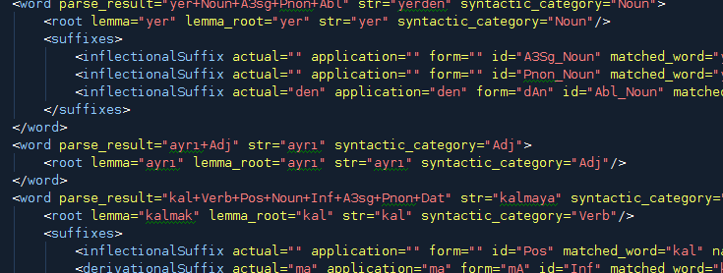
TRNLTK
Context Independent Operations
Tokenizing
Morphologic parsing
Context Dependent Operations
Tokenizing
Morphologic parsing
Part of speech tagging
...

Slide 8
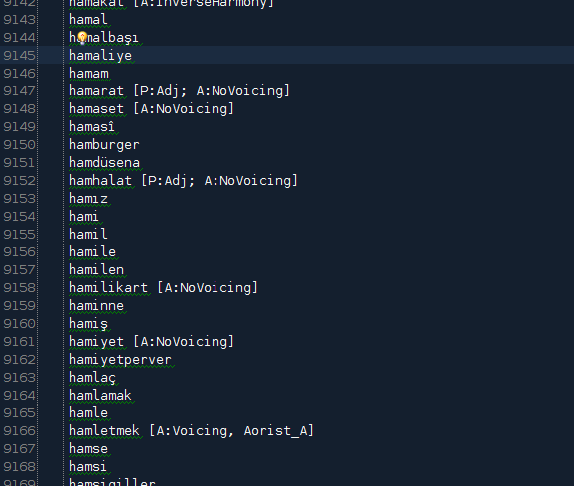
PART I
Context Independent Operations

Slide 9
Context Independent Operations
Context is ignored
No statistics etc. is used to check previous knowledge on the similar situations, only rule based
Ambiguity is not tried to be solved –yet –
Operations:
Context independent tokenizing
Context independent morphologic parsing
Rule based part-of-speech tagging

Slide 10
Context free tokenizing
Tokenize text to sentences
Tokenize sentences to words
Rule-based : does not check previous knowledge in a case of ambiguity
Daha sonra birçok gezgin ve bilim insanı bu bölgeye gelerek araştırmalar yapmış ve bu araştırmalar çeşitli kaynaklarda yayımlanmıştı.
Daha
Daha sonra birçok gezgin ve bilim insanı bu bölgeye gelerek araştırmalar yapmış ve bu araştırmalar çeşitli kaynaklarda yayımlanmıştı. Bu araştırmalar sonucunda elde edilen buluntular, o dönemde Osmanlı İmparatorluğu’nun başkenti İstanbul’da yeni kurulan “Müze-i Hümayun” a getiriliyordu
sonra
birçok
Bu araştırmalar sonucunda elde edilen buluntular, o dönemde Osmanlı İmparatorluğu’nun başkenti İstanbul’da yeni kurulan “Müze-i Hümayun” a getiriliyordu
gezgin
...

Slide 11
Turkish – An Agglutinative Language
Like other Turkic languages
Example:
Turkish | English
ev | (the) house
evler | (the) houses
evim | my house
evimde | in my house
evimdeydi | (it) was in my house
evimdeyse | if (it) is in my house
A more complicated example:
“Karnıyarık Türkmutfağı nın vazgeçilmezlerindendir.”
“Karnıyarık* is one of the indispensibles of Turkish kitchen.”
vazgeç-il-mez-leri-nden-dir
abandon/give_up+ Passive + Aorist_Negative + Plural + One_Of + Copula(is/are)

Slide 12
Context Free Morphologic Parsing
Parsing the given words without the context
Finding all morphologic possibilities for a given word
These possibilities later will be evaluated within the context of the word
>>> from trnltk.playground import playground
>>> playground.parse_context_free('masadan')
masa(masa)+Noun+A3sg+Pnon+Abl(dAn[dan])
>>> playground.parse_context_free('derim')
de(demek)+Verb+Pos+Aor(+Ar[r])+A1sg(+Im[im])
deri(deri)+Noun+A3sg+P1sg(+Im[m])+Nom
from the table
I say
my skin
A3sg: 3rd singular person/number agreement
Pnon: Possession agreement “None”
Abl : Ablative noun case agreement
Pos: Positive verb polarity
Aor : Aorist tense
P1sg: 1st singular person possession agreement
Nom: Nominative noun case agreement

Slide 13
Context Free Parsing : Approach#1
A normalized suffix graph with rules for succession of each suffix
e.g. “Suffix Y can follow suffix X”
Too many nodes (~300) and edges (~10000)
Hard to maintain, hard to have an overview of the graph
Better support for exceptional cases at the cost of difficulty in maintenance

Slide 14
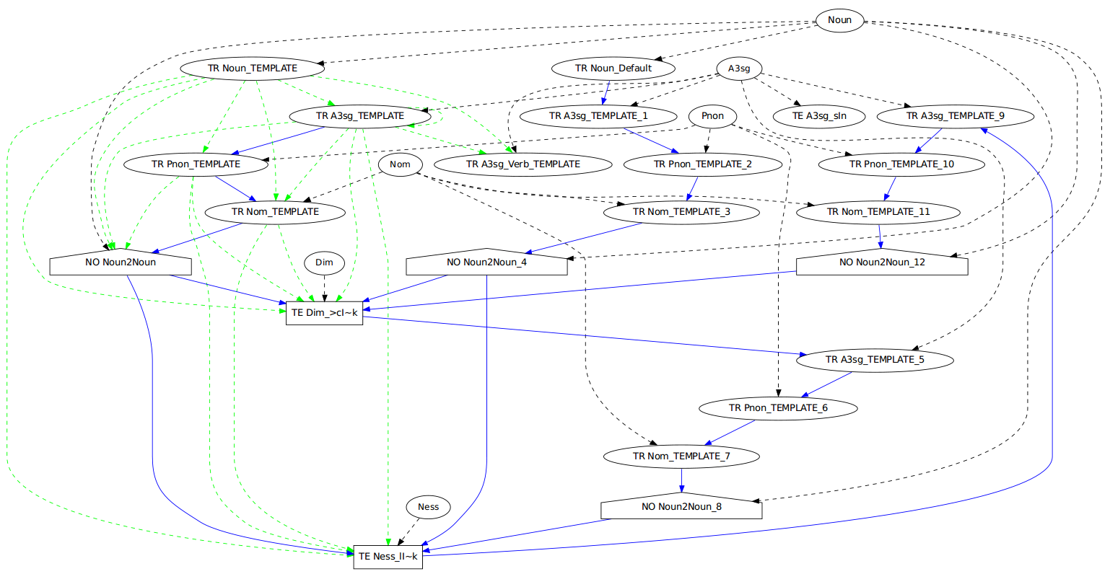
Approach#1 : A trimmed graph with 5 suffixes

Slide 15
Context Free Parsing : Approach#2
Approach used in TRNLTK
A semi-normalized suffix graph with rules for edges that go out from a syntactic category
E.g. “Suffix X can be applied to Nouns” or “Suffix Y can apply to singular Nouns which don’t have possession yet”
Merging the transfer states of the previous Approach#1 in a logical way
Less nodes (~50), less edges (~150)
Harder to support exceptional cases
e.g. : Suffix –sız works with singular nouns:
“vicdansız” works, but “vicdanlarsız” doesn’t

Slide 16
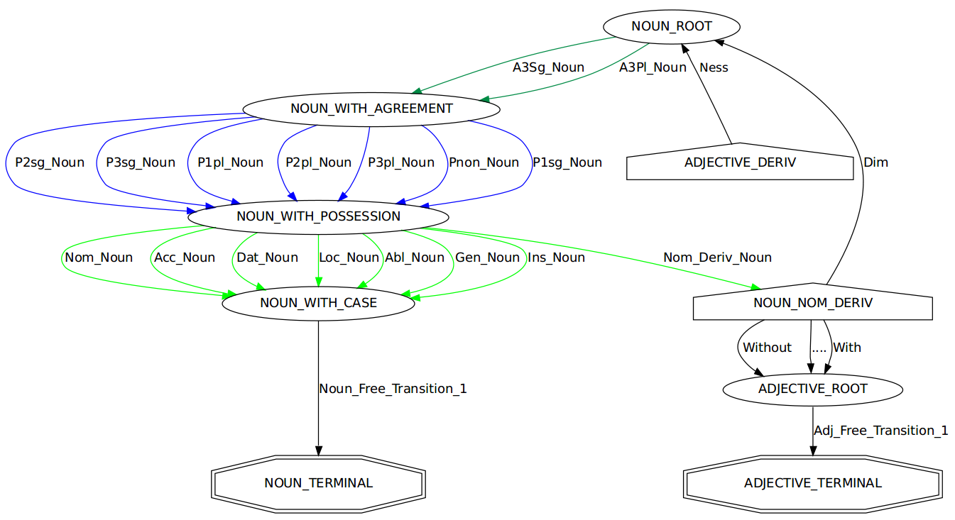
Approach#2 : A trimmed graph with ~20 suffixes

Slide 17
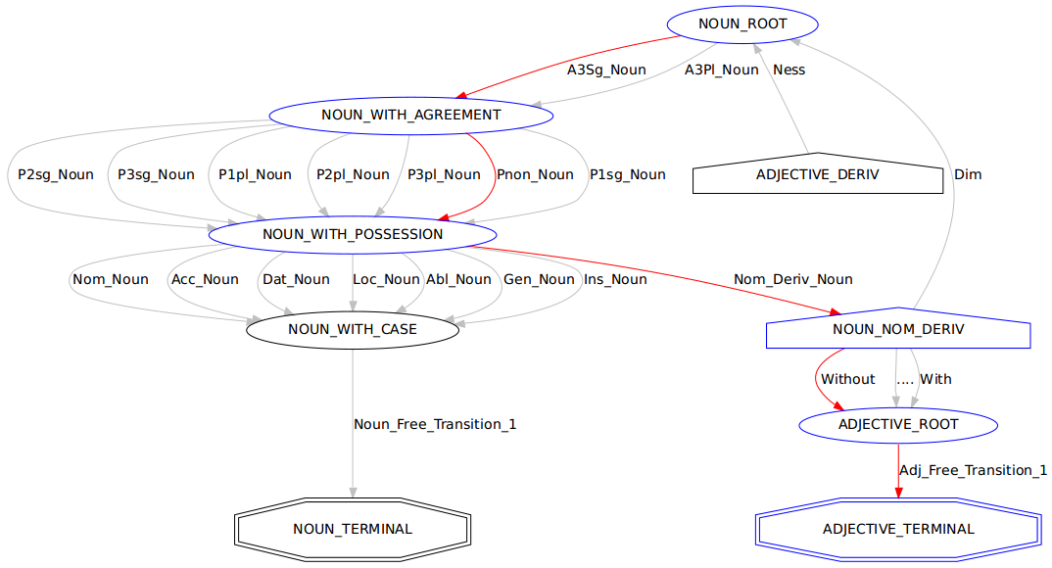
Graph traversal for word : “vicdansız”
vicdan:Noun
-sız → Adjective

Slide 18
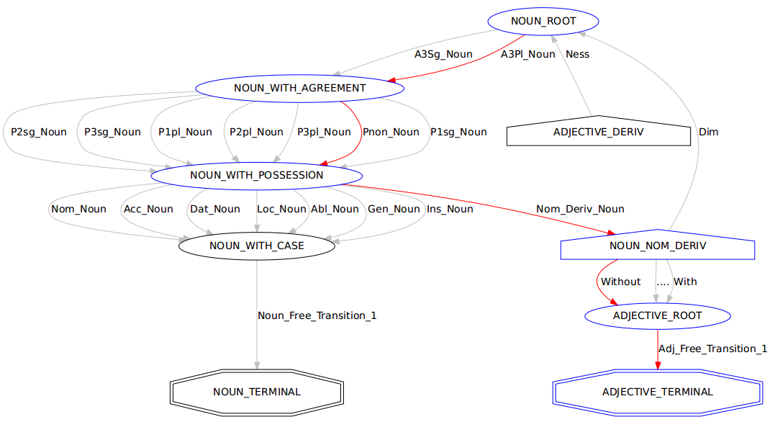
Graph traversal for word : “vicdanlarsız”
vicdan:Noun
-lar
-sız → Adjective

Slide 19
Graph traversing for word : “vicdanlarsız”
The parse shown in previous slide should NOT work
TRNLTK solution: rules for suffixes
Traversal for “vicdanlarsız” is stopped, because of the rule of the suffix “-sız” (Without)
self.NOUN_NOM_DERIV.add_out_suffix(self.Without, self.ADJECTIVE_ROOT)
self.Without.add_suffix_form(u"sIz", doesnt_come_after(self.A3Pl_Noun))
Matchers, using Specification Design Pattern
More of them:
comes_after(someSuffix)
doesnt_come_after_derivation(someSuffix)
has_root_attribute(someAttribute)
applies_to_root(someWordRoot)
Could be combined, etc. Support for “and”, “or”, “negation” operations
comes_after(someSuffix) | comes_after(someOtherSuffix)
~applies_to_root(someWordRoot) & ~applies_to_root(someOtherWordRoot)

Slide 20
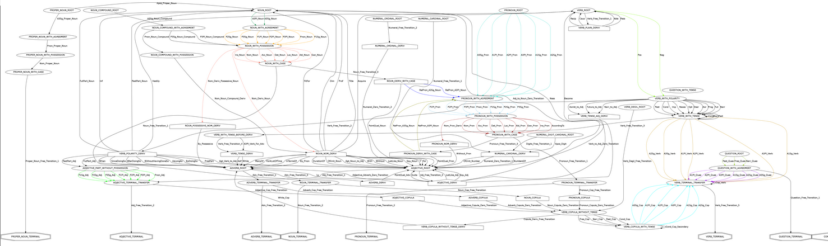
Complete suffix graph
https://raw.github.com/aliok/trnltk/master/suffixGraphExtended_20121010.png

Slide 21
Some numbers
Some numbers when TRNLTK contextless morphological parser is run on METU-Sabanci annotated corpus (~60000 words):
For 89% of the words, tagged parse result is given among the possible parse results
Average time to find the possible parse results for a word : 12 ms
Fast enough : would take 3.3 hours to parse a 1M word corpus

Slide 22
Implementation
Annotated dictionary :
No derived words in it
Words tagged with syntactic categories except nouns and verbs (verbs are in infinitive forms and can be recognized)
Words tagged with exceptions (e.g. no vowel harmony)
A little bit scary : 24% of 25000 entries has tags
Orthographics engine : handles voicing, vowel harmony etc
Morphotactics engine : checks the conditions for suffixes
Traversing engine : Goes over the FSM by using tools above
Numerals : a digit-to-text converter is implemented
1990’da : in 1990 ←→ 1991’de : in 1991
Same suffix, but because of vowel harmony, applied form is different → Need to find the last vowel
Checking only the last digit won’t work : last digits of 100 and 1000 are same, but last vowel is different

Slide 23
Implementation (cont'd)
Predefined paths for exceptional words
Prepare partially traversed paths for some words
When that word is seen, start from the last point of the prepared path
Needed for pronouns and words “to eat” and “to say”
Proper nouns : can’t really recognize them easily
Mark a word as a proper noun when an apostrophe is used : most of the time they have no suffixes → Not perfect
Mark a word as a proper noun if it starts with a capital letter → Other word types can be like that in the beginning of a sentence → Not good
Can’t be done without context (a better approach is described later)
Same problems with acronyms as proper nouns
ABD’de : in USA ←→ EMU’da : in EMU (European Monetary Union) →vowel harmony, find the last vowel

Slide 24
Part II

Slide 25
Tokenizing
“RNA (Ribonükleik asit) bir polimerdir.”
“Müze-i Hümayun’a konuldu.”
“Ali bana ‘Ben gelmiyorum.’ dedi.”
“Bu işleme ‘fotosentez’ denir.”
“Bu zincirin kesilmesine neden olabilir [Mikkola, s75].”
“N’apıyorsun?”

Slide 26
Problem with context independency : Ambiguity
Ambiguity
Agglutination creates ambiguity
leaf+es : leaves ←→ leave+s : leaves
derim : “de”+Positive+Aorist+A1sg → “I say”
derim : “deri”+P1sg → “my skin”
Some of the ambiguity types:
Polysemies:
My head←→ Head chief
Yakacak odun : “wood to burn” →Adjective
Roma’yı yakacak : “(He/she/it) will burn Rome” →Verb
Homographs:
Grizzly bear ←→ Bear in mind
Denizde yüz : “swim in the sea”
Yüz kişi : “hundred people”
Syntactic ambiguity : “I’m going to sleep.”
I am (now) falling asleep
I am leaving (this event) to (go and) sleep
Main problem since Turkish is an agglutinative language
Different syntactic categories for the same surfaces of a lexeme
Not in scope -yet-

Slide 27
Nasil karar verilecek dogru parse result’a?
1) Context kontrol edilecek
2) Mesela, kelime daha once sifat olarak kullanilmis mi?
3) Syntactic kategoriye gore rule based + statistical birsey : sifatlar isimlerden once gelirler
4) Kelime, bir onceki kelimenin bir ekinden (ya da sonraki) kullanilmis mi? –e kadar, -den beri
5) Yukaridakinin tersi (gelen ekin sonraki kelime ile birlikte kullanilma ihtimali) –e kadar, -den beri
6) ??? Verb’in accusative olmasi durumu mesela. Cumleyi komple gozden gecirip, fiile bak. Eger fiil accusative ise, ve baska “nesne” yoksa, buyuk ihtimalle bizim kelime objedir. Tabi eger Acc eki almissa. 4 ve 5’ in onceki veya sonraki kelime degil de, cumleye komple bakan hali

Slide 28
Context kontrol etme:
Onceki kelime ile iliski (onceki kelime parse edilmemisken, bizim kelimenin formlari ne kadar kullanilmis?)
Sonraki kelimeyi de dahil edip goster
Onceki kelimenin parse result’i biliniyorsa
Onceki kelimenin formlari ile bizim kelimenin formlari ne kadar kullanilmis
Sonraki kelimeyi de dahil edip goster
Matrisler falan, 9 parametre falan

Slide 29
Context Checking
Word “yaz”
“to write” and “summer” : homograph (also homonym -> pronunciation is also the same)
Surface “yazdı”
“(he/she/it) wrote” and “(it) was summer”
Parse results for “yazdı”
yaz+Verb+Past+A3sg
yaz+Noun+..+Verb+Past+A3sg
How to determine?

Slide 30
Context Checking
Answer (one of the answers) : Check context
Context: leading and following words
Context example with one leading word
“deftere yazdı” : “(he/she/it) wrote to the notebook”
“sıcak yazdı” : “(it) was (a) hot summer”
New question : “What is the correct parse result among possible ones, when the previous word is ‘deftere’ ?”

Slide 31
Answer :
Find in previous knowledge: how many times “deftere” and “yaz+Verb+Past+A3sg” are used together
Find in previous knowledge: how many times “deftere” and “yaz+Noun+...+Past+A3sg” are used together
This is called “likelihood”
The parse result with more likelihood is more likely to be correct parse result
Likelihood is not a definitive answer!
There might be cases where the correct parse result has actually less likelihood!
But it is a hint. To be combined with other hints (will be described later)

Slide 32
Context checking with surface, stem and root of target
Turkish -> Agglutinative Language
“yazdı” : “(he/she/it) wrote”
“yazıyor” : “(he/she/it) is writing”
“yazacak” : “(he/she/it) will write”
The relation is between “to write” and “notebook” → Better check the stem and the root in addition to the surface
Occurrences of “deftere yazacak” is also useful for “deftere yazdı”

Slide 33
Some word form variants
Surface : full token
Stem : Last derived word
Lexeme: The simplest atomic part
Token | Surface | Stem | Lexeme
kitap+Noun | kitap+Noun | kitap+Noun | kitap+Noun
book+Noun | book+Noun | book+Noun | book+Noun
yiyebildim+Verb | yiyebildim+Verb | yiyebil+Verb | ye+Verb
I was able to eat | I was able to eat | be able to eat | eat
Lexeme and stem matters!
Occurrences of “he is able to eat” is useful for “I was able to eat” (both are single words in Turkish, as shown above)

Slide 34
Occurrences of context word + surface
Full word has occurrence with same context →A less often situation
Likelihood coefficient: 0.55
Occurrences of context word + stem
Stem of the word has occurrence with same context → Might be still rare
Likelihood coefficient: 0.30
Occurrences of context word + lexeme
Root of the word has occurrence with same context → This can happen a lot
Likelihood coefficient: 0.15
Note : word form variants are looked up in the knowledge with the syntactic category (Noun, Verb, etc) →Eliminate homonyms of stem and lexeme with different syntactic categories

Slide 35
Same situation with context!
“defterde yazdı” : “defter+Noun+..+Loc yaz+Verb+A3sg+Past”
“deftere yazdı” : “defter+Noun+...+Dat yaz+Verb+A3sg+Past”
Occurrences with word form variants of context words are also important
Occurrences of context surface + target
Very important : →coefficient = 0.60
Occurrences of context stem + target
Important : →coefficient = 0.30
Occurrences of context lexeme + target
Less important →coefficient = 0.10

Slide 36
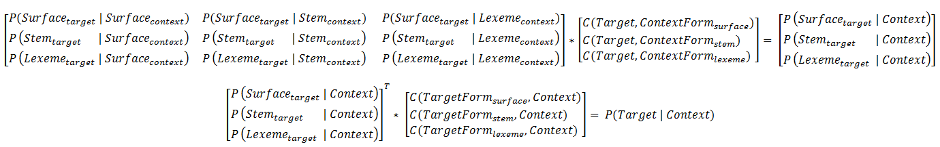



Maths...

Slide 37
Leading vs following

Slide 38
Likelihood = aL2 + bL1
a = 0.7, b = 0.3
L = aL3 + bL2 + cL1
a = 0.9, b= 0.1, c=0.05 mesela
Yoksa 2 kelimelik bile contextler cok zor bulunuyor!

Slide 39
Implementation
Mongodb
Why
Capped collections
Indexes
100Gram’i bile destekleyebilir kod!
Sadece bu context bulma islemi icin bir Ngram collection hazirlandi. Tum morpheme container (parse result)lari koymak yerine → performans
Zaman : 56000 kelime icin context bulma ne kadar zaman aliyor.
Tek yonlu (onceki veya sonraki)
Cift yonlu (onceki ve sonraki)
Onceki 1 kelimeye bakinca ne oluyor, iki kelimeye bakinca ne oluyor zaman olarak?
Sadece context bulma ile dogru parse result ne kadar oranda tutturuluyor? Sabanci treebank’taki dogru sonucu % kac oraninda alabiliyoruz?
Bu oran neden yeterli degil? Ne gibi degerli bilgileri kullanmiyoruz (henuz)?

Slide 40
Big picture

Slide 41
Advanced topics
Proper noun detection : Proper noun olarak daha once kullanilmis mi? Ya da annotated olmayan bir textte, hic cumle ortasinda buyuk harfle baslatilmis mi? Veya hic kesme ile ayrilmis mi?

Slide 42
Contact
Ali Ok (@aliok_tr)
Developer @ Innflow AG, Zurich, Switzerland
Apache MyFaces committer (not a very active one though)
Questions to aliok[AT]apache[DOT]org

