Slide 1
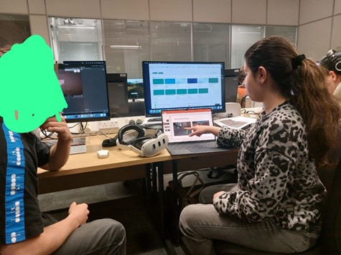

Integrating Visual AND AUDITORY CUES IN Immersive VIRTUAL REALITY TO ENHANCE SPATIAL COGNITION AND COGNITIVE PERFORMANCE
By: Basmah Arif

Slide 2

Contents
Introduction
Project Overview
Key Concepts
Environment Design
Instructions
Controls
Navigation Cues
Tasks
In-Game UI
Testing Session
Evaluation
Questionnaires

Slide 3
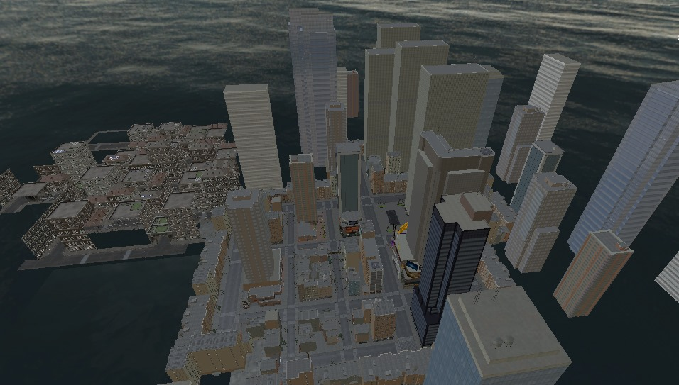
Introduction
Echoscape VR is an immersive 3D virtual reality environment designed to improve spatial cognition and memory skills.
It is a fully 3D world where users must find their way through an environment with multiple paths. It’s not a classic “maze” puzzle but it does have barriers to create realistic pathfinding challenges.

Slide 4
Project Overview
Objective: To examine how users engage with visual and auditory cues in a Virtual Reality environment to support spatial reasoning and pathfinding tasks.
Goal: To assess whether participants can effectively use the game mechanics, guided by visual and auditory cues to perform cognitive tasks such as locating objects, choosing correct paths and making spatial decisions.

Slide 5
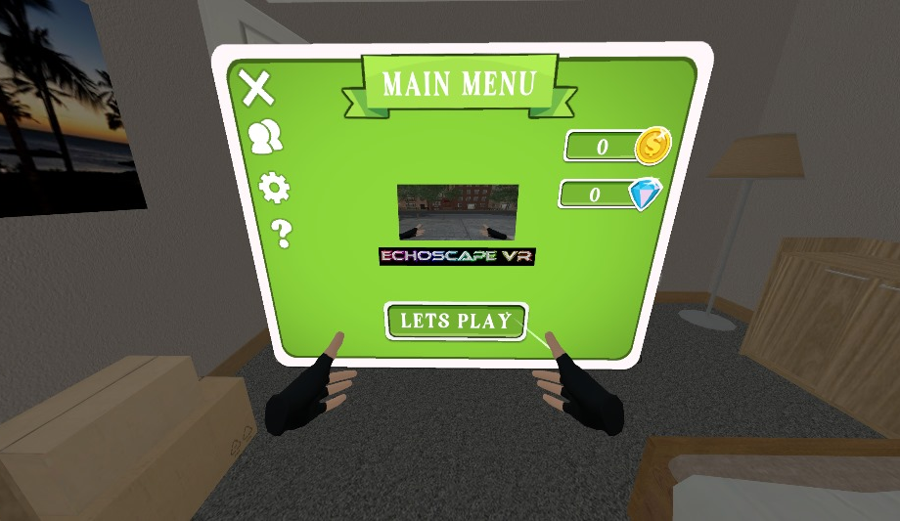
Key Concepts
Spatial Cognition: Your ability to perceive and navigate space.
Cognitive Performance: How well your brain performs tasks such as attention, memory and decision-making.
Immersive VR: A 3D environment that fully surrounds the user using a VR headset (Meta Quest 3).
Echoscape VR serves as a research platform for cognitive training, potentially helping those who struggle with pathfinding or memory by providing a safe, controlled space to practice these skills.

Slide 6
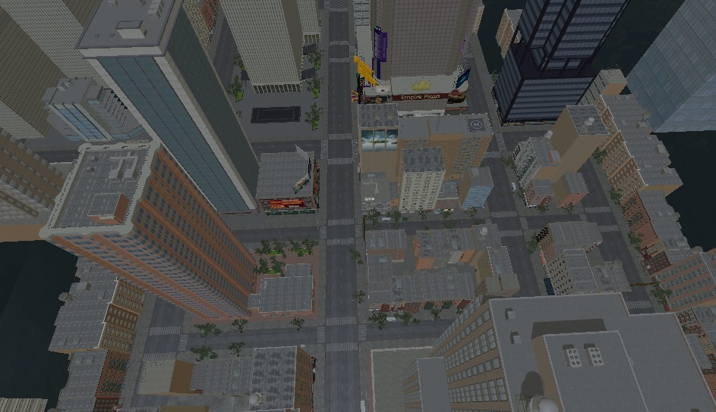
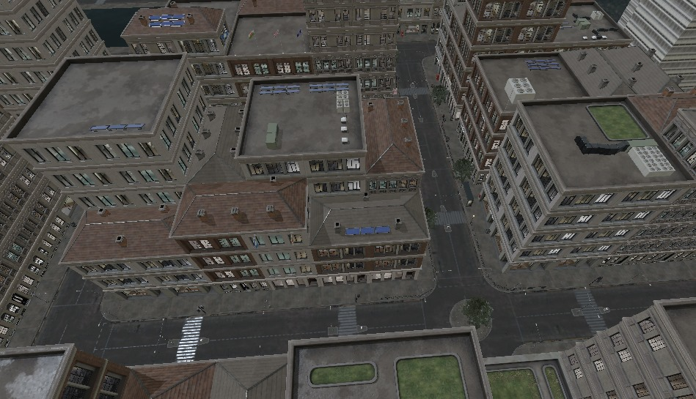
Environment Design
Think of it like a small virtual neighborhood. There are open pathways and some blocked routes, requiring the player to choose directions and remember paths. This design tests spatial awareness without being overly confusing or unfair.
No Random Labyrinth: Unlike a random maze, Echoscape VR’s layout is logical. There are clear start and end points (entrance and goal) and the paths connect in a way that makes sense. The focus is on learning the route, not on tricking the player.

Slide 7
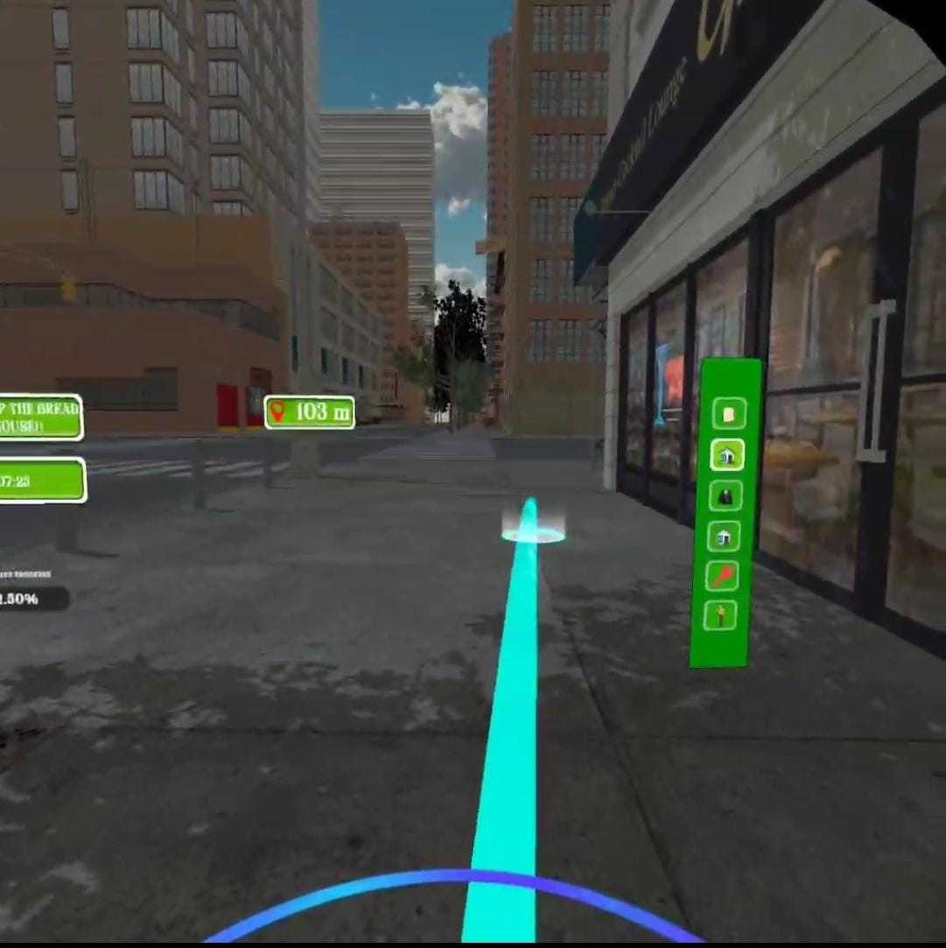
Instructions
You will wear a Meta Quest 3 headset and do pathfinding in a 3D virtual reality environment.
You’ll use joystick movement and be guided by:
Visual Cues: Color-Coded Trees
Auditory Cues: Background and Directional sounds that increases as you reach near to the objectives.
Teleporting Option: You can also use Teleporting options to save your time.
Objectives will involve reaching certain points and recognizing routes, cues, and landmarks.
The VR world lets you actually grab and carry the virtual objects (using VR controllers). Completing a task usually triggers a brief confirmation (sound or visual) so you know you did it right.

Slide 8
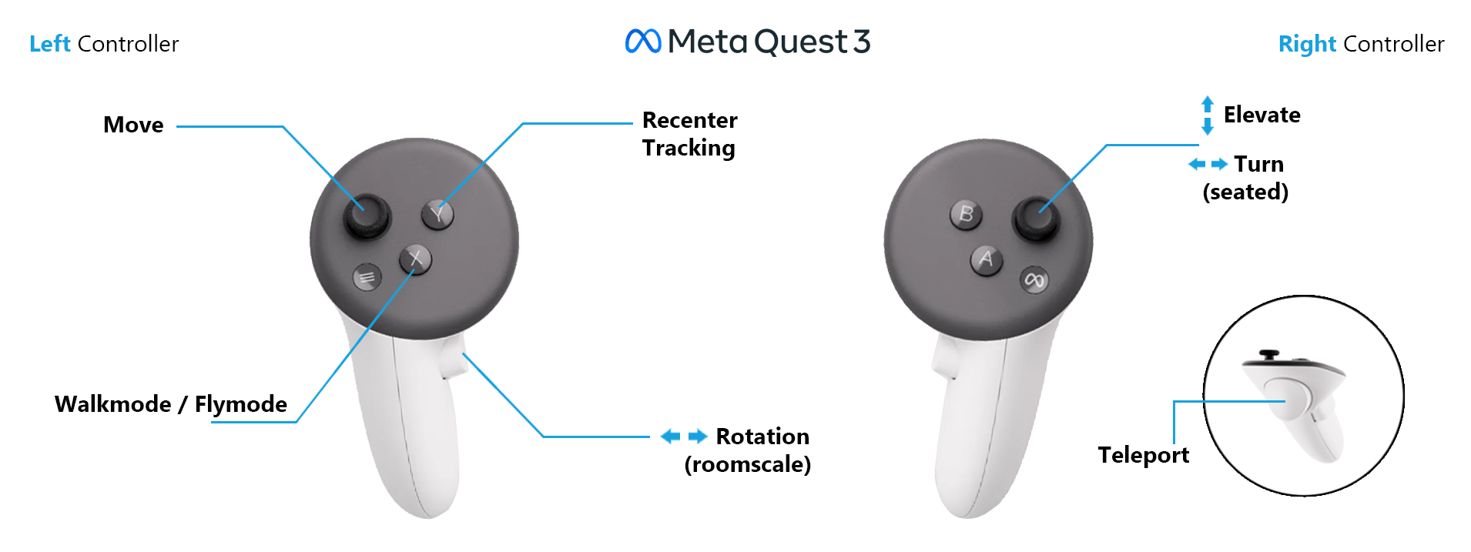
VR Controls
Hand Controllers:
Right Thumbstick for Player Movement and Turning.
Left Thumbstick for Camera Rotation. (The UI will move with the camera rotation).
Trigger Button R2 to pick up and drop objects.
Holding Button R2 + Button R3 enables Teleporting function.

Slide 9
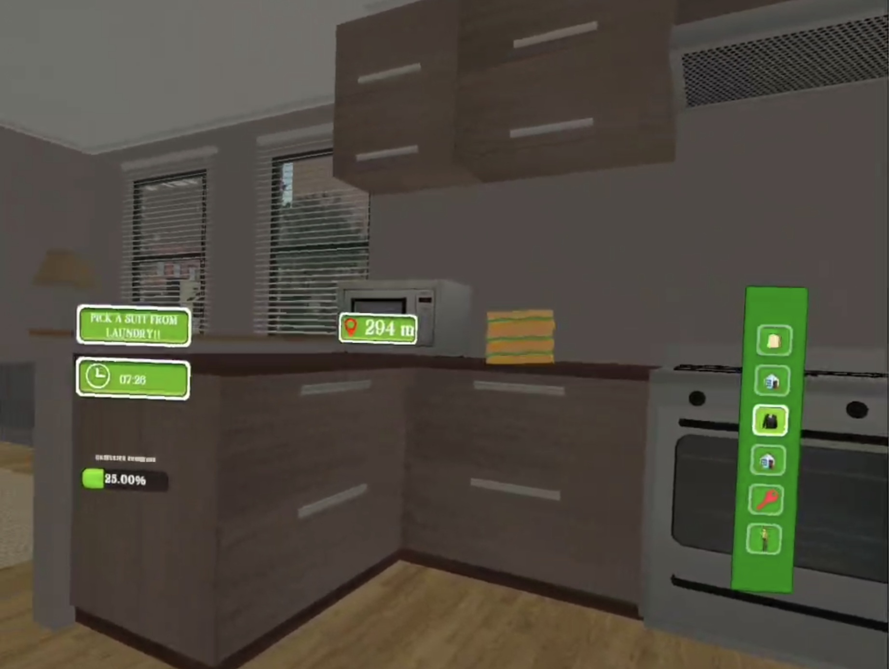
Participants’ Guide
Main Objective: Complete pickup & delivery tasks using VR controllers.
Use Cues:
Visual – Red/blue trees indicate wrong/right paths.
Audio – “Popping” sounds grow louder near objectives.
Timing:
Tasks closer = 7 minutes to complete.
Tasks farther = 10 minutes max.
Whole VR session = 15 minutes.
Feedback:
System shows task success with sound or visuals.
Warning cues for wrong paths (e.g., red trees, eerie sound).
Safety:
Can pause anytime; tutorial included before main test.

Slide 10

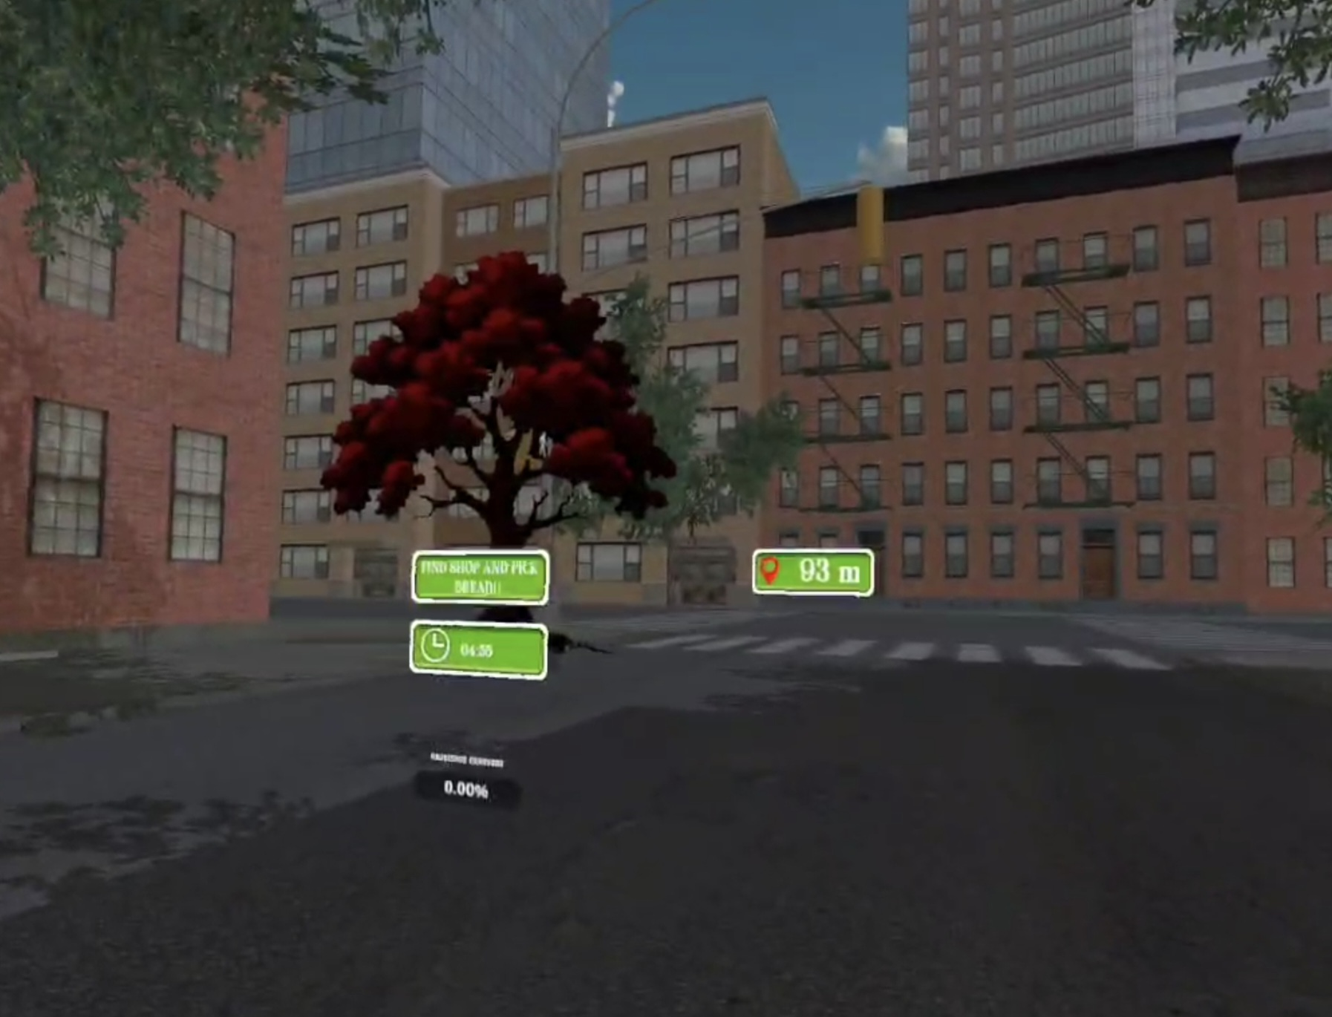
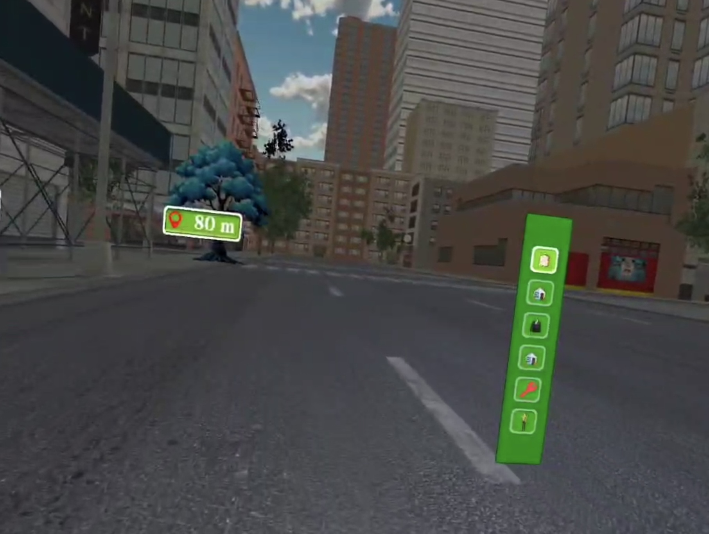
Navigation Cues – Visual and Auditory
Visual Cues: Certain trees are colored red or blue to stand out and act as markers indicating correct/wrong routes.
Auditory Cues: Players will hear a “popping” sound that gets louder or more frequent as they approach a target item. There are also ambient environmental sounds (wind or birds) that make the world feel real and can aid orientation (e.g., a water fountain sound in the distance could draw you toward that area).
Guiding Without GPS: These visual and audio cues work together to guide the player organically, without an on-screen arrow. They are designed to be noticed but not overly obvious, so the player still feels like they are discovering the path using their senses.

Slide 11
Interactive Tasks
Echoscape VR isn’t just free exploration, but it gives you missions!
There are 8 interactive tasks to complete, which involve picking up certain objects and delivering them to the correct place or person in the virtual world.
Real-Life Inspired Objectives: The tasks are everyday-type goals to make them relatable. For example, one task might be finding a loaf of bread and delivering it to a house, and another could be locating a car key and bringing it back to the car owner so it can start.
Each task has a clear start (where to pick up the item) and end location (where to drop it off).

Slide 12
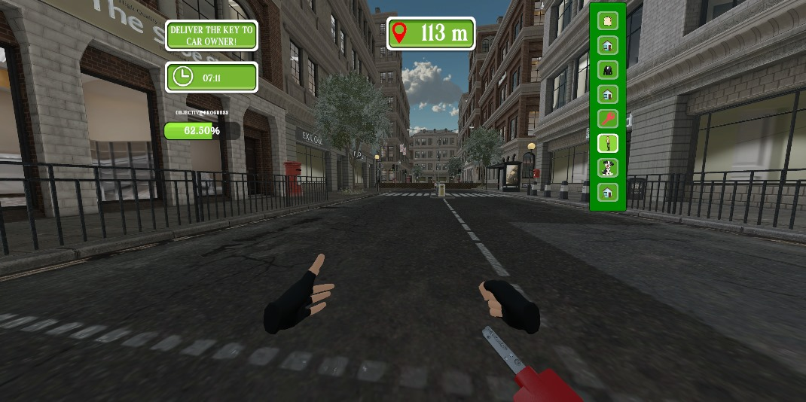
Objective Tracker & Progress UI
Heads-Up Display (HUD)
Objective List
Progress Bar
Feedback Tracker

Slide 13
Testing Session Breakdown
Introduction (2 min)
Tutorial/Presentation (3–5 min)
Pre-Questionnaire (10 min)
Break (5 min)
VR Test (15 min)
Post-Questionnaire & Quiz (10 min)

Slide 14
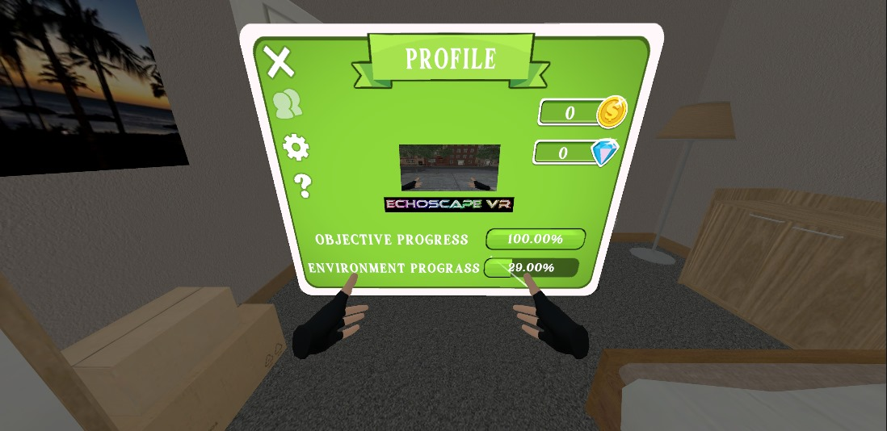
Evaluation Metrics
What is going to be Tracked:
Task Completion Time – How fast you finish each task.
Navigation Accuracy – Number of wrong turns, path deviations.
Memory Skills – Post-Quiz to test spatial recall.
User Feedback – Post-VR Questionnaire and experience ratings.
In-Game Progress Tracking UI:
Objective Progress Bar – Shows how many tasks (out of 8) were completed.
Environmental Progress Tracker – Displays how much of the environment was explored.
Purpose:
Understand how visual/sound cues affect spatial cognition.
Compare results across different player strategies and preferences.

Slide 15
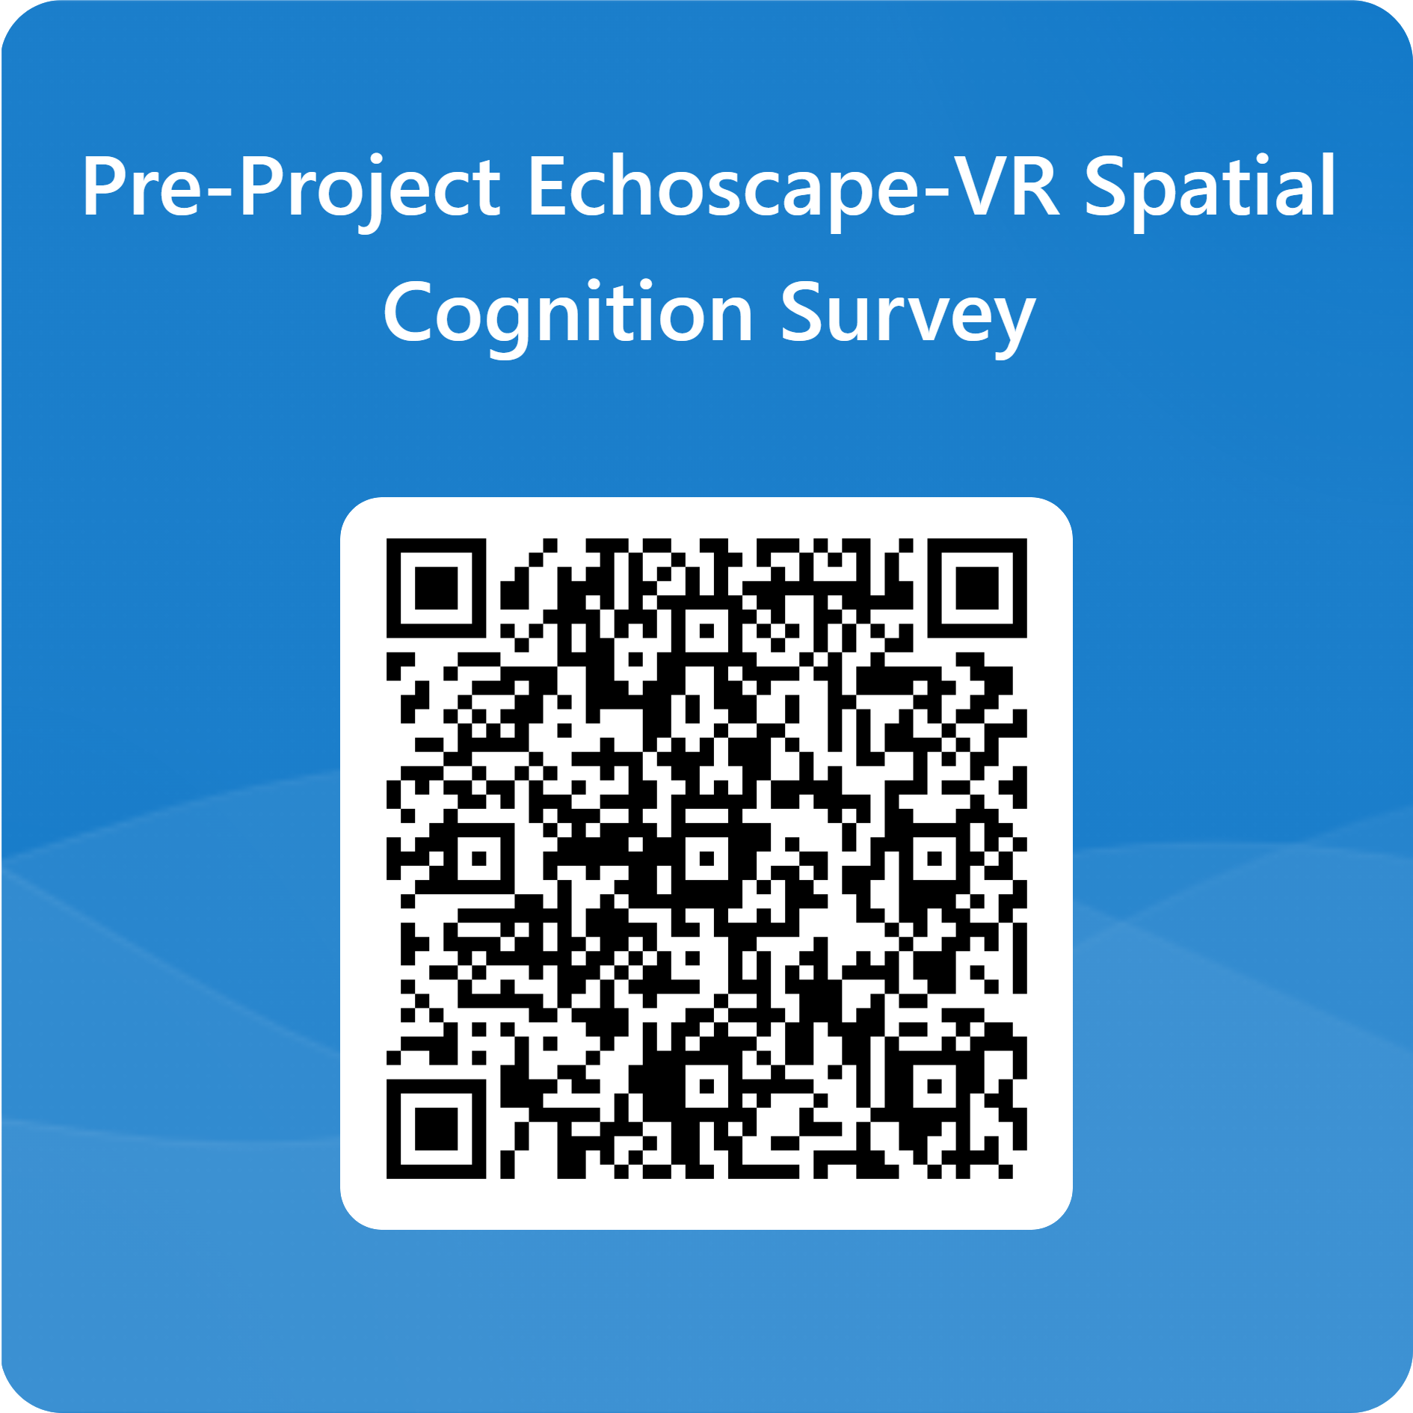
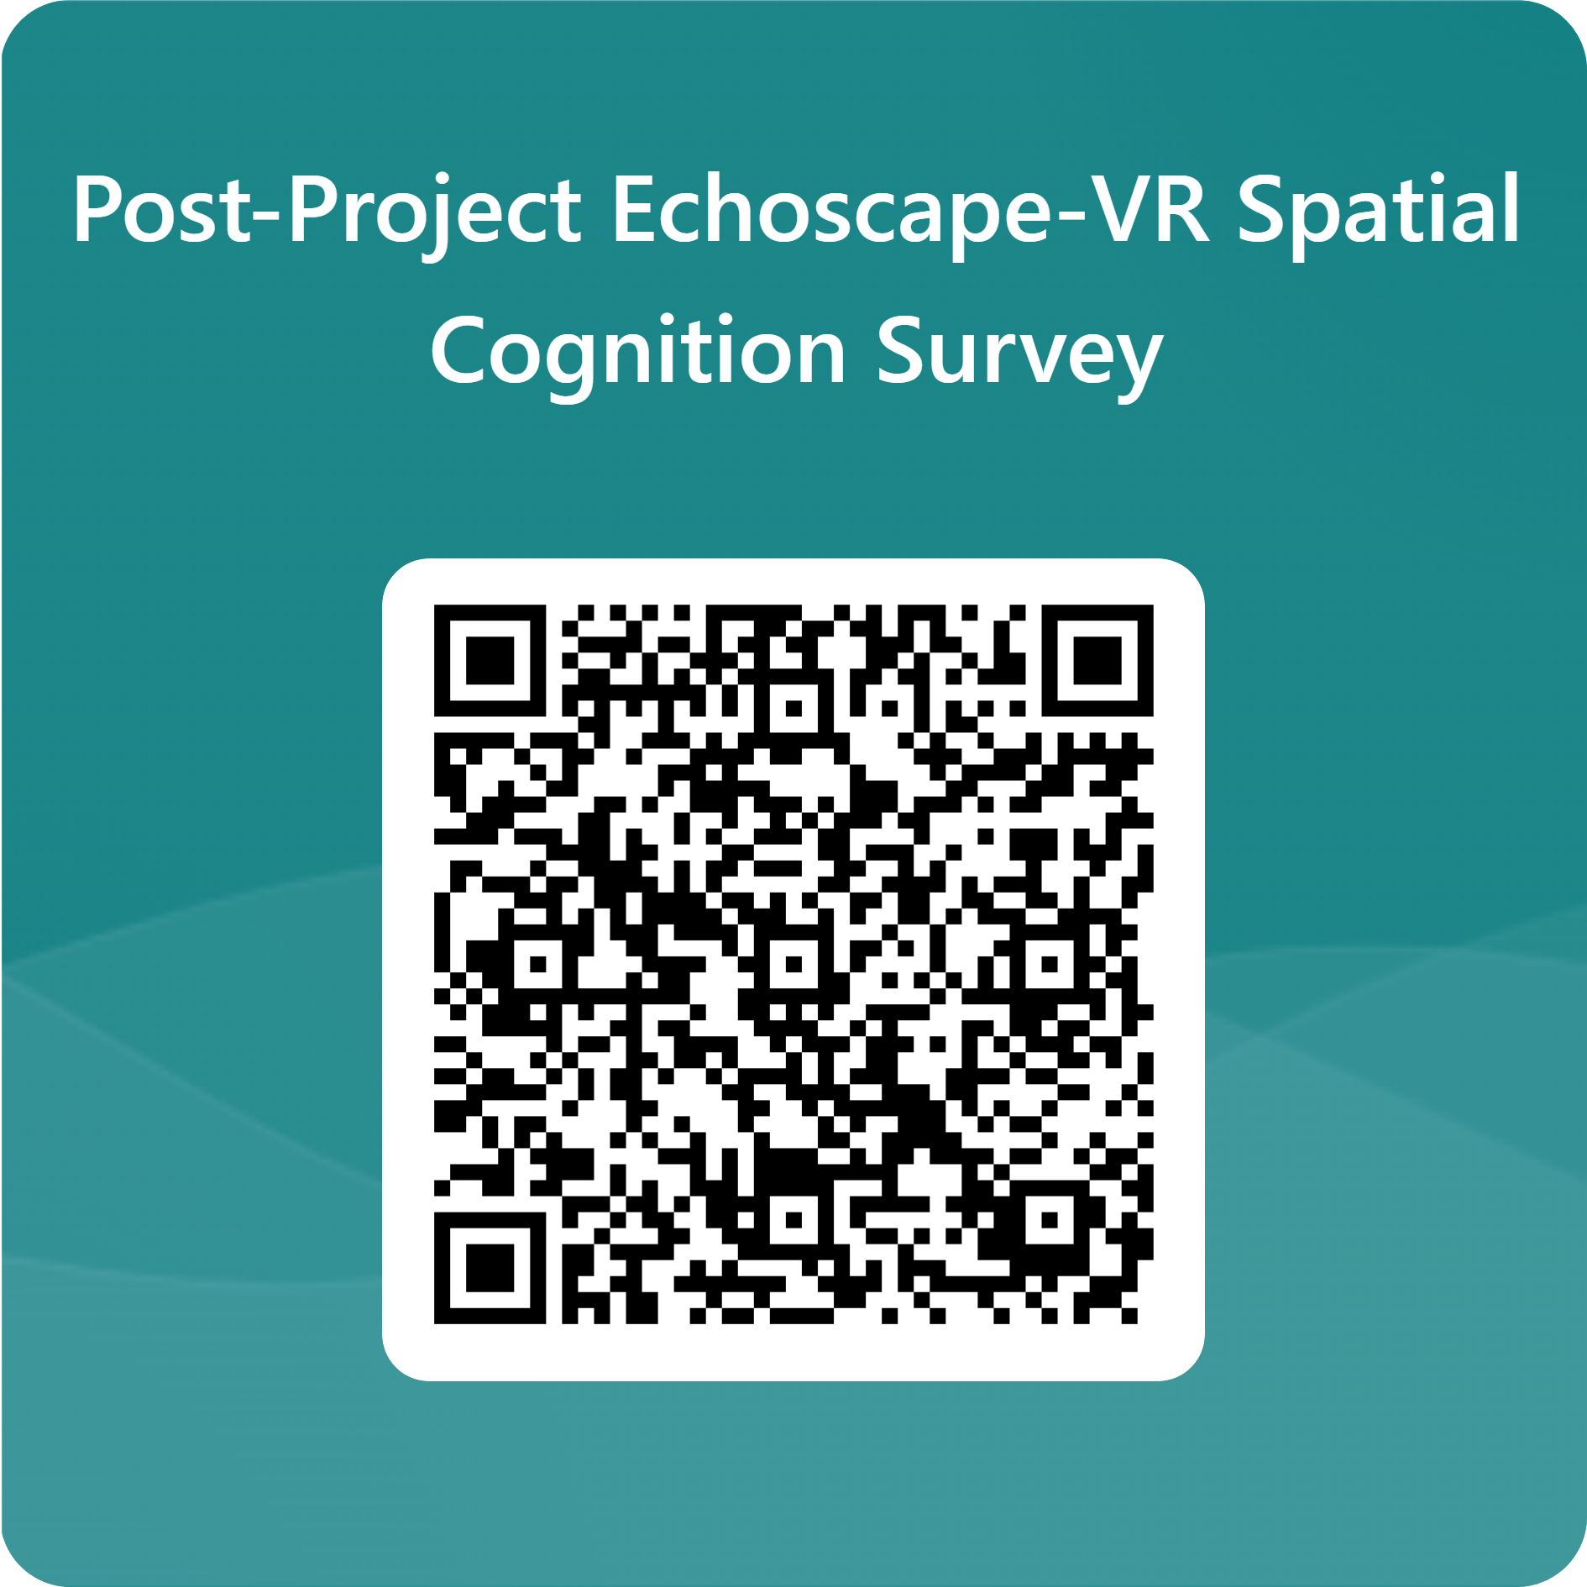
Questionnaires

Slide 16
References
Eon-xr.com. (2023). HMD controllers - EON-XR User Guides documentation. [online] Available at: https://docs.eon-xr.com/HTML/HMD/controllers.html.
Chaos.com. (2025). Virtual Reality Headset - Enscape for SketchUp - Global Site. [online] Available at: https://docs.chaos.com/display/ESKETCHUP/Virtual+Reality+Headset [Accessed 27 Apr. 2025].

