Slide 1
INTENT
Provide an interface for creating families of related or dependent objects without specifying their concrete classes.

Slide 2
INTENT
Separate the construction of a complex object from its representation so that the same construction process can create different representations

Slide 3
INTENT
Define an interface for creating an object, but let subclasses decide which class to instantiate.

Slide 4
INTENT
Specify the kinds of objects to create using a prototypical instance, and create new objects by copying this prototype.

Slide 5
INTENT
Ensure a class has only one instance, and provide a global point of access to it.

Slide 6
MNEMONIC platform independence for a family of products

Slide 7
MNEMONIC parse a complex representation, create one of several targets

Slide 8
MNEMONIC virtual creation through inheritance

Slide 9
MNEMONIC virtual creation through delegation

Slide 10
MNEMONIC guardian of the single instance

Slide 11
HOTSPOT host "platform"

Slide 12
HOTSPOT creation of an aggregate's elements

Slide 13
HOTSPOT subclass of object that is created

Slide 14
HOTSPOT class of object that is created

Slide 15
HOTSPOT the sole instance of a class

Slide 16
ANALOGY auto body parts stamping press

Slide 17
ANALOGY assembling fast food kids' meals

Slide 18
ANALOGY injection moulding form

Slide 19
ANALOGY biological cell division

Slide 20
ANALOGY the office of the President

Slide 21
GOAL many "platforms", one interface for creating a family of products

Slide 22
GOAL parse a complex representation, create one of several targets

Slide 23
GOAL dynamic (decoupled) creation through inheritance

Slide 24
GOAL dynamic (decoupled) creation through delegation

Slide 25
GOAL single instance enforcement, lazy initialization, global access

Slide 26
PROBLEM
If an application is to be portable, it needs to encapsulate platform dependencies. These "platforms" might include: windowing system, operating system, database, etc. Too often, this encapsulatation is not engineered in advance, and lots of #ifdef case statements with options for all currently supported platforms begin to procreate like rabbits throughout the code.

Slide 27
PROBLEM
An application needs to create the elements of a complex aggregate. The specification for the aggregate exists on secondary storage and one of many representations needs to be built in primary storage.

Slide 28
PROBLEM
A framework needs to standardize the architectural model for a range of applications, but allow for individual applications to define their own domain objects and provide for their instantiation.

Slide 29
PROBLEM
Application "hard wires" the class of object to create in each "new" expression.

Slide 30
PROBLEM
Application needs one, and only one, instance of an object. Additionally, lazy initialization and global access are necessary.

Slide 31
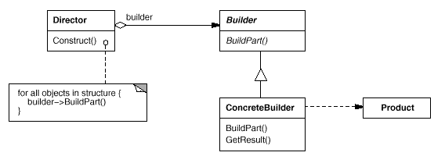

Slide 32
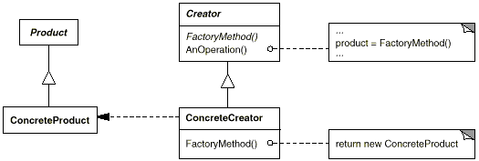

Slide 33
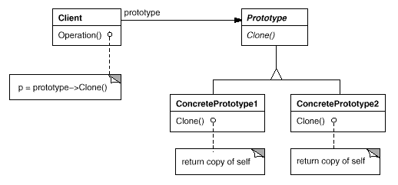

Slide 34
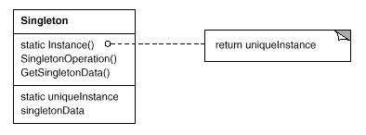

Slide 35


Slide 36
NON-SOFTWARE EXAMPLE
This pattern is found in the sheet metal stamping equipment used in the manufacture of Japanese automobiles. The stamping equipment creates auto body parts. The same machinery is used to stamp right hand doors, left hand doors, right front fenders, left front fenders, hoods, etc. for different models of cars. Through the use of rollers to change the stamping dies, the concrete products produced by the machinery can be changed within three minutes.

Slide 37
NON-SOFTWARE EXAMPLE
This pattern is used by fast food restaurants to construct children's meals. Children's meals typically consist of a main item, a side item, a drink, and a toy (e.g., a hamburger, fries, Coke, and toy car). Note that there can be variation in the content of the children's meal, but the construction process is the same. Whether a customer orders a hamburger, cheeseburger, or chicken, the process is the same. The employee at the counter directs the crew to assemble a main item, side item, and toy. These items are then placed in a bag. The drink is placed in a cup and remains outside of the bag. This same process is used at competing restaurants

Slide 38
NON-SOFTWARE EXAMPLE
Injection molding presses demonstrate this pattern. Manufacturers of plastic toys process plastic molding powder, and inject the plastic into molds of the desired shapes. The class of toy (car, action figure, etc.) is determined by the mold.

Slide 39
NON-SOFTWARE EXAMPLE
The mitotic division of a cell - resulting in two identical cells – the cell plays an active role in copying itself. When a cell splits, two cells of identical genotype result.

Slide 40
NON-SOFTWARE EXAMPLE
The United States Constitution specifies the means by which a president is elected, limits the term of office, and defines the order of succession. As a result, there can be at most one active president at any given time. Regardless of the personal identity of the active president, the title, "The President of the United States" is a global point of access that identifies the person in the office.

