Slide 1

Investigation of the Coulomb force using a torsion balance.
Brian Rogers
Level 2 labs
Queen’s university Belfast

Slide 2




Theory
For an electrostatic field, Gauss’ law states
If we have a uniform sphere with total charge, $Q_{1}$then at a distance, $r$
Therefore, for another point charge $Q_{2}$ we formulate Coulomb’s law
C
$$∇⋅\vec{E}=\frac{ρ}{ε_{0}}$$ | equation (1)
$$\vec{E}⋅4πr^{2} = \frac{Q}{ε_{0}} \hat{r}$$
$$\vec{F}=\frac{Q_{1}Q_{2}}{4πε_{0}r^{2}} \hat{r}$$ | equation (2)

Slide 3
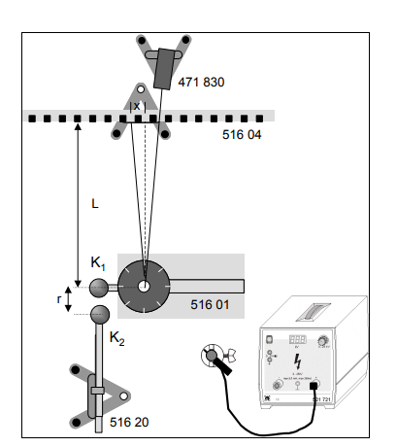
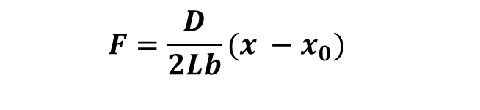
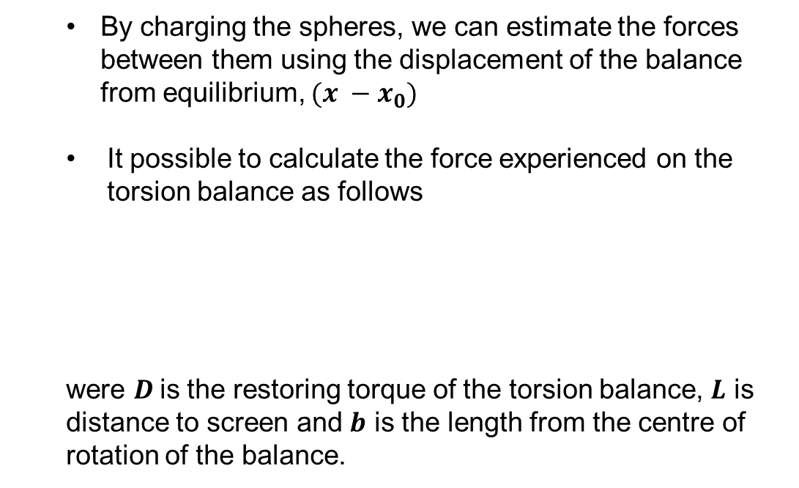
Methodology
By charging the spheres, we can estimate the forces between them using the displacement of the balance from equilibrium, $(x −x_{0})$
It possible to calculate the force experienced on the torsion balance as follows
were $D$is the restoring torque of the torsion balance, $L$ is distance to screen and $b$ is the length from the centre of rotation of the balance.
Torsion balance
$$F=\frac{D}{2Lb}(x −x_{0})$$
Charged spheres
Figure 1 – Schematic diagram of experimental setup [1]
[1] Confirming Coulomb’s law - Measuring with the torsion balance, Schürholz design – Leybold manual

Slide 4
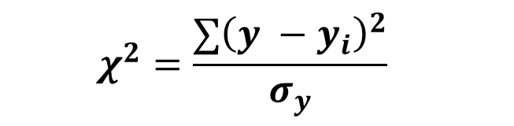
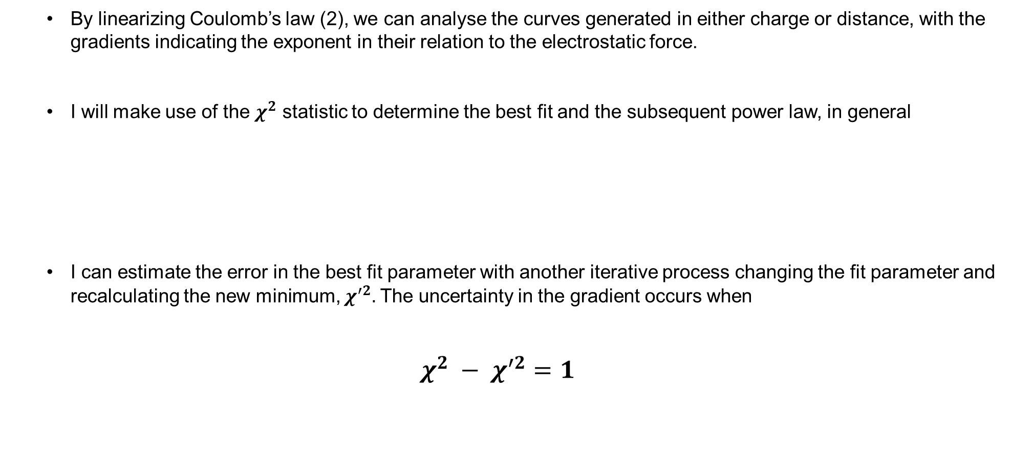
Methodology
By linearizing Coulomb’s law (2), we can analyse the curves generated in either charge or distance, with the gradients indicating the exponent in their relation to the electrostatic force.
I will make use of the $χ^{2}$ statistic to determine the best fit and the subsequent power law, in general
I can estimate the error in the best fit parameter with another iterative process changing the fit parameter and recalculating the new minimum, $χ^{′2}.$ The uncertainty in the gradient occurs when
$$χ^{2} − χ^{′2}=1$$
$$χ^{2}=\frac{∑{\left(y −y_{i}\right)}^{2}}{σ_{y}}$$

Slide 5
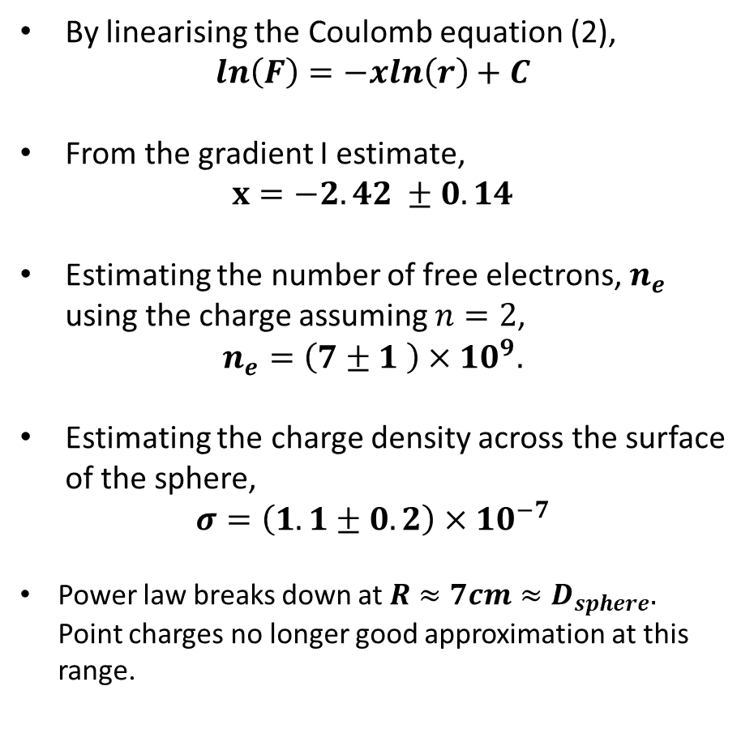
Determination of the power law - distance
By linearising the Coulomb equation (2),
$$ln\left(F\right)=−xln\left(r\right)+C$$
From the gradient I estimate,
$x=−2.42 ±0.14$
Estimating the number of free electrons, $n_{e}$ using the charge assuming $n=2$,
$$n_{e}=\left(7±1 \right)×{10}^{9}.$$
Estimating the charge density across the surface of the sphere,
$$σ=\left(1.1±0.2\right)×{10}^{−7}$$
Power law breaks down at $R≈7cm≈D_{sphere}.$ Point charges no longer good approximation at this range.
Figure 2 – Plot of log(F) on log(R).

Slide 6
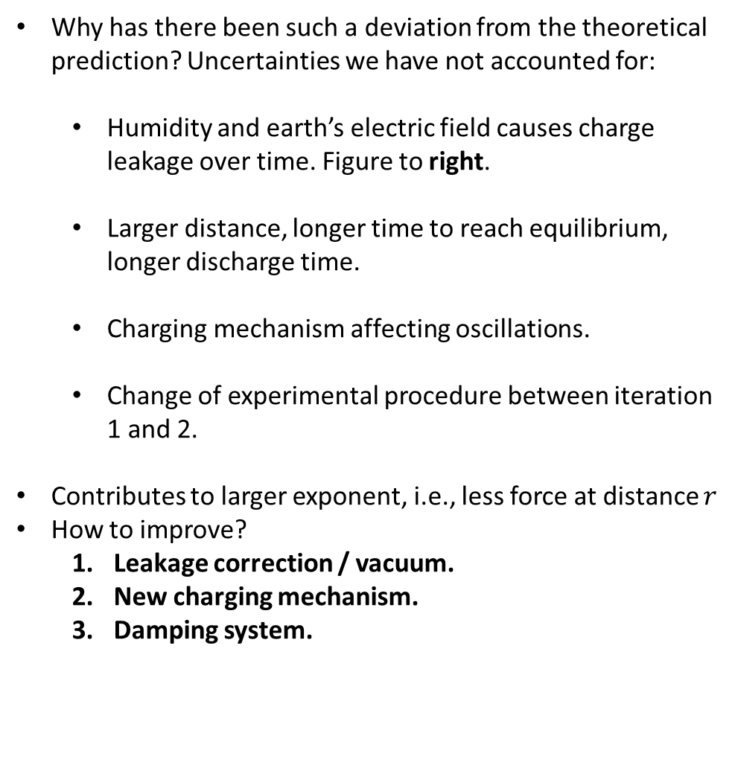
Determination of the power law - distance
Why has there been such a deviation from the theoretical prediction? Uncertainties we have not accounted for:
Humidity and earth’s electric field causes charge leakage over time. Figure to right.
Larger distance, longer time to reach equilibrium, longer discharge time.
Charging mechanism affecting oscillations.
Change of experimental procedure between iteration 1 and 2.
Contributes to larger exponent, i.e., less force at distance $r$
How to improve?
Leakage correction / vacuum.
New charging mechanism.
Damping system.
Figure 3 – Plot of Q on R
Figure 3 – Plot of Q on R

Slide 7
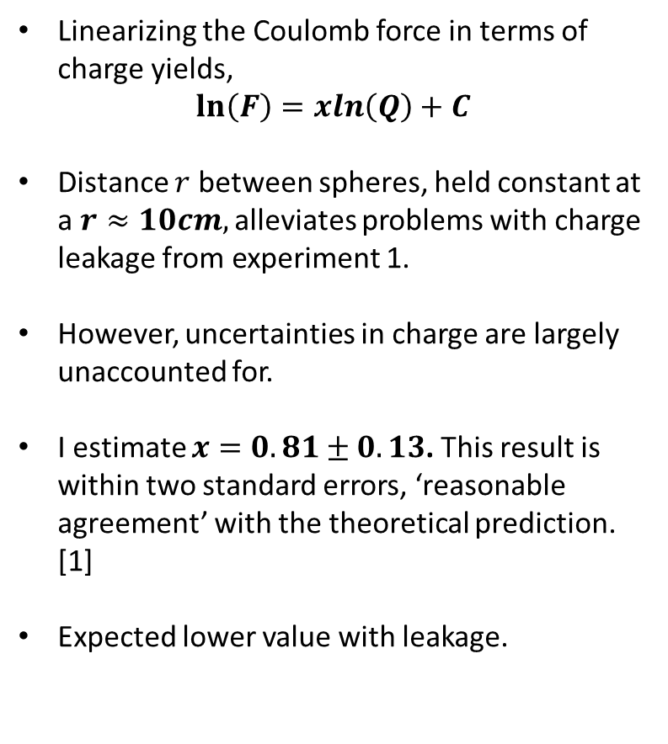
Determination of the power law - charge
Linearizing the Coulomb force in terms of charge yields,
$$\ln\left(F\right)=xln\left(Q\right)+C$$
Distance $r$ between spheres, held constant at a $r≈10cm,$ alleviates problems with charge leakage from experiment 1.
However, uncertainties in charge are largely unaccounted for.
I estimate $x=0.81±0.13$. This result is within two standard errors, ‘reasonable agreement’ with the theoretical prediction. [1]
Expected lower value with leakage.
Figure 4 – Plot of ln(F) on ln(Q).
[1] Measurements and their uncertainties – Hughes and Hase – pg.28

