Slide 1

Investigation of the electronic transport properties of a p-type doped Ge semi-conductor, using the Hall effect.
Brian Rogers
Level 2 labs
Queen’s university Belfast

Slide 2
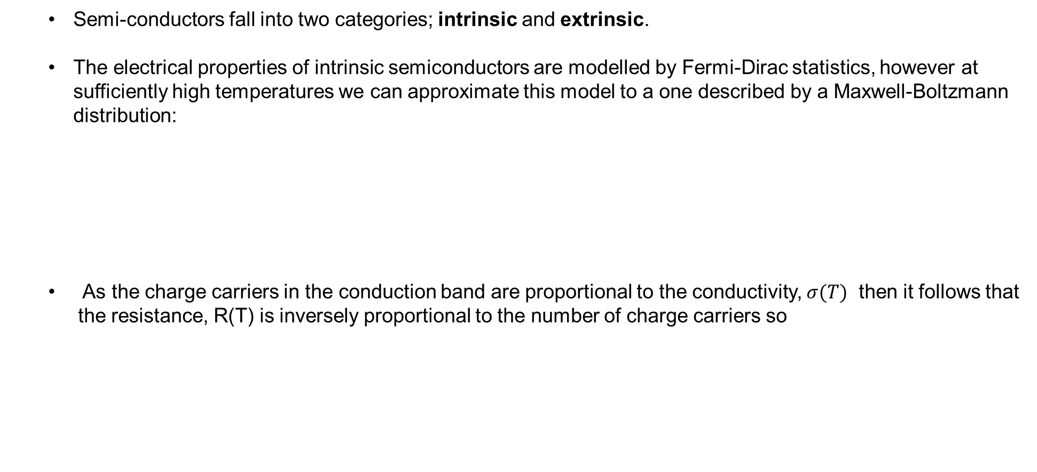


Theory
Semi-conductors fall into two categories; intrinsic and extrinsic.
The electrical properties of intrinsic semiconductors are modelled by Fermi-Dirac statistics, however at sufficiently high temperatures we can approximate this model to a one described by a Maxwell-Boltzmann distribution:
As the charge carriers in the conduction band are proportional to the conductivity, $σ(T)$ then it follows that the resistance, R(T) is inversely proportional to the number of charge carriers so
$$n\left(T\right)∝e^{−\frac{ΔE}{2k_{B}T}}$$ | equation (1)
C
R$\left(T\right)∝e^{\frac{ΔE}{2k_{B}T}}$ | equation (2)
C

Slide 3
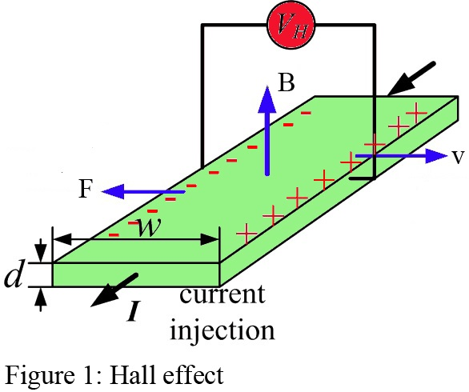
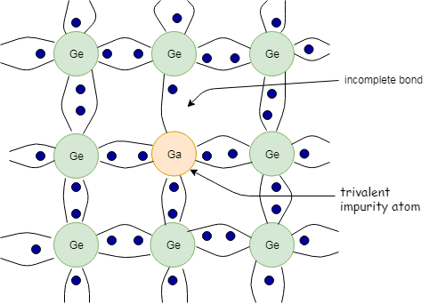
Theory – continued
Whilst in the extrinsic regime, a doped semiconductor electrical behaviour depends primarily on the dopant – an acceptor or donor species.
We will limit our consideration to p-type semiconductors. Impurity atoms create vacant energy levels that ‘accept’ electrons, leaving ‘holes’ in the valence band which are source of conduction.
Figure 1.1 – Schematic diagram Hall effect
https://electronicspani.com/hall-effect-hall-effect-derivation/
Figure 1.2 - P-type semi conductor
http://www.raulstutorial.com/wp-content/uploads/2019/07/drawit-diagram-11.png

Slide 4
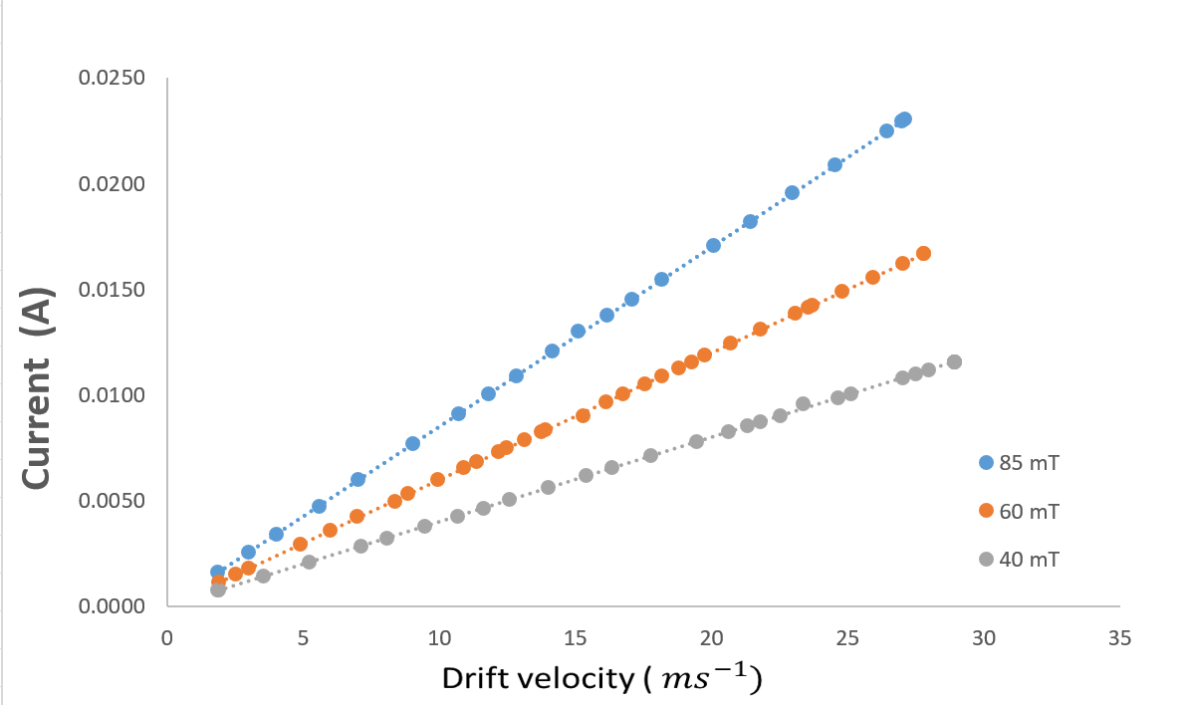
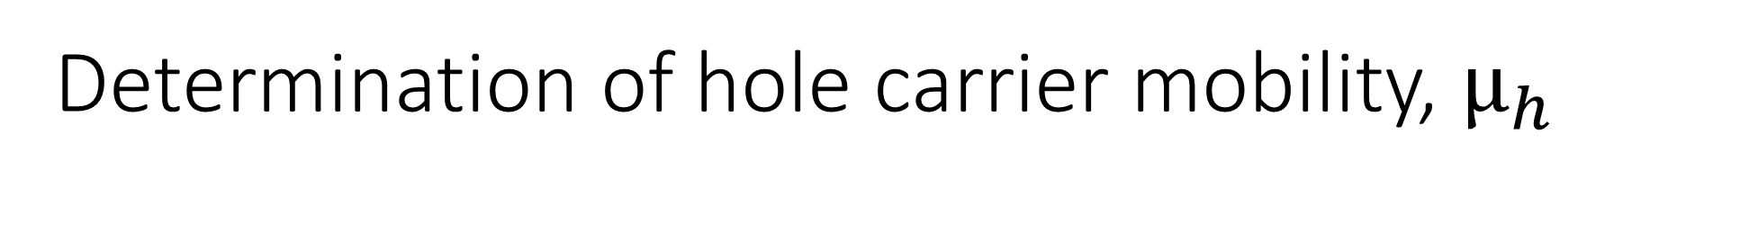
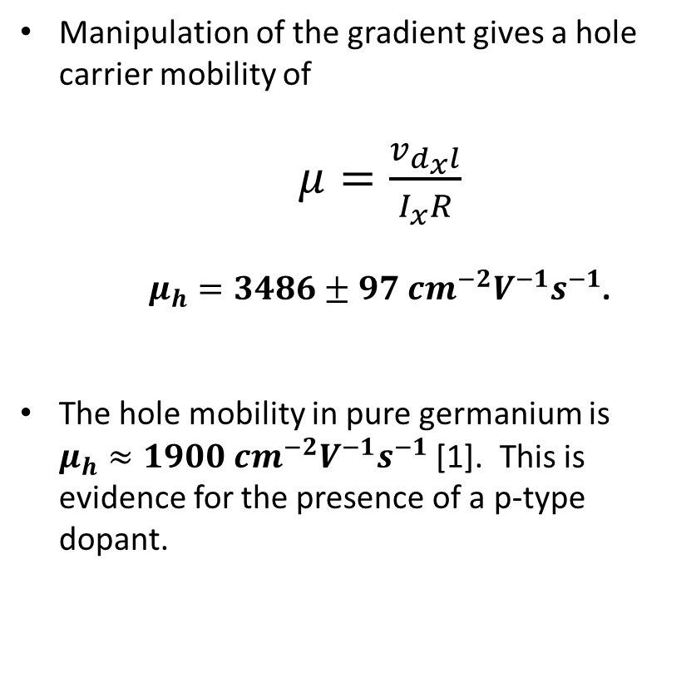
Determination of hole carrier mobility, $μ_{h}$
Manipulation of the gradient gives a hole carrier mobility of
$μ=\frac{v_{d_{x}l}}{I_{x}R}$
$μ_{h}=3486±97 {cm}^{−2}V^{−1}s^{−1}$.
The hole mobility in pure germanium is $μ_{h}≈1900 {cm}^{−2}V^{−1}s^{−1}$ [1]. This is evidence for the presence of a p-type dopant.
[1] http://www.ioffe.ru/SVA/NSM/Semicond/Ge/bandstr.html
Figure 2 – Drift velocity measurements across currents for fixed magnetic field values.

Slide 5
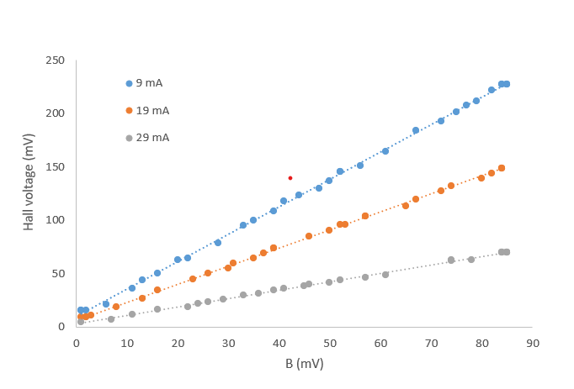
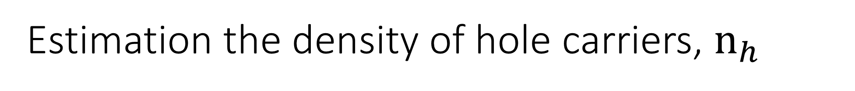
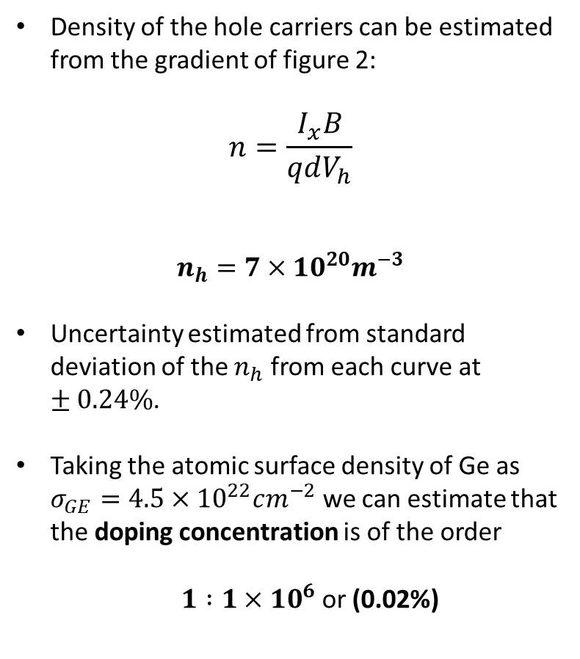
Estimation the density of hole carriers, $n_{h}$
Density of the hole carriers can be estimated from the gradient of figure 2:
$$n=\frac{I_{x}B}{qdV_{h}}$$
$$n_{h}=7×{10}^{20}m^{−3}$$
Uncertainty estimated from standard deviation of the $n_{h}$ from each curve at $±0.24\%$.
Taking the atomic surface density of Ge as $σ_{GE}=4.5×{10}^{22}cm^{−2}$ we can estimate that the doping concentration is of the order
$1 :1×{10}^{6}$ or (0.02%)
Figure 3 – Hall voltage values as a function of magnetic field across current values.

Slide 6

Extrinsic-intrinsic transition temperature
$$T=398±3 K$$
Extrinsic
Intrinsic
Figure 4:
Behavior of the hall voltage as a function of temperature.

Slide 7
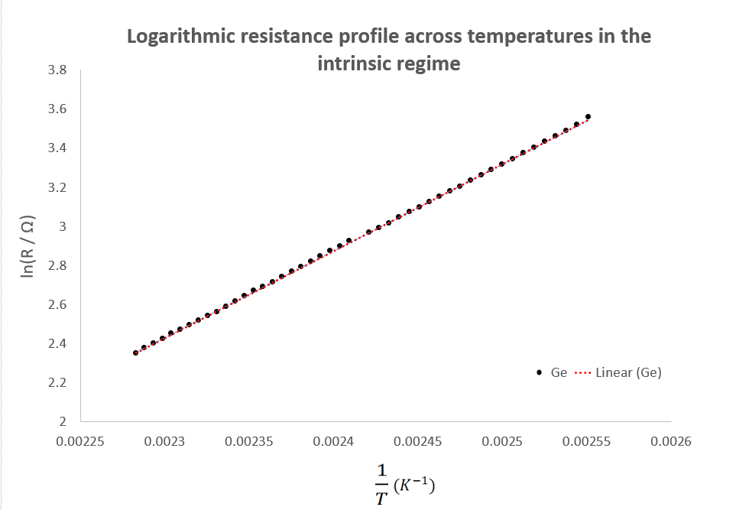
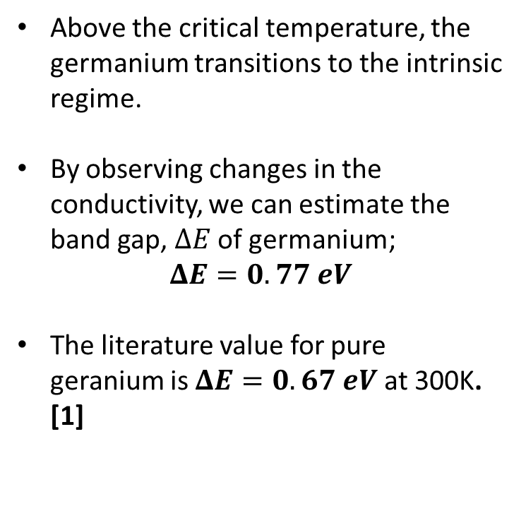
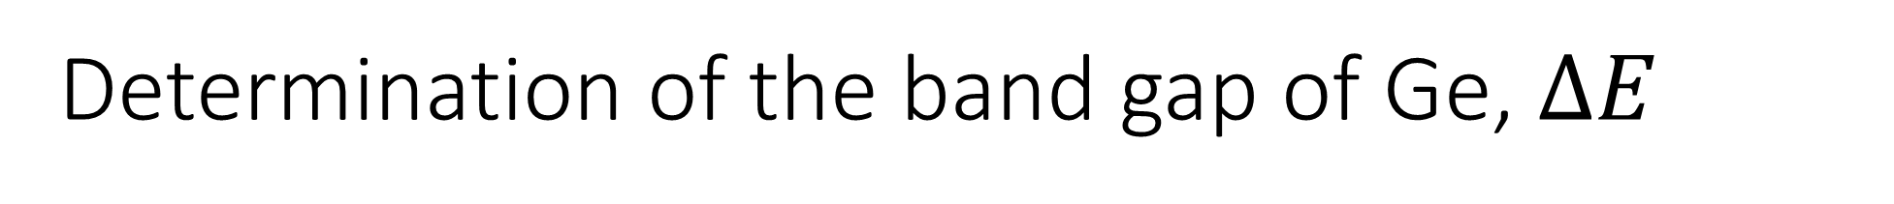
Determination of the band gap of Ge, $ΔE$
Above the critical temperature, the germanium transitions to the intrinsic regime.
By observing changes in the conductivity, we can estimate the band gap, $ΔE$ of germanium;
$$ΔE=0.77 eV$$
The literature value for pure geranium is $ΔE=0.67 eV$ at 300K. [1]
[1] http://www.ioffe.ru/SVA/NSM/Semicond/Ge/bandstr.html
Figure 5 – plot of the natural logarithm of resistance on $\frac{1}{T}$

