Slide 1

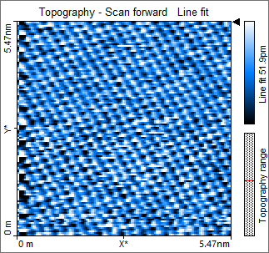
Investigating the surface properties of monoatomic samples using scanning tunnelling microscopy.
Brian Rogers
Level 2 labs
Queen’s university Belfast

Slide 2
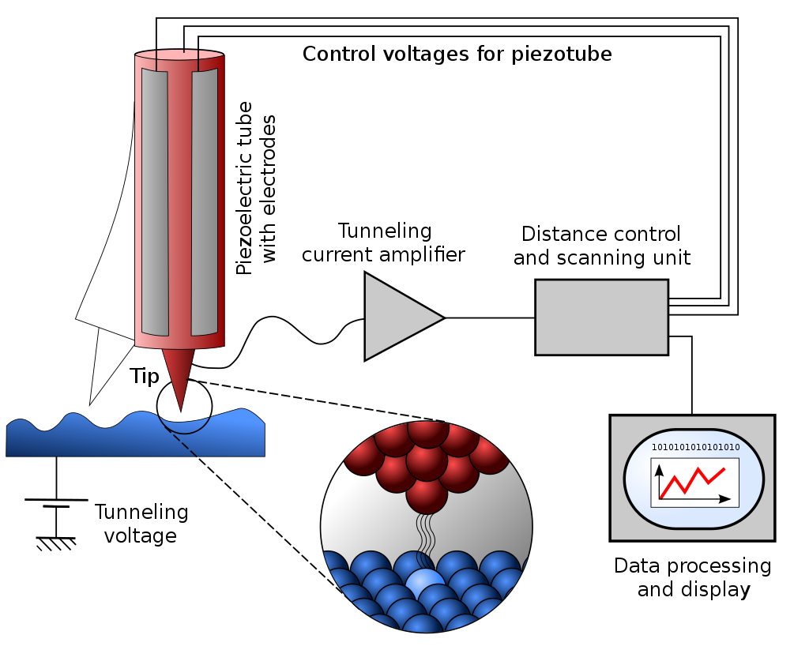
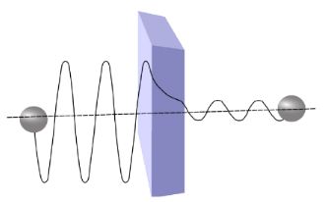
Theory
Tunnelling is a concept that arises from Schrödinger's equation.
Particles have a non-zero probability of passing through a potential greater than its total energy. This is referred to as energy borrowing.
The scanning tunnelling microscope exploits this idea by measuring the tunnelling current from escaped electrons on the surface of the material.
Figure 1 – schematic diagram of the scanning tunnelling microscope
Figure 2 – diagram of the probability amplitude decaying as the distance from the surface increases.

Slide 3
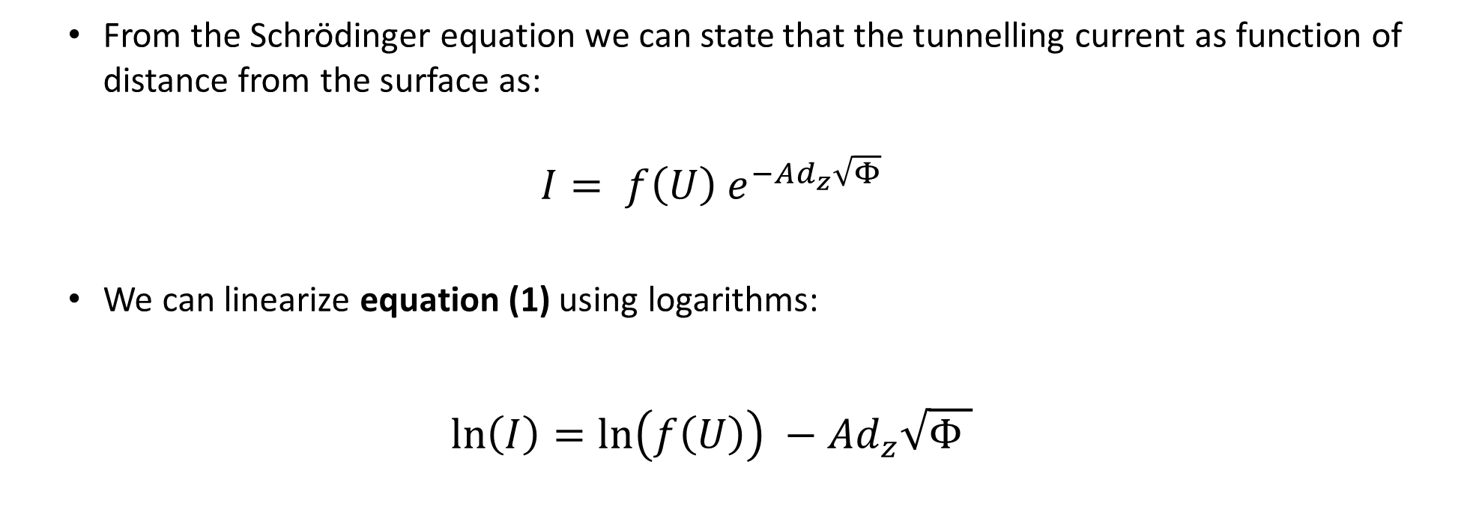
Theory
From the Schrödinger equation we can state that the tunnelling current as function of distance from the surface as:
$${I= f\left(U\right) e}^{−Ad_{z}\sqrt{Φ}}$$
We can linearize equation (1) using logarithms:
$$\ln\left(I\right)=\ln\left(f\left(U\right)\right) −Ad_{z}\sqrt{Φ }$$
equation (1)
equation (2)

Slide 4
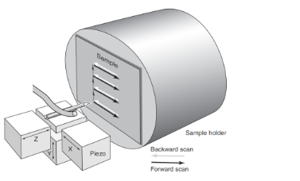
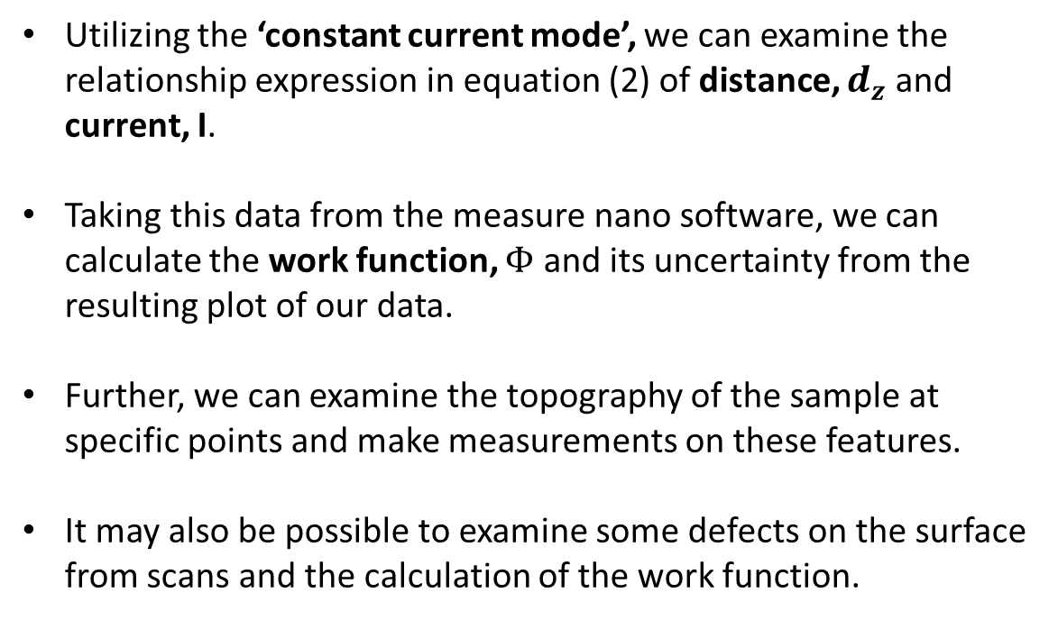
Methodology
Utilizing the ‘constant current mode’, we can examine the relationship expression in equation (2) of distance, $d_{z}$ and current, I.
Taking this data from the measure nano software, we can calculate the work function, $Φ$ and its uncertainty from the resulting plot of our data.
Further, we can examine the topography of the sample at specific points and make measurements on these features.
It may also be possible to examine some defects on the surface from scans and the calculation of the work function.
Figure 3 – magnified view of the piezo crystals driving the movement of the Pt-Ir tip

Slide 5
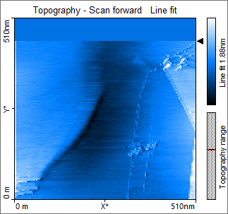
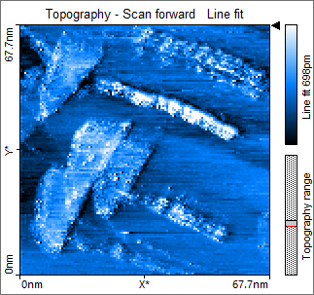
Graphite – investigation of terrace structures
Figure 3.1 – photograph of 510nm section of the graphite sample.
Figure 3.2 –inspection of subregion of figure 3.1.

Slide 6
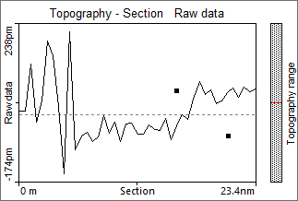
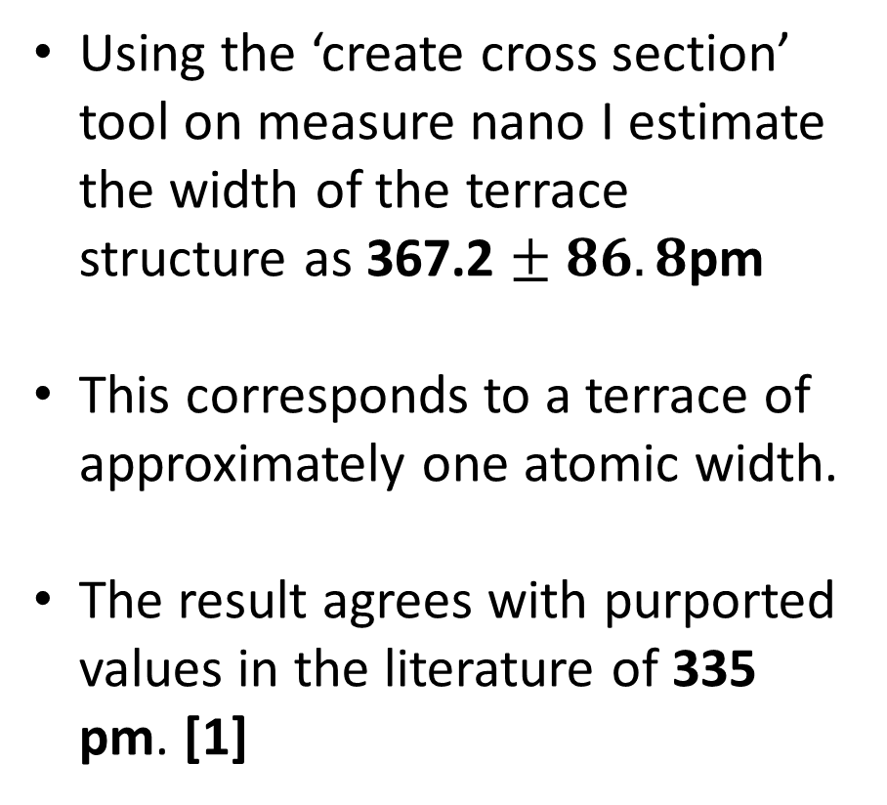
Graphite – investigation of terrace structures
Using the ‘create cross section’ tool on measure nano I estimate the width of the terrace structure as 367.2 $± 86.8$pm
This corresponds to a terrace of approximately one atomic width.
The result agrees with purported values in the literature of 335 pm. [1]
Figure 4 – results from the section of the terrace structure. Red lines indicate maximum and minimum depth of the structure.
[1] Delhaes, P. (2001). Graphite and Precursors. CRC Press. ISBN 978-90-5699-228-6.

Slide 7
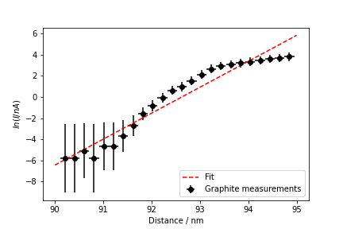
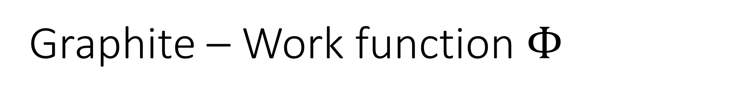
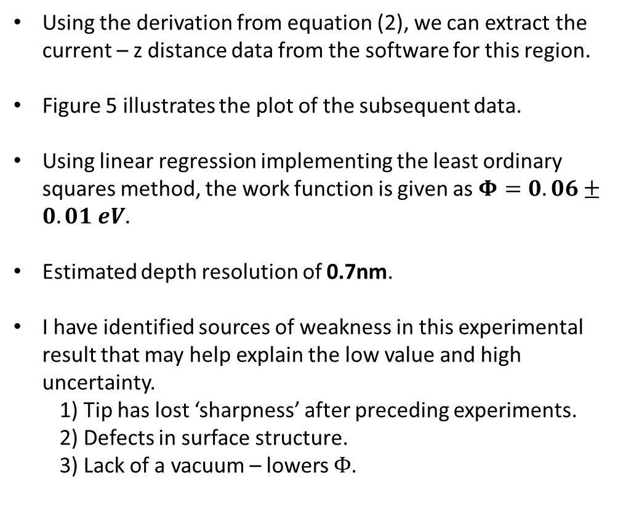
Graphite – Work function $Φ$
Using the derivation from equation (2), we can extract the current – z distance data from the software for this region.
Figure 5 illustrates the plot of the subsequent data.
Using linear regression implementing the least ordinary squares method, the work function is given as $Φ=0.06±0.01 eV.$
Estimated depth resolution of 0.7nm.
I have identified sources of weakness in this experimental result that may help explain the low value and high uncertainty.
1) Tip has lost ‘sharpness’ after preceding experiments.
2) Defects in surface structure.
3) Lack of a vacuum – lowers $Φ$.
Figure 5 – a plot of natural log of tunneling current on the distance to surface.

Slide 8
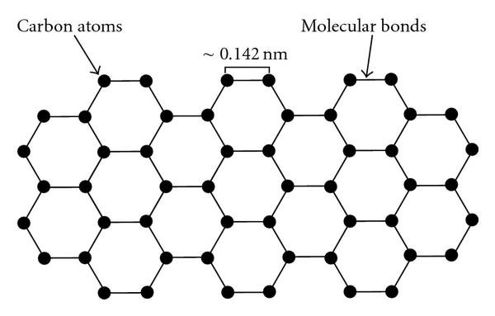
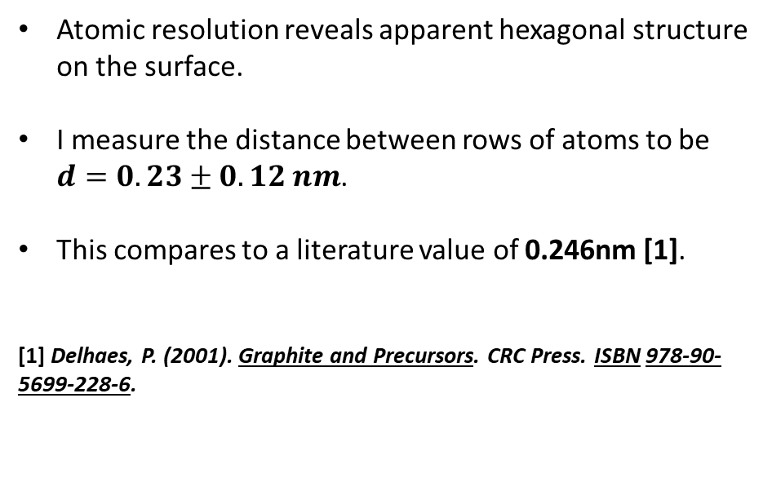
Graphite – atomic surface structure
Atomic resolution reveals apparent hexagonal structure on the surface.
I measure the distance between rows of atoms to be $d=0.23±0.12 nm$.
This compares to a literature value of 0.246nm [1].
[1] Delhaes, P. (2001). Graphite and Precursors. CRC Press. ISBN 978-90-5699-228-6.
Figure 6 – atomic resolution image of graphite.

Slide 9
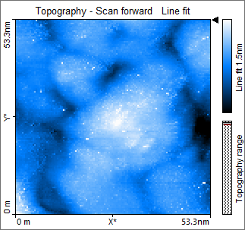
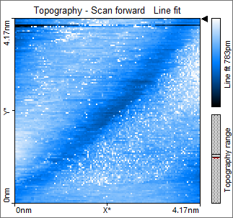
Gold – atomic surface structure
Figure 7.1 – imaging of gold sample at 53.3 nm.
Figure 7.2 – further imaging of gold sample at 4.17 nm.

Slide 10
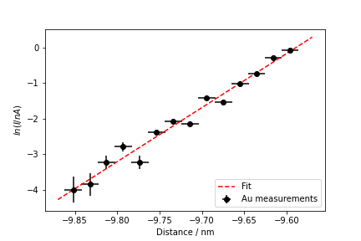
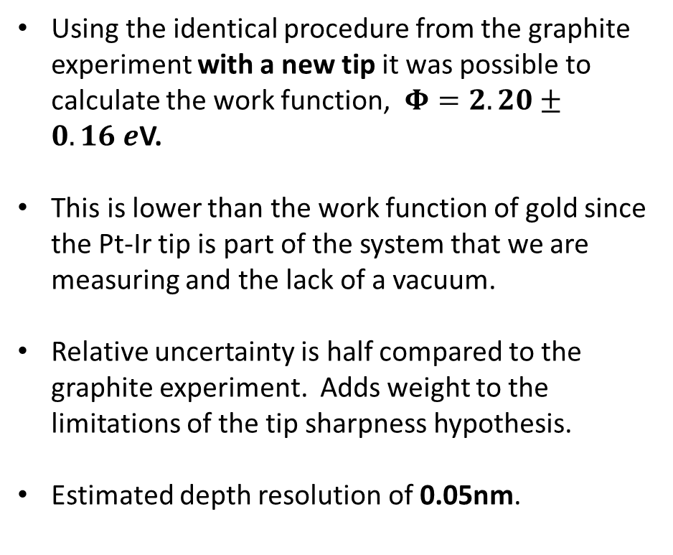
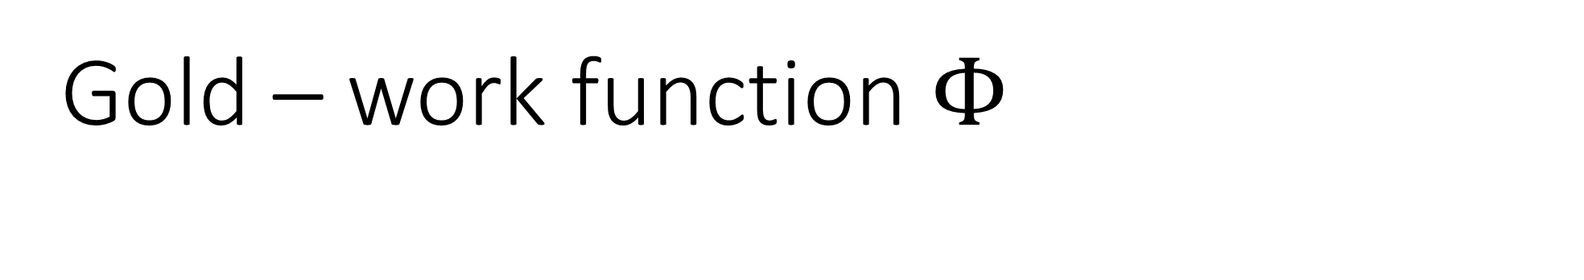
Gold – work function $Φ$
Using the identical procedure from the graphite experiment with a new tip it was possible to calculate the work function, $Φ=2.20±0.16 e$V.
This is lower than the work function of gold since the Pt-Ir tip is part of the system that we are measuring and the lack of a vacuum.
Relative uncertainty is half compared to the graphite experiment. Adds weight to the limitations of the tip sharpness hypothesis.
Estimated depth resolution of 0.05nm.
Figure 8 – a plot of natural log of tunneling current on the distance to surface for the gold sample.

Slide 11
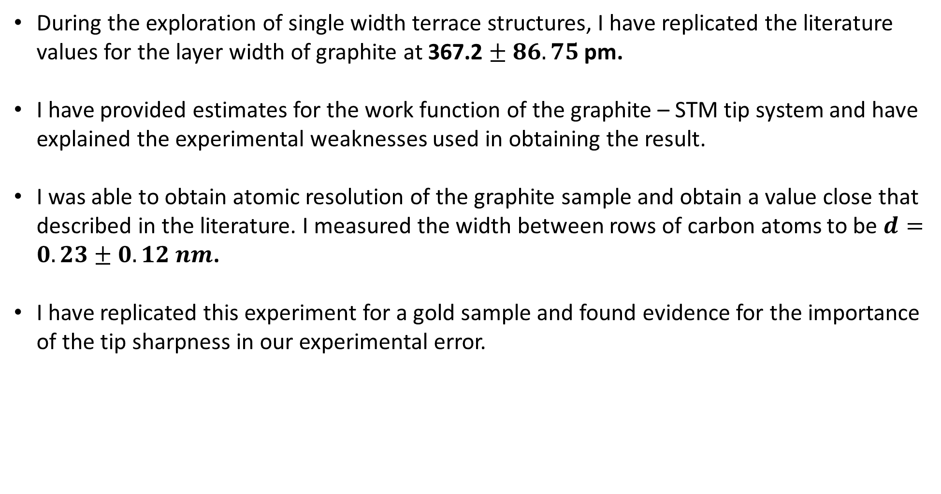
Summary
During the exploration of single width terrace structures, I have replicated the literature values for the layer width of graphite at 367.2 $± 86.75$pm.
I have provided estimates for the work function of the graphite – STM tip system and have explained the experimental weaknesses used in obtaining the result.
I was able to obtain atomic resolution of the graphite sample and obtain a value close that described in the literature. I measured the width between rows of carbon atoms to be $d=0.23±0.12 nm$.
I have replicated this experiment for a gold sample and found evidence for the importance of the tip sharpness in our experimental error.

