Slide 1
SONAR SEQURITY SYSTEM
DIY GROUP PROJECT #7

Slide 2
OVERVIEW
It is an Arduino based RADAR project which uses
Ultrasonic sensor to detect any object in its range.

Slide 3
OBJECTIVE OF THE PROJECT
To build a cost efficient ARDUINO circuit which detects the objects along with their distance.

Slide 4
TEAM MEMBERS
21BT10022 | R S THIRUVGNESH
21MT30031 | RAKESH TARENDRA
21EC10011 | BANISETTY HEMA SAI SAGAR
21EE10044 | SRI VYSHNAVI
21HS10018 | BIRRU LAVANYA

Slide 5
WORK DISTRIBUTION
SAGAR | THIRUVIGNESH | RAKESH | LAVANYA | VAISHNAVI
ORDERING COMPONENTS, COADING, VIDEO EDITING | VIRTUAL CIRCUIT DIAGRAM, COADING, | PHYSICAL ASSEMBLY VIDEO EDITING MAKING WEEK- WISE PRESENTATION | PHYSICAL ASSEMBLY FINAL PRESENTATION | DESIGN THE ALGORITHM OF CODE CODED THE CIRCUIT

Slide 6
COMPONENTS
1. ARDUINO UNO
2. BREADBOARD
3. SERVOMOTOR
4. ULTRASONIC SENSOR
5. JUMPER WIRES
TOTAL COST = 1300

Slide 7
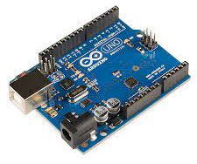
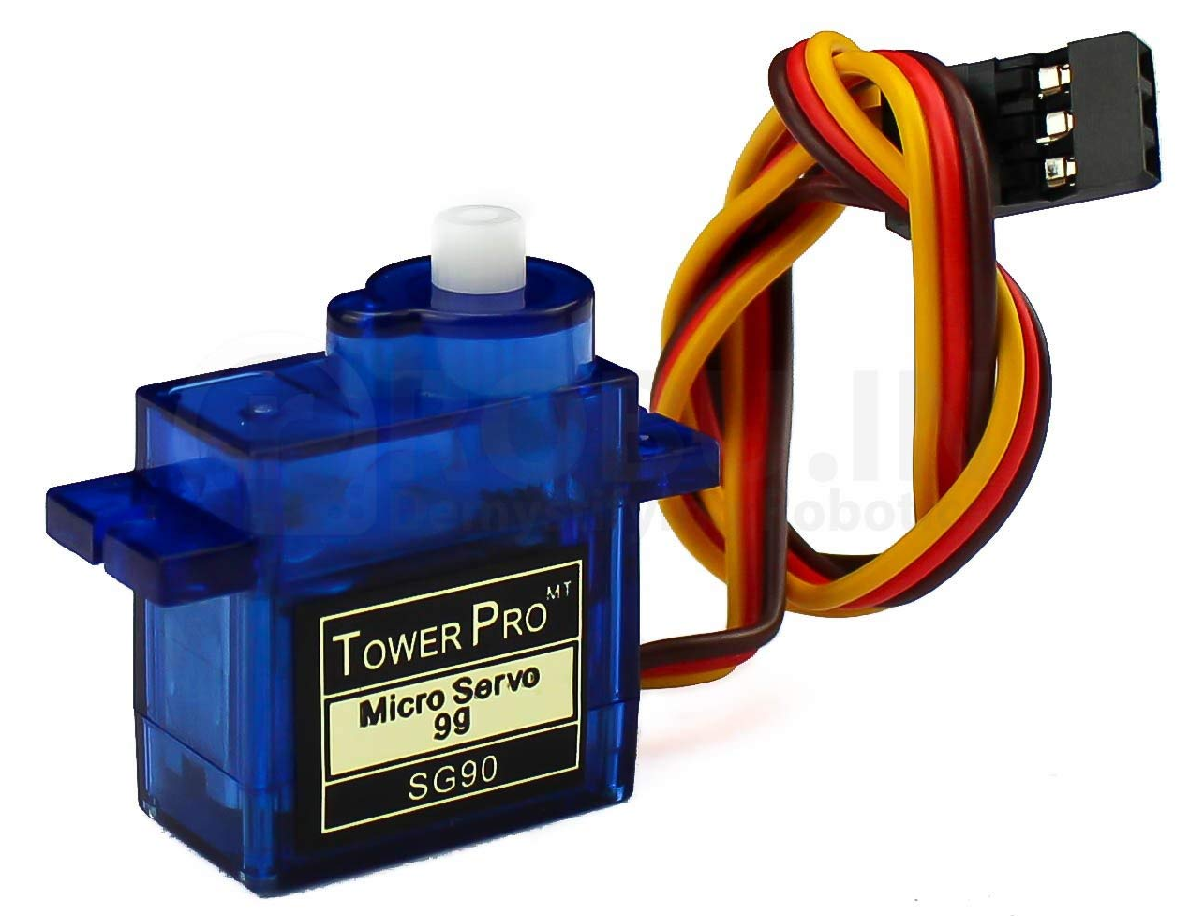
● COMPONENTS ●
ARDUINO UNO is an open-source electronics platform based on easy-to-use hardware and software. Arduino boards are able to read inputs - light on a sensor, a finger on a button, or a Twitter message - and turn it into an output - activating a motor, turning on an LED, publishing something online
A SERVOMOTOR (OR SERVO MOTOR) is a rotary actuator or linear actuator that allows for precise control of angular or linear position, velocity and acceleration. It consists of a suitable motor coupled to a sensor for position feedback.

Slide 8
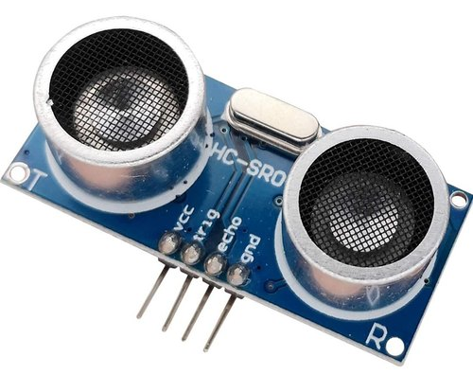
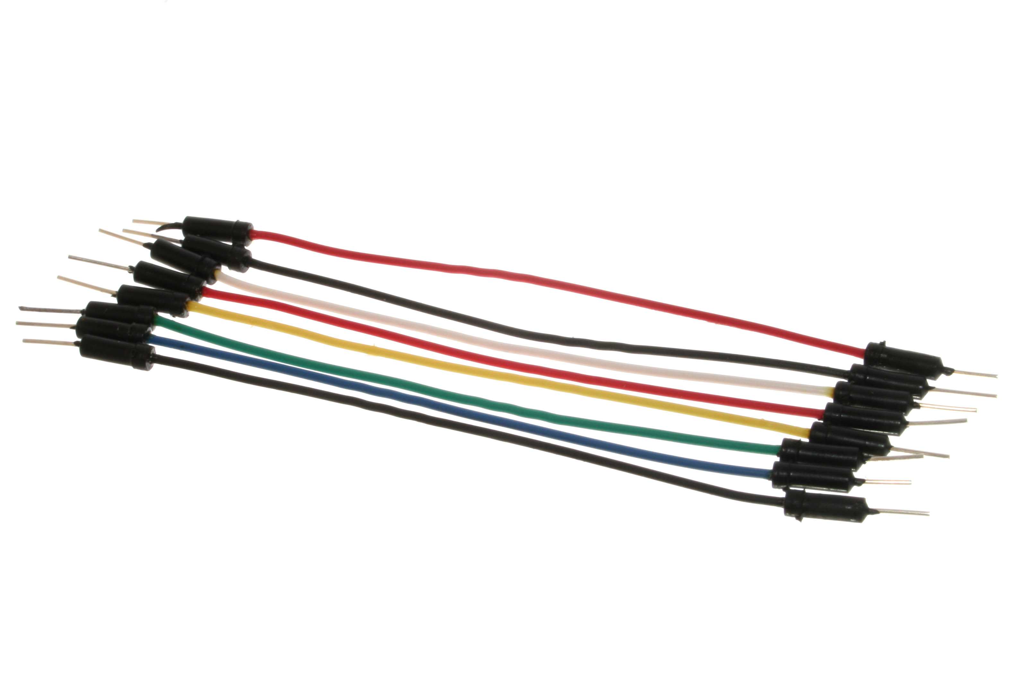
An ULTRASONIC SENSOR is an instrument that measures the distance to an object using ultrasonic sound waves. An ultrasonic sensor uses a transducer to send and receive ultrasonic pulses that relay back information about an object's proximity.
JUMPER WIRES are used to connect two points in a circuit. All Electronics stocks jumper wire in a variety of lengths and assortments. Frequently used with breadboards and other prototyping tools in order to make it easy to change a circuit as needed.

Slide 9
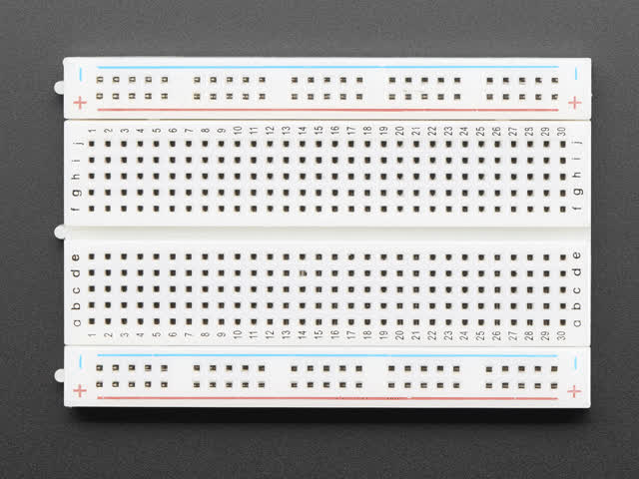
A breadboard is a solderless device for temporary prototype with electronics and test circuit designs. Most electronic components in electronic circuits can be interconnected by inserting their leads or terminals into the holes and then making connections through wires where appropriate.

Slide 10
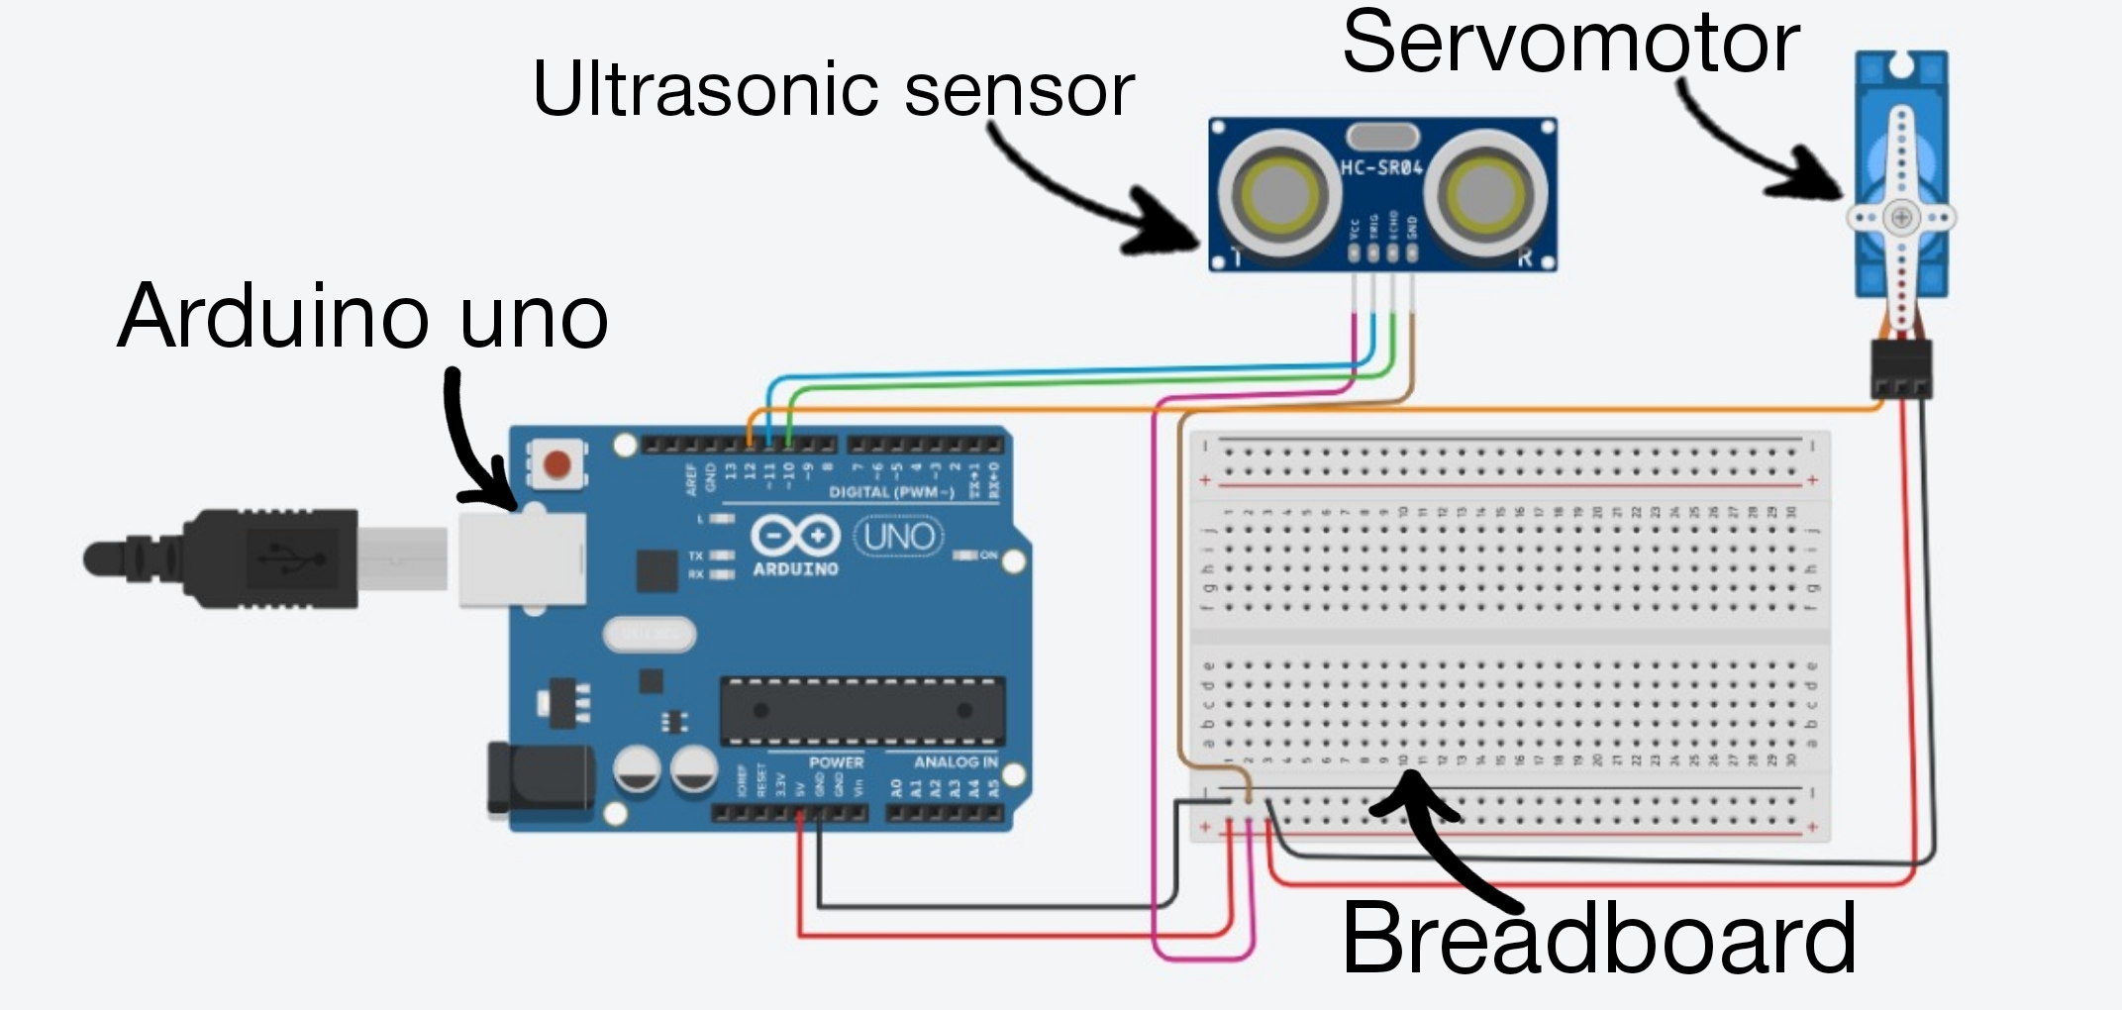
CIRCUIT DIAGRAM

Slide 11
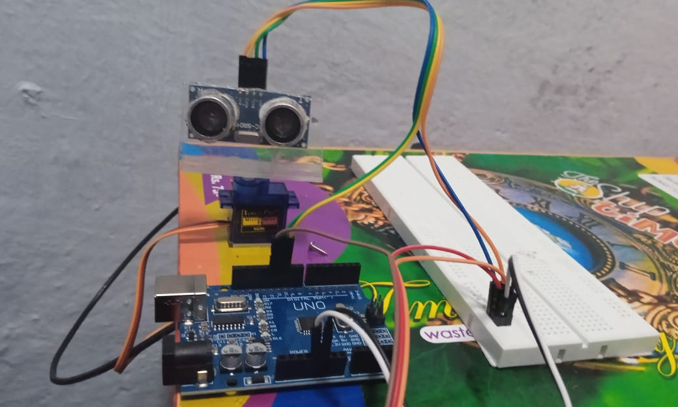
PHYSICAL ASSEMBLY

Slide 12
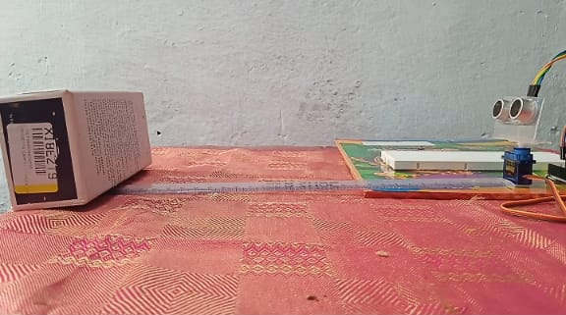

Slide 13
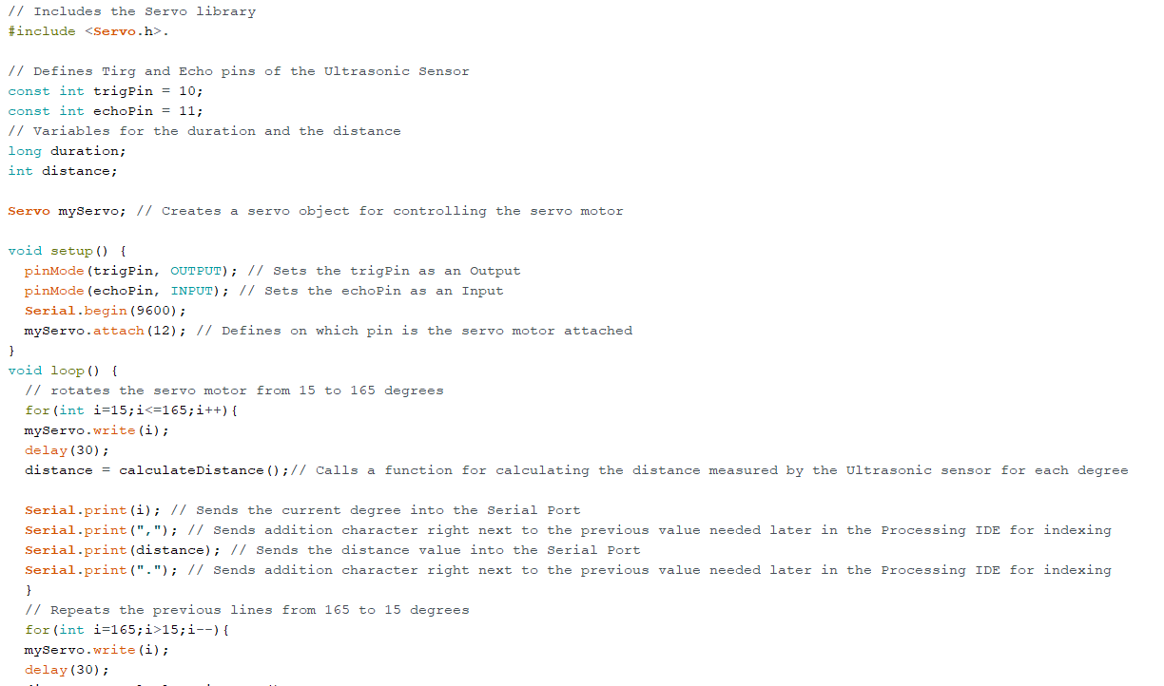
CODE
ARDUINO CODE

Slide 14
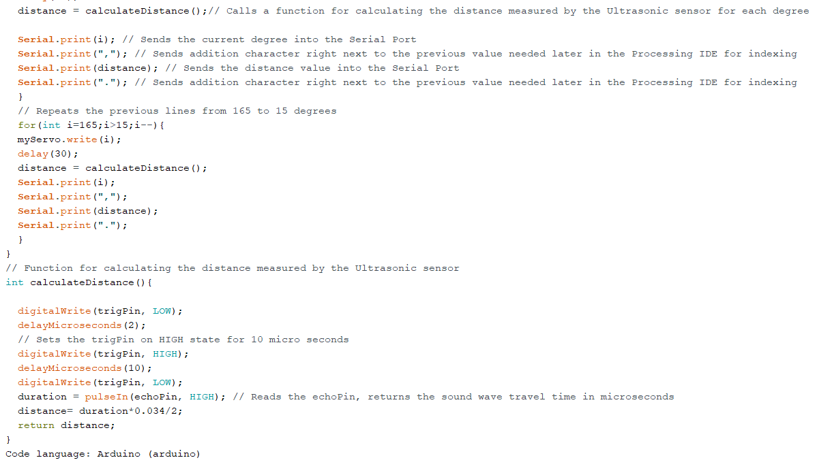

Slide 15
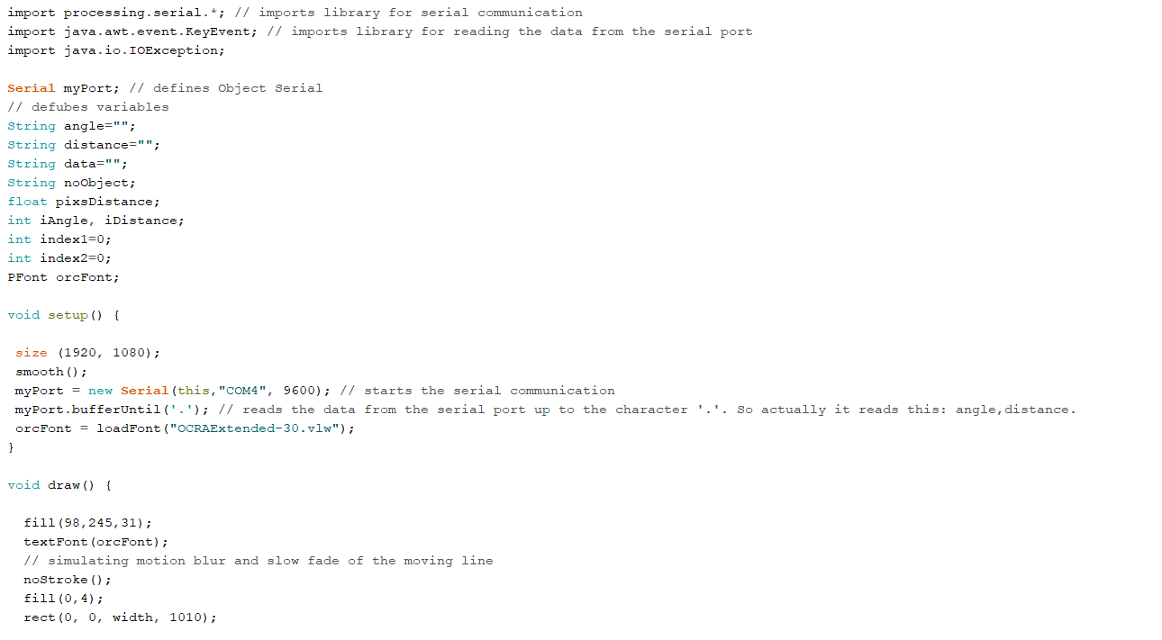
CODE
PROCESSING CODE

Slide 16
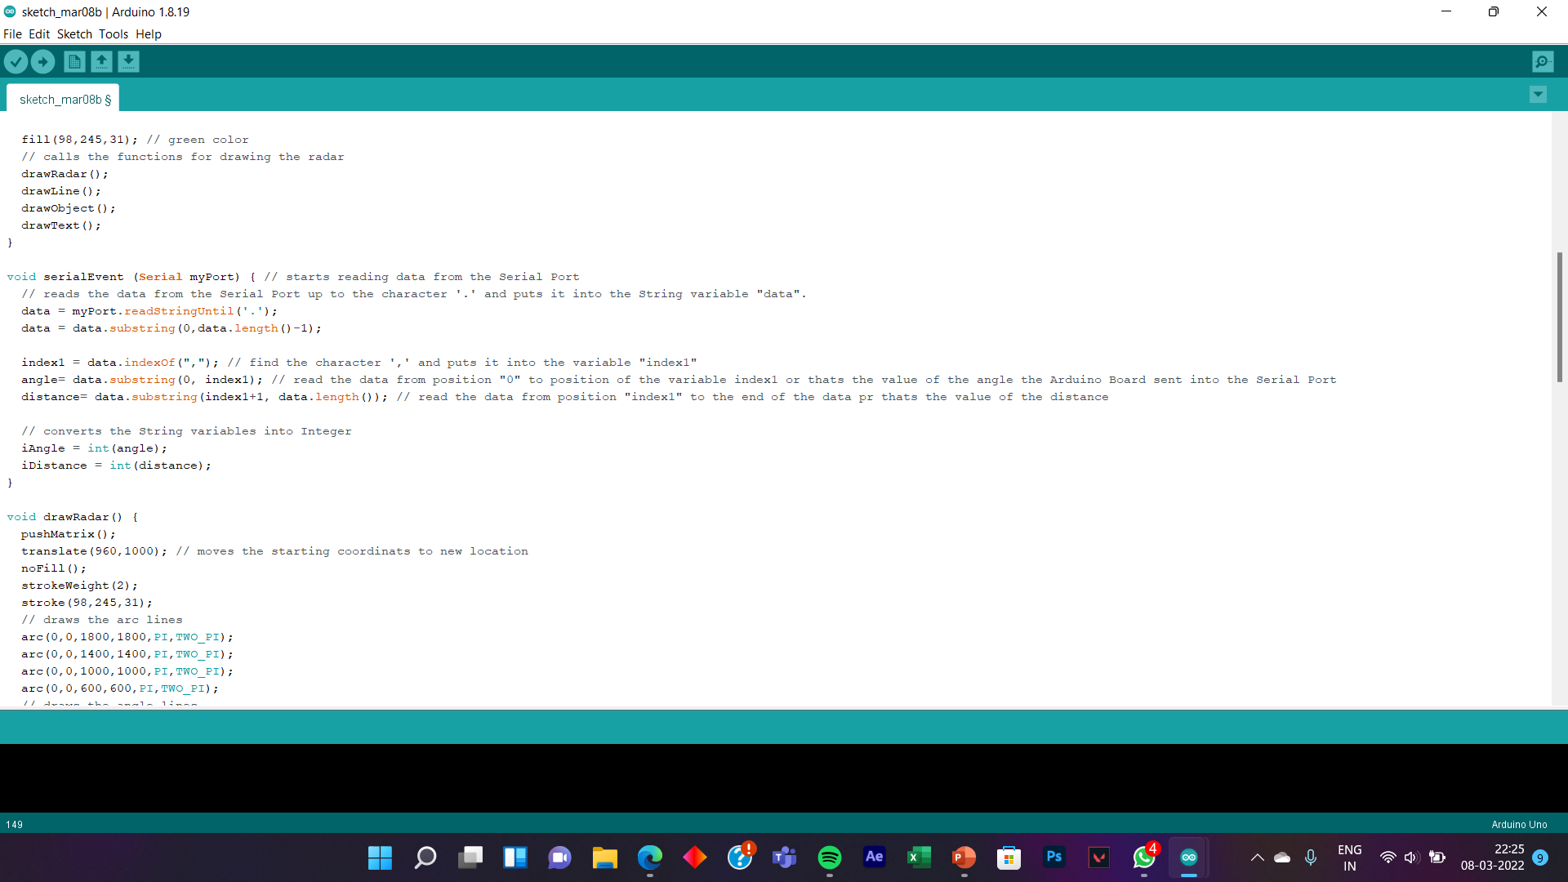

Slide 17
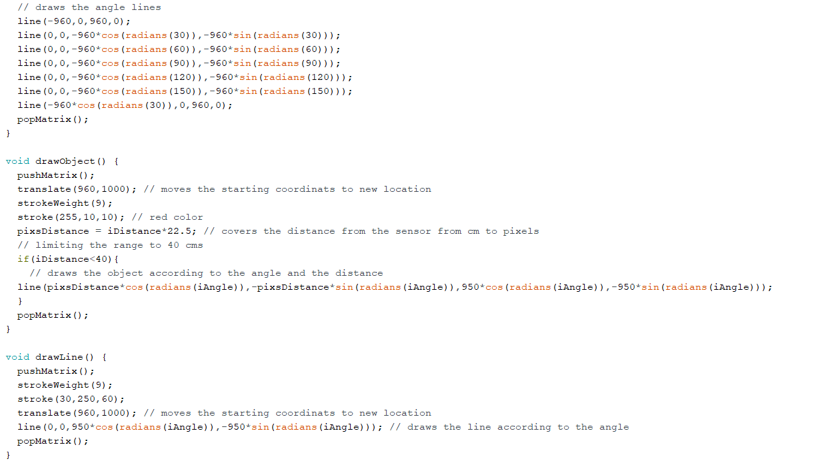

Slide 18
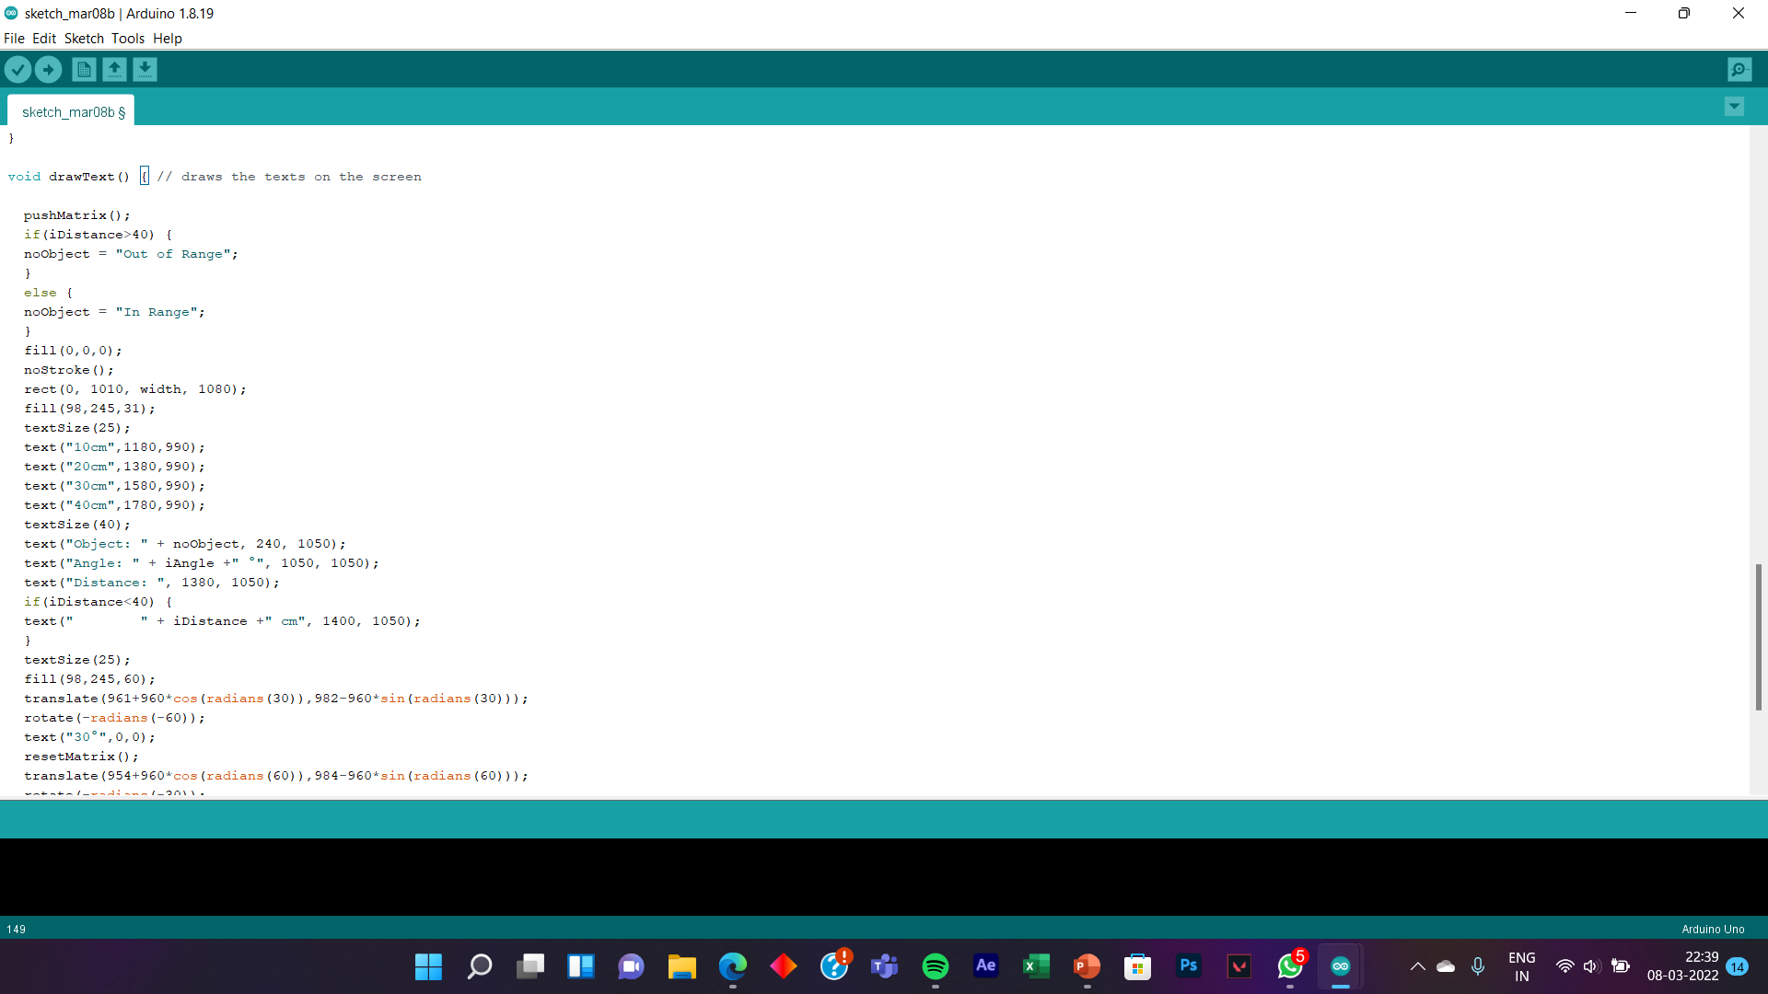

Slide 19
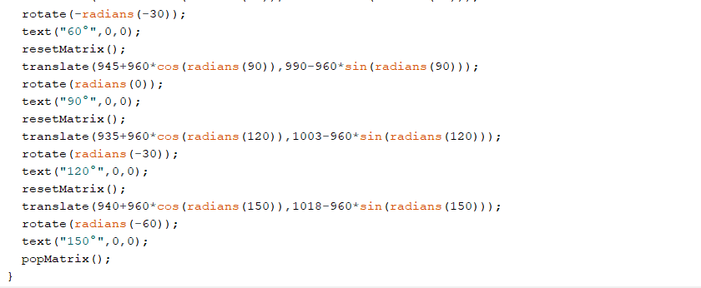

Slide 20
●♦● THANK YOU ●♦●
●♦● THANK YOU ●♦●

