Slide 1

RNA-seq data analysis Matt Settles, PhD University of California, Davis settles@ucdavis.edu
Workshop
ESALQ-USP, Piracicaba, SP
July 17th to July 19th, 2015 (8:30AM-6:00PM)

Slide 2
Outline
Introduction to the Command Line
Introduction to High Throughput Sequencing and RNA-seq
High throughput sequencing
RNA-seq Experimental Design
RNA Sequencing and Sample Preparation
Workshop Dataset
Overview of RNA-seq Data Analysis
Pipeline Workflow/Stages
Software
Metadata input
Files and Directory Structure

Slide 3
outline
Files and File Types
Read Preprocessing
Description of the expHTS preprocess pipeline
Parameters and what they mean
Preprocessing the Workshop Data
QA/QC
Read Mapping
Description of the expHTS mapping pipeline
Parameters and what they mean
Mapping the Workshop Data
QA/QC
Estimate known genes and transcripts expression – Counting
Description of the expHTS counting pipeline
Parameters and what they mean
Counting the Workshop Data
QA/QC

Slide 4
Outline
Differential Expression Analysis using edgeR
Overview of Differential Expression Analysis
Models and model formulation
QA/QC
Perform Differential Expression the Workshop Data
Summarization and Visualization of Output

Slide 5
The Command line
SECTION 1

Slide 6
The command line
The command line is powerful and the preferred way to run bioinformatics tools
BASICS:
Prompt msettles@MacBook-Pro:~$
~ is your home director
... $ command [parameters] [files] ENTER
parameters begin with a - short parameter or -- long parameter
Help ... $ man command
… $ command –h
… $ command –help
Tab complete!!

Slide 7
The command line
Command input/output:
file/folder on the command line, either as a positional argument or a parameter, or defaults
stdin aka ‘standard in’, input pipe
stdout aka ‘standard out’, output pipe
stderr aka ‘standard error’, pipe for error messages
Special characters:
| vertical bar is the pipe, it pipes the stdout of one command
to the stdin of another cmd
< > 2> feeds stdin, stdout, stderr to the command
>> append
& at the end of a command will run the command in the background
. Current directory
.. Up one folder
/ folder delimiter
* wild character, match anything
When naming files/folders avoid special characters and spaces ( use . and _ )!!

Slide 8
The command line
Basics Commands:
pwd print the working directory (current dir)
ls [file/dir] list the current contents of the directory
ls –lah [file/dir] long list, human readable, show hidden of the directory
cd to change directory
cp f1 f2 copy file f1 to file f2
mv from to mv directory (also way to rename)
mkdir dir make directory
rm file remove file
rmdir dir remove an empty directory
rm –r dir recursively remove a non-empty directory
nano file edit a document
cat f1 [f2] print to stdout file f1 then if provided file f2 (concatenate)
less file view file, one page at a time
head file view the first 10 lines of a file
tail file view the last 10 lines of a file

Slide 9
WoRK Session 1
Perform
Look at your home directory, what files are already there, what files are hidden
Create a new folder
Move into that folder and create a file (write anything)
Show that file, using less and cat
Go back to your home directory
Create a second folder
Copy the file from the first directory to the new directory
Move to your home directory
Remove both folders
Play with the new commands
Playing with the command line

Slide 10
Introduction to sequencing
Section 2

Slide 11
History
It would take a few more decades after the discovery of the double helix in 1953 before we could readily analyze fragments of DNA.
RNA sequencing actually preceded DNA sequencing when Walter Friers from the University of Ghent published the first complete gene and genome of Bacteriophage MS2 in 1972 and 1976 respectively.
Location specific primer extension: Raw Wu (1970), using DNA polymerase catalysis and specific nucleotide labeling.
Chain-terminating inhibitors: Frederick Sanger (1977), aided in speeding up the process

Slide 12
history
Leroy E. Hood’s laboratory at the California Institute of Technology announced the first semi-automated DNA sequencing machine in 1986.
Applied Biosystems’ produced the first fully automated sequencing machine, the ABI 370, in 1987, followed by the ABI Prism 373, (1990), ABI Prism 377 (1995), ABI Prism 310 (also 1995) represented the first capillary sequencer, ABI Prism 3700 (1999, the workhorse of the human genome project), ABI 3730xl DNA analyzer (2002) @ 2M bases per day.

Slide 13
Primer Walking
Design a primer that matches the sequence neighboring the unknown sequence
Sequence the short DNA strand using the Sanger method
The new sequenced portion is used to design a new primer and repeated
de novo sequencing or “shotgun sequencing”
High-molecular weight DNA is sheared into random
fragments
Shorter fragments are cloned into a vectors
clones are sequenced from both ends, creating two ”reads”
original sequence is reconstitutes by ”assembling” the reads

Slide 14
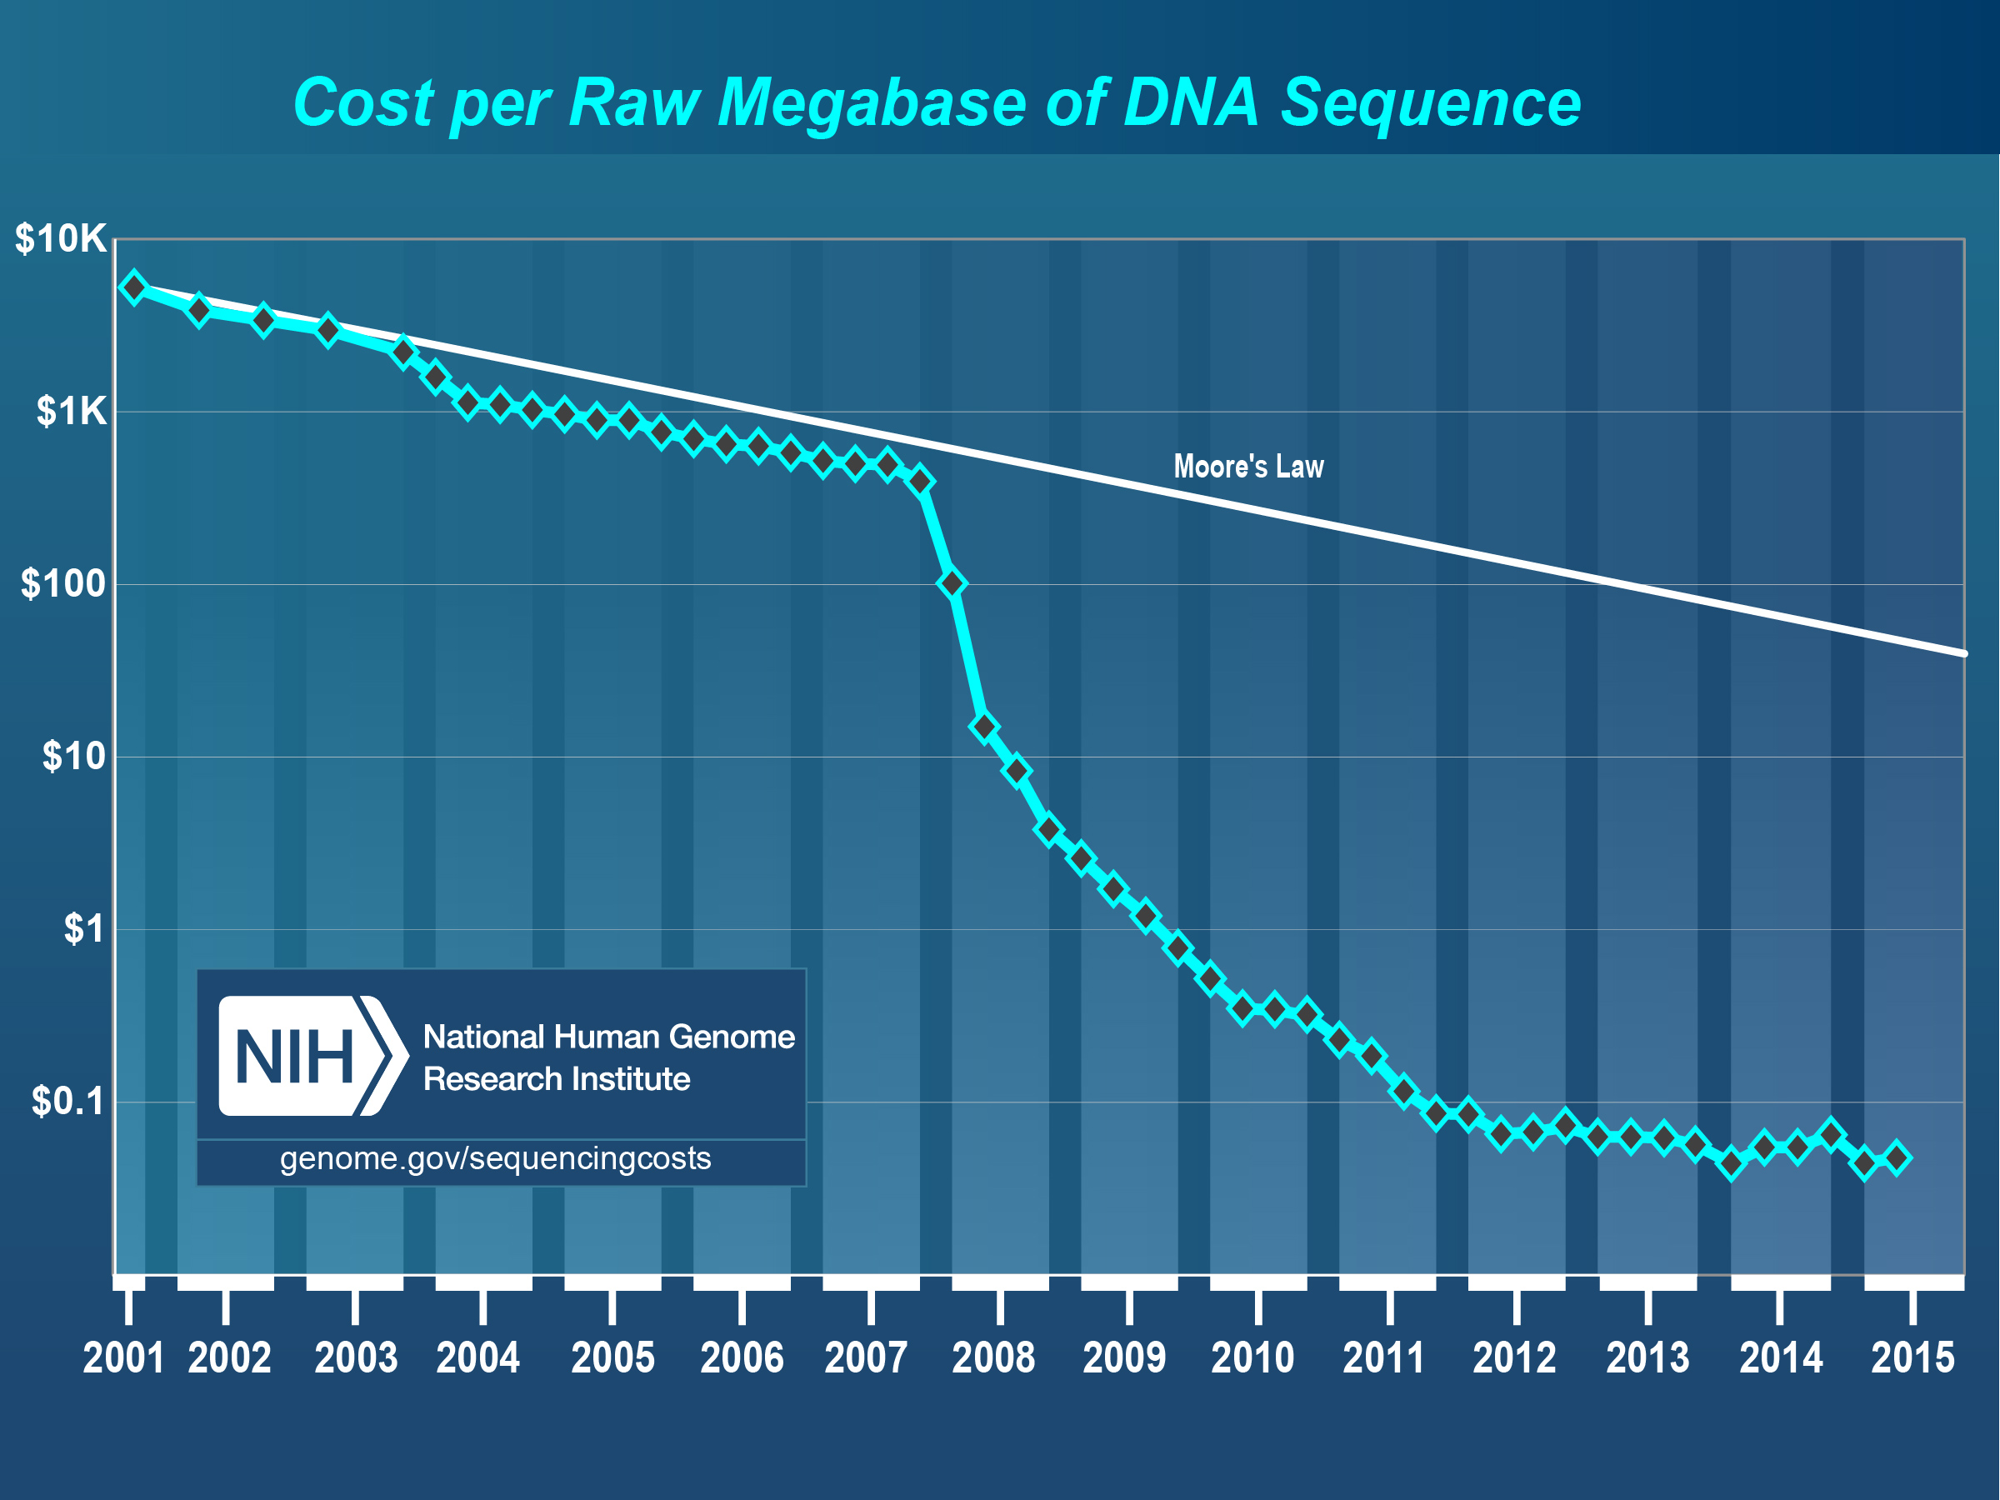
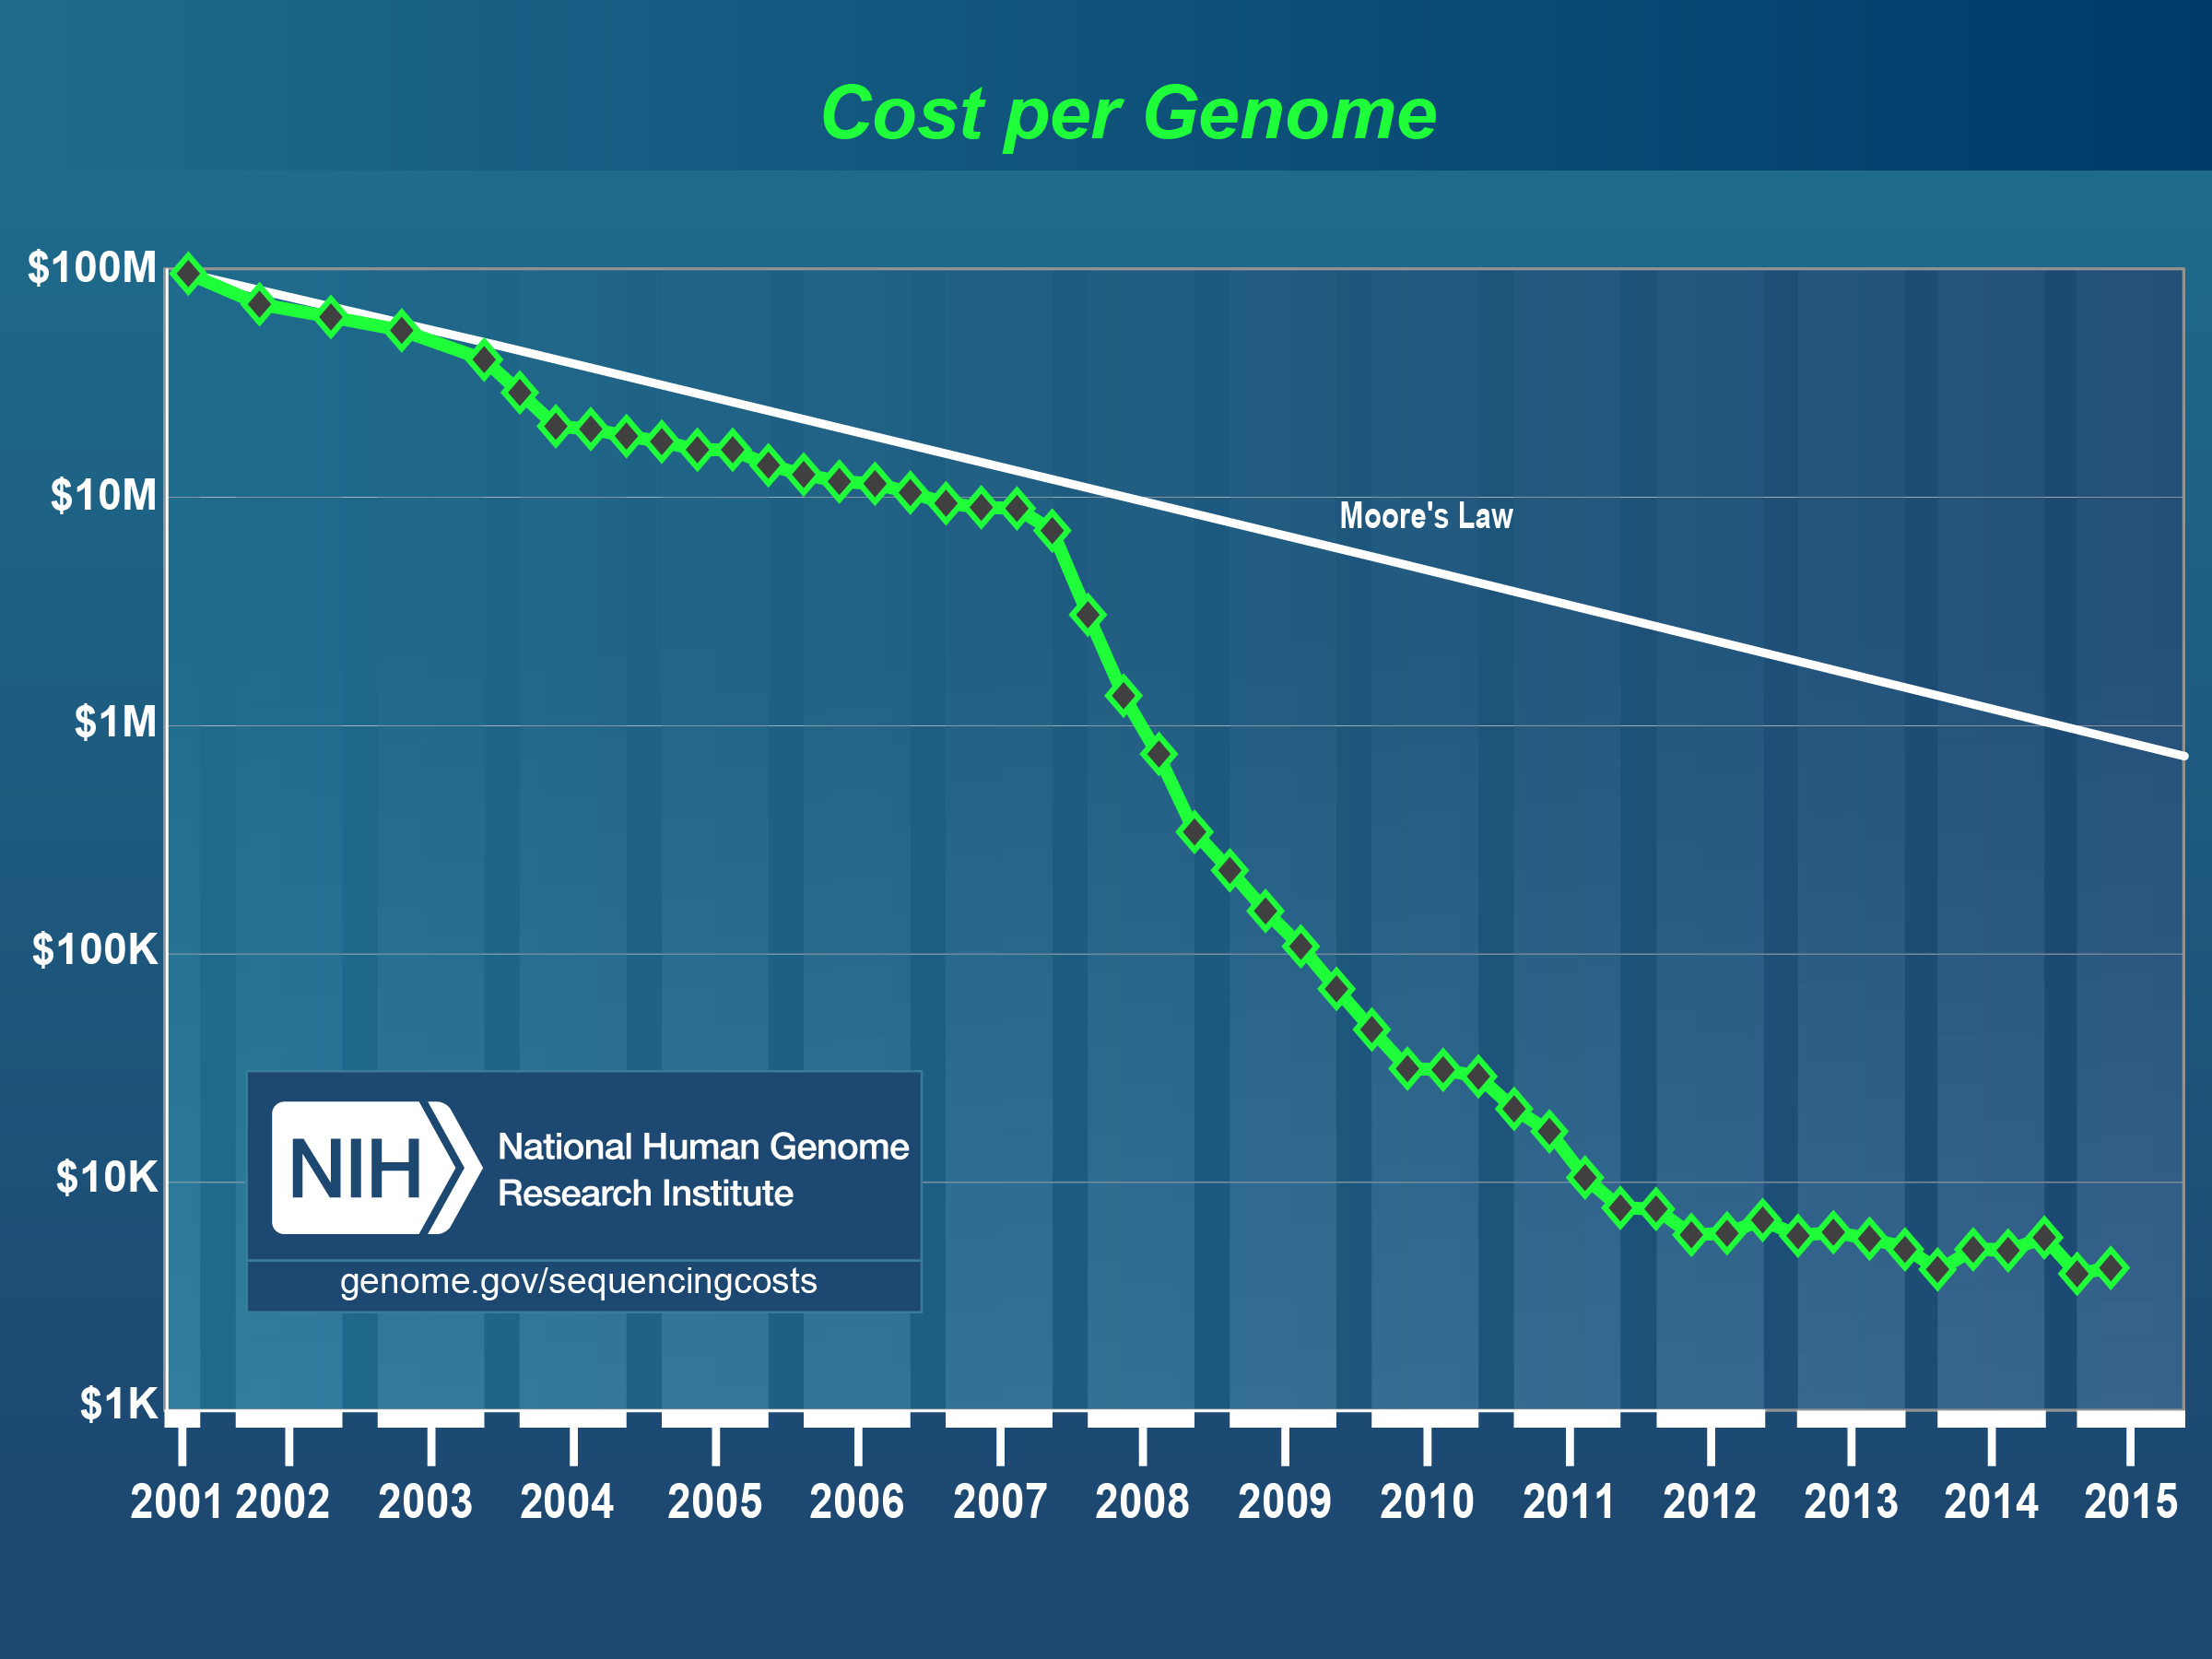
Sequencing Costs
GROWTH IN SEQUENCING
April – 2015
$0.05 per Megabase
$4,211 per Human Sized Genome (30x coverage)

Slide 15
Roche 454
The first massively parallel method to become commercially available was developed by 454 Life Sciences in 2005 (acquired by Roche in 2007) and is based on the pyrosequencing technique. Similar to the Sanger method, sequencing is carried out using primed synthesis by DNA polymerase. However in the 454 pyrosequencing method, the DNA fragments are presented with each of the four dNTPs sequentially and without a dye-terminator, as is done with Sanger sequencing, allowing for multiple incorporation in the same flow. The amount of the incorporation is monitored by luminometric detection of the pyrophosphate released (hence the name ”pyrosequencing”).

Slide 16
Illumina (SOLEXA)
The second next-generation sequencing technology to be released (in 2006) was Illumina Solexa sequencing. A key difference between Roche 454 and Illumina sequencing was the use of chain-terminating nucleotides. The fluorescent label on the terminating base can be removed to leave an unblocked 3’ terminus, mating the chain termination a reversible process. The method thus sequences one base at a time, rather than 0 or more bases as does Roche 454.
Illumina SBS

Slide 17
Life Technologies
Ion Torrent PGM, first available in 2011, generates up to 400bp reads (reported) and up to 2Gb (5.5m reads) per run. Cheap fast runs. Ion Proton system can generate up to 10Gb per run. Generates flowgrams and SFF files similar to Roche 454 data as well as the standard fastq files.

Slide 18
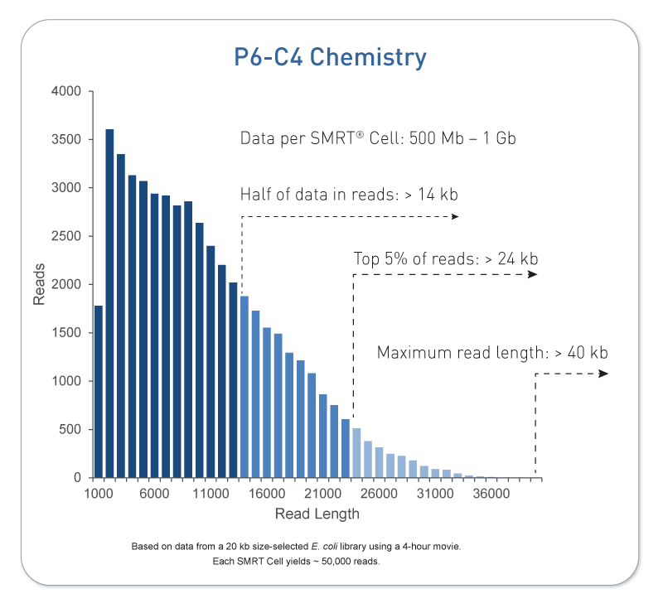
Pacific Biosystems
Pacific Biosystems is so far the most successful third generation DNA sequencing system. Key differences are that its a single molecule, real time (SMRT) technology and capable of producing sequences of multi-kilobases.

Slide 19
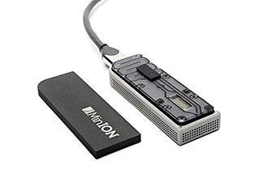
Oxford nanopore
Announced in 2012, Oxford Nanopore sent a ripple through the sequencing community but has yet to live up to expectations. Promises ”tens of kbs”.

Slide 20
WoRK Session 1
Perform
Visit the Illumina website
How many sequencing machines does Illumina Have?
What are the differences between the HiSeq 2500 series and HiSeq 3000/4000 series machines?
What are differences in read length between the MiSeq and HiSeq?
What are the differences between the HiSeq’s High Output Run Mode and the Rapid Run Mode
How many reads (and bp) do you get on one lane of a HiSeq 2500 in High Output Run Mode for 1x50 and 2x100, compare those to what you get on the HiSeq 3000
Getting to know Illumina

Slide 21
Experimental design
In high throughput biological work (Microarrays, Sequencing, HT Genotyping, etc.), what may seem like small technical artifacts introduced during sample extraction/preparation can lead to large changes, or technical bias, in the data.
Not to say this doesn’t occur with smaller scale analysis such as Sanger sequencing or qRT-PCR, but they do become more apparent and may cause significant issues during analysis.

Slide 22
General rules for preparing samples
Prepare more samples then you are going to need, i.e. expect some will be of poor quality, or fail
Preparation stages should occur across all samples at the same time (or as close as possible) and by the same person
Spend time practicing a new technique to produce the highest quality product you can, reliably
Quality and quantity should be established using Fragment analysis traces (pseudo-gel images)
DNA/RNA should not be degraded
260/280 ratios for RNA should be approximately 2.0 and 260/230 should be between 2.0 and 2.2. Values over 1.8 are acceptable
BE CONSISTENT ACROSS ALL SAMPLES!!!

Slide 23
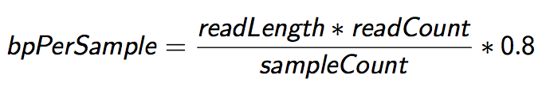
Sequencing Depth
The first and most basic question is how many base pairs of sequence data will I get Factors to consider are:
1. Number of reads being sequenced
2. Read length (if paired consider then as individuals)
3. Number of samples being sequenced
4. Expected percentage of usable data
The number of reads and read length data are best obtained from the manufacturer’s website (search for specifications) and always use the lower end of the estimate.

Slide 24
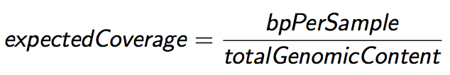
Sequencing Coverage
Once you have the number of base pairs per sample you can then determine expected coverage Factors to consider are:
1. Length of the genome (in bp)
2. Any extra-genomic sequence, or contamination
Coverage is counted differently for ”Counting” based experiments (RNAseq, amplicons) where an expected number of reads per sample is sometimes more suitable.

Slide 25
RNA-seq
Characterization of transcripts or differential gene expression
Factors to consider are:
Read length needed depends on likelihood of mapping uniqueness, but generally longer is better and paired-end is better than single-end. (2 x >75bp is recommended)
Interest in measuring genes expressed at low levels ( << level, the >> the depth and necessary complexity of library)
The fold change you want to be able to detect ( < fold change more replicates, more depth)
Detection of novel transcripts, or quantification of isoforms requires >> sequencing depth
The amount of sequencing needed for a given sample is determined by the goals of the experiment and the nature of the RNA sample.

Slide 26
Generating RNA-seq libraries
Considerations
QA/QC of RNA samples
RNA of interest
Library Preparation
Stranded vs Unstranded
Size Selection/Cleanup
Final QA

Slide 27
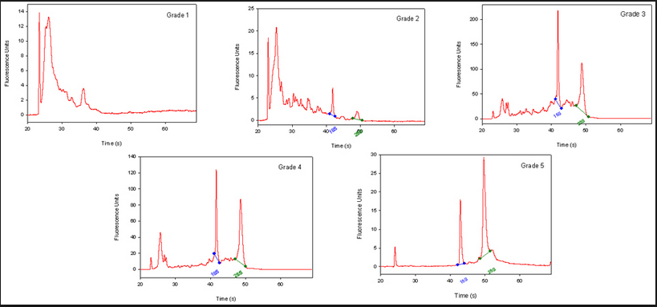
QA/QC of RNA samples
RNA Quality and RIN (RQN on AATI Fragment Analyzer)
RNA sequencing begins with high-quality total RNA, only an Agilant BioAnalyzer (or equivalent) can adequately determine the quality of total RNA samples. RIN values between 7 and 10 are desirable.
BE CONSISTANT!!!

Slide 28
RNA of interest
From total RNA we extract ”RNA of interest”. Primary goal is to NOT sequence 90% (or more) ribosomal RNAs, which are the most abundant RNAs in the typical sample. there are two main strategies for enriching your ”RNA of interest”.
polyA selection. Enrich mRNA (those with polyA tails) from the sample by oligo dT affinity.
rRNA depletion. rRNA knockdown using RiboZero (or Ribominus) is mainly used when your experiment calls for sequencing non-polyA RNA transcripts and non-coding RNA (ncRNA) populations. This method is also usually more costly.
rRNA depletion will result in a much larger proportion of reads align to intergenic and intronic regions of the genome.

Slide 29
Library Preparation
Most library prep methods first require you to generate cDNA, in order to ligate on the Illumina barcodes and adapters.
cDNA generation using oligo dT (3’ biased transcripts)
cDNA generation using random hexomers (less biased)
full-length cDNAs using SMART cDNA synthesis method
Also, can generate strand specific libraries, which means you only sequence the strand that was transcribed.
This is most commonly performed using dUDP rather than dNTPs in cDNA generation and digesting the “rna” strand.
Can also use a RNA ligase to attach adapters and then PCR the second strand and remainder of adapters.

Slide 30
Size Selection/Cleanup/qA
Very important to be consistent across all samples in an experiment on how you size select your final libraries. You can size select by:
Fragmenting your RNA, prior to cDNA generation.
Chemically heat w/magnesium
Mechanically (ex. ultra-sonicator)
Cleanup/Size select after library generation using SPRI beads or (gel cut)
QA the samples using an electrophoretic method (Bioanalyzer) and quantify with qPCR.
Most important thing is to be consistent!!!

Slide 31
BE CONSISTANT!
In high throughput biological work (Microarrays, Sequencing, HT Genotyping, etc.), what may seem like small technical artifacts introduced during sample extraction/preparation can lead to large changes, or bias, in the data.
Not to say this doesn’t occur with smaller scale analysis such as Sanger sequencing or qRT-PCR, but they do become more apparent and may cause significant issues during analysis.

Slide 32
WoRK Session 3
Perform
Search the internet for RNA-SEQ coverage recommendations. Then we will talk about them
RNA-SEQ COVERAGE

Slide 33
Workshop dataset
Section 3

Slide 34
Workshop data
Exophiala dermatitidis NIH/UT8656
Exophiala dermatitidis is a thermophilic black yeast, and a member of the Herpotrichiellaceae. While the species is only found at low abundance in nature, metabolically active strains are commonly isolated in saunas, steam baths, and dish washers. Exophiala dermatitidis only rarely causes infection in humans, however cases have been reported around the world. In East Asia, the species has caused lethal brain infections in young and otherwise healthy individuals. The fungus has been known to cause cutaneous and subcutaneous phaeohyphomycosis, and as a lung colonist in people with cystic fibrosis in Europe. In 2002, an outbreak of systemic E. dermatitidis infection occurred in women who had received contaminated steroid injections at North Carolina hospitals.

Slide 35
Workshop Data
Illumina sequencing of Exophiala dermatitidis NIH/UT8656
Reference transcriptome for the Human Microbiome Project
Data:
http://www.ncbi.nlm.nih.gov/Traces/sra/?study=SRP006291
Article:
http://www.ncbi.nlm.nih.gov/pmc/articles/PMC4059230
References:
Broad - http://www.broadinstitute.org/annotation/genome/Black_Yeasts/MultiHome.html
Ensembl –
http://fungi.ensembl.org/Exophiala_dermatitidis_nih_ut8656/Info/Index

Slide 36
WoRK Session 4
Perform
Briefly scan the data publication
What is the experimental condition: what are we going to compare?
Scanning the document, what was their workflow
How many differentially expressed genes did they get (up regulated / down regulated)?
What was the main result of their experiment?
Workshop Data

Slide 37
Overview of RNA-SEQ data analysis
Section 4

Slide 38
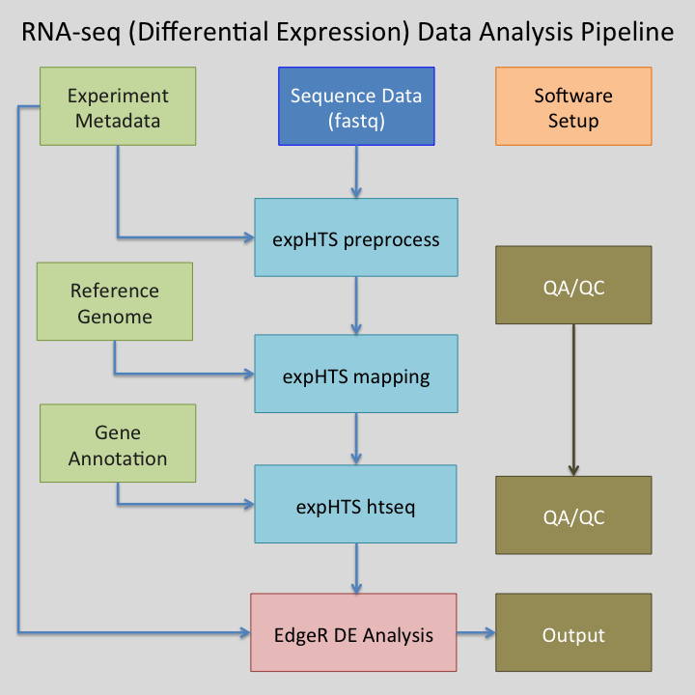
RNA-seq pipeline overview

Slide 39
Software
Preprocessing:
Python 2.7
Modules: argparse, optparse, distutils
bowtie2 - contaminant screening
http://bowtie-bio.sourceforge.net/bowtie2/index.shtml
Super-Deduper – Identify and remove PCR duplicates
https://github.com/dstreett/Super-Deduper
Sickle – Trim low quality regions
https://github.com/dstreett/sickle
Scythe – Identify and remove adapters in SE reads
https://github.com/ucdavis-bioinformatics/scythe
FLASH2 – Join overlapping reads, identify and remove adapter in PE reads
https://github.com/dstreett/FLASH2

Slide 40
Software
Mapping:
Python 2.7
Bwa mem – map reads to a reference
http://sourceforge.net/projects/bio-bwa/files/
samtools – processing of sam/bam file
http://www.htslib.org/
Read Counting:
Python 2.7
samtools – processing of sam/bam file
http://www.htslib.org/
HTeq-0.6.1 htseq_count – count reads occurrences within genes
http://www-huber.embl.de/users/anders/HTSeq/

Slide 41
Software
Analysis of differential expression:
R 3.2.0
http://www.r-project.org/
R Package: optparse from cran
R Package: EdgeR from bioconductor – differential expression analysis
http://bioconductor.org/packages/release/bioc/html/edgeR.html
RStudio
https://www.rstudio.com/

Slide 42
gIT
Git is an open source program for tacking changes in text files. Its was written by the author of the Linux operating system, Linus Torvalds. Use git for:
Tracking software changes
Tracking notes changes
Tracking document changes
Github is a web-based Git repository hosting service, free to use for open repositories
This workshop is available via git and github
https://github.com/msettles/Workshop_RNAseq_Piracicaba2015

Slide 43
GIT
git clone [repo] –to clone a copy of a repository from the remote server (github) onto your workstation. With your clone you can edit the documents as you please
git status – displays the differences between your repositories and the current working head (changes you’ve made).
git pull – when you fetch in changes to the repository and merging them in. for example if I edited the workshop repository, you can then pull in those changes to your workstation

Slide 44
WoRK Session 5
Perform
Find the expHTS repository on github
Using git clone the repository to your desktop
Go into the directory (cd)
Install expHTS with
python setup.py install
Install expHTS using git and python

Slide 45
Metadata File
Variables that describe each sample, including those that will be used to compare samples to each other (experimental factors). Also good to include all technical factors that may influence experimental results (ex. Day of RNA isolation) in order to test for effect later.
samples.txt – is a plain text tab delimited metadata file that will be used within the workshop to run expHTS and the R differential expression analysis. Rows are samples, columns are metadata
Two REQUIRED columns, add more columns as you need
“SEQUENCE_ID” – folder name containing the sequences
“SAMPLE_ID” – Name in which to assign the sample

Slide 46
Files and Directory Structure
We use a strict directory structure to show the relationship between results and input, expHTS assumes this directory structure though it can be changed.
PARENT folder, name of the experiment
00-RawData
SEQUENCE_ID_1
Fastq Files
SEQUENCE_ID_2
Fastq Files
02-Cleaned
SAMPLE_ID_1
Fastq Files
SAMPLE_ID_2
Fastq Files
Preprocessing_Summary.log

Slide 47
Files and Directory Structure
03-BWA
SAMPLE_ID_1
BAM Files
SAMPLE_ID_2
BAM Files
Mapping_Summary.log
04-HTseqCounts
SAMPLE_ID_1
Counts Files
SAMPLE_ID_2
Counts Files
Counts_Summary.log
Reference
Reference fasta
Reference gtf file
samples.txt

Slide 48
WoRK Session 6
Perform
Create the main experiment folder and 00-RawData folder
Move the supplied fastq files to the 00-RawData folder
Create the sample.txt text file for the experiment.
Download the reference genome fasta file and corresponding gene annotation gtf/gff file
Lets Set up the Experiment

Slide 49
Files and file types
Section 5

Slide 50
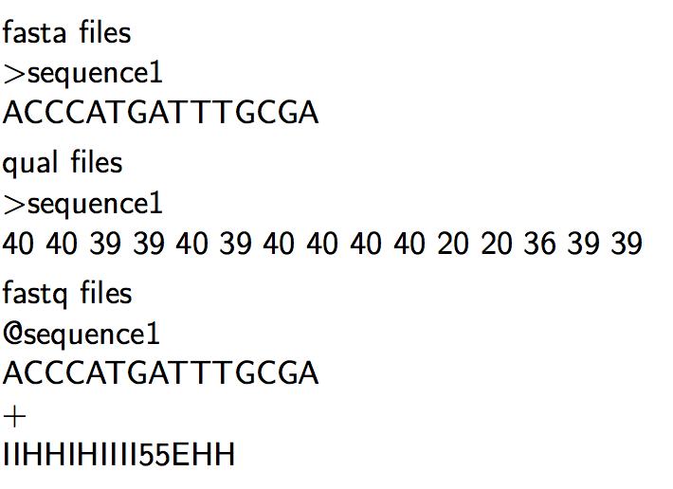
Sequencing Read files

Slide 51
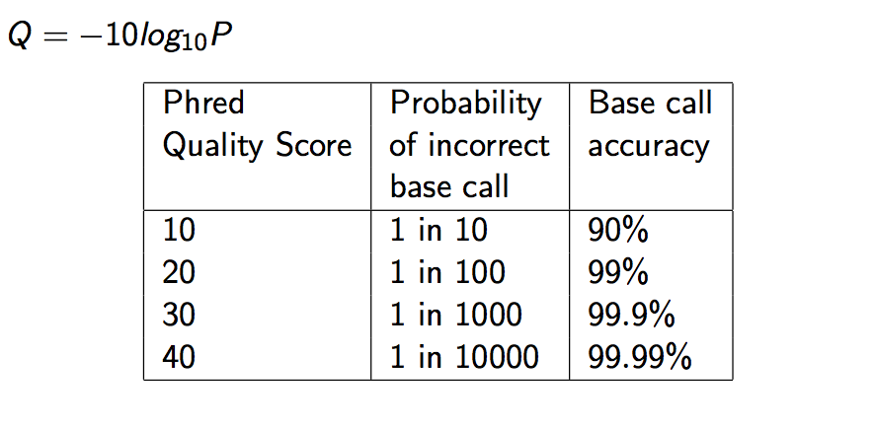
Quality Scores

Slide 52
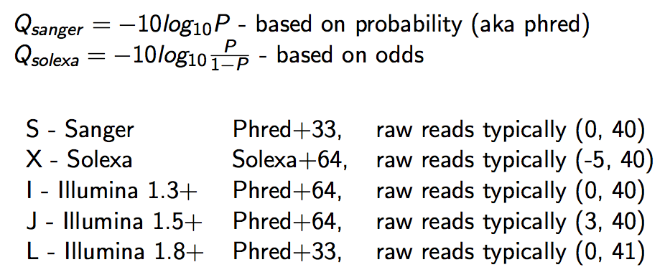
Qscore Conversion

Slide 53
Illumina Read naming conventions
CASAVA 1.8 Read IDs
@EAS139:136:FC706VJ:2:2104:15343:197393 1:Y:18:ATCACG
EAS139 the unique instrument name 136 the run id
FC706VJ the flowcell id 2 flowcell lane
2104 tile number within the flowcell lane
15343 ’x’-coordinate of the cluster within the tile
197393 ’y’-coordinate of the cluster within the tile
1 the member of a pair, 1 or 2 (paired-end or mate-pair reads only)
Y Y if the read fails filter (read is bad), N otherwise
18 0 when none of the control bits are on, otherwise it is an even number
ATCACG index sequence

Slide 54
sAM/BAM Files
SAM (Sequence Alignment/Map) format = unified format for storing read alignments to a reference sequence(Consistent since Sept. 2011). See http://samtools.sourceforge.net/SAM1.pdf
BAM = binary version of SAM for fast querying

Slide 55
SAM/BAM files
SAM files contain two regions
The header section
Each header line begins with character ’@’ followed by a two-letter record type code
The alignment section
Each alignment line has 11 mandatory fields. These fields always appear in the same order and must be present, but their values can be ’0’ or ’*’, if the corresponding information if unavailable, or not applicable.

Slide 56
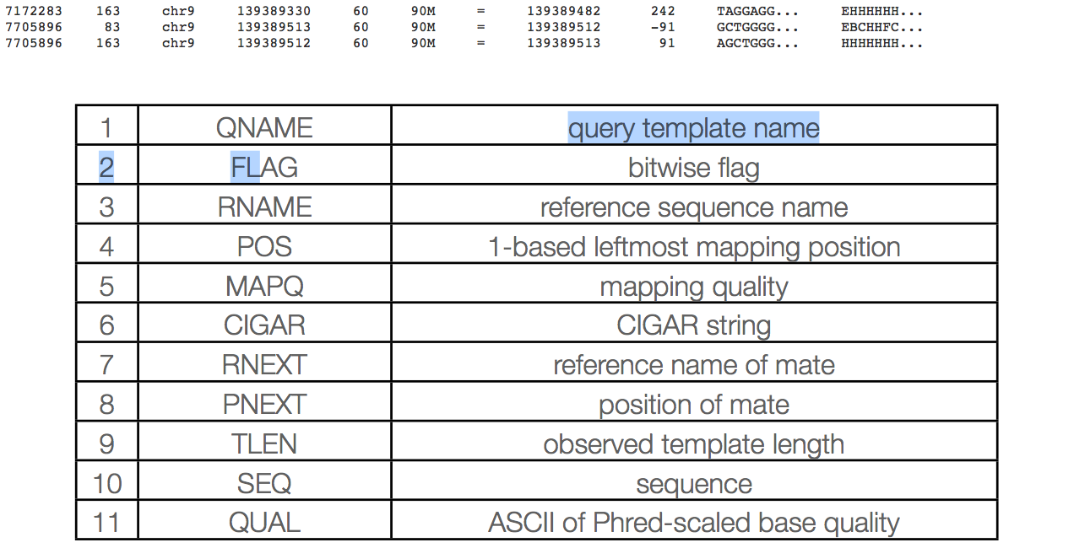
Sam columns

Slide 57
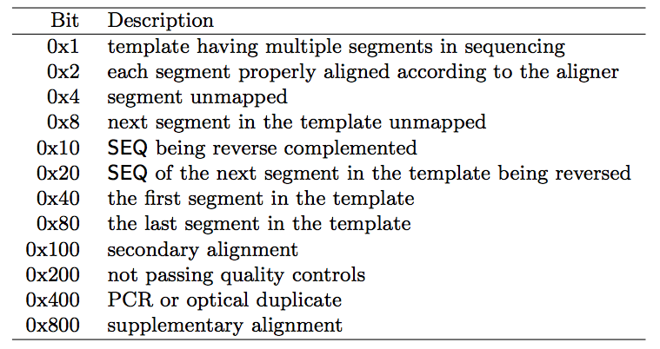
Sam flags

Slide 58
Mapq explained
MAPQ, contains the "phred-scaled posterior probability that the mapping position" is wrong.
In a probabilistic view, each read alignment is an estimate of the true alignment and is therefore also a random variable. It can be wrong. The error probability is scaled in the Phred. For example, given 1000 read alignments with mapping quality being 30, one of them will be incorrectly mapped to the wrong location on average.

Slide 59
Mapq explained
The calculation of mapping qualities is simple, but this simple calculation considers many of the factors below:
The repeat structure of the reference. Reads falling in repetitive regions usually get very low mapping quality.
The base quality of the read. Low quality means the observed read sequence is possibly wrong, and wrong sequence may lead to a wrong alignment.
The sensitivity of the alignment algorithm. The true hit is more likely to be missed by an algorithm with low sensitivity, which also causes mapping errors.
Paired end or not. Reads mapped in pairs are more likely to be correct.

Slide 60
Mapq explained
When you see a read alignment with a mapping quality of 30 or greater, it usually implies:
The overall base quality of the read is good.
The best alignment has few mismatches.
The read has few or just one ‘good’ hit on the reference, which means the current alignment is still the best even if one or two bases are actually mutations, or sequencing errors.
In practice however, each mapper seems to compute the MAPQ in their own way.

Slide 61
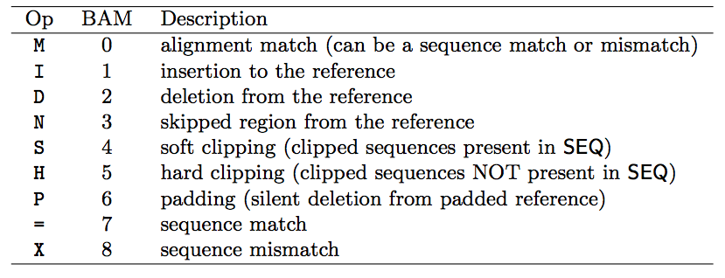
Sam cigar
Compact Idiosyncratic Gapped Alignment Report (CIGAR) SAM flag field:

Slide 62
CIGAR Example
0 0 0 0 0 0 0 0 0 1 1 1 1 1 1 1 1 1 1 2
Ref Pos: 1 2 3 4 5 6 7 8 9 0 1 2 3 4 5 6 7 8 9 0
Reference: C C A T A C T G A A C T G A C T A A C
Read: A C T A G A A T G G C T
POS: 5
CIGAR: 3M1I3M1D5M

Slide 63
GFF/GTF files
The GFF (General Feature Format) format consists of one line per feature, each containing 9 columns of data (fields). The GTF (General Transfer Format) is identical to GFF version 2.
Fields must be tab-separated and all fields must contain a value; “empty” fields should be denoted with a ‘.’.
Columns:
Seqname: Name of the sequence chromosome
Source: the program, or database, that generated the feature
Feature: feature type name, (e.g. gene, exon, cds, etc.)
Start: start position of the feature, sequences begin at 1
End: stop position of the feature, sequences begin at 1
Score: a floating point value (e.g. 0.01)
Strand: Defined as ‘+’ (forward),or ‘-’ (reverse)
Frame: One of ‘0’, ‘1’, ‘2’, ‘0’ represents the first base of a codon.
Attribute: A semicolon-separated list of tag-value pairs, providing additional information about each feature.

Slide 64
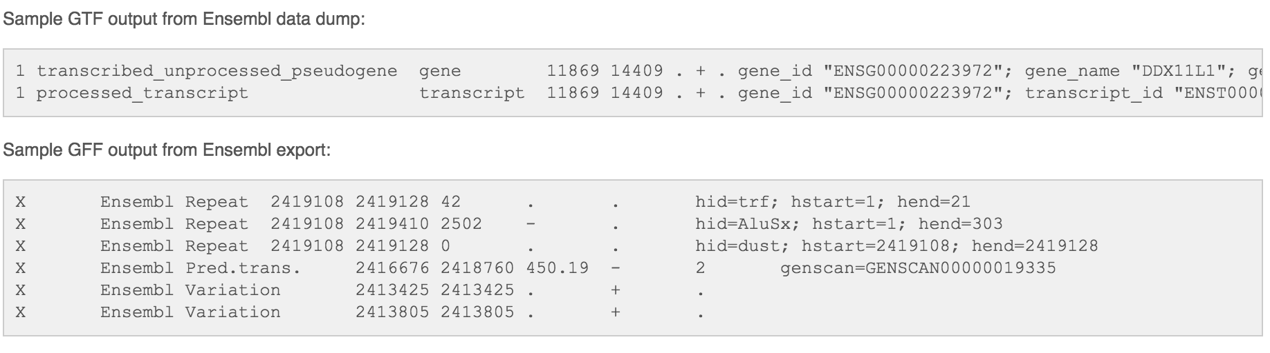
GFF/GTF files

Slide 65
WoRK Session 7
Perform
Explore the fastq files in the experiment
Use less to view gz files
What are the read lengths?
Barcode?
Sequencer ID?
Explore the reference fasta and annotation file, do the two appear concordant?
Files types

