Slide 1

RNA-seq data analysis Matt Settles, PhD University of California, Davis settles@ucdavis.edu
Workshop
ESALQ-USP, Piracicaba, SP
July 17th to July 19th, 2015 (8:30AM-6:00PM)

Slide 2
Outline
Introduction to the Command Line
Introduction to High Throughput Sequencing and RNA-seq
High throughput sequencing
RNA-seq Experimental Design
RNA Sequencing and Sample Preparation
Workshop Dataset
Overview of RNA-seq Data Analysis
Pipeline Workflow/Stages
Software
Metadata input
Files and Directory Structure

Slide 3
outline
Files and File Types
Read Preprocessing
Description of the expHTS preprocess pipeline
Parameters and what they mean
Preprocessing the Workshop Data
QA/QC
Read Mapping
Description of the expHTS mapping pipeline
Parameters and what they mean
Mapping the Workshop Data
QA/QC
Estimate known genes and transcripts expression – Counting
Description of the expHTS counting pipeline
Parameters and what they mean
Counting the Workshop Data
QA/QC

Slide 4
Outline
Differential Expression Analysis using edgeR
Overview of Differential Expression Analysis
Models and model formulation
QA/QC
Perform Differential Expression the Workshop Data
Summarization and Visualization of Output

Slide 5
The Command line
SECTION 1

Slide 6
The command line
The command line is powerful and the preferred way to run bioinformatics tools
BASICS:
Prompt msettles@MacBook-Pro:~$
~ is your home director
... $ command [parameters] [files] ENTER
parameters begin with a - short parameter or -- long parameter
Help ... $ man command
… $ command –h
… $ command –help
Tab complete!!

Slide 7
The command line
Command input/output:
file/folder on the command line, either as a positional argument or a parameter, or defaults
stdin aka ‘standard in’, input pipe
stdout aka ‘standard out’, output pipe
stderr aka ‘standard error’, pipe for error messages
Special characters:
| vertical bar is the pipe, it pipes the stdout of one command
to the stdin of another cmd
< > 2> feeds stdin, stdout, stderr to the command
>> append
& at the end of a command will run the command in the background
. Current directory
.. Up one folder
/ folder delimiter
* wild character, match anything
When naming files/folders avoid special characters and spaces ( use . and _ )!!

Slide 8
The command line
Basics Commands:
pwd print the working directory (current dir)
ls [file/dir] list the current contents of the directory
ls –lah [file/dir] long list, human readable, show hidden of the directory
cd to change directory
cp f1 f2 copy file f1 to file f2
mv from to mv directory (also way to rename)
mkdir dir make directory
rm file remove file
rmdir dir remove an empty directory
rm –r dir recursively remove a non-empty directory
nano file edit a document
cat f1 [f2] print to stdout file f1 then if provided file f2 (concatenate)
less file view file, one page at a time
head file view the first 10 lines of a file
tail file view the last 10 lines of a file

Slide 9
WoRK Session 1
Perform
Look at your home directory, what files are already there, what files are hidden
Create a new folder
Move into that folder and create a file (write anything)
Show that file, using less and cat
Go back to your home directory
Create a second folder
Copy the file from the first directory to the new directory
Move to your home directory
Remove both folders
Play with the new commands
Playing with the command line

Slide 10
Introduction to sequencing
Section 2

Slide 11
History
It would take a few more decades after the discovery of the double helix in 1953 before we could readily analyze fragments of DNA.
RNA sequencing actually preceded DNA sequencing when Walter Friers from the University of Ghent published the first complete gene and genome of Bacteriophage MS2 in 1972 and 1976 respectively.
Location specific primer extension: Raw Wu (1970), using DNA polymerase catalysis and specific nucleotide labeling.
Chain-terminating inhibitors: Frederick Sanger (1977), aided in speeding up the process

Slide 12
history
Leroy E. Hood’s laboratory at the California Institute of Technology announced the first semi-automated DNA sequencing machine in 1986.
Applied Biosystems’ produced the first fully automated sequencing machine, the ABI 370, in 1987, followed by the ABI Prism 373, (1990), ABI Prism 377 (1995), ABI Prism 310 (also 1995) represented the first capillary sequencer, ABI Prism 3700 (1999, the workhorse of the human genome project), ABI 3730xl DNA analyzer (2002) @ 2M bases per day.

Slide 13
Primer Walking
Design a primer that matches the sequence neighboring the unknown sequence
Sequence the short DNA strand using the Sanger method
The new sequenced portion is used to design a new primer and repeated
de novo sequencing or “shotgun sequencing”
High-molecular weight DNA is sheared into random
fragments
Shorter fragments are cloned into a vectors
clones are sequenced from both ends, creating two ”reads”
original sequence is reconstitutes by ”assembling” the reads

Slide 14
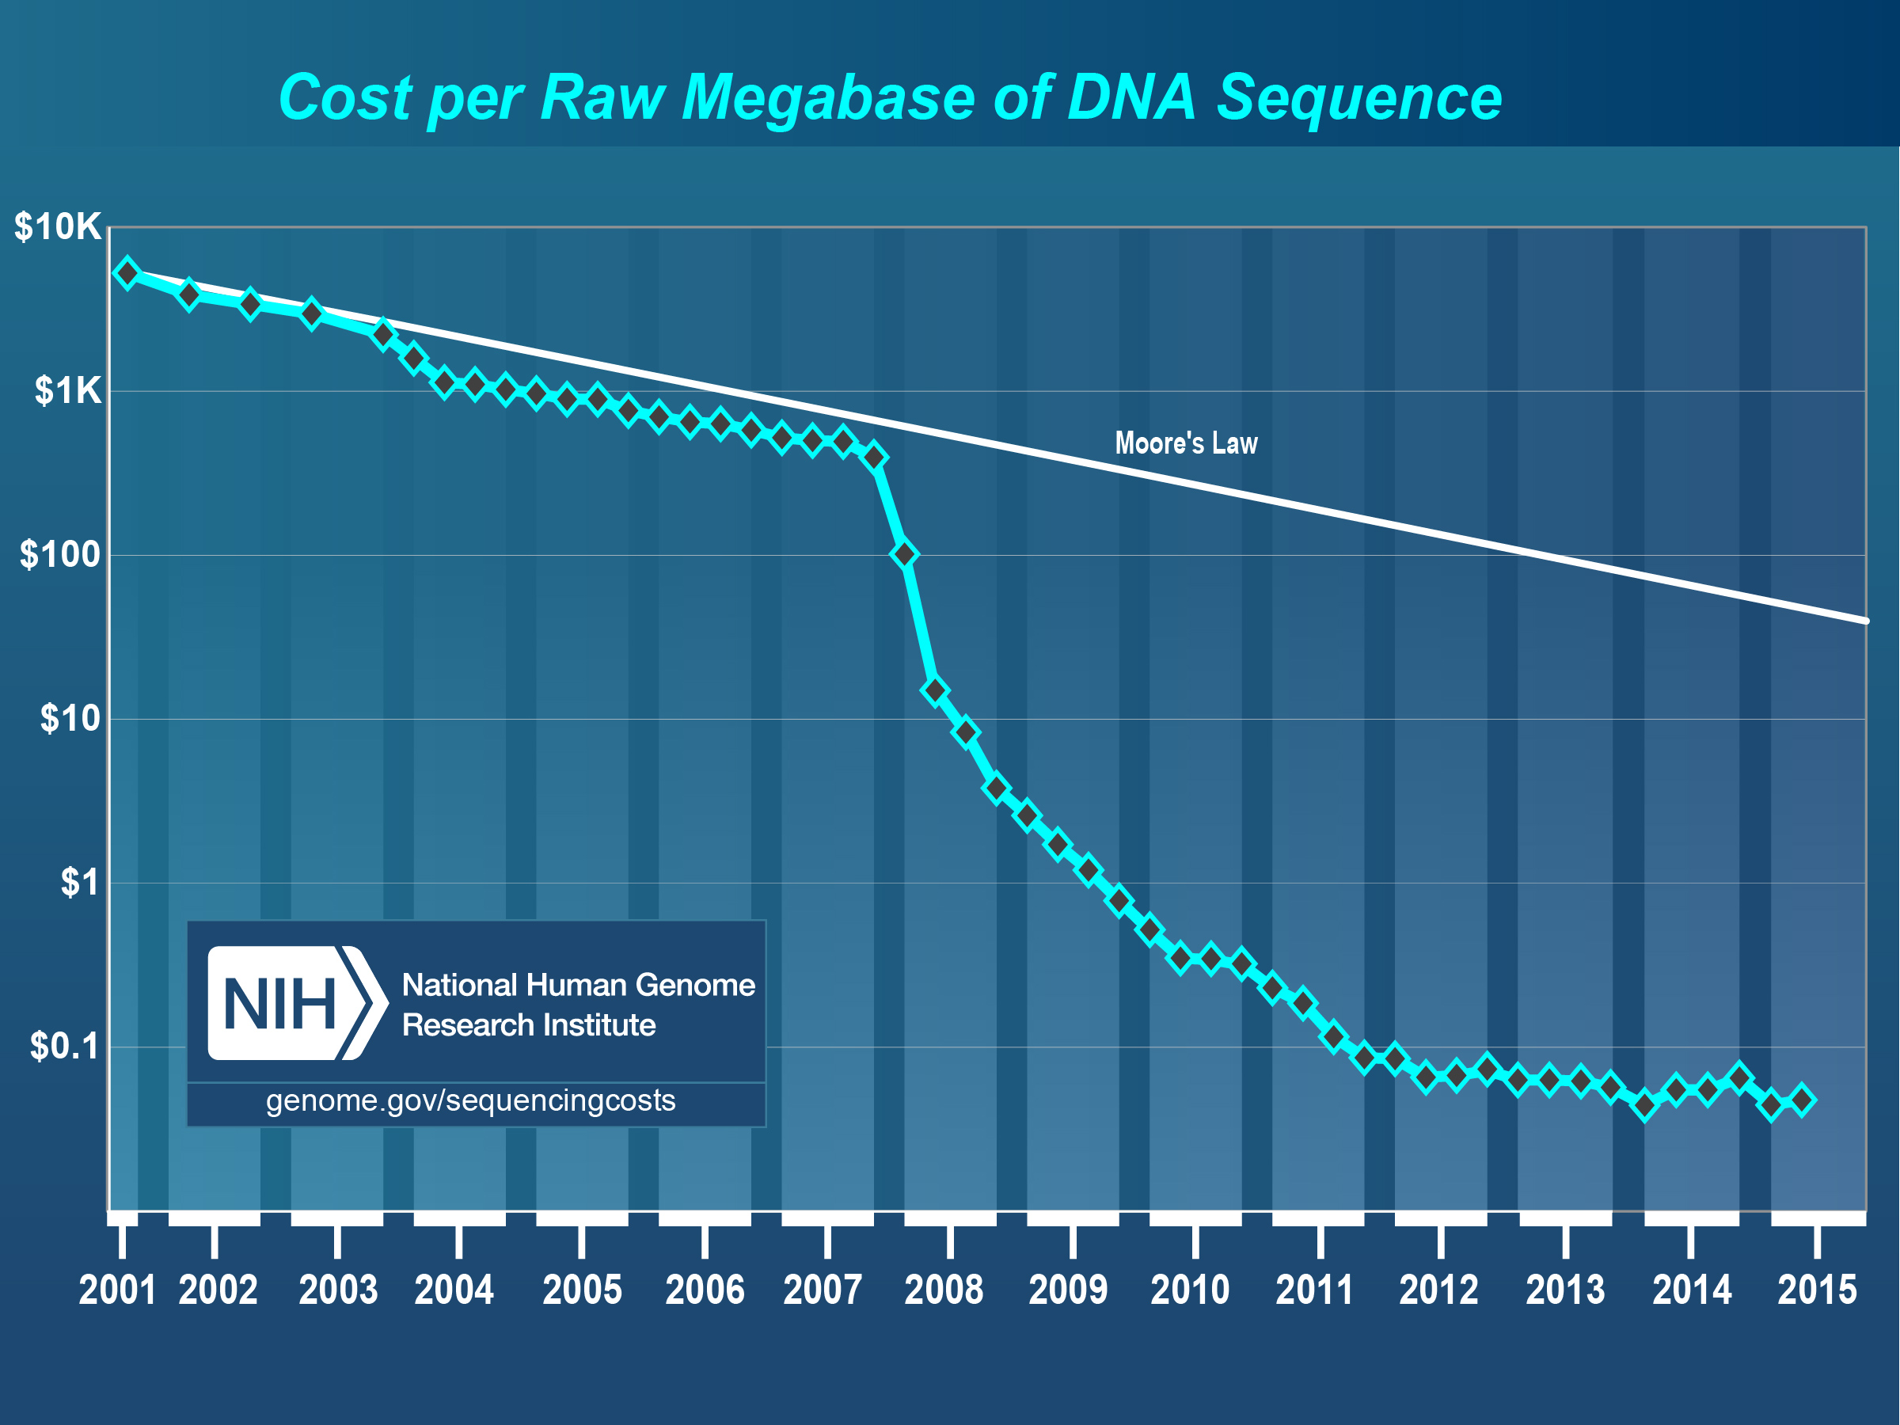
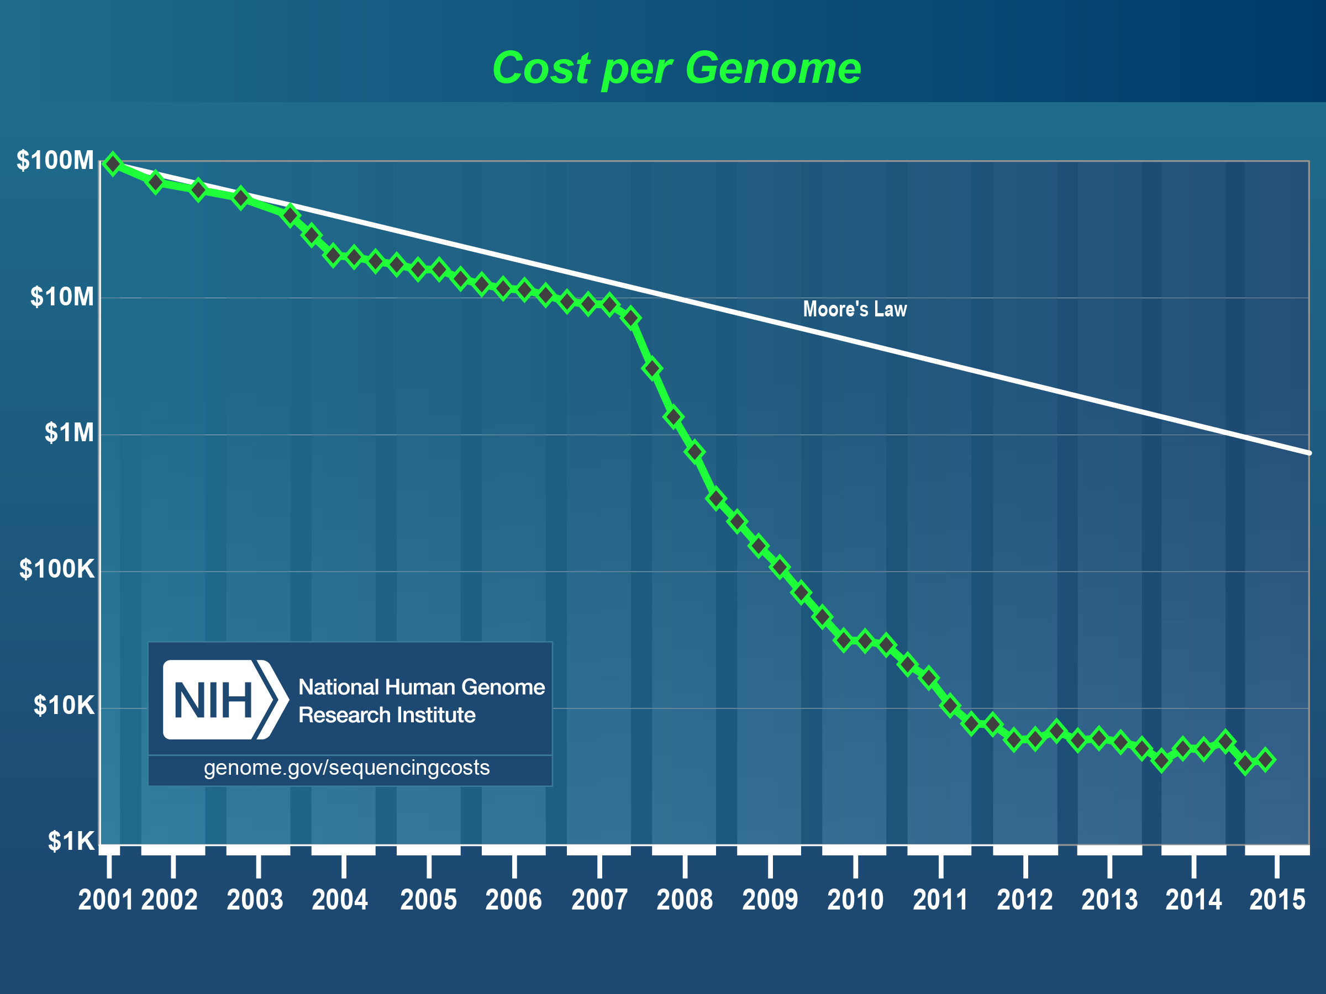
Sequencing Costs
GROWTH IN SEQUENCING
April – 2015
$0.05 per Megabase
$4,211 per Human Sized Genome (30x coverage)

Slide 15
Roche 454
The first massively parallel method to become commercially available was developed by 454 Life Sciences in 2005 (acquired by Roche in 2007) and is based on the pyrosequencing technique. Similar to the Sanger method, sequencing is carried out using primed synthesis by DNA polymerase. However in the 454 pyrosequencing method, the DNA fragments are presented with each of the four dNTPs sequentially and without a dye-terminator, as is done with Sanger sequencing, allowing for multiple incorporation in the same flow. The amount of the incorporation is monitored by luminometric detection of the pyrophosphate released (hence the name ”pyrosequencing”).

Slide 16
Illumina (SOLEXA)
The second next-generation sequencing technology to be released (in 2006) was Illumina Solexa sequencing. A key difference between Roche 454 and Illumina sequencing was the use of chain-terminating nucleotides. The fluorescent label on the terminating base can be removed to leave an unblocked 3’ terminus, mating the chain termination a reversible process. The method thus sequences one base at a time, rather than 0 or more bases as does Roche 454.
Illumina SBS

Slide 17
Life Technologies
Ion Torrent PGM, first available in 2011, generates up to 400bp reads (reported) and up to 2Gb (5.5m reads) per run. Cheap fast runs. Ion Proton system can generate up to 10Gb per run. Generates flowgrams and SFF files similar to Roche 454 data as well as the standard fastq files.

Slide 18
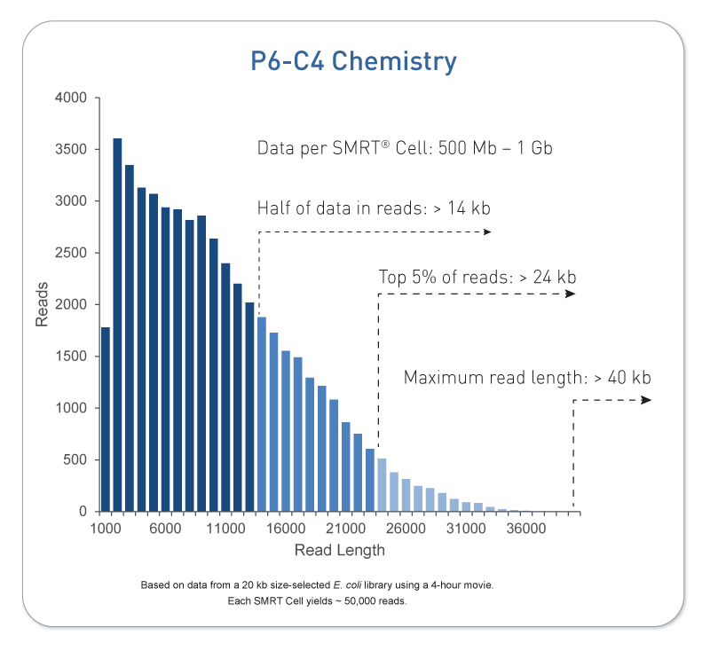
Pacific Biosystems
Pacific Biosystems is so far the most successful third generation DNA sequencing system. Key differences are that its a single molecule, real time (SMRT) technology and capable of producing sequences of multi-kilobases.

Slide 19
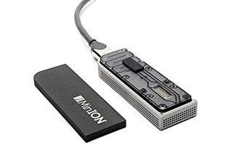
Oxford nanopore
Announced in 2012, Oxford Nanopore sent a ripple through the sequencing community but has yet to live up to expectations. Promises ”tens of kbs”.

Slide 20
WoRK Session 1
Perform
Visit the Illumina website
How many sequencing machines does Illumina Have?
What are the differences between the HiSeq 2500 series and HiSeq 3000/4000 series machines?
What are differences in read length between the MiSeq and HiSeq?
What are the differences between the HiSeq’s High Output Run Mode and the Rapid Run Mode
How many reads (and bp) do you get on one lane of a HiSeq 2500 in High Output Run Mode for 1x50 and 2x100, compare those to what you get on the HiSeq 3000
Getting to know Illumina

Slide 21
Experimental design
In high throughput biological work (Microarrays, Sequencing, HT Genotyping, etc.), what may seem like small technical artifacts introduced during sample extraction/preparation can lead to large changes, or technical bias, in the data.
Not to say this doesn’t occur with smaller scale analysis such as Sanger sequencing or qRT-PCR, but they do become more apparent and may cause significant issues during analysis.

Slide 22
General rules for preparing samples
Prepare more samples then you are going to need, i.e. expect some will be of poor quality, or fail
Preparation stages should occur across all samples at the same time (or as close as possible) and by the same person
Spend time practicing a new technique to produce the highest quality product you can, reliably
Quality and quantity should be established using Fragment analysis traces (pseudo-gel images)
DNA/RNA should not be degraded
260/280 ratios for RNA should be approximately 2.0 and 260/230 should be between 2.0 and 2.2. Values over 1.8 are acceptable
BE CONSISTENT ACROSS ALL SAMPLES!!!

Slide 23
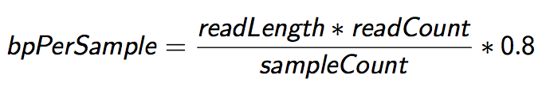
Sequencing Depth
The first and most basic question is how many base pairs of sequence data will I get Factors to consider are:
1. Number of reads being sequenced
2. Read length (if paired consider then as individuals)
3. Number of samples being sequenced
4. Expected percentage of usable data
The number of reads and read length data are best obtained from the manufacturer’s website (search for specifications) and always use the lower end of the estimate.

Slide 24
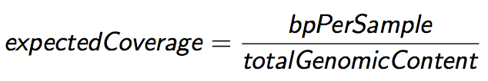
Sequencing Coverage
Once you have the number of base pairs per sample you can then determine expected coverage Factors to consider are:
1. Length of the genome (in bp)
2. Any extra-genomic sequence, or contamination
Coverage is counted differently for ”Counting” based experiments (RNAseq, amplicons) where an expected number of reads per sample is sometimes more suitable.

Slide 25
RNA-seq
Characterization of transcripts or differential gene expression
Factors to consider are:
Read length needed depends on likelihood of mapping uniqueness, but generally longer is better and paired-end is better than single-end. (2 x >75bp is recommended)
Interest in measuring genes expressed at low levels ( << level, the >> the depth and necessary complexity of library)
The fold change you want to be able to detect ( < fold change more replicates, more depth)
Detection of novel transcripts, or quantification of isoforms requires >> sequencing depth
The amount of sequencing needed for a given sample is determined by the goals of the experiment and the nature of the RNA sample.

Slide 26
Generating RNA-seq libraries
Considerations
QA/QC of RNA samples
RNA of interest
Library Preparation
Stranded vs Unstranded
Size Selection/Cleanup
Final QA

Slide 27
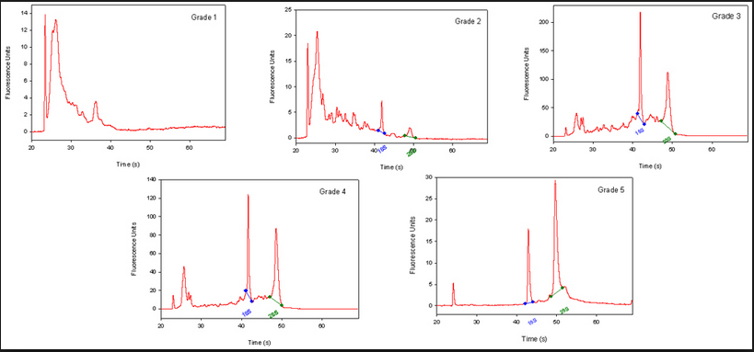
QA/QC of RNA samples
RNA Quality and RIN (RQN on AATI Fragment Analyzer)
RNA sequencing begins with high-quality total RNA, only an Agilant BioAnalyzer (or equivalent) can adequately determine the quality of total RNA samples. RIN values between 7 and 10 are desirable.
BE CONSISTANT!!!

Slide 28
RNA of interest
From total RNA we extract ”RNA of interest”. Primary goal is to NOT sequence 90% (or more) ribosomal RNAs, which are the most abundant RNAs in the typical sample. there are two main strategies for enriching your ”RNA of interest”.
polyA selection. Enrich mRNA (those with polyA tails) from the sample by oligo dT affinity.
rRNA depletion. rRNA knockdown using RiboZero (or Ribominus) is mainly used when your experiment calls for sequencing non-polyA RNA transcripts and non-coding RNA (ncRNA) populations. This method is also usually more costly.
rRNA depletion will result in a much larger proportion of reads align to intergenic and intronic regions of the genome.

Slide 29
Library Preparation
Most library prep methods first require you to generate cDNA, in order to ligate on the Illumina barcodes and adapters.
cDNA generation using oligo dT (3’ biased transcripts)
cDNA generation using random hexomers (less biased)
full-length cDNAs using SMART cDNA synthesis method
Also, can generate strand specific libraries, which means you only sequence the strand that was transcribed.
This is most commonly performed using dUDP rather than dNTPs in cDNA generation and digesting the “rna” strand.
Can also use a RNA ligase to attach adapters and then PCR the second strand and remainder of adapters.

Slide 30
Size Selection/Cleanup/qA
Very important to be consistent across all samples in an experiment on how you size select your final libraries. You can size select by:
Fragmenting your RNA, prior to cDNA generation.
Chemically heat w/magnesium
Mechanically (ex. ultra-sonicator)
Cleanup/Size select after library generation using SPRI beads or (gel cut)
QA the samples using an electrophoretic method (Bioanalyzer) and quantify with qPCR.
Most important thing is to be consistent!!!

Slide 31
BE CONSISTANT!
In high throughput biological work (Microarrays, Sequencing, HT Genotyping, etc.), what may seem like small technical artifacts introduced during sample extraction/preparation can lead to large changes, or bias, in the data.
Not to say this doesn’t occur with smaller scale analysis such as Sanger sequencing or qRT-PCR, but they do become more apparent and may cause significant issues during analysis.

Slide 32
WoRK Session 3
Perform
Search the internet for RNA-SEQ coverage recommendations. Then we will talk about them
RNA-SEQ COVERAGE

Slide 33
Workshop dataset
Section 3

Slide 34
Workshop data
Exophiala dermatitidis NIH/UT8656
Exophiala dermatitidis is a thermophilic black yeast, and a member of the Herpotrichiellaceae. While the species is only found at low abundance in nature, metabolically active strains are commonly isolated in saunas, steam baths, and dish washers. Exophiala dermatitidis only rarely causes infection in humans, however cases have been reported around the world. In East Asia, the species has caused lethal brain infections in young and otherwise healthy individuals. The fungus has been known to cause cutaneous and subcutaneous phaeohyphomycosis, and as a lung colonist in people with cystic fibrosis in Europe. In 2002, an outbreak of systemic E. dermatitidis infection occurred in women who had received contaminated steroid injections at North Carolina hospitals.

Slide 35
Workshop Data
Illumina sequencing of Exophiala dermatitidis NIH/UT8656
Reference transcriptome for the Human Microbiome Project
Data:
http://www.ncbi.nlm.nih.gov/Traces/sra/?study=SRP006291
Article:
http://www.ncbi.nlm.nih.gov/pmc/articles/PMC4059230
References:
Broad - http://www.broadinstitute.org/annotation/genome/Black_Yeasts/MultiHome.html
Ensembl –
http://fungi.ensembl.org/Exophiala_dermatitidis_nih_ut8656/Info/Index

Slide 36
WoRK Session 4
Perform
Briefly scan the data publication
What is the experimental condition: what are we going to compare?
Scanning the document, what was their workflow
How many differentially expressed genes did they get (up regulated / down regulated)?
What was the main result of their experiment?
Workshop Data

Slide 37
Overview of RNA-SEQ data analysis
Section 4

Slide 38
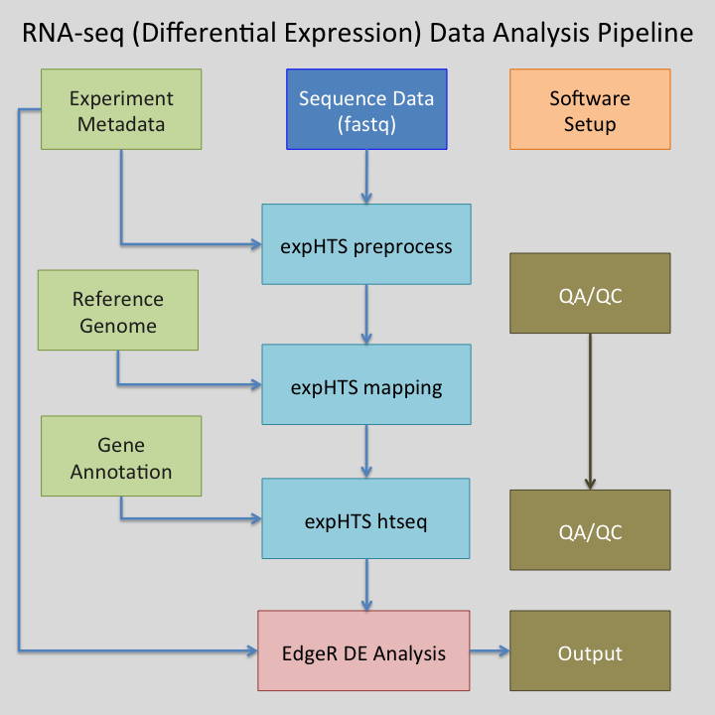
RNA-seq pipeline overview

Slide 39
Software
Preprocessing:
Python 2.7
Modules: argparse, optparse, distutils
bowtie2 - contaminant screening
http://bowtie-bio.sourceforge.net/bowtie2/index.shtml
Super-Deduper – Identify and remove PCR duplicates
https://github.com/dstreett/Super-Deduper
Sickle – Trim low quality regions
https://github.com/dstreett/sickle
Scythe – Identify and remove adapters in SE reads
https://github.com/ucdavis-bioinformatics/scythe
FLASH2 – Join overlapping reads, identify and remove adapter in PE reads
https://github.com/dstreett/FLASH2

Slide 40
Software
Mapping:
Python 2.7
Bwa mem – map reads to a reference
http://sourceforge.net/projects/bio-bwa/files/
samtools – processing of sam/bam file
http://www.htslib.org/
Read Counting:
Python 2.7
samtools – processing of sam/bam file
http://www.htslib.org/
HTeq-0.6.1 htseq_count – count reads occurrences within genes
http://www-huber.embl.de/users/anders/HTSeq/

Slide 41
Software
Analysis of differential expression:
R 3.2.0
http://www.r-project.org/
R Package: optparse from cran
R Package: EdgeR from bioconductor – differential expression analysis
http://bioconductor.org/packages/release/bioc/html/edgeR.html
RStudio
https://www.rstudio.com/

Slide 42
gIT
Git is an open source program for tacking changes in text files. Its was written by the author of the Linux operating system, Linus Torvalds. Use git for:
Tracking software changes
Tracking notes changes
Tracking document changes
Github is a web-based Git repository hosting service, free to use for open repositories
This workshop is available via git and github
https://github.com/msettles/Workshop_RNAseq_Piracicaba2015

Slide 43
GIT
git clone [repo] –to clone a copy of a repository from the remote server (github) onto your workstation. With your clone you can edit the documents as you please
git status – displays the differences between your repositories and the current working head (changes you’ve made).
git pull – when you fetch in changes to the repository and merging them in. for example if I edited the workshop repository, you can then pull in those changes to your workstation

Slide 44
WoRK Session 5
Perform
Find the expHTS repository on github
Using git clone the repository to your desktop
Go into the directory (cd)
Install expHTS with
python setup.py install
Install expHTS using git and python

Slide 45
Metadata File
Variables that describe each sample, including those that will be used to compare samples to each other (experimental factors). Also good to include all technical factors that may influence experimental results (ex. Day of RNA isolation) in order to test for effect later.
samples.txt – is a plain text tab delimited metadata file that will be used within the workshop to run expHTS and the R differential expression analysis. Rows are samples, columns are metadata
Two REQUIRED columns, add more columns as you need
“SEQUENCE_ID” – folder name containing the sequences
“SAMPLE_ID” – Name in which to assign the sample

Slide 46
Files and Directory Structure
We use a strict directory structure to show the relationship between results and input, expHTS assumes this directory structure though it can be changed.
PARENT folder, name of the experiment
00-RawData
SEQUENCE_ID_1
Fastq Files
SEQUENCE_ID_2
Fastq Files
02-Cleaned
SAMPLE_ID_1
Fastq Files
SAMPLE_ID_2
Fastq Files
Preprocessing_Summary.log

Slide 47
Files and Directory Structure
03-BWA
SAMPLE_ID_1
BAM Files
SAMPLE_ID_2
BAM Files
Mapping_Summary.log
04-HTseqCounts
SAMPLE_ID_1
Counts Files
SAMPLE_ID_2
Counts Files
Counts_Summary.log
Reference
Reference fasta
Reference gtf file
samples.txt

Slide 48
WoRK Session 6
Perform
Create the main experiment folder and 00-RawData folder
Move the supplied fastq files to the 00-RawData folder
Create the sample.txt text file for the experiment.
Download the reference genome fasta file and corresponding gene annotation gtf/gff file
Lets Set up the Experiment

Slide 49
Files and file types
Section 5

Slide 50
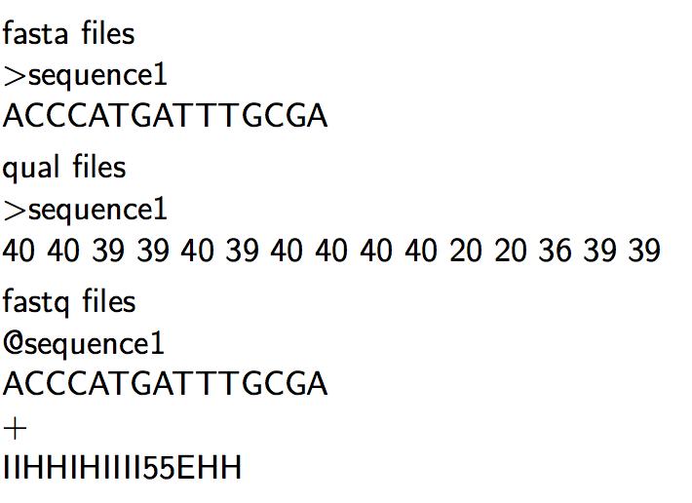
Sequencing Read files

Slide 51
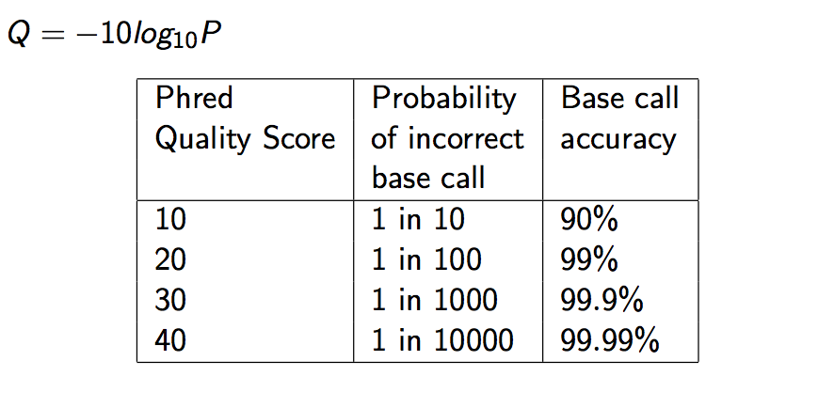
Quality Scores

Slide 52
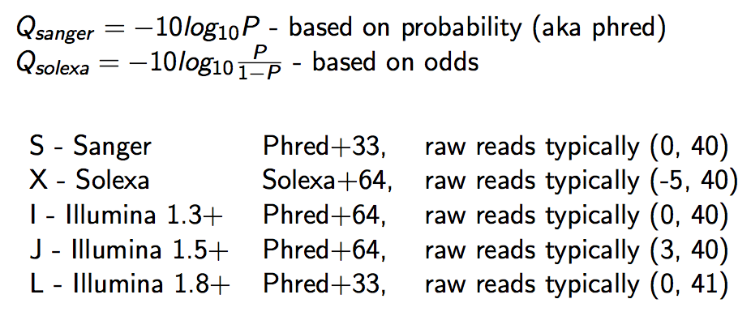
Qscore Conversion

Slide 53
Illumina Read naming conventions
CASAVA 1.8 Read IDs
@EAS139:136:FC706VJ:2:2104:15343:197393 1:Y:18:ATCACG
EAS139 the unique instrument name
136 the run id
FC706VJ the flowcell id
2 flowcell lane
2104 tile number within the flowcell lane
15343 ’x’-coordinate of the cluster within the tile
197393 ’y’-coordinate of the cluster within the tile
1 the member of a pair, 1 or 2 (paired-end or mate-pair reads only)
Y Y if the read fails filter (read is bad), N otherwise
18 0 when none of the control bits are on, otherwise it is an even number
ATCACG index sequence

Slide 54
sAM/BAM Files
SAM (Sequence Alignment/Map) format = unified format for storing read alignments to a reference sequence(Consistent since Sept. 2011). See http://samtools.sourceforge.net/SAM1.pdf
BAM = binary version of SAM for fast querying

Slide 55
SAM/BAM files
SAM files contain two regions
The header section
Each header line begins with character ’@’ followed by a two-letter record type code
The alignment section
Each alignment line has 11 mandatory fields. These fields always appear in the same order and must be present, but their values can be ’0’ or ’*’, if the corresponding information if unavailable, or not applicable.

Slide 56
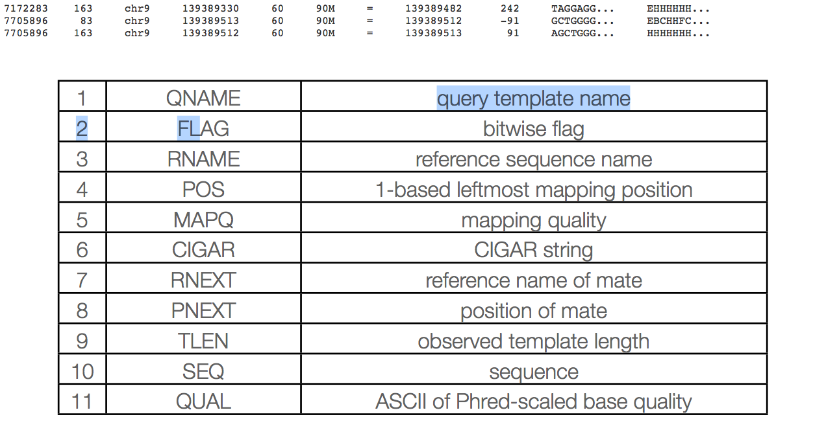
Sam columns

Slide 57
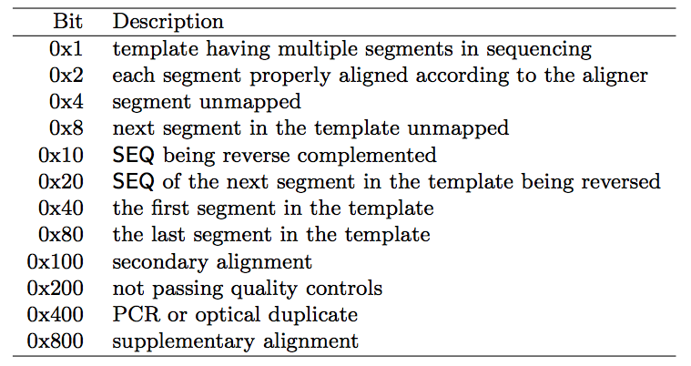
Sam flags

Slide 58
Mapq explained
MAPQ, contains the "phred-scaled posterior probability that the mapping position" is wrong.
In a probabilistic view, each read alignment is an estimate of the true alignment and is therefore also a random variable. It can be wrong. The error probability is scaled in the Phred. For example, given 1000 read alignments with mapping quality being 30, one of them will be incorrectly mapped to the wrong location on average.

Slide 59
Mapq explained
The calculation of mapping qualities is simple, but this simple calculation considers many of the factors below:
The repeat structure of the reference. Reads falling in repetitive regions usually get very low mapping quality.
The base quality of the read. Low quality means the observed read sequence is possibly wrong, and wrong sequence may lead to a wrong alignment.
The sensitivity of the alignment algorithm. The true hit is more likely to be missed by an algorithm with low sensitivity, which also causes mapping errors.
Paired end or not. Reads mapped in pairs are more likely to be correct.

Slide 60
Mapq explained
When you see a read alignment with a mapping quality of 30 or greater, it usually implies:
The overall base quality of the read is good.
The best alignment has few mismatches.
The read has few or just one ‘good’ hit on the reference, which means the current alignment is still the best even if one or two bases are actually mutations, or sequencing errors.
In practice however, each mapper seems to compute the MAPQ in their own way.

Slide 61
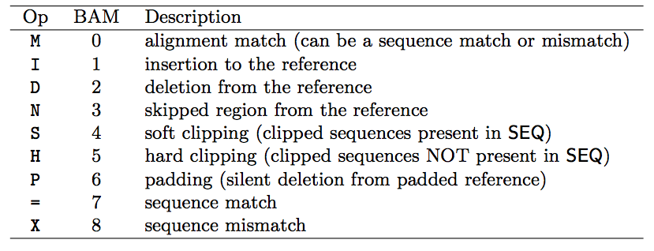
Sam cigar
Compact Idiosyncratic Gapped Alignment Report (CIGAR) SAM flag field:

Slide 62
CIGAR Example
0 0 0 0 0 0 0 0 0 1 1 1 1 1 1 1 1 1 1 2
Ref Pos: 1 2 3 4 5 6 7 8 9 0 1 2 3 4 5 6 7 8 9 0
Reference: C C A T A C T G A A C T G A C T A A C
Read: A C T A G A A T G G C T
POS: 5
CIGAR: 3M1I6M1D2M
** mismatches are not considered in standard CIGAR

Slide 63
GFF/GTF files
The GFF (General Feature Format) format consists of one line per feature, each containing 9 columns of data (fields). The GTF (General Transfer Format) is identical to GFF version 2.
Fields must be tab-separated and all fields must contain a value; “empty” fields should be denoted with a ‘.’.
Columns:
Seqname: Name of the sequence chromosome
Source: the program, or database, that generated the feature
Feature: feature type name, (e.g. gene, exon, cds, etc.)
Start: start position of the feature, sequences begin at 1
End: stop position of the feature, sequences begin at 1
Score: a floating point value (e.g. 0.01)
Strand: Defined as ‘+’ (forward),or ‘-’ (reverse)
Frame: One of ‘0’, ‘1’, ‘2’, ‘0’ represents the first base of a codon.
Attribute: A semicolon-separated list of tag-value pairs, providing additional information about each feature.

Slide 64
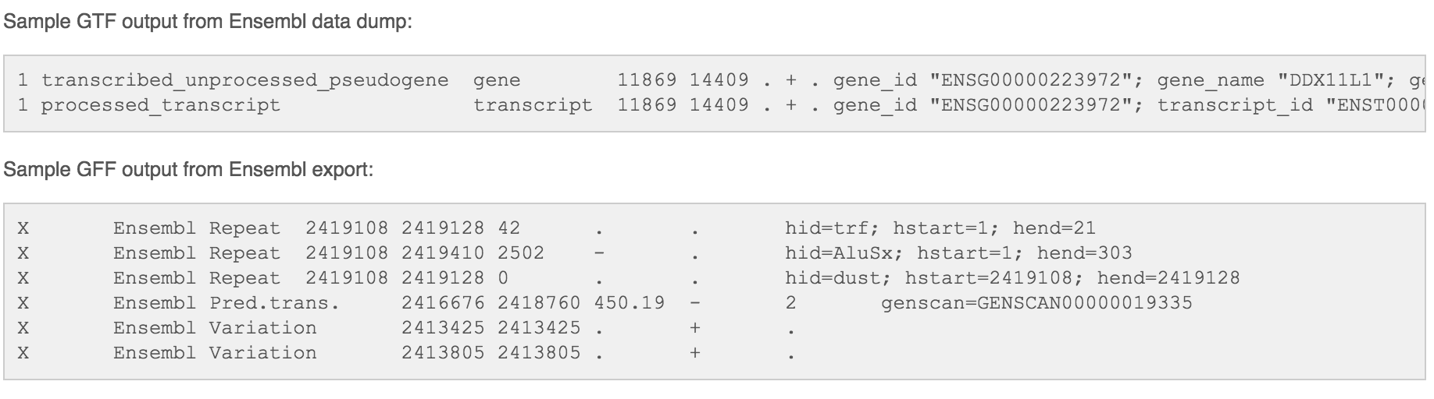
GFF/GTF files

Slide 65
WoRK Session 7
Perform
Explore the fastq files in the experiment
Use less to view gz files
What are the read lengths?
Barcode?
Sequencer ID?
Explore the reference fasta and annotation file, do the two appear concordant?
Files types

Slide 66
Read Preprocessing
Section 6

Slide 67
Why Preprocess reads
We have found that aggressively ”cleaning” and processing reads can make a large difference to speed and quality of assembly and mapping results. Cleaning your reads means, removing reads/bases
that are:
not of primary interest (contamination)
originate from PCR duplication
artificially added onto sequence of primary interest (vectors, adapters, primers)
low quality bases
other unwanted sequence (polyA tails in RNA-seq data)
join short overlapping paired-end reads

Slide 68
Read Preprocessing strategies
Identity and remove contaminant and vector reads
Reads which appear to fully come from extraneous sequence should be removed.
Quality trim/cut
“end” trim a read until the average quality > Q (Lucy)
remove any read with average quality < Q
eliminate singletons/duplicates
If you have excess depth of coverage, and particularly if you have at least x-fold coverage where x is the read length, then eliminating singletons is a nice way of dramatically reducing the number of error-prone reads.
Read which appear the same (particularly paired-end) are often more likely PCR duplicates and therefor redundant reads.
eliminate all reads (pairs) containing an “N” character
If you can afford the loss of coverage, you might throw away all reads containing Ns.
Identity and trim off adapter and barcodes if present
Believe it or not, the software provided by Roche or Illumina, either does not look for, or does a mediocre job of, identifying adapters and removing them.

Slide 69
Read preprocessing Pipeline
The pipeline we’ve developed for read preprocessing employs the following steps for each read:
Contaminant screening (phiX minimum) → PCR duplicate detection/removal → 5’ and 3’ end quality trimming, polyA/T removal → Join (when possible) and remove adapters from paired end reads → Final cleanup, remove too short sequence, second polyA/T removal. Finally generate statistic for each sample
This pipeline is realized using the following applications
screen.py (part of expHTS), extract_unmapped_reads.py (part of expHTS), Super Deduper, Sickle, Flash, cleanupWrapper.py (part of expHTS)

Slide 70
screen.py and extract_unmapped_reads.py
Remove contaminants (at least PhiX), uses bowtie2 then extracts all reads (pairs) that are marked as unmapped.
Super-Deduper
Remove PCR duplicates (we use bases 10-35 of each paired read)
Sickle
Trim sequences (Left and Right) by quality score (I like Q20)
Remove any polyA/T tails (if RNA)
FLASH2
Join and extend, overlapping paired end reads
If reads completely overlap they will contain adapter, remove adapters
Identify and remove any primer dimers present
cleanupWrapper.py
Remove any reads that are less then the minimum length parameter
Run a second polyA/T screen (if RNA)
Produce run statistics

Slide 71
QA/QC
Beyond generating better data for downstream analysis, cleaning statistics also give you an idea as to the quality of the sample, library generation, and sequencing technique used to generate the data.
This can help inform you of what you might do in the future.
I’ve found it best to perform QA/QC on both the run as a whole (poor samples can affect other samples) and on the samples themselves as they compare to other samples (REMEMBER, BE CONSISTANT).
Reports such as Basespace for Illumina, are great ways to evaluate the runs as a whole.
PCA/MDS plots of the preprocessing summary are a great way to look for technical bias across your experiment

Slide 72
expHts preprocess
To run preprocessing across all your samples using the raw fastq files stored in 00-RawData folder, use expHTS preprocess.
Parameter considerations (for RNA-seq):
Remove polyA/T (-a, --polyA): turn on detection and removal of polyA/T tails.
Skip overlapping of PE reads (-O, ----skip-overlap): Currently htseq-count cannot handle a sam/bam file with both single and paired-end reads, so for now we skip overlapping of reads (this also turns ‘off’ detection of adapters in Illumina data)
Force split of PE reads (-S, --forceSplit): EXPERIMENTAL, to handle the situation of htseq not handling both PE and SE we are playing with the idea of splitting resulting SE reads (in half) to generate pairs.
expHTS is defaulted for 2x100bp paired-end DNA samples

Slide 73
QA/QC
View the summary report (in a text editor)
In the workshop git repository is a script
expHTS_Processing_QAQC.R
Will produce multi-dimensional scaling (MDS) plots of the summary files, the purpose is to look for patterns in the plot that are non-random, and may be influenced by technical
Need to provide the script with
The input summary file
The output file to write the pdf to

Slide 74
WoRK Session 8
Perform
Launch read mapping via
expHTS preprocess
When complete perform QA/QC
Running preprocessing

Slide 75
Read Mapping
Section 7

Slide 76
Mapping vs ASSEMLY
Given sequence data,
Assembly seeks to put together the puzzle without knowing what the picture is
Mapping tries to put together the puzzle pieces directly onto an image of the picture
In mapping the question is more, given a small chunk of sequence, where in the genome did this piece most likely come from.
The goal then is to find the match(es) with either the “best” edit distance (smallest), or all matches with edit distance less than max edit dist. Main issues are:
Large search space
Regions of similarity (aka repeats)
Gaps (INDELS)
Complexity (RNA, transcripts)

Slide 77
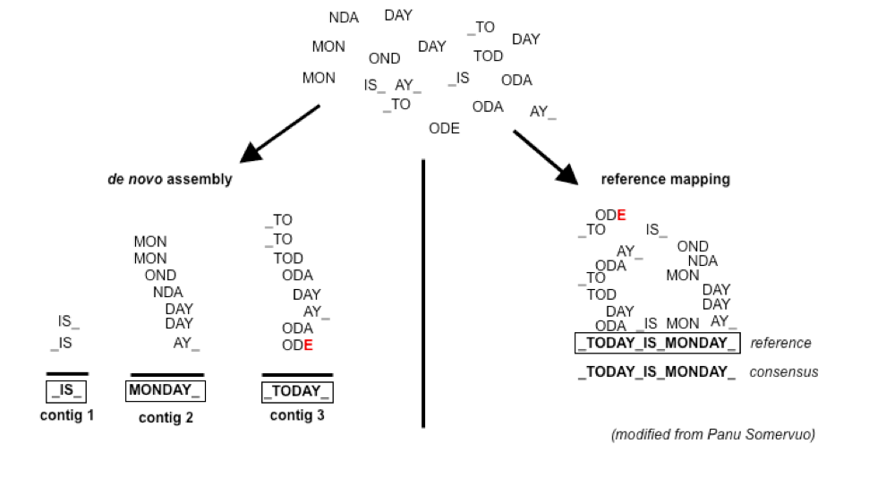
Example

Slide 78
BLAST
Some say the first bioinformatics tool, developed at NIH and published in 1990. Problem:
- Exact algorithms like Smith-Waterman and Needleman-Wunsch (dynamic programming) are slow, when the search space becomes large.
- With the advent of automated DNA sequencing technology, the database of possible matches was becoming increasingly larger.
the BLAST algorithm emphasizes speed over sensitivity, and does not guarantee an optimal alignment.
BLAST is a few-to-many - performs gapped alignment

Slide 79
Blast like alignment tool (Blat)
Blat (Jim Kent, UCSC, 2002) was designed to solve the problem of performing comparisons between large genomes and was one of the first algorithms to efficiently search many query sequences against a large database (a genome). Blat also performs a gapped-alignment for searching RNA sequences against a genome and handling splice junctions.
gapped-alignment alignment allowing for insertions and deletions greater than a few base pairs. Gapped alignment are
less efficient, but more accurate.
BLAT is a many-to-many algorithm - performs gapped alignments

Slide 80
High throughput mapping
Many additional algorithms have been developed since BLAST and BLAT, mainly improving on either speed or accuracy, or both.
and then came Illumina data
New Problem:
We still have a large search space (aka genome)
Small fragments with with to map with possibly many possible close matches
Millions or Billions of query sequences

Slide 81
Consideration
Placing reads in regions that do not exist in the reference genome (reads extend off the end) [ mitochondrial, plasmids, structural variants, etc.].
Sequencing errors and variations: alignment between read and true source in genome may have more differences than alignment with some other copy of repeat.
What if the closest fully sequenced genome is too divergent? (3% is a common alignment capability)
Placing reads in repetitive regions: Some algorithms only return 1 mapping; If multiple: map quality = 0
Algorithms that use paired-end information => might prefer correct distance over correct alignment.

Slide 82
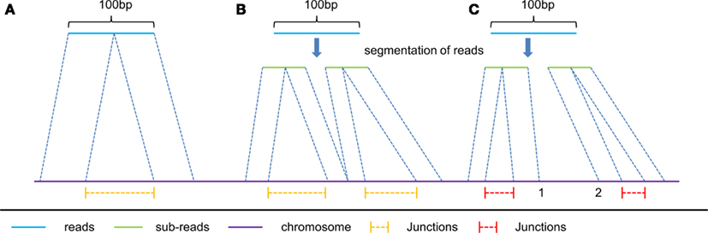
Intron/exon junctions
In RNA-seq data, you must also consider splice junctions, reads may span an intron

Slide 83
Some Aligners
Spliced Aligners
Tophat (Bowtie2)
GSNAP
SOAPsplice
MapSplice
TrueSite
rna-star
Aligners that can ’clip’
bowtie2-local
bwa-mem
http://en.wikipedia.org/wiki/List_of_sequence_ alignment_software

Slide 84
expHts Mapping
To run mapping across all your samples using the cleaned fastq files created with expHTS preprocess, use expHTS mapping.
Parameter considerations (for RNA-seq):
Sort by Read ID (-n, --sortByReadID): turns on bam resorting by read id instead of position, for compatibility with htseq-count (NOW PERFORMED IN HTSEQ, no longer needed)
Ignore singles (-s, --ignoreSingles): Ignore all SE read files present in the cleaned folder, for comparability with htseq-count. While there shouldn’t be any, since we turned off overlapping of reads, this parameters makes ‘sure’ they aren’t included.

Slide 85
QA/QC
View the summary report (in a text editor)
In the workshop git repository is a script
expHTS_Processing_QAQC.R
Will produce multi-dimensional scaling (MDS) plots of the summary files, the purpose is to look for patterns in the plot that are non-random, and may be influenced by technical
Need to provide the script with
The input summary file
The output file to write the pdf to

Slide 86
WoRK Session 9
Perform
Launch read mapping via
expHTS mapping
When complete perform QA/QC
Mapping

Slide 87
Estimate known genes and transcripts expression – Counting
Section 8

Slide 88
Counting as a measure of expression
The more you can count (and HTS sequencing systems can count a lot) the better the measure of copy number for even rare transcripts in a population.
Most RNA-seq techniques deal with count data. Reads are mapped to a reference genome, transcripts are detected, and the number of reads that map to a transcript (or gene) are counted.
Read counts for a transcript are roughly proportional to the gene’s length and transcript abundance.
technical artifacts should be considered during counting
mapping quality
mappability (uniqueness), the read is not ambiguous

Slide 89
Read Counting with HTSEQ
Problem:
Given a sam/bam file with aligned sequence reads and a list of genomic feature (genes locations), we wish to count the number of reads (fragments) than overlap each feature.
Features are defined by intervals, they have a start and stop position on a chromosome.
For this workshop and analysis, features are genes which are the union of all its exons. You could consider each exon as a feature, for alternative splicing.
Htseq-count has three overlapping modes
union:
intersection-strict
intersection-nonempty

Slide 90
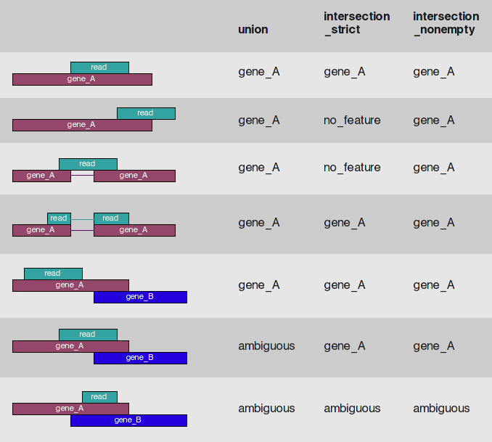
Htseq-count

Slide 91
expHts htseq
To run htseq-count across all your samples using bam files created with expHTS mapping, use expHTS htseq.
Parameter considerations:
Stranded/unstranded (-s, --stranded): ‘yes’ (stranded, same strand as reference), ‘reverse’ (stranded, reverse strand as reference), ‘no’ (unstranded libraries).
Minimum alignment quality (-a, --minaqual): skip all reads with lower than this minimum mapping quality value, default is 10.
Feature type (-y, --type): The feature type to use as reference (3rd column of the gtf/gff file, defines the interval to use, default is ‘exon’
Feature id (-i, --idattr): The feature id to use (union of feature type), defines the final count ‘groups’, default is ‘gene_id’.
Overlapping mode (-m, --mode): The mode to use to define overlaps, ‘union’, ‘intersection-strict’, ‘intersection-nonempty’, default is ‘union’.

Slide 92
QA/QC
View the summary report (in a text editor)
In the workshop git repository is a script
expHTS_Processing_QAQC.R
Will produce multi-dimensional scaling (MDS) plots of the summary files, the purpose is to look for patterns in the plot that are non-random, and may be influenced by technical
Need to provide the script with
The input summary file
The output file to write the pdf to

Slide 93
WoRK Session 10
Perform
Launch read mapping via
expHTS htseq –s reverse
When complete perform QA/QC
View the top (head) and bottom (tail) portion of the counts file, see what the the data looks like.
Read Counting

Slide 94
Differential Expression Analysis using edgeR
Section 9

Slide 95
Differential Expression Analysis
Differential Expression between conditions is determined from count data, which is modeled by a distribution (ie. Negative Binomial Distribution, Poisson, etc.)
Generally speaking differential expression analysis is performed in a very similar manner to DNA microarrays, once bias and normalization have been performed.
A lot of RNA-seq analysis has been done in R and so there are many packages available to analyze and view this data. Two of the best are:
DESeq, developed by Simon Anders (also created htseq) in Wolfgang Huber’s group at EMBL
edgeR (extension to Limma [microarrays] for RNA-seq), developed out of Gordon Smyth’s group from the Walter and Eliza Hall Institute of Medical Research in Australia
http://bioconductor.org/packages/release/BiocViews.html#___RNASeq

Slide 96
NORMALIZATION
In differential expression analysis, only sample-specific effects need to be normalized, concerned with comparisons and quantification of absolute expression.
Sequence depth – is a sample specific effect and needs to be adjusted for.
RNA composition - finding a set of scaling factors for the library sizes that minimize the log-fold changes between the samples for most genes (uses a trimmed mean of M-values between each pair of sample)
GC content – is NOT sample-specific (except when it is)
Gene Length – is NOT sample-specific (except when it is)
Normalization in edgeR is model-based

Slide 97
RPKM vs FPKM vs model based
RPKM - Reads per kilobase per million mapped reads
FPKM - Fragments per kilobase per million mapped reads
Model based - original read counts are not themselves transformed, but rather correction factors are used in the DE model itself.

Slide 98
Basic steps procedure - edger
Read the count data in
Remove (uninteresting genes, e.g. unexpressed)
Calculate normalizing factors (sample-specific adjustment)
Calculate dispersion (gene-gene variance-stabilizing transformation.)
Fit a model of your experiment
Perform likelihood ratio tests on comparisons of interest (using contrasts)
Adjust for multiple testing, Benjamini-Hochberg (BH) is the defaults.
Check results for confidence
Attach annotation if available and write tables

Slide 99
WoRK Session 11
Perform
Using the R-script, Analysis_EdgeR_RNAseq.R on the workshop repository, perform Differential expression analysis on the dataset.
Differential Expression Analysis

Slide 100
Summarization and Visualization
Section 10

Slide 101
Visualization and Next step tools
Visualization
Integrated Genome Viewer (https://www.broadinstitute.org/igv/)
Further Annotation of Genes
DAVID (http://david.abcc.ncifcrf.gov/tools.jsp)
ConsensusPathdb (http://cpdb.molgen.mpg.de/)
NetGestalt (http://www.netgestalt.org/)
Molecular Signatures Database (http://www.netgestalt.org/)
PANTHER (http://www.pantherdb.org/)
Cognoscente (http://vanburenlab.medicine.tamhsc.edu/cognoscente.shtml)
Pathway Commons (http://www.pathwaycommons.org/)
Readctome (http://www.reactome.org/)
PathVisio (http://www.pathvisio.org/)
Moksiskaan (http://csbi.ltdk.helsinki.fi/moksiskaan/)
More tools in R Bioconductor

Slide 102
Gene Set enrichment analysis (GSEA) And GO/Pathway Enrichment
Gene set enrichment analysis
A computational method that determines whether an a priori set of genes (e.g. gene ontology group, or pathway) shows statistically significant, concordant differences between two biological states (e.g. phenotypes)
Gene Ontology/Pathways enrichment analysis
Given a set of genes that are up-regulated, which gene ontologies or pathways are over-represented (or under-represented) using annotations for that gene set.

Slide 103
WoRK Session 12
Perform
View the output table
VERY BRIEFLY compare our results to those of the paper (PMC4059230)
Summarization

