Slide 1
Illumina Miseq Dual-barcoded Two-step PCR Amplicon Sequencing
UC Davis Bioinformatics
Matt Settles
Original Nov 29, 2012
Modified Nov 12, 2015

Slide 2
Outline
Introduction
Basics/Workflow
Primer Design
Dual Barcoding/Mulitple Targets

Slide 3
Amplicon sequencing with dual barcoding
2-step PCR, where the first PCR extracts out the target specific region and the second PCR add on adapters and barcodes. Target specific primers include universal sequences CS1 and CS2, the second PCR extends the universal sequences with adapters and barcodes.
Adapters and barcodes are not included in the target specific primers which allows for maximum flexibility in target specific primer usage and the ability to swap out targets, or include multiple targets in the same sequencing reaction without needing to purchase a large number of barcoded, target specific primers.
Barcodes are included in both adapters, therefor a pair of barcodes are used to uniquely identify a samples. This allows for 32 barcode pairs to be able to uniquely identify 1024 samples.

Slide 4
Benefits
Maximum Flexibility, fewer target specific primers needed, multiple target specific primers capable.
Dual barcoding, allowing for massively multiplexing of samples to occur.
Works with both Illumina, 454 Ion Torrent platforms.
Software for analysis, DNA to abundance table workflow.
Drawbacks
Two PCR reactions (however often allows for more efficient reactions)
Sequence the target specific primer (in my opinion not a drawback)

Slide 5
Basics/Workflow

Slide 6
DNA
Two-step PCR
highly multiplexed and modular amplicon design
Performed in Researcher’s Lab
Target Specific
Primer Design
Primer Validation
Dual-barcoded
Two-step
PCR
Pooling
And
Quantification
Performed in Core Facility
Python dbcAmplicons application
Downstream
Analysis
Demuliplex by barcodes and primer sequences
Illumina Sequencing
Four Read Setup

Slide 7
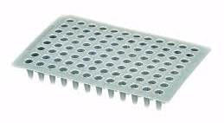
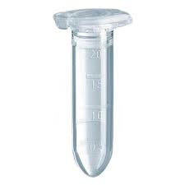
CS2-TS_R
3’
5’
Target Region
5’
3’
CS1-TS_F
PCR-1 Product
Extract target specific region
CS1 TS_F
Target Region
TS_R CS2
P7-BC1-CS2
CS1 TS_F
Target Region
TS_R CS2
P5-BC2-CS1
PCR-2 Product
Add sample specific barcodes and sequencing adapters
P5 BC2 CS1 TS_F
Target Region
TS_R CS2 BC1 P7
Read 4 (100-300bp)
Read 4 primer
P5 BC2 CS1 TS_F
Target Region
TS_R CS2 BC1 P7
Sequencing
Read 3 (8bp)
Read 1 (100 - 300bp)
Read 2 RC (8bp)
Read 3 primer
Read 1 primer
Read 2 RC primer

Slide 8
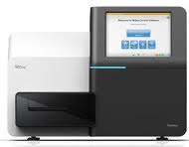
Bioinformatics
Illumina CASAVA 1.8
Four
Fastq files
Barcode Table
“Preprocess”
Demultiplex barcode and
primer sequences
dbcAmplicons
Python Application
Primer Table
Sample Sheet
Barcode | Match determined by edit-distance, allowing for 1 mismatch (by default)
Primers | Match determined by Levenshtein Distance allowing for 4 mismatches (by default) with the final 4 (by default) bases required to be perfect matches
Overlap paired reads
(wrapper around Flash)
Downstream Analysis
https://github.com/msettles/dbcAmplicons

Slide 9
Downstream Analysis
Population Community Profiling ( i.e. microbial, bacterial, fungal, etc. )
dbcAmplicons Python Application
Classify | Wrapper around the MSU Ribosomal Database Project (RDP) Classifier for Bacterial and Archaeal 16S rRNA sequences, Fungal LSU rRNA and ITS (warcup or unite).
Abundance | Reduce RDP classifier results to abundance tables and/or biom formated bile, rows are taxa and columns are samples ready for additional community analysis.
Ecological Analysis | Analysis within R packages such as Vegan, Vegetarian, etc.

Slide 10
Primer design

Slide 11
Primer design for PCR-1 and PCR-2
Primer | Sequence
CS1-TS-F | 5’- ACACTGACGACATGGTTCTACA – [TS_F] – 3’
CS2-TS-R | 5’- TACGGTAGCAGAGACTTGGTCT – [TS_R] – 3’
P5-BC2-CS1 | 5'-AATGATACGGCGACCACCGAGATCTACAC-[BC2]-ACACTGACGACATGGTTCTACA-3'
P7-BC1-CS2 | 5'-CAAGCAGAAGACGGCATACGAGAT-[BC1]-TACGGTAGCAGAGACTTGGTCT-3'

Slide 12
Nucleotide Diversity
Nucleotide diversity is critically important during the first 4 cycles of sequencing for all Illumina sequencing platforms. This is because the sequencing software uses images from these early cycles to identify the location of each cluster in a process called template generation. Furthermore, nucleotide diversity is also important for the first 12 nucleotides in a read because this data is used to calculate the phasing, pre-phasing and color matrix correction values. These correction factors are used in downstream calculations such as corrected intensities and quality scores.
Once a sample library is converted to clusters on a flow cell, “nucleotide diversity” refers to the distribution of nucleotides across the flow cell at any given cycle. From the viewpoint of the instrument software, a high diversity library translates into analyzing images containing an even distribution of spots from 4 different color channels corresponding to the 4 nucleotide bases A, T, C & G. In contrast, an unbalanced nucleotide distribution or “low diversity library” means that for any given image, or to two bases are present at a high percentage.

Slide 13
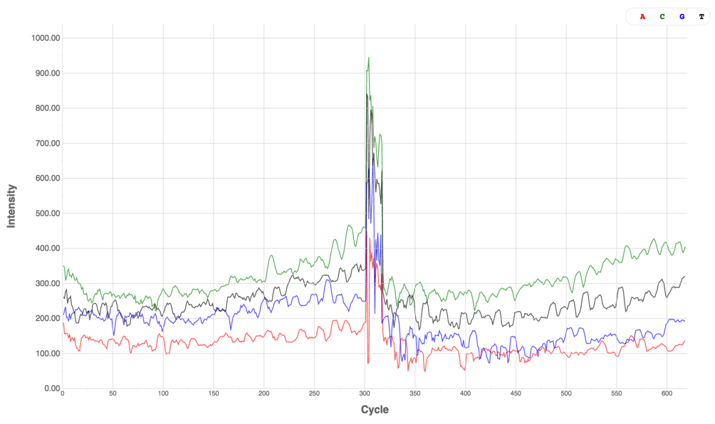

Low Diversity Library vs High Diversity Library
Low Diversity Library
High Diversity Library

Slide 14
Ways to ensure nucleotide diversity
Appropriate nucleotide diversity and cluster density are important for high quality data. Low nucleotide diversity in combination with high cluster density will most-likely lead to poor data quality and/or low data yield.
Ways to avoid low nucleotide diversity
Sequence the sample at a 30-40% lower density
Spiking in at a 5-50% a nucleotide balanced library
(such as PhiX, or better a shotgun library of a sample of interest)
Multiplex a high number of amplicon regions 12 or greater)
Build phase-shifted primers
Note: Experience has shown, that 15% shotgun spike-in, plus phase-shifted primers and/or multiple target region typically yields the best results.

Slide 15
Low complexity libraries will require phase-shifting primers on both flanking regions
4 forward PCR primer
4 reverse PCR primer
N
N
NN
NN
NNN
NNN
CS1
TS_F
TS_R
CS2
In this proposed framework, sequencing begins immediately following the CS1 tag for Read1 and CS2 tag for Read2. Phase-shifting of the primers is then introduced by generating additional primers with additional bases at the start of sequencing (between the CS tag and the target specific primer). These additional primers introduce 1, 2, 3, etc. additional bases and are further designed to allow for a maximum amount of “sequence diversity” in the first 4 bases.

Slide 16
Components of the target specific primer
CS1, or CS2 sequence
Provides the sequence necessary for priming of PCR-2, also serves as the sequencing primer site
Phase-shifting bases
Generates diversity in the sequencing reaction
Linker sequence
Buffers the target specific primer sequence from the rest of the primer, preventing some taxa (longer priming) from being more efficient than others.
Target specific primer sequence

Slide 17
Example target specific primers
Example 27F and 534R (red bases are the inserted bases)
ID | Primer
CS1-27F | ACACTGACGACATGGTTCTACAAGAGTTTGATCCTGGCTCAG
CS1-27F_2 | ACACTGACGACATGGTTCTACACAGAGTTTGATCCTGGCTCAG
CS1-27F_3 | ACACTGACGACATGGTTCTACATCAGAGTTTGATCCTGGCTCAG
CS1-27F_4 | ACACTGACGACATGGTTCTACAGTCAGAGTTTGATCCTGGCTCAG
ID | Primer
CS2-534R | TACGGTAGCAGAGACTTGGTCTATTACCGCGGCTGCTGG
CS2-534R_2 | TACGGTAGCAGAGACTTGGTCTCATTACCGCGGCTGCTGG
CS2-534R_3 | TACGGTAGCAGAGACTTGGTCTTGATTACCGCGGCTGCTGG
CS2-534R_4 | TACGGTAGCAGAGACTTGGTCTGCGATTACCGCGGCTGCTGG
CS1/CS2 sequence, Phase-shifting bases, Linker sequence, target specific primer

Slide 18
Components of the Barcoded adapter primers sequence
P5, or P7 sequence
Primers to the Illumina flow cell, Sequence on the P5 strand typically constitutes R1, those on P7 strand typically constitutes R2.
Barcode sequence
Uniquely identifies sample
CS1, or CS2 sequence
Necessary for extending PCR-1

Slide 19
Example barcoded adapter primers
Example 27F and 534R (red bases are the inserted bases)
ID | Primer
P5-Index1-CS1 | AATGATACGGCGACCACCGAGATCTACACTAGATCGCACACTGACGACATGGTTCTACA
P5-Index2-CS1 | AATGATACGGCGACCACCGAGATCTACACCTCTCTATACACTGACGACATGGTTCTACA
P5-Index3-CS1 | AATGATACGGCGACCACCGAGATCTACACTATCCTCTACACTGACGACATGGTTCTACA
P5-Index4-CS1 | AATGATACGGCGACCACCGAGATCTACACAGAGTAGAACACTGACGACATGGTTCTACA
ID | Primer
P7-Index1-CS2 | CAAGCAGAAGACGGCATACGAGATTAAGGCGATACGGTAGCAGAGACTTGGTCT
P7-Index2-CS2 | CAAGCAGAAGACGGCATACGAGATCGTACTAGTACGGTAGCAGAGACTTGGTCT
P7-Index3-CS2 | CAAGCAGAAGACGGCATACGAGATAGGCAGAATACGGTAGCAGAGACTTGGTCT
P7-Index4-CS2 | CAAGCAGAAGACGGCATACGAGATTCCTGAGCTACGGTAGCAGAGACTTGGTCT
P5/P7 sequence, Barcode, CS1/CS2 sequence

Slide 20
Illumina Sequencing Requires custom sequencing primers to be added to the reaction (Typical Illumina sequencing primers remain in the reaction for sequencing of PhiX or other shotgun library)
BC2 primer
BC2 (8bp)
BC1 primer
BC1 (8bp)
Read1 primer
Read1 (250bp)
Read2 (250bp)
Read2 primer
P5
BC2
CS1
Target Sequence
CS2
BC1
P7
Read | Sequencing Primers
Read1 primer | CS1 - 5’ ACACTGACGACATGGTTCTACA 3’
Read2 primer | CS2 - 5’ TACGGTAGCAGAGACTTGGTCT 3’
BC1 primer | CS2rc - 5’ AGACCAAGTCTCTGCTACCGTA 3’
BC2 primer | Uses the P5 amplification primer

Slide 21
Dual Barcoding Multiple Targets

Slide 22
Dual barcoding allows for massively multiplexing of sample using only relatively few primers
Pairing of BC1 and BC2 uniquely identifies sample
BC1 (attached to CS2)
BC2 (attached to CS1)
^{GTATCGTC}
^{TGCTCGTA}
^{GTCGTCGT}
^{GTGCGTGT}
^{GCGTCGTG}
^{GTCGTGTA}
^{GATGTAGC}
^{GAGTGATC}
^{CGCTATCA}
^{CGCTGTAG}
5 Pairs of Barcodes (5 BC1 and 5 BC2, 10 primers) allows for multiplexing of 25 samples. 32 Pairs can multiplex 1024 samples in the same sequencing reaction.

Slide 23
Multiple targets can be used and pooled into the same reaction
First PCR using 5 different template specific primers on the same samples
Pool the 5 different products into the same well.
Second PCR add on barcodes to identify the sample and sequencing adapters
Pool barcoded products, which are ready for sequencing

