Slide 1
Chapter-3
Database Designs

Slide 2
Relational Constraints/Integrity Rules
The different Relational Integrity Rules
Domain Integrity
No value of the attribute should be beyond the allowable limits
Entity Integrity
In a base relation, no attribute of a Primary Key can assume a value of NULL
Referential Integrity
If a Foreign Key exists in a relation, either the Foreign Key value must match a Candidate Key value in its home relation or the Foreign Key value must be NULL
Enterprise Integrity
Additional rules specified by the users or database administrators of a database are incorporated

Slide 3
Key constraints
Super Key:
set of attribute or attributes that uniquely identifies a tuple within a relation.
A key which we just understand or think at the beginning and they can even be every key in a table
Candidate:
It is minimal subset of super key
If any proper subset of a super key is super key then that key cannot be a candidate key.
Primary keys
The candidate key chosen to uniquely identify each row of data in a table
The DBA Picks any one of the candidate key to be the primary key
The rest one of the candidate key become alternate keys
Foreign key
Primary key of another table used to define relationship with another table and is used to maintain integrity

Slide 4
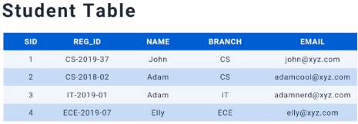

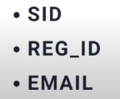
Key constraint Example
Possible combination of Super keys
The following key are combinations of candidate keys
REG_ID is the primary key
SID and EMAIL become alternate keys

Slide 5
Relational Views
There are two kinds of relation in relational database.
1. Base Relation(Named Relation)
corresponding to an entity in the conceptual schema, whose tuples are physically stored in the database.
2. View (Unnamed Relation)
A View is the dynamic result of one or more relational operations operating on the base relations to produce another virtual relation that does not actually exist as presented.
View is a virtually derived relation that does not necessarily exist in the database but can be produced upon request by a particular user at the time of request.

Slide 6
Purpose of a view
Hides unnecessary information from users:
since only part of the base relation (Some collection of attributes, not necessarily all) are to be included in the virtual table.
Provide powerful flexibility and security:
since unnecessary information will be hidden from the user there will be some sort of data security.
Provide customized view of the database for users:
each user is going to be interfaced with his own preferred data set and format by making use of the Views.

Slide 7
Purpose of a view
Update on views derived from various relations is not allowed since it may violate the integrity of the database.
Since aggregation and summary results are computed from a base relation and does not exist actually.
Update on view with aggregation and summary is not allowed.

Slide 8
Schemas and Instances
When a database is designed using a Relational data model
all the data is represented in a form of a table.
In such definitions and representation
there are two basic components of the database.
Schemas
Instances

Slide 9
Schemas and Instances
Database Schema:
specifies name of relation and the collection of the attributes (specifically the Name of attributes).
refer to a description of database or describes how data is to be structured
specified during database design
should not be changed unless during maintenance
Schema Diagrams
convention to display some aspect of a schema visually
Schema Construct
refers to each object in the schema (e.g. STUDENT)
E.g.: STUDENT (FName, LName, Id, Year, Dept, Sex)

Slide 10
Schemas and Instances
Instances
is the collection of data in the database at a particular point of time (snap-shot).
Also called State or Snap Shot or Extension of the database
Refers to the actual data in the database at a specific point in time
State of database is changed any time we add, delete or update an item.
Since Instance is actual data of database at some point in time, changes rapidly
To define a new database, we specify its database schema to the DBMS (database is empty)
database is initialized when we first load it with data

Slide 11
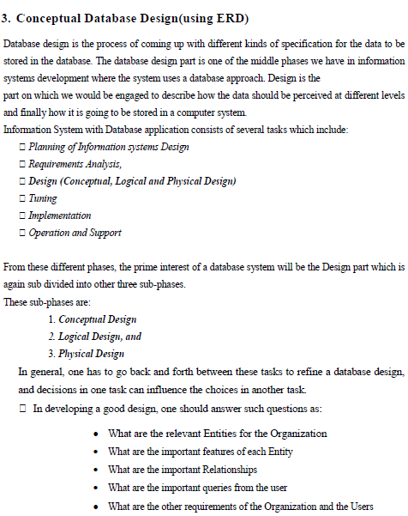
Database design

Slide 12
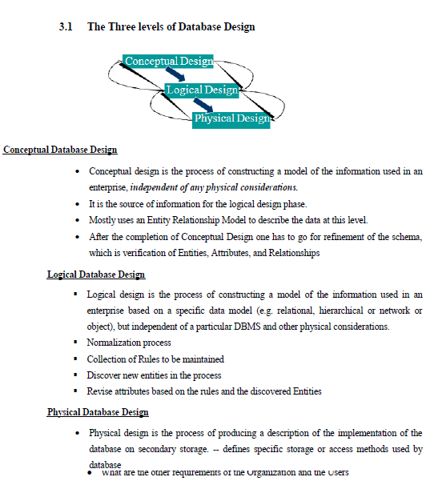
Database design

Slide 13
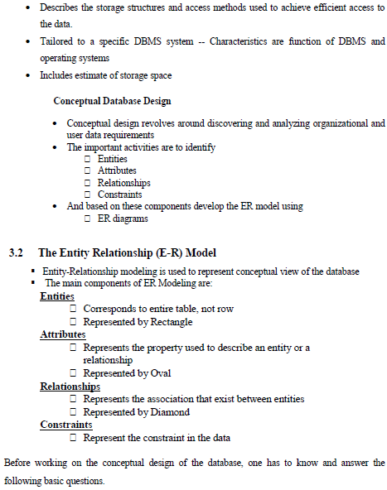
Database design

Slide 14
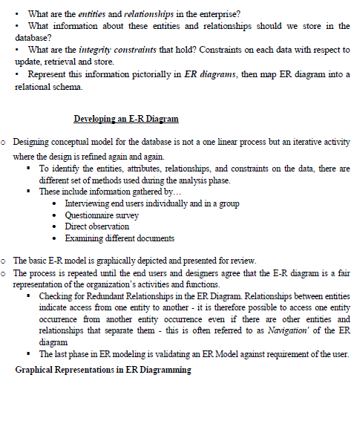
Entity Relationship Diagram (ERD)

Slide 15
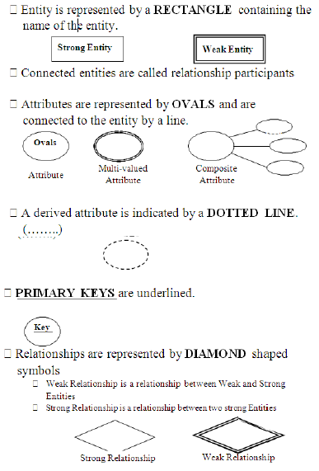
ERD

Slide 16
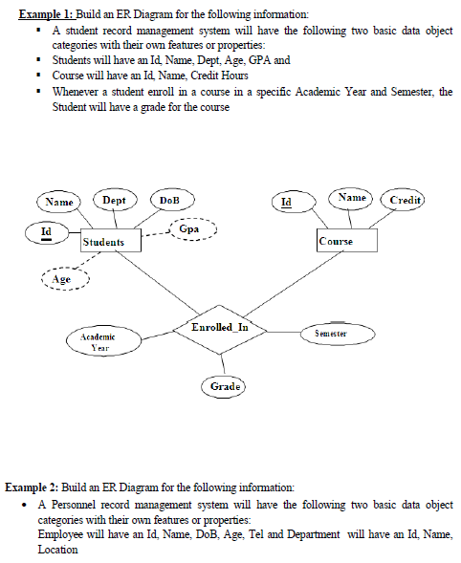
ERD Example

Slide 17
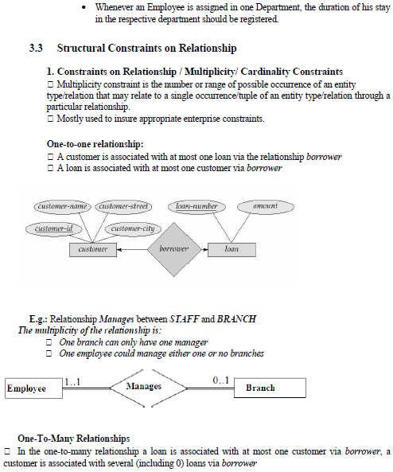
ERD

Slide 18
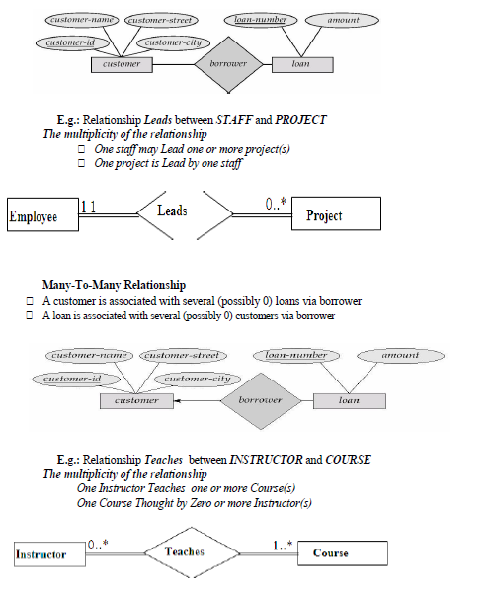
ERD

Slide 19
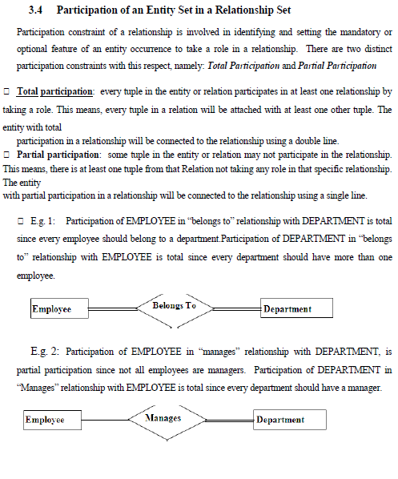
ERD

Slide 20
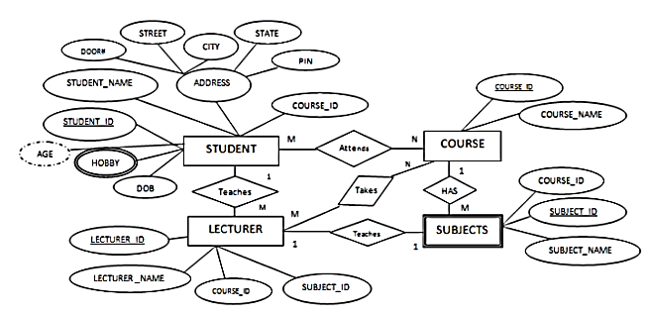
Mapping ERD into Relational model
converting the conceptual design to a form suitable for relational logical model, which is in a form of tables.

Slide 21
Mapping ERD into Relational model
1. The basic rule for converting the ER diagrams into tables
Convert all the Entities in the diagram to tables
All the entities represented in the rectangular box in the ER diagram become independent tables in the database.
In the diagram, STUDENT, COURSE, LECTURER and SUBJECTS forms individual tables

Slide 22
Mapping ERD into Relational model
1. The basic rule for converting the ER diagrams into tables
All single valued attributes of an entity is converted to a column of the table
All the attributes, whose value at any instance of time is unique, are considered as columns of that table.
In the STUDENT Entity, STUDENT_ID, STUDENT_NAME form the columns of STUDENT table.
Similarly, LECTURER_ID, LECTURER_NAME form the columns of LECTURER table. And so on

Slide 23
Mapping ERD into Relational model
1. The basic rule for converting the ER diagrams into tables
Declare the foreign key column, if applicable.
In the diagram, attribute COURSE_ID in the STUDENT entity is from COURSE entity.
Hence add COURSE_ID in the STUDENT table and assign it foreign key constraint.
COURSE_ID and SUBJECT_ID in LECTURER table forms the foreign key column.
Hence by declaring the foreign key constraints, mapping between the tables are established.

Slide 24
Mapping ERD into Relational model
1. The basic rule for converting the ER diagrams into tables
Any multi-valued attributes are converted into new table.
A hobby in the Student table is a multivalued attribute.
Any student can have any number of hobbies.
So we cannot represent multiple values in a single column of STUDENT table.
We need to store it separately, so that we can store any number of hobbies,
adding/ removing / deleting hobbies should not create any redundancy or anomalies in the system.
Hence we create a separate table STUD_HOBBY with STUDENT_ID and HOBBY as its columns.
We create a composite key using both the columns
STUD_HOBBY(student_id, hobby,…)

Slide 25
Mapping ERD into Relational model
1. The basic rule for converting the ER diagrams into tables
Any composite attributes are merged into same table as different columns.
In the diagram above, Student Address is a composite attribute.
It has Door#, Street, City, State and Pin.
These attributes are merged into STUDENT table as individual columns.

Slide 26
Mapping ERD into Relational model
1. The basic rule for converting the ER diagrams into tables
One can ignore derived attribute, since it can be calculated at any time.
In the STUDENT table, Age can be derived at any point of time by calculating the difference between yearOfBirth and current year.
Hence we need not create a column for this attribute.
It reduces the duplicity in the database.

Slide 27
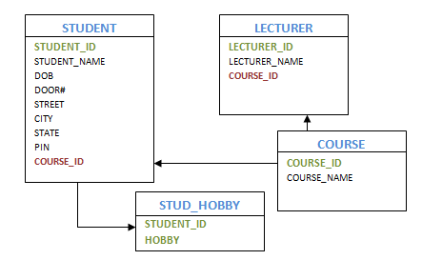
Mapping ERD into Relational model
The above ERD could be converted into Relationship Diagram as follows

Slide 28
Mapping ERD into Relational model
2. Let us see some of the special cases
Converting Weak Entity
Weak entity is also represented as table.
All the attributes of the weak entity forms the column of the table.
But the key attribute represented in the diagram cannot form the primary key of this table.
We have to add a foreign key column, which would be the primary key column of its strong entity.
This foreign key column along with its key attribute column forms the primary key of the table.

Slide 29
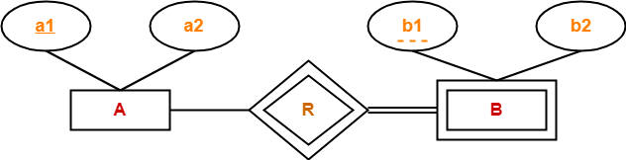
Mapping ERD into Relational model
2. Let us see some of the special cases
Weak entity set always appears in association with identifying relationship with total participation
In this case two tables are required
A(a1, a2)
BR(a1, b1, b2)

Slide 30
Mapping ERD into Relational model
2. Let us see some of the special cases
In our example above, SUBJECTS is the weak entity.
Although, SUBJECT_ID is represented as key attribute in the diagram, it cannot be considered as primary key.
In order to add primary key to the column, we have to find the foreign key first.
COURSE is the strong entity related to SUBJECT.
Hence the primary key COURSE_ID of COURSE is added to SUBJECT table as foreign key.
Now we can create a composite primary key out of COURSE_ID and SUBJECT_ID.
Course (COURSE_ID, course_name)
Subject(key{COURSE_ID(FK), subject_id(partial key)}, subject_name)

Slide 31
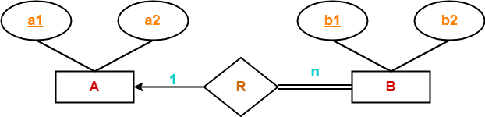
Mapping ERD into Relational model
2. Let us see some of the special cases
Binary relationship with both cardinality constraints and participation constraints
Case-1:Binary relationship with cardinality and total participation constraint from one side
Combine the entity set B and relationship set R then two tables will be required:
A(a1, a2)
BR(a1, b1, b2)

Slide 32
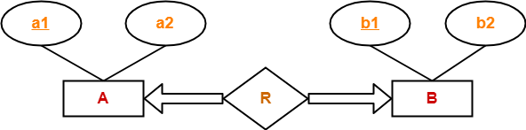
Mapping ERD into Relational model
2. Let us see some of the special cases
Case :Binary relationship with cardinality constraint and total participation from both sides
Here we need a single table ARB(a1,a2,b1,b2)
Both a1 and b1 together create primary key

Slide 33
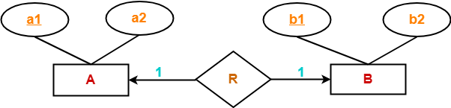
Mapping ERD into Relational model
2. Let us see some of the special cases
Representing 1:1 relationship
Either of the Two tables are needed
Case 1:
AR(a1, a2, b1)
B(b1, b2)
Case 2:
A(a1, a2)
BR(a1, b1, b2)

Slide 34
Mapping ERD into Relational model
2. Let us see some of the special cases
Imagine SUBJECT is not a weak entity, and we have LECTURER teaches SUBJECT relation.
It is a 1:1 relation. i.e.; one lecturer teaches only one subject.
We can represent this case in two ways
Case 1:Create table for both LECTURER and SUBJECT.
Add the primary key of LECTURER in SUBJECT table as foreign key.
It implies the lecturer name for that particular subject.
Case 2: Create table for both LECTURER and SUBJECT.
Add the primary key of SUBJECT in LECTURER table as foreign key.
It implies the subject taught by the lecturer.

Slide 35
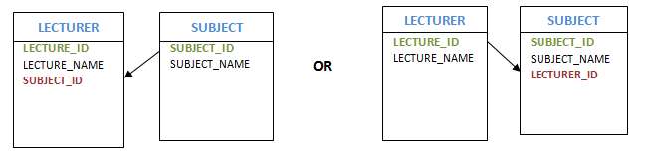
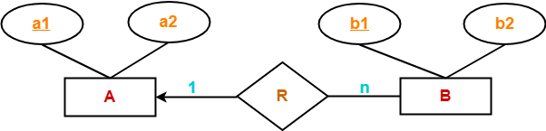
Mapping ERD into Relational model
2. Let us see some of the special cases
In both the case, meaning is same.
Foreign key column can be added in either of the table, depending on the developer’s choice.
Representing 1:N relationship
Two tables required
A(a1, a2)
BR(a1, b1, b2)

Slide 36
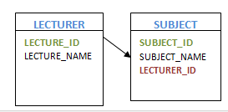
Mapping ERD into Relational model
2. Let us see some of the special cases
Consider SUBJECT and LECTURER relation, where each Lecturer teaches multiple subjects.
This is a 1: N relation.
In this case, primary key of LECTURER table is added to the SUBJECT table.
i.e.; the primary key at 1 cardinality entity is added as foreign key to N cardinality entity

Slide 37
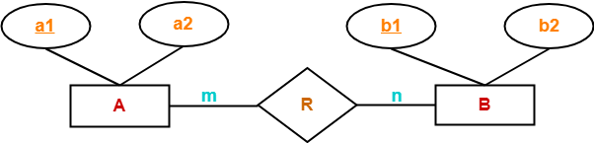
Mapping ERD into Relational model
2. Let us see some of the special cases
Representing M:N relationship
Three tables will be needed
A(a1, a2)
R(a1, b1)
B(b1,b2)

Slide 38
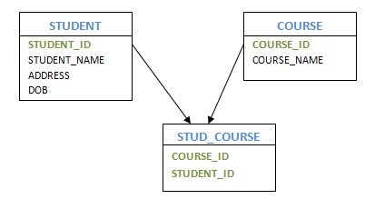
Mapping ERD into Relational model
2. Let us see some of the special cases
Consider the example, multiple students enrolled for multiple courses,
which is M:N relation.
In this case,
we create STUDENT and COURSE tables for the entities.
Create one more table for the relation between them and name it as STUD_COURSE.
Add the primary keys of COURSE and STUDENT which will become foreign key into it along with some additional attributes (if applicable) ,
which forms the composite primary key of the new table.
Student (student_id, student_name, …)
Course (course_id, course_name,…)
Stud_course( student_id , course_id, )

Slide 39
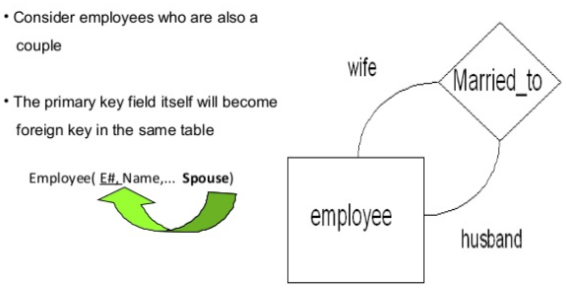
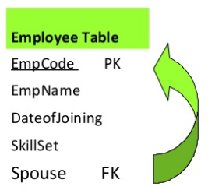
Mapping ERD into Relational model
2. Let us see some of the special cases
Self referencing 1:1

Slide 40
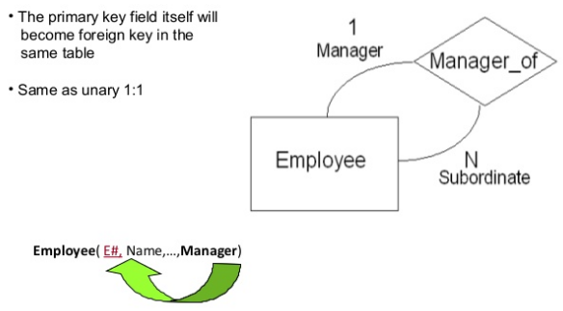
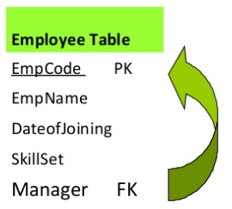
Mapping ERD into Relational model
2. Let us see some of the special cases
Self referencing 1:N

Slide 41
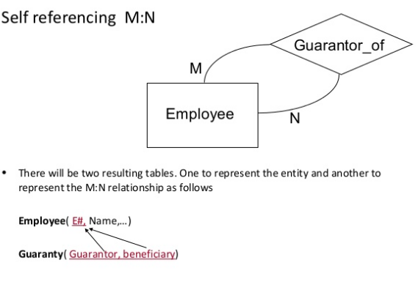
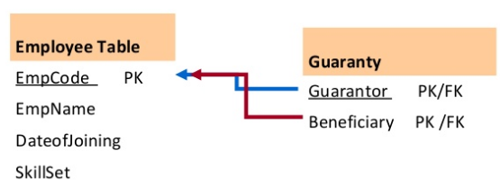
Mapping ERD into Relational model
2. Let us see some of the special cases

Slide 42
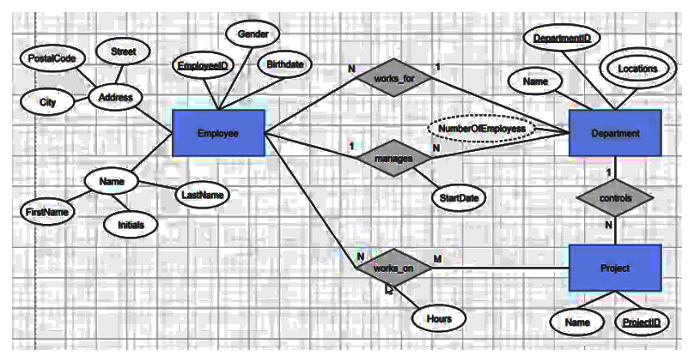
Exercise
Convert the following ERD into Relationship diagram

Slide 43
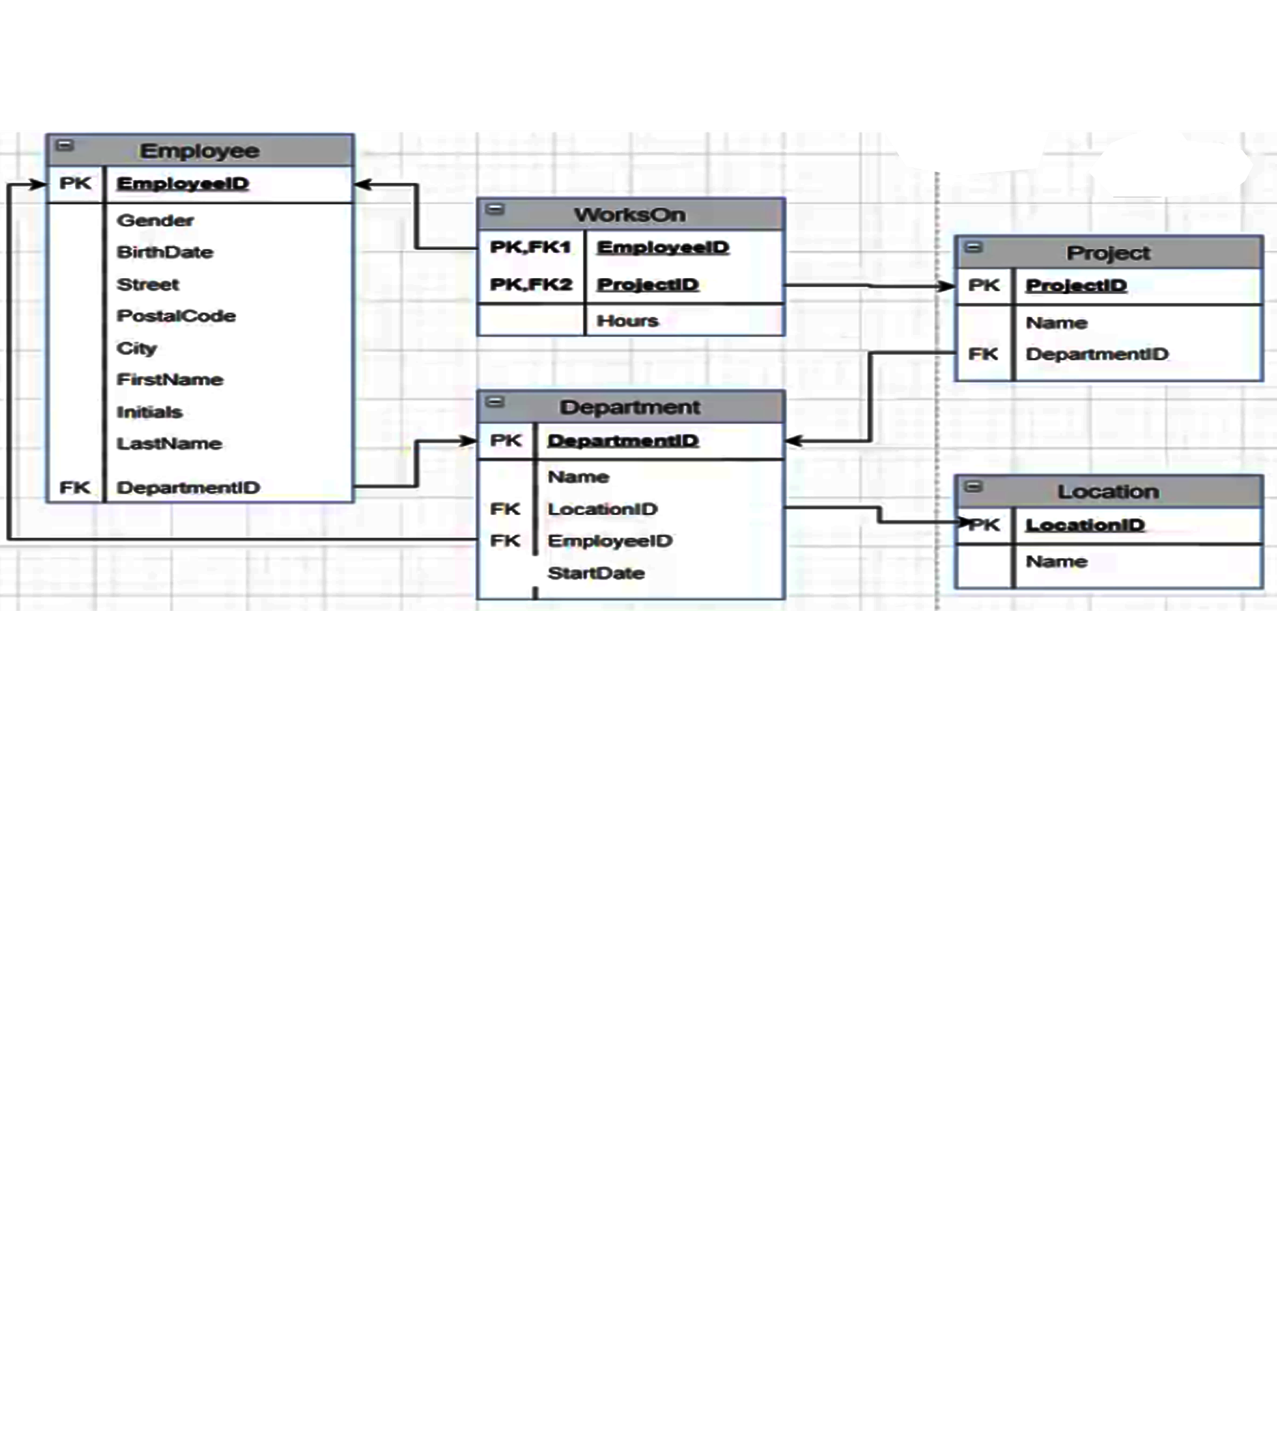
Possible Relationship diagram for the ERD on the previous slide

