Slide 1

COMP2332
Dr. Instructor : Dr.Adel Taweel
Assignment -1: Healthcare Case Study for an EPC Model
E-care
Bisan Ghoul 1181116
Razan Yassen 1182226
Daina Alqam 1180950
Yazan issa 1183066
Raneem Mansour 1181706
Lana Elayyan 1180839

Slide 2

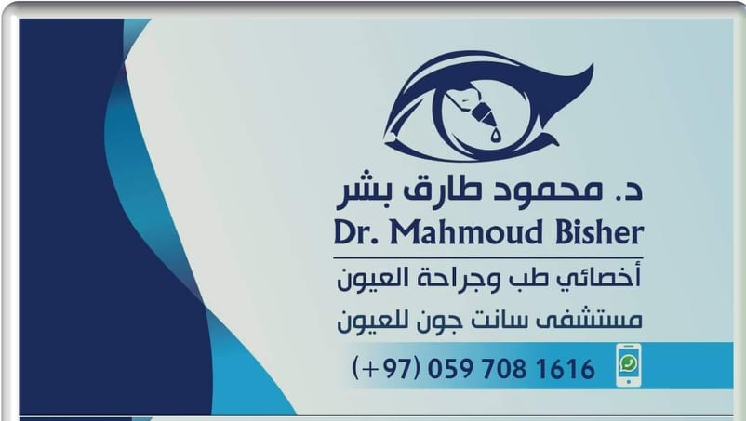

Introduction :
This case study is going to identify an Eye Clinic organizational business processes/services
Which medical center?
Dr. Mahmoud Bisher Clinic
Which service/part of it?
St John Eye Hospital

Slide 3

case study description:
(1/4)
Ophthalmology is a branch of medicine and surgery which deals with the diagnosis and treatment of eye disorders. An ophthalmologist is a specialist in ophthalmology. Ophthalmologists are allowed to use medications to treat eye diseases, implement laser therapy, and perform surgery when needed. Ophthalmologists may participate in academic research on the diagnosis and treatment for eye disorders.
Although most people may think that eye doctors do nothing but deal with appointments of people needing glasses and contacts, they actually do a whole lot more. Even general eye evaluations entail examining the health of the eye and looking for any potential concerns. Take for example, someone needing contacts for the first time; in addition to the evaluation, the doctor will need to provide additional services. This can include training on how to insert and remove contacts and providing general care information as well as diagnosing and solving any fit problems. They also need to know which type of contacts would be best for their patient as there are many varieties, including multifocal, soft disposable, keratoconus, rigid gas permeable, monovision and irregular-shaped lenses for individuals with corneas that have suffered disease or surgery.

Slide 4

case study description:
(2/4)
When the patient visits the clinic for an eye exam, the patient has to reserve an appointment first,
after the patient arrives at the clinic, they will pay the fees at the reception before they go to the
doctor’s office. If the patient has medical and/or vision coverage, the receptionist will check their
plan documents to see if these additional exams and tests are covered, If not the patient will pays in
cash. Then the receptionist will check if it’s the patient’s first time or if it’s a follow up, if it’s their first
time a record will be created for the patient, after that the patient will stay at the waiting room until
the doctor calls them in. At the beginning of the eye exam, the eye doctor will ask for the patient’s
medical history, if they have been experiencing any vision problems and the reason of the visit. If
they currently have glasses or contacts, they should bring them to the exam so the eye doctor can
see if they need prescription changes, and then the doctor will redirect the patient to optical to get
the prescribed lenses.

Slide 5
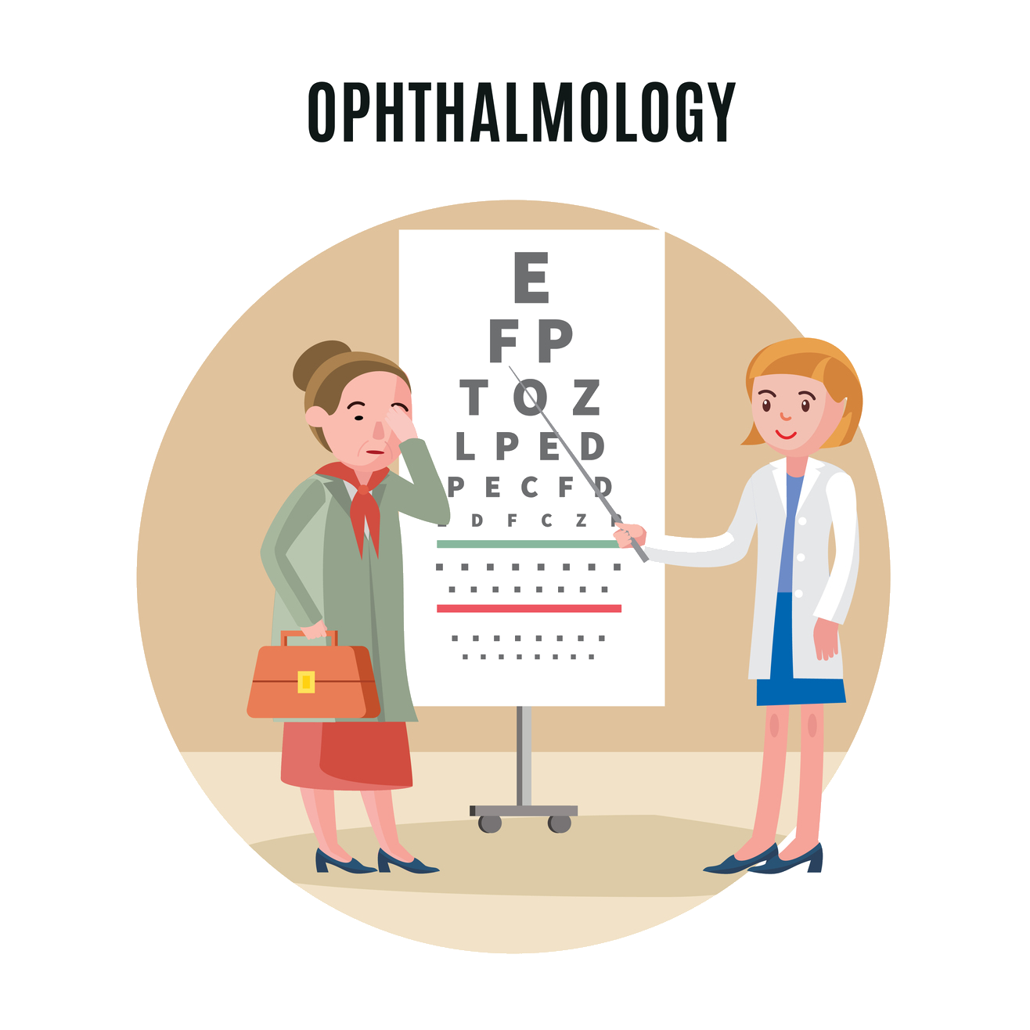
case study description:
(2/4)
During the eye exam, the eye doctor can perform a number of different tests such as a visual acuity test which examines how well you can see with each eye. The doctor may ask the patient to cover one eye at a time while identifying symbols. Typically, these symbols are different sized letters or numbers on a chart that’s displayed at a distance from the patient. Based on the results, the doctor can determine how well the patient can see at a distance.

Slide 6
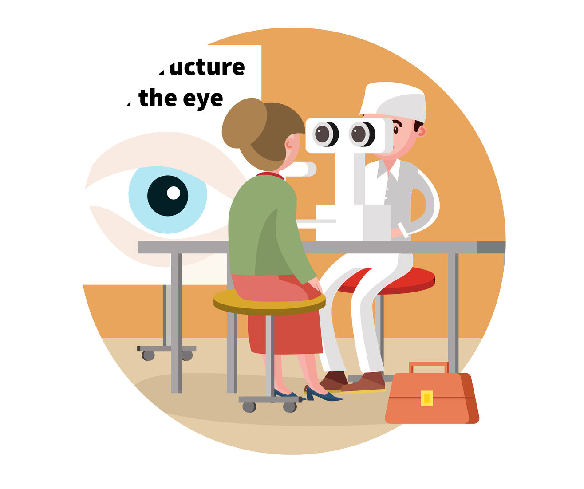
case study description:
(3/4)
The doctor may also perform a refraction eye exam which helps the doctor figure out what prescription is needed for glasses or contact lenses. To test this, the doctor may have the patient look into a machine that displays lenses of different strengths. By switching the lens in front of each eye while they read letters and numbers on a chart, the doctor can figure out which lens is best for them. This refraction test also helps the doctor to determine if the patient need a different strength lens in each eye. Doctor will check the patient’s results and give a diagnosis, further tests may be done if needed

Slide 7
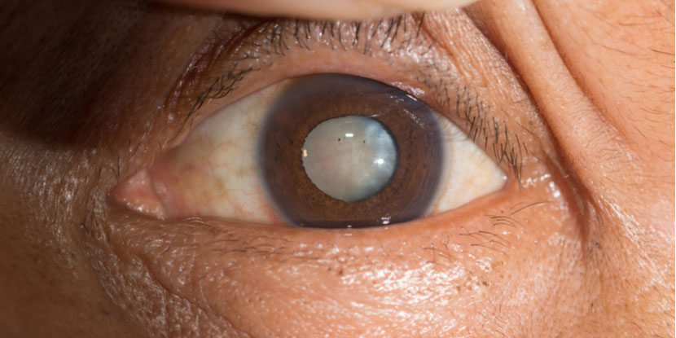
case study description:
(3/4)
If the doctor finds any problems during a comprehensive eye exam (a series of routine vision tests), they may ask the patient to come back for a follow-up eye exam so they can run additional vision tests. This is often done once a year or once every two years.
In some cases, like optic neuritis (when the optic nerve becomes inflamed) or in case of cataract (an opacification of the lens of the eye which leads to a decrease in vision) the doctor will redirect the patient to the hospital for further treatment
After the diagnosis is done, the patient will leave the doctor office.

Slide 8

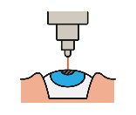



Other provided services include:
Examine eyes for health and vision problems.
Describe eye drops for dry eyes and conjunctivitis eyes.
Diagnose and treat eye disease
Detect and identify general health problems manifested in the eye (i.e. diabetes, high blood pressure, sickle cell anemia, etc.)
Provide pre-and post-operative care for pathologies and trauma
Remove foreign bodies from eyes
Prescribe glasses or other devices for specialized vision needs such as hunting, computer work, playing piano, etc.
Treat eye allergies.
Work with schools and community groups on vision screening, career days, programs on eye care, etc.
(4/4)

Slide 9
System analysis:
The clinic opens from
9:30-2:30 (S)
8:00-6:00 (S,M)
8:00-6:00 (W,R)
About 5-10 patients visit the clinic everyday
The clinic gets really busy on Sundays and Saturdays, and the clinic has only one doctor which can lead to messing up the appointments or some patient may take a long time for their appointment to come.
The clinic does not have its own software for booking appointments and arranging other things, they use excel to register patients and save their information.
Some patients do not come on time which can lead to some problems in the other patients appointments.
The clinic does not have all the machines and tools to preform some needed procedures.

Slide 10
EPC Model

Slide 11
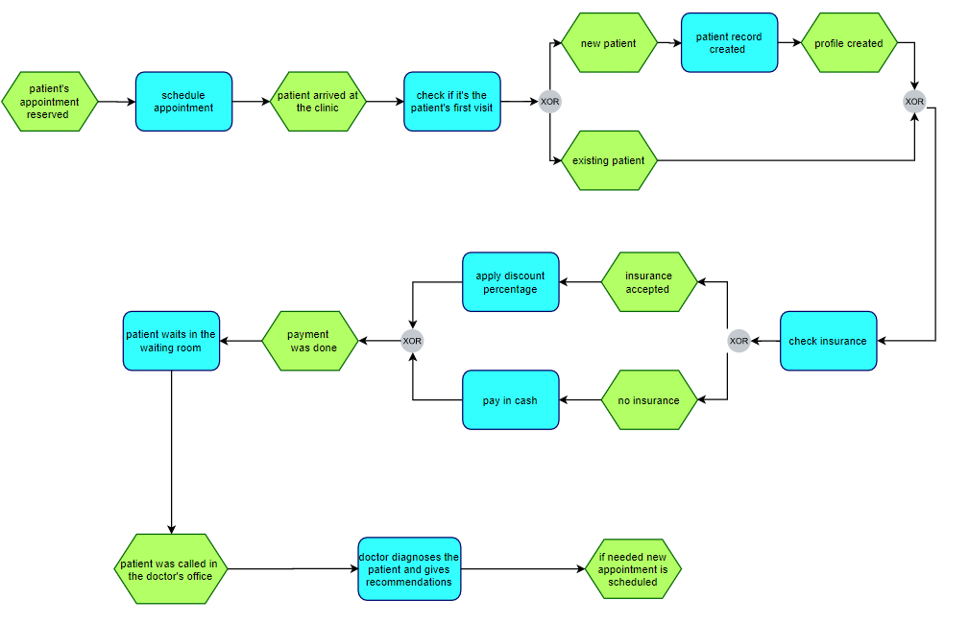

Slide 12
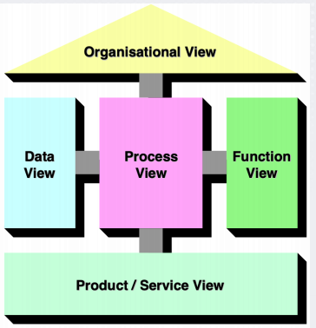
ARIS Views

Slide 13
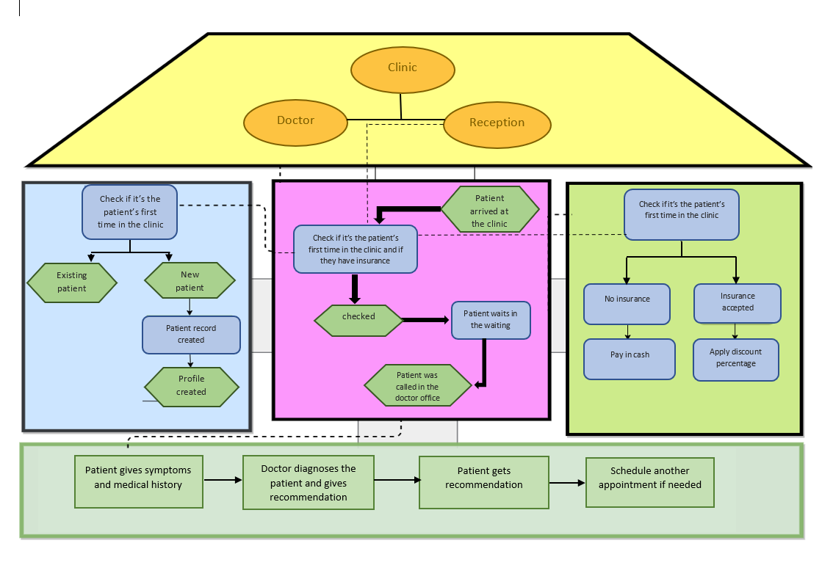

Slide 14
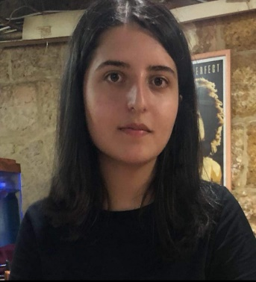


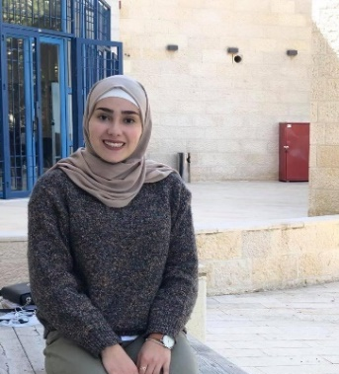

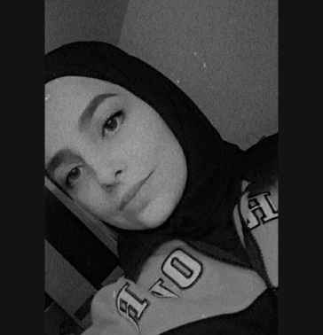
Bisan Ghoul 1181116
Raneem Mansour 1181706
Dania Alqam 1180950
Razan Yassen 1182226
Lana Elayyan 1180839
Yazan issa 1183066

Slide 15


