Slide 1
Correlation of 2014-2018 Internal US Migration Patterns to Local Cost of Living
Data Analytics Online Boot Camp – September 2020
Group 6
Adam Womer
Dillon Hanel
Valeria Sgambati
Bob Thomson

Slide 2
Project Overview
Even prior to the COVID-19 pandemic, many news sources covered stories of the migration of population from high cost of living regions such as NY, NJ and CA to lower cost of living regions such as southern and southwestern states
Our project focuses on testing these largely anecdotal observations against detailed public data, especially those available from the US Census Bureau and the Internal Revenue Service
Due to the substantial differences in the cost of living within states (e.g. metropolitan Dallas vs. its exurbs), we focused our analysis on county-level data
Our hypothesis is that differences in local cost of living is strongly correlated to county-level migration patterns

Slide 3
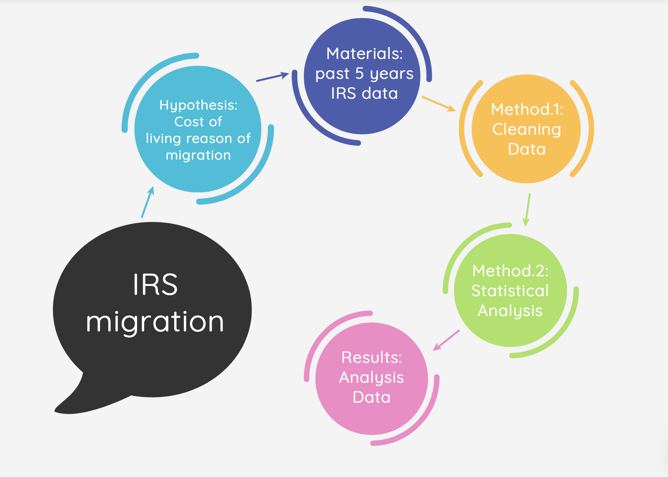
Project Flow

Slide 4
Data Sources
Publicly-available data from the U.S. Bureau provided the migration data
Migration patterns are reported on a cumulative five-year basis
IRS data provided the local costs
Data is published for each tax year based on zip code
Compilation of data for tax years 2014 through 2018 was necessary to provide an appropriate basis of comparison to the five-year cumulative migration data
“unitedstateszipcodes.org” provided county location for each zip code
Note: this data was made available free of charge for students

Slide 5
Data Analysis
Multiple linear regression model will be used to test hypothesis
Refinements will be based on outcome of initial model
Linear regression metrics will be outlined and reviewed
Focus on r-squared for overall fit and slope associated with cost of living as test of hypothesis
Color-coded maps showing
Net migration into (out of) counties
Local costs

Slide 6
Results
Expect to use SQL database as source data for exhibits developed using Tableau
Dash design and contents still under development

