Slide 1
Predicting Offensive Performance in the NBA
Jordan Wecler, Jake Friend, Bishoy Soliman, Kyle Lusignan,
Danilo Ruberti, Vagmi Bhagavathula

Slide 2
Table of Contents
01
03
05
Our Data / Questions
PCA,
Correlation Matrix, Regression Tree
Conclusions
Linear Regression
Failed Approaches / Best Approach / Why?
02
04

Slide 3
Our Data / Questions
01
2 Basketball Reference Database Sources (2015-16 Golden State Warriors and Celtics)
Info included everything from team, individual, game by game and overall statistics.
How many points will a team score based of a multitude of variables?
How many points will a team score based off their 3p%?
Notes:
At first, we attempting to use a Kaggle Database with every game since 1946, including every single statistic you can imagine. However, we saw it as overwhelming, and multiple points of data were thrown at us in every direction. Csv files were all over, data was missing, and it was unnecessary for the conclusions we wanted with this project.
Next, we decided to pick up a GitHub database…

Slide 4
Our Approaches
02
How many points will a team score based of a multitude of variables?
How many points will a team score based off their 3p%?
Linear Regression
Regression Tree
Notes:
At first, we attempting to use a Kaggle Database with every game since 1946, including every single statistic you can imagine. However, we saw it as overwhelming, and multiple points of data were thrown at us in every direction. Csv files were all over, data was missing, and it was unnecessary for the conclusions we wanted with this project.
Next, we decided to pick up a GitHub database…

Slide 5
Approach 1: Linear Regression
02
How many points will a team score based off their 3p%?
Step 1:
Step 2:
Step 3:
Step 4:
Data Engineering
Training
Testing
Compare
Removal of rows, columns, missing data and incorrect data
Train 3p% vs points scored for the first 70%, that being 56 games
Test the predictor model by estimating points scored using 3p% values from the remaining 30% of games
Compare the estimates of points scored for the remainder of the season to the actual points scored
Notes:
Removing all columns except for warriors 3p% and points scored, removing fg, fg%, ft, ft%, ast, steals, blocks etc. We want to focus on specific 2. Trained the dataset using the first 56 games, which is 70% of the 82 game season and tested using the last 26 games (30%). Then analyze the results and draw conclusions.

Slide 6
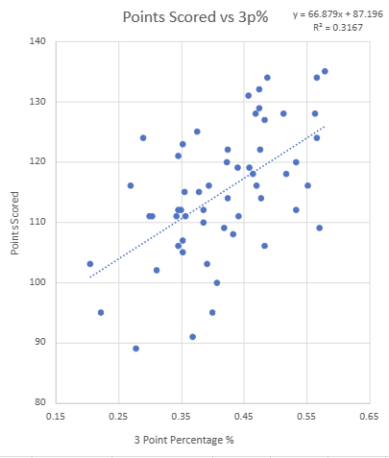
Training Model Results
02
02
Training first 56 games
Notes:
After removing the columns that didn’t relate to the Warrior’s 3p% or points scored during a game, we created a linear regression trained on those first 56 games in the season.
We created a scatter plot with 3 point percentage along the x-axis and points scored along the y-axis, then found the linear regression equation for the 56 data points plotted on the graph.
Using this linear regression model trained on the first 70% of the dataset, we acquired an equation of y = 66.879x + 87.196, showing a positive trend in between 3p% and points scored.

Slide 7
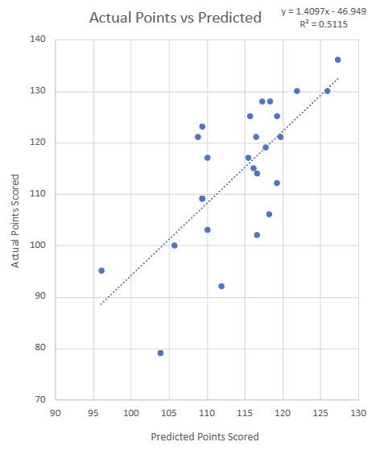
Testing Prediction Results
02
02
Testing last 26 games
Notes:
In order to test this model on the remaining 30% of the dataset, 3p% values were plugged into the equation (for x), and the output was the predicted value of points scored for the corresponding 3p%.
Once these values were calculated, we had to compare the predictions to the actual points scored. We created a second scatter plot with predicted values along the x-axis and actual values along the y-axis.
We then calculated the R^2 value to determine how closely the models was able to predict the points scored by the warriors based on 3p%.
The R^2 value came out to 0.5115, correlated linearly. This shows that the training model was not perfect at predicting the points scored, but did a good job since it was a linear model, having only two trainable parameters (slope and intercept).
The model worked especially well when predicting higher scoring games (using a higher 3p%) since high scoring values within the training data were more closely correlated with the 3p% than lower scoring games.
The model had the hardest time predicting low scoring games, as seen by some of the outliers in the comparison scatter plot. This is due to the fact that that the lowest scoring game in the training dataset was 89, while the testing data set had a much lower minimum score of 79. The model was not able to predict the score of the 79 point game accurately because the 3p% was relatively normal despite the low scoring of the team. This is most likely due to the fact that the Warriors this season had average 3p% games even when having a low scoring game overall.

Slide 8
Approach 2: Correlation Matrix / PCA & Regression Tree
03
How many points will a team score based of a multitude of variables?
Step 1:
Step 2:
Step 3:
Step 4:
Data Engineering
Correlation Matrix
PCA Analysis
Regression Tree
Removal of rows, columns, missing data and incorrect data
Create a correlation to visualize which variables correlate strongest to points scored
Finding the variables in the dataset that show the most amount of information about a particular team
Start branching out to more precisely estimate points scored based off these variables

Slide 9
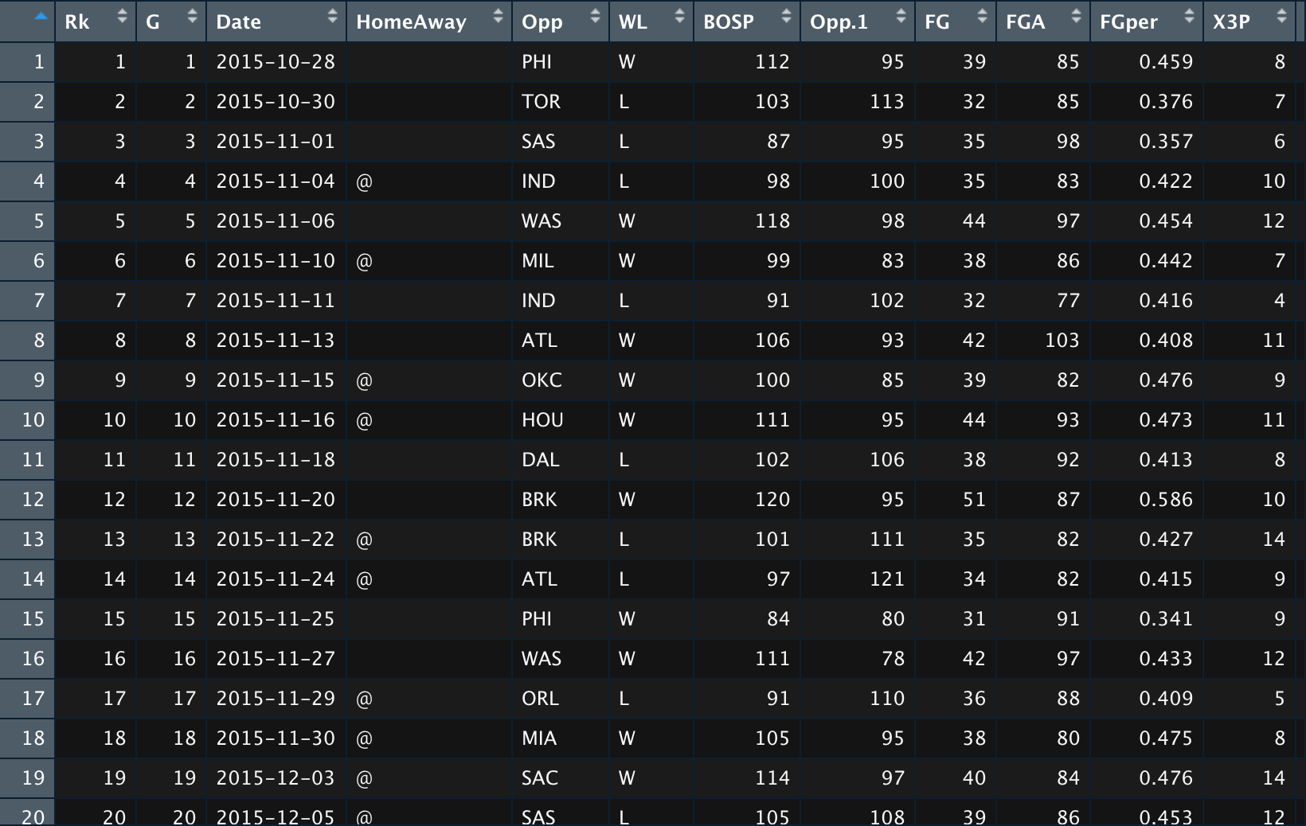
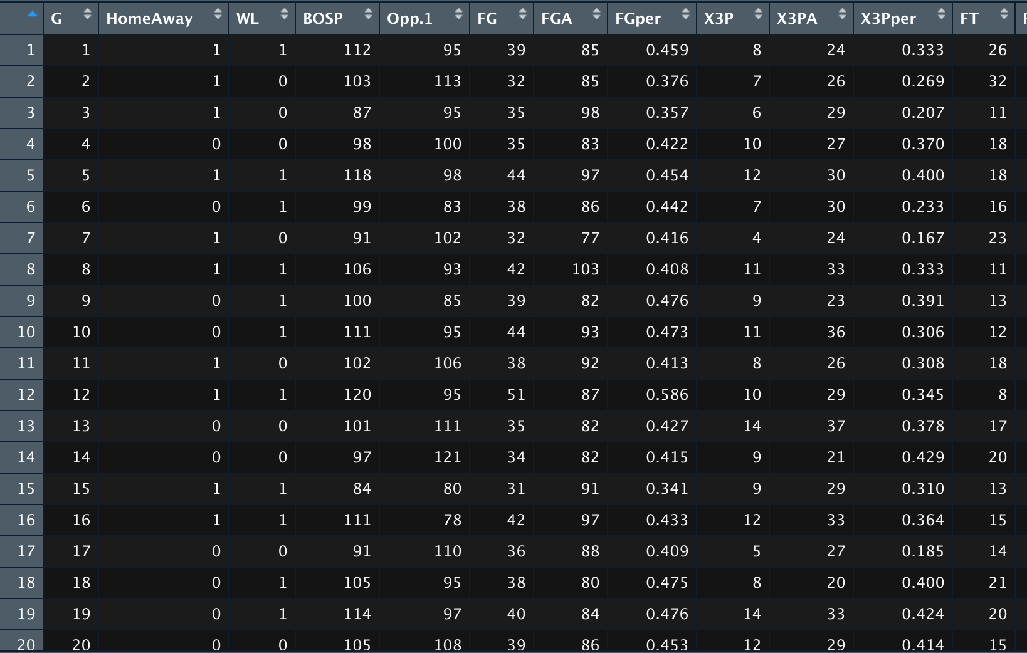
Data Engineering
03
Removing Unnecessary Data
Restructuring Data
W or L to 1 or 0
Home or Away to 1 or 0

Slide 10
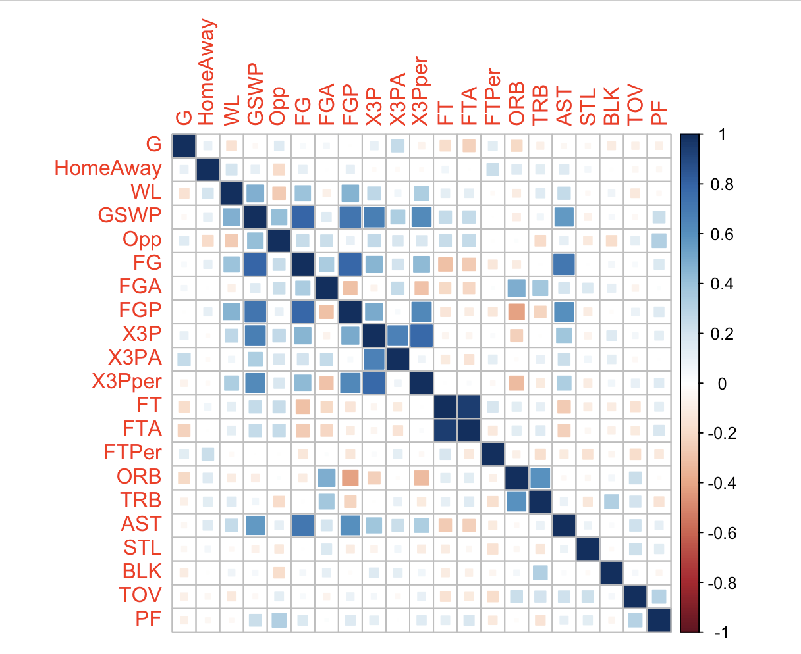
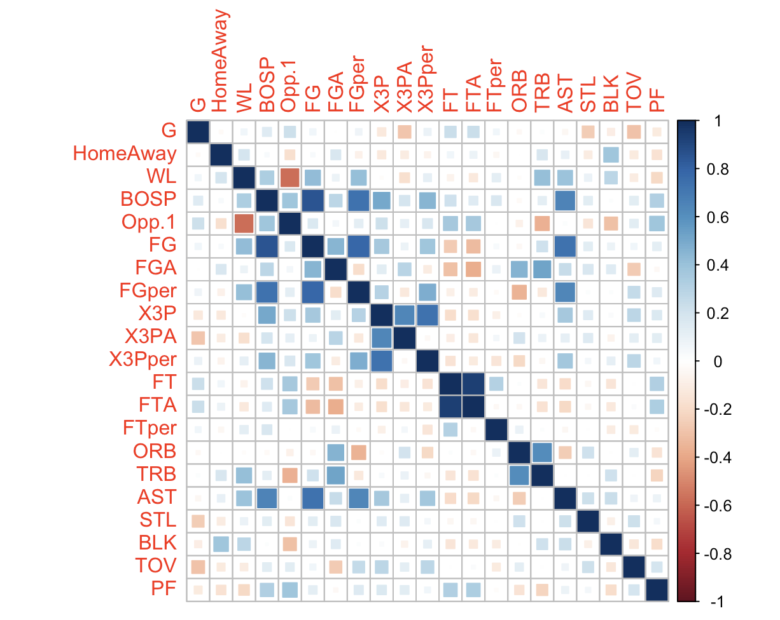
Correlation Matrix
03
Warriors Correlation
Celtics Correlation

Slide 11
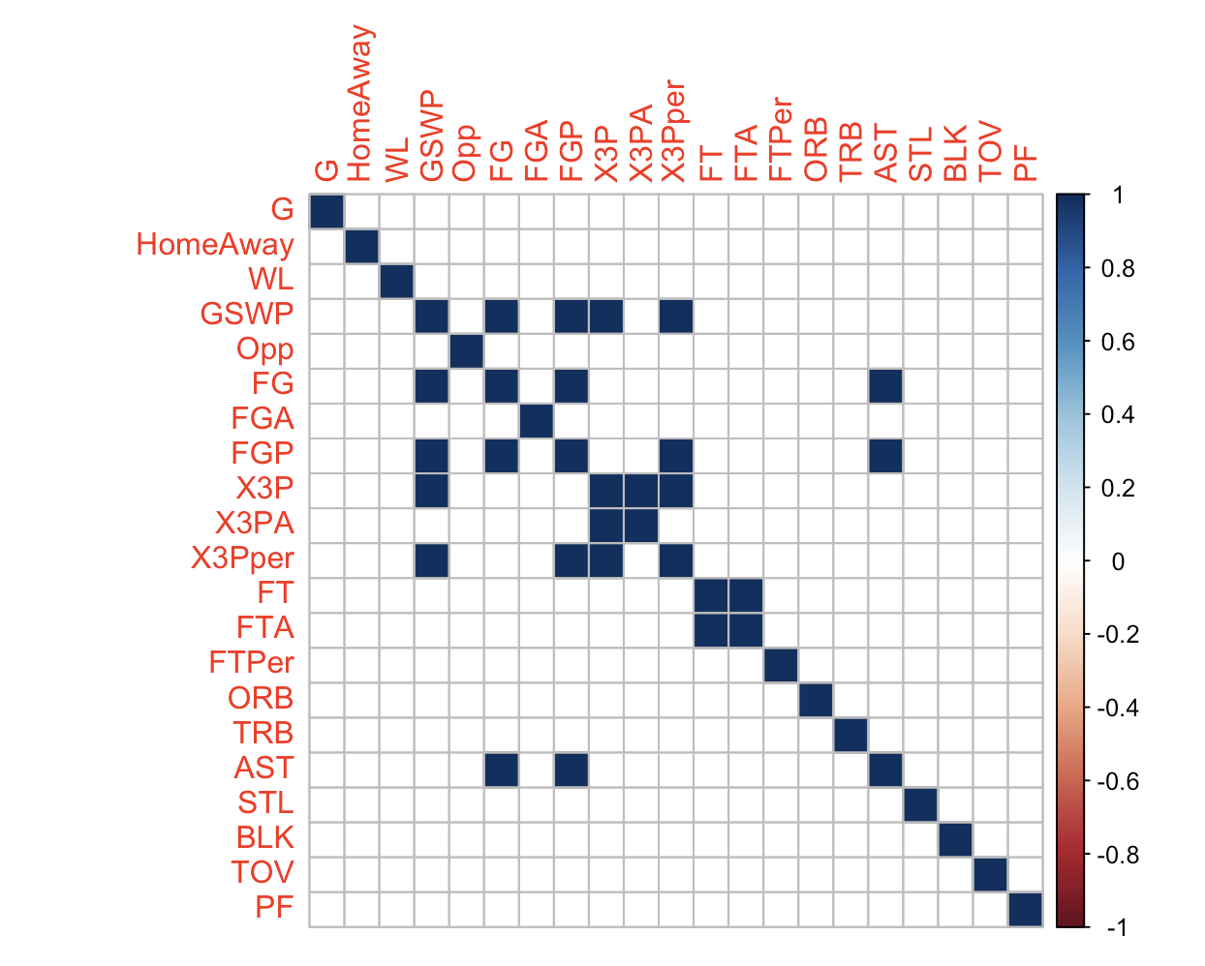
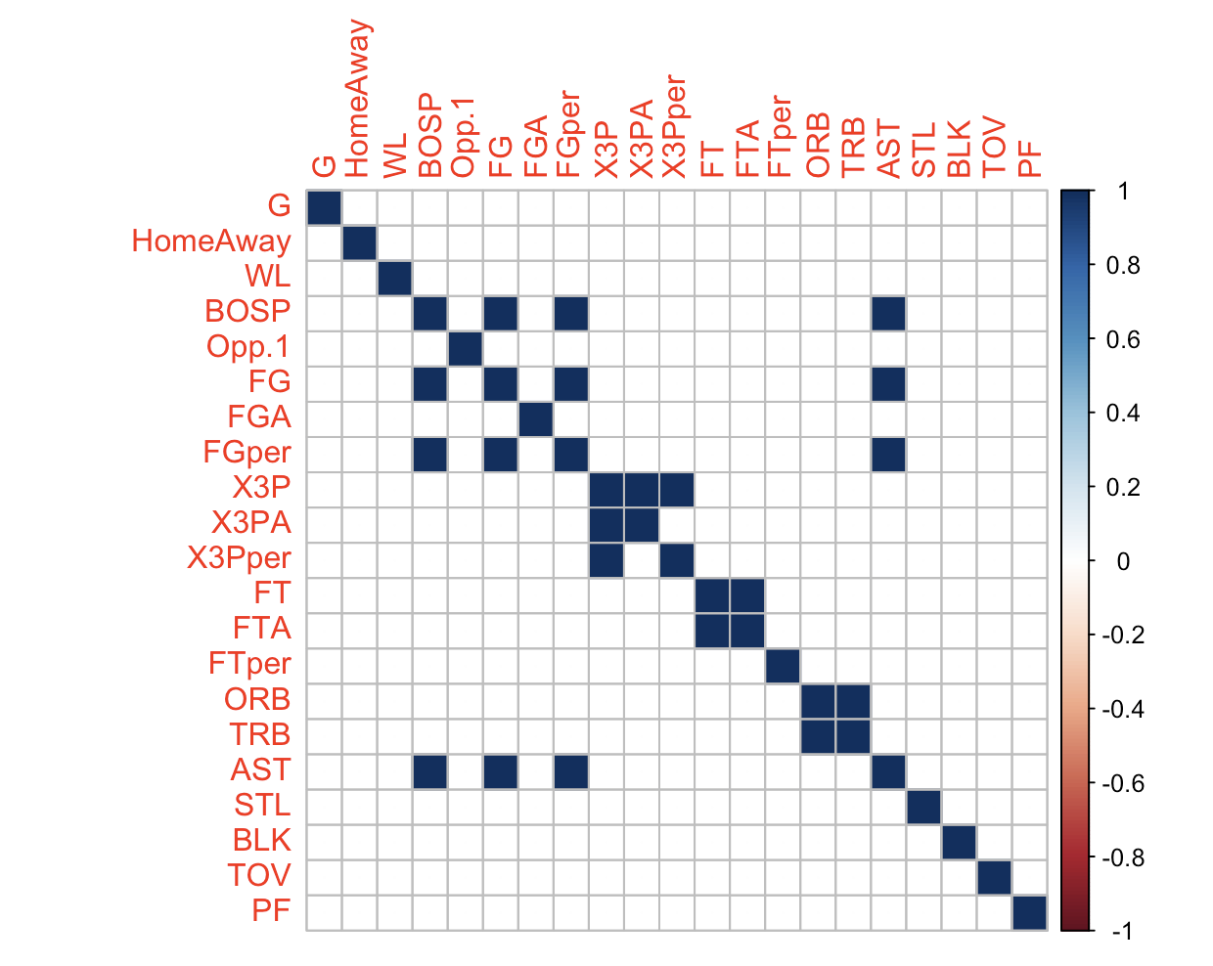
Correlation Matrix Greater than 0.6
03
Warriors Correlation
Celtics Correlation

Slide 12
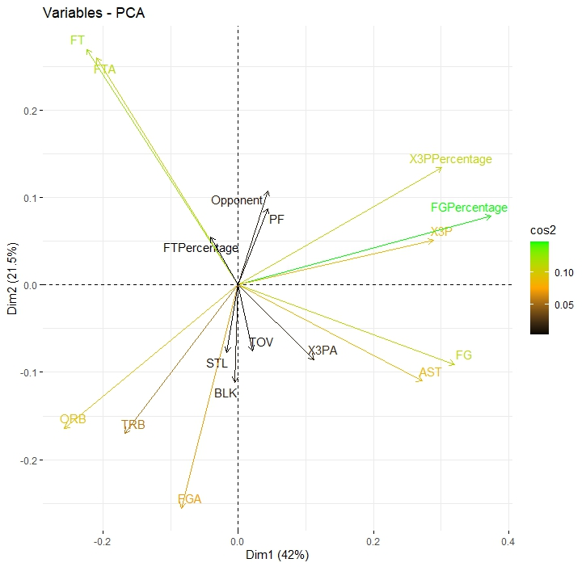
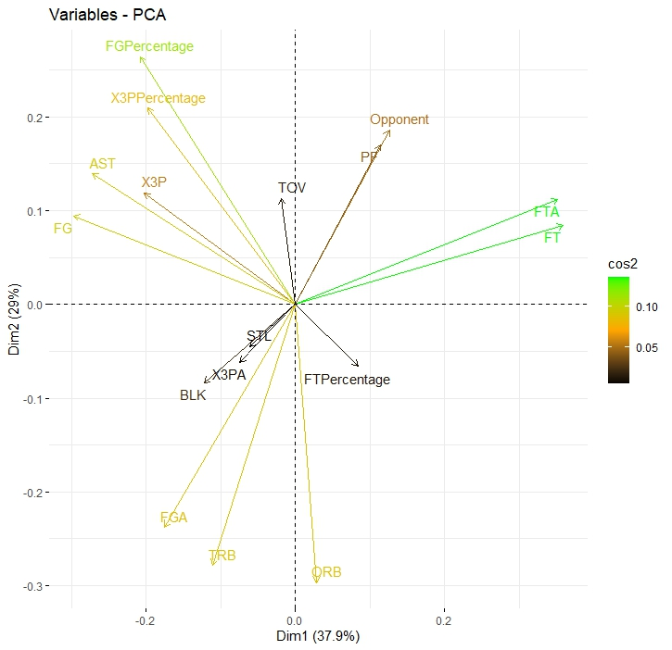
PCA Analysis
03
03
Warriors PCA
Celtics PCA

Slide 13
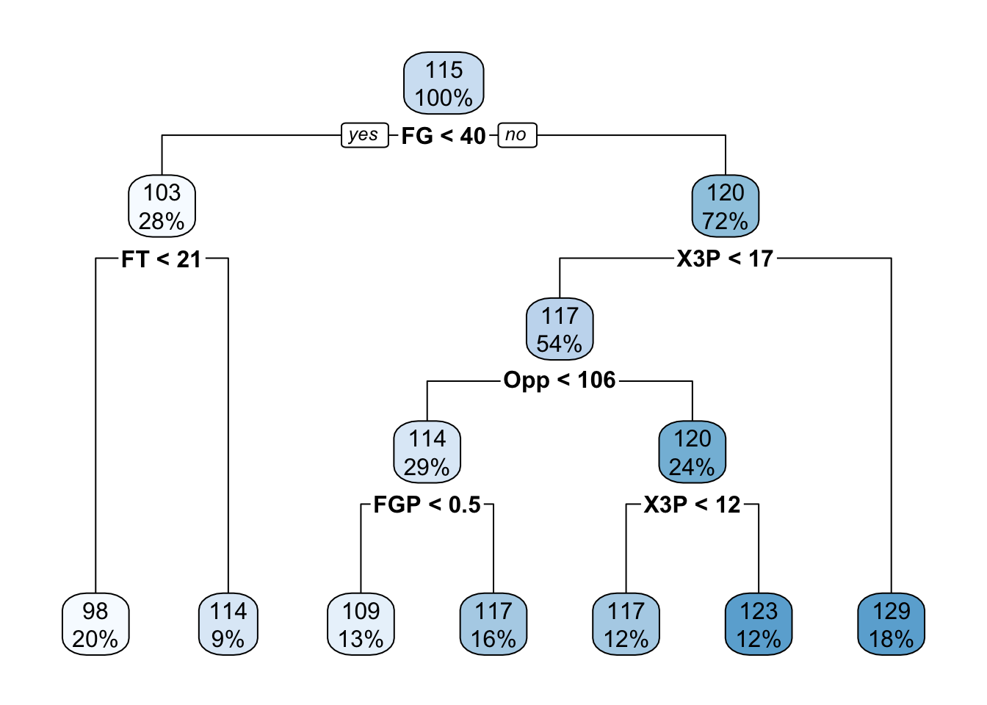
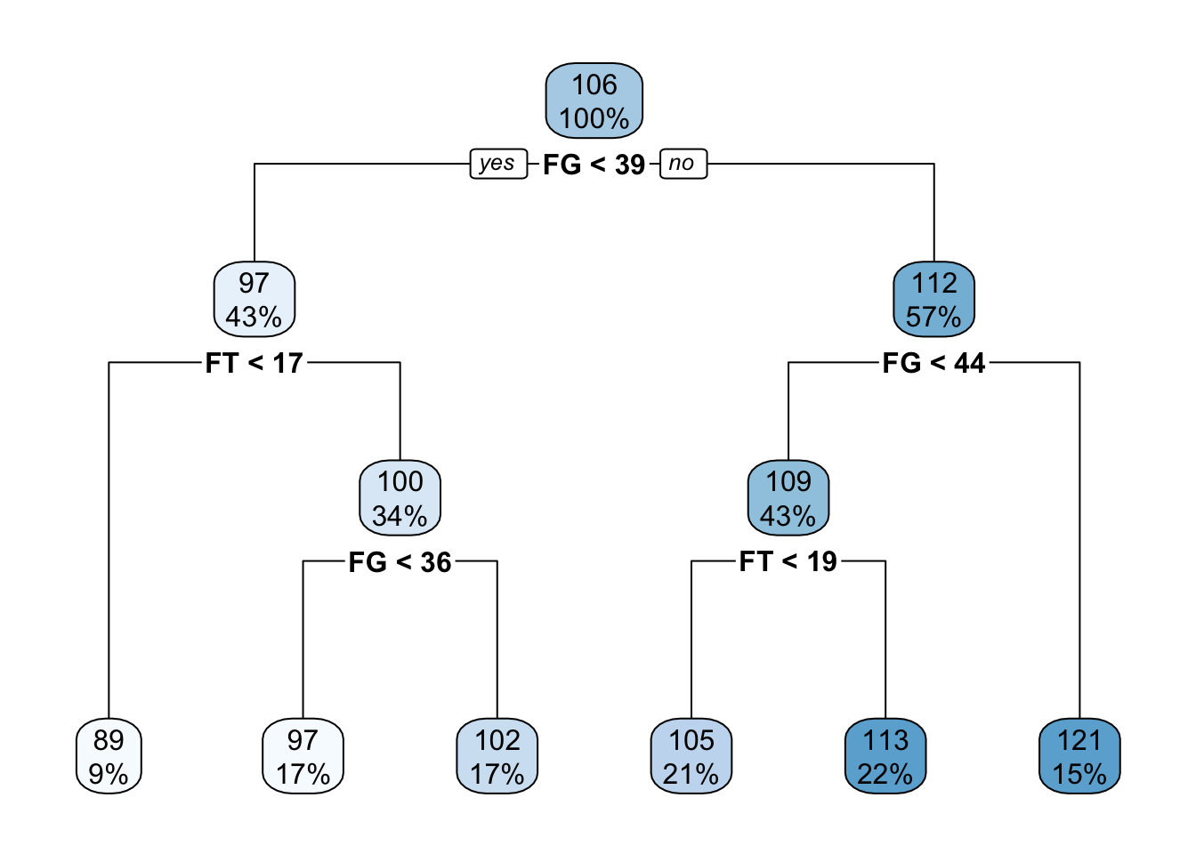
Summary & Final Regression Tree
03
03
Warriors Points Tree
Celtics Points Tree

Slide 14
Failed Approaches
04
Downloading certain libraries from Kaggle/Github that contained too many attributes
Overflow in data
Regression trees that produce a win or loss probabilistic value
Inconsistent graphs

Slide 15
Best Approach and Why?
04
Depends on what output you’re trying to produce
If you’re only testing correlation between 2 variables, linear regression is simpler and easier.
More effective at estimating based off the info you have.
If you’re attempting to estimate a value with multiple variables, a correlation matrix with a regression tree is more effective.
Although more complex, it yields a more precise value

Slide 16
Conclusion
05
Total scoring has positive relationship with three point percentage
Efficiency plays a strong role in determining probabilistic values for point total
Regression trees more complex and precise, linear regression simplistic but prone to variability

Slide 17
Questions?

