Slide 1
Sales Performance Dashboard
Task 4: Dashboard Design | Data Analyst Internship
| Muhammed Bishar Ashraf N

Slide 2
Objective & Approach
Objective
Tool
Design an interactive dashboard that helps business stakeholders make decisions
Microsoft Power BI
Dataset
Deliverables
Global Sales & Financial (Superstore-style) dataset from Kaggle
Interactive dashboard + PPT summary

Slide 3
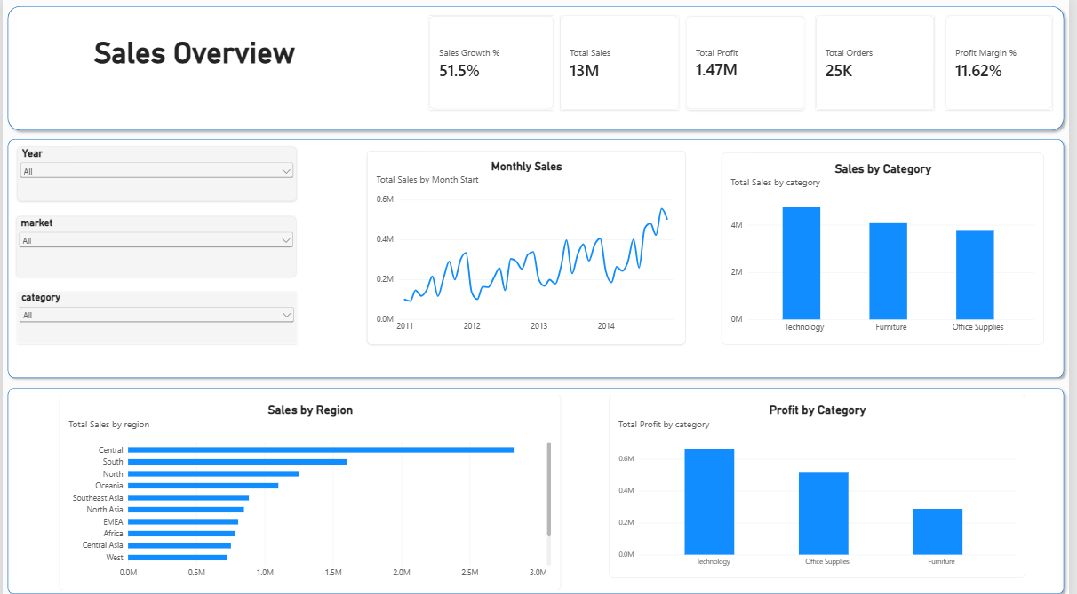
The Dashboard
What it shows
5 KPI cards
3 slicers: Year, Market, Category
Monthly sales trend
Sales and profit by category
Sales by region

Slide 4
Headline KPIs
13M
1.47M
25K
11.62%
51.5%
Total Sales
Total Profit
Total Orders
Profit Margin
Sales Growth
Sales volume is strong, but only about 11 cents of every sales dollar becomes profit.

Slide 5
Category: Sales vs Profit
Insights
Technology leads in both sales and profit
Furniture has high sales but the lowest profit, so its margin is weak
Office Supplies is steady and profitable

Slide 6
Trend & Regional View
Monthly Sales Trend
Sales grew from about 0.1M per month in 2011 to about 0.5M by late 2014
Clear seasonality: peaks late each year, dips early in the year
Plan stock and campaigns around the seasonal peaks

Slide 7
Design Features Applied
✓
KPIs
✓
Slicers
✓
Time series
Sales, Profit and Growth chosen
Year, Market, Category
Monthly sales line chart
✓
Cards
✓
Colour theme
✓
Layout
Totals and summary figures
One consistent blue palette
Clean sections: KPIs, trends, breakdowns

Slide 8
Conclusions & Recommendations
1
Protect margin
Review pricing and discounts in Furniture to lift its profit.
2
Back the winners
Keep investing in Technology and the Central region.
3
Plan for seasons
Align inventory and promotions with the yearly sales peaks.
Thank you

