Slide 1
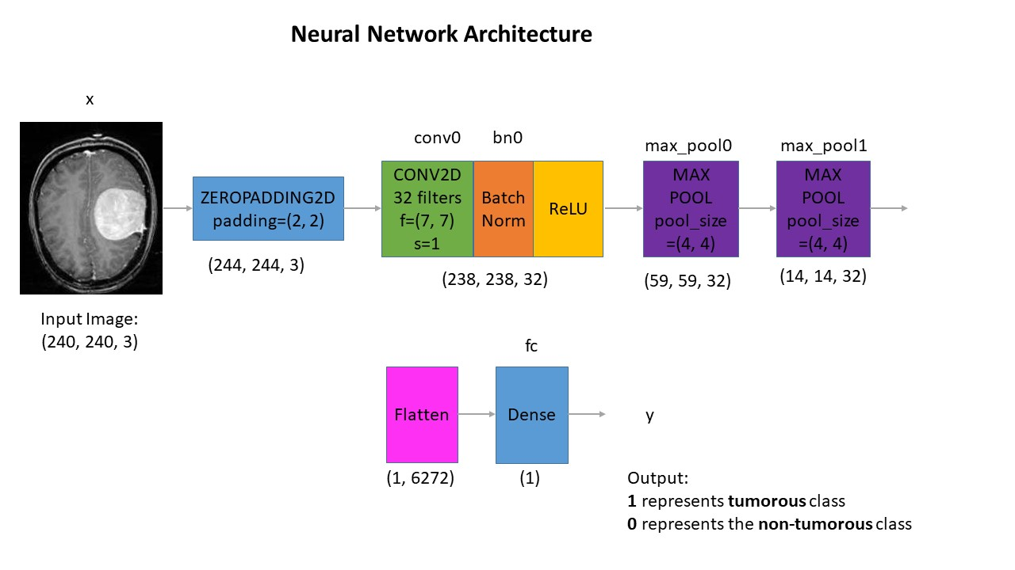
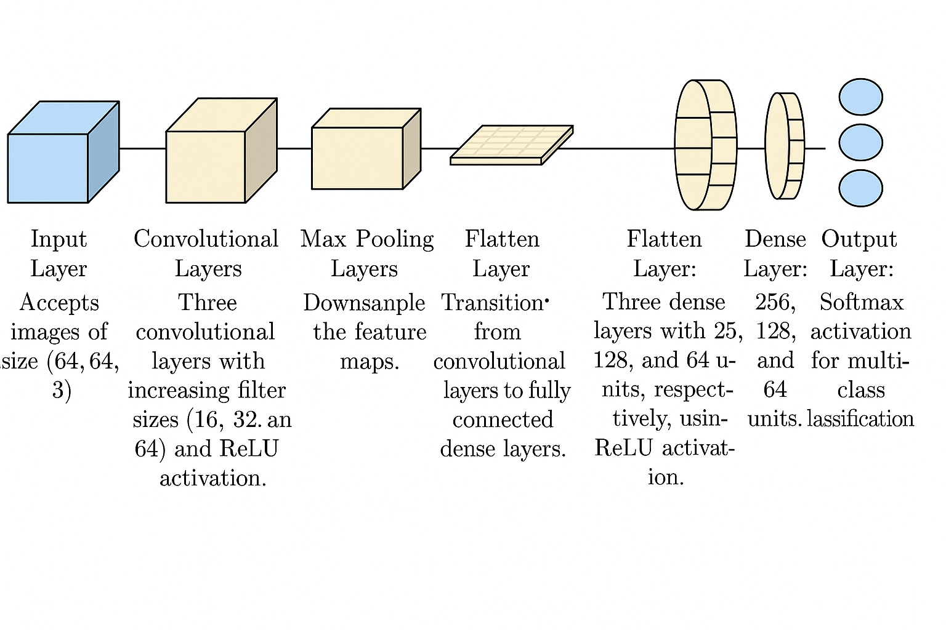
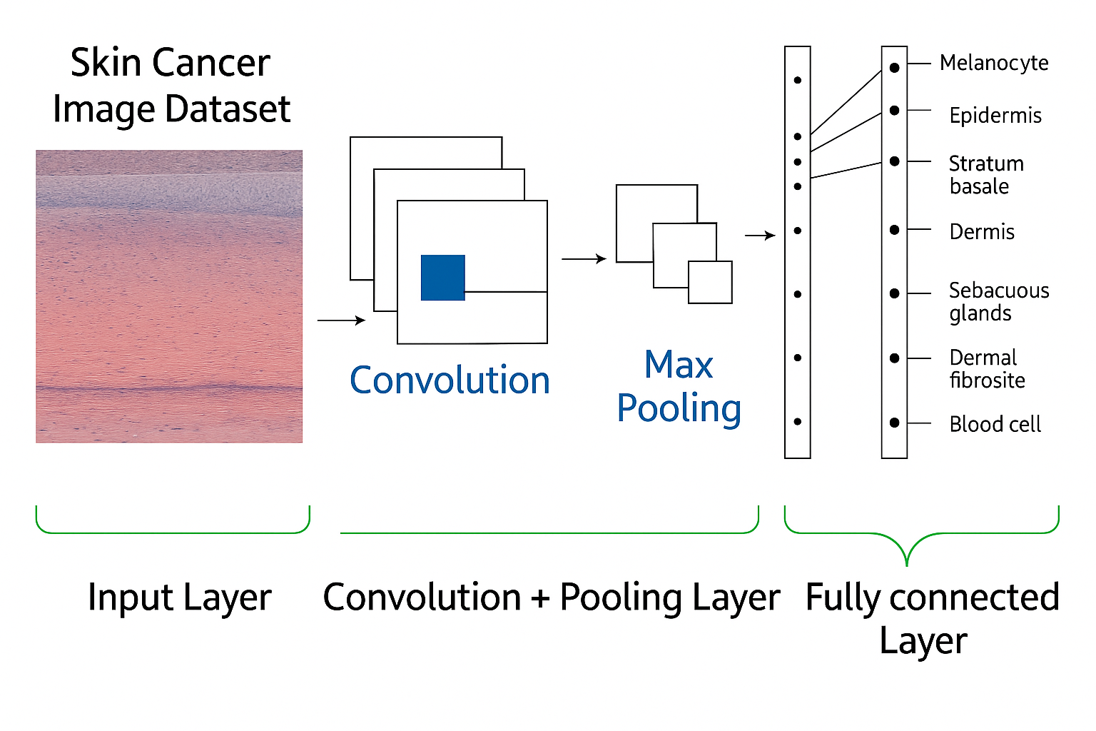
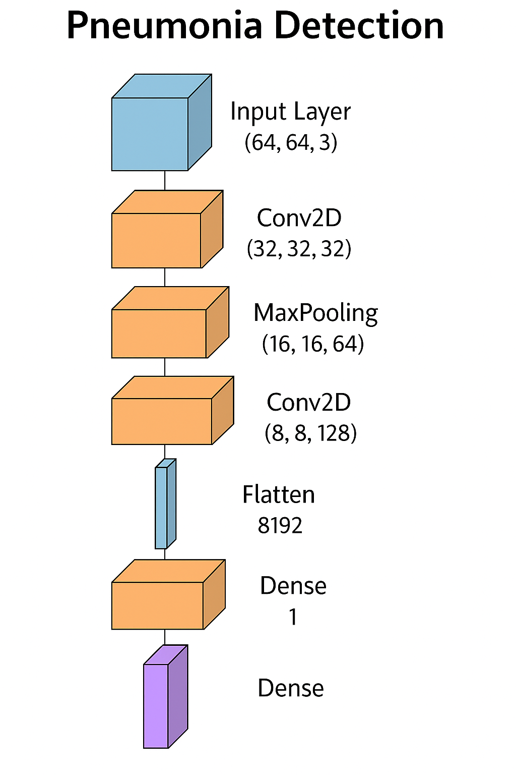
Diagnosis AI
Objective :- This project leverages AI and machine learning to develop an efficient diagnostic system for early detection of skin cancer, brain tumors, and pneumonia, aiming to reduce manual effort and improve healthcare outcomes
Related Work : As of 2025, some of the best-performing models for disease image classification—especially for medical imaging—combine deep CNN backbones with attention mechanisms, transformers, or multi-modal learning.
Dataset :
Brain Tumor : The Brain MRI dataset includes 253 images—155 with tumors and 98 without tumor.
Lung Cancer : The Lung cancer dataset contains 5 types of Lung cancer data.
Skin cancer : The HAM10000 dataset comprises 10,015 dermatoscopic images across seven skin lesion categories.
Pneumonia : Dataset contains 5,863 pediatric chest X-ray images (Pneumonia/Normal), organized into train/test/val sets.
Architecture -
Brain Tumor : Lung cancer : skin cancer: Pneumonia :

Slide 2
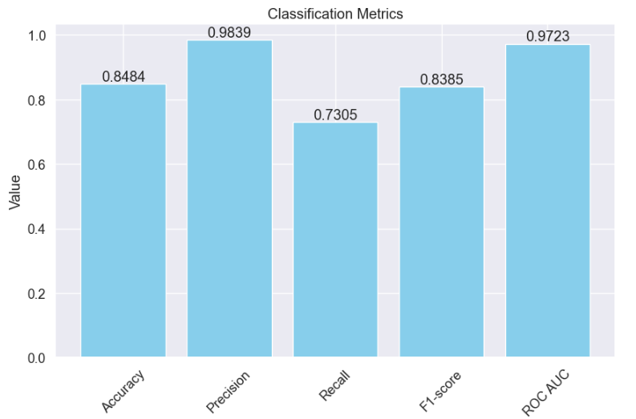
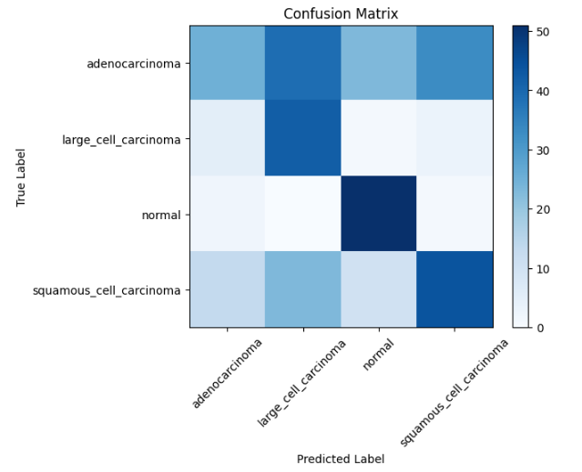
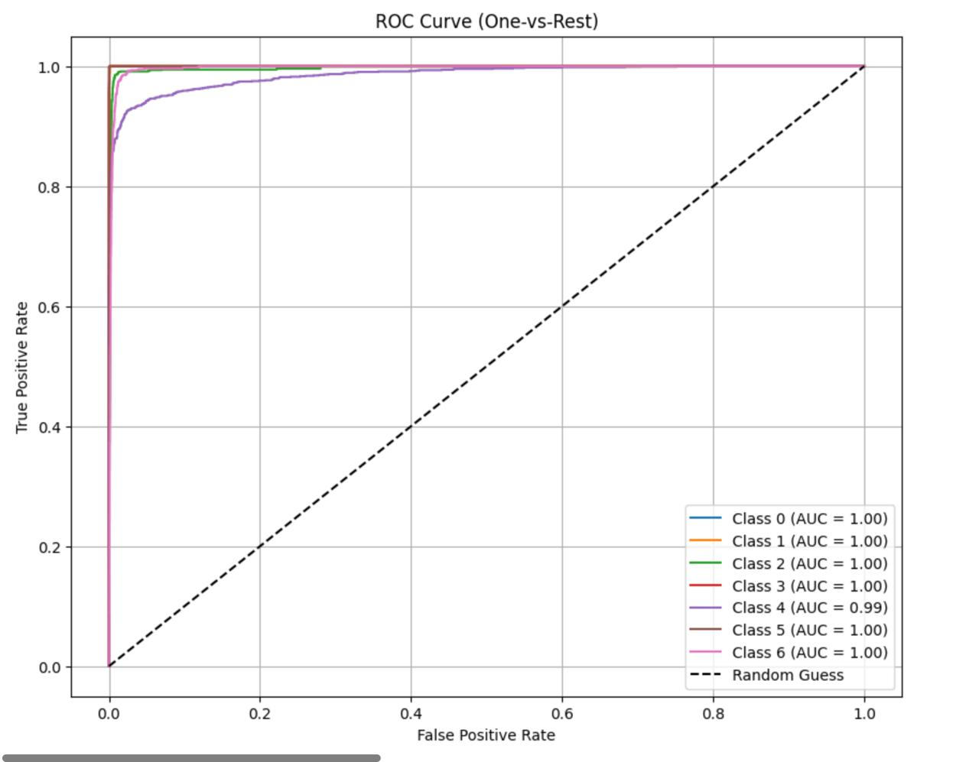
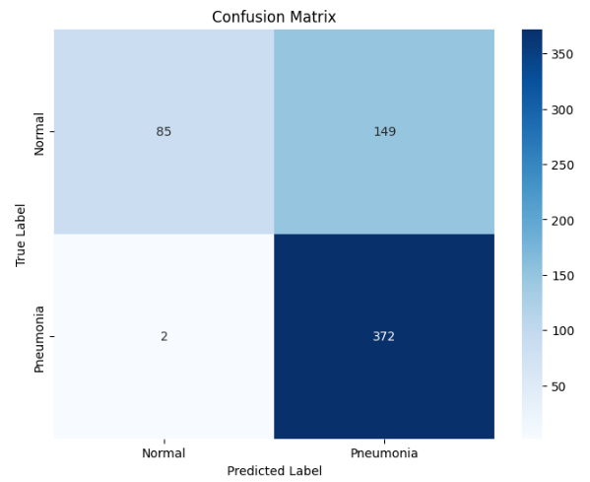
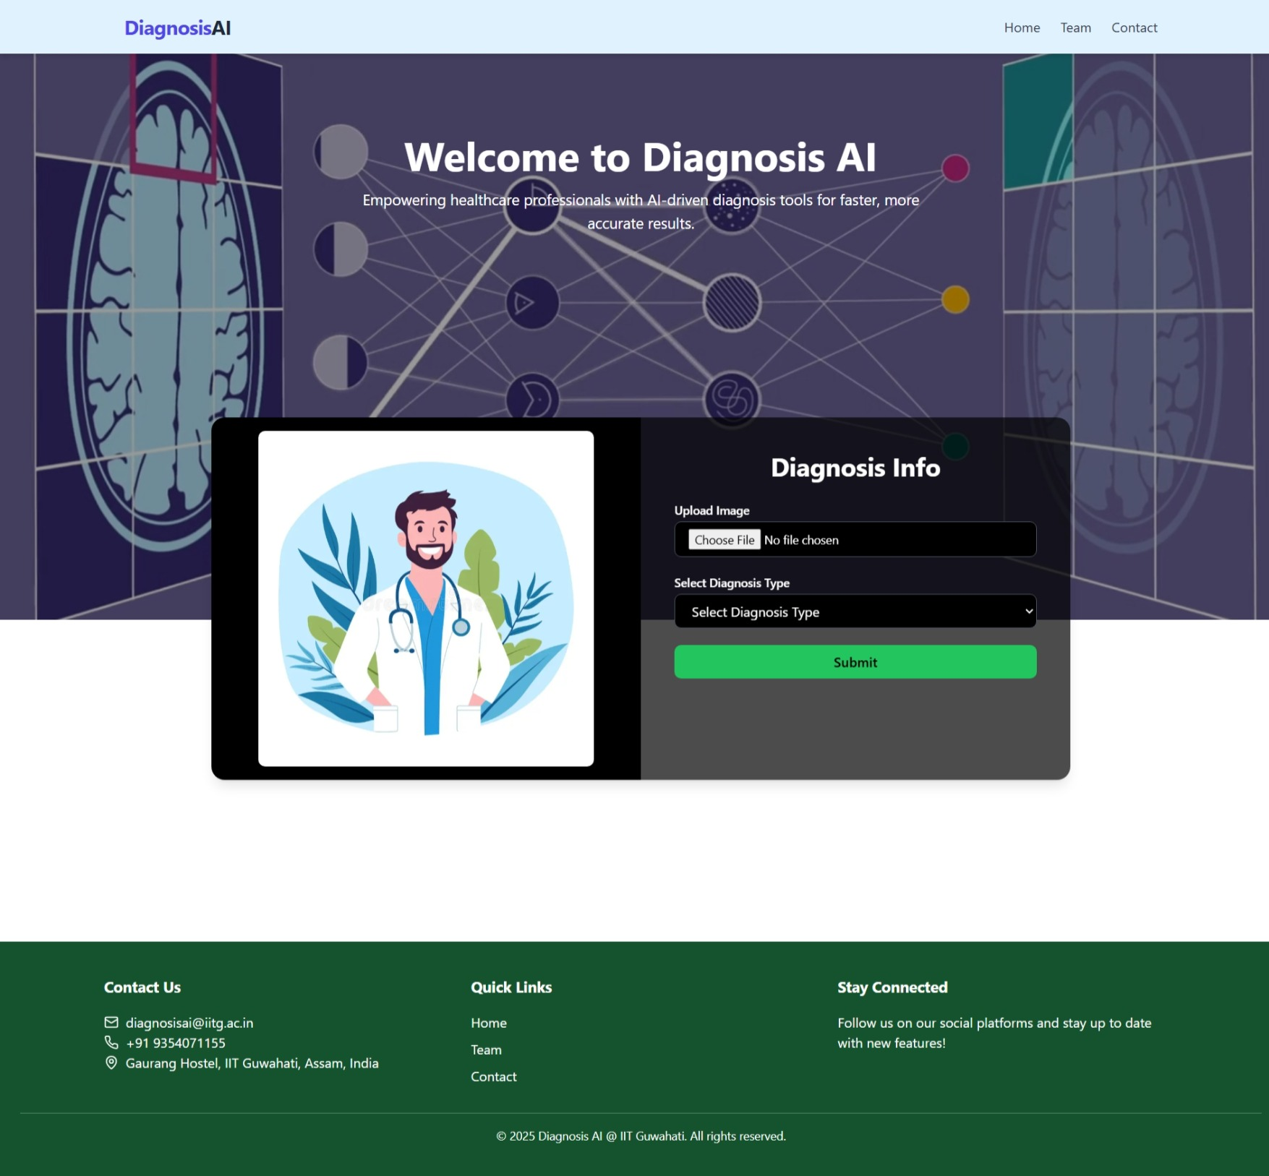

Results -
Brain Tumor: Lung cancer : Skin cancer : Pneumonia :
Website :
Challenges :
Unsatisfactory dataset in some cases.
Lack of computational power.
Time constraints.

