Slide 1
Indian startups funding analysis
Python Programming Lab
Prof- Dr. Neeraj Kumar Sharma
Bishal Sarkar
Roll-244161003

Slide 2
Motivation
To explore factors driving startup growth in India.
To analyze India’s startup market to uncover investment trends and opportunities.
Sectors, that attract investors most.

Slide 3
Block Diagram
Data Collection (Funding Records, Investor etc)
Observation
Insights
Data Analysis & Visualizations
Data Cleansing (Remove Duplicates, Handle Missing Values)

Slide 4
Pseudo code
Import required libraries
Read Data from the .csv file
Cleanse the data – remove the redundant, null values, replace the anonymous characters/words by appropriate values.
Plot the data in block chart.
Plot some data in py chart.

Slide 5
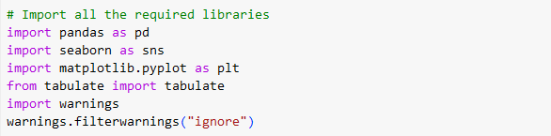
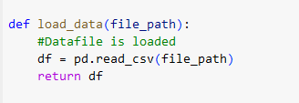
Snapshots of Code
Used Librabies:
Pandas library is used.

Slide 6
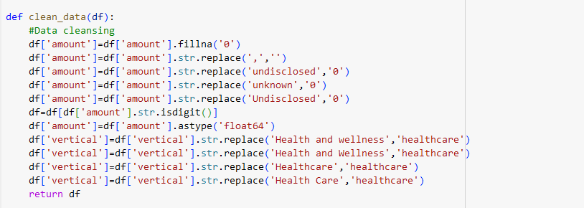
Snapshots of Code(Continued)
Data Cleansing:

Slide 7
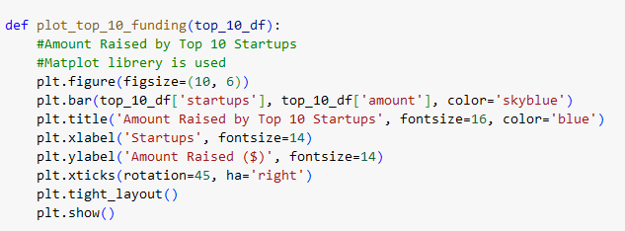
Snapshots of Code(Continued)
Matplotlib library is used

Slide 8
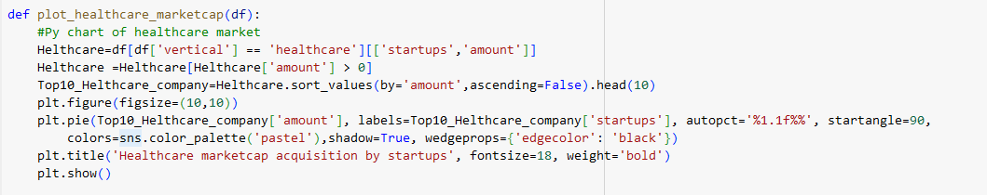
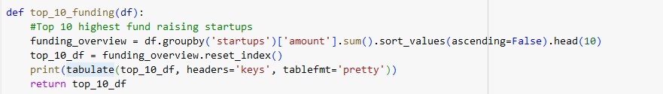
Snapshots of Code(Continued)
Seaborn library is used
Tabulate library is used

Slide 9
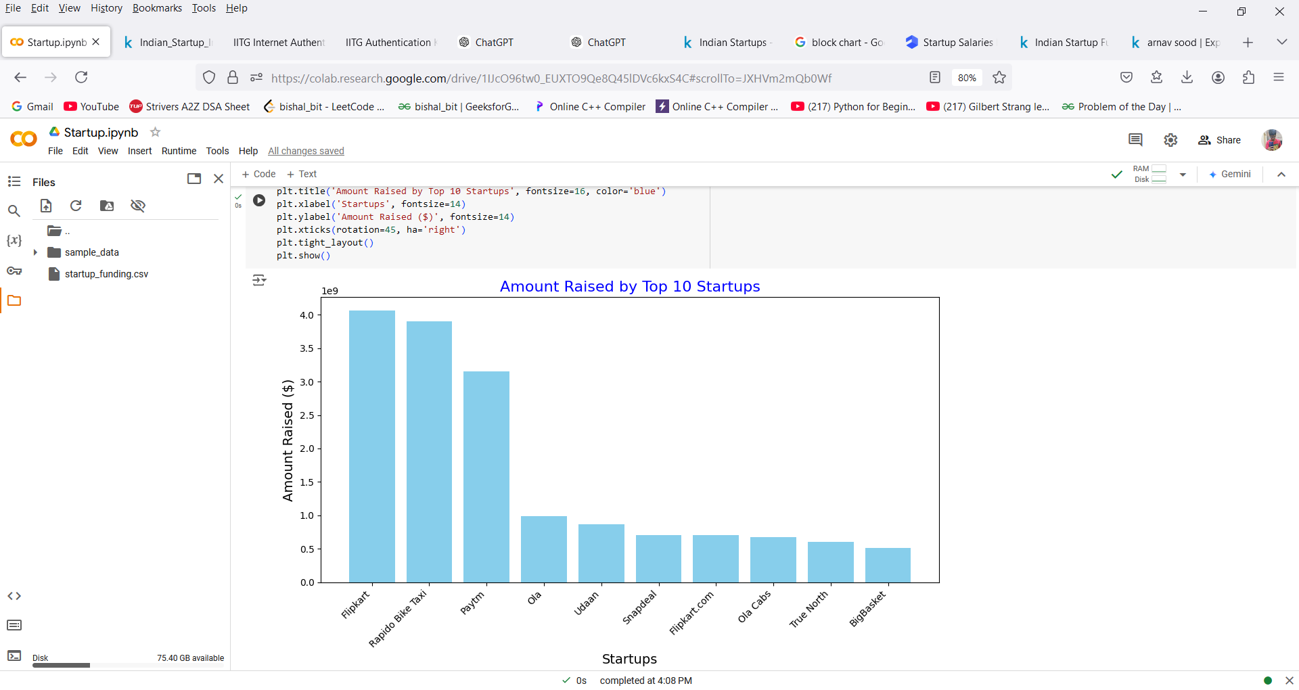
result:​

Slide 10
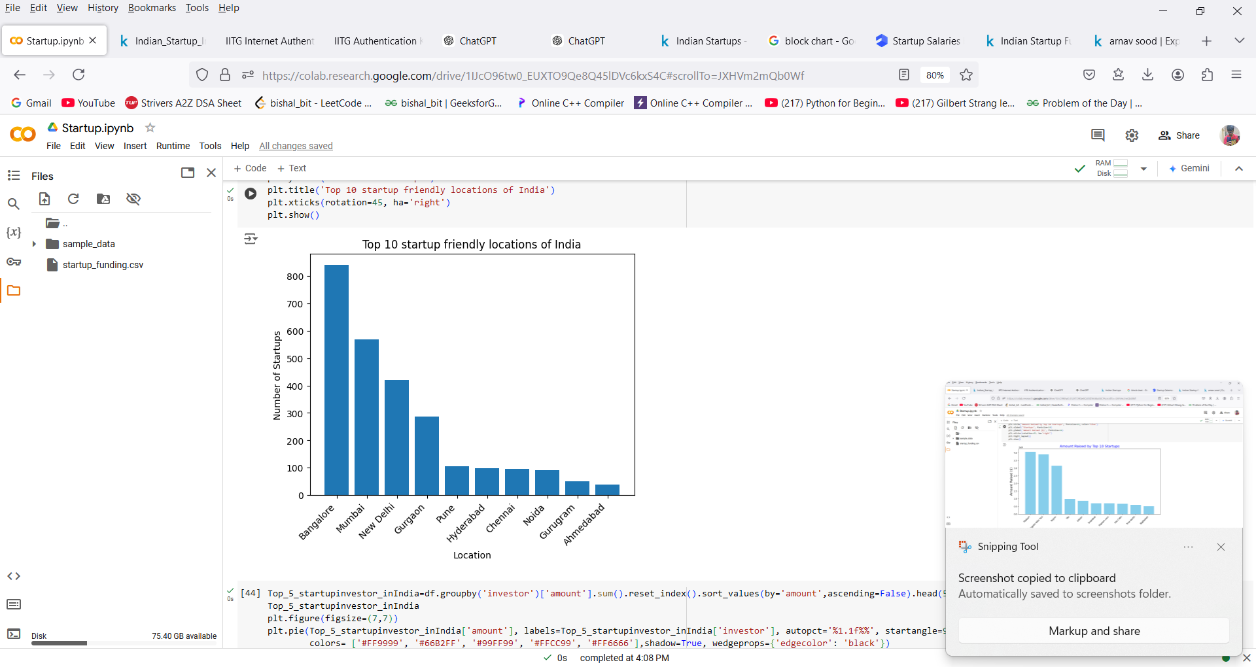
Result(Continued):​

Slide 11
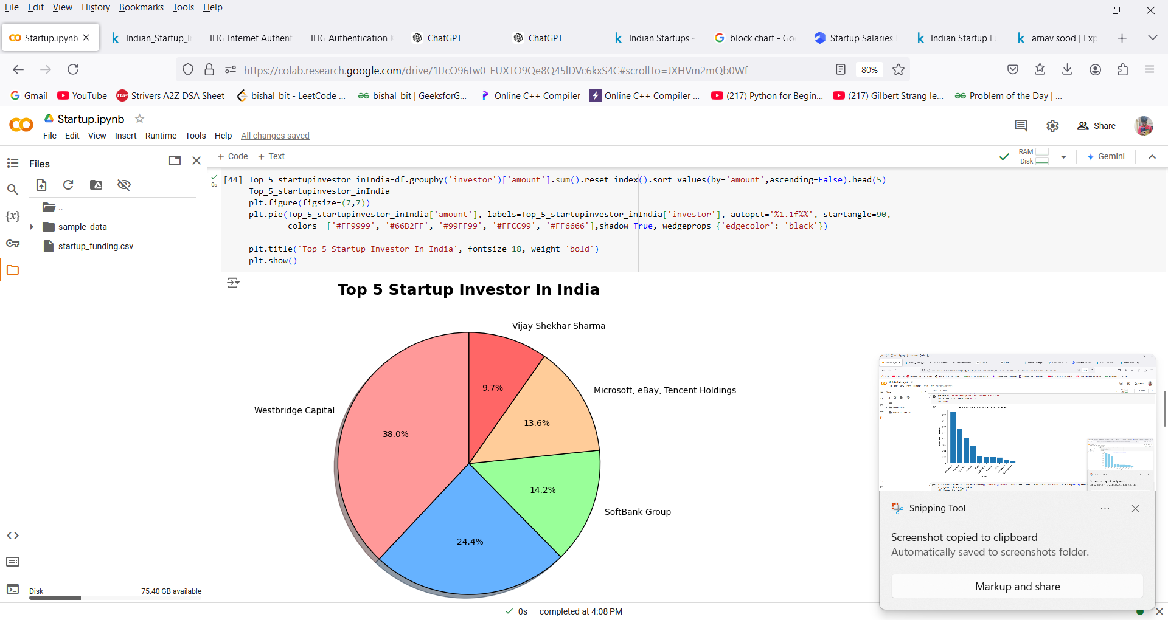
result (Continued): ​

Slide 12
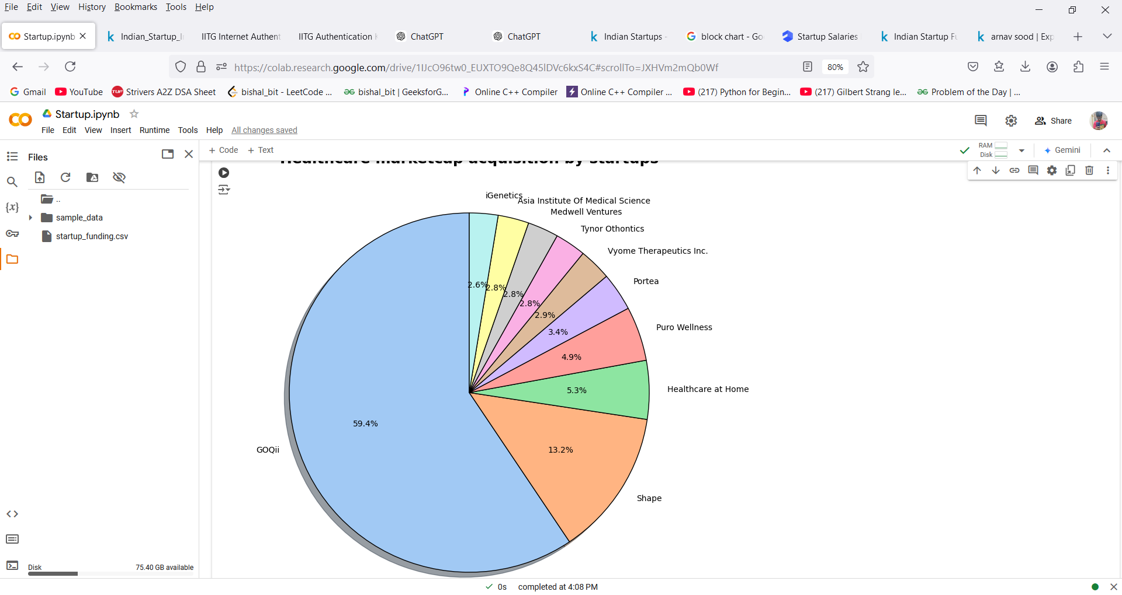
result (Continued): ​
Healthcare marketcap acquisition by startups

Slide 13
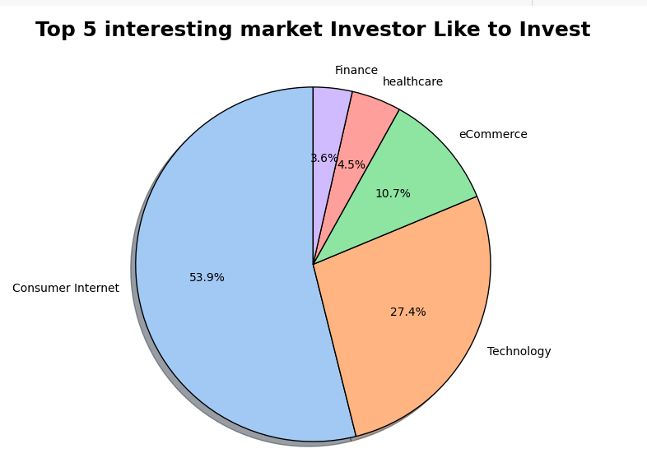
result (Continued): ​

Slide 14
Observations:​
Technology-driven sectors, especially fintech, e-commerce, and edtech, receive a significant share of funding.
Major startup hubs like Bengaluru, Mumbai, and Delhi-NCR lead in funding activity, driven by a concentration of talent, infrastructure, and investor presence.
Indian startups see a mix of domestic and international investors.
Learnings:​
The use of libraries like Numpy, Pandas, Matplot.lib,time
File handling, Image handle

Slide 15
THANK YOU

