Slide 1
ADAPTIVE SUDOKU SOLVER
An AI-based solver that selects an appropriate search / CSP strategy based on
puzzle characteristics.
5
3
7
6
1
9
5
9
8
6
8
6
3
4
8
3
1
7
2
6
CSP
Heuristic Search
Local Search
6
2
8
4
1
9
5
8
7
9
Foundations of Artificial Intelligence Project
Bishal Sunar
240701628
Computer Science Engineering

Slide 2
1. Abstract
Project Overview
Adaptive Sudoku Solver models a Sudoku puzzle as a Constraint Satisfaction Problem (CSP) and supports multiple solving strategies. Instead of applying one fixed algorithm to every puzzle, the system extracts structural features such as empty-cell count, candidate-domain sizes and branching characteristics, then selects an appropriate strategy. The project compares solver performance using execution time, search effort and backtracking/assignment counts.
Core Idea
AI Concepts
Expected Benefit
Analyze → Select → Solve → Measure
CSP • heuristics • backtracking • local search
Reduce unnecessary search by matching the strategy to the puzzle.
2

Slide 3
2. Problem Statement
A standard Sudoku solver often applies the same solving procedure to every puzzle.
Different puzzles can have very different search-space characteristics even when they are the same size.
Pure brute-force backtracking may explore many unnecessary states.
A heuristic/CSP solver can reduce search, while local search provides a fundamentally different alternative.
The problem is therefore to design a solver that can select an appropriate strategy from a small set of AI algorithms.
Input
9×9 Sudoku grid with given values.
Decision
Which solver should be used?
Output
Valid completed grid + performance metrics.
3

Slide 4
3. Literature Survey
Selected work relevant to Sudoku, CSP solving and local search
Work
Approach / contribution
Relevance
FLAIRS 2007 – Teaching AI using Sudoku
Students implemented basic backtracking, ordering heuristics, forward checking and constraint propagation; performance metrics were compared.
Directly supports the choice of CSP techniques and baseline comparisons. [1]
AAAI 2007 – Interactive Constraint-Based Sudoku
Interactive Sudoku solver using AC/SAC, GAC/SGAC, forward checking, maintaining arc consistency and backtracking.
Shows the effectiveness of combining propagation with search. [2]
Springer 2024 – Perception-based constraint solving for Sudoku images
Formulates 9×9 Sudoku explicitly as a CSP with variables, domains and row/column/subgrid constraints.
Provides a modern formal CSP formulation of Sudoku. [3]
CMU CSP material
Backtracking and min-conflicts are presented as alternative CSP solving approaches; constraint propagation reduces search space.
Motivates including local search as a complementary strategy. [4]
4

Slide 5
4. Research Gap
Existing Focus
Limitation
Proposed Gap
Most educational Sudoku solvers compare or demonstrate individual CSP techniques.
A fixed solver does not explicitly adapt its strategy to the observed structure of each input puzzle.
Investigate whether lightweight puzzle features can guide dynamic selection among a small set of AI strategies.
Research question:
Can puzzle-level characteristics be used to select a solving strategy that reduces search effort
compared with using one fixed solver?
5

Slide 6
5. Research Objectives
Objective 1
Objective 2
Model Sudoku as a Constraint Satisfaction Problem with variables, domains and constraints.
Implement a small, syllabus-aligned set of complementary solving strategies.
Objective 3
Objective 4
Extract measurable puzzle features before solving.
Design a strategy-selection mechanism that chooses an appropriate solver.
Objective 5
Objective 6
Benchmark the strategies using time, assignments/nodes, backtracks and success rate.
Study whether adaptive selection reduces unnecessary search on a representative puzzle set.
6

Slide 7
6. Proposed Work
Adaptive pipeline
Sudoku Input
Puzzle Analyzer
Feature Extraction
Strategy Selector
1. Basic
Backtracking
2. CSP + MRV +
Propagation
3. Min-Conflicts
Local Search
Solved Grid + Metrics
7

Slide 8
7. Algorithms Used
Algorithm 1 — Basic Backtracking
Algorithm 2 — CSP + MRV
+ Propagation
Algorithm 3 — Min-Conflicts
• Select an unfilled cell
• Try legal values 1–9
• Recurse after assignment
• Backtrack when a constraint is violated
Purpose: baseline for measuring the value of heuristics and propagation.
• Maintain candidate domains
• Apply constraint propagation
• Select the cell with Minimum Remaining Values (MRV)
• Use forward checking
• Backtrack only when necessary
Purpose: reduce branching and search effort.
• Start from a complete candidate assignment
• Detect conflicted cells
• Reassign a value that minimizes conflicts
• Repeat until solved or a restart/limit is reached
Purpose: provide a local-search alternative.
8

Slide 9
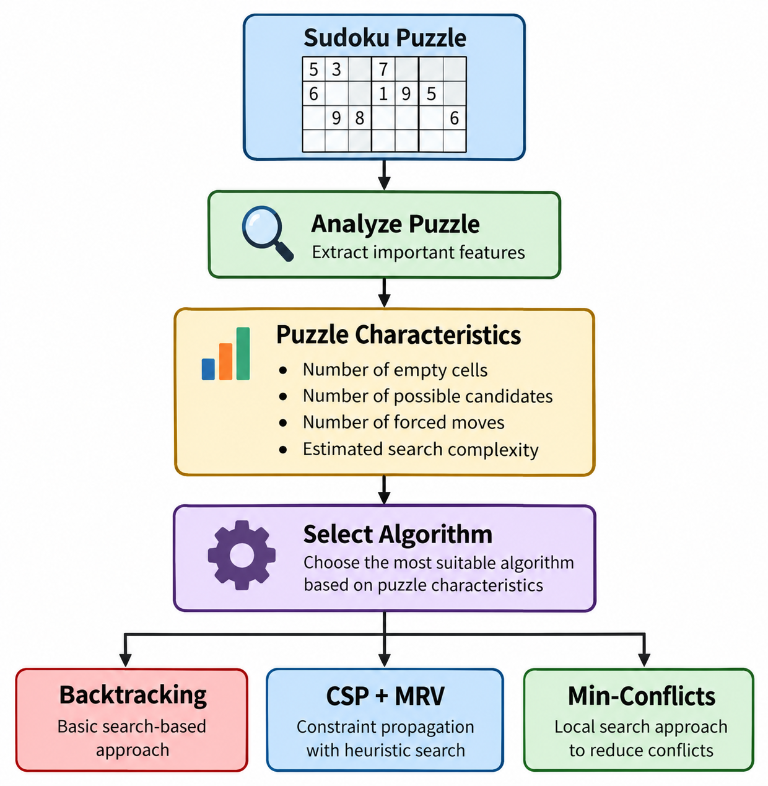
8. Adaptive Strategy Selection
Why adaptation?
Different Sudoku puzzles have different complexity.
A single algorithm may not be efficient for every puzzle.
The solver analyzes the puzzle before solving.
Based on its characteristics, a suitable algorithm is selected.

Slide 10
9. Implementation
Planned implementation configuration
Programming language
Python 3.14
Development environment
Visual Studio Code
Core libraries
Python Standard Library
Interface
Interface: Simple web/desktop interface
Input
9×9 Sudoku grid / puzzle dataset
Operating environment
Windows 10/11 or equivalent Python environment
Evaluation
Execution time, assignments/nodes, backtracks, propagation steps, success rate
Implementation status
Core algorithms and selector are to be implemented and benchmarked; this presentation does not claim final performance results.
10

Slide 11
10. Expected Result and Output
Planned evaluation and user-visible output
5
3
7
Algorithm Selection
Solver
Time
Nodes
6
1
9
5
Determined from puzzle characteristics
Backtracking
TBD
TBD
9
8
6
8
6
3
Expected Output
CSP + MRV
TBD
TBD
4
8
3
1
Completed Sudoku + selected algorithm
Min-Conflicts
TBD
TBD
7
2
6
6
2
8
Performance
Final Output
4
1
9
5
Time: <to be measured>
Nodes: <to be measured>
8
7
9
1. Completed Sudoku
2. Algorithm selected
3. Search/performance metrics
4. Comparative benchmark report
Important
Numerical results will be populated after running the same test set through all solvers.
11

Slide 12
11. Expected Contribution & Future Work
Expected Contribution
Possible Extensions
• A syllabus-aligned Sudoku CSP model
• Three complementary AI solving strategies
• A feature-based adaptive selector
• A reproducible benchmark framework
• Evidence on when each strategy is effective
The project evaluates adaptation experimentally rather than assuming one algorithm is universally best.
• Learn the selection policy from benchmark data
• Add AC-3 / stronger consistency techniques
• Add image-based Sudoku recognition
• Support larger or variant Sudoku boards
• Visualize search trees and candidate domains
• Add puzzle generation and difficulty estimation
12

Slide 13
12. References
[1] Teaching Artificial Intelligence across the Computer Science Curriculum Using Sudoku as a Problem Domain, FLAIRS-2007. https://cdn.aaai.org/FLAIRS/2007/FLAIRS07-066.pdf
[2] An Interactive Constraint-Based Approach to Sudoku, AAAI-2007. https://cdn.aaai.org/AAAI/2007/AAAI07-362.pdf
[3] Perception-based constraint solving for sudoku images, Constraints / Springer, 2024. https://doi.org/10.1007/s10601-024-09372-9
[4] Carnegie Mellon University, Constraint Satisfaction Problems / Min-Conflicts teaching material. https://www.cs.cmu.edu/~ggordon/780-spring09/slides/CSPs%2C%20SAT%2C%20FOL%20resolution%20strategies.pdf
[5] Russell, S. & Norvig, P., Artificial Intelligence: A Modern Approach — CSP, backtracking, heuristics and local search concepts.
Note
Literature survey sources are used to motivate the CSP, propagation, heuristic and local-search components.
13

