Slide 1
Machine Learning
Exercise 3 – Topic 3.2.3 Next-word prediction
WS 2022
Wien, 1st March 2023
Members of ‚Group 31’
- Petkova Violeta (01636660)
- Upadhyaya Bishal (12119246)
- Gabor Toaso (12127079)
WS 2022
TU Wien, Austria

Slide 2
Short description of Deep Learning for Text classification
We have genuine interest in choosing the topic „Next-word prediction” (3.2.3) from the Deep Learning list, since it is an actively investigated topic nowadays – especially in connection to ChatGPT;
After reviewing the provided research paper („A Survey on Neural Network Language Models”¹), we selected a Long Short-term Memory RNN Language Model (LSTM-RNNLM) in combination of „Reuters” data²;
We have investigated few reference materials from internet in order to acquire the necessary insights to build the necessary data science pipeline (with method of NLP, LM and Deep Learning) and satisfy the task descriptions – by using „python” language;
The pre-processing of the input data …
Concerning the length of the text, the necessary time for training the model was …
The model was evaluated by a „self-automated” way. We have selected few sentences from the original corpus and the end of those were trimmed. These were typed into the „prediction” part of the implementation expecting that the model will predict the final word of the incomplete sentences.
Based on our experience …
From the description: You can reuse existing materials / tutorials / etc. from the Internet, but (i) you need to
clearly quote / cite what you use, (ii) there still needs to be an original contribution from your side.
1 1906.03591.pdf (arxiv.org)
2 http://www.daviddlewis.com/resources/testcollections/reuters21578/

Slide 3
Key specifics of the selected dataset – „Reuters”
Characterisitcs
Length of the corup: ….xxx
remove all unnecessary data and delete the starting and end of the dataset (?),
save the pre-processed data as txt file (access the file using the encoding as utf-8),
replace all (i) unnecessary extra new lines, (ii) the carriage return and (iii) the Unicode character,
we have only unique words (consider each word only once and remove repetitions) to avoid confusion,
tokenize the data (splitting bigger text corpus into smaller segments),
Keras Tokenizer is used to vectorize a text corpus, by turning each text into either a sequence of integers (each integer being the index of a token in a dictionary) or into a vector where the coefficient for each token could be binary, based on word count, based on tf-idf.
convert the texts to sequences (interpreting the text data into numbers),
create the training dataset ('X'),
define output for training data ('y') => 'y' contains all the next word predictions for each input 'X',
calculate "vocab_size" by using the length extracted from "tokenizer.word_index" and then add 1 to it ("0" is reserved for padding and we start our cont from "1"),
convert our predictions data 'y' to categorical data of the "vocab_size" => convert a class vector (integers) to the binary class matrix. This will be useful with our loss which will be categorical_crossentropy.
improvements in pre-processing is still possible => to achieve a better loss and accuracy in lesser epochs,
Pre-processed & Tokenization

Slide 4
Train model / Model architecture
Deep learning layers …

Slide 5
Predict model / Model validation based on croped sentences
…
…
…
…
…

Slide 6
Hyperparamter tuning / Accuracy / Runtime
Accuracy
Runtime
…
Tran/Test split
.
..
..
..
..
..
..
….
….
# Epoch
…
…
…
…

Slide 7
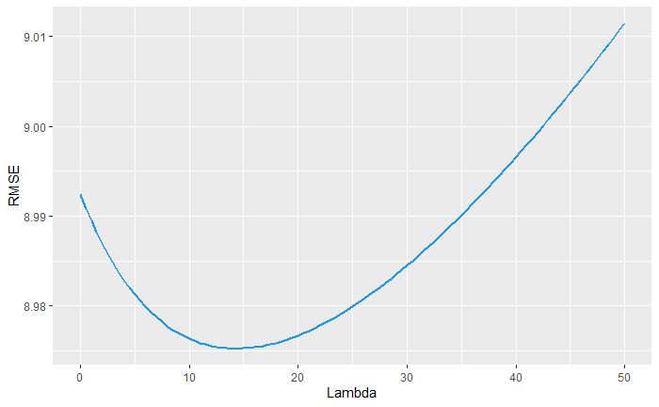
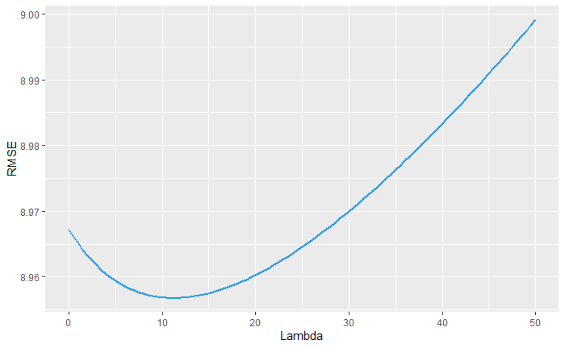
Visualization
xxx
xxx
Difficulties:
Xxx accuracy
Xxx accuracy

Slide 8
Conclusions / lessons learned / other findings
Data Split:
Train/Test …
Model development:
…
Predicting the result:
…

Slide 9
Technical information to be able to run the python code
import tensorflow as tf
from tensorflow.keras.preprocessing.text import Tokenizer
from tensorflow.keras.layers import Embedding, LSTM, Dense
from tensorflow.keras.models import Sequential
from tensorflow.keras.utils import to_categorical
from tensorflow.keras.optimizers import Adam
import pickle import numpy as np import os

